Slide 1
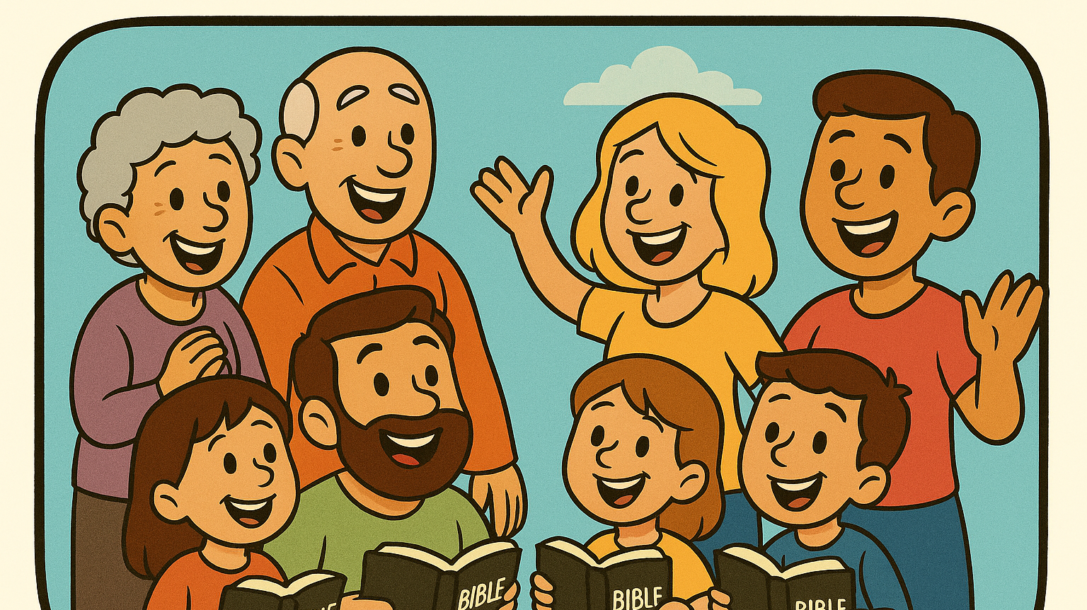
Sabbath
Kids Bible Fellowship

Slide 2
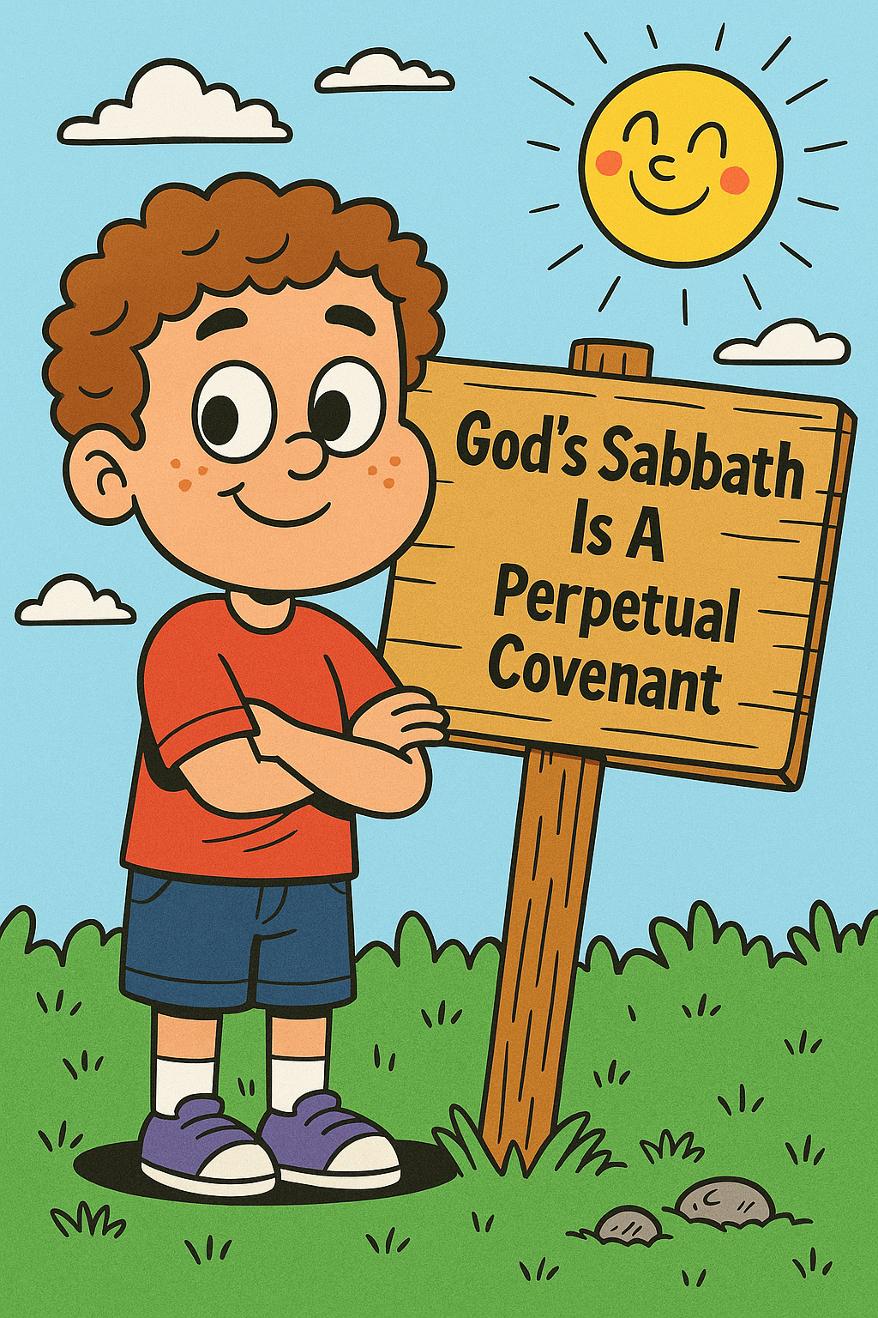
Importance of the Sabbath
The Sabbath is the mark of Yah. It’s FOREVER and to be KEPT as HE said in HIS word which is the seventh day SATURDAY.
Genesis 2:2-3 And on the 🔥seventh day🔥 God ended his work which he had made; and he rested on the 🔥seventh day🔥 from all his work which he had made. And God blessed the 🔥seventh day🔥, and sanctified it: because that in it he had rested from ALL his work which God created and made.

Slide 3
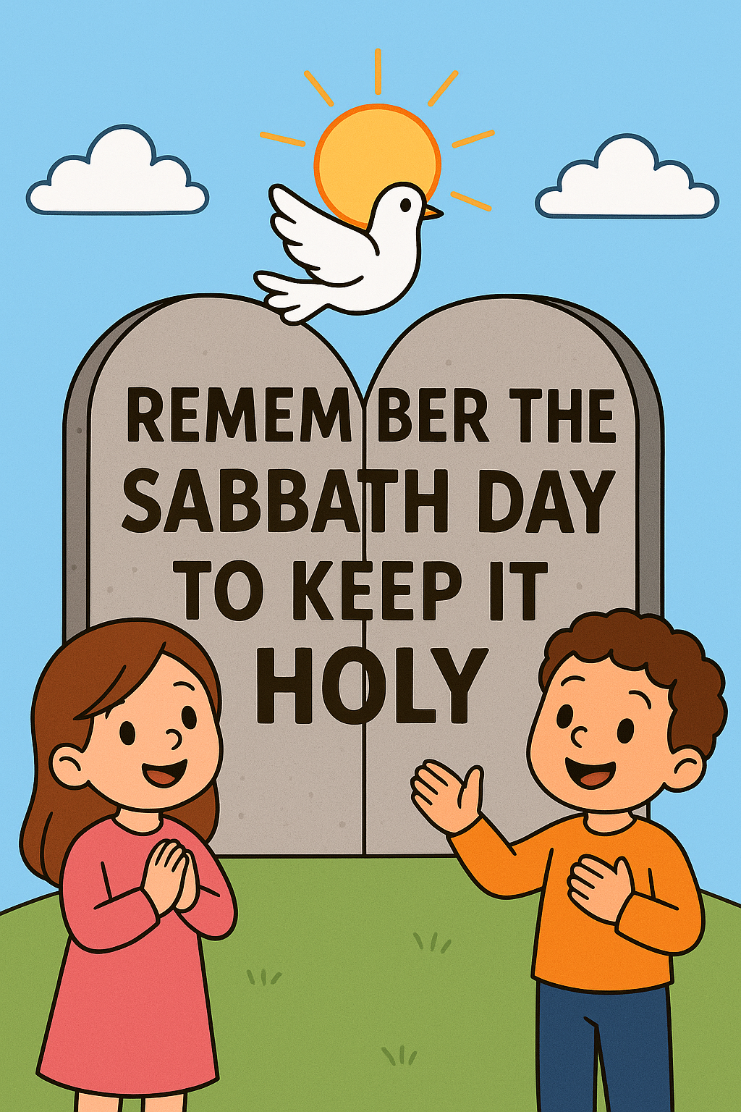
The Sabbath is the 4th Commandment
Exodus 20:8-11 REMEMBER the sabbath day, to keep it holy. Six days shalt thou labour, and do all thy work: But the seventh day is the sabbath of the Lord thy God: in it thou shalt not do any work, thou, nor thy son, nor thy daughter, thy manservant, nor thy maidservant, nor thy cattle, nor thy stranger that is within thy gates: For in six days the Lord made heaven and earth, the sea, and all that in them is, and rested the seventh day: wherefore the Lord blessed the sabbath day, and hallowed it.
Deuteronomy 5:12-15 Keep the sabbath day to sanctify it, as the Lord thy God hath commanded thee. Six days thou shalt labour, and do all thy work: But the seventh day is the sabbath of the Lord thy God: in it thou shalt not do any work, thou, nor thy son, nor thy daughter, nor thy manservant, nor thy maidservant, nor thine ox, nor thine ass, nor any of thy cattle, nor thy stranger that is within thy gates; that thy manservant and thy maidservant may rest as well as thou. And remember that thou wast a servant in the land of Egypt, and that the Lord thy God brought thee out thence through a mighty hand and by a stretched out arm: therefore the Lord thy God commanded thee to keep the sabbath day.

Slide 4

Mark of Yah
Exodus 31:12-18 And the Lord spake unto Moses, saying, Speak thou also unto the children of Israel, saying, Verily my sabbaths ye shall keep: for it is a sign between me and you throughout your generations; that ye may know that I am the Lord that doth sanctify you. Ye shall keep the sabbath therefore; for it is holy unto you: every one that defileth it shall surely be put to death: for whosoever doeth any work therein, that soul shall be cut off from among his people. Six days may work be done; but in the seventh is the sabbath of rest, holy to the Lord: whosoever doeth any work in the sabbath day, he shall surely be put to death. Wherefore the children of Israel shall keep the sabbath, to observe the sabbath throughout their generations, for a perpetual covenant. It is a sign (mark) between me and the children of Israel for ever: for in six days the Lord made heaven and earth, and on the seventh day he rested, and was refreshed. And he gave unto Moses, when he had made an end of communing with him upon mount Sinai, two tables of testimony, tables of stone, written with the finger of God.

Slide 5
There is a blessing for the gentiles who lay hold of the Sabbath they will have names better than sons or daughters!
Isaiah 56:1-5 Thus saith the Lord, Keep ye judgment, and do justice: for my salvation (YESHUA) is near to come, and my righteousness to be revealed. Blessed is the man that doeth this, and the son of man that layeth hold on it; that keepeth the ☀️sabbath☀️ from polluting it, and keepeth his hand from doing any evil. Neither let the son of the stranger, that hath joined himself to the Lord, speak, saying, 🚫THE Lord HATH UTTERLY SEPARATED ME FROM HIS PEOPLE (ISRAEL)🚫: 👉🏻neither let the eunuch say, Behold, I am a dry tree👈🏻. For thus saith the Lord unto the eunuchs that keep my sabbaths, and choose the things that please me, and take hold of my covenant; Even unto them will I give in mine house and within my walls a place and a name better than of sons and of daughters: I will give them an everlasting name, that shall not be cut off👑.
If you OBEY, then you’re no longer a gentile, do NOT separate yourself from Israel!

Slide 6

No Worldly Pleasures
Isaiah 58:13-14 If thou turn away thy foot from the sabbath, from doing thy pleasure on my holy day; and call the ✨sabbath a delight✨, the holy of the Lord, honourable; and shalt honour him, not doing thine own ways, nor finding thine own pleasure, nor speaking thine own words: Then shalt thou delight thyself in the Lord; and I will cause thee to ride upon the high places of the earth, and feed thee with 👑 the heritage of Jacob 👑 thy father: for the mouth of the Lord hath spoken it.
i.e., Video Games, Watching Sports, Playing Sports, etc.

Slide 7
Sabbath was made for man
Mark 2:27 And he said unto them, The sabbath was made for man, and NOT man for the sabbath:

Slide 8

Sabbath is Saturday dawn to Sunday dawn
A biblical day begins at dawn according to scripture.
Matthew 28:1 In the end of the sabbath, as it began to dawn toward the first day of the week, came Mary Magdalene and the other Mary to see the sepulchre.
Judges 16:2 And it was told the Gazites, saying, Samson is come hither. And they compassed him in, and laid wait for him all night in the gate of the city, and were quiet all the night, saying, In the morning, when it is day, we shall kill him.
Judges 19:25 But the men would not hearken to him: so the man took his concubine, and brought her forth unto them; and they knew her, and abused her all the night until the morning: and when the day began to spring, they let her go.

Slide 9
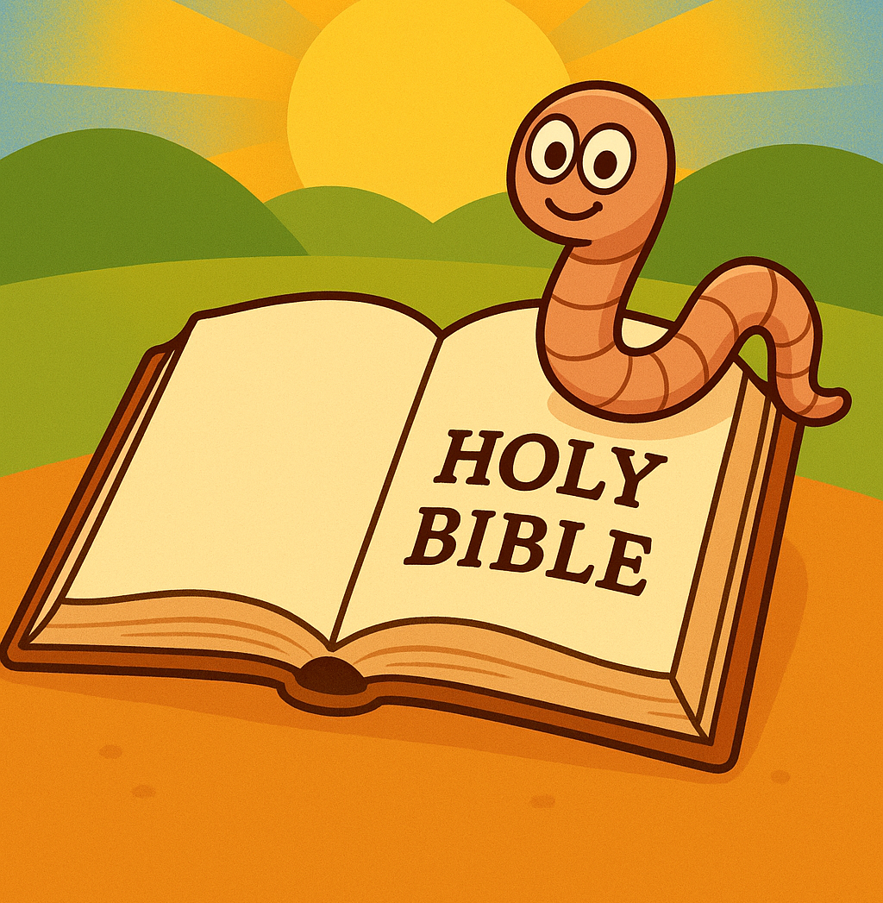
Day Dawning Scriptures
John 20:1 The first day of the week cometh Mary Magdalene early, when it was yet dark, unto the sepulchre, and seeth the stone taken away from the sepulchre.
Luke 24:1 Now upon the first day of the week, very early in the morning, they came unto the sepulchre, bringing the spices which they had prepared, and certain others with them.
Jonah 4:7 But God prepared a worm when the morning rose the next day, and it smote the gourd that it withered.
Job 3:9 Let the stars of the twilight thereof be dark; let it look for light, but have none; neither let it see the dawning of the day:
Job 7:4 When I lie down, I say, When shall I arise, and the night be gone? and I am full of tossings to and fro unto the dawning of the day.

Slide 10
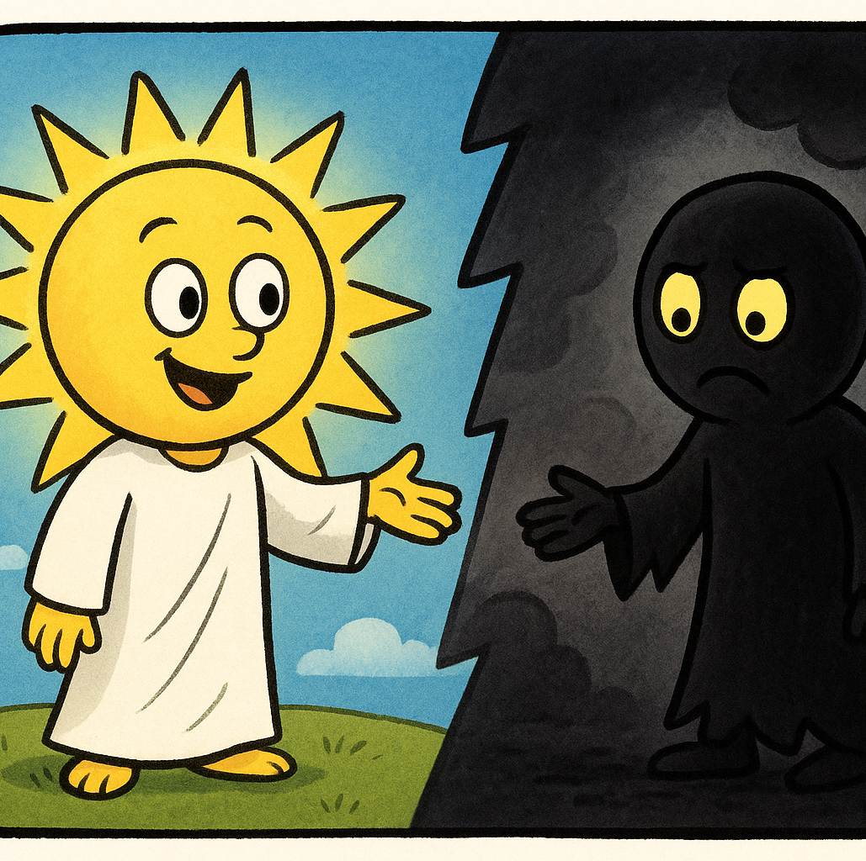
Day Dawning Scriptures
Mark 1:35 And in the morning, rising up a great while before day, he went out, and departed into a solitary place, and there prayed.
Mark 16:2 And very early in the morning the first day of the week, they came unto the sepulchre at the rising of the sun.
1 Thessalonians 5:4-5 But ye, brethren, are not in darkness, that that day should overtake you as a thief. Ye are all the children of light, and the children of the day: we are not of the night, nor of darkness.

Slide 11
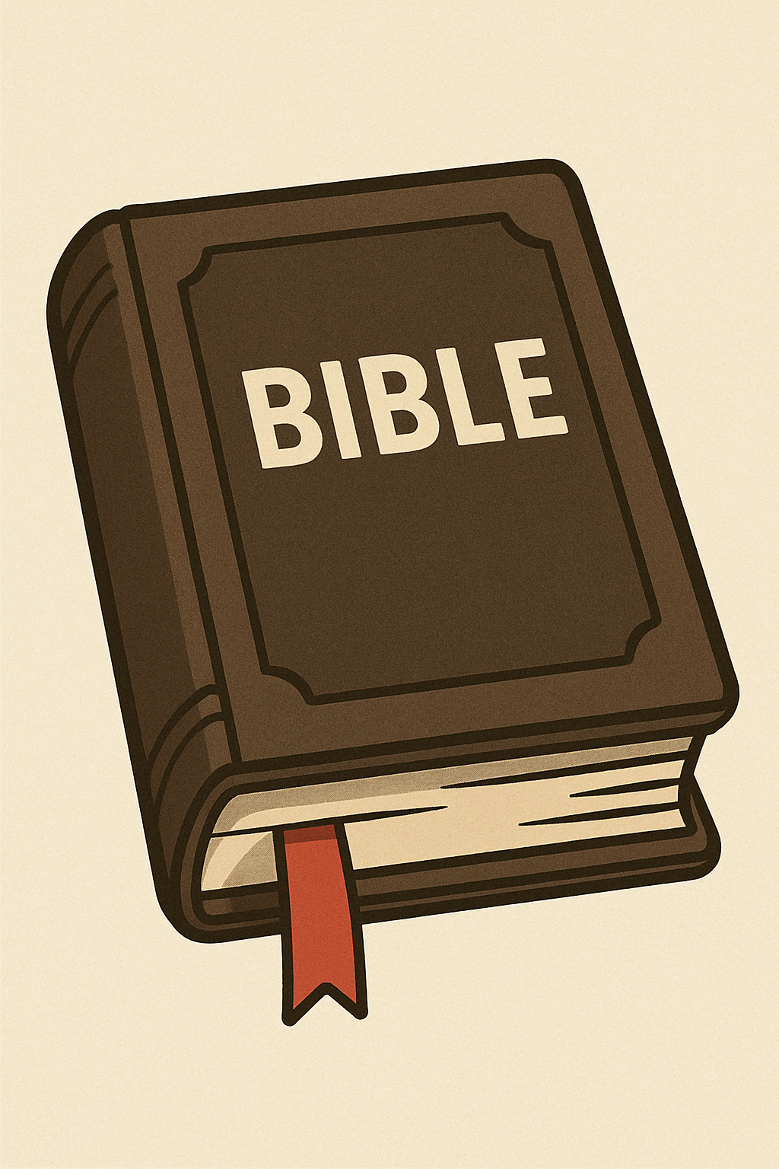
Keep the Sabbath According to the Bible!
No buying or selling:
Nehemiah 10:31
Nehemiah 13:15-17
No work/labor:
Exodus 20:9-11
Exodus 31:15
Exodus 34:21
Exodus 35:2
Deuteronomy 5:13-14
Holy Convocation:
Leviticus 23:3
Hebrews 10:25

Slide 12
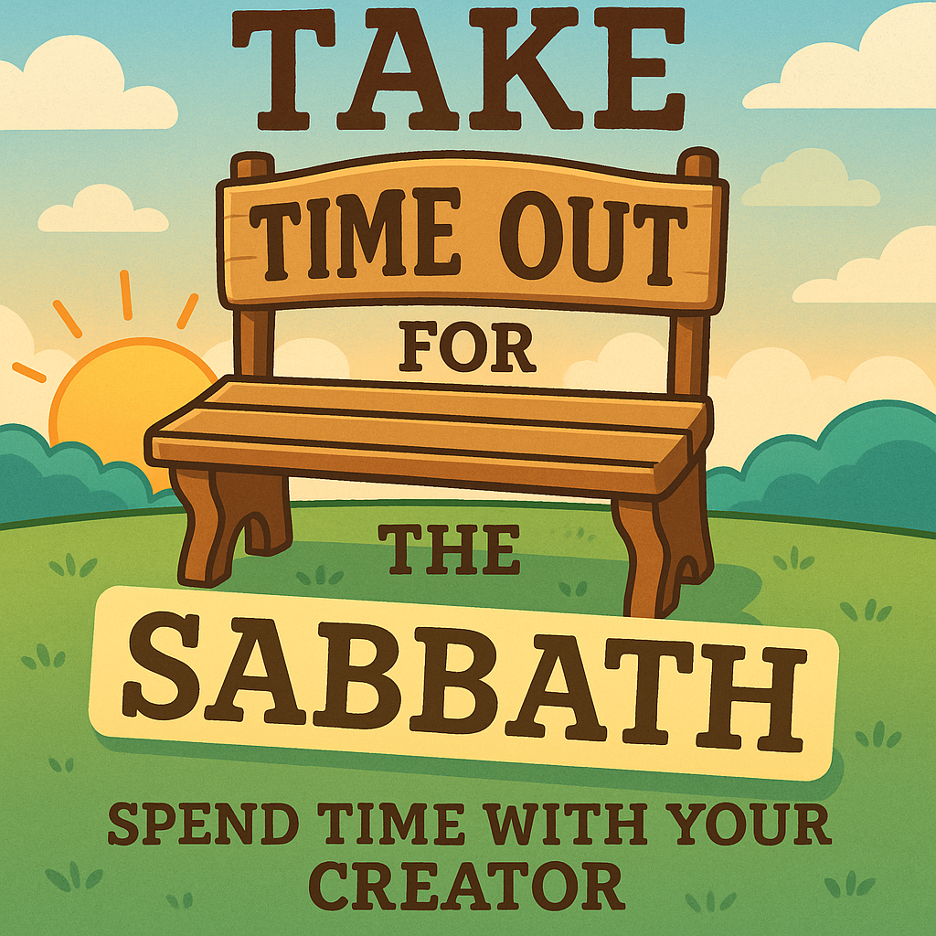
Remember
Do not buy or sell
Do not labor or cause others to labor
Do not do your own pleasures
Stay rooted in the word of Yah
Honor Yah
Delight in His Holy Day
Do not forsake the gathering
We are called to be SET APART from the World!

Slide 13
Discussion
Do you care?
Is it important to you?
Why do you think you’re here?

