Slide 1

New Years is Pagan
Kids Bible fellowship

Slide 2
January 1st
January 1st is celebrated as the start of the New Year for a number of reasons, including its connection to the Roman god Janus and the January Kalends.
Janus
The Romans made January 1 their new year dedicated to Janus, the Roman God of doorways and New beginnings.
Janus represented the middle ground between both concrete and abstract dualities such as life/death, beginning/end, youth/adulthood, rural/urban, war/peace, and barbarism/civilization.
The god who has two faces.

Slide 3
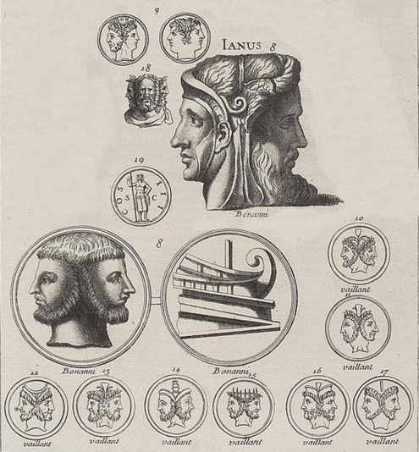
Janus

Slide 4
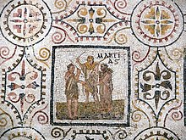
January Kalends
A celebratory season that lasted for centuries, the January Kalends marked the New Year and was when Roman consuls began their terms of office.
The word "calendar" comes from the January Kalends.

Slide 5

January Kalends Continued…
Civic Rituals
These included a procession of consuls, gifts to the domestic gods, and exchanging gifts.
Masquerades
These involved masks, animal masks, cross-dressing, and mocking the gods. Some say the masquerades were a precursor to the Feast of Fools.
Ludi Saturnales
This was a grand ceremony that included theatrical performances, games, and festivities. It was dedicated to Saturn, the god of agriculture and harvest.
Sacrifices to Janus
Sacrifices were offered to Janus, the god of beginnings and ends, to seek his favor and protection for the coming year.
House Preparation
Before the Kalends, people would sweep their homes clean, extinguish fires, and light new candles.
New Year's Eve Rituals
People would lay tables with an abundance of food and drink to ensure plenty for the year to come.

Slide 6

Julius Caesar
Julius Caesar, emperor of Pagan Rome instituted the New Years Festival of January 1st
In 46 B.C. Caesar adopted the Julian Calendar
January is named after the Roman God Janus

Slide 7
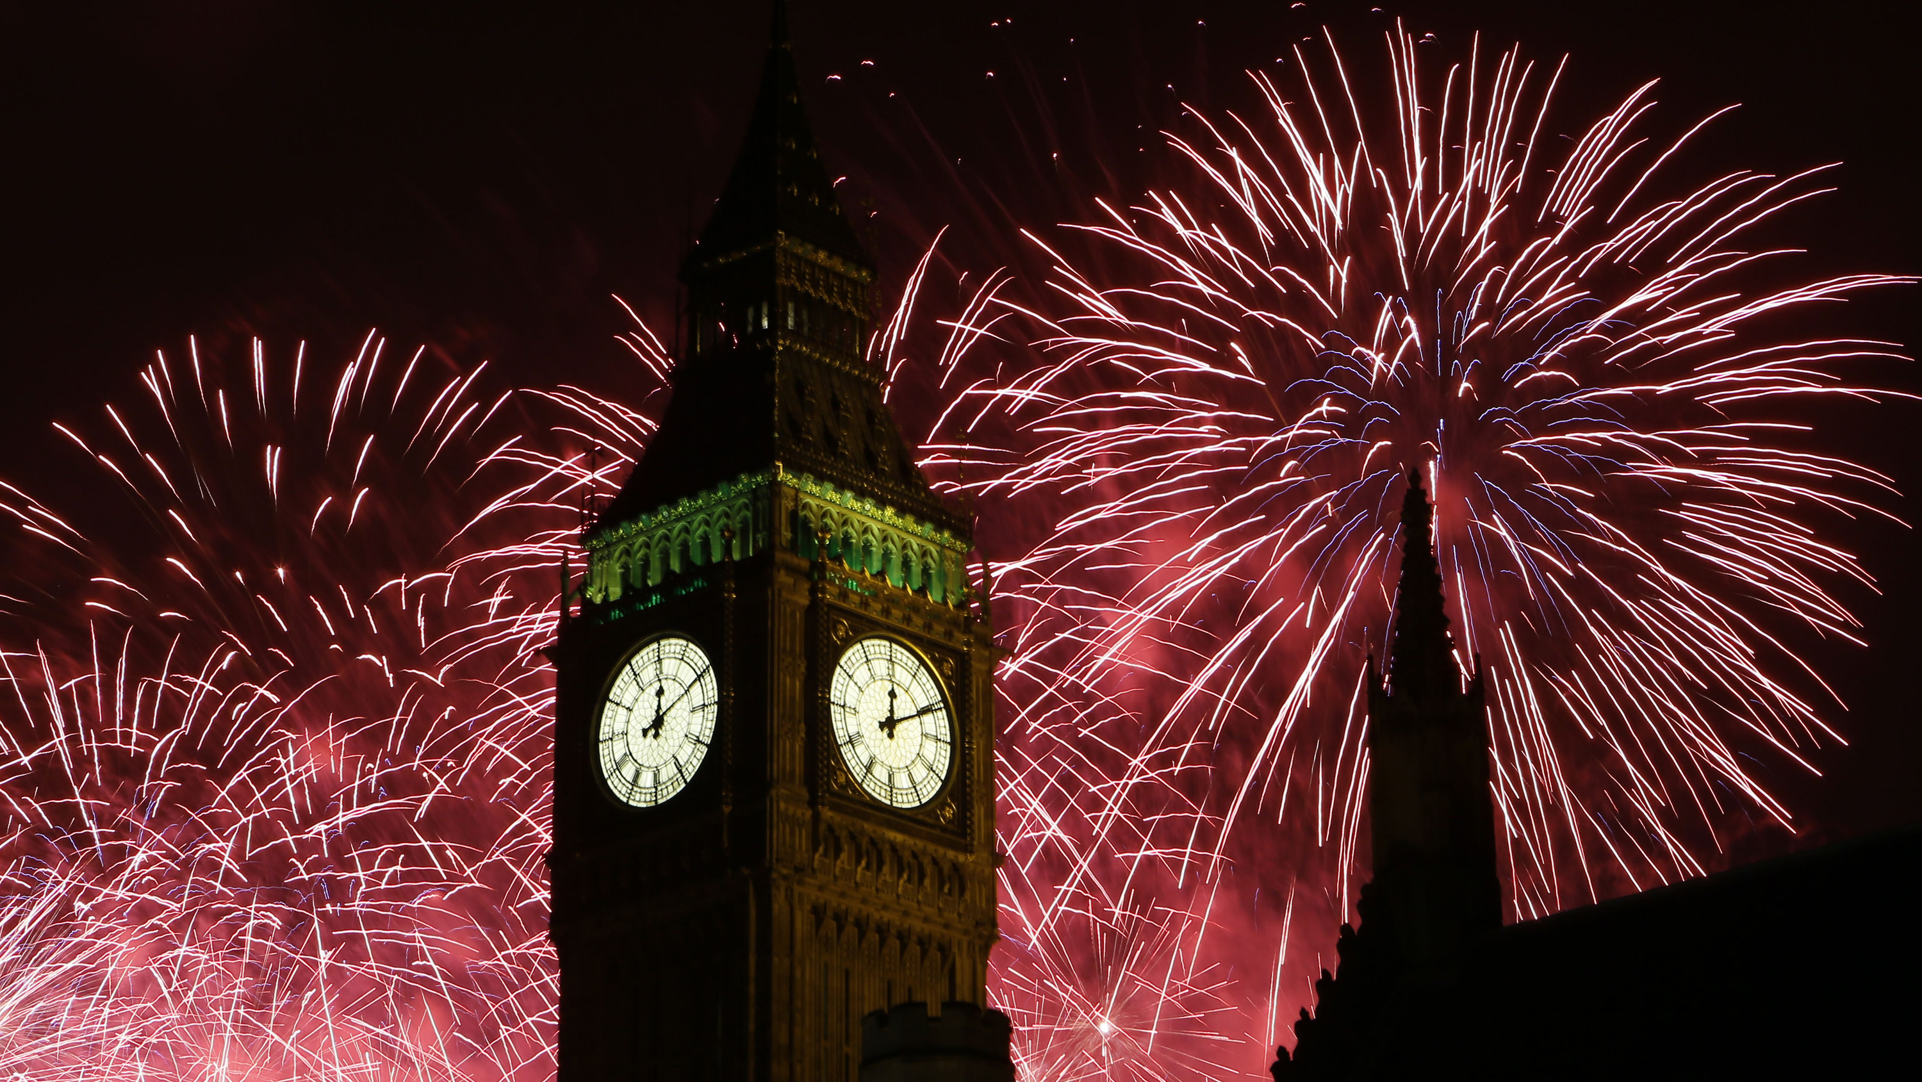
New Year’s: The god of Beginnings
Beware lest any man spoil you through philosophy and vain deceit, after the tradition of men, after the rudiments of the world, and not after Messiah.
Colossians 2:8

