Slide 1


Why we can’t be partakers…
Kids Bible Fellowship

Slide 2

Have no fellowship with the unfruitful works of darkness, but rebuke them…
Before coming to Yah and His truth we used to be children of darkness, slaves to sin, headed for Gods wrath just like everyone else. But God being so rich in mercy, rose us up from the dead just like He did with Yeshua our Messiah so that we may lay hold of everlasting life, prepared for those who love Him which means obey Him.
Since He removed the scales from our eyes, we’re now called to remove the scales from other people’s eyes Matt 7:1-5, James 2:1-9, Lev 19:15-18. Which means we can no longer partake in the ways of this world that is passing away, but live according to Gods righteousness and teach our neighbors to do the same so that they too can be saved.
Ephesians 5:1-11 shows us this.

Slide 3
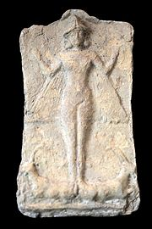

The unfruitful works of darkness surrounding Easter:
As we know this day does not worship our Heavenly Father, but some fertility goddess named Ishtar (Ashteroth). Originates from a Babylonian celebration that we now in modern times call Easter formally was Ishtar.
The eggs and bunny seem innocent but also hold symbols surrounding fertility and fornication. It has been twisted to symbolize “rebirth/renewal of life”, even though that is simply not true. Especially concerning our Messiahs resurrection.
And how much more do the Catholics like to “venerate” Mary on this day regarding our Messiahs resurrection? Truly nothing new under the sun! Ecclesiastes 1:9-11
Part of why Israel was divorced and booted from the land of their inheritance in 2 Kings 17-25 and how much sooner will we be cut off if we do exactly what they did?! Romans 11
This Photo by Unknown Author is licensed under CC BY-SA

Slide 4
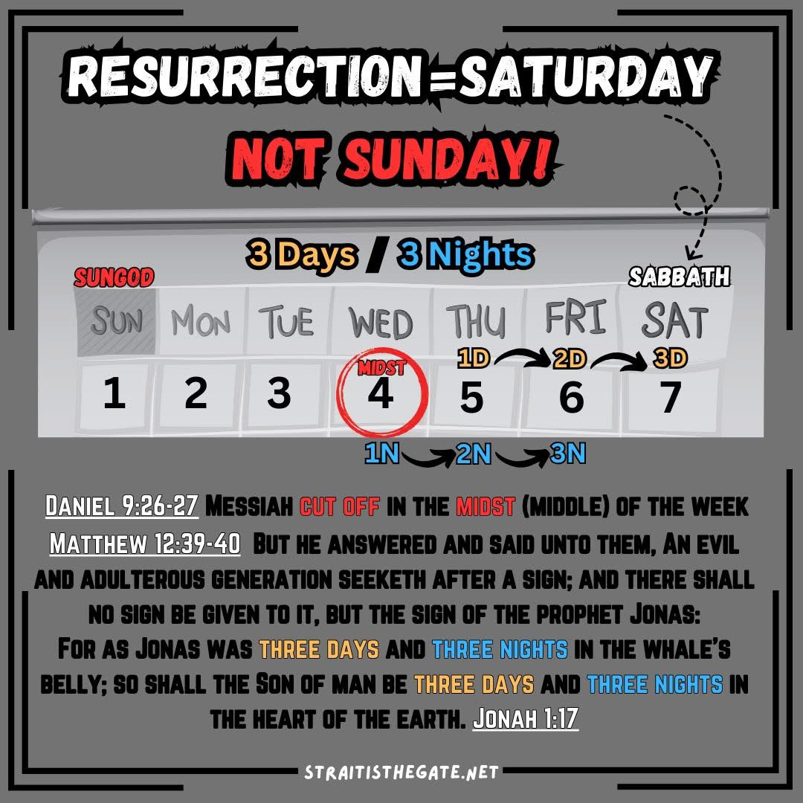

Slide 5
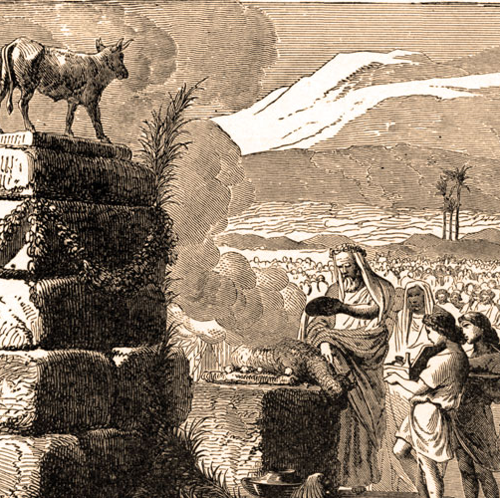
1 John 5 idolatry is the sin that leads to death:
1 John 5:13-21, Ezekiel 14:1-11 it’s the sin that leads to death because it causes people to become blind Psalm 115:1-8, Psalm 135:15-18. Blind to what His word says and who He is for His word is truth, and He is the One true God worthy of worship & praise. It’s not just idolatry against God but adultery against Him. And if one does not repent from this, He will repay them to their face! Exodus 20:3-6, Deuteronomy 5:7-10
This Photo by Unknown Author is licensed under CC BY-SA-NC

Slide 6
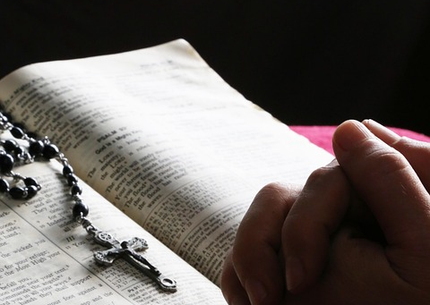

How to handle idolaters:
Rebuke and pray for them to experience Gods conviction on their hearts, but outright prayer we can not do Jeremiah 7:16-20, Jeremiah 11:11-17 since they’re full of idols, pride, covetousness, and vanity. They loved not God, they loved their own ways (unless if they repent) they will be damned as 2 Thessalonians 2.
Whether or not they hear or forbear we’re called to warn them anyways, laying down our lives as Yeshua did Ezekiel 2-3, 33, John 15:12-17.

Slide 7

More scriptures:
Matthew 15:7-9, 1 Corinthians 10, 1 Corinthians 8, 1 Corinthians 6:9-11, Acts 15:28-29

Slide 8
Conclusion:
This day neither honors the Father nor the Son (he arose during the Sabbath Luke 24:5-8) all the church has done is try to take an unclean, unholy day and whitewash it into something it’s not Job 14:4.
If you love the Father just do what He asks of you, don’t add or take away. He doesn’t exact much of you besides this Micah 6:8 He hath shewed thee, O man, what is good; and what doth the Lord require of thee, but to do justly (royal law/righteous judgement/pleading the cause of the fatherless & widow), and to love mercy (obey the Ten Commandments & teach men so), and to walk humbly with thy God (a humble contrite heart He will not despise)?

