Slide 1
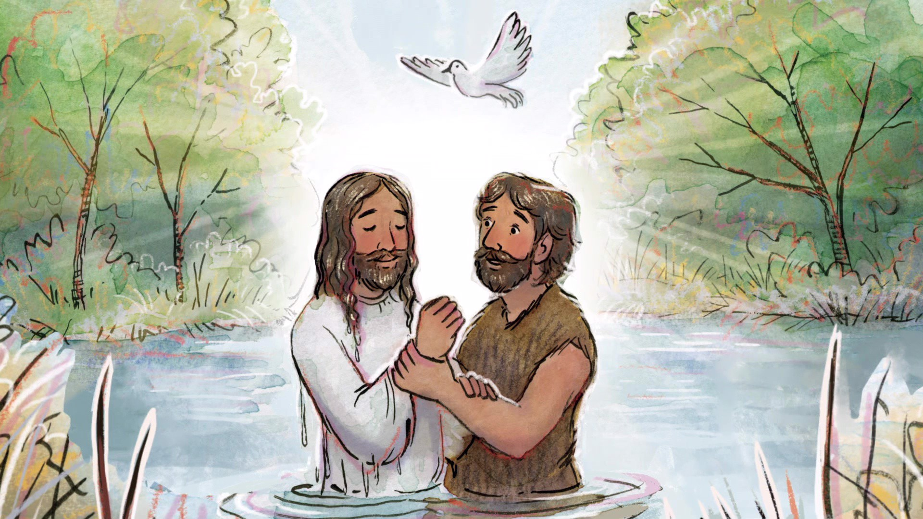
Catholic Baptism, Communion, Confirmation is NOT
Biblical Baptism

Slide 2
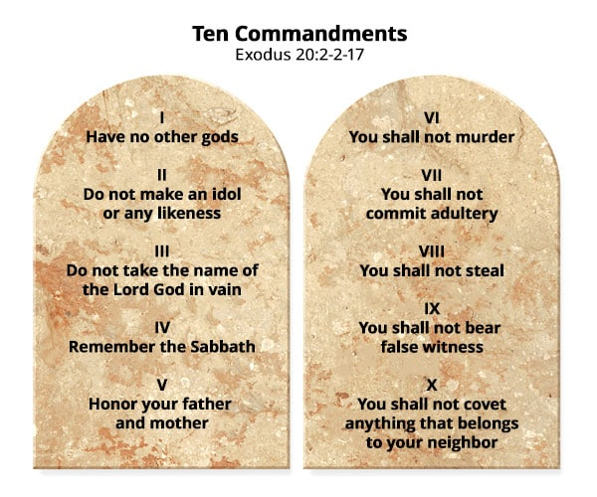

What does Baptize Mean?
G907
βαπτίζω
baptizō
bap-tid'-zo
From a derivative of G911; to make whelmed (that is, fully wet); used only (in the New Testament) of ceremonial ablution, especially (technically) of the ordinance of Christian baptism: - baptist, baptize, wash.
G911
βάπτω
baptō
bap'-to
A primary verb; to whelm, that is, cover wholly with a fluid; in the New Testament only in a qualified or specific sense, that is, (literally) to moisten (a part of one’s person), or (by implication) to stain (as with dye): - dip.
Where can we see an example of Baptism in the Old Testament?
2 Kings 5:9-14 So Naaman came with his horses and with his chariot, and stood at the door of the house of Elisha. (10) And Elisha sent a messenger unto him, saying, Go and wash in Jordan seven times, and thy flesh shall come again to thee, and thou shalt be clean. (11) But Naaman was wroth, and went away, and said, Behold, I thought, He will surely come out to me, and stand, and call on the name of the LORD his God, and strike his hand over the place, and recover the leper. (12) Are not Abana and Pharpar, rivers of Damascus, better than all the waters of Israel? may I not wash in them, and be clean? So he turned and went away in a rage. (13) And his servants came near, and spake unto him, and said, My father, if the prophet had bid thee do some great thing, wouldest thou not have done it? how much rather then, when he saith to thee, Wash, and be clean? (14) Then went he down, and dipped himself seven times in Jordan, according to the saying of the man of God: and his flesh came again like unto the flesh of a little child, and he was clean.

Slide 3
What would cause us to repent from our sins? How are we able to do that?
Titus 2:11-14 For the grace[G5485] of God that bringeth salvation hath appeared to all men, (12) Teaching us that, denying ungodliness and worldly lusts, we should live soberly, righteously, and godly, in this present world; (13) Looking for that blessed hope, and the glorious appearing of the great God and our Saviour Yeshua Messiah; (14) Who gave himself for us, that he might redeem us from all iniquity, and purify unto himself a peculiar people, zealous of good works.
G5485
χάρις
charis
khar'-ece
From G5463; graciousness (as gratifying), of manner or act (abstract or concrete; literal, figurative or spiritual; especially the divine influence upon the heart, and its reflection in the life; including gratitude): - acceptable, benefit, favour, gift, grace (-ious), joy liberality, pleasure, thank (-s, -worthy).
Because of Yehovah’s grace/conviction on our conscience, we turn from out sins, and repent from them, and obey the 10 commandments and are baptized by the Holy Spirit of Truth (another comforter), the 10 commandments are the life giving water.

Slide 4
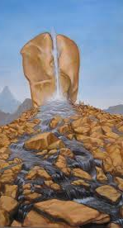
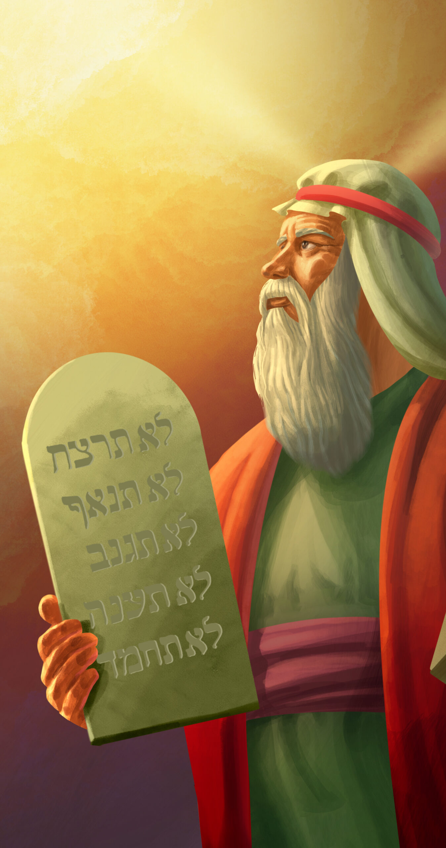
Build our foundation on the Rock
1 Corinthians 10:1-4 Moreover, brethren, I would not that ye should be ignorant, how that all our fathers were under the cloud, and all passed through the sea; (2) And were all baptized[G907] unto Moses in the cloud and in the sea; (3) And did all eat the same spiritual meat; (4) And did all drink the same spiritual drink: for they drank of that spiritual Rock that followed them: and that Rock was Christ.
Exodus 17:6 Behold, I will stand before thee there upon the rock in Horeb; and thou shalt smite the rock, and there shall come water out of it, that the people may drink. And Moses did so in the sight of the elders of Israel.
Exodus 19:5-11 Now therefore, if ye will obey my voice indeed, and keep my covenant, then ye shall be a peculiar treasure unto me above all people: for all the earth is mine: (6) And ye shall be unto me a kingdom of priests, and an holy nation. These are the words which thou shalt speak unto the children of Israel. (7) And Moses came and called for the elders of the people, and laid before their faces all these words which the LORD commanded him. (8) And all the people answered together, and said, All that the LORD hath spoken we will do. And Moses returned the words of the people unto the LORD. (9) And the LORD said unto Moses, Lo, I come unto thee in a thick cloud, that the people may hear when I speak with thee, and believe thee for ever. And Moses told the words of the people unto the LORD. (10) And the LORD said unto Moses, Go unto the people, and sanctify them to day and to morrow, and let them wash their clothes, (11) And be ready against the third day: for the third day the LORD will come down in the sight of all the people upon mount Sinai.
Deuteronomy 5:1-2 And Moses called all Israel, and said unto them, Hear, O Israel, the statutes and judgments which I speak in your ears this day, that ye may learn them, and keep, and do them. (2) The LORD our God made a covenant with us in Horeb.

Slide 5
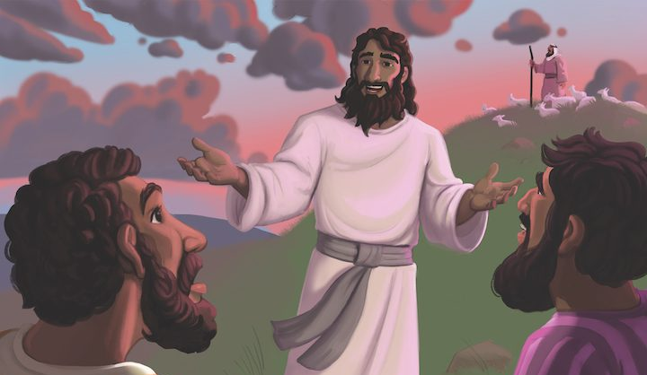
The Great Commission
(look this up in the strongs G2011 -> G2010)
Matthew 28:16-20 Then the eleven disciples went away into Galilee, into a mountain where Yeshua had appointed them. (17) And when they saw him, they worshipped him: but some doubted. (18) And Yeshua came and spake unto them, saying, All power is given unto me in heaven and in earth. (19) Go ye therefore, and teach all nations, baptizing them in the name of the Father, and of the Son, and of the Holy Ghost: (20) Teaching them to observe all things whatsoever I have commanded you: and, lo, I am with you alway, even unto the end of the world. Amen.
1 John 5:1-21 Whosoever believeth that Yeshua is the Christ is born of God: and every one that loveth him that begat loveth him also that is begotten of him. (2) By this we know that we love the children of God, when we love God, and keep his commandments. (3) For this is the love of God, that we keep his commandments: and his commandments are not grievous. (4) For whatsoever is born of God overcometh the world: and this is the victory that overcometh the world, even our faith. (5) Who is he that overcometh the world, but he that believeth that Yeshua is the Son of God? (6) This is he that came by water and blood, even Yeshua Christ; not by water only, but by water and blood. And it is the Spirit that beareth witness, because the Spirit is truth. (7) For there are three that bear record in heaven, the Father, the Word, and the Holy Ghost: and these three are one. (8) And there are three that bear witness in earth, the Spirit, and the water, and the blood: and these three agree in one. (9) If we receive the witness of men, the witness of God is greater: for this is the witness of God which he hath testified of his Son. (10) He that believeth on the Son of God hath the witness in himself: he that believeth not God hath made him a liar; because he believeth not the record that God gave of his Son. (11) And this is the record, that God hath given to us eternal life, and this life is in his Son. (12) He that hath the Son hath life; and he that hath not the Son of God hath not life. (13) These things have I written unto you that believe on the name of the Son of God; that ye may know that ye have eternal life, and that ye may believe on the name of the Son of God. (14) And this is the confidence that we have in him, that, if we ask any thing according to his will, he heareth us: (15) And if we know that he hear us, whatsoever we ask, we know that we have the petitions that we desired of him. (16) If any man see his brother sin a sin which is not unto death, he shall ask, and he shall give him life for them that sin not unto death. There is a sin unto death: I do not say that he shall pray for it. (17) All unrighteousness is sin: and there is a sin not unto death. (18) We know that whosoever is born of God sinneth not; but he that is begotten of God keepeth himself, and that wicked one toucheth him not. (19) And we know that we are of God, and the whole world lieth in wickedness. (20) And we know that the Son of God is come, and hath given us an understanding, that we may know him that is true, and we are in him that is true, even in his Son Yeshua Christ. This is the true God, and eternal life. (21) Little children, keep yourselves from idols. Amen.

Slide 6
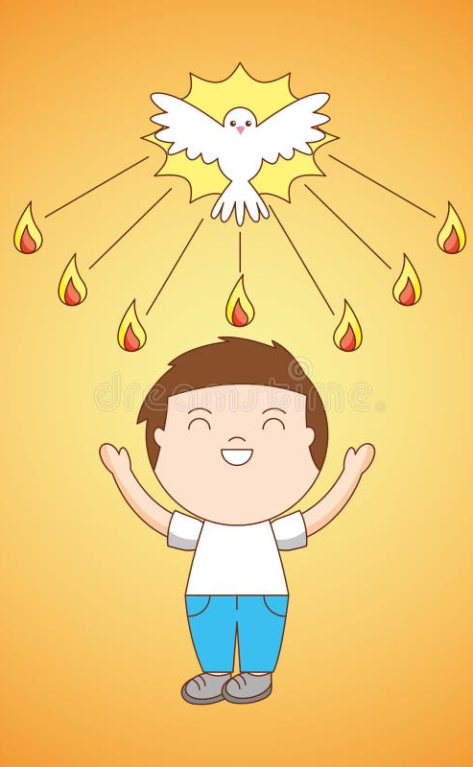
How are we baptized by the Holy Ghost/Spirit?
John 14:15-17 If ye love me, keep my commandments. (16) And I will pray the Father, and he shall give you another Comforter, that he may abide with you for ever; (17) Even the Spirit of truth; whom the world cannot receive, because it seeth him not, neither knoweth him: but ye know him; for he dwelleth with you, and shall be in you.
John 15:10 If ye keep my commandments, ye shall abide in my love; even as I have kept my Father's commandments, and abide in his love.
John 16:7-15 Nevertheless I tell you the truth; It is expedient for you that I go away: for if I go not away, the Comforter will not come unto you; but if I depart, I will send him unto you. (8) And when he is come, he will reprove the world of sin, and of righteousness, and of judgment: (9) Of sin, because they believe not on me; (10) Of righteousness, because I go to my Father, and ye see me no more; (11) Of judgment, because the prince of this world is judged. (12) I have yet many things to say unto you, but ye cannot bear them now. (13) Howbeit when he, the Spirit of truth, is come, he will guide you into all truth: for he shall not speak of himself; but whatsoever he shall hear, that shall he speak: and he will shew you things to come. (14) He shall glorify me: for he shall receive of mine, and shall shew it unto you. (15) All things that the Father hath are mine: therefore said I, that he shall take of mine, and shall shew it unto you.
John 12:44-50 Yeshua cried and said, He that believeth on me, believeth not on me, but on him that sent me. (45) And he that seeth me seeth him that sent me. (46) I am come a light into the world, that whosoever believeth on me should not abide in darkness. (47) And if any man hear my words, and believe not, I judge him not: for I came not to judge the world, but to save the world. (48) He that rejecteth me, and receiveth not my words, hath one that judgeth him: the word that I have spoken, the same shall judge him in the last day. (49) For I have not spoken of myself; but the Father which sent me, he gave me a commandment, what I should say, and what I should speak. (50) And I know that his commandment is life everlasting: whatsoever I speak therefore, even as the Father said unto me, so I speak.

Slide 7
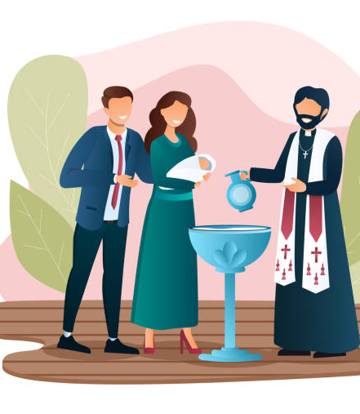
Catholic Baptism
Catholic baptism is the first sacrament of Christian initiation, washing away original sin and incorporating the individual into the Church. It's typically performed by a priest or deacon, either through immersion in water or by pouring water over the head, while reciting the Trinitarian formula. A valid baptism requires the proper matter (water) and form (Trinitarian invocation).
Key Aspects of Catholic Baptism:
Significance:
Baptism is a foundational sacrament, marking the beginning of a Christian life and entry into the Body of Christ.
Requirements:
Generally, at least one parent must be Catholic, and there should be a reasonable expectation the child will be raised in the Catholic faith. Preparation for parents, and godparents (who must be confirmed, practicing Catholics) is often required.
Rite:
The ritual includes the sign of the cross, scripture readings, anointing with oil, the baptismal water, and anointing with chrism oil, often followed by a white garment and a lit candle.
Effects:
Baptism forgives original and personal sin, infuses sanctifying grace, and permanently marks the individual as a Christian.
Necessity:
Baptism is generally considered necessary for salvation, though the Church acknowledges God's mercy extends beyond the sacraments.
Validity:
A valid baptism, once received, is never repeated.
Ministers:
While typically performed by a priest or deacon, in cases of necessity, anyone who intends to do what the Church does can baptize.

Slide 8
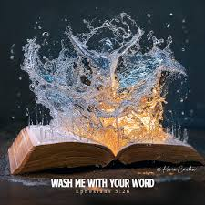
Washing of water by the word
Ephesians 5:26-27 That he might sanctify and cleanse it with the washing[G3067] of water by the word, (27) That he might present itto himself a glorious church, not having spot, or wrinkle, or any such thing; but that it should be holy and without blemish.
  G3067
  Λουτρόν loutron loo-tron'
  From G3068; a bath, that is, (figuratively) baptism: - washing.
1 John 2:1-2 My little children, these things write I unto you, that ye sin not. And if any man sin, we have an advocate with the Father, Yeshua Messiah the righteous: (2) And he is the propitiation for our sins: and not for ours only, but also for the sins of the whole world.
Now, we may have an occasion of stumbling, but by the grace/conviction of Yehovah, we can repent, but we do not continue in that same sin.
John 17:16-17 They are not of the world, even as I am not of the world. (17) Sanctify them through thy truth: thy word is truth.
G37
ἁγιάζω
hagiazō
hag-ee-ad'-zo
From G40; to make holy, that is, (ceremonially) purify or consecrate; (mentally) to venerate: - hallow, be holy, sanctify.
G40
ἅγιος
hagios
hag'-ee-os
From ἅγος hagos (an awful thing) compare G53, [H2282]; sacred (physically pure, morally blameless or religious, ceremonially consecrated): - (most) holy (one, thing), saint.
Revelation 14:12 Here is the patience of the saints[G40]: here are they that keep the commandments of God, and the faith of Yeshua.

Slide 9

You can lose the Holy Spirit NOT OSAS
Traditions of Man
John 5:14 Afterward Yeshua findeth him in the temple, and said unto him, Behold, thou art made whole: sin no more, lest a worse thing come unto thee.
Matthew 12:43-45 When the unclean spirit is gone out of a man, he walketh through dry places, seeking rest, and findeth none. (44) Then he saith, I will return into my house from whence I came out; and when he is come, he findeth it empty, swept, and garnished. (45) Then goeth he, and taketh with himself seven other spirits more wicked than himself, and they enter in and dwell there: and the last state of that man is worse than the first. Even so shall it be also unto this wicked generation.
Hebrews 10:26-29 For if we sin wilfully after that we have received the knowledge of the truth, there remaineth no more sacrifice for sins, (27) But a certain fearful looking for of judgment and fiery indignation, which shall devour the adversaries. (28) He that despised Moses' law died without mercy under two or three witnesses: (29) Of how much sorer punishment, suppose ye, shall he be thought worthy, who hath trodden under foot the Son of God, and hath counted the blood of the covenant, wherewith he was sanctified, an unholy thing, and hath done despite unto the Spirit of grace?
Remember what grace is?
(read all) Psalms 51:11 Cast me not away from thy presence; and take not thy holy spirit from me.
Mark 7:6-13 He answered and said unto them, Well hath Esaias prophesied of you hypocrites, as it is written, This people honoureth me with their lips, but their heart is far from me. (7) Howbeit in vain do they worship me, teaching for doctrines the commandments of men. (8) For laying aside the commandment of God, ye hold the tradition of men, as the washing of pots and cups: and many other such like things ye do. (9) And he said unto them, Full well ye reject the commandment of God, that ye may keep your own tradition. (10) For Moses said, Honour thy father and thy mother; and, Whoso curseth father or mother, let him die the death: (11) But ye say, If a man shall say to his father or mother, It is Corban, that is to say, a gift, by whatsoever thou mightest be profited by me; he shall be free. (12) And ye suffer him no more to do ought for his father or his mother; (13) Making the word of God of none effect through your tradition, which ye have delivered: and many such like things do ye.
Isaiah 29:13-14 Wherefore the Lord said, Forasmuch as this people draw near me with their mouth, and with their lips do honour me, but have removed their heart far from me, and their fear toward me is taught by the precept of men: (14) Therefore, behold, I will proceed to do a marvellous work among this people, even a marvellous work and a wonder: for the wisdom of their wise men shall perish, and the understanding of their prudent men shall be hid.

Slide 10
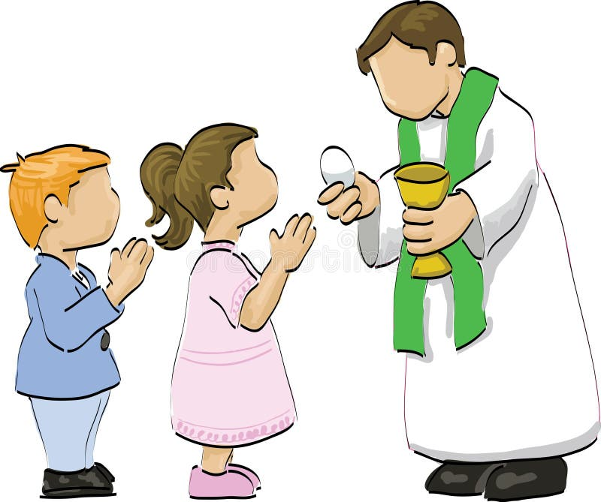
Catholic Communion/Eucharist
In Catholic tradition, Communion, also known as the Eucharist, is a sacrament where Catholics receive the body and blood of Christ in the form of consecrated bread and wine. This ritual, central to Catholic worship, is believed to be more than a symbol; it's a real encounter with Christ. Catholics believe that the bread and wine are transformed into the actual body and blood of Jesus through transubstantiation. Receiving Communion is seen as a way to be incorporated into Christ and united with other believers.
Key aspects of Catholic Communion:
Transubstantiation:
The belief that the bread and wine become the actual body and blood of Christ during the consecration at Mass.
Real Presence:
Catholics believe that Christ is truly and substantially present in the Eucharist, not just symbolically.
Preparation:
Catholics are encouraged to prepare spiritually for Communion, often through prayer and, for those with serious sins, Reconciliation (Confession).
Eucharistic Fast:
A one-hour fast from food and drink (excluding water and medicine) is required before receiving Communion.
Who can receive:
Only baptized Catholics who are in a state of grace (free from serious sin) and have prepared properly can receive Communion.
Importance:
The Eucharist is considered the "source and summit of the Christian life" and is a central part of Catholic worship.
Receiving:
During Mass, the consecrated bread (host) is received on the tongue or in the hand, and the consecrated wine (the Precious Blood) is received by drinking from the chalice.
First Communion:
For Catholics, receiving Communion for the first time (First Communion) is a significant event, typically celebrated around the age of seven or eight

Slide 11
Catholic Confirmation
11
In the Catholic Church, Confirmation is a sacrament where a baptized person receives a special outpouring of the Holy Spirit, deepening their commitment to Christian life and strengthening their faith. It is one of the three sacraments of Christian initiation, alongside Baptism and Eucharist. Through Confirmation, individuals are empowered to live a life of faith, service, and witness, becoming "soldiers of Christ".
Here's a more detailed explanation:
Deepening Baptismal Gifts:
Confirmation is seen as completing the grace received in Baptism, strengthening the person's relationship with God.
Outpouring of the Holy Spirit:
It's a sacrament where the Holy Spirit is bestowed upon the individual, providing them with spiritual gifts and enabling them to live a more committed Christian life.
Mature Christian Commitment:
Confirmation signifies a conscious and mature commitment to the Catholic faith, affirming the promises made during Baptism.
Seal of the Holy Spirit:
The sacrament is often described as the "sealing" of the Holy Spirit, marking the individual as belonging to God.
Rite of Confirmation:
The ceremony typically involves the bishop (or a priest delegated by the bishop) laying hands on the candidate, anointing them with chrism (holy oil), and praying for the Holy Spirit to fill them. The bishop or priest says, "Be sealed with the Holy Spirit" while anointing.
Responsibility and Service:
Confirmation empowers individuals to witness their faith and serve the Church as active members
Read: 1 Corinthians 11:23-34; John 1:14

Slide 12
Laying on of Hands
1 Timothy 4:6-16 If thou put the brethren in remembrance of these things, thou shalt be a good minister of Yeshua Messiah, nourished up in the words of faith and of good doctrine, whereunto thou hast attained. (7) But refuse profane and old wives' fables, and exercise thyself rather unto godliness. (8) For bodily exercise profiteth little: but godliness is profitable unto all things, having promise of the life that now is, and of that which is to come. (9) This is a faithful saying and worthy of all acceptation. (10) For therefore we both labour and suffer reproach, because we trust in the living God, who is the Saviour of all men, specially of those that believe. (11) These things command and teach. (12) Let no man despise thy youth; but be thou an example of the believers, in word, in conversation, in charity, in spirit, in faith, in purity. (13) Till I come, give attendance to reading, to exhortation, to doctrine. (14) Neglect not the gift that is in thee, which was given thee by prophecy, with the laying on of the hands of the presbytery. (15) Meditate upon these things; give thyself wholly to them; that thy profiting may appear to all. (16) Take heed unto thyself, and unto the doctrine; continue in them: for in doing this thou shalt both save thyself, and them that hear thee.

Slide 13
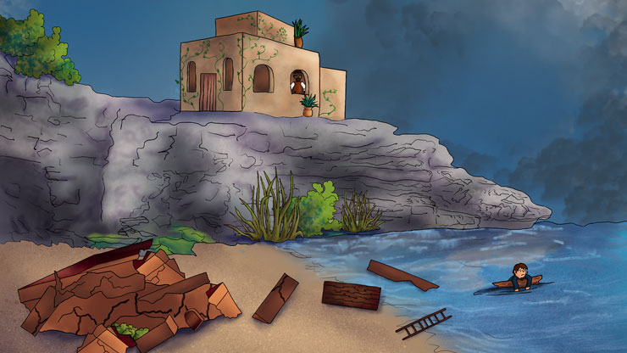
What happens if we do not build our house on the Rock?
Matthew 7:21-27 Not every one that saith unto me, Lord, Lord, shall enter into the kingdom of heaven; but he that doeth the will of my Father which is in heaven. (22) Many will say to me in that day, Lord, Lord, have we not prophesied in thy name? and in thy name have cast out devils? and in thy name done many wonderful works? (23) And then will I profess unto them, I never knew you: depart from me, ye that work iniquity. (24) Therefore whosoever heareth these sayings of mine, and doeth them, I will liken him unto a wise man, which built his house upon a rock: (25) And the rain descended, and the floods came, and the winds blew, and beat upon that house; and it fell not: for it was founded upon a rock. (26) And every one that heareth these sayings of mine, and doeth them not, shall be likened unto a foolish man, which built his house upon the sand: (27) And the rain descended, and the floods came, and the winds blew, and beat upon that house; and it fell: and great was the fall of it.

