Slide 1
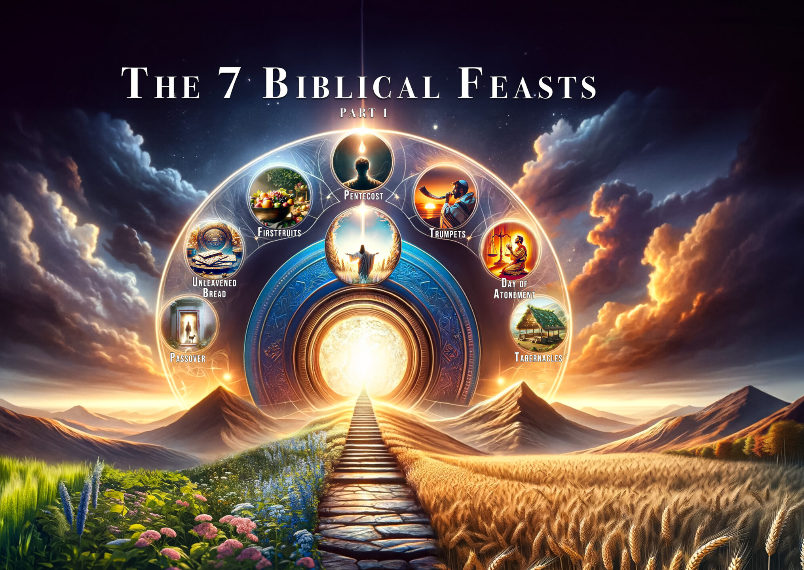
Yah's Feasts Days are Holy, but Mystery Bablyon is NOT Holy
This is a Time For Lamentations, Mourning & Woe

Slide 2

Specific Instructions from Yah: When we are in our rest & our land of inheritance
Deuteronomy 12:8-14
(8) Ye shall not do after all the things that we do here this day, every man whatsoever is right in his own eyes.
(9) For ye are not as yet come to the rest and to the inheritance, which the LORD your God giveth you.
(10) But when ye go over Jordan, and dwell in the land which the LORD your God giveth you to inherit, and when he giveth you rest from all your enemies round about, so that ye dwell in safety;
(11) Then there shall be a place which the LORD your God shall choose to cause his name to dwell there; thither shall ye bring all that I command you; your burnt offerings, and your sacrifices, your tithes, and the heave offering of your hand, and all your choice vows which ye vow unto the LORD:
(12) And ye shall rejoice before the LORD your God, ye, and your sons, and your daughters, and your menservants, and your maidservants, and the Levite that is within your gates; forasmuch as he hath no part nor inheritance with you.
(13) Take heed to thyself that thou offer not thy burnt offerings in every place that thou seest:
(14) But in the place which the LORD shall choose in one of thy tribes, there thou shalt offer thy burnt offerings, and there thou shalt do all that I command thee.

Slide 3
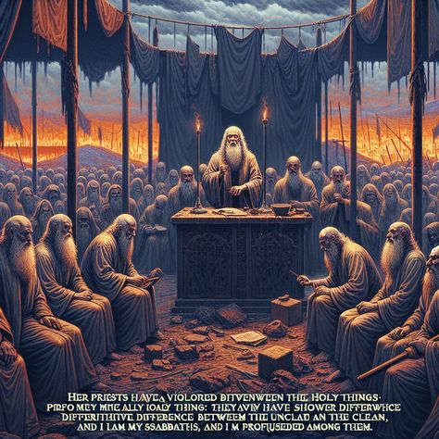
Yah is Holy & His Feasts Days are Holy. Cannot mix the Holy with the profane.
Leviticus 20:22-26
(22) Ye shall therefore keep all my statutes, and all my judgments, and do them: that the land, whither I bring you to dwell therein, spue you not out.
(23) And ye shall not walk in the manners of the nation, which I cast out before you: for they committed all these things, and therefore I abhorred them.
(24) But I have said unto you, Ye shall inherit their land, and I will give it unto you to possess it, a land that floweth with milk and honey: I am the LORD your God, which have separated you from other people.
(25) Ye shall therefore put difference between clean beasts and unclean, and between unclean fowls and clean: and ye shall not make your souls abominable by beast, or by fowl, or by any manner of living thing that creepeth on the ground, which I have separated from you as unclean.
(26) And ye shall be holy unto me: for I the LORD am holy, and have severed you from other people, that ye should be mine.

Slide 4
Second Passover
2 Chronicles 30:1-5
(1) And Hezekiah sent to all Israel and Judah, and wrote letters also to Ephraim and Manasseh, that they should come to the house of the LORD at Jerusalem, to keep the passover unto the LORD God of Israel.
(2) For the king had taken counsel, and his princes, and all the congregation in Jerusalem, to keep the passover in the second month.
(3) For they could not keep it at that time, because the priests had not sanctified themselves sufficiently, neither had the people gathered themselves together to Jerusalem.
(4) And the thing pleased the king and all the congregation.
(5) So they established a decree to make proclamation throughout all Israel, from Beersheba even to Dan, that they should come to keep the passover unto the LORD God of Israel at Jerusalem: for they had not done it of a long time in such sort as it was written.

Slide 5
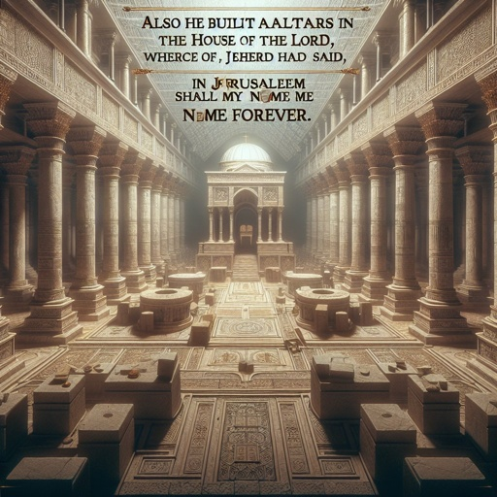
Where Yah puts his name FOREVER
2 Chronicles 6:6
(6) But I have chosen Jerusalem, that my name might be there; and have chosen David to be over my people Israel.
2 Chronicles 33:4
(4) Also he built altars in the house of the LORD, whereof the LORD had said, In Jerusalem shall my name be for ever.
2 Kings 21:7-8
(7) And he set a graven image of the grove that he had made in the house, of which the LORD said to David, and to Solomon his son, In this house, and in Jerusalem, which I have chosen out of all tribes of Israel, will I put my name for ever:
(8) Neither will I make the feet of Israel move any more out of the land which I gave their fathers; only if they will observe to do according to all that I have commanded them, and according to all the law that my servant Moses commanded them.

Slide 6
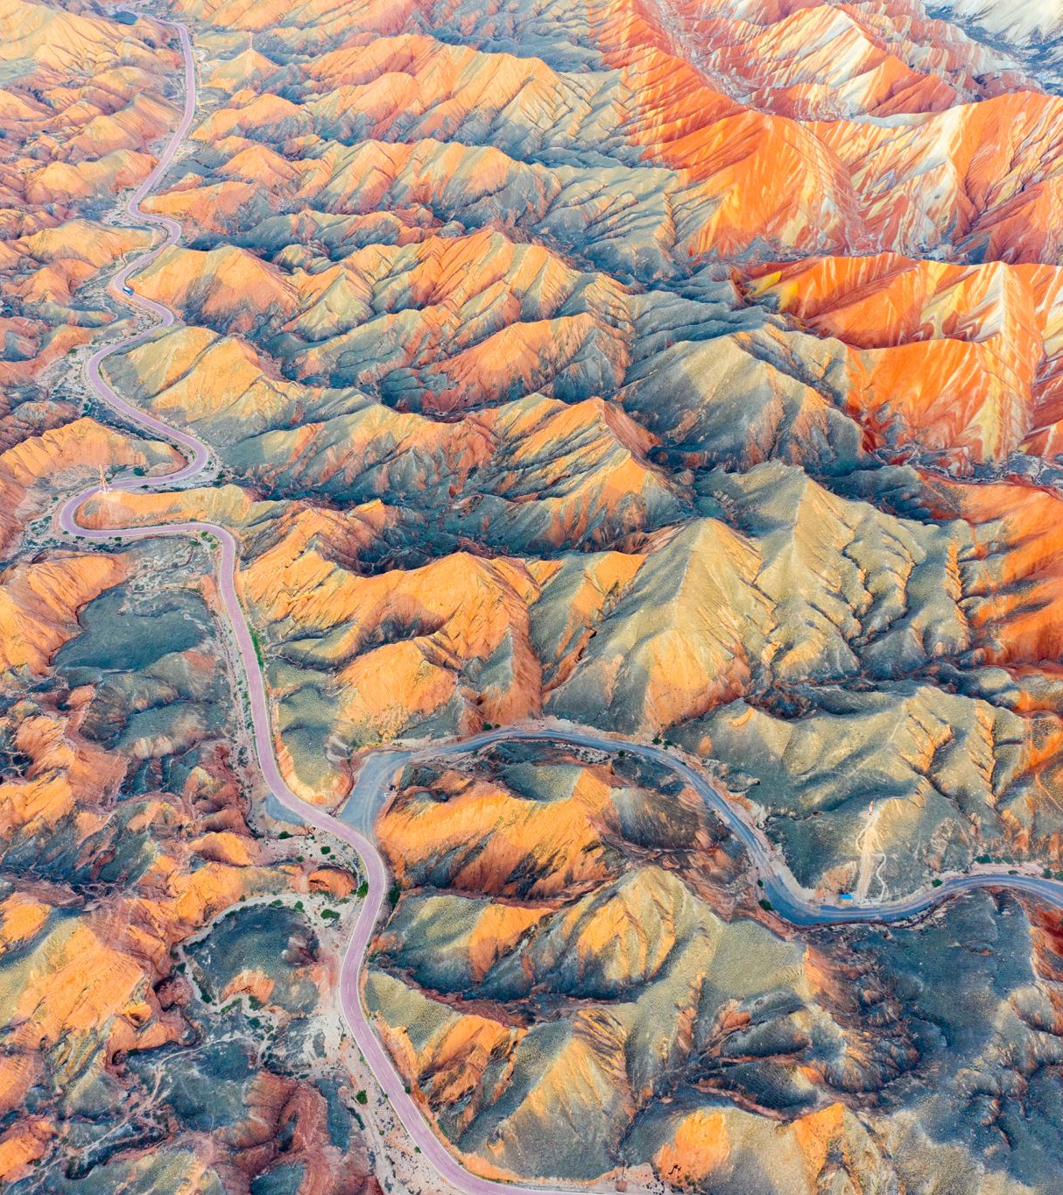
The time they celebrated Passover in the wilderness & NOT in the land of their inheritance
Numbers 9:4-5
(4) And Moses spake unto the children of Israel, that they should keep the passover.
(5) And they kept the passover on the fourteenth day of the first month at even in the wilderness of Sinai: according to all that the LORD commanded Moses, so did the children of Israel.
They celebrated the Passover in the wilderness, because they had:
  The Tabernacle
  The Priests
  The Ark of the Covenant
  AND they had Yehovah himself there at that time dwelling with them in the cloud

Slide 7

Change of Preisthood Levitical to Melchizedek
1 Chronicles 23:25-32
(25) For David said, The LORD God of Israel hath given rest unto his people, that they may dwell in Jerusalem for ever:
(26) And also unto the Levites; they shall no more carry the tabernacle, nor any vessels of it for the service thereof.
(27) For by the last words of David the Levites were numbered from twenty years old and above:
(28) Because their office was to wait on the sons of Aaron for the service of the house of the LORD, in the courts, and in the chambers, and in the purifying of all holy things, and the work of the service of the house of God;
(29) Both for the shewbread, and for the fine flour for meat offering, and for the unleavened cakes, and for that which is baked in the pan, and for that which is fried, and for all manner of measure and size;
(30) And to stand every morning to thank and praise the LORD, and likewise at even;
(31) And to offer all burnt sacrifices unto the LORD in the sabbaths, in the new moons, and on the set feasts, by number, according to the order commanded unto them, continually before the LORD:
(32) And that they should keep the charge of the tabernacle of the congregation, and the charge of the holy place, and the charge of the sons of Aaron their brethren, in the service of the house of the LORD.
Hebrews 7:11-28 (READ) Yeshua is our High Priest Now and FOREVER

Slide 8
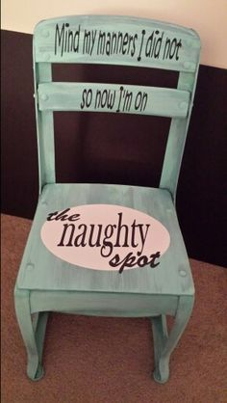
Yehovah has taken away his tabernacle
Lamentations 2:5-7
(5) The Lord was as an enemy: he hath swallowed up Israel, he hath swallowed up all her palaces: he hath destroyed his strong holds, and hath increased in the daughter of Judah mourning and lamentation.
(6) And he hath violently taken away his tabernacle, as if it were of a garden: he hath destroyed his places of the assembly: the LORD hath caused the solemn feasts and sabbaths to be forgotten in Zion, and hath despised in the indignation of his anger the king and the priest.
(7) The Lord hath cast off his altar, he hath abhorred his sanctuary, he hath given up into the hand of the enemy the walls of her palaces; they have made a noise in the house of the LORD, as in the day of a solemn feast.
Zephaniah 3:9
(9) For then will I turn to the people a pure language, that they may all call upon the name of the LORD, to serve him with one consent.
Acts 3:19-21
(19) Repent ye therefore, and be converted, that your sins may be blotted out, when the times of refreshing shall come from the presence of the Lord;
(20) And he shall send Yeshua Messiah, which before was preached unto you:
(21) Whom the heaven must receive until the times of restitution of all things, which God hath spoken by the mouth of all his holy prophets since the world began.

Slide 9
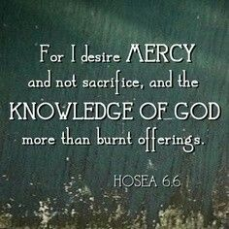
Yah desires mercy & NOT sacrifice
Matthew 9:13
(13) But go ye and learn what that meaneth, I will have mercy, and not sacrifice: for I am not come to call the righteous, but sinners to repentance.
Hosea 6:6
(6) For I desired mercy, and not sacrifice; and the knowledge of God more than burnt offerings.
Psalms 51:16-17
(16) For thou desirest not sacrifice; else would I give it: thou delightest not in burnt offering.
(17) The sacrifices of God are a broken spirit: a broken and a contrite heart, O God, thou wilt not despise.
Job 21:11-15
(11) They send forth their little ones like a flock, and their children dance.
(12) They take the timbrel and harp, and rejoice at the sound of the organ.
(13) They spend their days in wealth, and in a moment go down to the grave.
(14) Therefore they say unto God, Depart from us; for we desire not the knowledge of thy ways.
(15) What is the Almighty, that we should serve him? and what profit should we have, if we pray unto him?

Slide 10

Lamenting & Mourning NOT Feasting
Isaiah 5:11-13
(11) Woe unto them that rise up early in the morning, that they may follow strong drink; that continue until night, till wine inflame them!
(12) And the harp, and the viol, the tabret, and pipe, and wine, are in their feasts: but they regard not the work of the LORD, neither consider the operation of his hands.
(13) Therefore my people are gone into captivity, because they have no knowledge: and their honourable men are famished, and their multitude dried up with thirst.
Amos 6:4-6
(4) That lie upon beds of ivory, and stretch themselves upon their couches, and eat the lambs out of the flock, and the calves out of the midst of the stall;
(5) That chant to the sound of the viol, and invent to themselves instruments of musick, like David;
(6) That drink wine in bowls, and anoint themselves with the chief ointments: but they are not grieved for the affliction of Joseph.
Luke 6:25
(25) Woe unto you that are full! for ye shall hunger. Woe unto you that laugh now! for ye shall mourn and weep.
Jude 1:12
(12) These are spots in your feasts of charity, when they feast with you, feeding themselves without fear: clouds they are without water, carried about of winds; trees whose fruit withereth, without fruit, twice dead, plucked up by the roots;

Slide 11
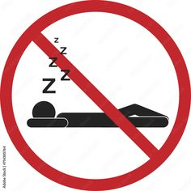
For This is Not Your Rest
Ecclesiastes 7:1-4
(1) A good name is better than precious ointment; and the day of death than the day of one's birth.
(2) It is better to go to the house of mourning, than to go to the house of feasting: for that is the end of all men; and the living will lay it to his heart.
(3) Sorrow is better than laughter: for by the sadness of the countenance the heart is made better.
(4) The heart of the wise is in the house of mourning; but the heart of fools is in the house of mirth.
Micah 2:10
(10) Arise ye, and depart; for this is not your rest: because it is polluted, it shall destroy you, even with a sore destruction.

