Slide 1
Praying to Mary and the Saints VS. Biblical Prayer: Yeshua as Our Only Mediator
Kids Bible Fellowship

Slide 2
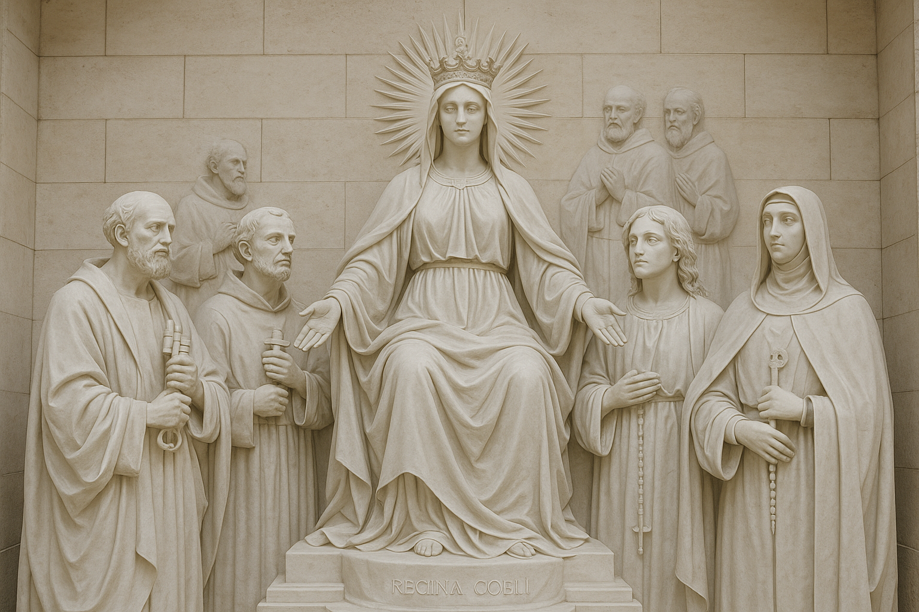
Catholics Beliefs
Catholics believe that Mary and the ‘Saints’ can intercede on their behalf with God, acting as powerful intercessors.
The Catholic Church has a formal process, called canonization, to officially declare someone a ‘Saint.’ This process involves investigation into the person's life, writings, and miracles attributed to their intercession. Catholics choose a ‘Saint’ whose life or virtues resonate with them.
  Prayer to Saint Joseph: Many Catholics pray to ‘St. Joseph,’ particularly for protection and guidance in family life and work.
  Prayer to Saint Anthony: This prayer is often used to ask for help in finding lost items or for guidance in difficult situations.
  Prayer to Saint Michael the Archangel: This prayer is for protection against evil and spiritual attacks.
Other Catholic practices include the Rosary and Hail Mary (prayer to Mary).
Based on Tradition, not Biblical Command.
  Mark 7:7-9 Howbeit in vain do they worship me, teaching for doctrines the commandments of men. For laying aside the commandment of God, ye hold the tradition of men, as the washing of pots and cups: and many other such like things ye do. And he said unto them, Full well ye reject the commandment of God, that ye may keep your own tradition.

Slide 3
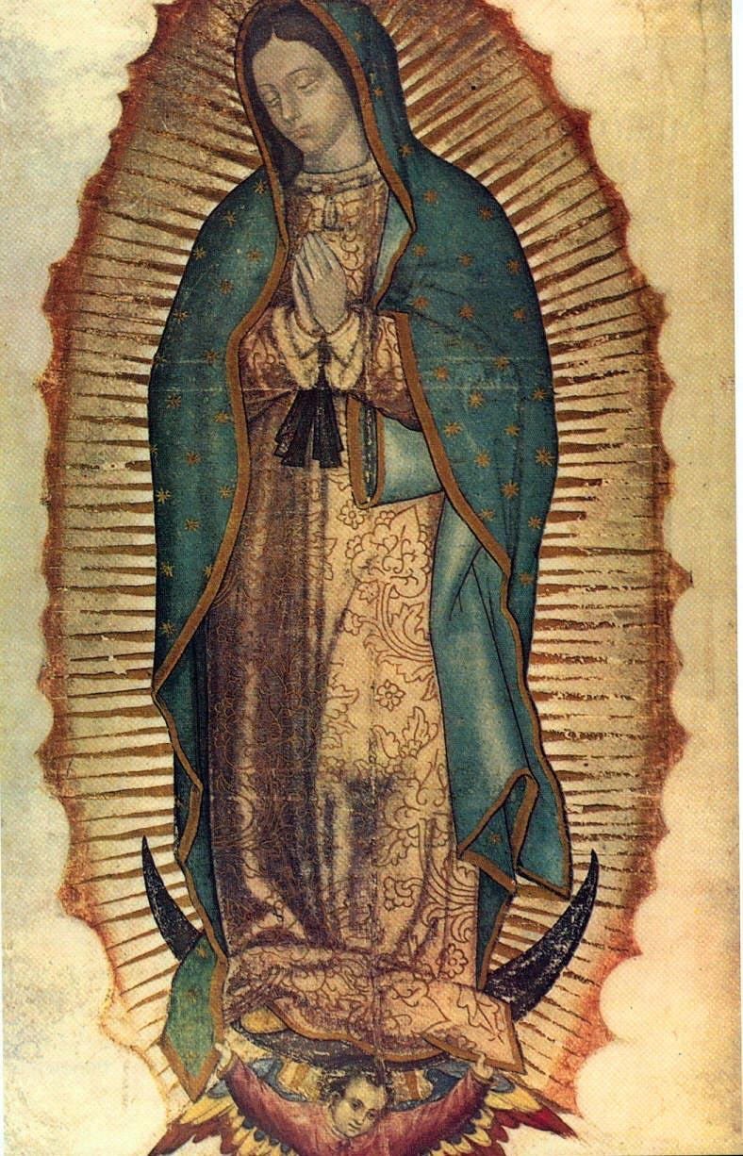
The Role of Mary in Catholicism
Mary is often referred to as the ‘Queen of Heaven,’ ‘Mediatrix,’ and ‘Mother of the Church.’ Catholics believe she holds a special, exalted position as the ‘Mother of God,’ and that she has a unique relationship with Yeshua (whom they call Jesus Christ). They view her as someone who can bring their needs to Him, similar to asking a trusted friend to pray on their behalf. It is believed that Mary can intercede with her Son for believers, presenting their prayers to Him. Because of this, Catholics give Mary the highest honor and veneration, seeing her not only as the mother of Yeshua but also as a powerful model of faith and obedience.
Prayers offered to her:
  Example: 'Holy Mary, Mother of God, pray for us sinners…'
  The Magnificat, also referred to as the Song of Mary, is based on Mary’s response to Elizabeth during the Visitation in the Gospel of Luke.
  The Rosary includes the Apostles’ Creed, Our Father, and Hail Mary prayers, as well as Scripture readings for each of the four mysteries.
  The Angelus prayer commemorates the Incarnation of Christ through Mary.
  The Scapular of Our Lady of Mount Carmel, a gift to the Carmelites from Mary, the scapular is used for prayer and devotion to Mary to “venerate her, love her and trust in her protection.”
  Miraculous Medals, bestow graces on those who pray for Mary’s intercession while wearing the medal.
  Seven Sorrows of Mary is a devotion to Mary, ‘Our Lady of Sorrows,’ that includes seven instances from Scripture of Mary’s suffering in relation to ‘JC.’
  Consecration to Jesus through Mary is a devotion where you give yourself completely to Mary, typically preceded by 33 days of devotional preparations.

Slide 4

Rosaries and Hail Mary’s are an ABOMINATION to the Father Yehovah!
A rosary is a graven image, thus breaking the Second Commandment.
  Exodus 20:4-6 Thou shalt not make unto thee any graven image, or any likeness of any thing that is in heaven above, or that is in the earth beneath, or that is in the water under the earth. Thou shalt not bow down thyself to them, nor serve them: for I the Lord thy God am a jealous God, visiting the iniquity of the fathers upon the children unto the third and fourth generation of them that hate me; And shewing mercy unto thousands of them that love me, and keep my commandments.
  Deuteronomy 5:8-10 Thou shalt not make thee any graven image, or any likeness of any thing that is in heaven above, or that is in the earth beneath, or that is in the waters beneath the earth: Thou shalt not bow down thyself unto them, nor serve them: for I the Lord thy God am a jealous God, visiting the iniquity of the fathers upon the children unto the third and fourth generation of them that hate me, And shewing mercy unto thousands of them that love me and keep my commandments.
The rosary relies on repeating the same prayers over and over, but Yeshua warned us not to pray with vain repetitions, thinking we’ll be heard for our many words.
  Matthew 6:7 But when ye pray, use not vain repetitions, as the heathen do: for they think that they shall be heard for their much speaking.
Calling on the dead, including ‘Saints’ or Mary, is biblically defined as necromancy. It's forbidden in Scripture and considered an abomination to the Most High.
  Deuteronomy 18:10-12 There shall not be found among you any one that maketh his son or his daughter to pass through the fire, or that useth divination, or an observer of times, or an enchanter, or a witch. Or a charmer, or a consulter with familiar spirits, or a wizard, or a necromancer. For all that do these things are an abomination unto the Lord: and because of these abominations the Lord thy God doth drive them out from before thee.
Mary is DEAD!
  According to 2 Esdras 7, when we die, we either go to a place of rest and peace or a place of torment—there is no in-between. Mary cannot hear prayers, nor can she intercede, just like no other person who has died. The dead are not aware of the living; they do not see, hear, or respond. Scripture makes it clear: once we pass, our end is sealed, and only the Most High has authority over the soul.
Catholics have become deaf, dumb, and blind just like their idols – as it says in Psalms 115 and 135!

Slide 5
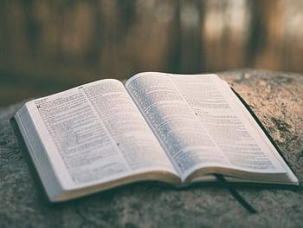
Bible Verses

Slide 6
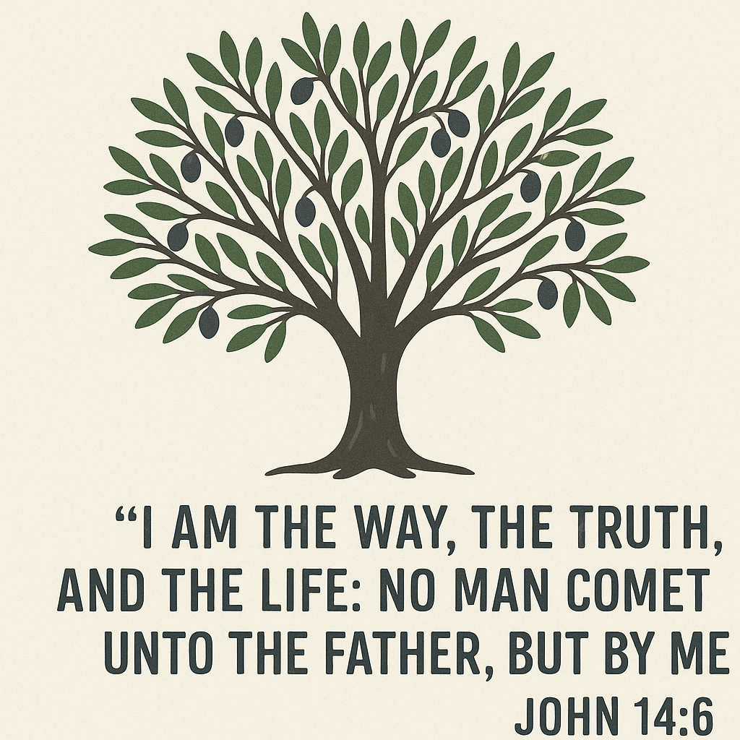
1 Timothy 2:5 For there is one God, and one mediator between God and men, the man Messiah Yeshua;
John 14:6 Yeshua saith unto him, I am the way, the truth, and the life: no man cometh unto the Father, but by me.
Romans 8:34 Who is he that condemneth? It is Messiah that died, yea rather, that is risen again, who is even at the right hand of God, who also maketh intercession for us.
Who is OUR Mediator?

Slide 7
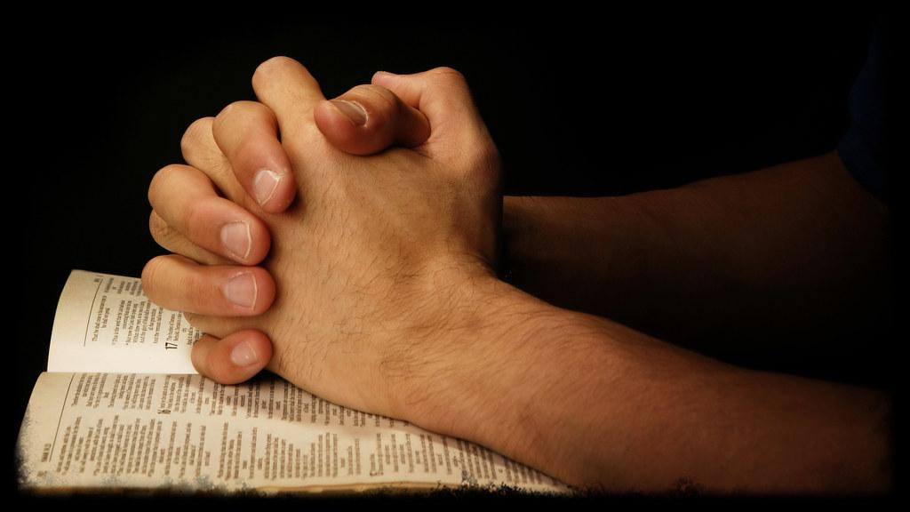
Read Matthew 6 and Luke 11 to Figure out HOW to Pray and WHO to Pray to!
You don’t need ‘Prayer Props’
  I.e., a rosary, prayer wall, beads, cross, crucifix, incense, ‘holy water’, etc.
You don’t need Mary
You don’t need Statues
You don’t need ‘Saints’
You don’t need a Church/Temple
  1 Corinthians 3:16 Know ye not that ye are the temple of God, and that the Spirit of God dwelleth in you?
You don’t need a Priest
You need to pray to the Father, Yehovah, in His Son Yeshua’s Name!

Slide 8
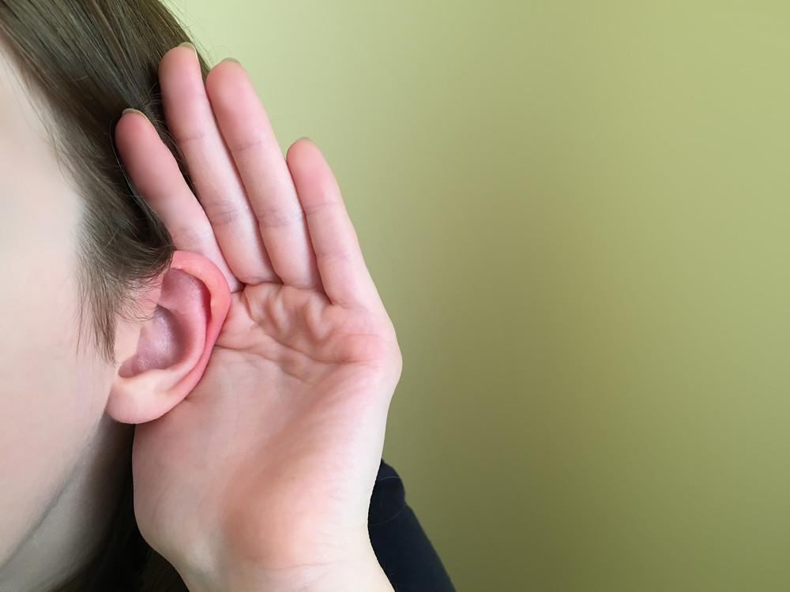
How do you know your prayers are being heard?
Be in obedience to Yehovah! Keep the Covenants of Promise (Ephesians 2:12/Acts 15:29) – which are the Holy Covenant (Ten Commandments), Exodus 20, Deuteronomy 5, Deuteronomy 6:1-5, 1 John 5:3, and John 14:15; and the Noahic Covenant (Eating Biblically Clean), Genesis 6-9, Leviticus 11, and Deuteronomy 14. AND Fulfil the Royal Law (Rebuke Sin/Become a Watchmen), James 2:8-9, Leviticus 19:15-18, Mark 13:32-37, Ezekiel 2,3, and 33. You have to have clean hands and a pure heart!
Proverbs 28:9 He that turneth away his ear from hearing the law, even his prayer shall be abomination.
John 9:31 Now we know that God heareth not sinners: but if any man be a worshipper of God, and doeth his will, him he heareth.
Psalm 34:15 The eyes of the Lord are upon the righteous, and his ears are open unto their cry.

Slide 9
Scriptures
You have to have no blood on your hands (Ezekiel 3:18-21)!
  Isaiah 1:15 And when ye spread forth your hands, I will hide mine eyes from you: yea, when ye make many prayers, I will not hear: your hands are full of blood.
Yah doesn’t hear the wicked. The path of the wicked mirrors the ways of the heathen (i.e., Breaking of the Ten Commandments, Idolatry, etc.)—ways that are rooted in rebellion against God.
  Proverbs 15:8 The sacrifice of the wicked is an abomination to the Lord: but the prayer of the upright is his delight.
  Proverbs 15:29 The Lord is far from the wicked: but he heareth the prayer of the righteous.
The catholic church twisted this verse and created ‘confession’. This is where you confess your sins in a booth to an unrighteous man. This is not what God desires. What God desires is for us to become righteous. To become righteous, in the eyes of the Lord, is to keep his commandments (Psalms 119:172 and Deuteronomy 6:24-25). When we become righteous in the eyes of the Lord, He will hear our prayers.
  James 5:15-18 And the prayer of faith shall save the sick, and the Lord shall raise him up; and if he have committed sins, they shall be forgiven him. Confess your faults one to another, and pray one for another, that ye may be healed. The effectual fervent prayer of a righteous man availeth much. Elias was a man subject to like passions as we are, and he prayed earnestly that it might not rain: and it rained not on the earth by the space of three years and six months. And he prayed again, and the heaven gave rain, and the earth brought forth her fruit.

