Slide 1

Rules to Rebuke
Kids Bible Fellowship

Slide 2

Leviticus 19
Ye shall do no unrighteousness in judgment: thou shalt not respect the person of the poor, nor honor the person of the mighty: but in righteousness shalt thou judge thy neighbour. Thou shalt not go up and down as a talebearer among thy people: neither shalt thou stand against the blood of thy neighbour; I am the Lord. Thou shalt not hate thy brother in thine heart: thou shalt in any wise rebuke thy neighbour, and not suffer sin upon him. Thou shalt not avenge, nor bear any grudge against the children of thy people, but thou shalt love thy neighbour as thyself: I am the Lord.

Slide 3

Take the Log out of your Eye!
Matthew 7:1-5 Judge not, that ye be not judged. For with what judgment ye judge, ye shall be judged: and with what measure ye mete, it shall be measured to you again. And why beholdest thou the mote that is in thy brother's eye, but considerest not the beam that is in thine own eye? Or how wilt thou say to thy brother, Let me pull out the mote out of thine eye; and, behold, a beam is in thine own eye? Thou hypocrite, first cast out the beam out of thine own eye; and then shalt thou see clearly to cast out the mote out of thy brother's eye.

Slide 4

Public Rebuke VS. Private Rebuke

Slide 5

Private Rebuke
Luke 17:3-4 Take heed to yourselves: If thy brother trespass against thee, rebuke him; and if he repent, forgive him. And if he trespass against thee seven times in a day, and seven times in a day turn again to thee, saying, I repent; thou shalt forgive him.
Galatians 6:1 Brothers, if anyone is caught in any transgression, you who are spiritual should restore him in a spirit of gentleness. Keep watch on yourself, lest you too be tempted.
James 5:19-20 Brethren, if any of you do err from the truth, and one convert him; Let him know, that he which converteth the sinner from the error of his way shall save a soul from death, and shall hide a multitude of sins.

Slide 6
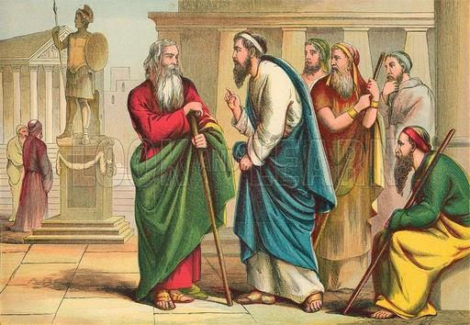
Public Rebuke
Proverbs 27:5 Open rebuke is better than secret love.
1 Timothy 5:19-20 Do not admit a charge against an elder except on the evidence of two or three witnesses. As for those who persist in sin, rebuke them in the presence of all, so that the rest may stand in fear.
Paul rebuking Peter
  Galatians 2:11-14 But when Peter was come to Antioch, I withstood him to the face, because he was to be blamed. For before that certain came from James, he did eat with the Gentiles: but when they were come, he withdrew and separated himself, fearing them which were of the circumcision. And the other Jews dissembled likewise with him; insomuch that Barnabas also was carried away with their dissimulation. But when I saw that they walked not uprightly according to the truth of the gospel, I said unto Peter before them all, If thou, being a Jew, livest after the manner of Gentiles, and not as do the Jews, why compellest thou the Gentiles to live as do the Jews?

Slide 7

Private to Public Rebuke
Matthew 18:15-17 If your brother sins against you, go and tell him his fault, between you and him alone. If he listens to you, you have gained your brother. But if he does not listen, take one or two others along with you, that every charge may be established by the evidence of two or three witnesses. If he refuses to listen to them, tell it to the church. And if he refuses to listen even to the church, let him be to you as a Gentile and a tax collector.

Slide 8
General Scriptures
James 5:19-20 Brethren, if any of you do err from the truth, and one convert him; Let him know, that he which converteth the sinner from the error of his way shall save a soul from death, and shall hide a multitude of sins.
Jude 1:22-23 And of some have compassion, making a difference: And others save with fear, pulling them out of the fire; hating even the garment spotted by the flesh.
Proverbs 10:12 Hatred stirreth up strifes: but love covereth all sins.

Slide 9
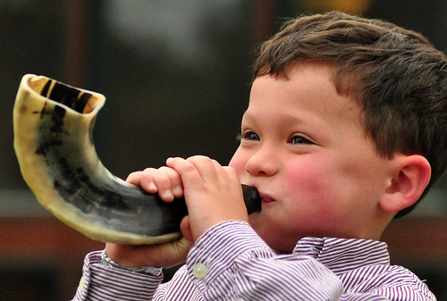
When to Rebuke Sharply
Titus 1:13-14 This witness is true. Wherefore rebuke them sharply, that they may be sound in the faith; Not giving heed to Jewish fables, and commandments of men, that turn from the truth.
2 Timothy 4:2 Preach the word; be instant in season, out of season; reprove, rebuke, exhort with all long suffering and doctrine.
Titus 2:15 These things speak, and exhort, and rebuke with all authority. Let no man despise thee.
Examples: Pagan Holidays, Babylonian Dusk to Dusk Sabbath, Feasts (going after the commandments of men), When a Person is in Pride, Jezebel/Ahab Spirit, Idols (i.e., Cross/Crucifix, Star of David, Statues, etc.), Talmud, False Doctrine (i.e., Pre-Trib Rapture, Preterism, OSAS, etc.), Circumcision of the Flesh

Slide 10
Meeting People Where They Are At
Isaiah 28:23-29 Give ye ear, and hear my voice; hearken, and hear my speech. Doth the plowman plow all day to sow? doth he open and break the clods of his ground? When he hath made plain the face thereof, doth he not cast abroad the fitches, and scatter the cummin, and cast in the principal wheat and the appointed barley and the rie in their place? For his God doth instruct him to discretion, and doth teach him. For the fitches are not threshed with a threshing instrument, neither is a cart wheel turned about upon the cummin; but the fitches are beaten out with a staff, and the cummin with a rod. Bread corn is bruised; because he will not ever be threshing it, nor break it with the wheel of his cart, nor bruise it with his horsemen. This also cometh forth from the Lord of hosts, which is wonderful in counsel, and excellent in working.
1 Corinthians 9:19-23 For though I be free from all men, yet have I made myself servant unto all, that I might gain the more. And unto the Jews I became as a Jew, that I might gain the Jews; to them that are under the law, as under the law, that I might gain them that are under the law; To them that are without law, as without law, (being not without law to God, but under the law to Christ,) that I might gain them that are without law. To the weak became I as weak, that I might gain the weak: I am made all things to all men, that I might by all means save some. And this I do for the gospel's sake, that I might be partaker thereof with you.

Slide 11
Women DO NOT Usurp the Authority of Men
Women are to be like Deborah (Judges 4)--- asking men questions. We are called to teach women and children!
1 Timothy 2:11-12 Let the woman learn in silence with all subjection. But I suffer not a woman to teach, nor to usurp authority over the man, but to be in silence.
Titus 2:3-5 The aged women likewise, that they be in behaviour as becometh holiness, not false accusers, not given to much wine, teachers of good things; That they may teach the young women to be sober, to love their husbands, to love their children, To be discreet, chaste, keepers at home, good, obedient to their own husbands, that the word of God be not blasphemed.

Slide 12
Examples of Convicting Questions for Women to Ask Men
Why follow Jesus/lesous when you can follow the Hebrew Messiah Yeshua? Isn’t Jesus the name of Baal, Jeremiah 23:27, Hosea 2:17, Psalms 68:4, John 5:42-43, & Acts 4:12? Won’t his people know his name, Isaiah 52:6?
Isn’t grace conviction, the divine influence upon the heart and its reflection in the life? Titus 2:11-12, Hebrews 10:29, & 2 Peter 3:18
Do you keep the Ten Commandments?
How does one receive the Holy Spirit of Truth? John 14:15-26 & Acts 5:32
What was added (Galatians 3:19) to the 10 Commandments? Weren’t we told nothing more was added (Deuteronomy 5:22) to the Holy Covenant (10 Commandments)? How come you do not know what your Messiah came to teach (Deuteronomy 18:15-19)? What was desired at Horeb?

Slide 13
Nonbelievers-Agnostic/Atheist
1 Corinthians 5:11-13 But now I have written unto you not to keep company, if any man that is called a brother be a fornicator, or covetous, or an idolator, or a railer, or a drunkard, or an extortioner; with such an one no not to eat. For what have I to do to judge them also that are without? do not ye judge them that are within? But them that are without God judgeth. Therefore put away from among yourselves that wicked person.
1 Timothy 6:20-21 O Timothy, keep that which is committed to thy trust, avoiding profane and vain babblings, and oppositions of science falsely so called: Which some professing have erred concerning the faith. Grace be with thee. Amen.

Slide 14

Do NOT Rebuke the Devil
Jude 1:8-9 Likewise also these filthy dreamers defile the flesh, despise dominion, and speak evil of dignities. Yet Michael the archangel, when contending with the devil he disputed about the body of Moses, durst not bring against him a railing accusation, but said, The Lord rebuke thee.
Zechariah 3:2 And the Lord said unto Satan, The Lord rebuke thee, O Satan; even the Lord that hath chosen Jerusalem rebuke thee: is not this a brand plucked out of the fire?

Slide 15


Do NOT Rail Against the Government
Romans 13
1 Peter 2:13-17 Submit yourselves to every ordinance of man for the Lord's sake: whether it be to the king, as supreme; Or unto governors, as unto them that are sent by him for the punishment of evildoers, and for the praise of them that do well. For so is the will of God, that with well doing ye may put to silence the ignorance of foolish men: As free, and not using your liberty for a cloke of maliciousness, but as the servants of God. Honour all men. Love the brotherhood. Fear God. Honour the king.
Exodus 22:28 Thou shalt not revile the gods, nor curse the ruler of thy people.

