Slide 1

Law of God VS Law of Moses
STRAITISTHEGATE.NET

Slide 2
Law of God or Law of Moses
Outline
Importance of Hearing God’s Voice
What is a Covenant?
What is a Schoolmaster?
What was the purpose of the Temple and Priests to have sacrifices?
What evidence is there of Two Laws Spoken?
Other Laws written in the Torah
Scripture that explains when sacrificial law ended and what is now required to serve God.

Slide 3
Law of God or Law of Moses
Importance of Hearing God’s Voice
  From the beginning, God has wanted his creation (man), made in his own image, to hear his voice, obey his voice, and for man to dwell with him and have relationship with him and act as a steward to the rest of His creation. Eve unfortunately listened to the serpent and Adam listened to his wife instead of obeying God’s voice. Therefore, they were both thrust out of the Garden of Eden and God established the curse of death upon them and all of humanity, for at least up to the end of 6 prophetic Days (where a Day to God is like 1000 years - 2 Peter 3:4-13, Psalm 90, Gen 6:3, Epistle of Barnabus 15, Isa 46:10-11, Gen 3:19, Isaiah 65, 1 Cor 15:22-24, also Day of the Lord).
  Noah and Abraham are two big examples of servants of God whose obedience was counted for righteousness, and this act of believing and hearing is commended and held as the standard of Faith. Read Gen 6:9-22 and 7, Gen 12, Gen 22, Gen 26:5,Gen 27, Heb 11.
  God led Israel out of Egypt, across the wilderness and brought them to Horeb to establish his Holy Covenant by His voice. Read Exo 19-20, Deut 4-5, Deut 8, Deut 13, Deut 18:15-22.
  Other scripture on Obeying God’s Voice: Deut 30, 1 Sam 12, 2 Kings 17:7-41, 2 Kings 18:1-12, Jer 7:19-34, Jer 11, John 5:25-28, John 10 – sheep obey, John 18:37, Rev 1:3, Rev 3:20, Rev 14:12, Rev 12:17, Rev 19:10, Rev 21:3, Rev 22:14.

Slide 4
Law of God or Law of Moses
What is a Covenant?
A legal agreement, a blood oath, between two or more parties. Considered eternally binding (Gen 9). The Agreement contains first principles and presiding tenants that both parties agree to follow. A Covenant often is only annulled by manner of death by one or more parties. The principle is the same as a marriage Covenant between Husband and Wife. The “two become one flesh”, and “what God brings together let no man separate (Mat 19:4-6).”
What is a Statute?
A State Law that contains rules, regulations and judgements passed by a legislative body as “violation of crimes,” as defined by the Statute (1 Tim 1:9). Considered temporary and subject to periodic ratification. Usually written to uphold the first principles of the Covenant and aids the enforcement and adherence to it as well as added laws, rules and regulations.
What is an Ordinance?
A local Law. Otherwise, the same as a Statute.
Testimony
Personal witness to an event or vision, or a formal statement given as evidence to a court, that is used in support the upholding of Truth. Two types: Expert Witness and Peer Witness. In the Bible a testimony is the “Spirit of Prophecy” (Rev 19:10) And prophecy is the telling or interpretation of a vision of a future event yet to occur. Testimonies spoken are a witness of God’s Promises made and kept and the veracity of his Word overall.

Slide 5
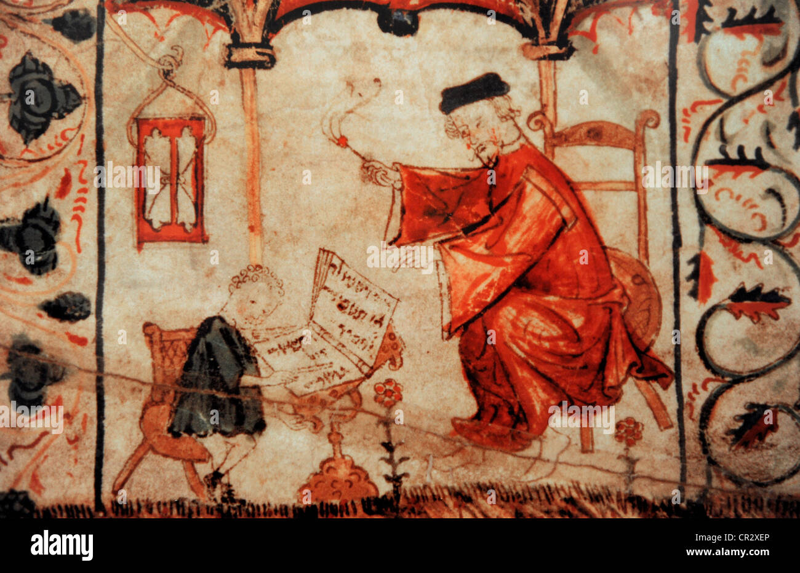
Law of God or Law of Moses
What was/is a Schoolmaster?
  One that disciplines or directs. The law so designated by Paul (Galatians 3:24, 25). As so used, the word does not mean teacher, but pedagogue (shortened into the modern page), i.e., one who was entrusted with the supervision of a family, taking them to and from the school, being responsible for their safety and manners. Hence the pedagogue was stern and severe in his discipline, often standing behind students reciting the Torah and carrying a whip or a stick to issue minor corporal punishment. Thus, the law was a pedagogue to the Jews, with a view to Christ, i.e., to prepare for faith in Christ by producing convictions of guilt and helplessness. The office of the pedagogue ceased when "faith came", i.e., the object of that faith, the seed, which is Christ.
Recognitions of Clement
Chapters 35-39 – The words of Peter

Slide 6
Law of God or Law of Moses
What was the purpose of the Temple Priests to perform sacrifices?
  As we read in Recognitions of Clement, the Temple was established to serve God for a temporary time in order to show Israel, by the head and seed of Aaron, how to atone for the sin of Israel when they made a Golden Calf and broke the Holy Covenant that was established by God’s voice. The Temple system was a punishment (or “schoolmaster”) forcing them to do continual and painstaking rituals and sacrifices, with the blood of beasts sprinkled upon the mercy seat or burned in fire. The temple had a long history of being overthrown and torn down to demonstrate to Israel this is not how God wants His people to worship Him, but impress upon them how much easier it is to simply
  Obey His Voice!
  Aaron shall “Bear the Iniquity” Read Ex 28:38-43, Leviticus 10:17, Deut 9:20-24, Psalm 106:23, Exo 27:21, Num 1:53, Num 14, Num 18:1, Isa 24
  Deut 5:22 “He added no more”, Exodus 40:19-20 “Two Tables of Stone inside the Ark”
  Deut 29:21-27 – “Lord shall separate him unto evil out of all the tribes of Israel, according to the curses of the Covenant that are written in the book of the law.”
  Deut 30 (Read all) “If thou shalt hearken unto the voice to keep His commandments (in stone) and his statutes which are written in this book of the law (of Moses).
  Deut 31:24-26 – “Book placed on the side of the Ark as a witness against them until they were finished”
  Study the difference the Allegory of Hagar and Sarah, of Flesh vs Spirit, of writing on the heart.

Slide 7
Law of God or Law of Moses
Other Laws Written in the Torah – 613 Mitzvah
  Compiled first in 3rd century AD, by Rabbi Simlai, the word Mitzvah occurs over 180 times in Masoretic text, and the laws are spread all throughout the Torah. No where in the Bible do we obey all 613.
  These laws were used to regulate the State of Israel in ancient times, and were the “law of the land”, but most do not apply to Gentiles after Christ’s crucifixion in early first century and after the destruction of the Temple in 70ad. IF Israel simply obeyed the 10c, these would be unnecessary.
Other Torah Laws
Deut 10:19 | Treatment of Gentiles | Deut 23 | Do not borrow on interest
Ex 22”20 | No wrong to a stranger | Ex 23:19 | Don’t boil meat with milk
Deut 7:3 & 25 | Not to intermarry with Gentiles | Lev 25 | Treatment of servants
Gen 1:28 | Be Fruitful and Multiply | Num 27 | Adjudication of Inheritences
Deut 15:7 | Not to refrain maintaining a poor man | Deut 13 | Examine a Witness
Deut 24:5 | Bridegroom is exempt from service | Deut 17 | Don’t rebel against orders of a court
Lev 18 | No incest or vile relations with anything | Deut 22 | Death Penalty
Deut 14 & Lev 11 | Dietary Law | Lev 7 | Guilt and peace offerings
Lev 7:26 | Don’t eat the blood | Lev 13 | Clean and unclean rules

Slide 8
Law of God or Law of Moses
Other Laws Written in the Torah – 613 Mitzvah
  Compiled first in 3rd century AD, by Rabbi Simlai, the word Mitzvah occurs over 180 times in Masoretic text, and the laws are spread all throughout the Torah. No where in the Bible do we obey all 613.
  These laws were used to regulate the State of Israel in ancient times, and were the “law of the land”, but most do not apply to Gentiles after Christ’s crucifixion in early first century and after the destruction of the Temple in 70ad. IF Israel simply obeyed the 10c, these would be unnecessary.
Other Torah Laws
Deut 10:19 | Treatment of Gentiles | Deut 23 | Do not borrow on interest
Ex 22”20 | No wrong to a stranger | Ex 23:19 | Don’t boil meat with milk
Deut 7:3 & 25 | Not to intermarry with Gentiles | Lev 25 | Treatment of servants
Gen 1:28 | Be Fruitful and Multiply | Num 27 | Adjudication of Inheritences
Deut 15:7 | Not to refrain maintaining a poor man | Deut 13 | Examine a Witness
Deut 24:5 | Bridegroom is exempt from service | Deut 17 | Don’t rebel against orders of a court
Lev 18 | No incest or vile relations with anything | Deut 22 | Death Penalty
Deut 14 & Lev 11 | Dietary Law | Lev 7 | Guilt and peace offerings
Lev 7:26 | Don’t eat the blood | Lev 13 | Clean and unclean rules

Slide 9
Law of God or Law of Moses
What is required after Sacrificial Law ended, by Christ’s Testimony
  What was finished? (sacrificial law): Deu 29:1, Deu 31:24-26, Ez 20:25, Col 2:14, Gal 3:19, Hosea 6:6,
  Heb 9,10 & 13
  What was refreshed? (Holy Covenant): Deut 18: 15-22, Deu 4-8, Psa 103:17-20, Isa 28:10, Isa 30:15,
  Matt 5:17-20, John 14: 15-16, Acts 3:19-26, Acts 7, 1 John 5:2-3, Rev 12:17, Rev 14:12, Rev 21:3, Rev 22:14, Rom 10, Isa 52:7, Isa 61:1
  2 Greatest Commandments: Love God (Deut 6) and Love your neighbor (Leviticus 19)
  James 2:8-9, Lev 19:9-18, Ezekiel 2&3&33, Isa 52:8, Isa 62:6-7, Titus 1:10-14, 1 Tim 5:20, Matt 7:1-5, 1 John 3:4, 2 Peter 3:18, Phil 4:14, Gal 6:6, Psalm 34:8-19, Psalm 51:10-17, Jer 31 vs Heb 8,
  What was magnified and made honorable? (Royal Law): Isa 42:21-23, Mat 22:37, Lev 19:16-18, Rom 8:3-4, Rom 13:8, James 2:8-9, Jas 2:12, Jas 1:25, 1 Pet 2:9, Lev 19:18, Lev 19:34, Mat 22:39, Mrk 12:31-33, Luk 10:27-37, Rom 13:8-9
  Acts 15 – Jerusalem Council – Ephesians 2:12 “Covenants of Promise”
  1 John 2:1-6

Slide 10
Law of God or Law of Moses
Questions?

