Slide 1

Why do so many not know Christmas is Pagan?
Celebrating Christmas Will, Make You Deaf, Dumb & Blind
FOREVER

Slide 2
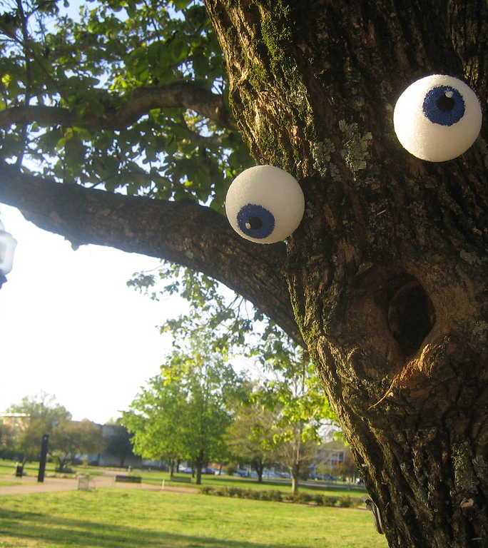
Those Who Worship Idols Are Like Them
Psalm 115:4-8
(4) Their idols are silver and gold, the work of men's hands.
(5) They have mouths, but they speak not: eyes have they, but they see not:
(6) They have ears, but they hear not: noses have they, but they smell not:
(7) They have hands, but they handle not: feet have they, but they walk not: neither speak they through their throat.
(8) They that make them are like unto them; so is every one that trusteth in them.

Slide 3
Psalm 135:15-18
(15) The idols of the heathen are silver and gold, the work of men's hands.
(16) They have mouths, but they speak not; eyes have they, but they see not;
(17) They have ears, but they hear not; neither is there any breath in their mouths.
(18) They that make them are like unto them: so is every one that trusteth in them.

Slide 4
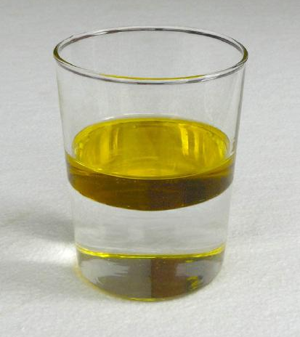
Do Not Mix The Holy & Profane
Ezekiel 22:26
(26) Her priests have violated my law, and have profaned mine holy things: they have put no difference between the holy and profane, neither have they shewed difference between the unclean and the clean, and have hid their eyes from my sabbaths, and I am profaned among them.
Leviticus 19:1-2
(1) And the LORD spake unto Moses, saying,
(2) Speak unto all the congregation of the children of Israel, and say unto them, Ye shall be holy: for I the LORD your God am holy.

Slide 5
2Corinthians 6:14-18
(14) Be ye not unequally yoked together with unbelievers: for what fellowship hath righteousness with unrighteousness? and what communion hath light with darkness?
(15) And what concord hath Christ with Belial? or what part hath he that believeth with an infidel?
(16) And what agreement hath the temple of God with idols? for ye are the temple of the living God; as God hath said, I will dwell in them, and walk in them; and I will be their God, and they shall be my people.
(17) Wherefore come out from among them, and be ye separate, saith the Lord, and touch not the unclean thing; and I will receive you,
(18) And will be a Father unto you, and ye shall be my sons and daughters, saith the Lord Almighty.

Slide 6
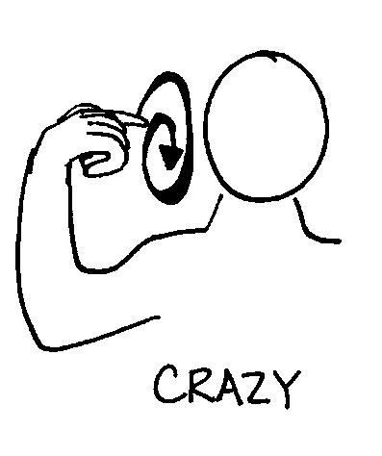
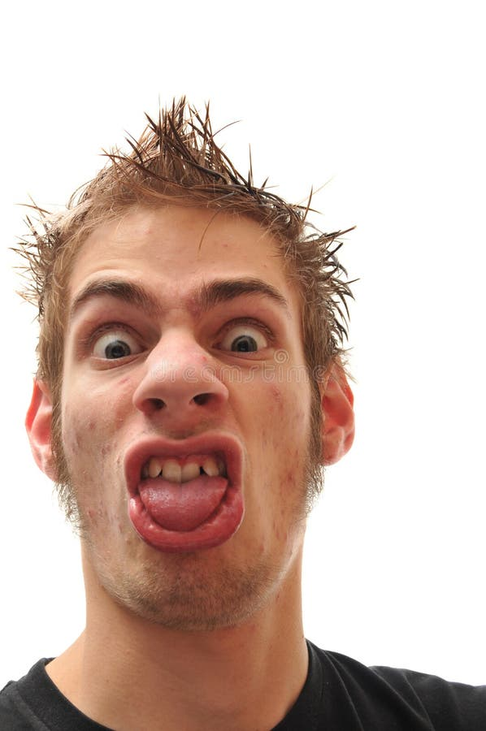
Strong Delusion
Romans 1:18-25
(18) For the wrath of God is revealed from heaven against all ungodliness and unrighteousness of men, who hold the truth in unrighteousness;
(19) Because that which may be known of God is manifest in them; for God hath shewed it unto them.
(20) For the invisible things of him from the creation of the world are clearly seen, being understood by the things that are made, even his eternal power and Godhead; so that they are without excuse:
(21) Because that, when they knew God, they glorified him not as God, neither were thankful; but became vain in their imaginations, and their foolish heart was darkened.
(22) Professing themselves to be wise, they became fools,
(23) And changed the glory of the uncorruptible God into an image made like to corruptible man, and to birds, and fourfooted beasts, and creeping things.
(24) Wherefore God also gave them up to uncleanness through the lusts of their own hearts, to dishonour their own bodies between themselves:
(25) Who changed the truth of God into a lie, and worshipped and served the creature more than the Creator, who is blessed for ever. Amen.

Slide 7
Isaiah 29:10-14
(10) For the LORD hath poured out upon you the spirit of deep sleep, and hath closed your eyes: the prophets and your rulers, the seers hath he covered.
(11) And the vision of all is become unto you as the words of a book that is sealed, which men deliver to one that is learned, saying, Read this, I pray thee: and he saith, I cannot; for it is sealed:
(12) And the book is delivered to him that is not learned, saying, Read this, I pray thee: and he saith, I am not learned.
(13) Wherefore the Lord said, Forasmuch as this people draw near me with their mouth, and with their lips do honour me, but have removed their heart far from me, and their fear toward me is taught by the precept of men:
(14) Therefore, behold, I will proceed to do a marvellous work among this people, even a marvellous work and a wonder: for the wisdom of their wise men shall perish, and the understanding of their prudent men shall be hid.

Slide 8
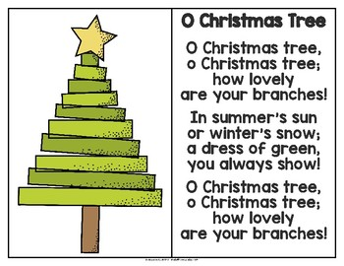
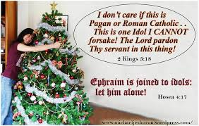
We Don’t Worship the Christmas Tree
Hos 4:17-19
(17) Ephraim is joined to idols: let him alone.
(18) Their drink is sour: they have committed whoredom continually: her rulers with shame do love, Give ye.
(19) The wind hath bound her up in her wings, and they shall be ashamed because of their sacrifices.

Slide 9
Isaiah 44:9-20
(9) They that make a graven image are all of them vanity; and their delectable things shall not profit; and they are their own witnesses; they see not, nor know; that they may be ashamed.
(10) Who hath formed a god, or molten a graven image that is profitable for nothing?
(11) Behold, all his fellows shall be ashamed: and the workmen, they are of men: let them all be gathered together, let them stand up; yet they shall fear, and they shall be ashamed together.
(12) The smith with the tongs both worketh in the coals, and fashioneth it with hammers, and worketh it with the strength of his arms: yea, he is hungry, and his strength faileth: he drinketh no water, and is faint.
(13) The carpenter stretcheth out his rule; he marketh it out with a line; he fitteth it with planes, and he marketh it out with the compass, and maketh it after the figure of a man, according to the beauty of a man; that it may remain in the house.
(14) He heweth him down cedars, and taketh the cypress and the oak, which he strengtheneth for himself among the trees of the forest: he planteth an ash, and the rain doth nourish it.
(15) Then shall it be for a man to burn: for he will take thereof, and warm himself; yea, he kindleth it, and baketh bread; yea, he maketh a god, and worshippeth it; he maketh it a graven image, and falleth down thereto.
(16) He burneth part thereof in the fire; with part thereof he eateth flesh; he roasteth roast, and is satisfied: yea, he warmeth himself, and saith, Aha, I am warm, I have seen the fire:
(17) And the residue thereof he maketh a god, even his graven image: he falleth down unto it, and worshippeth it, and prayeth unto it, and saith, Deliver me; for thou art my god.
(18) They have not known nor understood: for he hath shut their eyes, that they cannot see; and their hearts, that they cannot understand.
(19) And none considereth in his heart, neither is there knowledge nor understanding to say, I have burned part of it in the fire; yea, also I have baked bread upon the coals thereof; I have roasted flesh, and eaten it: and shall I make the residue thereof an abomination? shall I fall down to the stock of a tree?
(20) He feedeth on ashes: a deceived heart hath turned him aside, that he cannot deliver his soul, nor say, Is there not a lie in my right hand?

Slide 10
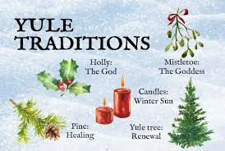
What is on December 25th?
Does this sound familiar?
Yuletide is a term for the Christmas season, or the festive period that begins at Christmas and continues into early January. The word is a combination of the Old English words "geol" (Yule or Christmas) and "tid" (time or season).
Yuletide traditions include: singing, lighting candles, decorating homes, feasting, dancing, and sharing gifts.
Yuletide can also refer to a 12-day celebration that begins on the eve of the Winter Solstice and ends with the new year. In ancient times, it was a significant celebration for Pagans in Europe, and marked the return of the sun after winter. The word "Yule" comes from the Old Norse word for wheel, which symbolizes new beginnings and the cyclical nature of the planet.

Slide 11
Yule is a Pagan celebration of the winter solstice, which is the shortest day and longest night of the year. It's celebrated on December 21 or 22 in the Northern Hemisphere.
Yule is one of the oldest winter solstice festivals in the world, with origins in Scandinavia among the ancient Norse. The festival's themes often include light, fire, and feasting. Some modern Yule celebrations are based on ancient traditions, while others are adapted to contemporary practices.
Here are some ways to celebrate Yule:
Decorate: Decorate your home with evergreen plants like holly, ivy, and mistletoe.
Burn a Yule log: Traditionally, a Yule log is burned for 12 days to encourage the sun to return and bring longer, warmer days.
Make wreaths: You can make wreaths by tying together sprigs of holly and ivy with a ribbon.
Make ornaments: You can make simple ornaments with loved ones, using symbols and motifs that are personally significant.
Make a seasonal stocking: You can make a stocking to gift to friends and family.
Make Sloe Gin: You can make Sloe Gin by gathering autumnal sloes.
Write a note: You can write a note to honor a loved one who has passed away.
Make a list of goals: You can make a list of goals and aspirations for the upcoming year.

Slide 12
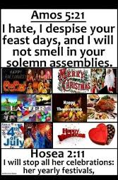
I hate, I despise your feast days!
Amo 5:21-23
(21) I hate, I despise your feast days, and I will not smell in your solemn assemblies.
(22) Though ye offer me burnt offerings and your meat offerings, I will not accept them: neither will I regard the peace offerings of your fat beasts.
(23) Take thou away from me the noise of thy songs; for I will not hear the melody of thy viols.
Hosea 2:11
(11) I will also cause all her mirth to cease, her feast days, her new moons, and her sabbaths, and all her solemn feasts.

