Slide 1
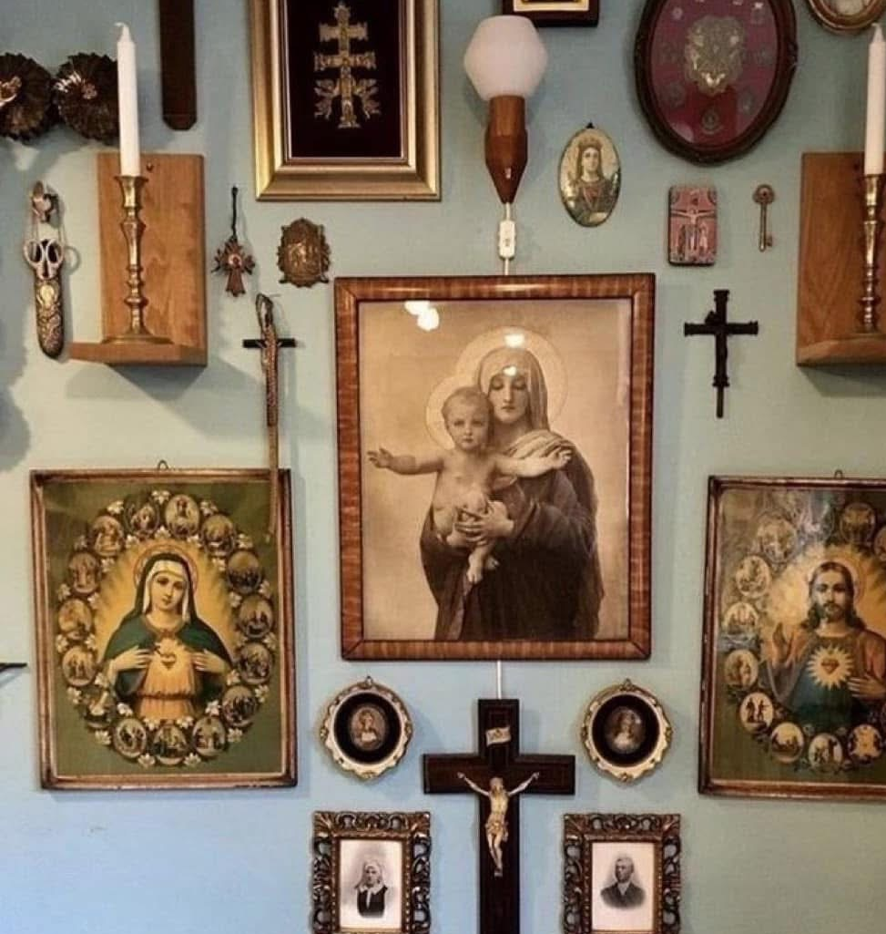
Idolatry in Plain Sight: The Truth About Graven Images
Kids Bible Fellowship: Exposing the Lies of the Catholic Church

Slide 2
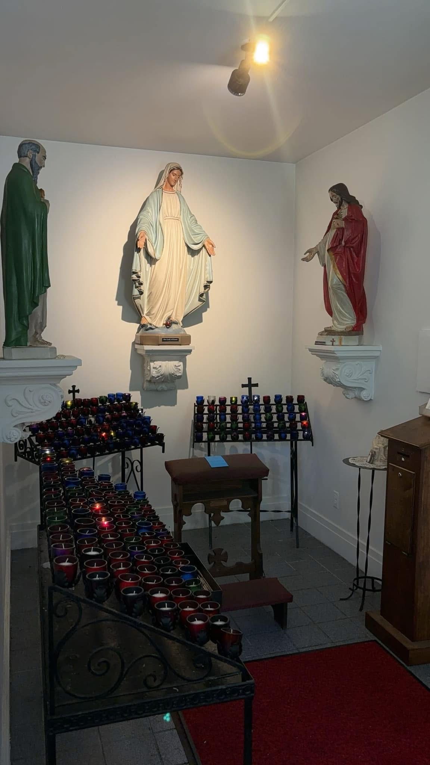
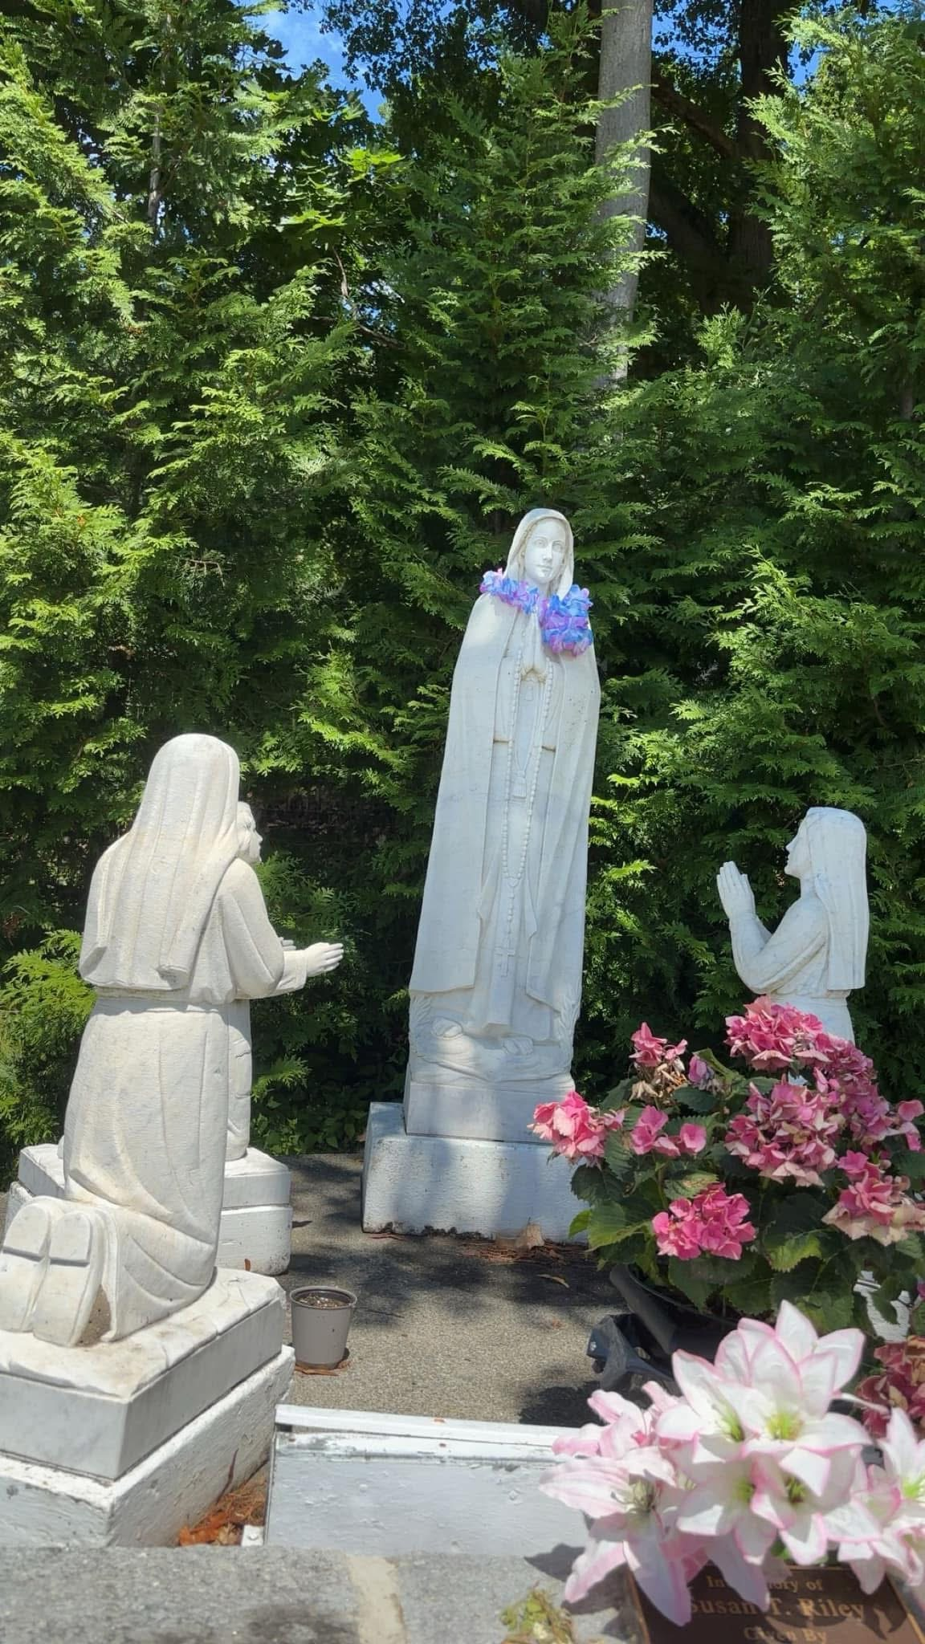
What Is Idolatry?
Idolatry means worshipping something other than the one true God Yehovah.
It can be statues, objects, people, or anything you put above Yah!
  That’s why the Bible says covetousness (wanting what others have) is also idolatry. When we chase after stuff — like money, fame, toys, or approval — we are putting our earthly desires above Yah’s will.

Slide 3
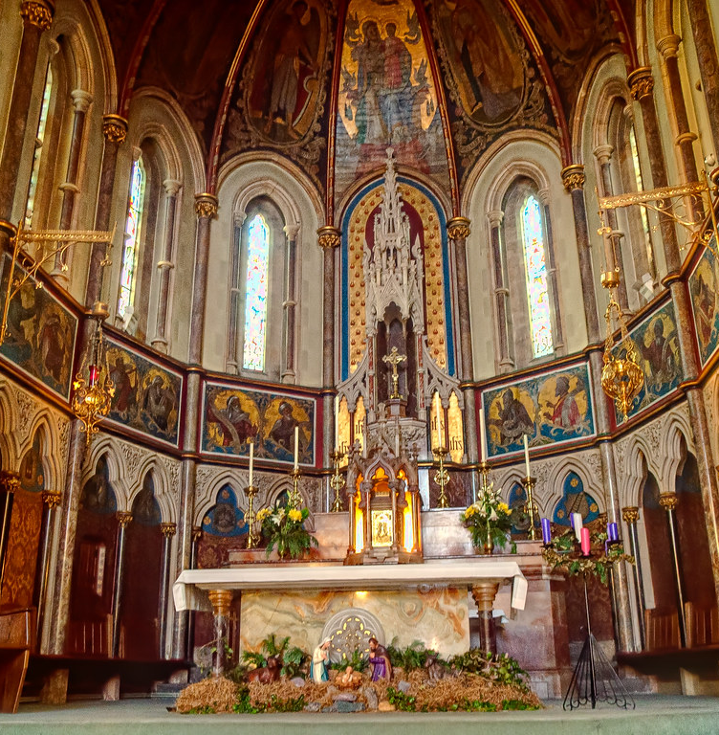
What Is a Graven Image?
A graven image is something carved or made by human hands to be worshipped.
Example: statues of saints, Mary, or even ‘JC' that people pray to.
Yah says NOT to make or bow down to them!

Slide 4
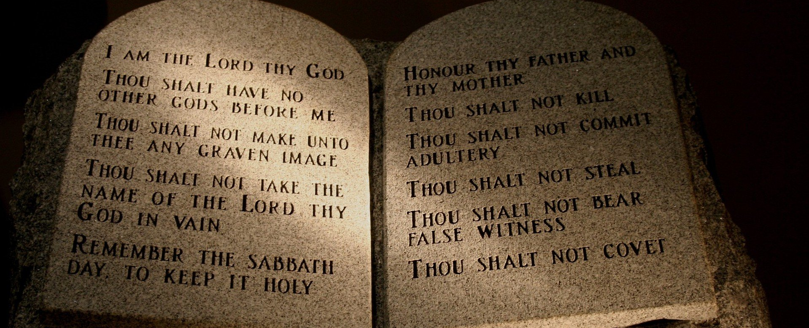
The Second Commandment
Exodus 20:4-6 Thou shalt not make unto thee any graven image, or any likeness of any thing that is in heaven above, or that is in the earth beneath, or that is in the water under the earth. Thou shalt not bow down thyself to them, nor serve them: for I the Lord thy God am a jealous God, visiting the iniquity of the fathers upon the children unto the third and fourth generation of them that hate me; And shewing mercy unto thousands of them that love me, and keep my commandments.
Deuteronomy 5:8-10 Thou shalt not make thee any graven image, or any likeness of any thing that is in heaven above, or that is in the earth beneath, or that is in the waters beneath the earth: Thou shalt not bow down thyself unto them, nor serve them: for I the Lord thy God am a jealous God, visiting the iniquity of the fathers upon the children unto the third and fourth generation of them that hate me, And shewing mercy unto thousands of them that love me and keep my commandments.
This is a BIG deal to Yah!

Slide 5
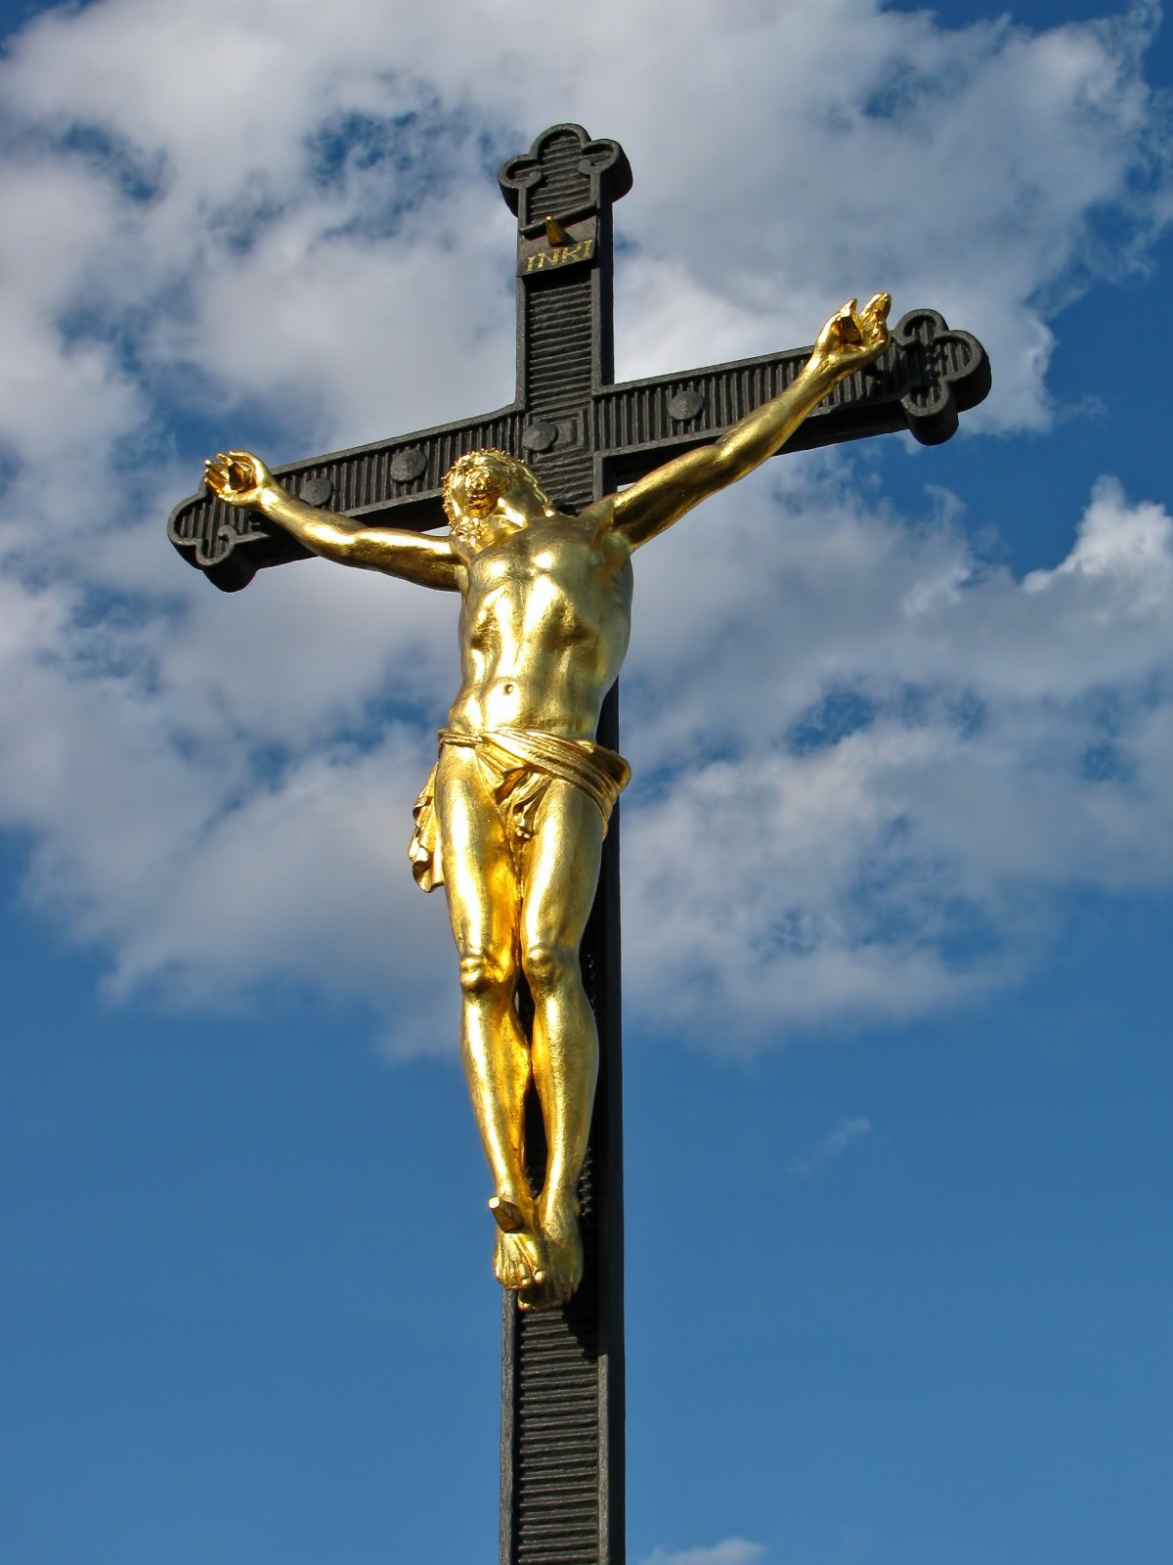
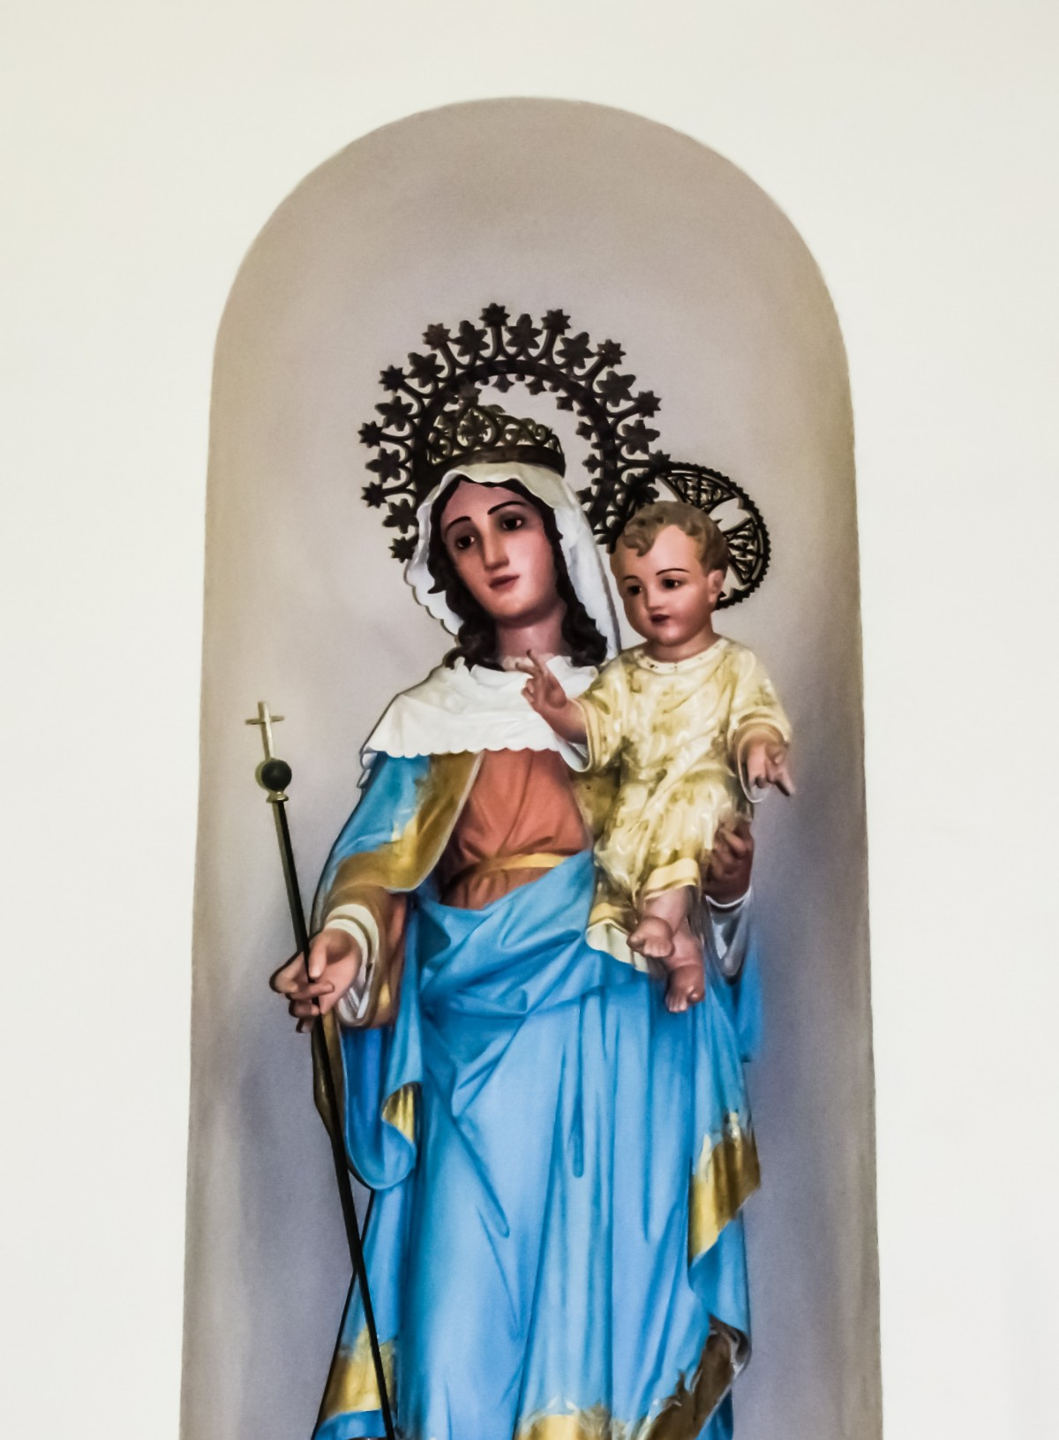
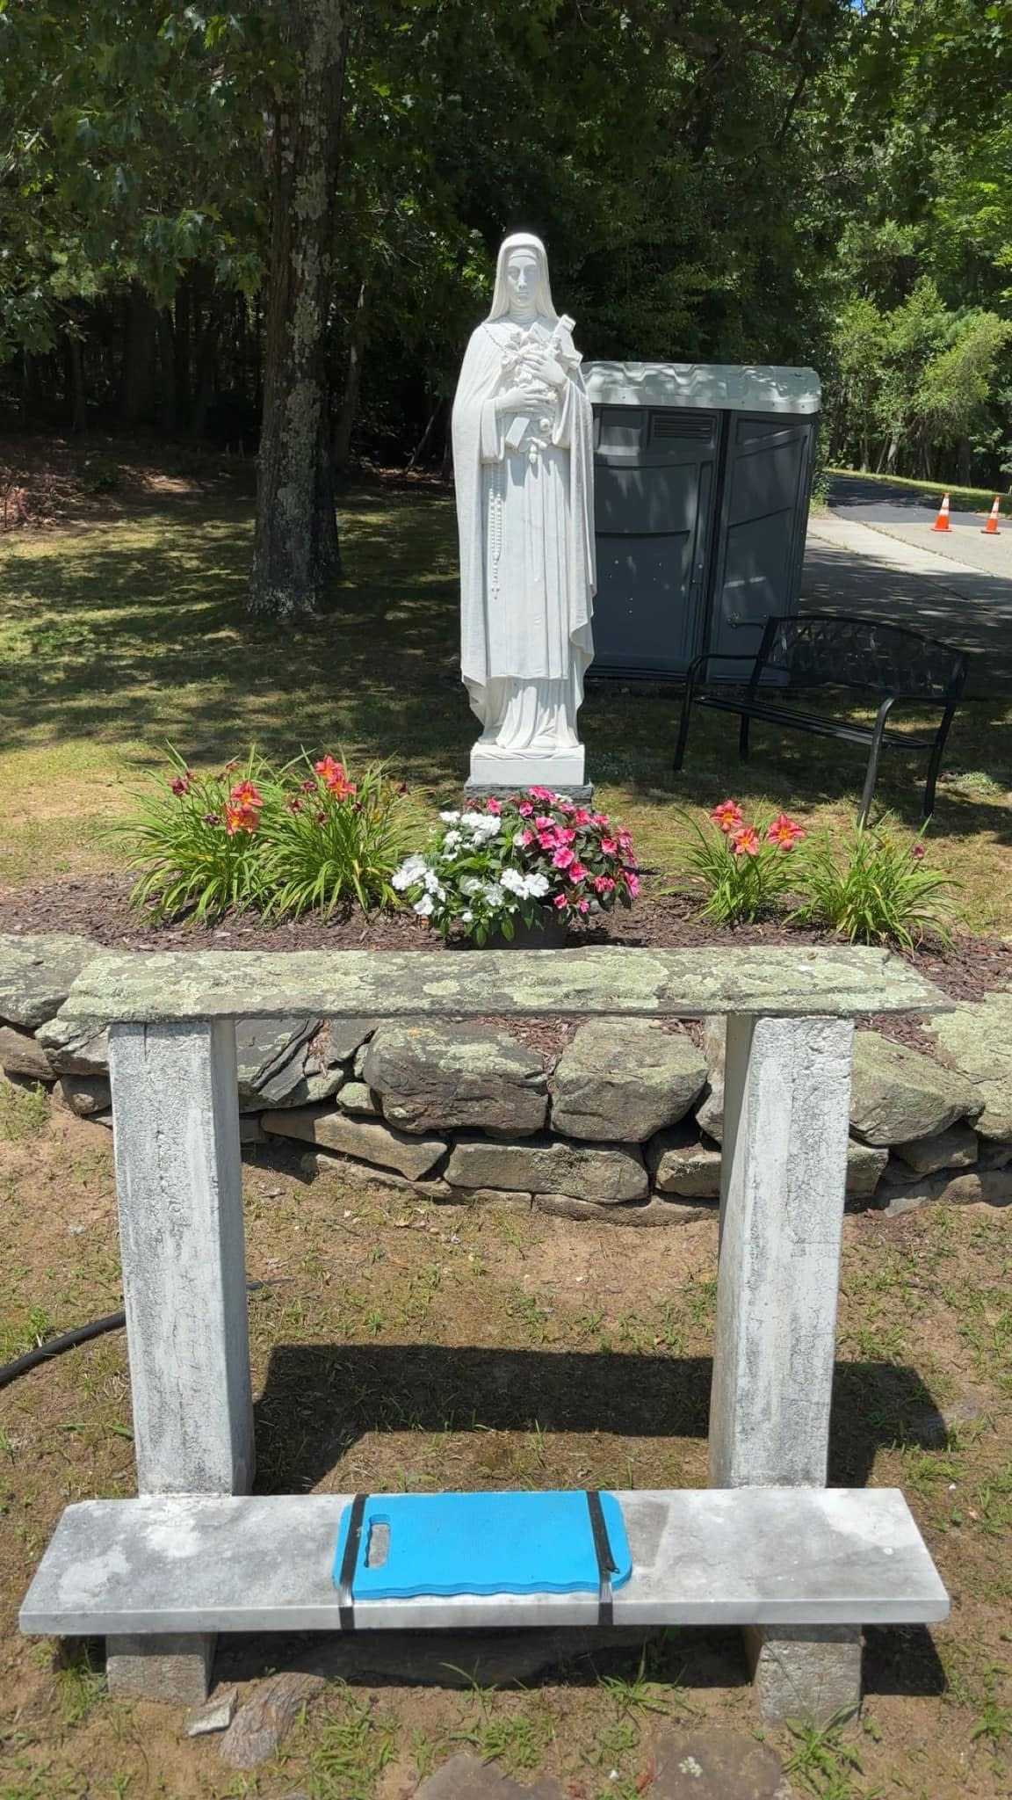
What Does the Catholic Church Do?
The Catholic Church has statues of Mary, 'saints,' and JC that people kneel before and pray to.
This is idolatry, even if they say it's just 'showing respect’ or ‘honor.’

Slide 6
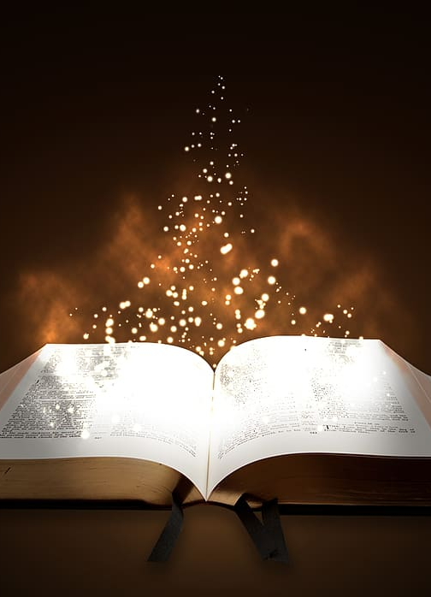
What Does the Bible Say?
Deuteronomy 4:23-24 Take heed unto yourselves, lest ye forget the covenant of the Lord your God, which he made with you, and make you a graven image, or the likeness of any thing, which the Lord thy God hath forbidden thee. For the Lord thy God is a consuming fire, even a jealous God.
Psalm 106:36 And they served their idols: which were a snare unto them.
Leviticus 26:1 Ye shall make you no idols nor graven image, neither rear you up a standing image, neither shall ye set up any image of stone in your land, to bow down unto it: for I am the Lord your God.
Isaiah 42:8 I am the Lord: that is my name: and my glory will I not give to another, neither my praise to graven images.
Isaiah 42:17 They shall be turned back, they shall be greatly ashamed, that trust in graven images, that say to the molten images, Ye are our gods.
Habakkuk 2:16-18 Thou art filled with shame for glory: drink thou also, and let thy foreskin be uncovered: the cup of the Lord's right hand shall be turned unto thee, and shameful spewing shall be on thy glory. For the violence of Lebanon shall cover thee, and the spoil of beasts, which made them afraid, because of men's blood, and for the violence of the land, of the city, and of all that dwell therein. What profiteth the graven image that the maker thereof hath graven it; the molten image, and a teacher of lies, that the maker of his work trusteth therein, to make dumb idols?

Slide 7
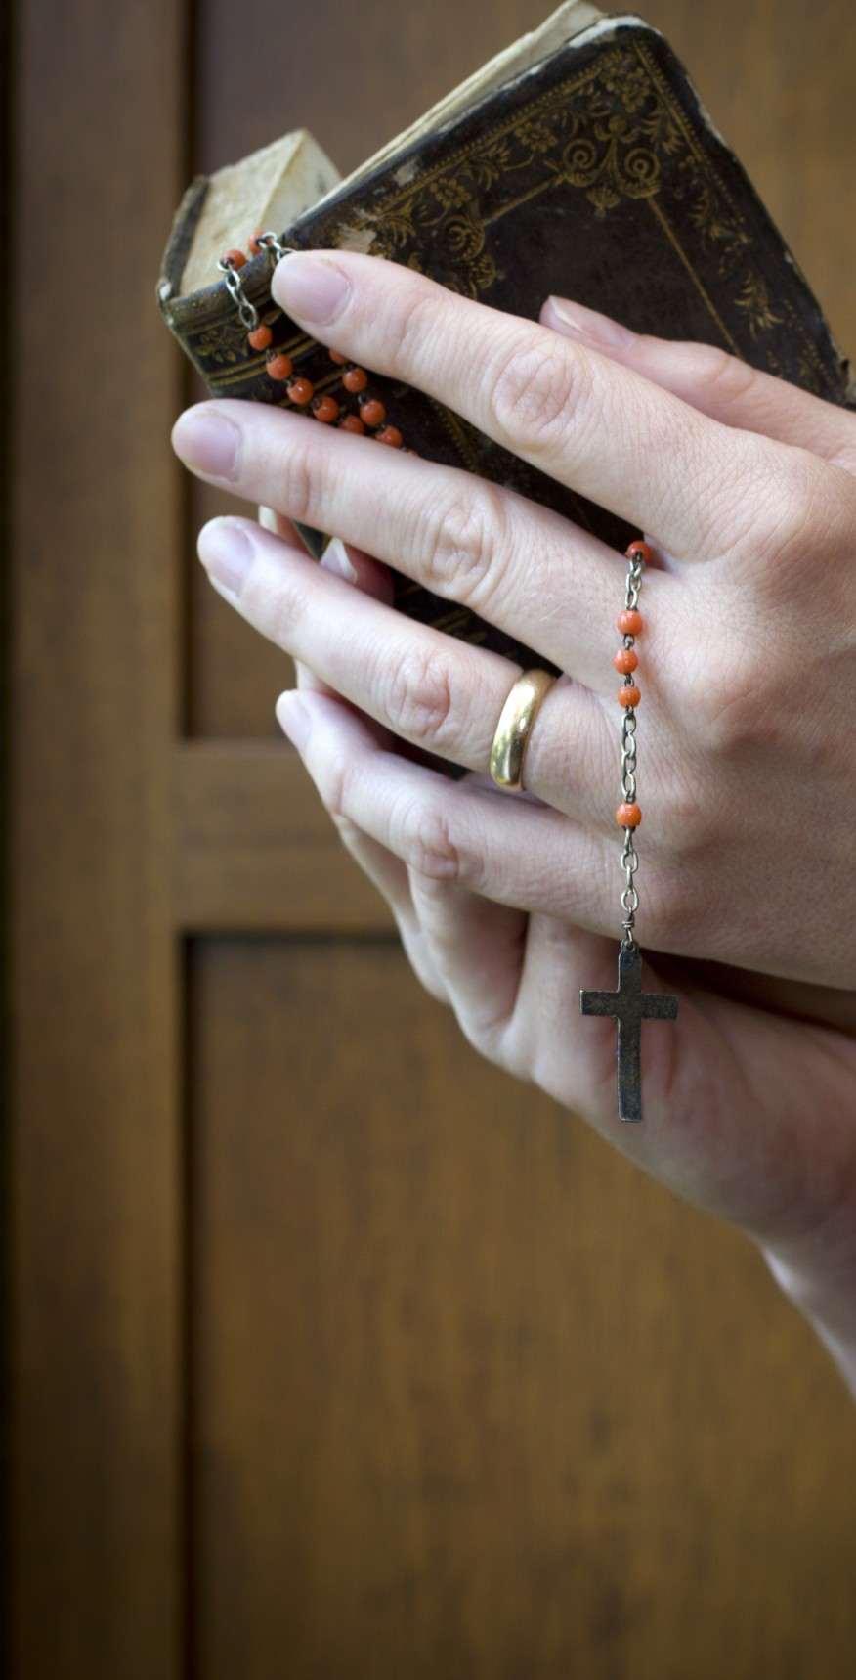
The Rosary
Catholics use the rosary to ‘pray’ to Mary and usually after “confession” (confessing sins to a priest instead of God).
  It is their form of devotion in reverence of her.
The Messiah taught us how to pray and who to pray to in Matthew 6, Luke 11, and John 17.
The Messiah never broke out rosary beads or prayer props to speak to the Father.
Matthew 6:7 But when ye pray, use not vain repetitions, as the heathen do: for they think that they shall be heard for their much speaking.

Slide 8
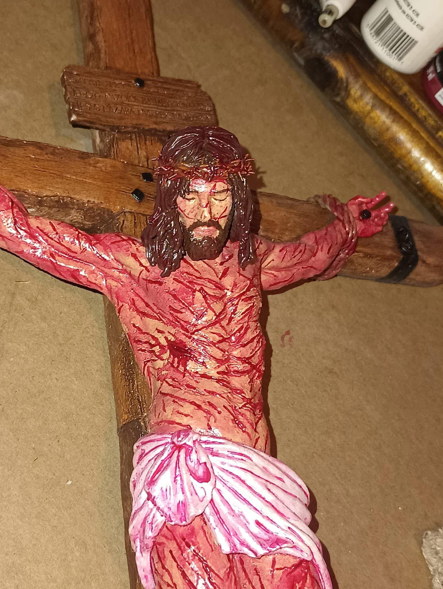
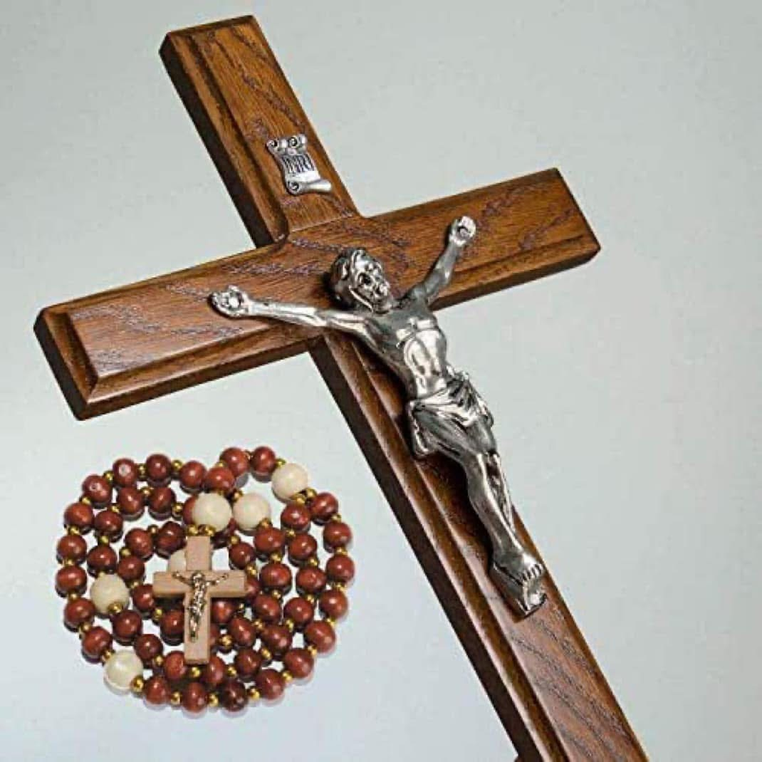
The Cross/Crucifix is a Graven Image
Yah does not like cross necklaces and using the symbol of the cross as a form of worship.
  It is a pagan idol used in ancient Tammuz Worship.
Hosea 2:2 Plead with your mother, plead: for she is not my wife, neither am I her husband: let her therefore put away her whoredoms out of her sight, and her adulteries from between her breasts;
Isaiah 44:9-13 They that make a graven image are all of them vanity; and their delectable things shall not profit; and they are their own witnesses; they see not, nor know; that they may be ashamed. Who hath formed a god, or molten a graven image that is profitable for nothing? Behold, all his fellows shall be ashamed: and the workmen, they are of men: let them all be gathered together, let them stand up; yet they shall fear, and they shall be ashamed together. The smith with the tongs both worketh in the coals, and fashioneth it with hammers, and worketh it with the strength of his arms: yea, he is hungry, and his strength faileth: he drinketh no water, and is faint. The carpenter stretcheth out his rule; he marketh it out with a line; he fitteth it with planes, and he marketh it out with the compass, and maketh it after the figure of a man, according to the beauty of a man; that it may remain in the house.
Deuteronomy 4:15-19 Take ye therefore good heed unto yourselves; for ye saw no manner of similitude on the day that the Lord spake unto you in Horeb out of the midst of the fire: Lest ye corrupt yourselves, and make you a graven image, the similitude of any figure, the likeness of male or female, The likeness of any beast that is on the earth, the likeness of any winged fowl that flieth in the air, The likeness of any thing that creepeth on the ground, the likeness of any fish that is in the waters beneath the earth: And lest thou lift up thine eyes unto heaven, and when thou seest the sun, and the moon, and the stars, even all the host of heaven, shouldest be driven to worship them, and serve them, which the Lord thy God hath divided unto all nations under the whole heaven.

Slide 9
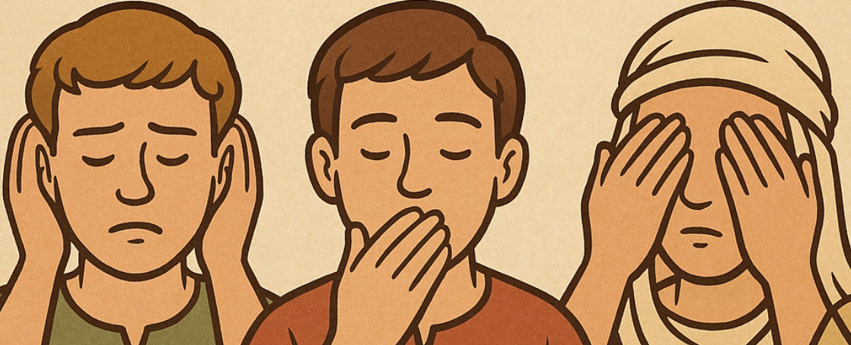
Idolatry Makes People Deaf, Dumb, and Blind
Psalm 115:4-8 Their idols are silver and gold, the work of men's hands. They have mouths, but they speak not: eyes have they, but they see not: They have ears, but they hear not: noses have they, but they smell not: They have hands, but they handle not: feet have they, but they walk not: neither speak they through their throat. They that make them are like unto them; so is every one that trusteth in them.
Psalm 135:15-18 The idols of the heathen are silver and gold, the work of men's hands. They have mouths, but they speak not; eyes have they, but they see not; They have ears, but they hear not; neither is there any breath in their mouths. They that make them are like unto them: so is every one that trusteth in them.

Slide 10
Idolatry is the SIN Leading to Death
1 John 5:16 If any man see his brother sin a sin which is not unto death, he shall ask, and he shall give him life for them that sin not unto death. There is a sin unto death: I do not say that he shall pray for it.
1 John 5:21 Little children, keep yourselves from idols. Amen.

Slide 11
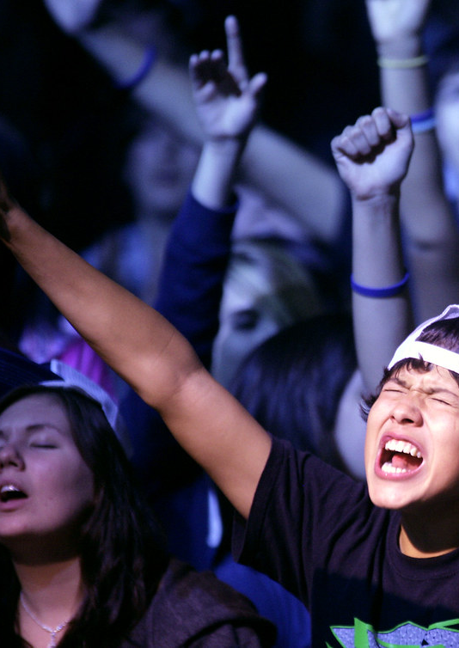
Real Worship
We worship God in spirit and in truth!
  John 4:22-24 Ye worship ye know not what: we know what we worship: for salvation is of the Jews. But the hour cometh, and now is, when the true worshippers shall worship the Father in spirit and in truth: for the Father seeketh such to worship him. God is a Spirit: and they that worship him must worship him in spirit and in truth.
We don’t need a statue to talk to God!
  Yeshua is our Mediator, not Mary or a saint.
    1 Timothy 2:5 For there is one God, and one mediator between God and men, the man Yeshua Messiah;

Slide 12

Let’s Talk!
Why does Yah care so much about idolatry?
How can we help others understand?
What can we do if we see someone bowing to a statue?

