Slide 1
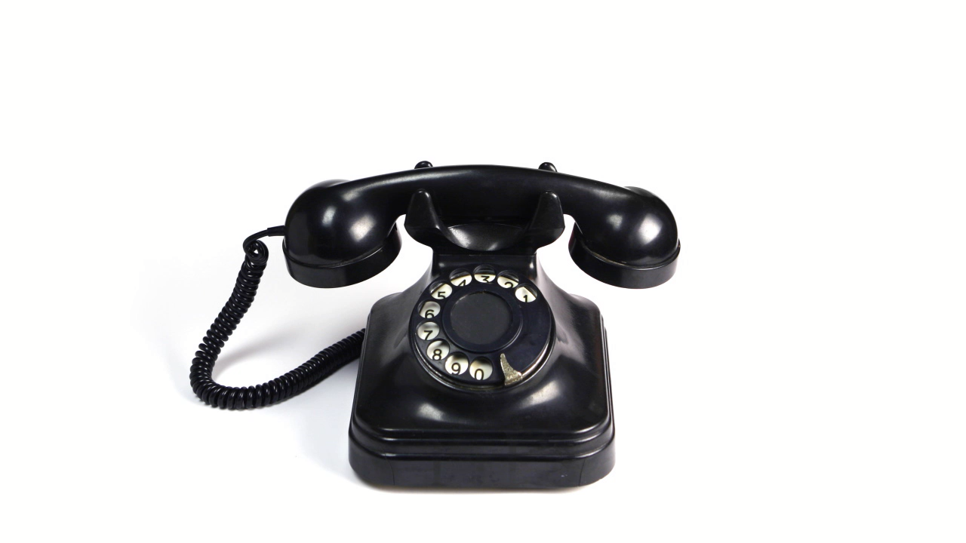
The Watchmen Calling
Kids Bible Fellowship

Slide 2
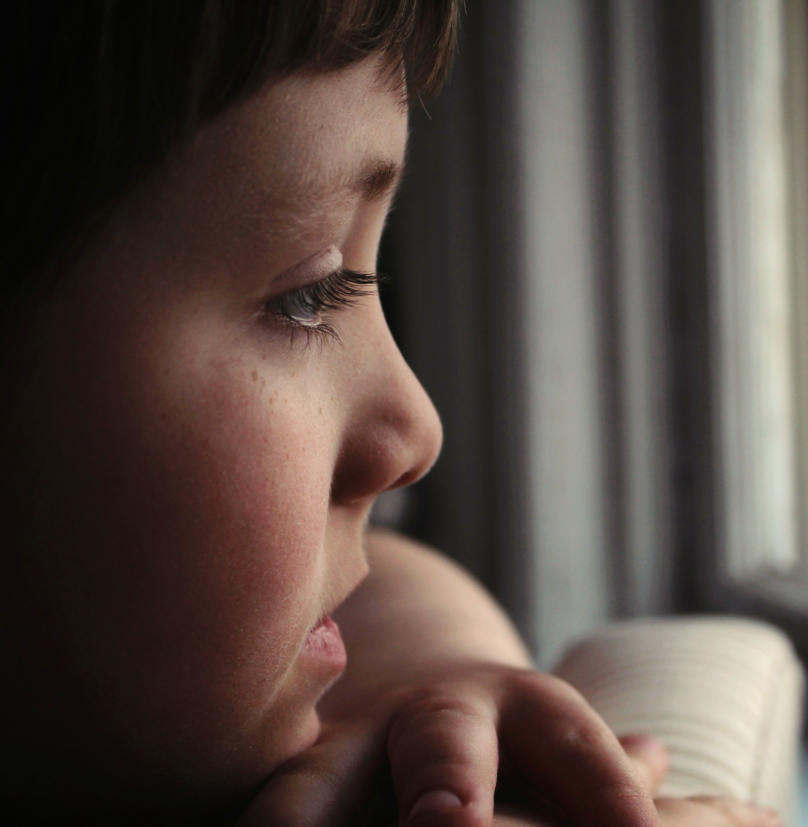
Yeshua called us to WATCH
Mark 13:32-37 But of that day and hour no one knows, not even the angels in heaven, nor the Son, but only the Father. Take heed, watch and pray; for you do not know when the time is. It is like a man going to a far country, who left his house and gave authority to his servants, and to each his work, and commanded the doorkeeper to watch. Watch therefore, for you do not know when the master of the house is coming—in the evening, at midnight, at the crowing of the rooster, or in the morning— lest, coming suddenly, he find you sleeping. And what I say to you, I say to all: Watch!
Proverbs 8:32-35 Now therefore, listen to me, my children, For blessed are those who keep my ways. Hear instruction and be wise, And do not disdain it. Blessed is the man who listens to me, Watching daily at my gates, Waiting at the posts of my doors. For whoever finds me finds life, And obtains favor from the Lord;

Slide 3

What does it mean to WATCH?
To Watch = To Warn people to repent from their sins before destruction hits (sounding the shofar)
The watchmen calling is referenced in Ezekiel 2, 3 (cf Revelation 10:9-11 spirit of John), & 33
James 2:8-9 If you really fulfill the royal law according to the Scripture, “You shall love your neighbor as yourself,” you do well; but if you show partiality, you commit sin, and are convicted by the law as transgressors.
Leviticus 19:15-18 ‘You shall do no injustice in judgment. You shall not be partial to the poor, nor honor the person of the mighty. In righteousness you shall judge your neighbor. You shall not go about as a talebearer among your people; nor shall you take a stand against the life of your neighbor: I am the Lord. ‘You shall not hate your brother in your heart. You shall surely rebuke your neighbor, and not bear sin because of him. You shall not take vengeance, nor bear any grudge against the children of your people, but you shall love your neighbor as yourself: I am the Lord.

Slide 4
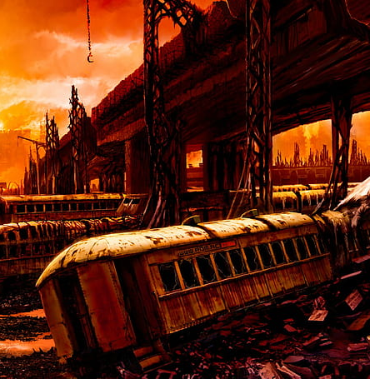
Who is Yah’s wrath NOT appointed to?
1 Thessalonians 5:1-10 But concerning the times and the seasons, brethren, you have no need that I should write to you. For you yourselves know perfectly that the day of the Lord so comes as a thief in the night. For when they say, “Peace and safety!” then sudden destruction comes upon them, as labor pains upon a pregnant woman. And they shall not escape. But you, brethren, are not in darkness, so that this Day should overtake you as a thief. You are all sons of light and sons of the day. We are not of the night nor of darkness. Therefore let us not sleep, as others do, but let us watch and be sober. For those who sleep, sleep at night, and those who get drunk are drunk at night. But let us who are of the day be sober, putting on the breastplate of faith and love, and as a helmet the hope of salvation. For God did not appoint us to wrath, but to obtain salvation through our Lord Yeshua Messiah, who died for us, that whether we wake or sleep, we should live together with Him.
Zephaniah 2:3 Seek the Lord, all you meek of the earth, Who have upheld His justice. Seek righteousness, seek humility. It may be that you will be hidden In the day of the Lord’s anger.

Slide 5

What does it mean to have clean hands a pure heart?

Slide 6
Clean Hands and a Pure Heart
Psalm 24:4 He who has clean hands and a pure heart, Who has not lifted up his soul to an idol, Nor sworn deceitfully.
When you have clean hands, it means you did your job as a watchmen in warning your neighbor to repent — whether they hear or forbear. Their blood is no longer on your hands. You have sounded the shofar, and if they do not repent now then they will know when the time comes that there was a prophet in their midst.
We are called to enter into the work of the prophets. As you’re in obedience to the Holy Covenant (10 Commandments) you will receive the Holy Spirit of Truth (John 14:15-26 & Acts 5:32), then you will be able to declare plainly what the prophets spoke.
  John 4:34-38 Yeshua said to them, “My food is to do the will of Him who sent Me, and to finish His work. Do you not say, ‘There are still four months and then comes the harvest’? Behold, I say to you, lift up your eyes and look at the fields, for they are already white for harvest! And he who reaps receives wages, and gathers fruit for eternal life, that both he who sows and he who reaps may rejoice together. For in this the saying is true: ‘One sows and another reaps.’ I sent you to reap that for which you have not labored; others have labored, and you have entered into their labors.
To have a pure heart means to have a good conscience towards Yah and His people. You will listen to His grace (conviction).
  Acts 24:16 This being so, I myself always strive to have a conscience without offense toward God and men.
  2 Corinthians 4:2 But we have renounced the hidden things of shame, not walking in craftiness nor handling the word of God deceitfully, but by manifestation of the truth commending ourselves to every man’s conscience in the sight of God.

Slide 7
Clean Hands and a Pure Heart Cont.
Psalm 18:20 The Lord rewarded me according to my righteousness; According to the cleanness of my hands He has recompensed me.
Isaiah 33:15-16 He who walks righteously and speaks uprightly, He who despises the gain of oppressions, Who gestures with his hands, refusing bribes, Who stops his ears from hearing of bloodshed, And shuts his eyes from seeing evil: He will dwell on high; His place of defense will be the fortress of rocks; Bread will be given him, His water will be sure.
James 4:8 Draw near to God and He will draw near to you. Cleanse your hands, you sinners; and purify your hearts, you double-minded.
Psalm 51:10-13 Create in me a clean heart, O God, And renew a steadfast spirit within me. Do not cast me away from Your presence,
And do not take Your Holy Spirit from me. Restore to me the joy of Your salvation, And uphold me by Your generous Spirit. Then I will teach transgressors Your ways, And sinners shall be converted to You.
Acts 15:8-9 So God, who knows the heart, acknowledged them by giving them the Holy Spirit, just as He did to us, and made no distinction between us and them, purifying their hearts by faith.
2 Corinthians 7:1 Therefore, having these promises, beloved, let us cleanse ourselves from all filthiness of the flesh and spirit, perfecting holiness in the fear of God.

Slide 8
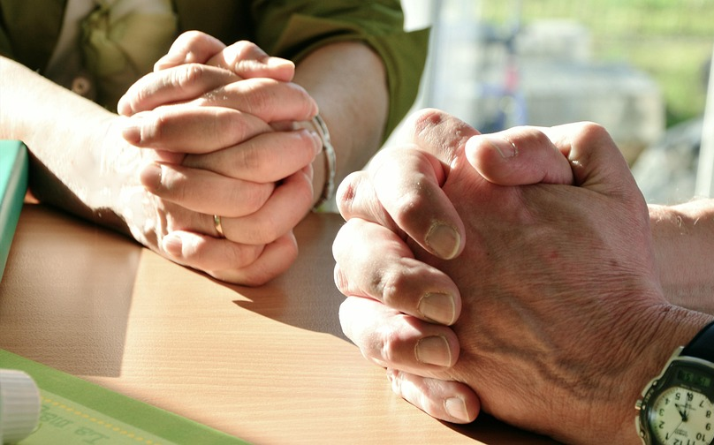
Pray for a Burden for Souls
Romans 9:1-5 I say the truth in Messiah, I lie not, my conscience also bearing me witness in the Holy Ghost, That I have great heaviness and continual sorrow in my heart. For I could wish that myself were accursed from Messiah for my brethren, my kinsmen according to the flesh: Who are Israelites; to whom pertaineth the adoption, and the glory, and the covenants, and the giving of the law, and the service of God, and the promises; Whose are the fathers, and of whom as concerning the flesh Messiah came, who is over all, God blessed for ever. Amen.
Romans 10:1 Brethren, my heart's desire and prayer to God for Israel is, that they might be saved.
Psalm 119:136 Rivers of waters run down mine eyes, because they keep not thy law.
Ezekiel 9:4 And the Lord said unto him, Go through the midst of the city, through the midst of Jerusalem, and set a mark upon the foreheads of the men that sigh and that cry for all the abominations that be done in the midst thereof.
Acts 20:28-31 Take heed therefore unto yourselves, and to all the flock, over the which the Holy Ghost hath made you overseers, to feed the church of God, which he hath purchased with his own blood. For I know this, that after my departing shall grievous wolves enter in among you, not sparing the flock. Also of your own selves shall men arise, speaking perverse things, to draw away disciples after them. Therefore watch, and remember, that by the space of three years I ceased not to warn every one night and day with tears.

