Slide 1
What it means to judge the cause of the fatherless, orphan, widow, and poor
Kids Bible Fellowship

Slide 2
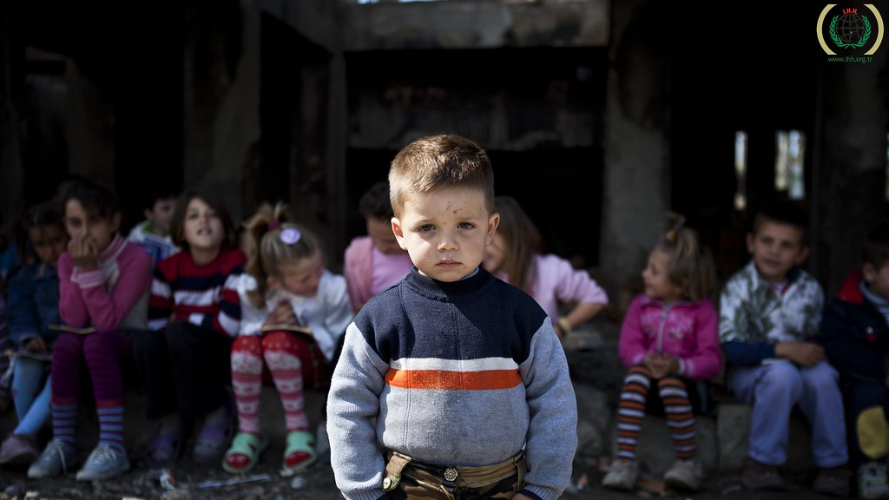
The cause of the fatherless, orphan, widow, & poor (spiritually & literally)
In this life there are people who have grown up fatherless or motherless, at times both or don’t even have a family at all (orphan), people who were married but have since lost their spouses (widows), people who have no homes or money (poor). But also spiritually there are people without our Heavenly Father (Fatherless), people who haven’t been adopted/grafted into the commonwealth of Israel (Orphans), people who haven’t been reconciled to our Husband Yah & husbandman Yeshua (Widows), and people who are without the Spirit & the riches you receive when He shows you His truth (Poor in Spirit). For both the literal and spiritual reasons as to why the Fatherless, orphan, widow, and poor exist the answer remains the same: all due to disobedience/sin.

Slide 3

Scriptures:
Leviticus 26 & Deuteronomy 28 these are the chapters showing what happens if you obey vs what happens if you disobey.

Slide 4

What happens today? Perversion in judgement & justice
Instead of believers in the churches & torah movement doing the righteous judgement (Leviticus 19) that we’re all called to do, they pervert it. Whether it’s through respect of persons, trying to sweep sins under the rug, not telling people the cause of their suffering, withholding the truth, defending the wicked instead of the innocent, being a hypocrite in judgement/judging unrighteously, accepting bribes, staying silent when they see wrong/sin, laying burdens/expectations on others that they themselves can’t bear or not lifting a finger to help someone, etc. they don’t love their neighbor whom they have seen, therefore they don’t love Yah whom they have not seen. This is a part of why punishment is coming, not just because of disobedience to Yah but also because they’re not loving their neighbors as themselves. The 2 greatest Commandments go hand in hand Matthew 22:37-40 can’t have one without the other.

Slide 5
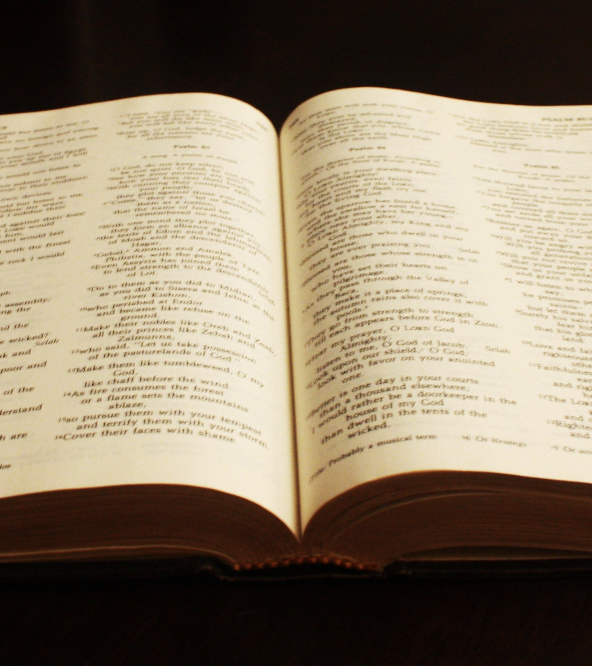
Scriptures:
Luke 16
1 Samuel 8:1-3
Deuteronomy 16:19 & Exodus 23:8
Jeremiah 23 & Ezekiel 34. (what the churches & Torah movement pastors and shepherds are doing) James 5:1-6
Proverbs 17:23
Micah 3:1-9
Proverbs 1:24-32 & 21:7
Isaiah 1:21-28 & Ezekiel 22:6-12 & 16:47-52 & 18:4-20 & Jeremiah 5:28
Mark 14:10-11
Proverbs 11:1-3 & 16:11 & 20:13, 20:23
Deuteronomy 24:13-16
Amos 8:5-6 & Micah 6:10-11

Slide 6

How to judge/plead the cause of the fatherless, orphan, widow, & poor
When you judge the cause of the fatherless, orphan, widow, and poor there’s a literal side & spiritual side.
Literal: you will be explaining to them why they are fatherless, orphan, widow, or poor/if you see them in sin you will rebuke them (i.e. rules to rebuke). You won’t have respect of persons in judgement.
Spiritual: you will be pleading/defending their cause if they’ve been done wrong especially if it’s a believer who has done them wrong. You won’t pervert justice, you will be a voice for the voiceless.

Slide 7
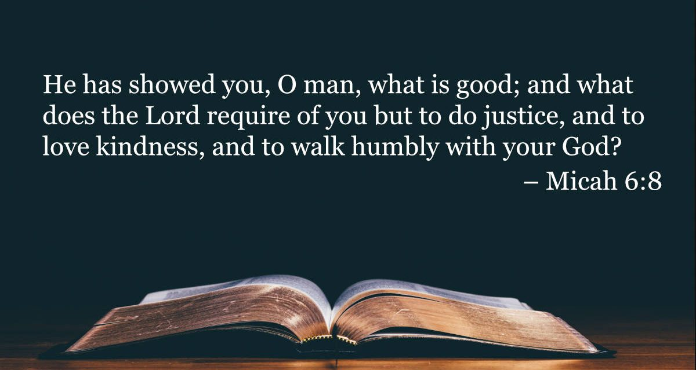
Scriptures:
Isaiah 1:16-17 & 33:15-17 & 58:6-12
Leviticus 19:15-18 & 33-36
Deuteronomy 24:17-22 & 27:19
Exodus 22:21-27 & 23:1-9
Psalm 82:1-5, Proverbs 22:22-23 & 31:4-5
Isaiah 33:15-16
Zechariah 7:9-10, Jeremiah 23:3 & 15-16
James 1:27 & 2:1-9
Matthew 25:31-46 (then shall ye discern between the righteous & the wicked)
Psalm 15

Slide 8

Conclusion:
Even if everyone falls away & pervert’s justice/judgement, don’t do as they did. Don’t forget our Father in Heaven is watching to see what YOU do. Follow Him, His ways, and His judgements irregardless of what everyone else is doing.
Walk as our Messiah Yeshua did loving God, loving your neighbor, and judging righteously being humble as you do it so you & those who hear you may enter into eternal life.
Pray 1 Kings 3:7-9 & James 1:5-10 ask according to His will in faith without impure motives and He will give you an understanding heart, so you can follow Him spiritually & truthfully.

