Slide 1
Halloween is Pagan
Kids Bible Fellowship

Slide 2


Samhain: The Celtic New Year
Timing:
Sunset on October 31 to sunset on November 1, marking the end of the harvest and the beginning of winter — the “dark half” of the year.
“Spiritual” Beliefs:
The Celts believed the veil between the living and the dead was thinnest on this night.
Spirits of ancestors could return to visit loved ones.
Malevolent spirits or fairies (called Aos Sí) could also cross over, so people left offerings or wore disguises to ward them off.

Slide 3
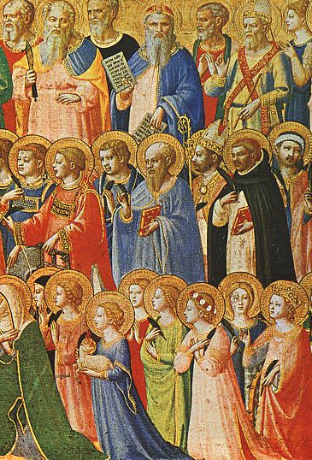
All Saints’ Day and All Soul’s Day
All Saints’ Day is a “Christian” holiday to honor all the “good” and “holy” people who have died. It’s a time to remember everyone who lived “good” lives and tried to follow God’s ways — even the ones who don’t have a special day of their own.
The next day, November 2, is called All Souls’ Day.
That’s when people remember all their loved ones who have died, not just the saints. Families might go to church, light candles, or say prayers to show love and respect for those who have passed away.

Slide 4
Necromancy in Scripture
Deuteronomy 18:10-12 There shall not be found among you any one that maketh his son or his daughter to pass through the fire, or that useth divination, or an observer of times, or an enchanter, or a witch. Or a charmer, or a consulter with familiar spirits, or a wizard, or a necromancer. For all that do these things are an abomination unto the Lord: and because of these abominations the Lord thy God doth drive them out from before thee.
Leviticus 20:27 A man also or woman that hath a familiar spirit, or that is a wizard, shall surely be put to death: they shall stone them with stones: their blood shall be upon them.
As believers, we should not call upon the dead, as the Celts do, it is an abomination to our Father in Heaven, Yehovah!

Slide 5
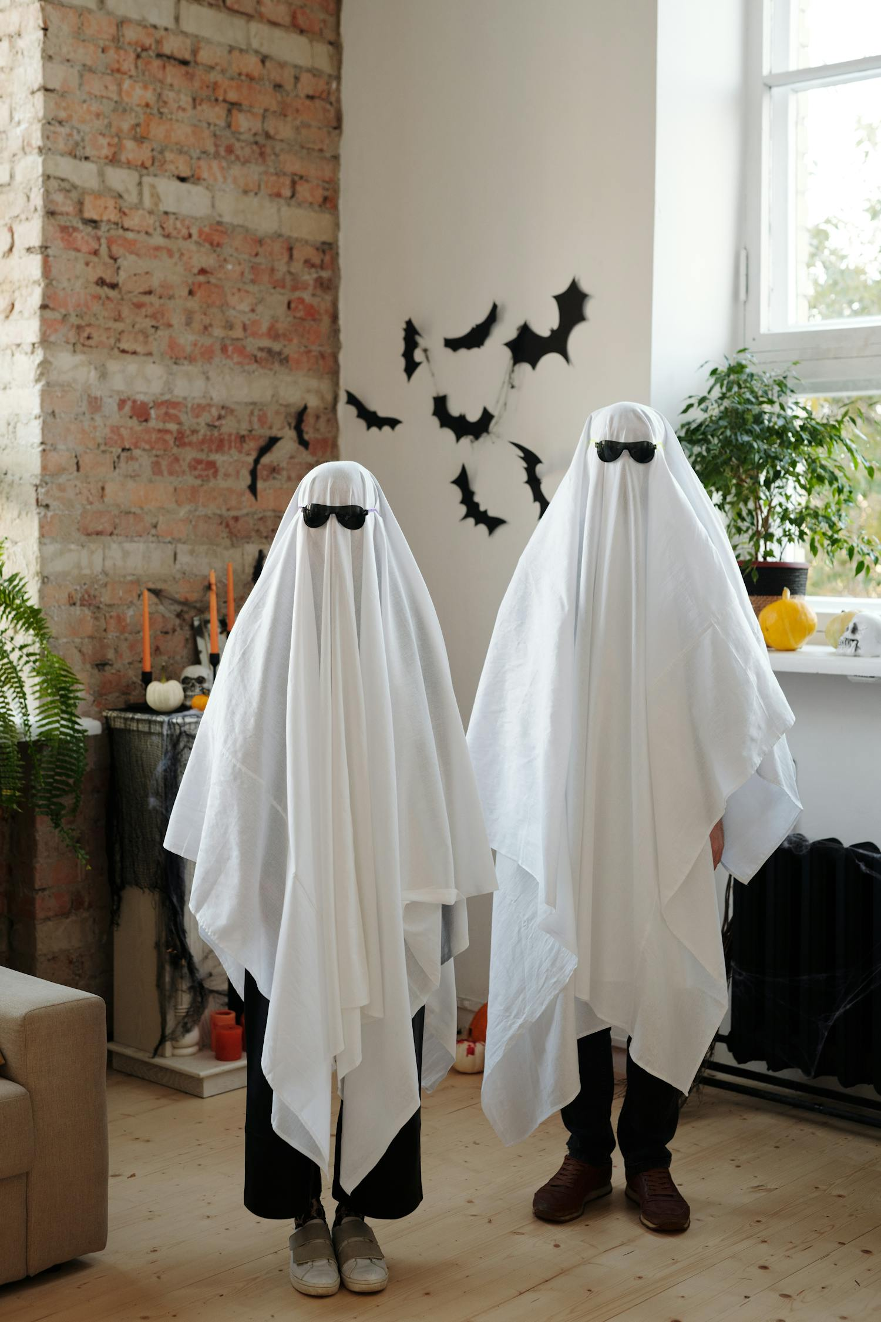
Costumes
A long time ago, the Celtic people believed that on the night before Samhain (which became Halloween), ghosts and spirits came out and wandered around the earth.
To stay safe from these spirits, the Celts decided to dress up in costumes.
They thought that if they looked like the scary spirits, the real ghosts would think they were one of them and leave them alone!
That’s how the idea of wearing costumes on Halloween first began.
Even if someone chooses to wear a “positive” or “innocent” costume, they are still opening doors to the enemy by participating.

Slide 6
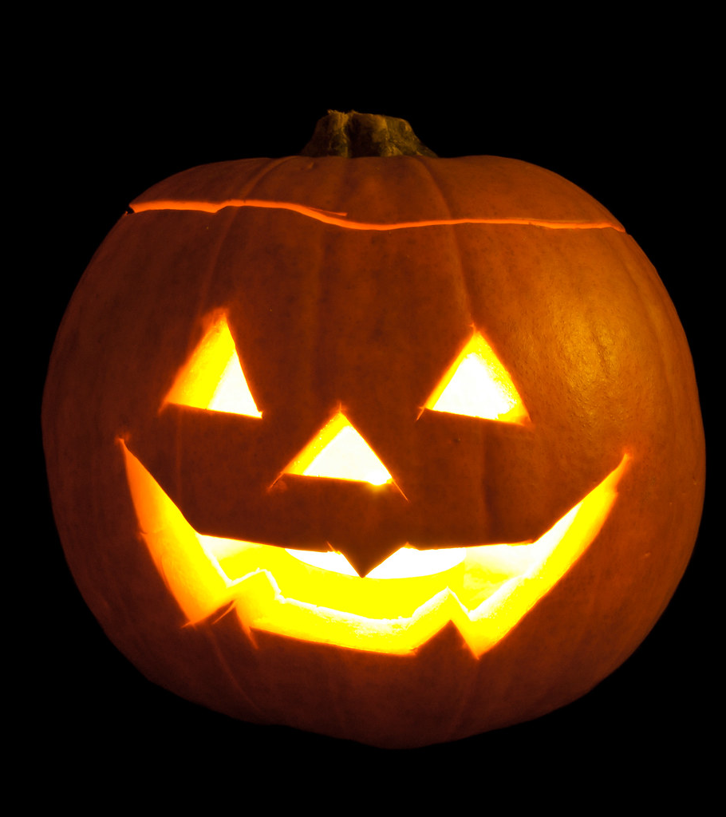
Why Pumpkins?
In old Ireland, people carved turnips or beets with faces and put candles inside to scare away evil spirits.
When they moved to America, they found that pumpkins were bigger and easier to carve — and so the jack-o’-lantern was created.

Slide 7
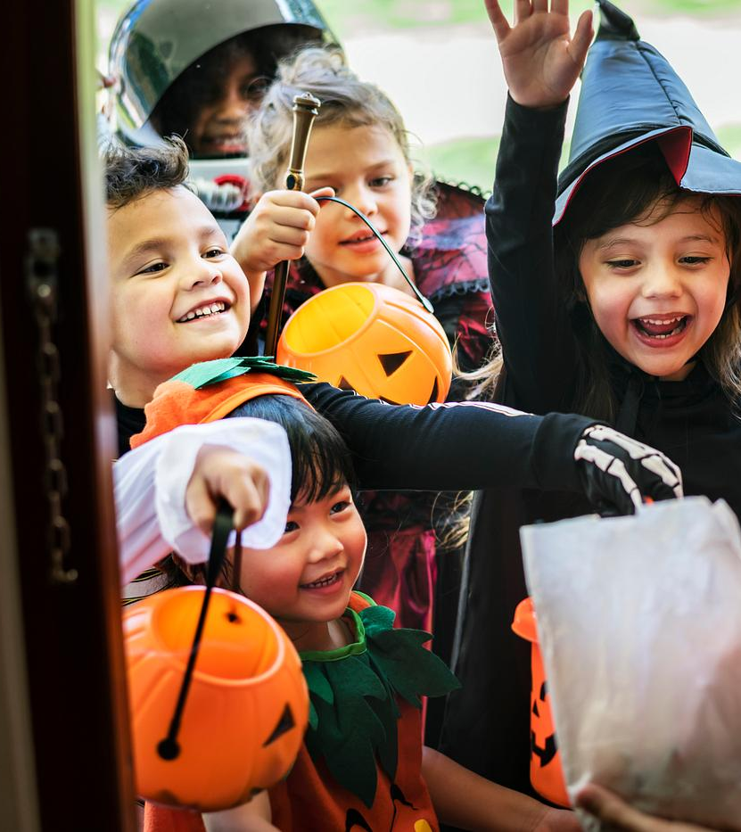
Trick-or-Treat
The history of trick-or-treating stems from Samhain when people left food for wandering spirits and wore disguises to ward off evil.
This evolved into the medieval Christian practices like “souling,” where poor people begged for “soul cakes” in exchange for prayers for the dead.
Later the Scottish/Irish custom of “guising” where children performed for tricks for treats, combined with German-American “belsnickeling,” where costumed participants were rewarded for their antics.
The phrase “Trick or Treat” and the modern, candy-focused tradition solidified in America in the early 20th century.

Slide 8
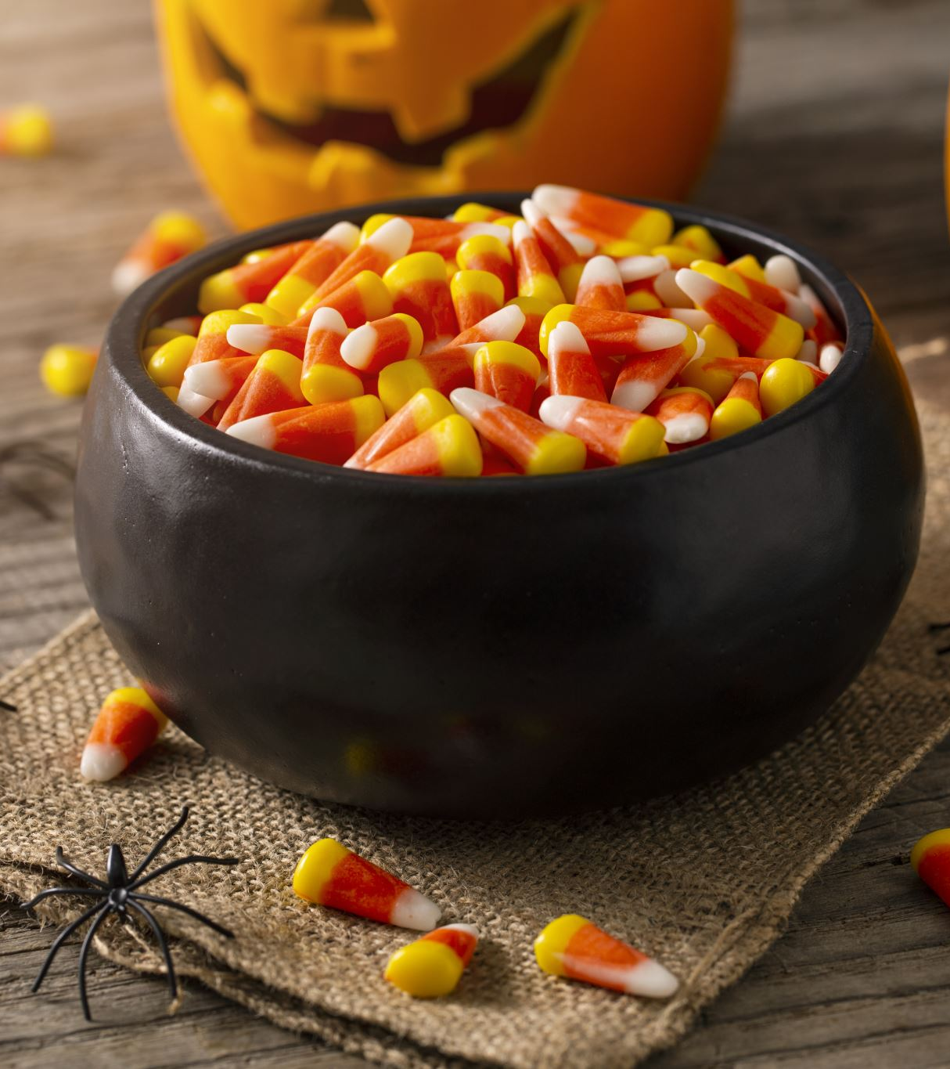
Trick-or-Treat
Candy has replaced the human sacrifices of old, but is still an appeasement of those deceptive evil spirits.
The traditional response to those who do not treat is to have a trick played on them.
When you give out Halloween candy, you are in essence providing a sacrifice to false gods.
You are participating in idolatry, which is the sin that leads to death.
1 John 5:16 If any man see his brother sin a sin which is not unto death, he shall ask, and he shall give him life for them that sin not unto death. There is a sin unto death: I do not say that he shall pray for it. 21 Little children, keep yourselves from idols. Amen.

Slide 9
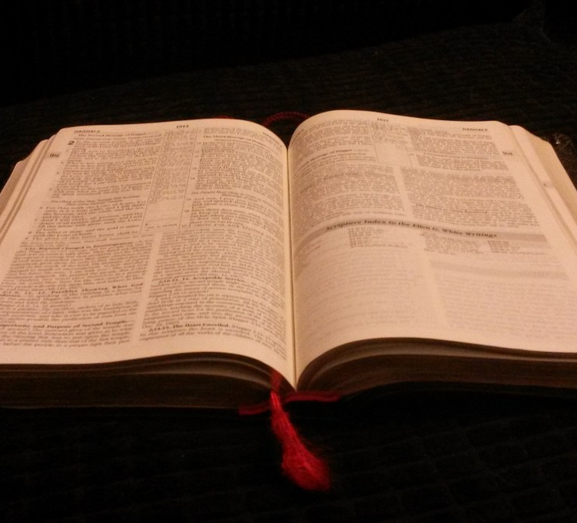
Scriptures against Halloween
1 Thessalonians 5:22 Abstain from all appearance of evil.
1 Peter 1:16 Because it is written, Be ye holy; for I am holy.
Matthew 15:9 But in vain they do worship me, teaching for doctrines the commandments of men.
Mark 7:7-9 Howbeit in vain do they worship me, teaching for doctrines the commandments of men. For laying aside the commandment of God, ye hold the tradition of men, as the washing of pots and cups: and many other such like things ye do. And he said unto them, Full well ye reject the commandment of God, that ye may keep your own tradition.

Slide 10
Scriptures against Halloween
2 Corinthians 6:14 Be ye not unequally yoked together with unbelievers: for what fellowship hath righteousness with unrighteousness? and what communion hath light with darkness?
Ephesians 5:11 And have no fellowship with the unfruitful works of darkness, but rather reprove them.
Jeremiah 4:22 For my people is foolish, they have not known me; they are sottish children, and they have none understanding: they are wise to do evil, but to do good they have no knowledge.
1 Corinthians 10:21 Ye cannot drink the cup of the Lord, and the cup of devils: ye cannot be partakers of the Lord's table, and of the table of devils.

Slide 11

Scriptures against Halloween
Isaiah 5:20 Woe unto them that call evil good, and good evil; that put darkness for light, and light for darkness; that put bitter for sweet, and sweet for bitter!
Galatians 4:10-11 Ye observe days, and months, and times, and years. I am afraid of you, lest I have bestowed upon you labour in vain.
Jeremiah 10:1-2 Hear ye the word which the Lord speaketh unto you, O house of Israel: Thus saith the Lord, Learn not the way of the heathen, and be not dismayed at the signs of heaven; for the heathen are dismayed at them.

Slide 12
In Conclusion….
Yehovah abhors our traditions and pagan holidays! We are NOT to partake in the traditions of men.
Halloween has NOTHING to do with our Father, it has everything to do with the wicked one.
We were commanded to “come out her, my people”…. out of the ways of Mystery Babylon and the Apostate Churches!
What we can do is REBUKE those who celebrate!
  Leviticus 19:15-18 Ye shall do no unrighteousness in judgment: thou shalt not respect the person of the poor, nor honor the person of the mighty: but in righteousness shalt thou judge thy neighbour. Thou shalt not go up and down as a talebearer among thy people: neither shalt thou stand against the blood of thy neighbour; I am the Lord. Thou shalt not hate thy brother in thine heart: thou shalt in any wise rebuke thy neighbour, and not suffer sin upon him. Thou shalt not avenge, nor bear any grudge against the children of thy people, but thou shalt love thy neighbour as thyself: I am the Lord.

