Slide 1
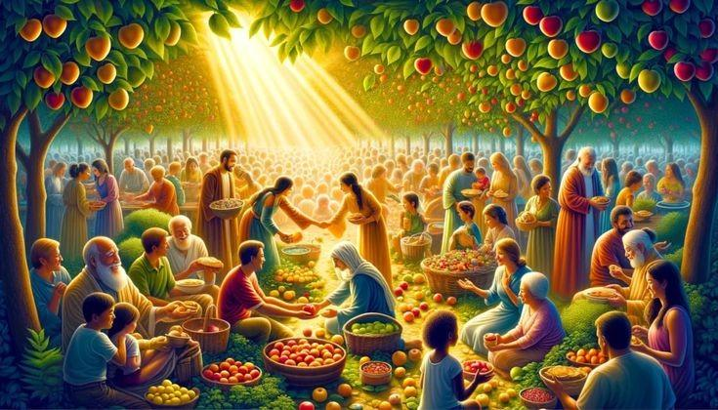
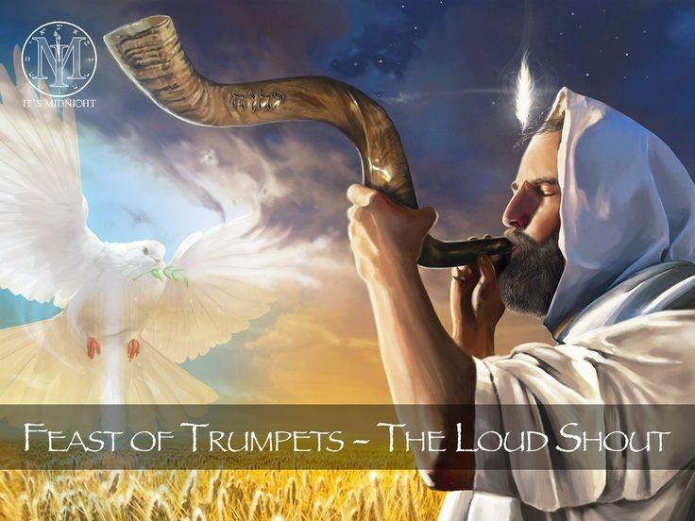
Gods Feasts
The Feast of First Fruits
Why Dont We Do Them?

Slide 2
2 Chronicles 30:1-5
2Ch 30:1 And Hezekiah sent to all Israel and Judah, and wrote letters also to Ephraim and Manasseh, that they should come to the house of the LORD >at Jerusalem<, to keep the passover unto the LORD God of Israel.
2Ch 30:2 For the king had taken counsel, and his princes, and all the congregation >in Jerusalem<, to keep the passover in the second month.
2Ch 30:3 For they could not keep it at that time, because the priests had not sanctified themselves sufficiently, neither had the people gathered themselves together to Jerusalem.
2Ch 30:4 And the thing pleased the king and all the congregation.
2Ch 30:5 So they established a decree to make proclamation throughout all Israel, from Beersheba even to Dan, that they should come to keep the passover unto the LORD God of Israel >at Jerusalem<: for they had not done it of a long time in such sort as it was written.
*This is showing they had to go to Jerusalem to keep the Passover.

Slide 3
Isaiah 66:3-4
Isa 66:3 He that killeth an ox is as if he slew a man; he that sacrificeth a lamb, as if he cut off a dog's neck; he that offereth an oblation, as if he offered swine's blood; he that burneth incense, as if he blessed an idol. Yea, they have chosen their own ways, and their soul delighteth in their abominations.
Isa 66:4 I also will choose their delusions, and will bring their fears upon them; because when I called, none did answer; when I spake, they did not hear: but they did evil before mine eyes, and chose that in which I delighted not.
*The practice of the feasts really upsets Yehovah, and these verses clearly show just how much He hates it. Verse 3 shows how Yah sees what they’re doing, and verse 4 shows exactly how He feels and what it’s like for Him.

Slide 4
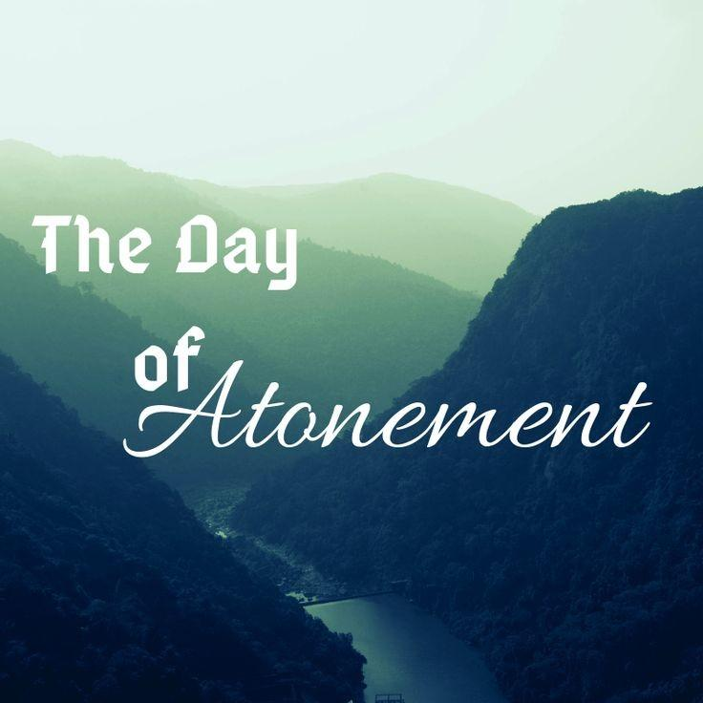
Amos 3:12
Amo 3:12 Thus saith the LORD; As the shepherd taketh out of the mouth of the lion two legs, or a piece of an ear; so shall the children of Israel be taken out that dwell in Samaria in the corner of a bed, and in Damascus in a couch.
*When I asked Chris and he showed me the cross-references, I saw it as Yah removing some of the Torah-following people—but others being killed for not listening.

Slide 5
Micah 6:6-8
Mic 6:6 Wherewith shall I come before the LORD, and bow myself before the high God? shall I come before him with burnt offerings, with calves of a year old?
Mic 6:7 Will the LORD be pleased with thousands of rams, or with ten thousands of rivers of oil? shall I give my firstborn for my transgression, the fruit of my body for the sin of my soul?
Mic 6:8 He hath shewed thee, O man, what is good; and what doth the LORD require of thee, but to do justly, and to love mercy, and to walk humbly with thy God?
*Yah doesn’t want these things anymore—He just wants us to keep it simple: keep the commandments, fulfil the Royal Law, and eat clean!

Slide 6
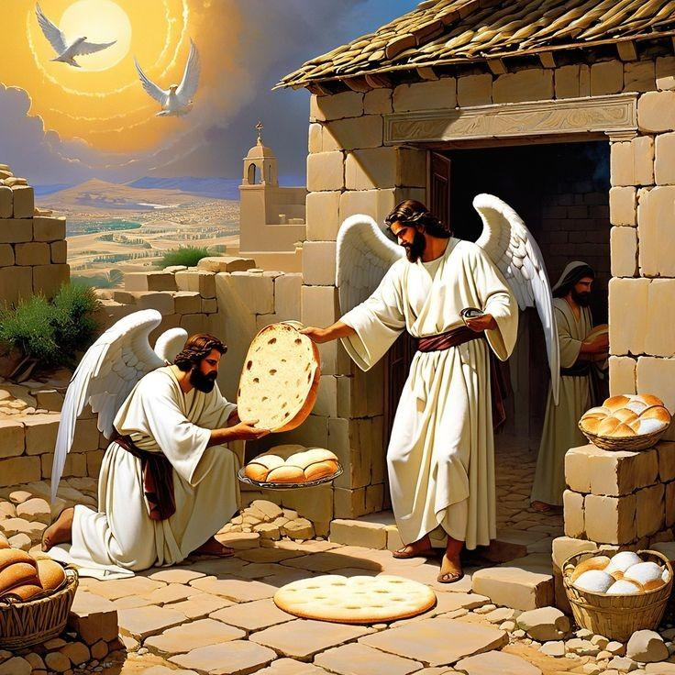
Colossians 2:16
Col 2:16 Let no man therefore judge you in meat, or in drink, or in respect of an holyday, or of the new moon, or of the sabbath days:
*The feasters like to use this to justify doing their feasts and also how they keep their Sabbaths! But we know exactly how Yah wants us to do these things—and it’s no feasting and keeping Sabbath on Saturday!
The Feast of Unleavened Bread

Slide 7
Romans 14:5-6
Rom 14:5 One man esteemeth one day above another: another esteemeth every day alike. Let every man be fully persuaded in his own mind.
Rom 14:6 He that regardeth the day, regardeth it unto the Lord; and he that regardeth not the day, to the Lord he doth not regard it. He that eateth, eateth to the Lord, for he giveth God thanks; and he that eateth not, to the Lord he eateth not, and giveth God thanks.
*This is also another verse they use to try and justify doing the feasts.

Slide 8
Why Can’t We Do These Things???

Slide 9
We’re not in the land. Nor do we have the right calendar. You can see this is Enoch 80!

Slide 10
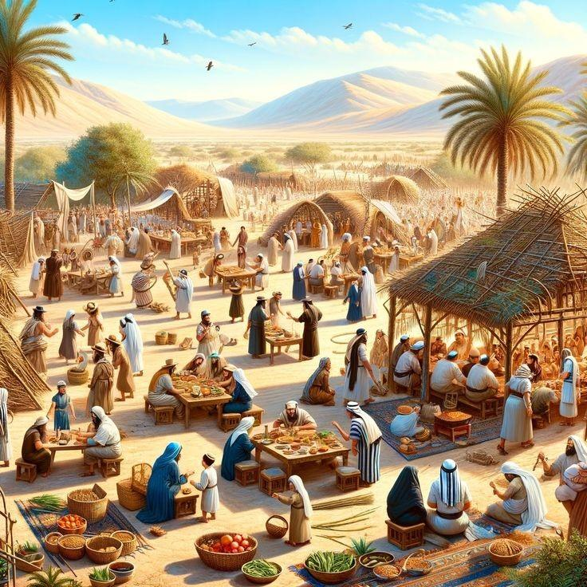
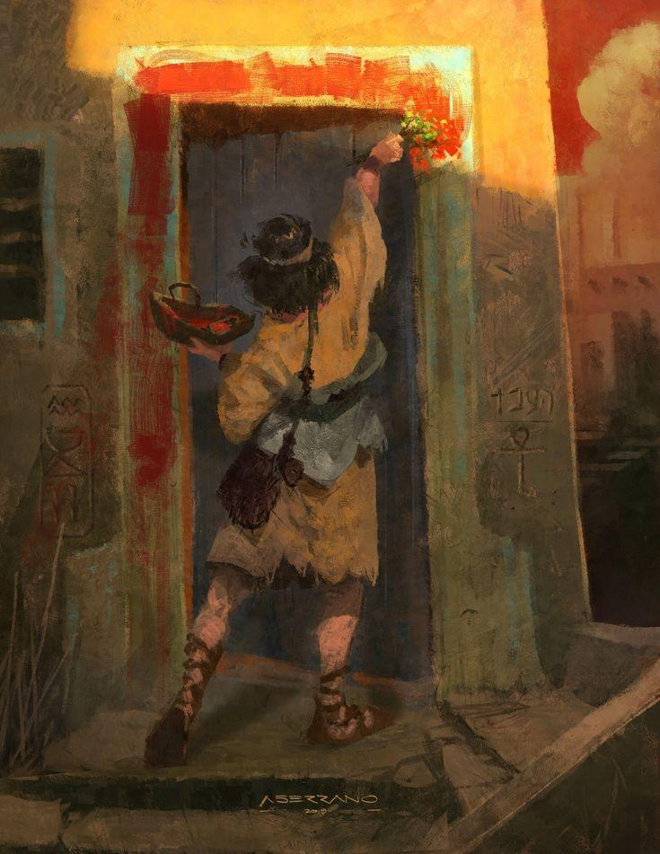
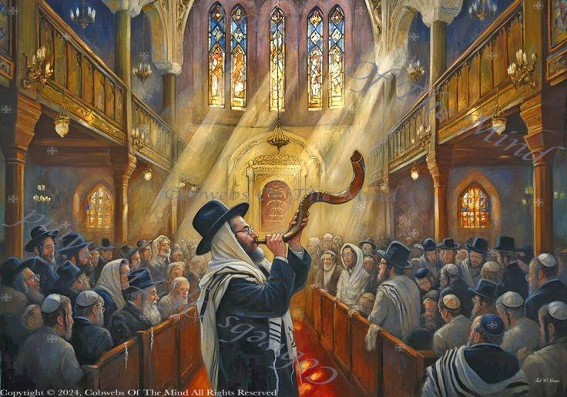
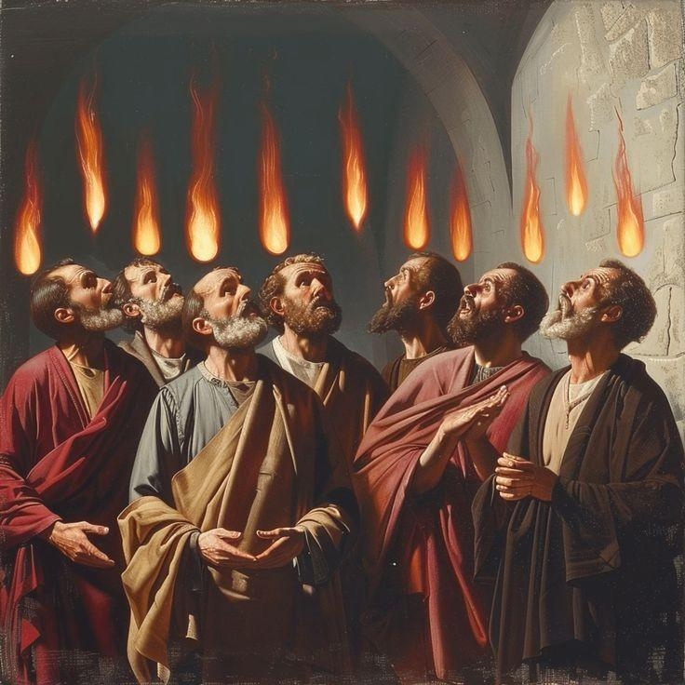
Yom Kippur
Passover
Feasts of tabernacle
Pentecost
It is also a time for mourning and lamentation!

