Slide 1
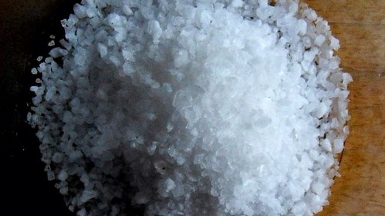
The Sacrifice of communication vs corrupt communication
Kids Bible Fellowship

Slide 2
Sacrifice of Communication wherewith God is well-pleased Scriptures:
Hebrews 13:15-16 By him therefore let us offer the SACRIFICE OF PRAISE to God CONTINUALLY, that is, THE FRUIT OF OUR LIPS giving thanks to his name. But TO DO GOOD and TO COMMUNICATE forget not: for WITH SUCH SACRIFICES GOD IS WELL PLEASED.
Hosea 14:2 Take with you words, and turn to the Lord: say unto him, Take away all iniquity, and receive us graciously: SO WILL WE RENDER THE CALVES (SACRIFICES) OF OUR LIPS.
Leviticus 2:13 And EVERY OBLATION of thy meat offering SHALT THOU SEASON WITH SALT; NEITHER SHALT THOU SUFFER THE SALT OF THE COVENANT of thy God !!to be lacking!! from thy meat offering: WITH ALL THINE OFFERINGS THOU SHALT OFFER SALT.
Colossians 4:6 Let YOUR SPEECH be always with GRACE, SEASONED WITH SALT, that ye may know how ye ought to answer every man.

Slide 3

Sacrifice of Communication Explained:
Sacrifice of communication goes back to the royal law according to scripture, when you rebuke someone it’s to be done according to His standard of righteousness (Ten Commandments), His word (in Spirit & in Truth), and with salt (conviction) so you can God willing cut through one’s conscience and lead them to repent through His Spirit. It’s supposed to be useful/edifying so it may impart grace (conviction) unto the hearers so telling someone to “Repent and turn back to Gods covenant the Ten Commandments before tribulation hits otherwise His wrath is coming on you” would be an example of this because if they do listen and repent they too can be saved and now being set free by His truth they can go set others free. If you don’t do it with salt it will be a useless rebuke because the whole point is to get people either to repent now or remember in tribulation and if you say things like “Maybe you should keep the Ten Commandments when He leads you to do it” “It’s fine we’re all believers in Christ anyways” “We’ll have to agree to disagree” “You’re still saved anyway Ten Commandments aren’t necessary for salvation” that is leading no one to repent but many to the PIT and becomes corrupt according to scripture.
Matthew 5:13 Ye are the salt of the earth: but if the salt have lost his savour, wherewith shall it be salted? it is thenceforth good for nothing, but to be cast out, and to be trodden under foot of men.
Isaiah 28 verses 1-4, 17-19 don’t want to be trodden under foot, speak with salt whether they hear or forbear!

Slide 4

Mix of Sacrifice of Communication vs Corrupt:
Ephesians 4:22-30 That ye put off concerning the former conversation the old man, which is corrupt according to the deceitful lusts; And be renewed in the spirit of your mind; And that ye put on the new man, which after God is created in righteousness and true holiness. WHEREFORE PUTTING AWAY LYING, SPEAK EVERY MAN TRUTH WITH HIS NEIGHBOUR: for we are members one of another. Be ye angry, and sin not: let not the sun go down upon your wrath: Neither give place to the devil. Let him that stole steal no more: but rather let him labour, working with his hands the thing which is good, that he may have to give to him that needeth. LET NO CORRUPT COMMUNICATION PROCEED OUT OF YOUR MOUTH, BUT THAT WHICH IS GOOD TO THE USE OF EDIFYING, that it MAY MINISTER GRACE UNTO THE HEARERS. And grieve not the holy Spirit of God, whereby ye are sealed unto the day of redemption.

Slide 5
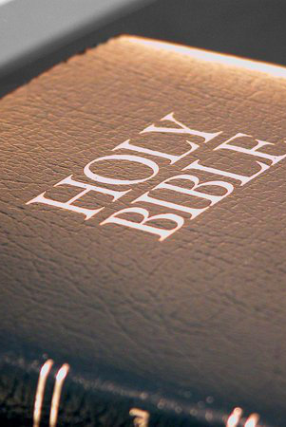
Corrupt Communication Scriptures:
Jeremiah 23:13-22 And I have seen folly in the prophets of Samaria; they prophesied in Baal, and caused my people Israel to err. I have seen also in the prophets of Jerusalem an horrible thing: they commit adultery, and walk in lies: they strengthen also the hands of evildoers, that none doth return from his wickedness; they are all of them unto me as Sodom, and the inhabitants thereof as Gomorrah. Therefore thus saith the Lord of hosts concerning the prophets; Behold, I will feed them with wormwood, and make them drink the water of gall: for from the prophets of Jerusalem is profaneness gone forth into all the land. Thus saith the Lord of hosts, Hearken not unto the words of the prophets that prophesy unto you: they make you vain: they speak a vision of their own heart, and not out of the mouth of the Lord. They say still unto them that despise me, The Lord hath said, Ye shall have peace; and they say unto every one that walketh after the imagination of his own heart, No evil shall come upon you. For who hath stood in the counsel of the Lord, and hath perceived and heard his word? who hath marked his word, and heard it? Behold, a whirlwind of the Lord is gone forth in fury, even a grievous whirlwind: it shall fall grievously upon the head of the wicked. The anger of the Lord shall not return, until he have executed, and till he have performed the thoughts of his heart: in the latter days ye shall consider it perfectly. I have not sent these prophets, yet they ran: I have not spoken to them, yet they prophesied. But if they had stood in my counsel, and had caused my people to hear my words, then they should have turned them from their evil way, and from the evil of their doings.
Colossians 3:8-11 But now ye also put off all these; anger, wrath, malice, blasphemy, filthy communication out of your mouth. Lie not one to another, seeing that ye have put off the old man with his deeds; And have put on the new man, which is renewed in knowledge after the image of him that created him: Where there is neither Greek nor Jew, circumcision nor uncircumcision, Barbarian, Scythian, bond nor free: but Messiah is all, and in all.
Matthew 12:34-37 O generation of vipers, how can ye, being evil, speak good things? for out of the abundance of the heart the mouth speaketh. A good man out of the good treasure of the heart bringeth forth good things: and an evil man out of the evil treasure bringeth forth evil things. But I say unto you, That every idle word that men shall speak, they shall give account thereof in the day of judgment. For by thy words thou shalt be justified, and by thy words thou shalt be condemned.

Slide 6
Corrupt Communication Explained:
Corrupt communication is the opposite of sacrifice of communication, as we saw in those verses it’s people lying about the word of God preaching from their vain imaginations and telling their neighbors they’ll have peace even though they walk according to the dictates of their own heart. No salt, no conviction, nothing useful or edifying to lead one to repent from their sins but instead tolerating them, being complacent, even promoting lies that they should be abhorring. Which we see in especially in the Christian churches, even with the Torah movement they still have a similar mindset to the Christians just in a different way!
Examples of corrupt communication: “Jesus is my Sabbath” “OSAS” “You don’t need to keep the Ten Commandments to be saved/they’ve been done away with” “Faith only” “You can do the feasts wherever and however you want” “Must keep the whole law” “We’re all sinners, God loves us anyways” “Jesus made all foods clean so I can eat whatever I want” the list of lies just goes on and on and on, leading no one to true repentance but instead 2 Thessalonians 2 loving the lie instead of loving the truth that can save them, and if they don’t repent then they’ll be damned.

Slide 7

Conclusion:
Psalm 50:14-15 Offer unto God thanksgiving; and pay thy vows unto the Most High: And call upon me in the day of trouble: I will deliver thee, and thou shalt glorify me.
We’re either establishing the Father’s name, offering the sacrifices of communication that He is well pleased with, leading His people to repent and come to know Him. Or, we’re doing the corrupt communication that He hates leading people to be complacent in their sins damning them to hell (unless if they repent). If you’re going to preach the word, do it with salt (conviction) and truth in order to bring His lost sheep home to Him. Stay salty friends!

