Slide 1
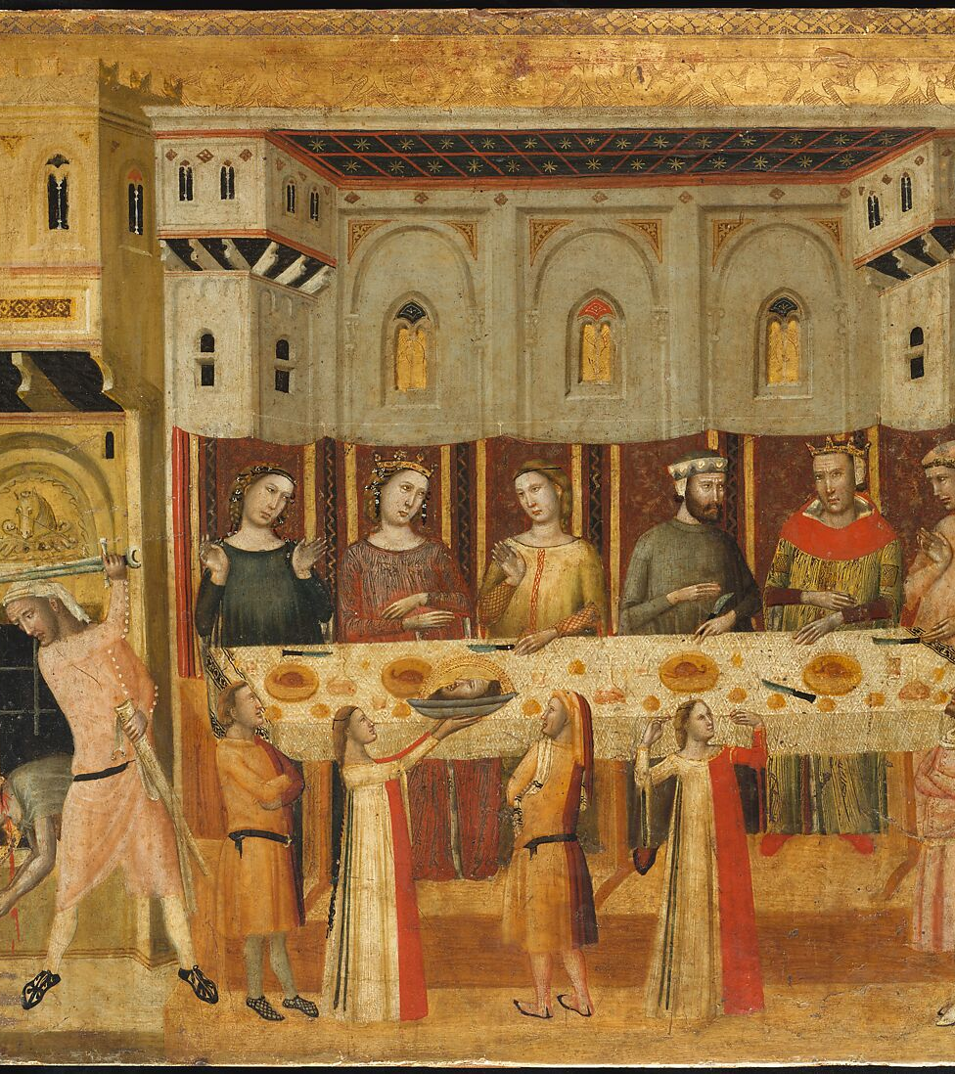
No feasting
Kids Bible Fellowship

Slide 2
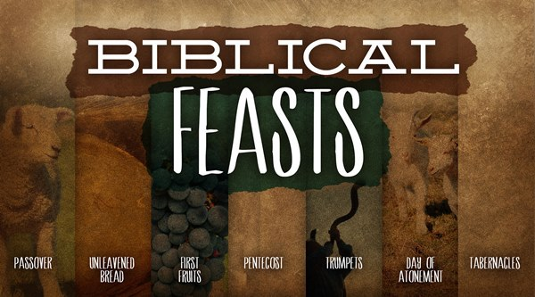

Slide 3
The Feasts can’t be kept yet
There’s only one place He put His name (in Jerusalem) forever, we did not become the land.
We’re in exile and don’t have the correct calendar either, you’re profaning them doing them presumptuously.
It’s to be done as a holy convocation, can’t do that when we’re all scattered abroad in the diaspora.
Can’t feast without our bridegroom Yeshua, times of mourning, lamentation, and woe. Even he won’t be feasting till we’re in the Kingdom.
You are going to be going into captivity for doing the feasts now and when you teach others to do so, you are leading them to captivity fulfilling prophecy (Isaiah 5:13, 22:17, Jeremiah 15:2, 22:22, Revelation 13:10).

Slide 4
Verses about not doing the feasts now

Slide 5
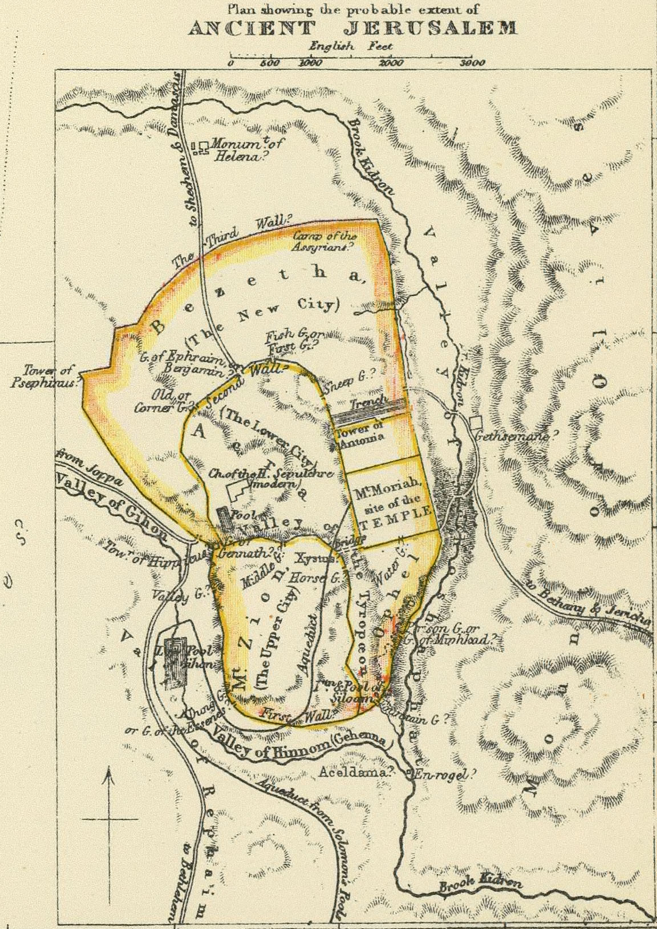
Deuteronomy 12 & 16
IN JERUSALEM
This Photo by Unknown Author is licensed under CC BY

Slide 6
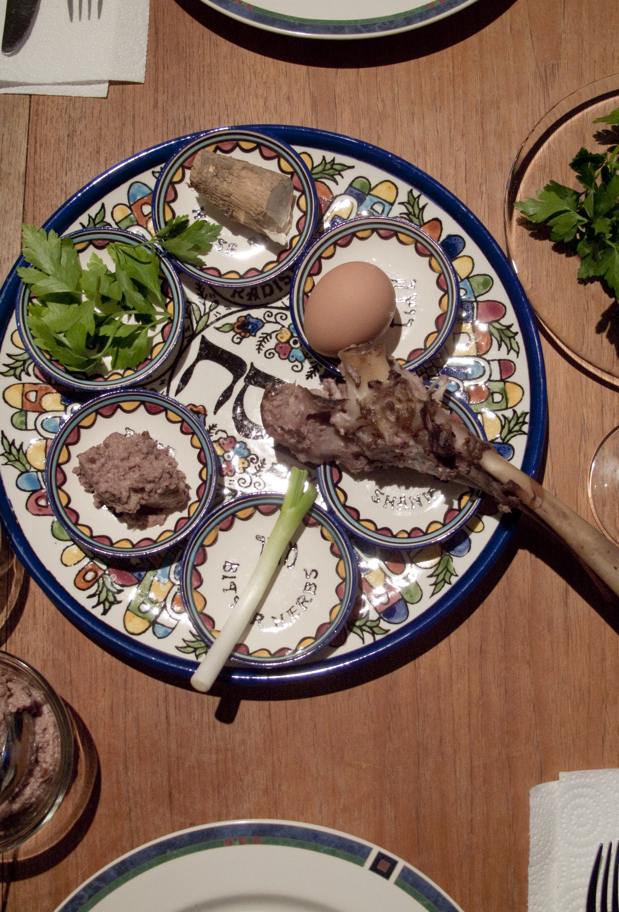
Daniel 10:1-4
In the third year of Cyrus king of Persia a thing was revealed unto Daniel, whose name was called Belteshazzar; and the thing was true, but the time appointed was long: and he understood the thing, and had understanding of the vision. In those days I Daniel was mourning three full weeks. I ate no pleasant bread, neither came flesh nor wine in my mouth, neither did I anoint myself at all, till three whole weeks were fulfilled. And in the four and twentieth day of the first month, as I was by the side of the great river, which is Hiddekel;
Daniel fasted over the Passover when he was in Babylon

Slide 7
Hosea 8:11-14
Because Ephraim hath made many altars to sin, altars shall be unto him to sin. I have written to him the great things of my law, but they were counted as a strange thing. They sacrifice flesh for the sacrifices of MINE OFFERINGS (feasts) and EAT IT; but the LORD ACCEPTS THEM NOT not; now will he remember THEIR INIQUITY, and visit their sins: they shall return to Egypt. For Israel hath forgotten his Maker, and buildeth temples; and Judah hath multiplied fenced cities: but I will send a fire upon his cities, and it shall devour the palaces thereof.
They will go into tribulation for profaning His feasts
Goes with Jubilees 6:34-38

Slide 8
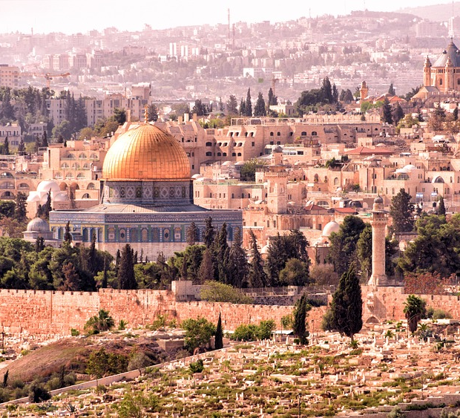
Paul has to return to Jerusalem
Acts 18:21 But bade them farewell, saying, I must by all means keep this feast that cometh in Jerusalem: but I will return again unto you, if God will. And he sailed from Ephesus.
Acts 20:16 For Paul had determined to sail by Ephesus, because he would not spend the time in Asia: for he hasted, if it were possible for him, to be at Jerusalem the day of Pentecost.

Slide 9
Exodus 12:25 & 13:10
And it shall come to pass, when ye be come to the land which the Lord will give you, according as he hath promised, that ye shall keep this service.
Thou shalt therefore keep this ordinance in his season from year to year.
Shows even when they were originally given, they’re to be kept in the land. And on the appointed time. Can’t do what’s right in our own eyes Deuteronomy 12:8.

Slide 10
Luke 5:35 & 22:15-19
But the days will come, when the bridegroom shall be taken away from them, and then shall they fast in those days.
And he said unto them, With desire I have desired to eat this passover with you before I suffer: For I say unto you, I will not any more eat thereof, until it be fulfilled in the kingdom of God. And he took the cup, and gave thanks, and said, Take this, and divide it among yourselves: For I say unto you, I will not drink of the fruit of the vine, until the kingdom of God shall come.
His servants will be fasting giving up their lives in these days for the sake of His people not feeding their own bellies. We’re to wait on Yah no feasting when destruction is near!

Slide 11
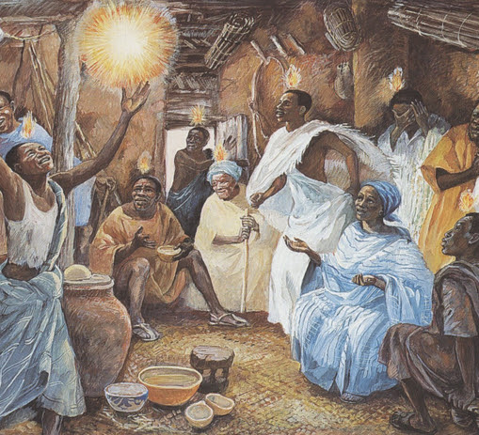
Acts 2:1-4
And when the day of Pentecost was fully come, they were all with one accord in one place. And suddenly there came a sound from heaven as of a rushing mighty wind, and it filled all the house where they were sitting. And there appeared unto them cloven tongues like as of fire, and it sat upon each of them. And they were all filled with the Holy Ghost, and began to speak with other tongues, as the Spirit gave them utterance

