Slide 1

Yeshua our Messiah is
NOT Jesus

Slide 2
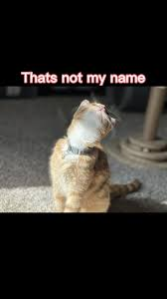
Yeshua knows that one will come in his own name.
John 5:42-43 KJV But I know you, that ye have not the love of God in you. (43) I am come in my Father's name, and ye receive me not: if another shall come in his own name, him ye will receive.
How does Yeshua know that they do not have the love of Yehovah in them?
  1 John 2:3-4 KJV And hereby we do know that we know him, if we keep his commandments. 4 He that saith, I know him, and keepeth not his commandments, is a liar, and the truth is not in him.
What is the Father's name?
  Psalms 83:18 KJV That men may know that thou, whose name alone is JEHOVAH[H3068], art the most high over all the earth.
  H3068
  יְהֹוָה
  yehôvâh
  yeh-ho-vaw'
  From H1961; (the) self Existent or eternal; Jehovah, Jewish national name of God: - Jehovah, the Lord. Compare H3050, H3069.

Slide 3
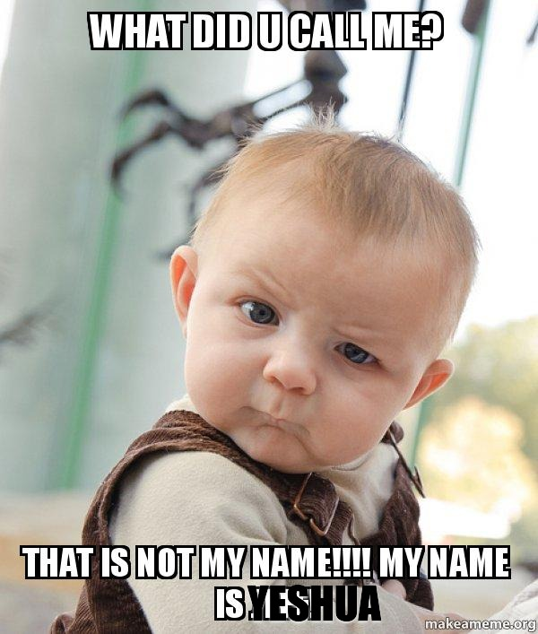
What does it mean he came in his Father's name?
Zechariah 3:1 KJV And he shewed me Joshua[H3091] the high priest standing before the angel of the LORD, and Satan standing at his right hand to resist him.
H3091
יְהוֹשֻׁעַ יְהוֹשׁוּעַ
yehôshûa‛ yehôshûa‛
yeh-ho-shoo'-ah, yeh-ho-shoo'-ah
From H3068 and H3467; Jehovah-saved; Jehoshua (that is, Joshua), the Jewish leader: - Jehoshua, Jehoshuah, Joshua. Compare H1954, H3442.
Psalms 140:7 KJV O GOD the Lord, the strength of my salvation[H3444], thou hast covered my head in the day of battle.
H3444
יְשׁוּעָה
yeshû‛âh
yesh-oo'-aw
Feminine passive participle of H3467; something saved, that is, (abstractly) deliverance; hence aid, victory, prosperity: - deliverance, health, help (-ing), salvation, save, saving (health), welfare.

Slide 4
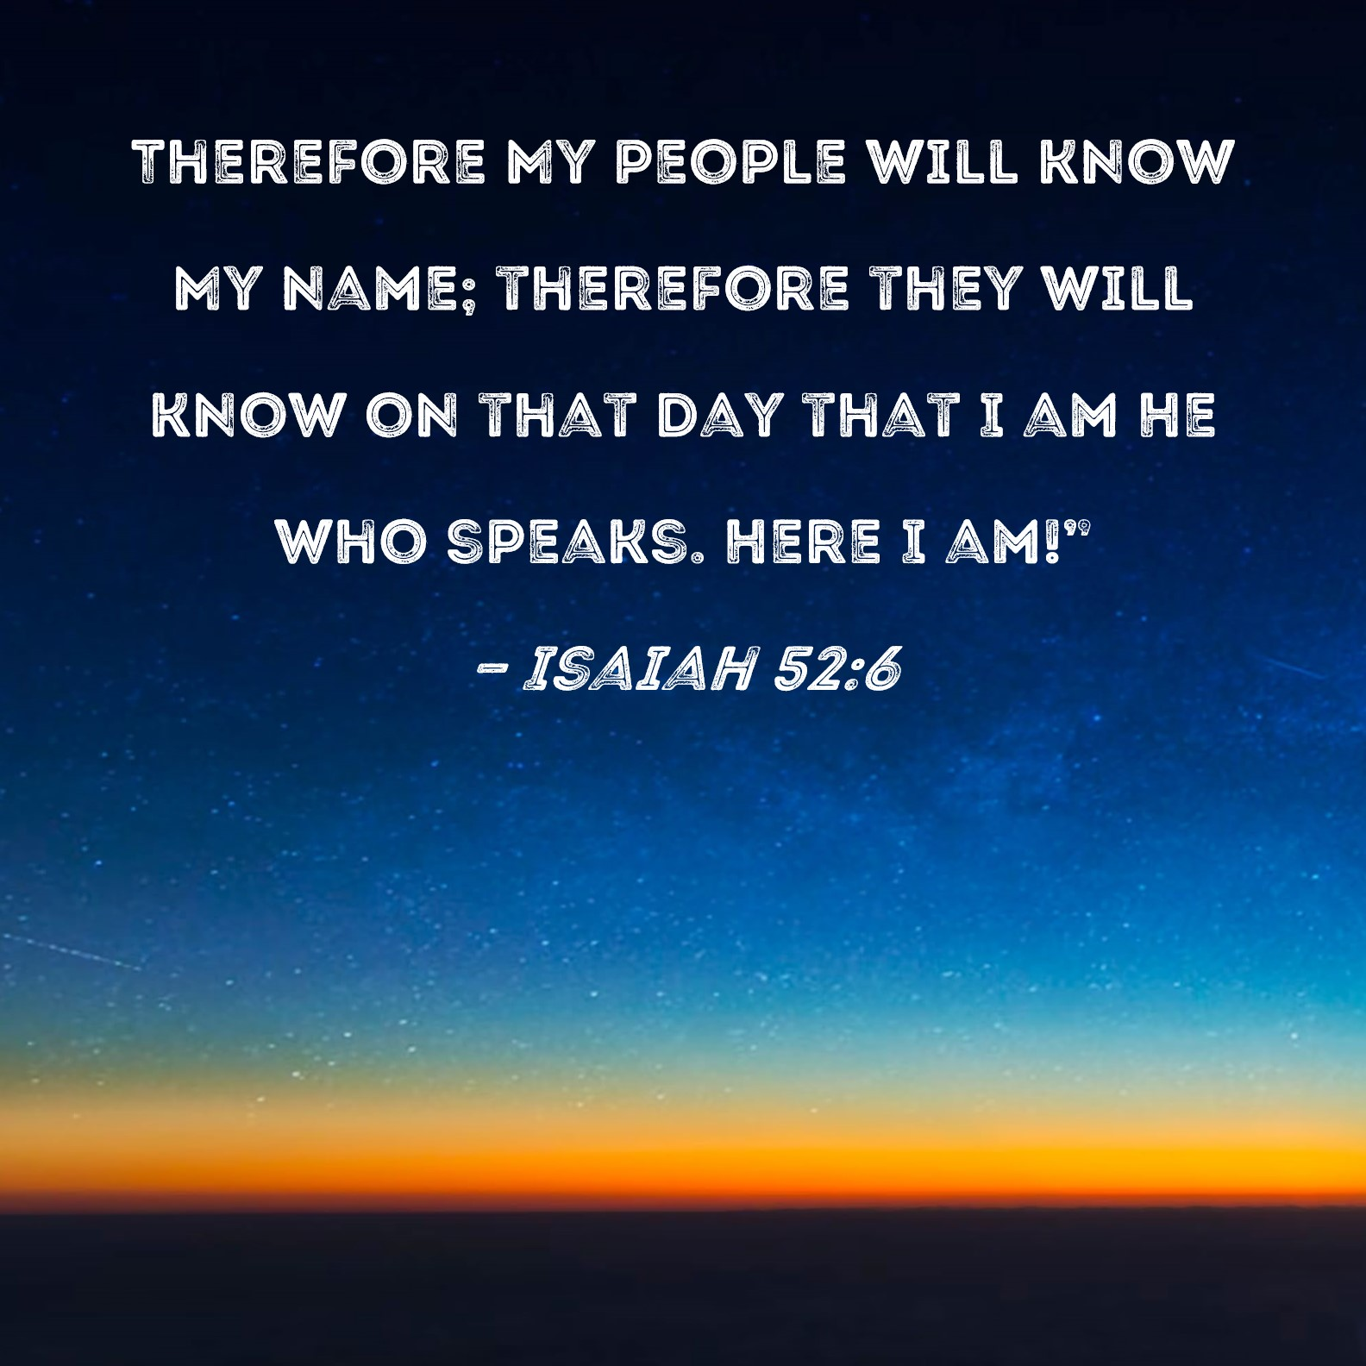
Psalms 20:5 KJV We will rejoice in thy salvation, and in the name of our God we will set up our banners: the LORD fulfil all thy petitions.
Acts 4:12 KJV Neither is there salvation in any other: for there is none other name under heaven given among men, whereby we must be saved.
Titus 2:11-12 KJV For the grace of God that bringeth salvation hath appeared to all men, (12) Teaching us that, denying ungodliness and worldly lusts, we should live soberly, righteously, and godly, in this present world;
Acts 26:14-15 KJV And when we were all fallen to the earth, I heard a voice speaking unto me, and saying in the Hebrew tongue, Saul, Saul, why persecutest thou me? it is hard for thee to kick against the pricks. (15) And I said, Who art thou, Lord? And he said, I am Jesus [He would have said Yehoshua or Yeshua not Jesus] whom thou persecutest.
G2424
Ἰησοῦς
Iēsous
ee-ay-sooce'
Of Hebrew origin [H3091]; Jesus (that is, Jehoshua), the name of our Lord and two (three) other Israelites: - Jesus.
John 1:9-13 KJV That was the true Light, which lighteth every man that cometh into the world. (10) He was in the world, and the world was made by him, and the world knew him not. (11) He came unto his own, and his own received him not. (12) But as many as received him, to them gave he power to become the sons of God, even to them that believe on his name: (13) Which were born, not of blood, nor of the will of the flesh, nor of the will of man, but of God.
John 20:30-31 KJV And many other signs truly did Yeshua in the presence of his disciples, which are not written in this book: (31) But these are written, that ye might believe that Yeshua is the Christ, the Son of God; and that believing ye might have life through his name.

Slide 5

What is in a name?
Name definition in the strongs in the Greek
G3686
ὄνομα
onoma
on'-om-ah
From a presumed derivative of the base of G1097 (compare G3685); a “name” (literally or figuratively), (authority, character): - called, (+ sur-) name (-d).
Name definition in the strongs in the Hebrew
H8034
שֵׁם
shêm
shame
A primitive word (perhaps rather from H7760 through the idea of definite and conspicuous position; compare H8064); an appellation, as a mark or memorial of individuality; by implication honor, authority, character: - + base, [in-] fame [-ous], name (-d), renown, report.
Isaiah 52:5-6 KJV Now therefore, what have I here, saith the LORD, that my people is taken away for nought? they that rule over them make them to howl, saith the LORD; and my name continually every day is blasphemed. (6) Therefore my people shall know my name: therefore they shall know in that day that I am he that doth speak: behold, it is I.
Deuteronomy 32:3 KJV Because I will publish the name of the LORD: ascribe ye greatness unto our God.
John 17:3-6 KJV And this is life eternal, that they might know thee the only true God, and Yeshua Christ, whom thou hast sent. (4) I have glorified thee on the earth: I have finished the work which thou gavest me to do. (5) And now, O Father, glorify thou me with thine own self with the glory which I had with thee before the world was. (6) I have manifested thy name unto the men which thou gavest me out of the world: thine they were, and thou gavest them me; and they have kept thy word.
Genesis 1:3-4 KJV And God said, Let there be light: and there was light. (4) And God saw the light, that it was good: and God divided the light from the darkness.
Isaiah 8:20 KJV To the law and to the testimony: if they speak not according to this word, it is because there is no light in them.

Slide 6
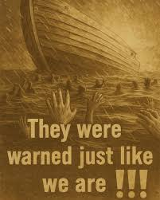
Don't they blaspheme that worthy name by which ye are called?
James 2:7 KJV Do not they blaspheme that worthy name by the which ye are called?
Jeremiah 23:11-13 KJV For both prophet and priest are profane; yea, in my house have I found their wickedness, saith the LORD. (12) Wherefore their way shall be unto them as slippery ways in the darkness: they shall be driven on, and fall therein: for I will bring evil upon them, even the year of their visitation, saith the LORD. (13) And I have seen folly in the prophets of Samaria; they prophesied in Baal, and caused my people Israel to err.
Jeremiah 23:25-27 KJV I have heard what the prophets said, that prophesy lies in my name, saying, I have dreamed, I have dreamed. (26) How long shall this be in the heart of the prophets that prophesy lies? yea, they are prophets of the deceit of their own heart; (27) Which think to cause my people to forget my name by their dreams which they tell every man to his neighbour, as their fathers have forgotten my name for Baal.
Jeremiah 2:8 KJV The priests said not, Where is the LORD? and they that handle the law knew me not: the pastors also transgressed against me, and the prophets prophesied by Baal, and walked after things that do not profit.
Hosea 2:17 KJV For I will take away the names of Baalim out of her mouth, and they shall no more be remembered by their name.

Slide 7
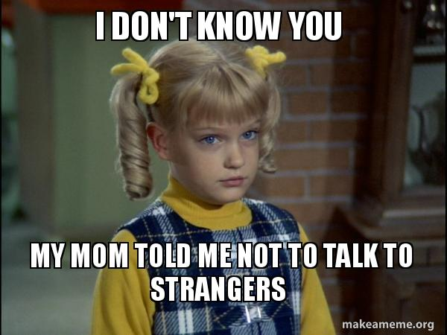
Lying Signs and Wonders
Deuteronomy 13:1-5 KJV If there arise among you a prophet, or a dreamer of dreams, and giveth thee a sign or a wonder, (2) And the sign or the wonder come to pass, whereof he spake unto thee, saying, Let us go after other gods, which thou hast not known, and let us serve them; (3) Thou shalt not hearken unto the words of that prophet, or that dreamer of dreams: for the LORD your God proveth you, to know whether ye love the LORD your God with all your heart and with all your soul. (4) Ye shall walk after the LORD your God, and fear him, and keep his commandments, and obey his voice, and ye shall serve him, and cleave unto him. (5) And that prophet, or that dreamer of dreams, shall be put to death; because he hath spoken to turn you away from the LORD your God, which brought you out of the land of Egypt, and redeemed you out of the house of bondage, to thrust thee out of the way which the LORD thy God commanded thee to walk in. So shalt thou put the evil away from the midst of thee.
2 Thessalonians 2:1-12 KJV Now we beseech you, brethren, by the coming of our Lord Yeshua Christ, and by our gathering together unto him, (2) That ye be not soon shaken in mind, or be troubled, neither by spirit, nor by word, nor by letter as from us, as that the day of Christ is at hand. (3) Let no man deceive you by any means: for that day shall not come, except there come a falling away first, and that man of sin be revealed, the son of perdition; (4) Who opposeth and exalteth himself above all that is called God, or that is worshipped; so that he as God sitteth in the temple of God, shewing himself that he is God. (5) Remember ye not, that, when I was yet with you, I told you these things? (6) And now ye know what withholdeth that he might be revealed in his time. (7) For the mystery of iniquity doth already work: only he who now letteth will let, until he be taken out of the way. (8) And then shall that Wicked be revealed, whom the Lord shall consume with the spirit of his mouth, and shall destroy with the brightness of his coming: (9) Even him, whose coming is after the working of Satan with all power and signs and lying wonders, (10) And with all deceivableness of unrighteousness in them that perish; because they received not the love of the truth, that they might be saved. (11) And for this cause God shall send them strong delusion, that they should believe a lie: (12) That they all might be damned who believed not the truth, but had pleasure in unrighteousness.
Isaiah 14:12-15 KJV How art thou fallen from heaven, O Lucifer, son of the morning! how art thou cut down to the ground, which didst weaken the nations! (13) For thou hast said in thine heart, I will ascend into heaven, I will exalt my throne above the stars of God: I will sit also upon the mount of the congregation, in the sides of the north: (14) I will ascend above the heights of the clouds; I will be like the most High. (15) Yet thou shalt be brought down to hell, to the sides of the pit.
Revelation 12:9 KJV And the great dragon was cast out, that old serpent, called the Devil, and Satan, which deceiveth the whole world: he was cast out into the earth, and his angels were cast out with him.

Slide 8
Yeshua warns us there will be false Christs
Matthew 24:4-5 KJV And Yeshua answered and said unto them, Take heed that no man deceive you. (5) For many shall come in my name, saying, I am Christ; and shall deceive many.
Matthew 24:11 KJV And many false prophets shall rise, and shall deceive many.
Matthew 24:23-24 KJV Then if any man shall say unto you, Lo, here is Christ, or there; believe it not. (24) For there shall arise false Christs, and false prophets, and shall shew great signs and wonders; insomuch that, if it were possible, they shall deceive the very elect.
Mark 13:22 KJV For false Christs and false prophets shall rise, and shall shew signs and wonders, to seduce, if it were possible, even the elect.

