Slide 1
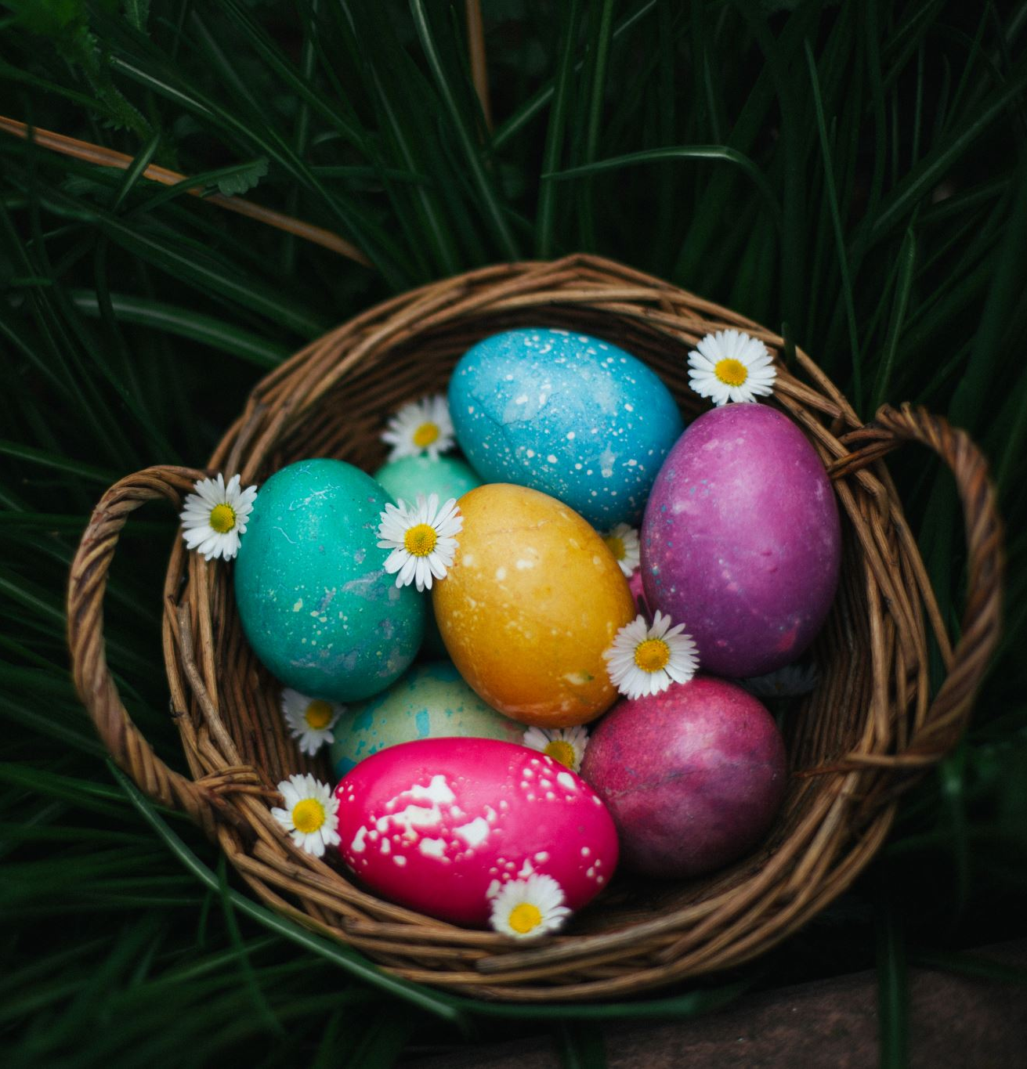
Easter is Pagan
Kids Bible Fellowship

Slide 2
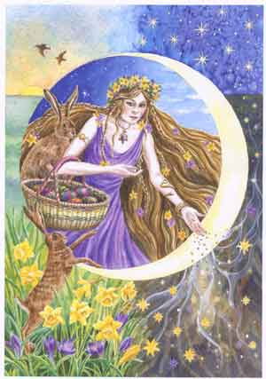
The spirit of Easter/Ishtar
Satanic goddess worship
Ishtar is Ashteroth that the Israelites were worshipping in 2 Kings 17
  God divorced them for doing this
  Paul warned us in Romans 11
Ishtar is the 👑queen of Heaven👑
  Jeremiah 7:18 The children gather wood, and the fathers kindle the fire, and the women knead their dough, to make cakes to the 👑queen of heaven👑, and to pour out drink offerings unto other gods🐣🐰, that they may provoke me to anger.
  Jeremiah 44:17-18 But we will certainly do whatsoever thing goeth forth out of our own mouth, to burn incense unto the 👑 queen of heaven 👑, and to pour out drink offerings unto her, as we have done, we, and our fathers, our kings, and our princes, in the cities of Judah, and in the streets of Jerusalem: for then had we plenty of victuals, and were well, and saw no evil. But since we left off to burn incense to the queen of heaven, and to pour out drink offerings unto her, we have wanted all things, and have been consumed by the sword and by the famine.

Slide 3
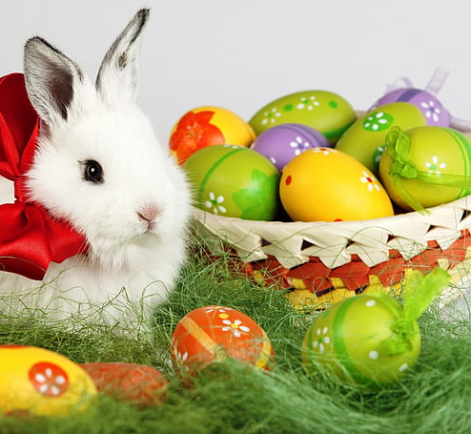
Evil good and good Evil
Like the celebration of Messiah’s birth at Christmas, Easter has turned into a melting pot of activities that have NOTHING to do with our Yeshua’s death and resurrection.
Although traditions like the Easter bunny and Easter egg hunts seems as harmless as believing in Santa (SATAN) Claus, they actually have a significant association with pagan worship and rituals from the past.
Isaiah 5:20 Woe unto them that call evil good, and good evil; that put darkness for light, and light for darkness; that put bitter for sweet, and sweet for bitter!

Slide 4
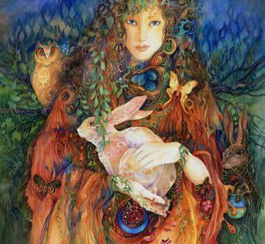
Easter’s Name
The name Easter is never associated with death and resurrection of Yeshua Messiah in the original scriptures and is actually derived from the word “Eostre”.
Eostre was Queen Semiramis; the wife of Nimrod, (Noah’s evil but enterprising great grandson).

Slide 5
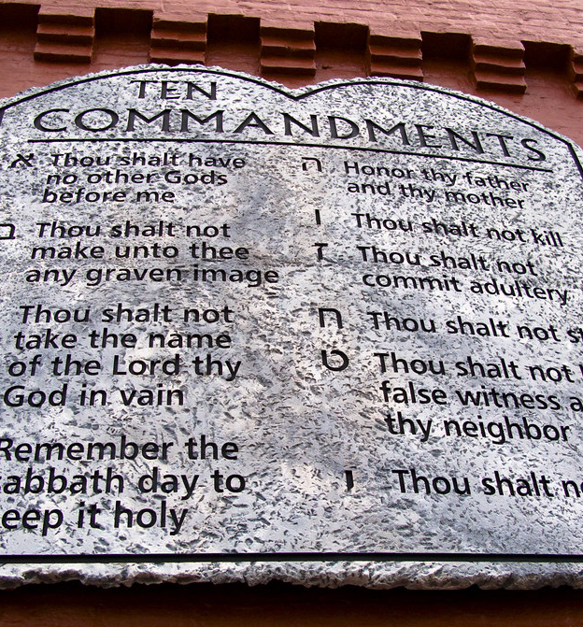
ISHTAR Sunday is IDOLATRY!
Jeremiah 10:2 Thus saith the Lord, ⚠️ Learn NOT the way of the heathen ⚠️, and be not dismayed at the signs of heaven; for the heathen are dismayed at them.
IDOLATRY is the SIN leading to death.
  1 John 5:16 If any man see his brother sin a sin which is not unto death, he shall ask, and he shall give him life for them that sin not unto death. There is a sin unto death: I do not say that he shall pray for it.
  1 John 5:21 Little children, keep yourselves from idols 🐣🐰. Amen.

Slide 6



3 days and 3 nights
The Church says that Messiah died on Friday and rose on Sunday. They can’t count to 3!
Matthew 12:40 For as Jonah was three days and three nights in the whale's belly; so shall the Son of man be three days and three nights in the heart of the earth.
The Messiah was cut off on Wednesday.
  Daniel 9:27 And he shall confirm the covenant with many for one week: and in the midst of the week he shall cause the sacrifice and the oblation to cease, and for the overspreading of abominations he shall make it desolate, even until the consummation, and that determined shall be poured upon the desolate.
The Messiah rose on Saturday (Sabbath).
  Matthew 28:1 In the end of the sabbath, as it began to dawn toward the first day of the week, came Mary Magdalene and the other Mary to see the sepulchre.

Slide 7
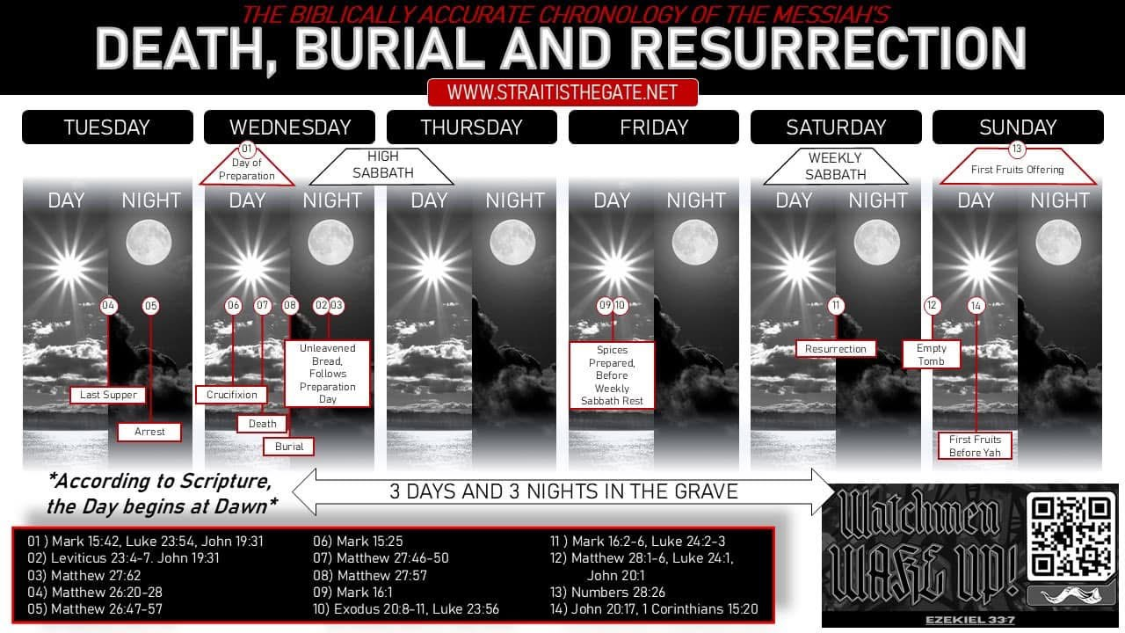

Slide 8
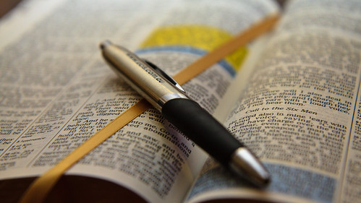
Scriptures against Easter

Slide 9
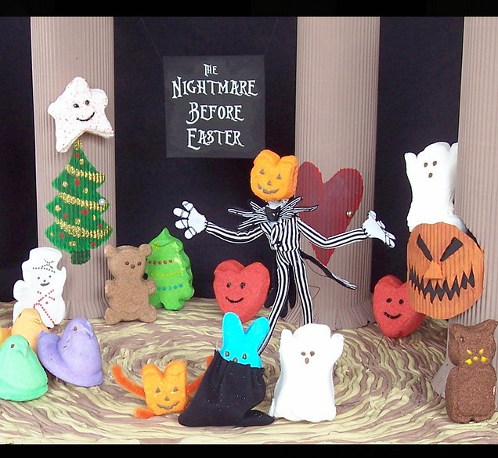
Mark 7:7-9
Howbeit in vain do they worship me, teaching for doctrines the commandments of men. For laying aside the commandment of God, ye hold the tradition of men 🎄 🎅🏻 🎃 🐣🐰, as the washing of pots and cups: and many other such like things ye do. And he said unto them, Full well ye reject the commandment of God, that ye may keep your own tradition.

Slide 10

Ephesians 5:11
And have no fellowship with the unfruitful works of darkness 🎄 🎅🏻 🎃 🐣🐰, but rather reprove them.

Slide 11

1 Thessalonians 5:22
Abstain from all appearance of evil🎄 🎅🏻 🎃 🐣🐰.

Slide 12
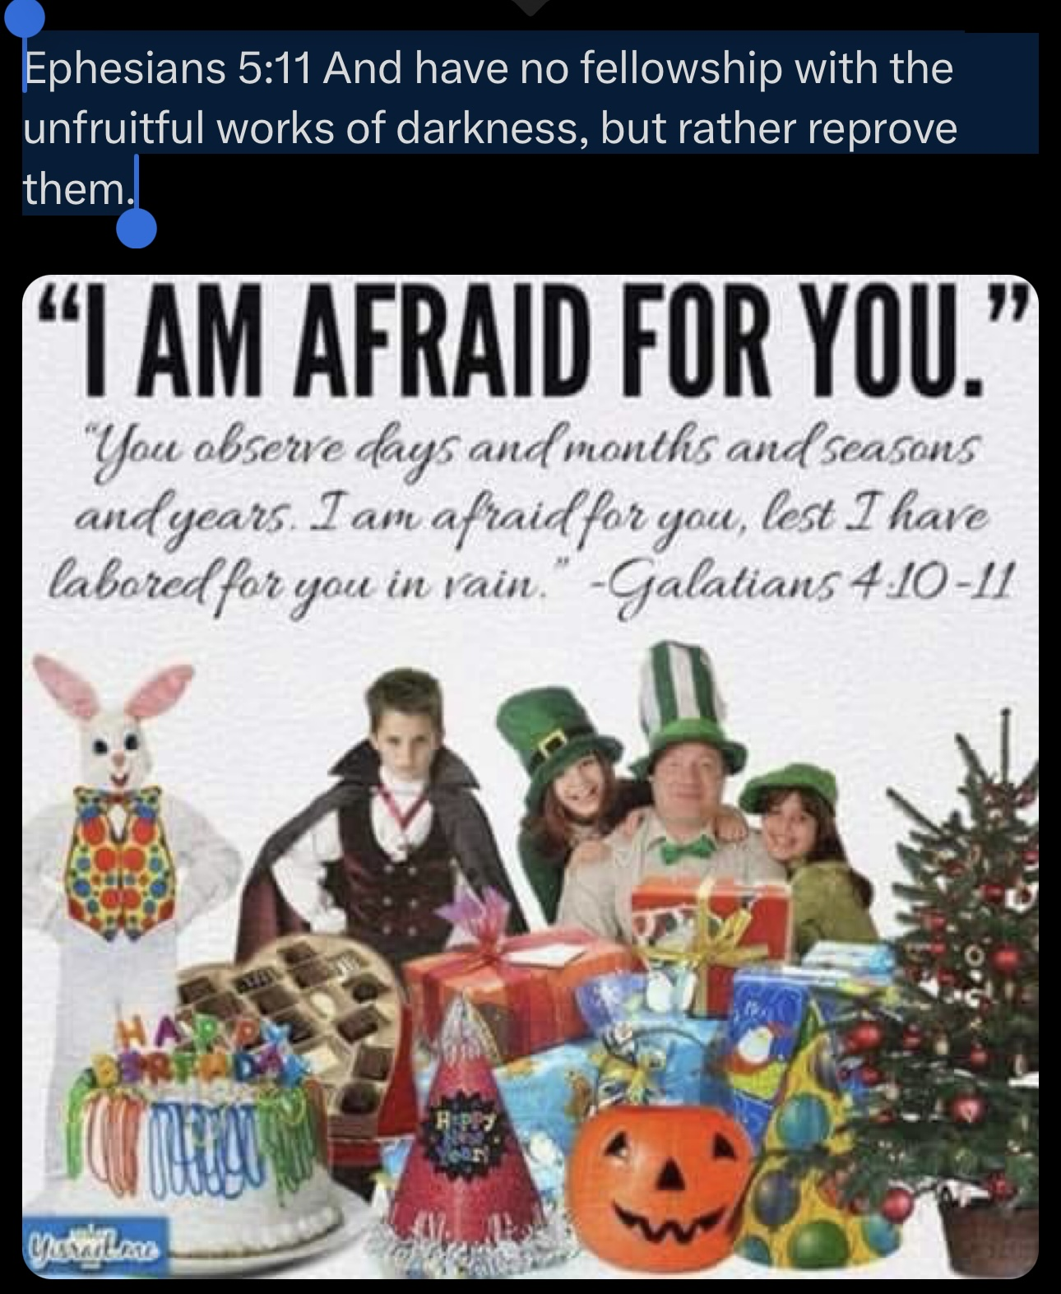
Galatians 4:10-11
Ye observe days, and months, and times, and years. I am afraid of you, lest I have bestowed upon you labour in vain.

Slide 13
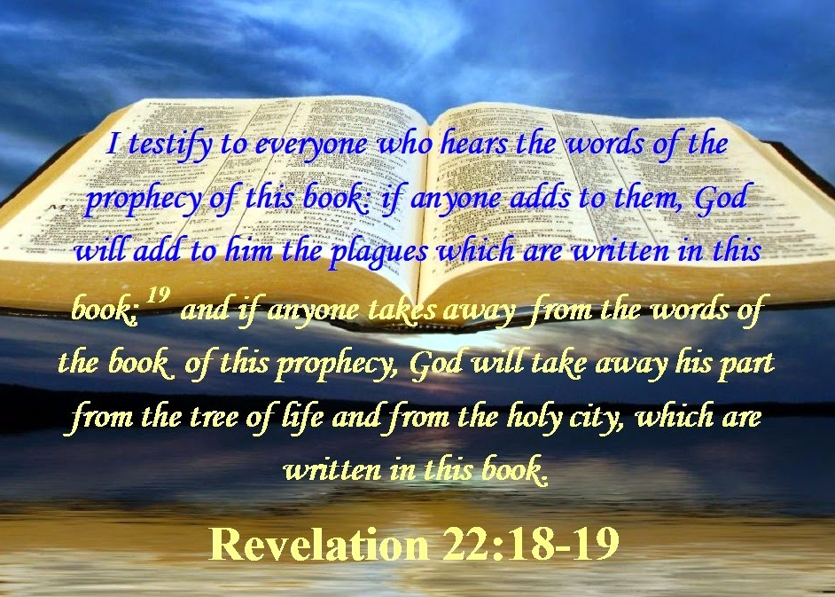
In Conclusion…
Easter is not rooted in anything good, it initially was a way for non-Jews (gentiles) to separate themselves from Passover.
Saying the Messiah was cut off on Friday and rose on Sunday is one of the silliest things out there. That is 1.5 days not even 3 days and 3 nights!
Celebrating Easter is committing idolatry and Yah says NO idolaters will enter into the kingdom of heaven.
We’re called to worship Yah in spirit and in truth and keep His commandments instead of the traditions of the churches that Yah will destroy for blaspheming Him.

