Slide 1

Catholic vs. Biblical Ten Commandments
A Side-by-Side Comparison

Slide 2

Introduction
Found in Exodus 20 and repeated in Deuteronomy 5.
The Ten Commandments were written on Two Tables of Stone by the finger of Yah.
  Exodus 31:18 And he gave unto Moses, when he had made an end of communing with him upon mount Sinai, two tables of testimony, tables of stone, written with the finger of Yah.
  Deuteronomy 5:22 These words the Lord spake unto all your assembly in the mount out of the midst of the fire, of the cloud, and of the thick darkness, with a great voice: AND HE ADDED NO MORE. And he wrote them in two tables of stone, and delivered them unto me.
This presentation compares the Catholic version with the Biblical text.

Slide 3
Commandments Comparison
# | Biblical Commandments | Catholic Catechism Version
1 | You shall have no other gods before Me | You shall not have strange gods before me
2 | No graven images or idols | Do not take the LORD’s name in vain
3 | Do not take the LORD’s name in vain | Remember to keep holy the LORD’s Day
4 | Remember the Sabbath day, to keep it holy | Honor your father and mother
5 | Honor your father and mother | You shall not kill
6 | Do not murder | You shall not commit adultery
7 | Do not commit adultery | You shall not steal
8 | Do not steal | You shall not bear false witness
9 | Do not bear false witness | You shall not covet your neighbor’s wife
10 | Do not covet | You shall not covet your neighbor’s goods

Slide 4
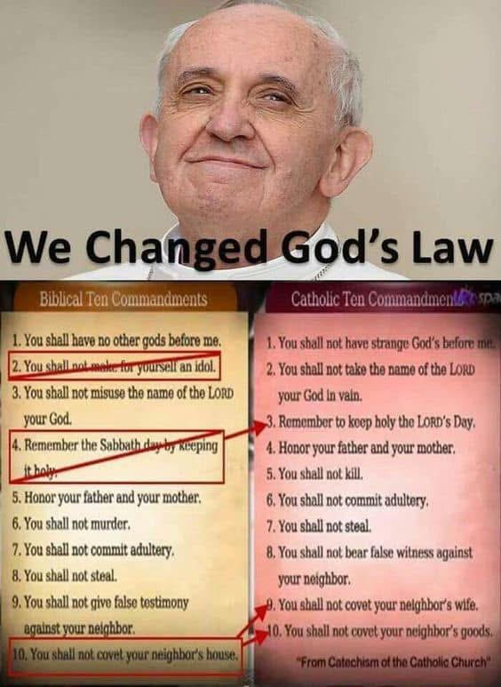
Key Differences
Graven Images: Biblical version prohibits images (Exodus 20:4–6).
  Catholic version often omits this.
Coveting: Catholic version splits into two commandments.
Numbering differs by tradition vs. Scripture.

Slide 5
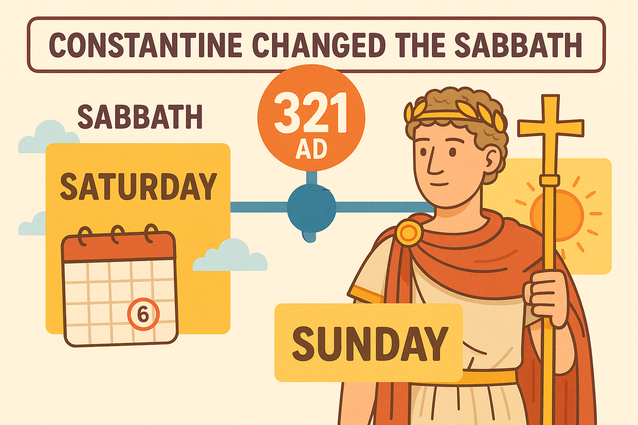

Slide 6
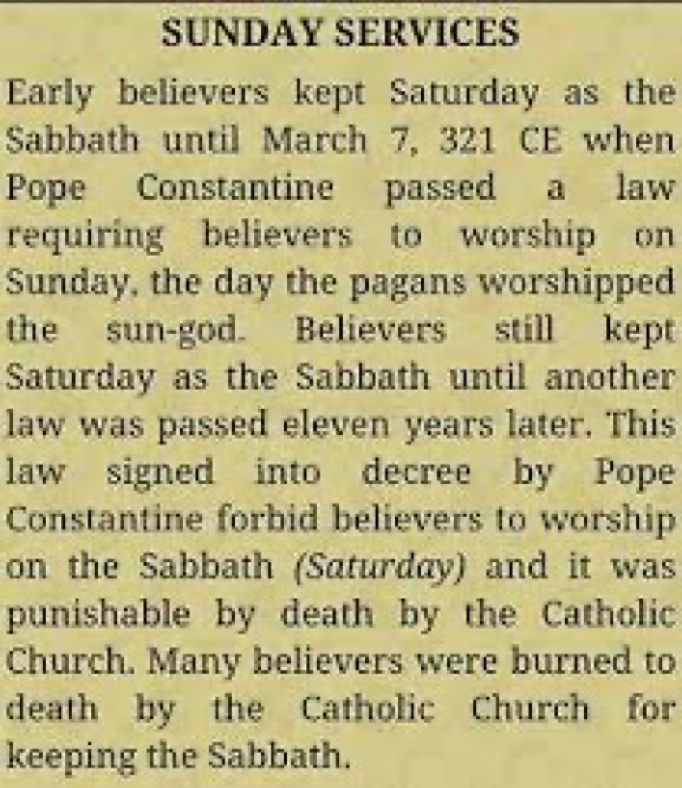
The Lord’s Day
Constantine made Sunday, the "venerable day of the Sun," the official day of rest in the Roman Empire.
  Official Decree:
    “On the venerable day of the Sun let the magistrates and people residing in cities rest, and let all workshops be closed.”
    — Codex Justinianus, book 3, title 12, law 3 (March 7, 321 AD)

Slide 7
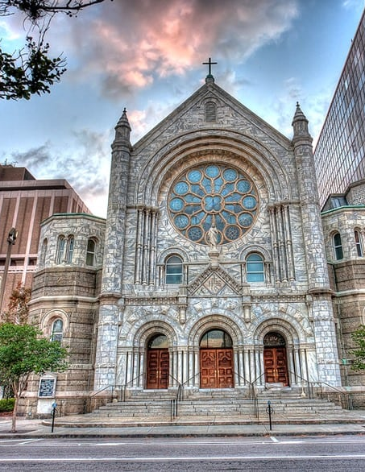
The Catholic Church Later Adopted and Enforced Sunday Worship
The Council of Laodicea (around 363–364 AD) declared:
  "Christians must not Judaize by resting on the Sabbath, but must work on that day... and honor the Lord’s Day [Sunday] instead."
The Church openly admits to changing the Sabbath from Saturday to Sunday by its own authority, not by Scripture.

Slide 8
Catholic Admissions (Historical Quotes):
“Sunday is our mark of authority... The Church is above the Bible.”
— Catholic Record, London, Ontario, Sept. 1, 1923
“The Church... transferred the Sabbath to Sunday by the plenitude of that divine power which Jesus Christ bestowed upon her.”
— Catechism of the Catholic Church

Slide 9

Scripture Warnings
Proverbs 30:6 Add thou not unto his words, lest he reprove thee, and thou be found a liar.
Deuteronomy 4:2 Ye shall not add unto the word which I command you, neither shall ye diminish ought from it, that ye may keep the commandments of the Lord your God which I command you.
Revelation 22:18-19 For I testify unto every man that heareth the words of the prophecy of this book, If any man shall add unto these things, God shall add unto him the plagues that are written in this book: And if any man shall take away from the words of the book of this prophecy, God shall take away his part out of the book of life, and out of the holy city, and from the things which are written in this book.

Slide 10

Scriptures
Mark 7:7-9 Howbeit in vain do they worship me, teaching for doctrines the commandments of men. For laying aside the commandment of God, ye hold the tradition of men, as the washing of pots and cups: and many other such like things ye do. And he said unto them, Full well ye reject the commandment of God, that ye may keep your own tradition.
Isaiah 29:13-14 Wherefore the Lord said, Forasmuch as this people draw near me with their mouth, and with their lips do honour me, but have removed their heart far from me, and their fear toward me is taught by the precept of men: Therefore, behold, I will proceed to do a marvellous work among this people, even a marvellous work and a wonder: for the wisdom of their wise men shall perish, and the understanding of their prudent men shall be hid.

