Slide 1

The Royal Law
Kids Bible Fellowship

Slide 2

What is the Royal law?
Royal = KING’S Law
Who is our King? Yeshua the Messiah━ the King of Kings
You know you are a part of the royal priesthood if you do what Yeshua the Messiah did (Exodus 19:5-6 and 1 Peter 2:5-10)
🎯James 2:8-9 If ye fulfil the 👑royal law👑 according to the scripture, Thou shalt love thy neighbor as thyself, ye do well: But if ye have respect to persons, ye commit sin, and are convinced of the law as transgressors.
🎯Leviticus 19:15-18 Ye shall do no unrighteousness in judgment: thou shalt not respect the person of the poor, nor honor the person of the mighty: but in righteousness shalt thou judge thy neighbour. Thou shalt not go up and down as a talebearer among thy people: neither shalt thou stand against the blood of thy neighbour; I am the Lord. Thou shalt not hate thy brother in thine heart: thou shalt in any wise rebuke thy neighbour, and not suffer sin upon him. Thou shalt not avenge, nor bear any grudge against the children of thy people, but thou shalt love thy neighbour as thyself: I am the Lord.

Slide 3
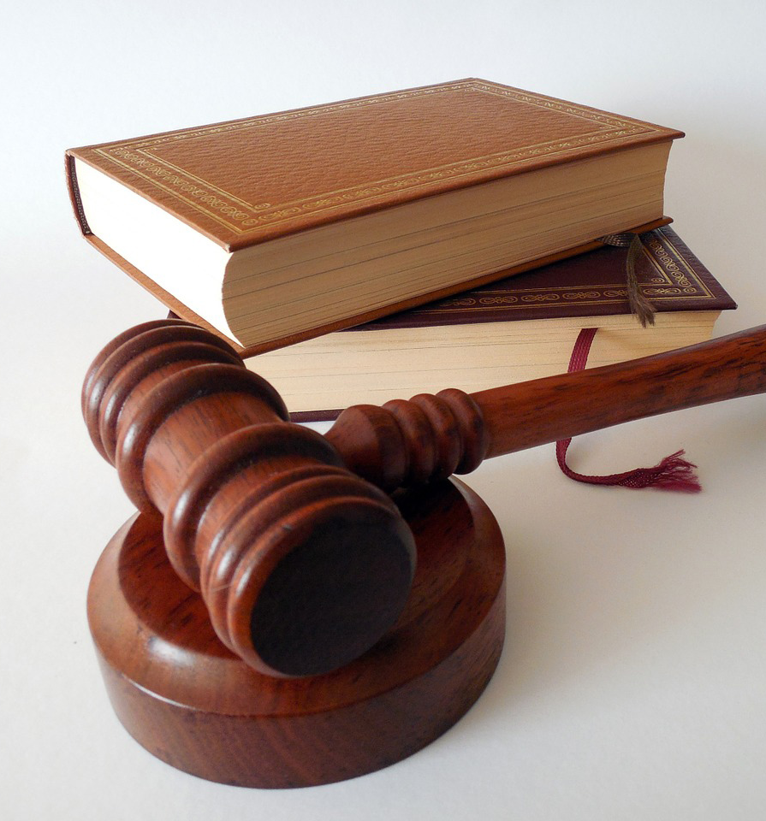
Royal Law Scriptures
🎯Galatians 5:14 For all the law is fulfilled in one word, even in this; Thou shalt love thy neighbour as thyself.
🎯 Romans 13:10 Love worketh no ill to his neighbour: therefore love is the fulfilling of the law.
🎯Matthew 22:37-39 Yeshua said unto him, Thou shalt love the Lord thy God with all thy heart, and with all thy soul, and with all thy mind (Deuteronomy 6:1-5). This is the first and great commandment. And the second is like unto it, Thou shalt love thy neighbour as thyself. On these two commandments hang all the law and the prophets.
  Isaiah 42:21 The Lord is well pleased for his righteousness' sake; he will magnify the law, and make it honourable.
The 👑Royal Law👑 is Yeshua’s command to live by His standard of love, which includes correction, truth, and righteousness.

Slide 4
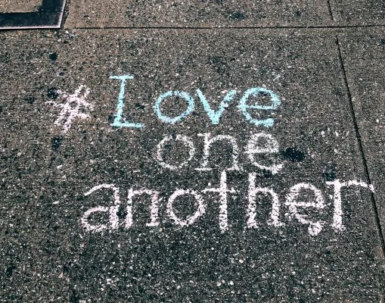
Love one another
John 15:12-17 This is my commandment, That ye love one another, as I have loved you. Greater love hath no man than this, that a man lay down his life for his friends. Ye are my friends, if ye do whatsoever I command you. Henceforth I call you not servants; for the servant knoweth not what his lord doeth: but I have called you friends; for all things that I have heard of my Father I have made known unto you. Ye have not chosen me, but I have chosen you, and ordained you, that ye should go and bring forth fruit, and that your fruit should remain: that whatsoever ye shall ask of the Father in my name, he may give it you. These things I command you, that ye love one another.

Slide 5

Judge righteously
While the royal law is rebuking your neighbor in righteousness & equity (fairness) according to scripture, it also is pleading/judging the cause of the orphans, widows, fatherless, and the stranger. Not just physical orphans & widows but spiritual orphans/fatherless from our Heavenly Father, spiritual widows from Yah who also is our husband, spiritual strangers from the One whose called us to walk in His truth. It’s all because they don’t know Him, meaning they don’t keep the Ten Commandments. This is why they are estranged from Him because of their disobedience, unless if they repent.
Scriptures: Zechariah 7:9-10, Exodus 22:21-24, Exodus 23:1-9, Deuteronomy 24:14-18, Proverbs 22:22-23, Isaiah 1:16-19, Jeremiah 22:15-17, Malachi 3:5, Zechariah 8:16-17, Leviticus 19:35-37, Deuteronomy 10:17-19, Deuteronomy 15:7-14, Psalm 82:2-4, Proverbs 21:3, Isaiah 58 (fast acceptable to the Lord), Micah 6:8

Slide 6
Worldly Example
Liam and his friend Noah were at the park. They saw a cool skateboard ramp — but Liam noticed it looked wobbly and had a crack in it.
Noah was about to ride down the ramp when Liam shouted,
“Wait! I think it’s broken — you could fall and get hurt!”
Noah stopped just in time. They told a grown-up, and the ramp was fixed later that day.
Liam warned Noah because he cared about him.
He treated Noah the way he’d want to be treated.

Slide 7

Biblical Example
Arianna and Mia will share a real life experience

Slide 8

SALTY LIKE YESHUA
All throughout Yeshua’s ministry you see him doing the royal law in various ways. With the higher ups & his disciples he was harsher with them because they’re held to a higher standard, in the sense the higher ups are supposed to be teaching the people. Then with his disciples because he was teaching them the truth, and once you know His truth you’re no longer blind. Versus the people especially the gentiles/those with ears to hear he spoke plainly to them/“gently” because they were without understanding and even drew near at times (Luke 15) to hear him. This shows us the way how we’re to treat each person we come across. Some we will be more harsh with vs others we may have a more compassionate approach, all that matters is speaking His truth according to scripture the way how He leads you to speak. And not quenching the Spirit, but speaking with salt (conviction) unto the hearers so if they repent they may be saved.

Slide 9
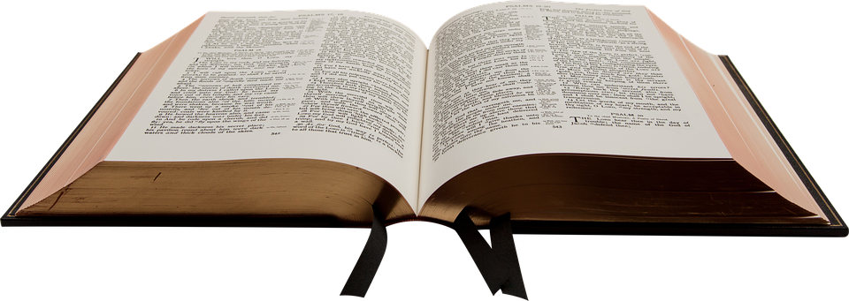
John 8 + luke 10:30-37
Examples of Yeshua fulfilling the Royal Law

