Slide 1


The Parable of the Fig Tree

Slide 2
Introduction
The parable of the figtree is an idiom for the time and season of the end days when Satan will be cast down over Ephraim/Mystery Babylon (USA). It outlines what we need to do to Watch in order to be ready for this time and not be walking in ignorance otherwise the day of Yehovah will come upon us as a theif in the night.

Slide 3

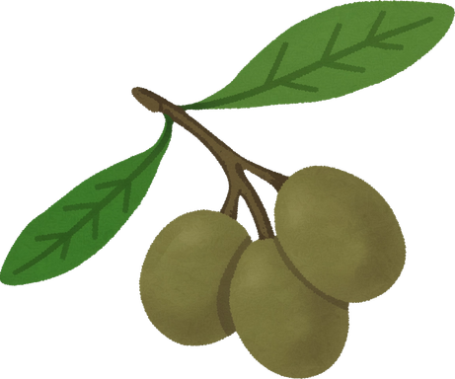


Early harvest
Late Harvest
A fig tree loses its crop twice a year. The early crop is in late spring and the main crop is during the late summer to autumn.
Main Crop:
Early fall
More abundant harvest
Sweeter
Breba Crop:
Late spring
Smaller in size/quantity
Sour/bitter

Slide 4
The Greek word translated as untimely ( ‘olynthos’, G3653 ) means unripe
“An unripe fig which grows during the winter, yet does not come to maturity but falls off in the spring”

Slide 5
Yeshua commanded us to learn this parable!
Now learn a parable of the fig tree; When her branch is yet tender, and putteth forth leaves, ye know that summer is near:
So ye in like manner, when ye shall see these things come to pass, know that it is nigh, even at the doors.
-Mark 13:28-29
Now learn a parable of the fig tree; When his branch is yet tender, and putteth forth leaves, ye know that summer is nigh:
So likewise ye, when ye shall see all these things, know that it is near, even at the doors.
-Matt 24:32-33

Slide 6
Verily I say unto you, that this generation shall not pass, till all these things be done.
Heaven and earth shall pass away: but my words shall not pass away.
But of that day and that hour knoweth no man, no, not the angels which are in heaven, neither the Son, but the Father.
Take ye heed, watch and pray: for ye know not when the time is.
For the Son of Man is as a man taking a far journey, who left his house, and gave authority to his servants, and to every man his work, and commanded the porter to watch.
Watch ye therefore: for ye know not when the master of the house cometh, at even, or at midnight, or at the cockcrowing, or in the morning:
Lest coming suddenly he find you sleeping.
And what I say unto you I say unto all, Watch.
-Mark 13:30-37

Slide 7
1 Thessalonians 5:1
“But of the times and the seasons ( and the parable of the fig tree ), brethren, ye have no need that I write unto you. For yourselves know perfectly that the day of the Lord so cometh as a thief in the night.”
As Yeshua told us, you only know this perfectly if you are watching (see Ezekiel 2-3).
So let’s recall the parable:
“Mark 13:28 Now learn a parable of the fig tree; When her branch is yet tender, and putteth forth leaves, ye know that summer is near:”
Mark 13:29
“So ye in like manner, when ye shall see these things come to pass, know that it is nigh, even at the doors.

Slide 8

Watching=warning=biblical love
Loving our neighbors as ourselves is to warn others of what happens by not being obedient to God’s instruction, to teach them to keep the commandments and to rebuke transgression of the commandments.
If we don’t rebuke people in sin and warn them of what happens for disobeying God’s commandments (punishment in great tribulation or hell if they still don’t repent and obey), their blood will be on own hands.
*Sin=transgression of the law, the 10 commandments

Slide 9
Jas 2:8 If ye fulfil the royal law according to the scripture, Thou shalt love thy neighbour as thyself, ye do well:
Jas 2:9 But if ye have respect to persons, ye commit sin, and are convinced of the law as transgressors.
Lev 19:15 Ye shall do no unrighteousness in judgment: thou shalt not respect the person of the poor, nor honour the person of the mighty: but in righteousness shalt thou judge thy neighbour.
Lev 19:16 Thou shalt not go up and down as a talebearer among thy people: neither shalt thou stand against the blood of thy neighbour: I am the LORD.
Lev 19:17 Thou shalt not hate thy brother in thine heart: thou shalt in any wise rebuke thy neighbour, and not suffer sin upon him.
Lev 19:18 Thou shalt not avenge, nor bear any grudge against the children of thy people, but thou shalt love thy neighbour as thyself: I am the LORD.

Slide 10
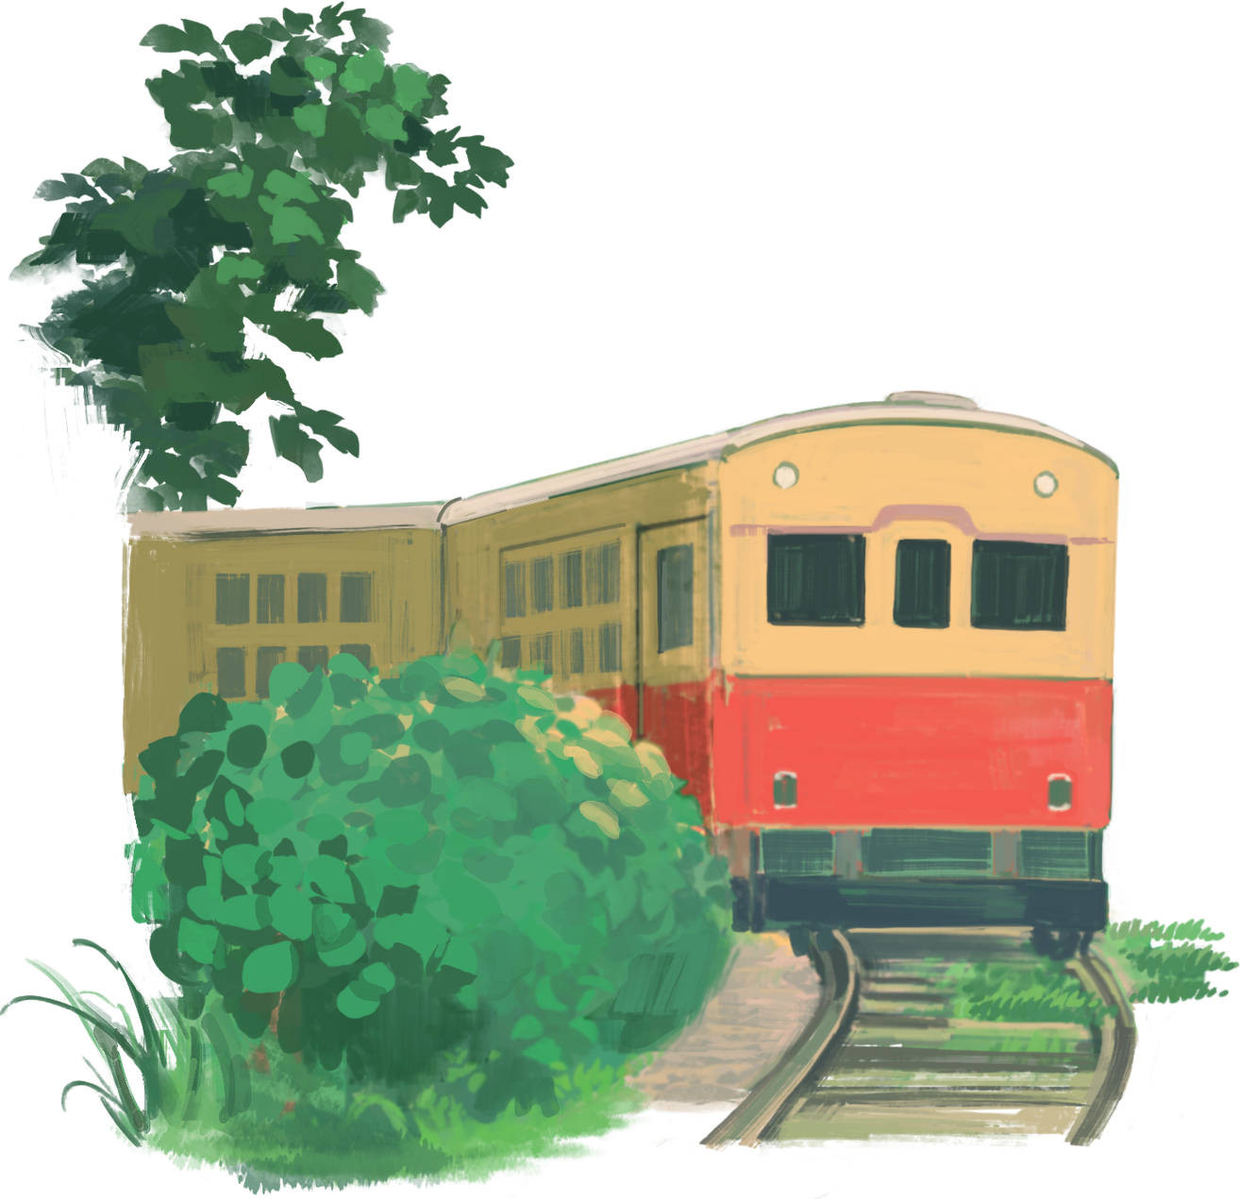
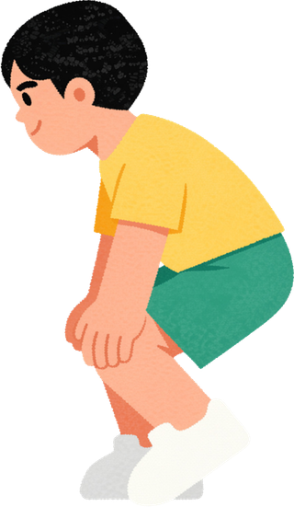
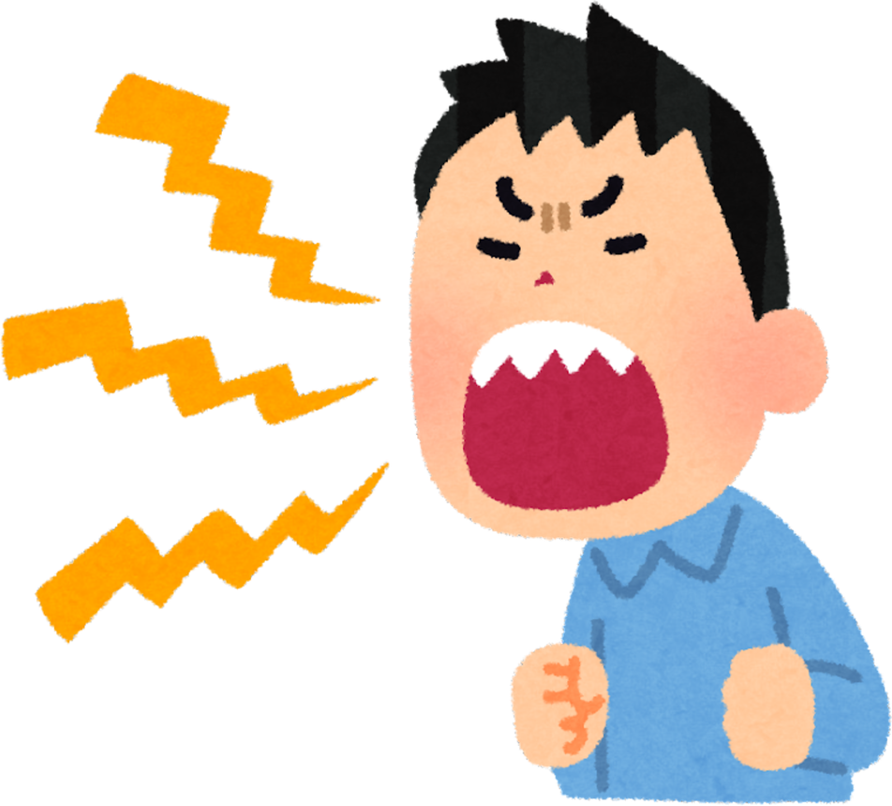

An example of what this would look like pysically would be seeing someone walking on a train track and noticing a train heading straight for the person. If you care about the person’s life, you would do everything you could to warn them and get them out of the way of the train. You would yell out wouldn’t you? You wouldn’t just walk past thinking “it’s not my business, I don’t want to interfere in someone elses day”.

Slide 11


NO ONE KNOWS THE TIME OR DAY...
BUT the servants will know the season
Jhn 14:15 If ye love me, keep my commandments.
Jhn 14:16 And I will pray the Father, and he shall give you another Comforter, that he may abide with you for ever;
Jhn 14:17 Even the Spirit of truth; whom the world cannot receive, because it seeth him not, neither knoweth him: but ye know him; for he dwelleth with you, and shall be in you.
Act 1:7 And he said unto them, It is not for you to know the times or the seasons, which the Father hath put in his own power.
Act 1:8 But ye shall receive power, after that the Holy Spirit is come upon you: and ye shall be witnesses unto me both in Jerusalem, and in all Judaea, and in Samaria, and unto the uttermost part of the earth.
Jhn 16:7 Nevertheless I tell you the truth; It is expedient for you that I go away: for if I go not away, the Comforter will not come unto you; but if I depart, I will send him unto you.
Jhn 16:8 And when he is come, he will reprove the world of sin, and of righteousness, and of judgment:

Slide 12
We also read about the 6th seal opening(end days/satan coming down) as a springtime event in Isiah 28:1-4 “Woe to the crown of pride, to the drunkards of Ephraim, whose glorious beauty is a fading flower, which are on the head of the fat valleys of them that are overcome with wine!
2 Behold, the Lord hath a mighty and strong one, which as a tempest of hail and a destroying storm, as a flood of mighty waters overflowing, shall cast down to the earth with the hand.
3 The crown of pride, the drunkards of Ephraim, shall be trodden under feet:
4 And the glorious beauty, which is on the head of the fat valley, shall be a fading flower, and as the hasty fruit before the summer; which when he looketh upon it seeth, while it is yet in his hand he eateth it up.”

Slide 13
Revelations 6:12-13
“And I beheld when he had opened the sixth seal, and, lo, there was a great earthquake; and the sun became black as sackcloth of hair, and the moon became as blood;
And the stars of heaven fell unto the earth, even as a fig tree casteth her untimely figs, when she was shaken by a mighty wind.”

Slide 14
We are told this is a springtime event.
Moreover, Isaiah 28, which also describes the 6th seal of Revelation opening also tells us it will be a springtime event.
“Hasty fruit” is the Hebrew word 'bikkurim' (H1061) and its definition is “the first-fruits of the crop” clearly pointing us to the first drop of the fig tree which is the spring.
But we didn’t even have to know that because the rest of the verse leaves us without doubt as it reads “before the summer”
Before the summer is obviously spring, remember Yeshua said this happens “when summer is near”.

Slide 15
Other important verses
Isaiah 34:4 “And all the hosts of heaven shall be dissolved, and the heavens shall be rolled together as a scroll: and all their hosts shall fall down, as the leaf falleth off from the vine, and as a falling fig from the fig tree.” (2 Peter 3:11 quotes this).
Micah 7:1
“Woe is me! For I am as when they have gathered the summer fruits, as the grape gleanings of the vintage: there is no cluster to eat: my soul desires the first ripe fruit.”

Slide 16

Are you ready to watch?
Come join the watchmen calling and harvest work. Let’s go find the lost sheep and warn the people before it’s too late!

