Slide 1
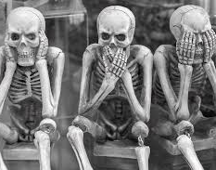
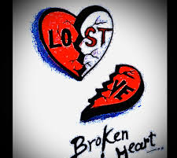
Valentine's Day
Another Pagan Tradition
Why won't GOD's people listen to him?

Slide 2
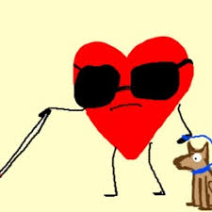
Deaf, Dumb & Blind
Psalms 115:2-8
(2) Wherefore should the heathen say, Where is now their God?
(3) But our God is in the heavens: he hath done whatsoever he hath pleased.
(4) Their idols are silver and gold, the work of men's hands.
(5) They have mouths, but they speak not: eyes have they, but they see not:
(6) They have ears, but they hear not: noses have they, but they smell not:
(7) They have hands, but they handle not: feet have they, but they walk not: neither speak they through their throat.
(8) They that make them are like unto them; so is every one that trusteth in them.
Habakkuk 2:18-19
(18) What profiteth the graven image that the maker thereof hath graven it; the molten image, and a teacher of lies, that the maker of his work trusteth therein, to make dumb idols?
(19) Woe unto him that saith to the wood, Awake; to the dumb stone, Arise, it shall teach! Behold, it is laid over with gold and silver, and there is no breath at all in the midst of it.

Slide 3
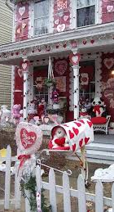
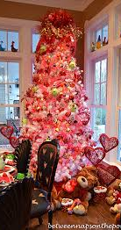
Does this look like Idolatry?
Colossians 3:5
(5) Mortify therefore your members which are upon the earth; fornication, uncleanness, inordinate affection, evil concupiscence, and covetousness, which is idolatry:
1 Samuel 15:23
(23) For rebellion is as the sin of witchcraft, and stubbornness is as iniquity and idolatry. Because thou hast rejected the word of the LORD, he hath also rejected thee from being king.
Acts 17:16
(16) Now while Paul waited for them at Athens, his spirit was stirred in him, when he saw the city wholly given to idolatry.
Colossians 3:5
(5) Mortify therefore your members which are upon the earth; fornication, uncleanness, inordinate affection, evil concupiscence, and covetousness, which is idolatry:
Look up Idols on E-Sword

Slide 4
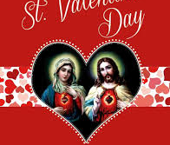
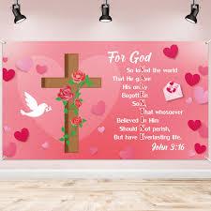
NO GRAVEN IMAGES
Exodus 20:3-5
(3) Thou shalt have no other gods before me.
(4) Thou shalt not make unto thee any graven image, or any likeness of any thing that is in heaven above, or that is in the earth beneath, or that is in the water under the earth:
(5) Thou shalt not bow down thyself to them, nor serve them: for I the LORD thy God am a jealous God, visiting the iniquity of the fathers upon the children unto the third and fourth generation of them that hate me;
Deuteronomy 4:15-19
(15) Take ye therefore good heed unto yourselves; for ye saw no manner of similitude on the day that the LORD spake unto you in Horeb out of the midst of the fire:
(16) Lest ye corrupt yourselves, and make you a graven image, the similitude of any figure, the likeness of male or female,
(17) The likeness of any beast that is on the earth, the likeness of any winged fowl that flieth in the air,
(18) The likeness of any thing that creepeth on the ground, the likeness of any fish that is in the waters beneath the earth:
(19) And lest thou lift up thine eyes unto heaven, and when thou seest the sun, and the moon, and the stars, even all the host of heaven, shouldest be driven to worship them, and serve them, which the LORD thy God hath divided unto all nations under the whole heaven.

Slide 5
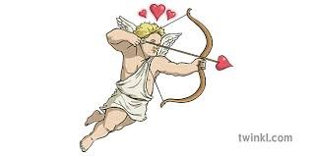
Deuteronomy 5:7
Thou shalt have none other gods before me.
Deuteronomy 4:24
For the LORD thy God is a consuming fire, even a jealous God.
Cupid
The winged god of love is either Eros, the Greek god, or Cupid, the Roman god.
Eros
The Greek god of love, lust, and desire
Often depicted as a winged youth carrying a bow and arrows
The original god of love and intercourse
Also worshiped as a fertility deity
Associated with athleticism, and often depicted with dolphins, flutes, roosters, roses, and torches
The origin of the word “erotic”
Cupid
The Roman god of love, desire, and attraction
Often depicted as a winged infant carrying a bow and a quiver of arrows
The son of Venus, the goddess of love, and either Vulcan or Mars
Sometimes portrayed wearing armor like that of Mars, the god of war
Often portrayed on Valentine's Day cards as a naked cherub launching arrows of love at unsuspecting lovers
In Hinduism, Kamadeva is the god of love

Slide 6
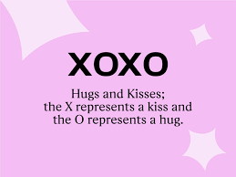
Hugs & Kisses XOXOXO
"XO" stands for "hugs and kisses" where the "X" represents a kiss, likely because it visually resembles two lips meeting, and the "O" represents a hug, with some theories suggesting it could be due to its circular shape resembling arms wrapped around someone, or because it was used by illiterate Jewish immigrants who avoided the Christian symbol of the "X" when signing documents; essentially, the "O" became the opposite of the "X" in this context.
Key points about the origin of "XO":
"X" as a kiss:
The "X" is widely believed to symbolize a kiss due to its visual similarity to two lips meeting.
"O" as a hug:
The "O" is thought to represent a hug, with theories connecting it to the circular shape of arms wrapped around someone or the practice of Jewish immigrants using "O" instead of "X" when signing documents.
Historical context:
The "X" has a long history as a symbol in writing, often used as a signature by people who couldn't write in the Middle Ages, further contributing to its association with a kiss.
Speculations include that the use of x to indicate a kiss was transferred from earlier symbolic uses of the letter. Allegedly, in the Middle Ages, a Christian cross might be drawn on documents or letters to mean sincerity, faith, and honesty; the sign was certainly sometimes used in place of a signature.
Look up "Holy Kiss & Kiss" on Esword & in Stongs

Slide 7
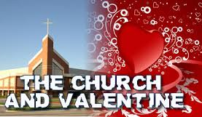
Traditions of Man over The Word of GOD
Mark 7:6-13
(6) He answered and said unto them, Well hath Esaias prophesied of you hypocrites, as it is written, This people honoureth me with their lips, but their heart is far from me.
(7) Howbeit in vain do they worship me, teaching for doctrines the commandments of men.
(8) For laying aside the commandment of God, ye hold the tradition of men, as the washing of pots and cups: and many other such like things ye do.
(9) And he said unto them, Full well ye reject the commandment of God, that ye may keep your own tradition.
(10) For Moses said, Honour thy father and thy mother; and, Whoso curseth father or mother, let him die the death:
(11) But ye say, If a man shall say to his father or mother, It is Corban, that is to say, a gift, by whatsoever thou mightest be profited by me; he shall be free.
(12) And ye suffer him no more to do ought for his father or his mother;
(13) Making the word of God of none effect through your tradition, which ye have delivered: and many such like things do ye.
Isaiah 29:13
(13) Wherefore the Lord said, Forasmuch as this people draw near me with their mouth, and with their lips do honour me, but have removed their heart far from me, and their fear toward me is taught by the precept of men:

