Slide 1
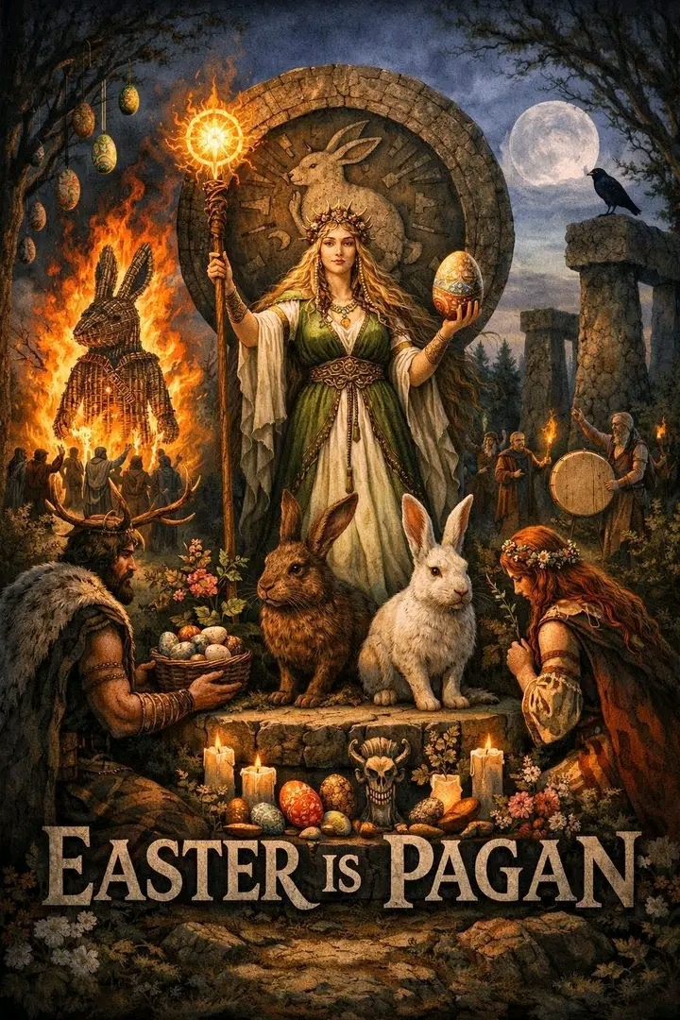
TEACHING FOR WOMEN AND CHILDREN
Straitisthegate.net

Slide 2
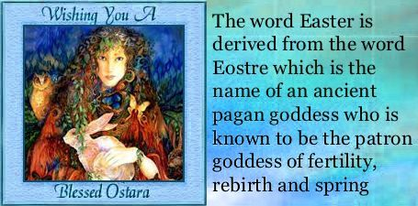
Where does the word Easter come from?

Slide 3
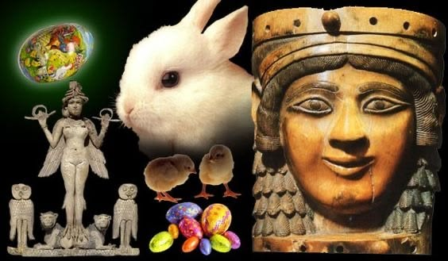
What EASTER / ISHTAR is really all about?
It’s a Babylonian tradition that involves worship of a fertility and sex goddess Ishtar also referred to as Ashtoreth.
The worship of Ishtar involves the belief that Ishtar’s husband, Nimrod, was tragically murdered for for his iniquities against YEHOVAH.
Ishtar made people believe Nimrod was god, she made them believe that the evergreen tree that sprang out of the roots of a dead tree stump symbolised new life for Nimrod.
She told the people of Babylon that Nimrod had ascended to the sun according to the original sun worship and now is to be called Baal, the sun god.

Slide 4
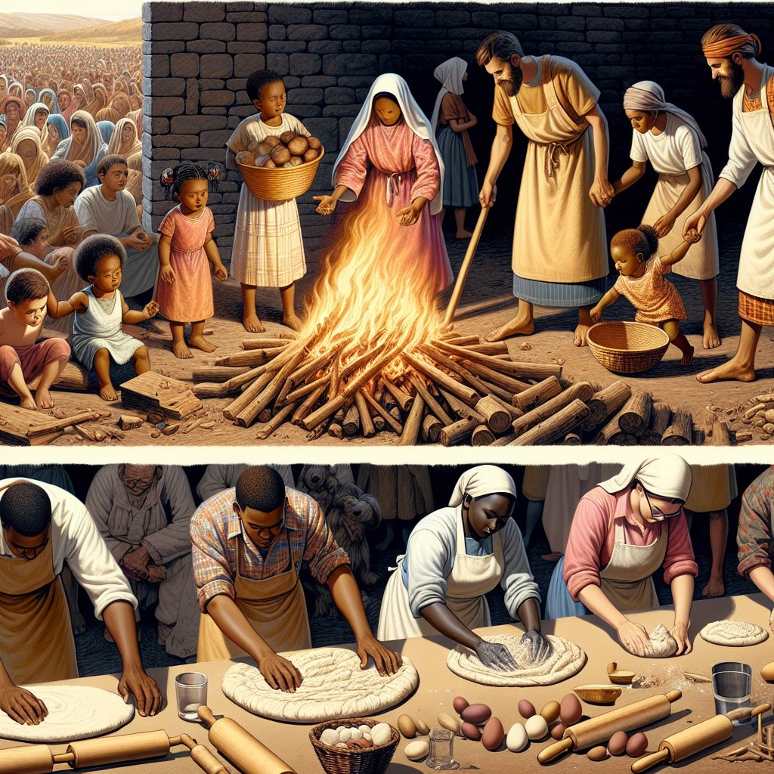
WHY EASTER IS A PAGAN TRADITION?
🚫🐰🐣Easter is PAGAN🐣🐰🚫
Easter = Eostre = Ishtar (goddess of fertility)
Jeremiah 7:18 The children gather wood, and the fathers kindle the fire, and the women knead their dough, to make cakes to the 👑queen👑 of heaven (Ishtar), and to pour out drink offerings unto other gods🐣🐰, that they may provoke me to anger.
The people of Judah were engaging in worshipping the "queen of heaven" and making offerings to other gods, which was a direct violation of the first commandment given by God to Moses, "You shall have no other gods before me" (Exodus 20:3). The act of making cakes and pouring out drink offerings to these false gods was a clear indication of their devotion and service to entities other than the true God.

Slide 5
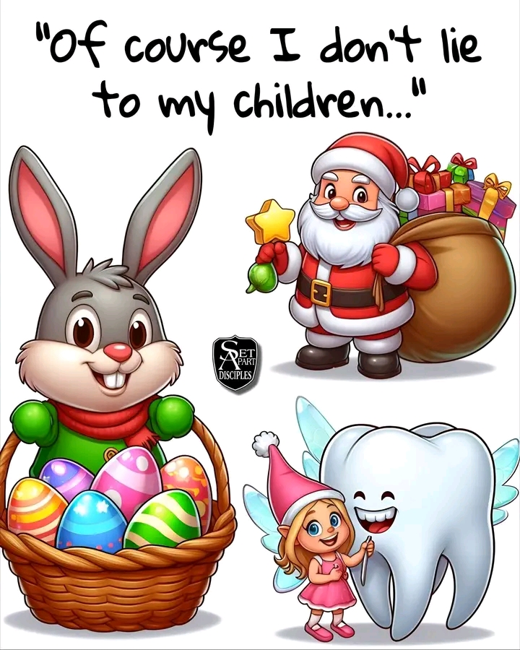
What EASTER / ISHTAR is really all about?
"Full well ye reject the commandment of God, that ye may keep your own tradition" (Mark 7:9) and that they were "making the word of God of none effect through your tradition" (Mark 7:13).
So many claim to follow God, yet their worship is built on man-made traditions, not His commands. Parents say they want to raise their children in truth, yet many still use Easter to feed their children lies. Easter itself is a syncretized pagan tradition that Christianity adopted and dressed up with Jesus language. The bunny, the eggs, the fertility imagery, the myths, and the sentimental family rituals are not unfortunate side issues. They belong to the whole corrupt package.

Slide 6
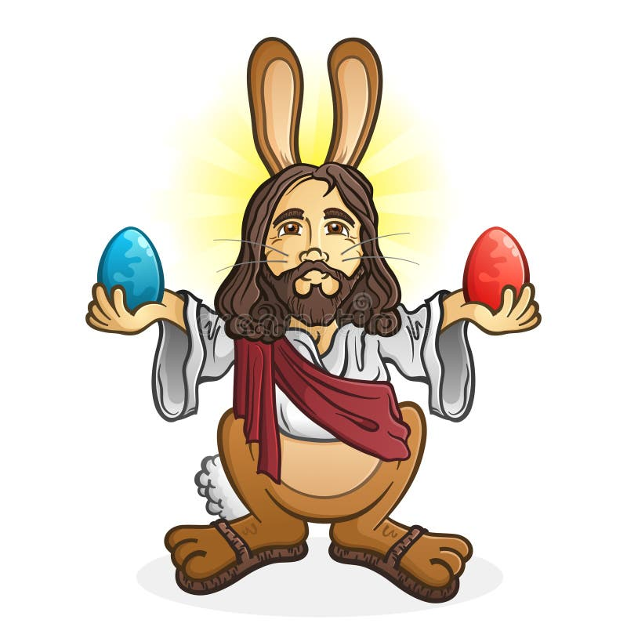
WHY EASTER IS A PAGAN TRADITION?
Jeremiah 44:17-18 But we will certainly do whatsoever thing goeth forth out of our own mouth, to burn incense unto the 👑queen👑 of heaven (Ishtar), and to pour out drink offerings unto her, as we have done, we, and our fathers, our kings, and our princes, in the cities of Judah, and in the streets of Jerusalem: for then had we plenty of victuals, and were well, and saw no evil. But since we left off to burn incense to the 👑queen👑 of heaven (Ishtar), and to pour out drink offerings unto her, we have wanted all things, and have been consumed by the sword and by the famine.
Deuteronomy 12:31 Thou shalt not do so unto the LORD thy God: for every🔥abomination🔥to the LORD, which he hateth, have they done unto their gods; for even their sons and their daughters they have burnt in the fire to their gods🐣🐰.

Slide 7
WHY EASTER IS A PAGAN TRADITION?
Mark 7:7-9 Howbeit in vain do they worship me, teaching for doctrines the commandments of men.For laying aside the commandment of God, 👉🏻ye hold the tradition of men🐣🐰👈🏻, as the washing of pots and cups: and many other such like things ye do. And he said unto them, Full well ye reject the commandment of God, 👉🏻that ye may keep your own tradition🐣🐰👈🏻.
Matthew 15:9 But in vain they do worship me, 👉🏻teaching for doctrines the commandments of men🐣🐰👈🏻.

Slide 8
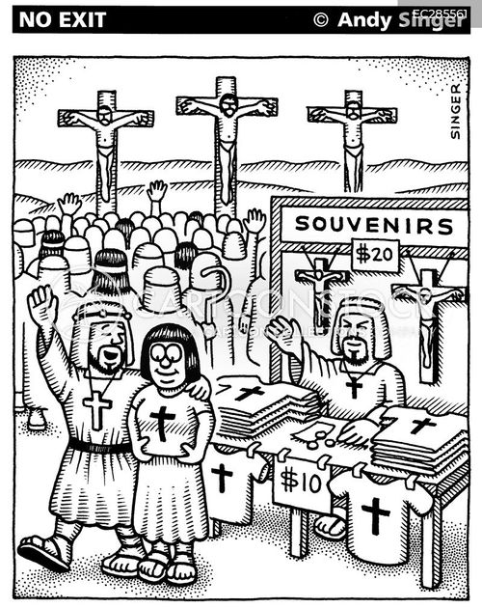
WHY EASTER IS A PAGAN TRADITIONS?
Jeremiah 10:2 Thus saith the LORD, 👉🏻Learn not the way of the heathen🐣🐰👈🏻, and be not dismayed at the signs of heaven; for the heathen are dismayed at them.
When you partake in this🔥ABOMINATION🔥you are comitting idolatry, which is spiritual adultery against Yehovah.
Ezekiel 23:37 That they have committed adultery, and blood is in their hands, and 👉🏻with their idols🐣🐰have they committed adultery👈🏻, and have also caused their sons, whom they bare unto me, to pass for them through the fire, to devour them.

Slide 9
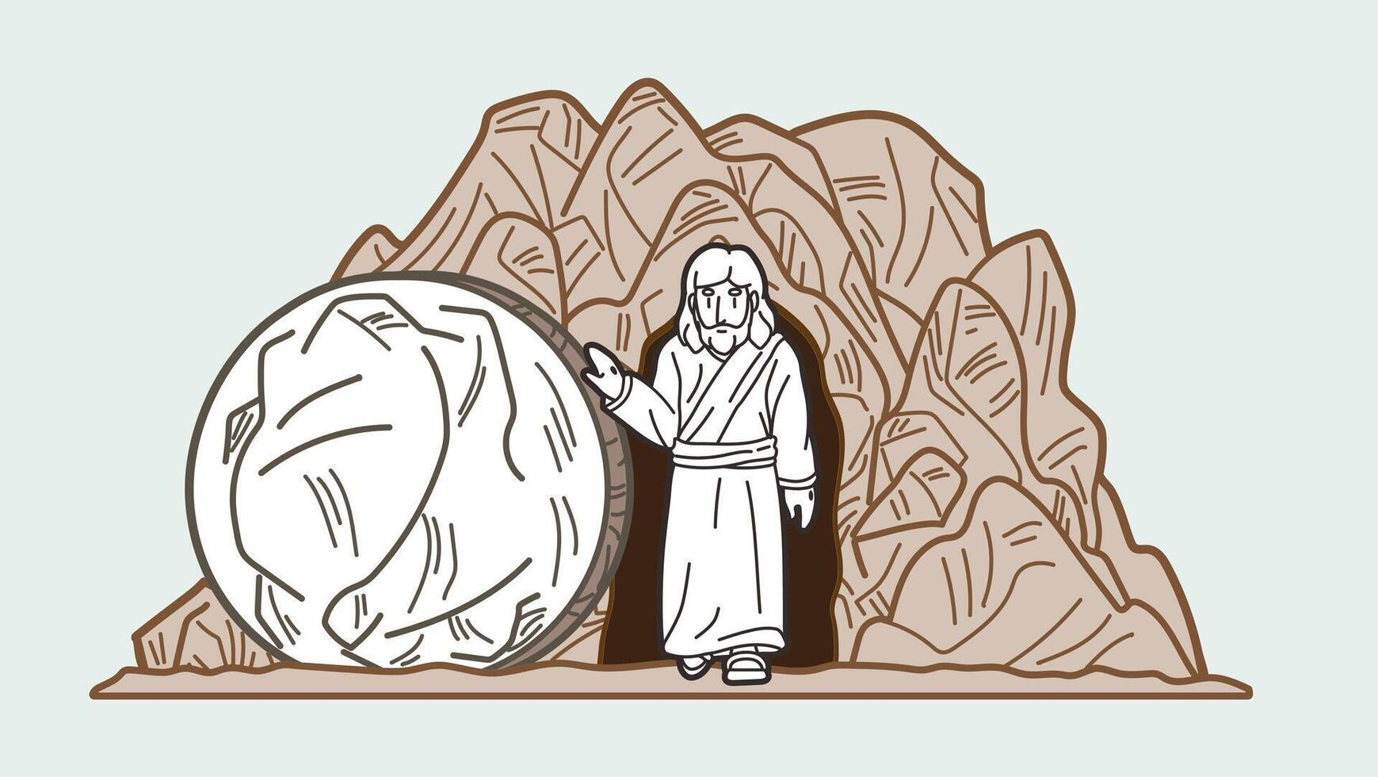
Why Friday death/burial and Sunday resurrection is NOT Biblical?
Matthew 12:40 👉🏻For as Jonas was 🔥three days and three nights in the whale's belly🔥👈🏻; so shall the Son of man be three days and three nights in the heart of the earth.
Messiah was cut off in the midst of the week (WEDNESDAY)
Daniel 9:27 And he shall confirm the covenant with many for one week: 👉🏻and in the MIDST of the week👈🏻 he shall cause the sacrifice and the oblation to cease, and for the overspreading of abominations he shall make it desolate, even until the consummation, and that determined shall be poured upon the desolate.

Slide 10
Why Friday death/burial and Sunday resurrection is NOT Biblical?
Mark 15:25 And it was the 👉🏻third hour👈🏻, and they crucified him.
Mark 15:33-37 And when the 👉🏻sixth hour👈🏻 was come, there was darkness over the whole land until the 👉🏻ninth hour👈🏻. And at the 👉🏻ninth hour👈🏻 Yeshua cried with a loud voice, saying, Eloi, Eloi, lama sabachthani? which is, being interpreted, My God, my God, why hast thou forsaken me? And some of them that stood by, when they heard it, said, Behold, he calleth Elias. And one ran and filled a spunge full of vinegar, and put it on a reed, and gave him to drink, saying, Let alone; let us see whether Elias will come to take him down. 👉🏻And Yeshua cried with a loud voice, and gave up the ghost👈🏻.

Slide 11
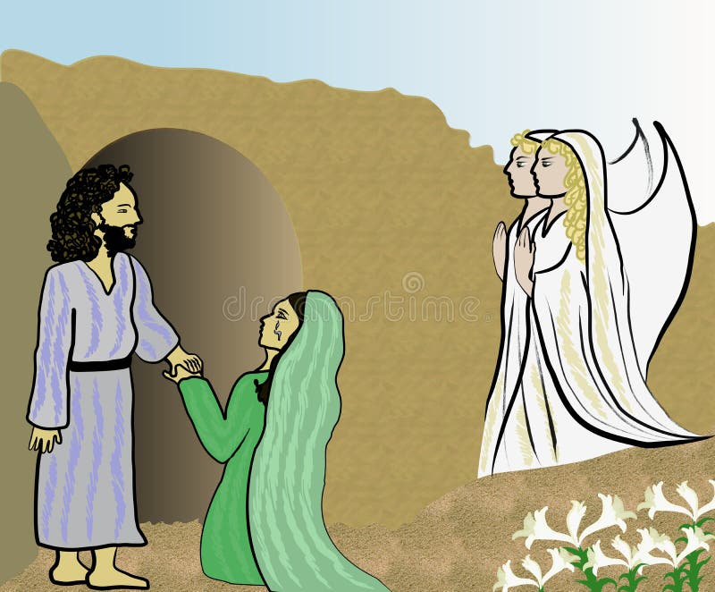
Why Friday death/burial and Sunday resurrection is NOT Biblical?
Messiah rose on the Sabbath (SATURDAY)‼️
Matthew 28:1-6 In the end of the sabbath, 👉🏻as it BEGAN TO DAWN☀️👈🏻 toward the FIRST DAY of the week, came Mary Magdalene and the other Mary to see the sepulchre. And, behold, there was a great earthquake: for the angel of the Lord descended from heaven, and came and rolled back the stone from the door, and sat upon it. His countenance was like lightning, and his raiment white as snow: And for fear of him the keepers did shake, and became as dead men. And the angel answered and said unto the women, Fear not ye: for I know that ye seek Yeshua, which was crucified. He is not here: for he is risen, as he said. Come, see the place where the Lord lay.

Slide 12
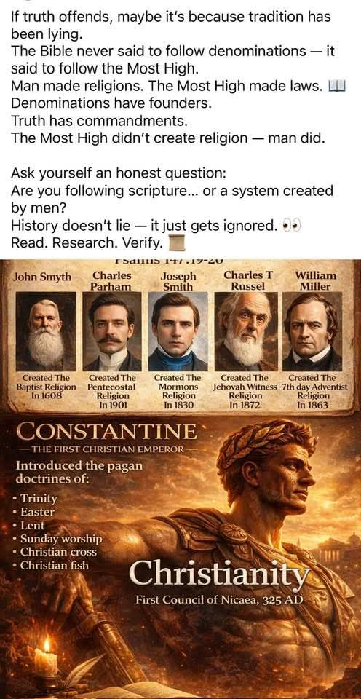
What EASTER / ISHTAR is really all about?
Let us remember that Constantine who in 321 AD enforced Sun god day (Sunday) worship on believers, he adopted pagan practices and Christianized them. Let us not forget he was a sun worshipper. (Catholic religion)
Let us remember that the real Lord's Day is Saturday (aka Sabbath) “In the end of the sabbath, as it began to dawn toward the first day of the week, came Mary Magdalene and the other Mary to see the sepulchre. And the angel answered and said unto the women, Fear not ye: for I know that ye seek Yeshua, which was crucified. He is not here: for he is risen, as he said. Come, see the place where the Lord lay.” Matthew 28:1, 5-6

Slide 13
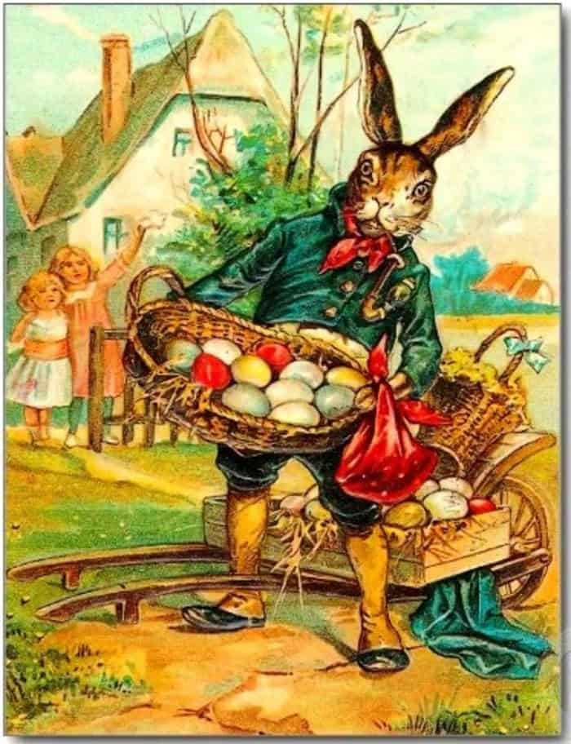
God never told His people to celebrate Easter. He never told them to honor Him through spring fertility imagery. He never told them to bring in pagan symbols, rename them, and act like the mixture became holy.
Ezekiel 44:23: "And they shall teach my people the difference between the holy and profane, and cause them to discern between the unclean and the clean."
Ezekiel 22:26: "Her priests have violated my law, and have profaned mine holy things: they have put no difference between the holy and profane.
Scripture warns against learning the religious ways of the nations and then using them in worship. Yet that is exactly what Easter represents. It is not biblical at the core and then made worse by a bunny. The bunny is one expression of the same pagan system.
1 Corinthians 10:21 Ye cannot drink the cup of the Lord, 👉🏻and the cup of devils 🐣🐰👈🏻: ye cannot be partakers of the Lord's table, 👉🏻and of the table of devils🐣🐰👈🏻.

Slide 14
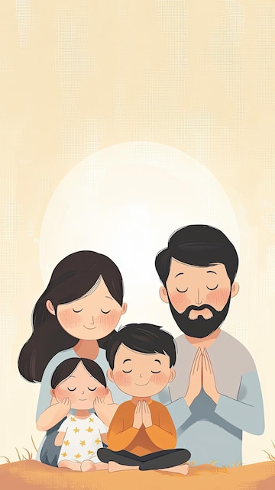
Parents, Teach your children what God actually said. Walk them through what God actually commanded. Children obey your parents as you obey God.
3 John 1:4 says, I have no greater joy than this, to hear about my children walking in truth.
Children are not trained to walk in truth by being fed lies inside pagan tradition. They are trained to walk in truth when parents stop excusing mixture, stop defending deception, and start building family life around what God actually gave. Easter is not a Christian celebration that got a little corrupted. It is corruption. Parents who fear God should stop treating it like something worth saving.

Slide 15
That is why Christian parents who promote the Easter Bunny are not just adding innocent fun to a Christian season. They are participating in a paganized tradition and then adding direct deception on top of it. They are handing their children mixture and calling it faith. They are normalizing pagan symbolism and falsehood while claiming to care about truth and obedience.
✅ Proverbs 22:6 says, Train up a child in the way he should go, and when he is old he will not depart from it.
✅Deuteronomy 11:19 says, You shall teach them to your children, talking of them when you sit in your house, and when you walk by the way, and when you lie down, and when you rise up.
✅1 John 5:21 Little children, keep yourselves from idols
Acts 15 Basic Instructions:
Keep the 10C & 7th day Sabbath Holy
✅Sat Dawn to Dawn
✅Yeshua Messiah
✅EAT CLEAN🌈Eph 2:12

