Slide 1
Alicia Keys
Raveena Devjee
Professor Barron
WGST 1301 01
30 November, 2023

Slide 2
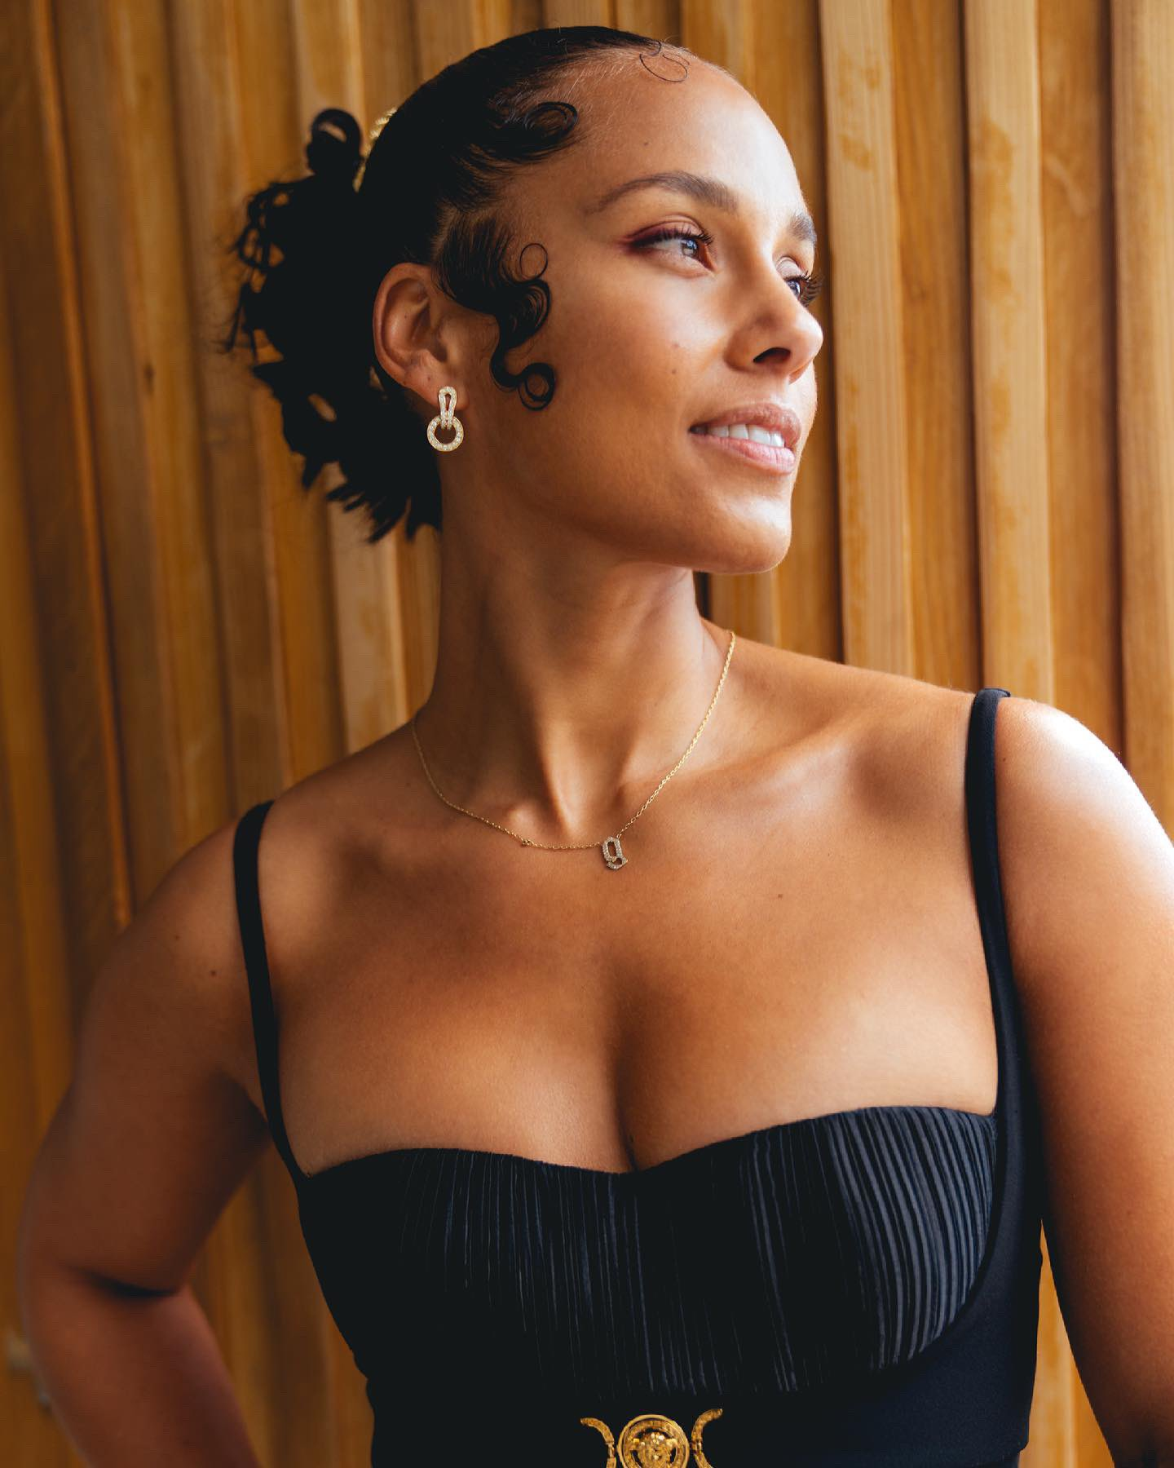
Who Is Alicia Keys?
Alicia Augello Cook
Grammy winning American singer and songwriter
Activist, philanthropist and humanitarian
Married to Swizz Beatz :)
(2) Alicia Keys on X: “Haven’t been dressed up in awhile but loving these cute date vibes with my 👑 @THEREALSWIZZZ for the illustrious @naacpimageaward tonight ⁣ ⁣ I still like my sneakers better 🤣🤣 Who can feel me?😘😘😘⁣ ⁣ Congrats @verzuzonline for outstanding variety show!!!💜💜💜 https://t.co/Tkl4PkOGU8” / X. (n.d.). X (Formerly Twitter). https://twitter.com/aliciakeys/status/1375931695480897543

Slide 3
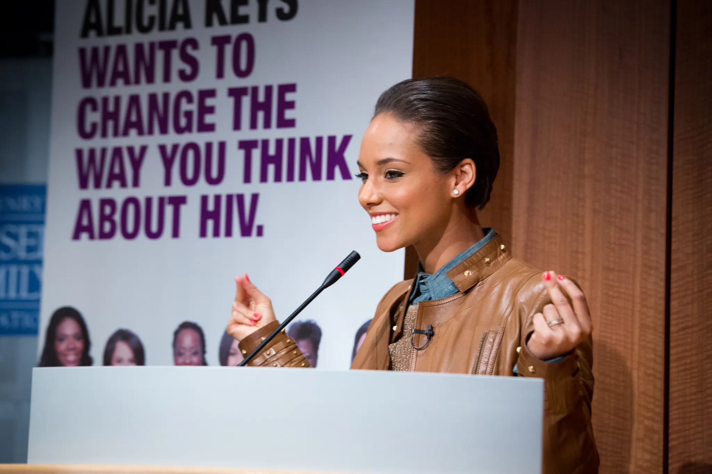
Organizations Keys Is Apart Of
Amnesty International named her Ambassador of Conscience
Global ambassador for Keep a Child Alive (KCA) which she co-founded in 2003
Non-profit organization We Are Here founded in 2014
Supports Oxfam through her work
Has travelled to countries such as Uganda, Kenya and South Africa to speak to people who have lost loved ones to AIDS
Co-founder of She Is The Music
“Alicia Keys in Washington, D.C., With Kaiser Family Foundation to Introduce Empowered Campaign to Reach Women in the U.S. About HIV/AIDS | KFF.” KFF, 21 May 2013, www.kff.org/hivaids/press-release/alicia-keys-in-washington-d-c-with-kaiser-family-foundation-to-introduce-empowered-campaign-to-reach-women-in-the-u-s-about-hivaids.

Slide 4
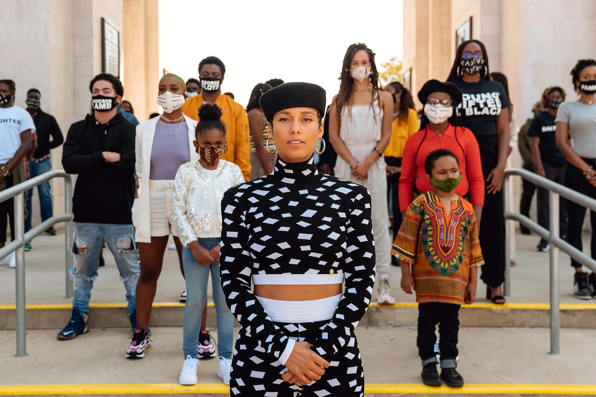
Goals
Keys main goals include;
Making sure women are included throughout the music industry equally.
People with HIV/AIDS get the love and treatment they need.
Showing people that we are all people in this world we live in.
Overall, empowering people to create a world in which we are all equal and people’s voices are heard, respected and treated with dignity.
Robinson, L. (2020, September 17). “We started to see each other in a different way”: Alicia Keys talks Art and activism in the time of COVID. Vanity Fair. https://www.vanityfair.com/style/2020/09/alicia-keys-talks-art-and-activism-in-the-time-of-covid

Slide 5
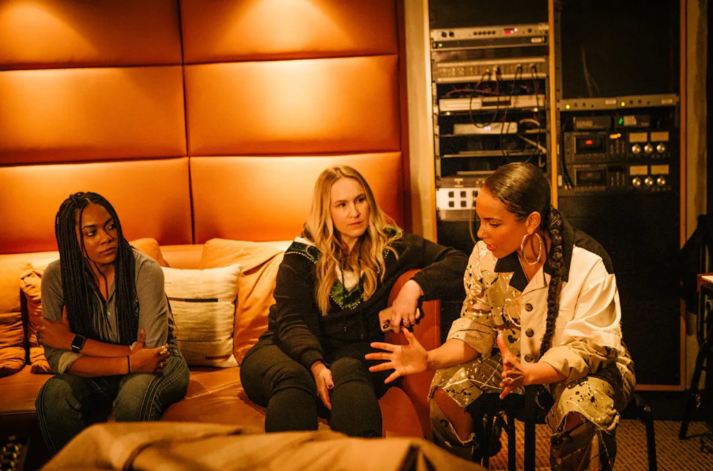
She Is The Music (SITM)
Non-profit organization dedicated to increasing the number of women who work in the music industry.
Provide resources, support and all women songwriting courses.
Overall trying to encourage women of today and the future generations for an equal world in the music space.
Platon, A. (2023, September 18). Billboard. Billboard. https://www.billboard.com/music/music-news/alicia-keys-on-she-is-the-music-songwriters-camp-we-all-have-to-be-focused-8550579/

Slide 6
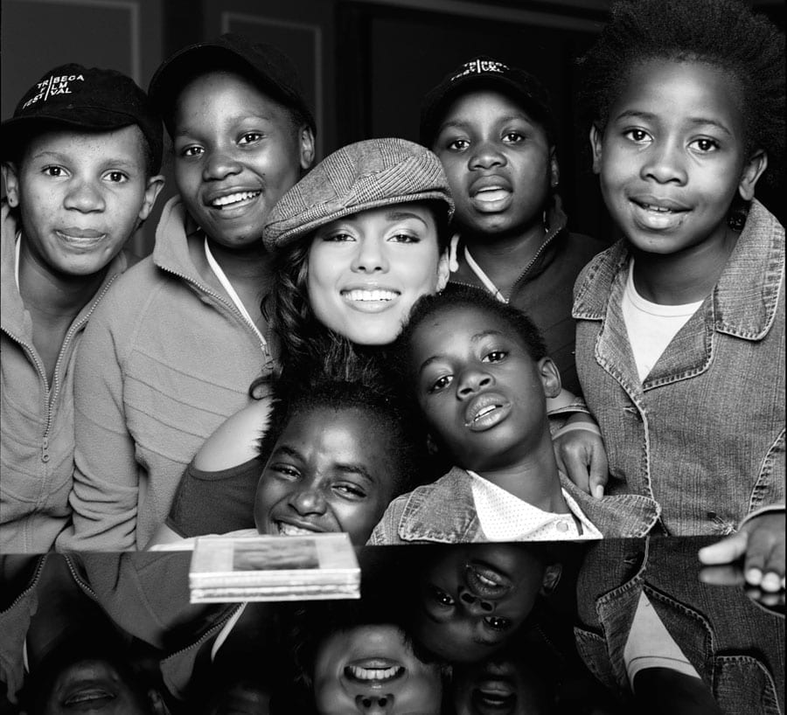
Keep A Child Alive (KCA)
Non-profit organization that gives healthcare, housing and other needed support to people who have been affected by HIV/AIDS in communities in India and Africa.
Alicia Keys co-founded this org in 2003
Serves over 150,000 people every year.

Slide 7
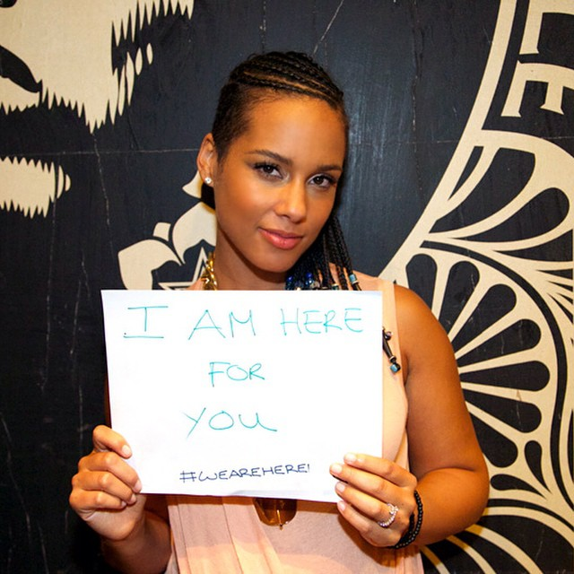
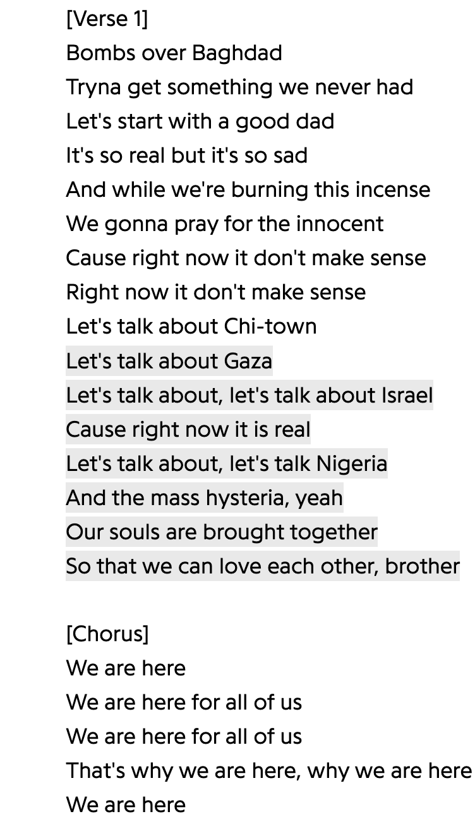
We Are Here Movement (WAH)
Non-profit organization created by Alicia Keys.
Founded in 2014 to empower people to empower people around world issues that are important to Keys.
Also released a song under the same name which is where the movement started.
Nsenduluka, B. (2014, September 22). Alicia Keys bares baby bump for “We Are Here” movement; says “I wouldn’t be naked for nothin.” The Christian Post. https://www.christianpost.com/news/alicia-keys-bares-baby-bump-for-we-are-here-movement-says-i-wouldnt-be-naked-for-nothin.html
Alicia Keys – We are here. (n.d.). Genius. https://genius.com/Alicia-keys-we-are-here-lyrics

Slide 8
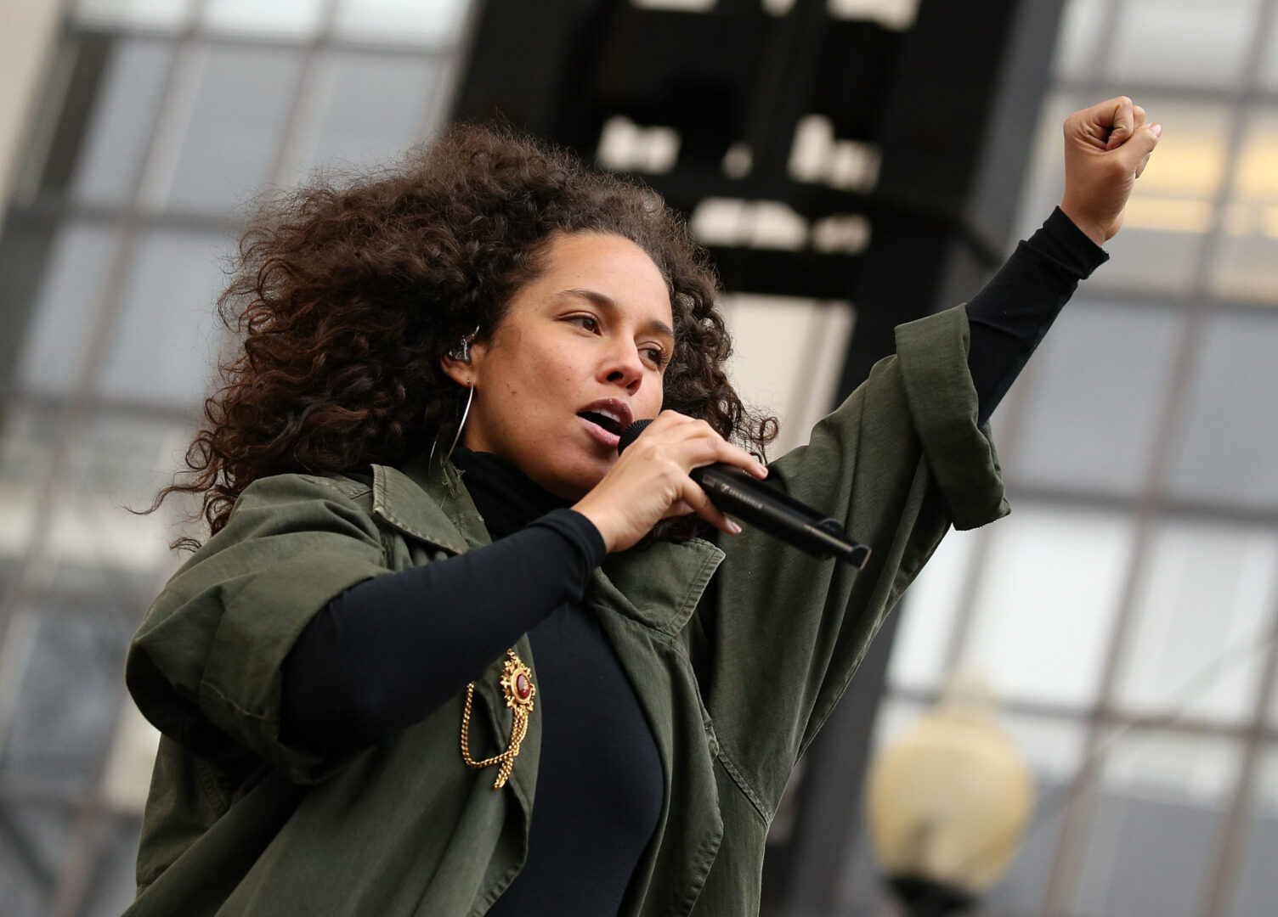
Oxfam
A global organization aimed to end poverty and injustice
Demand equal treatment and equal rights, “The future is equal”.
Keys supports this movement through the WAH movement.
Created a short film called “Let Me In”.
Amnesty International USA. “Alicia Keys and the Indigenous Rights Movement in Canada Receive Amnesty International Award | Amnesty International USA.” Amnesty International USA, 30 May 2017, www.amnestyusa.org/press-releases/alicia-keys-indigenous-rights-movement-canada-receive-amnesty-international-award.

Slide 9
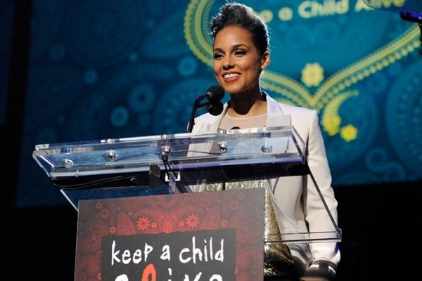
Strategies She Is Using
Spreading awareness.
Co-founding organizations herself.
Using other movements to help other organizations as well.
Offering resources and funding to organizations.
Creating safe spaces for people to feel like they belong and are worthy.
Creating music and film as another way of reaching out to different audiences.

Slide 10
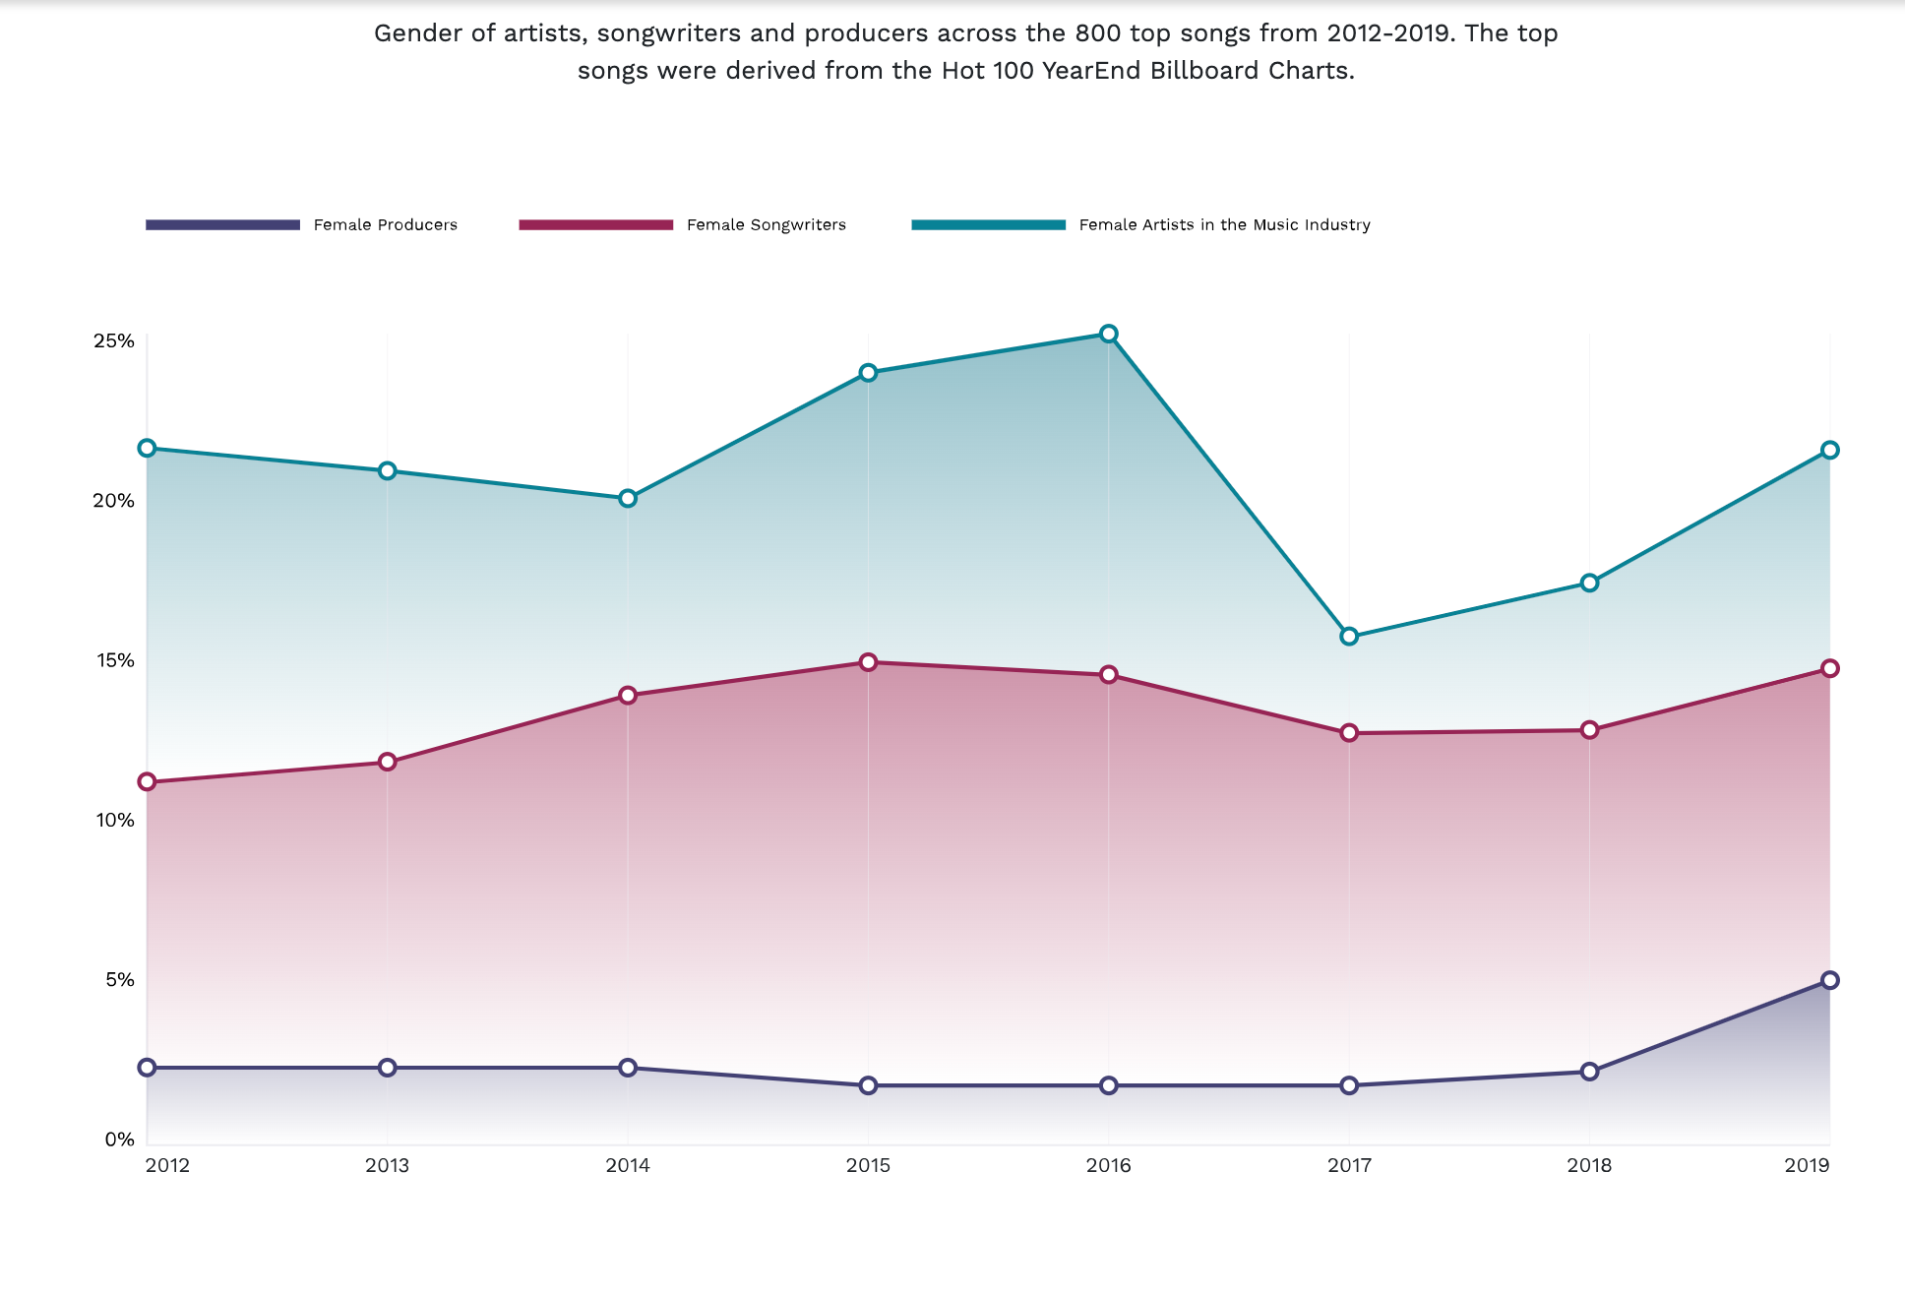
Has She Been Successful/Effective?
YES!
With the help of someone like Alicia Keys and her using her platform to inform, all the organizations she is apart of have benefited greatly including;
Helping more women become apart of the music industry.
Creating conversation around important issues with film and music.
Helping over 150 thousand people each year battle HIV/AIDS.
Lucid Design Concepts. (2021, March 23). Mission - she is the music. She Is the Music. https://sheisthemusic.org/mission/

Slide 11
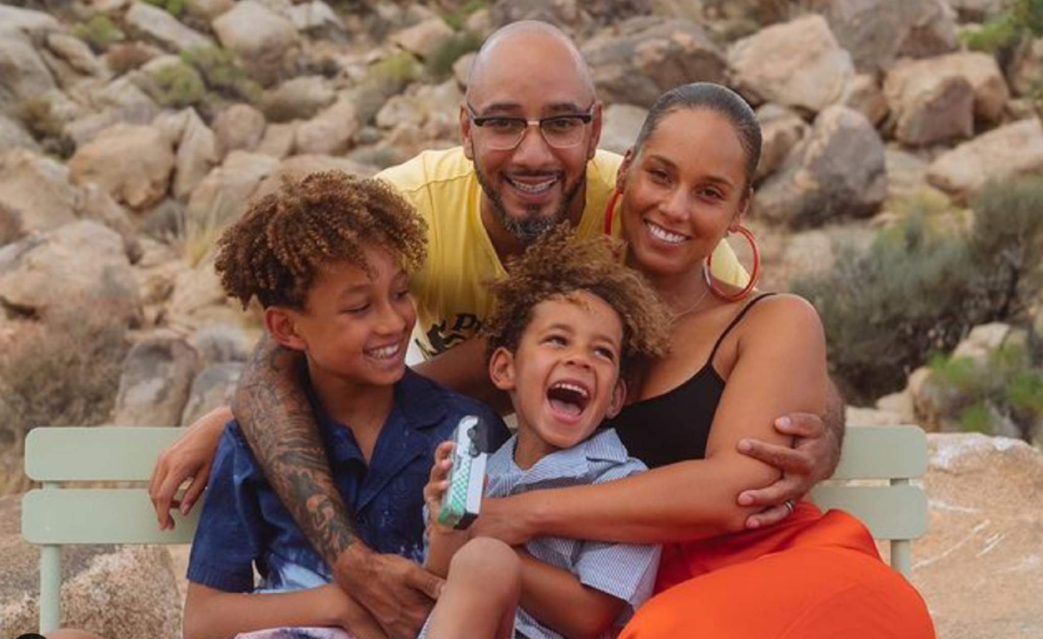
Why I Chose Alicia Keys
A popular women figure in the music industry.
I am very passionate about music.
Did not know much about her activism and wanted to learn more.
Thompson, Shayne Rodriguez. “Alicia Keys Is 40: To Celebrate, We Rounded up Her Cutest Family Moments.” CafeMom.com, 25 Jan. 2021, cafemom.com/entertainment/alicia-keys-is-40-to-celebrate-we-rounded-up-her-cutest-family-moments.

Slide 12
Work Cited
Mediaplanet. “Why Alicia Keys Is on a Mission for the Voiceless - Impacting Our Future.” Impacting Our Future, 13 Feb. 2020, www.impactingourfuture.com/global-action-for-children/why-alicia-keys-is-on-a-mission-for-the-voiceless.
Alicia Keys. (n.d.). Oxfam. https://www.oxfamamerica.org/explore/people/alicia-keys/
Kristof, N. (2014, September 20). Opinion | Alicia Keys asks: Why are we here? The New York Times. https://www.nytimes.com/2014/09/21/opinion/sunday/nicholas-kristof-alicia-keys-asks-why-are-we-here.html
Wikipedia contributors. (2023, November 29). Alicia Keys. Wikipedia. https://en.wikipedia.org/wiki/Alicia_Keys
About Oxfam. (n.d.). https://www.oxfamamerica.org/about-us/
Ruiz-Gimenez, Almudena. “Alicia Keys.” Keep a Child Alive, 29 Aug. 2021, www.keepachildalive.org/alicia-keys.
keep a child alive. “Keep a Child Alive: Shifting From Charity, to Solidarity.” Keep a Child Alive, 24 Aug. 2023, www.keepachildalive.org.
Lucid Design Concepts. (2021, March 23). Mission - she is the music. She Is the Music. https://sheisthemusic.org/mission/

