Slide 1


Slide 2
OVERVIEW
Littoral Zone
Riparian Area
Aquatic Plants
Management
Aquatic Invasive Species
Ask questions!

Slide 3
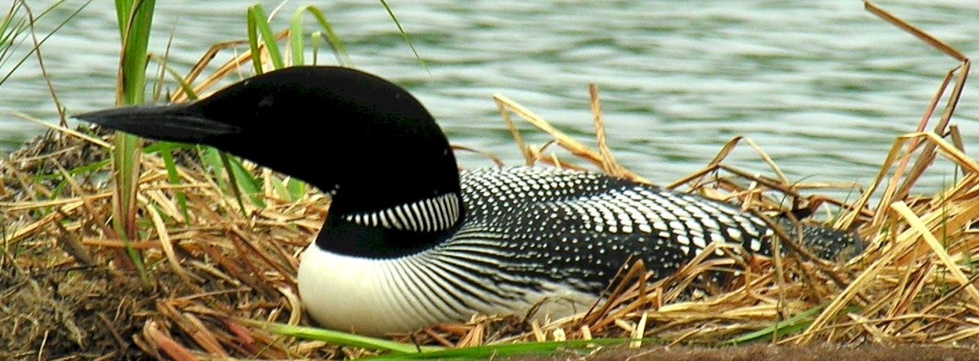
Why?

Slide 4
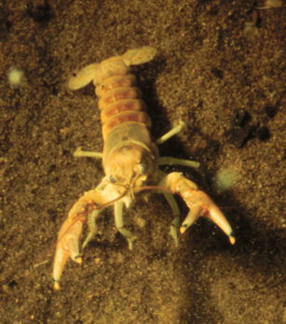
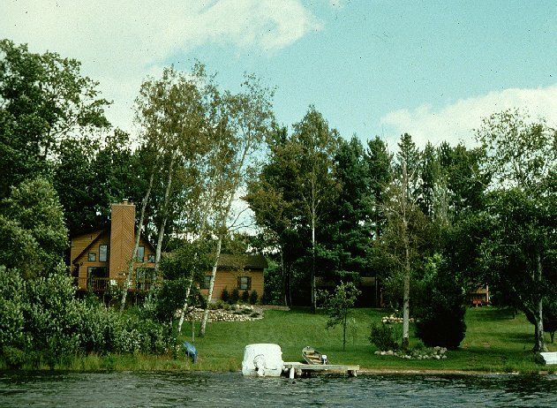
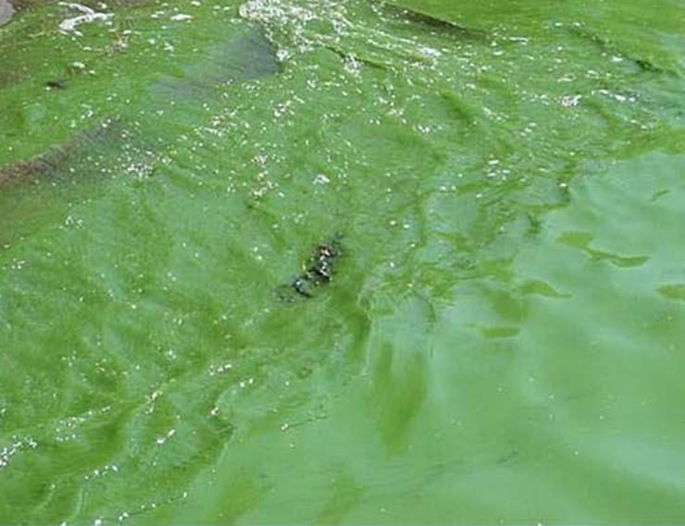
Lakes are Changing Faster than Ever:
    Algae blooms (phosphorus pollution)
    Destruction of shoreline habitat
    Invading plants and animals

Slide 5
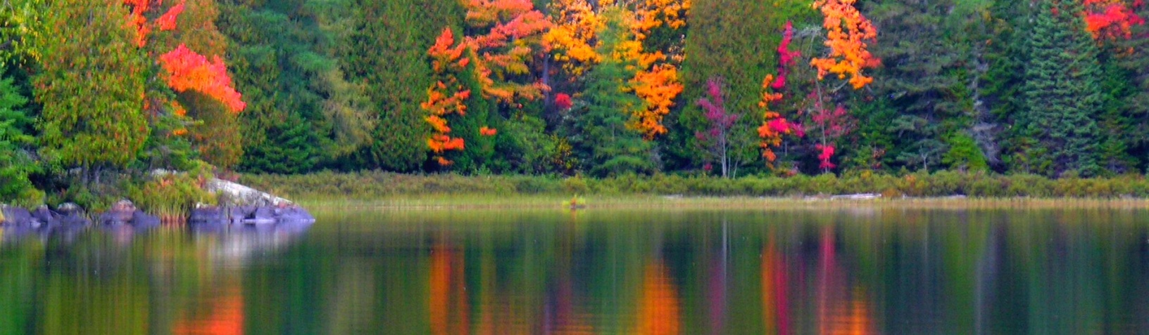
Our lakes are rare
71% Earth’s surface covered by water
<1% Water on earth is freshwater
0.009% water on earth is freshwater lakes

Slide 6
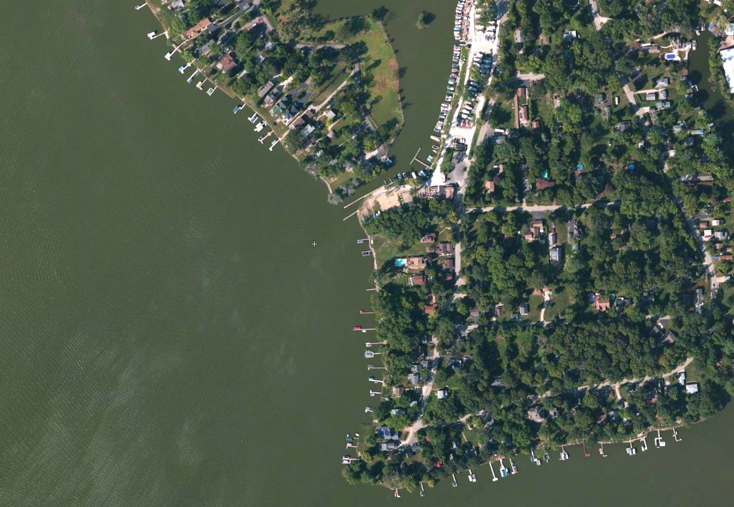
We live on and influence watersheds

Slide 7
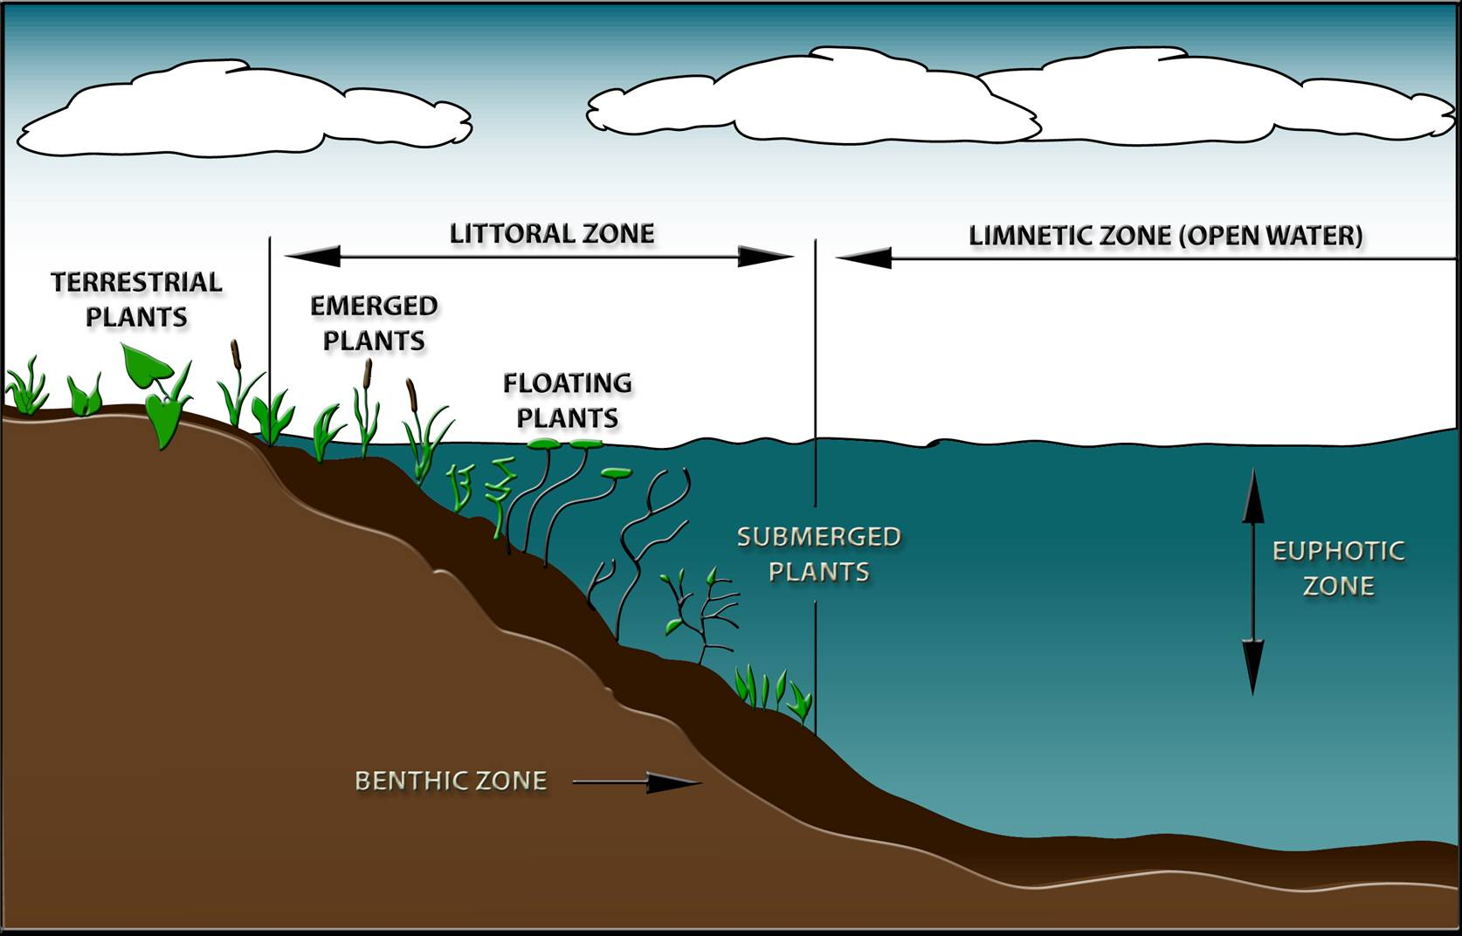
Lake Habitat Zones
Riparian Area

Slide 8
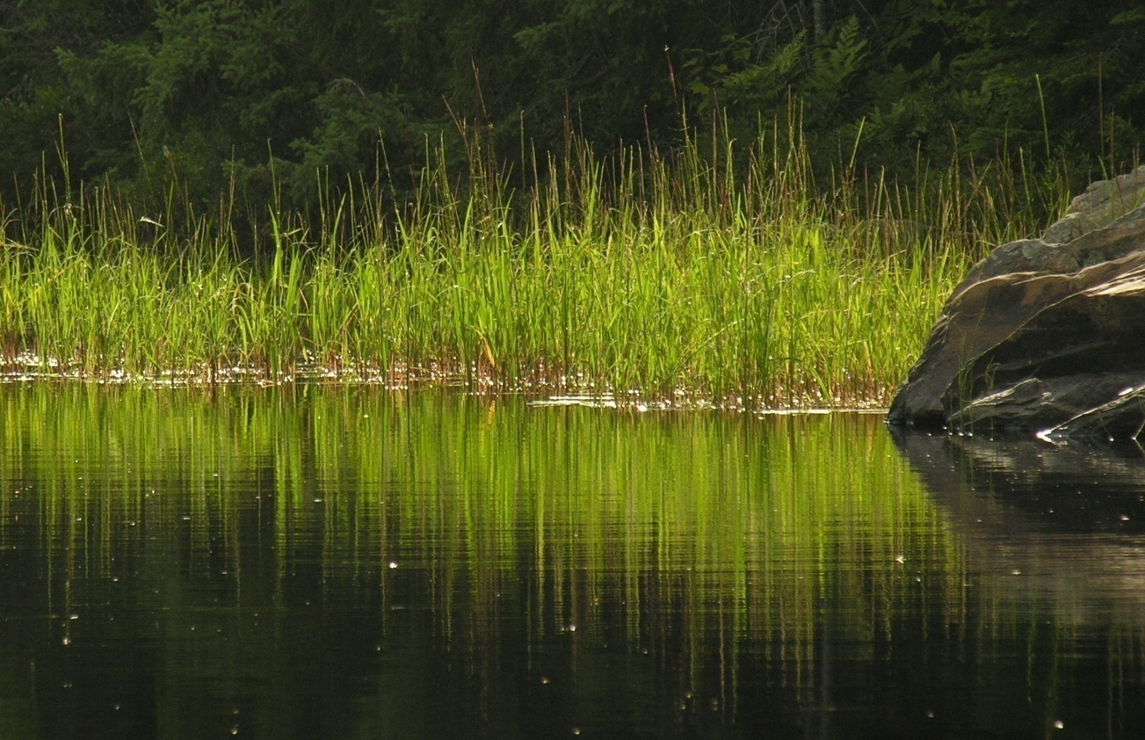
90% of all lake life is born, raised, and fed in the area where land and water meet. (Ontario Ministry of Natural Resources)

Slide 9
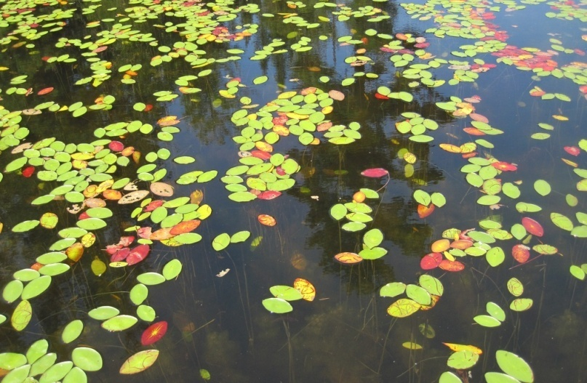
Littoral Zone
The area of the lake that is shallow enough to have rooted vegetation.
Oligotrophic Northern Lake
Eutrophic Southern Lake

Slide 10
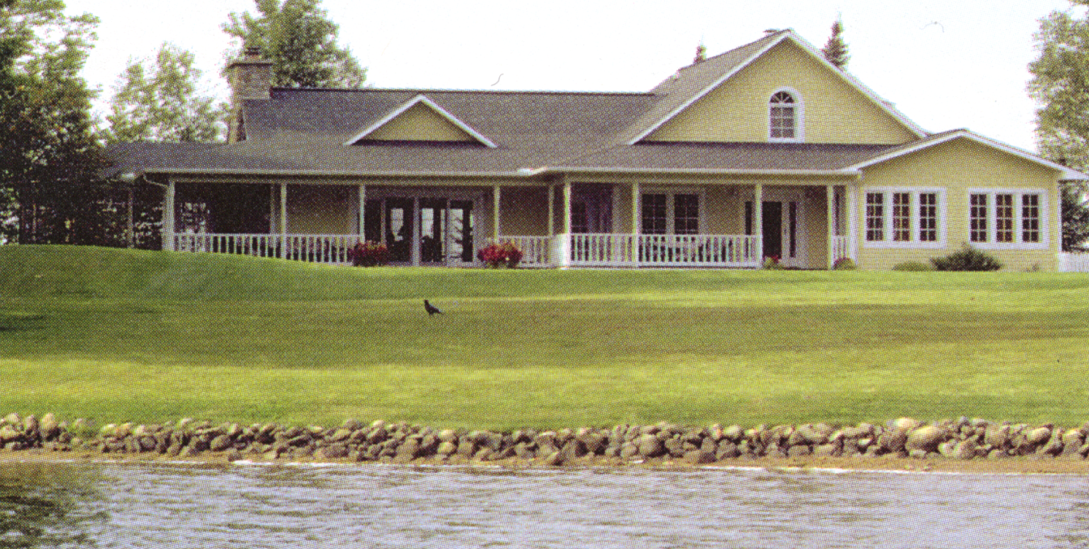
Threats to Lakes
Poor lakeshore habitat (riparian vegetation) is the number one stressor of lake ecosystems.
Poor littoral zone habitat is number two.
The 2007 National Lakes Assessment

Slide 11
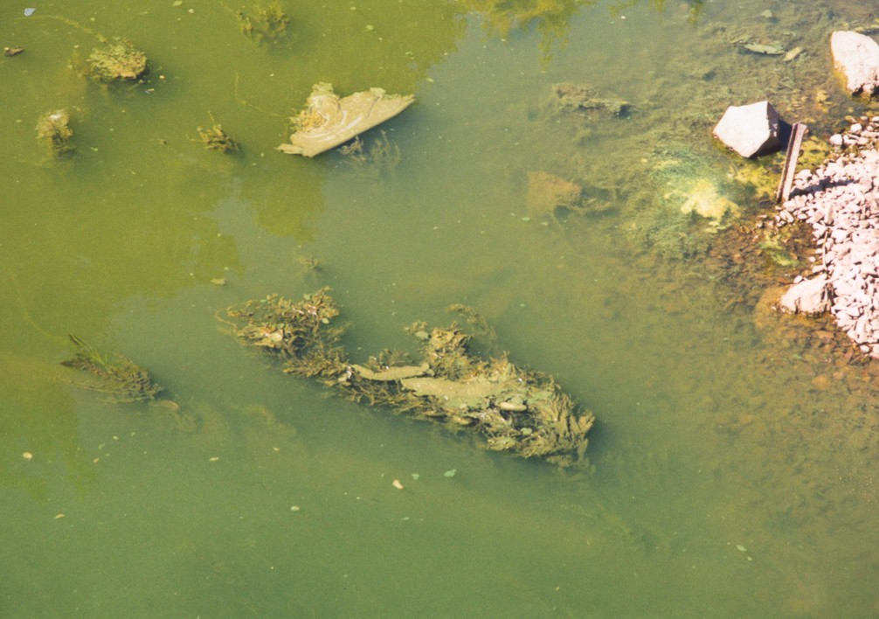
Other Threats to Lakes: Nutrients

Slide 12
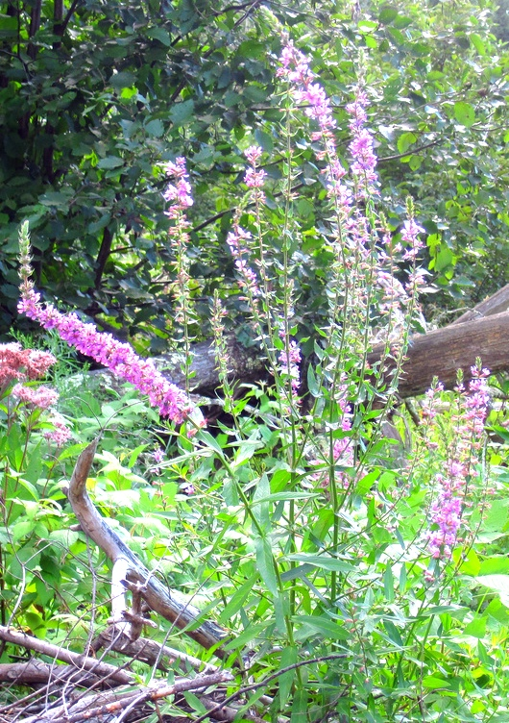
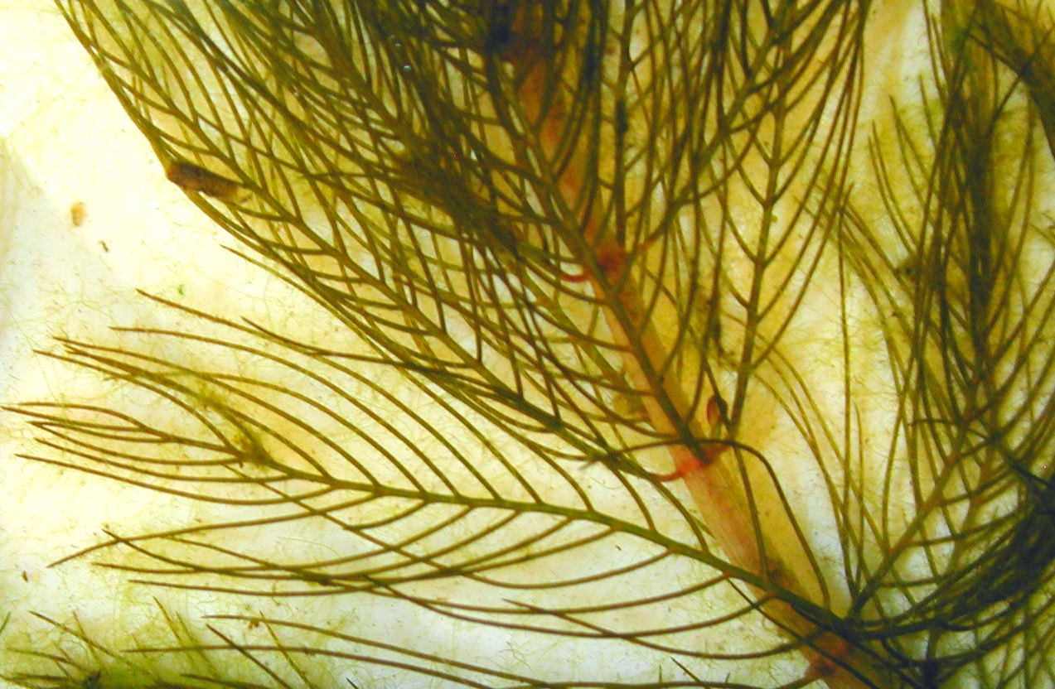
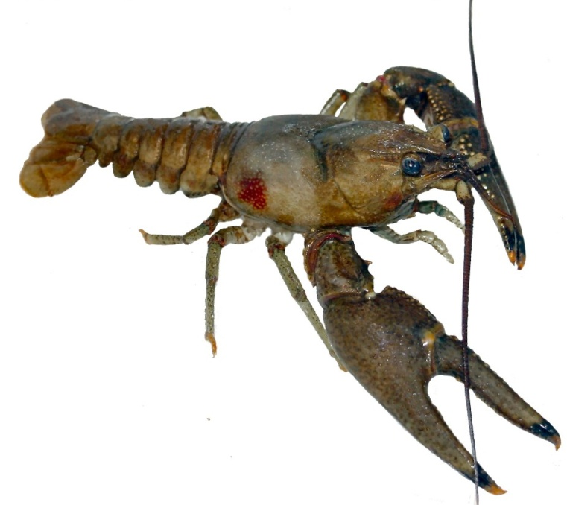
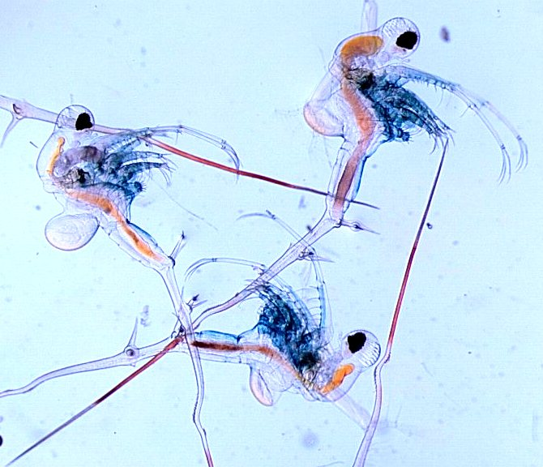
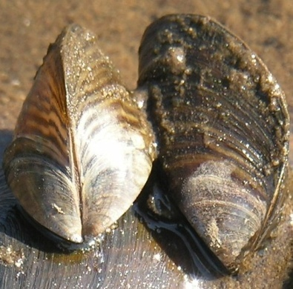
Other Threats to Lakes: AIS

Slide 13
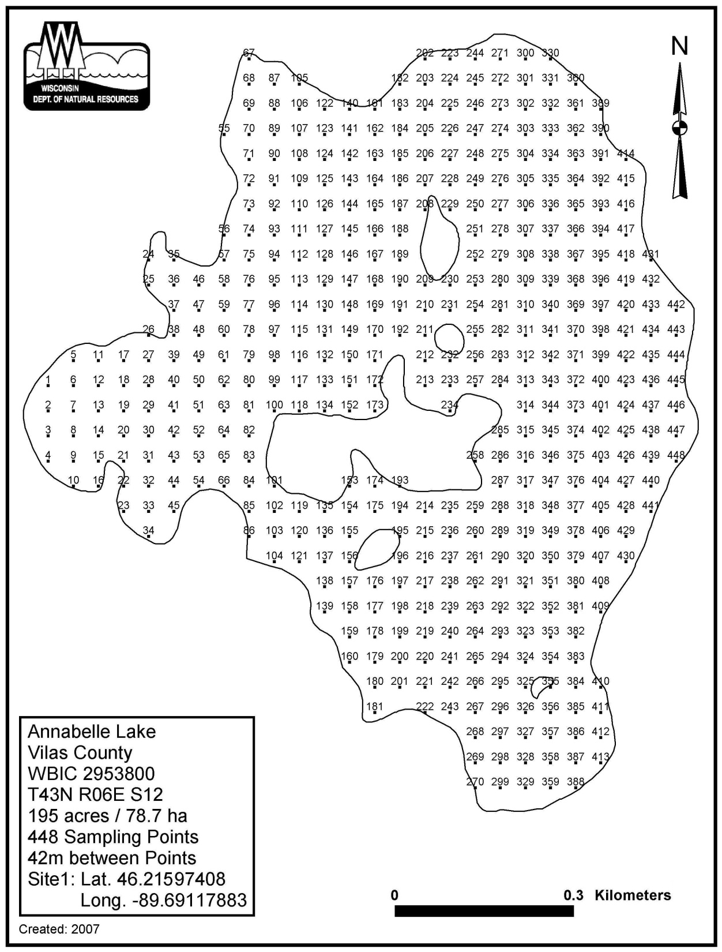
Point-Intercept Aquatic
Plant
Survey

Slide 14
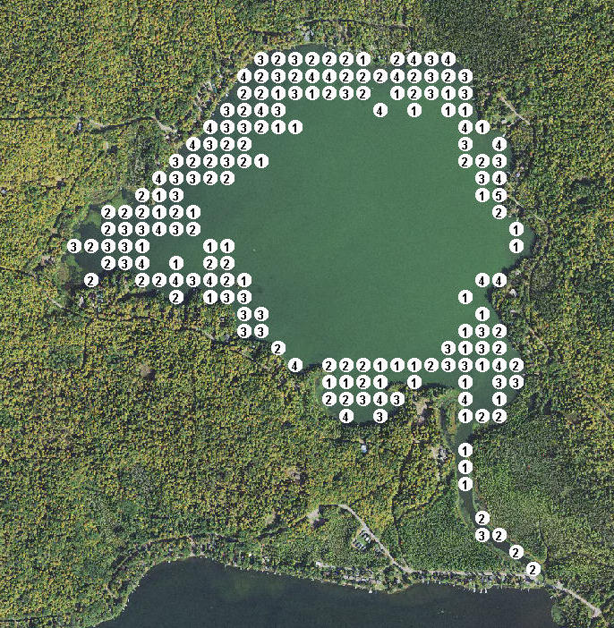

Number of plant species recorded at Crane Lake sample sites (2019).
300 ft.

Slide 15
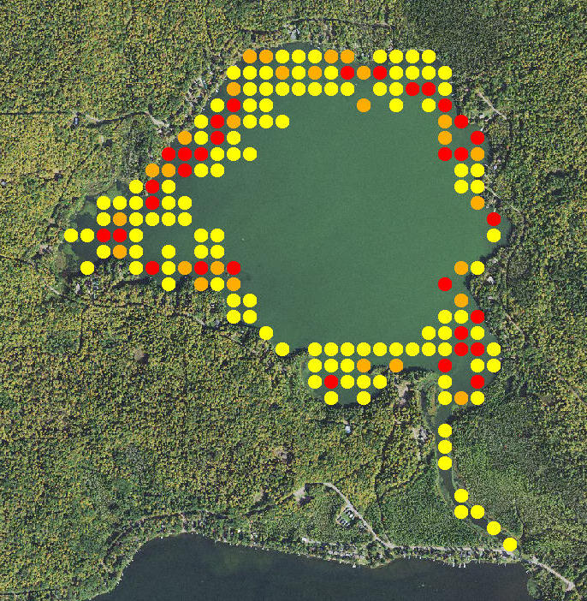
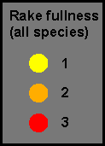
Rake fullness ratings for Crane Lake sample sites (2019).
300 ft.

Slide 16
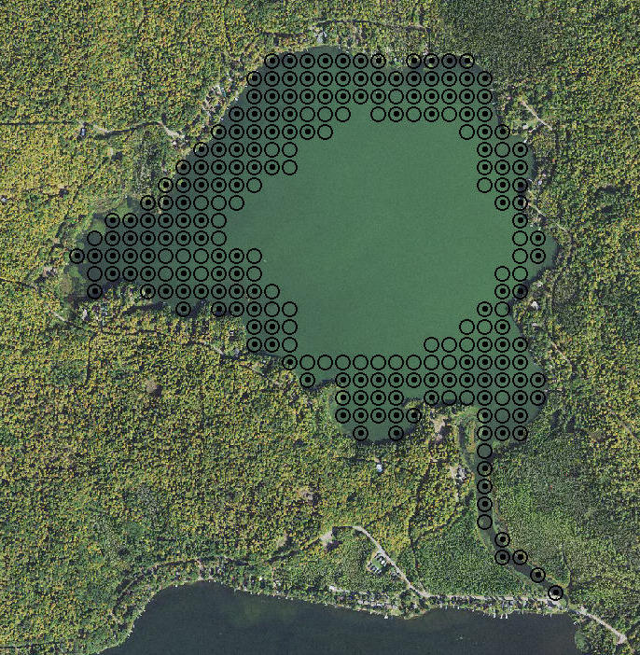
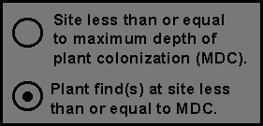
Crane Lake sampling sites less than or equal to maximum depth of rooted vegetation (2019).
300 ft.

Slide 18
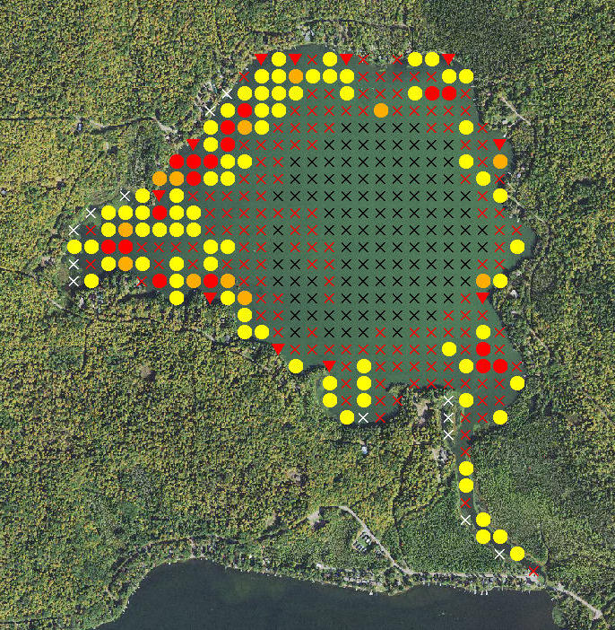
Distribution of plant species,
Crane Lake (2019).
Ceratophyllum demersum,
Coontail
1 (Rake fullness)
2
3
Visual
Not found
Unsampled (depth)
Non-navigable
300 ft.

Slide 19
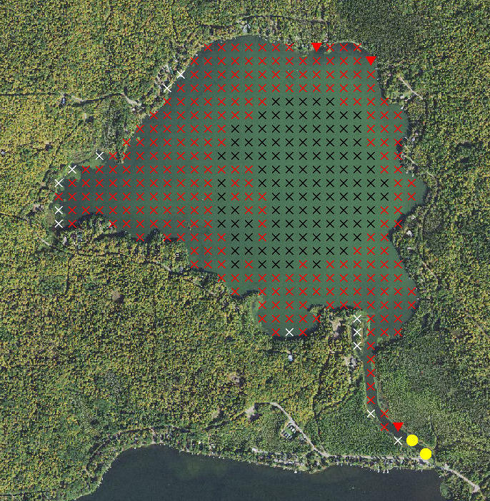
Distribution of plant species,
Crane Lake (2019).
Myriophyllum spicatum, Eurasian water milfoil
1 (Rake fullness)
2
3
Visual
Not found
Unsampled (depth)
Non-navigable
1 (Rake fullness)
2
3
Visual
Not found
Unsampled (depth)
Non-navigable
300 ft.

Slide 20
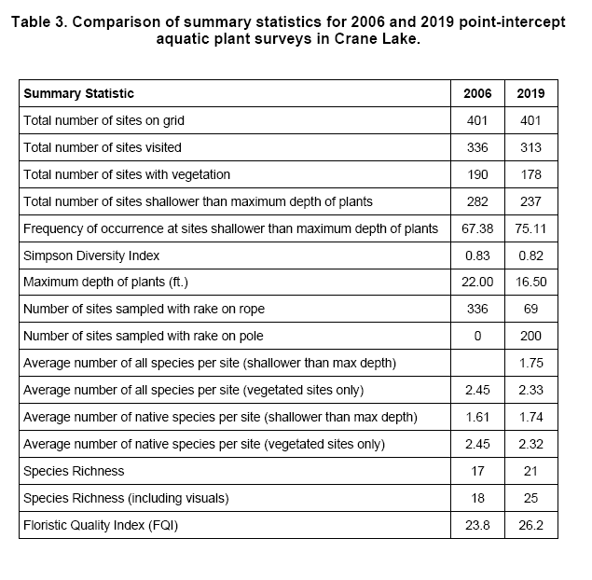

Slide 21
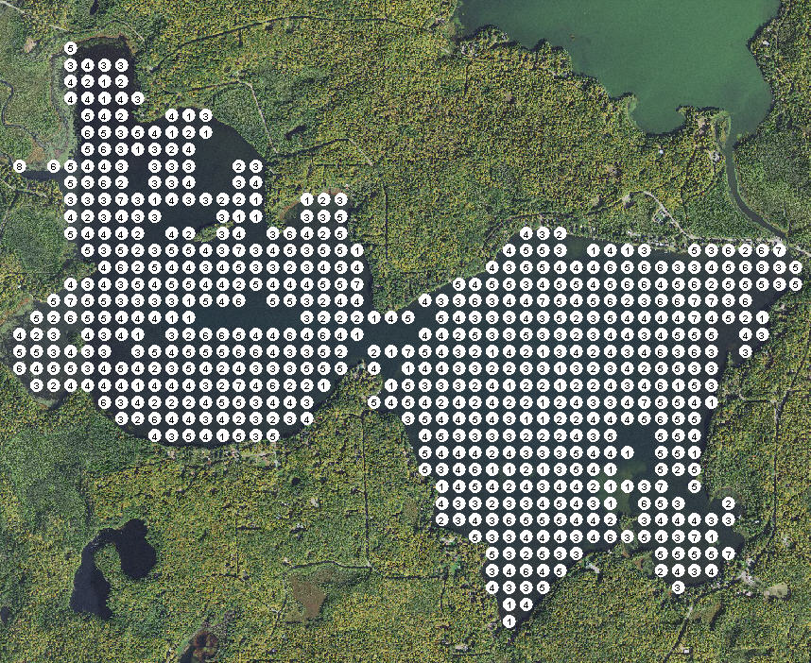
Number of plant species recorded at Pickerel Lake sample sites (2019).

Slide 22
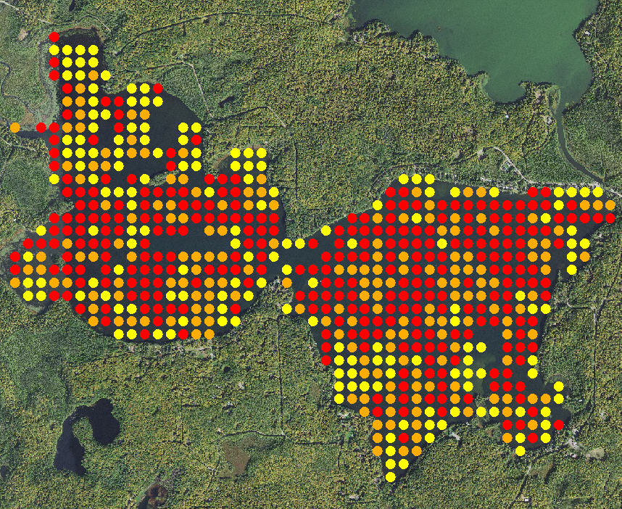
Rake fullness ratings for Pickerel Lake sample sites (2019).
300 ft.

Slide 23
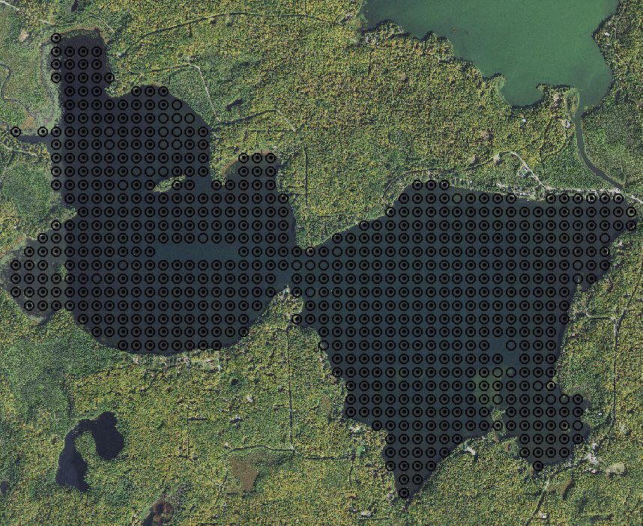
Pickerel Lake sampling sites less than or equal to maximum depth of rooted vegetation (2019).

Slide 24
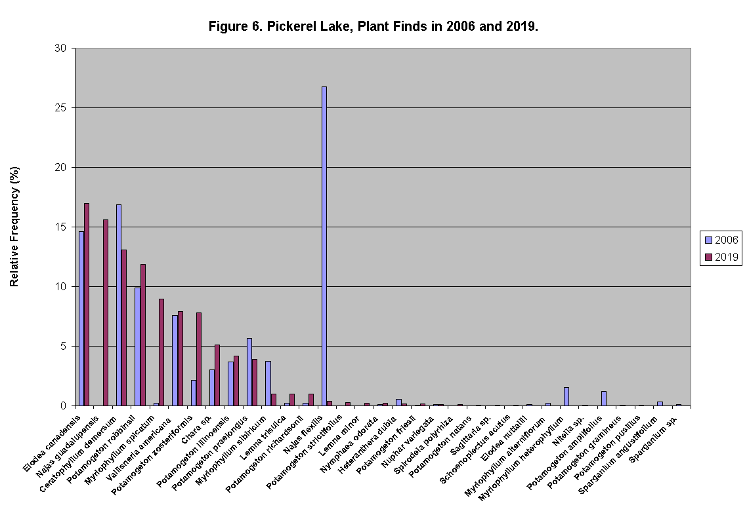

Slide 25
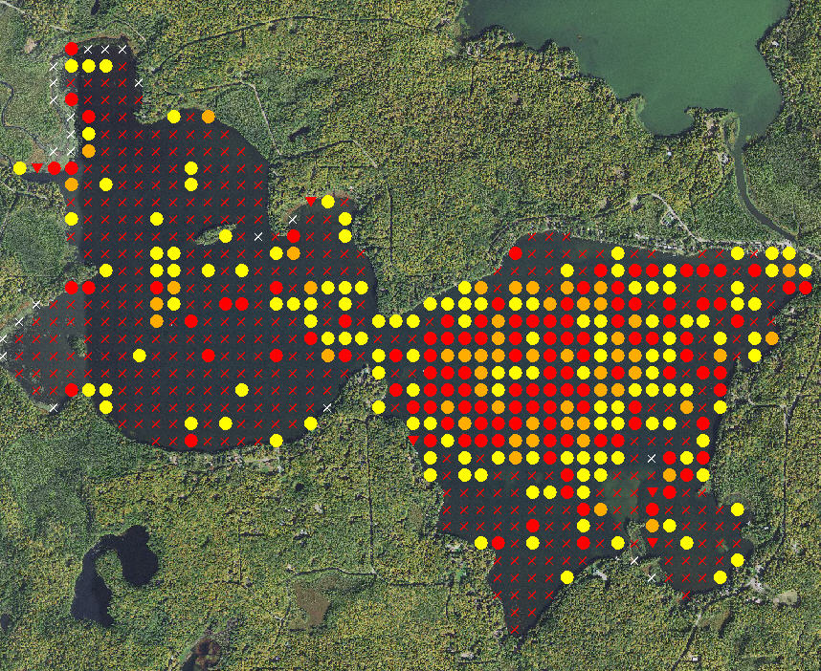
Distribution of plant species, Pickerel Lake (2019)
Ceratophyllum demersum,
Coontail
1 (Rake fullness)
2
3
Visual
Not found
Unsampled (depth)
Non-navigable

Slide 26
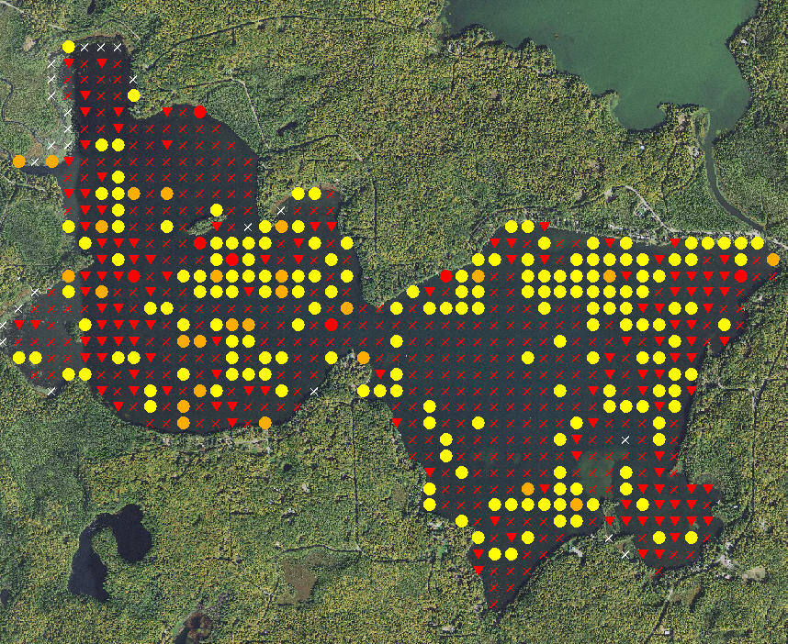
Distribution of plant species, Pickerel Lake (2019)
Myriophyllum spicatum, Eurasian water milfoil
1 (Rake fullness)
2
3
Visual
Not found
Unsampled (depth)
Non-navigable
1 (Rake fullness)
2
3
Visual
Not found
Unsampled (depth)
Non-navigable

Slide 27
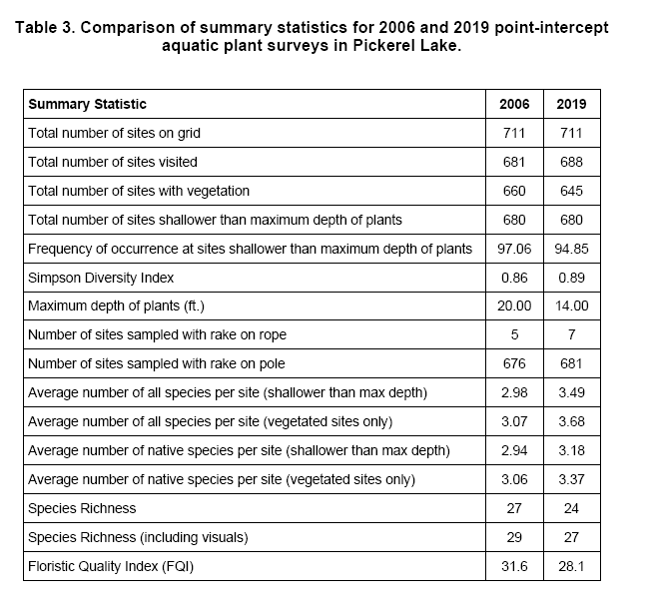

Slide 28
Comparison of Rake fullness ratings between Crane and Pickerel Lakes (2019) (this slide and next).

Slide 30
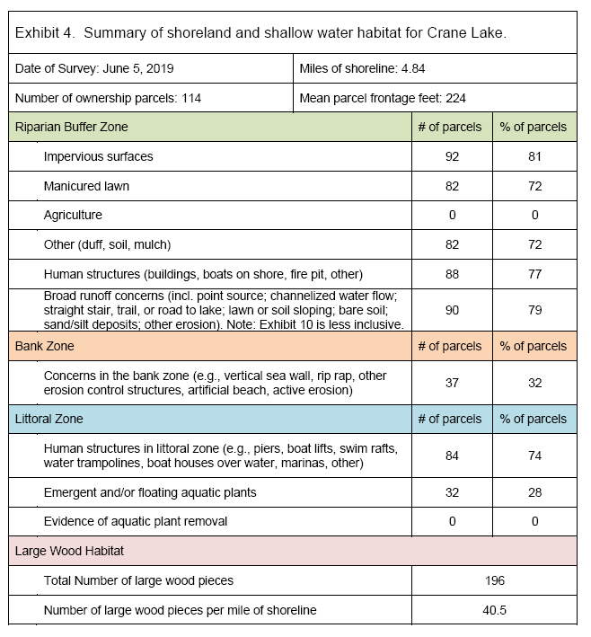

Slide 31
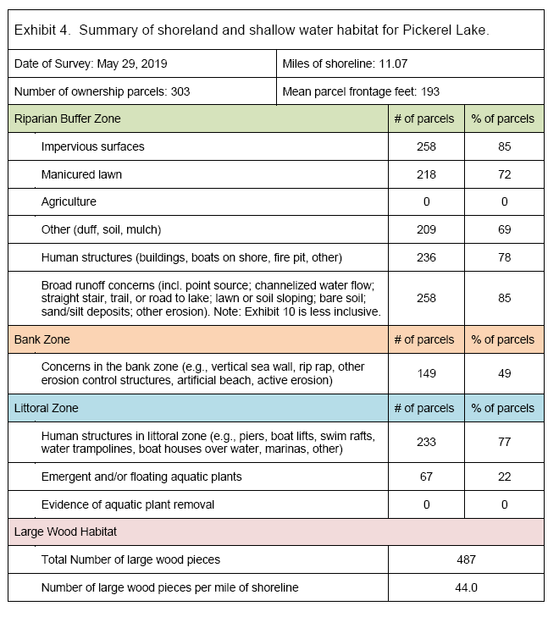

Slide 32
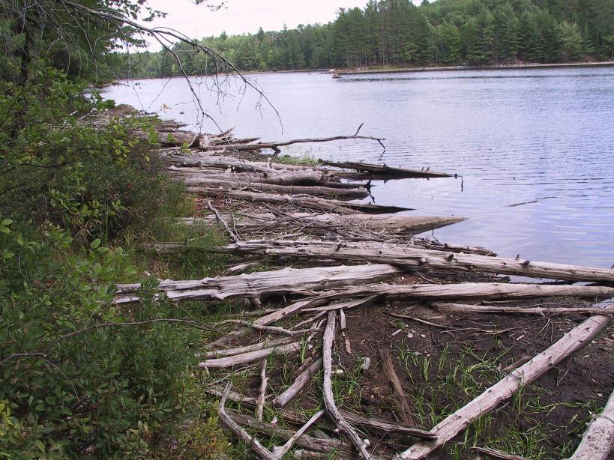
Large woody
material
Notes:
32

Slide 33
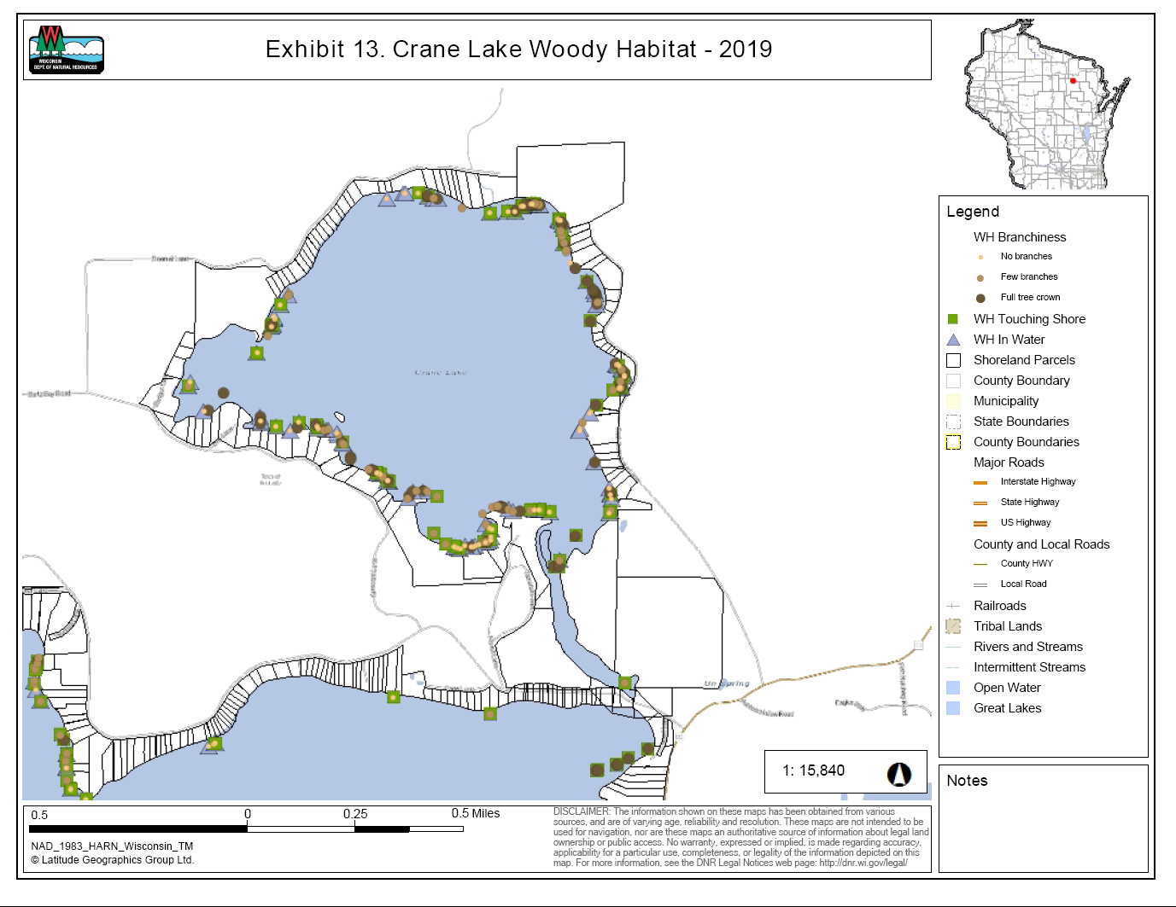

Slide 34
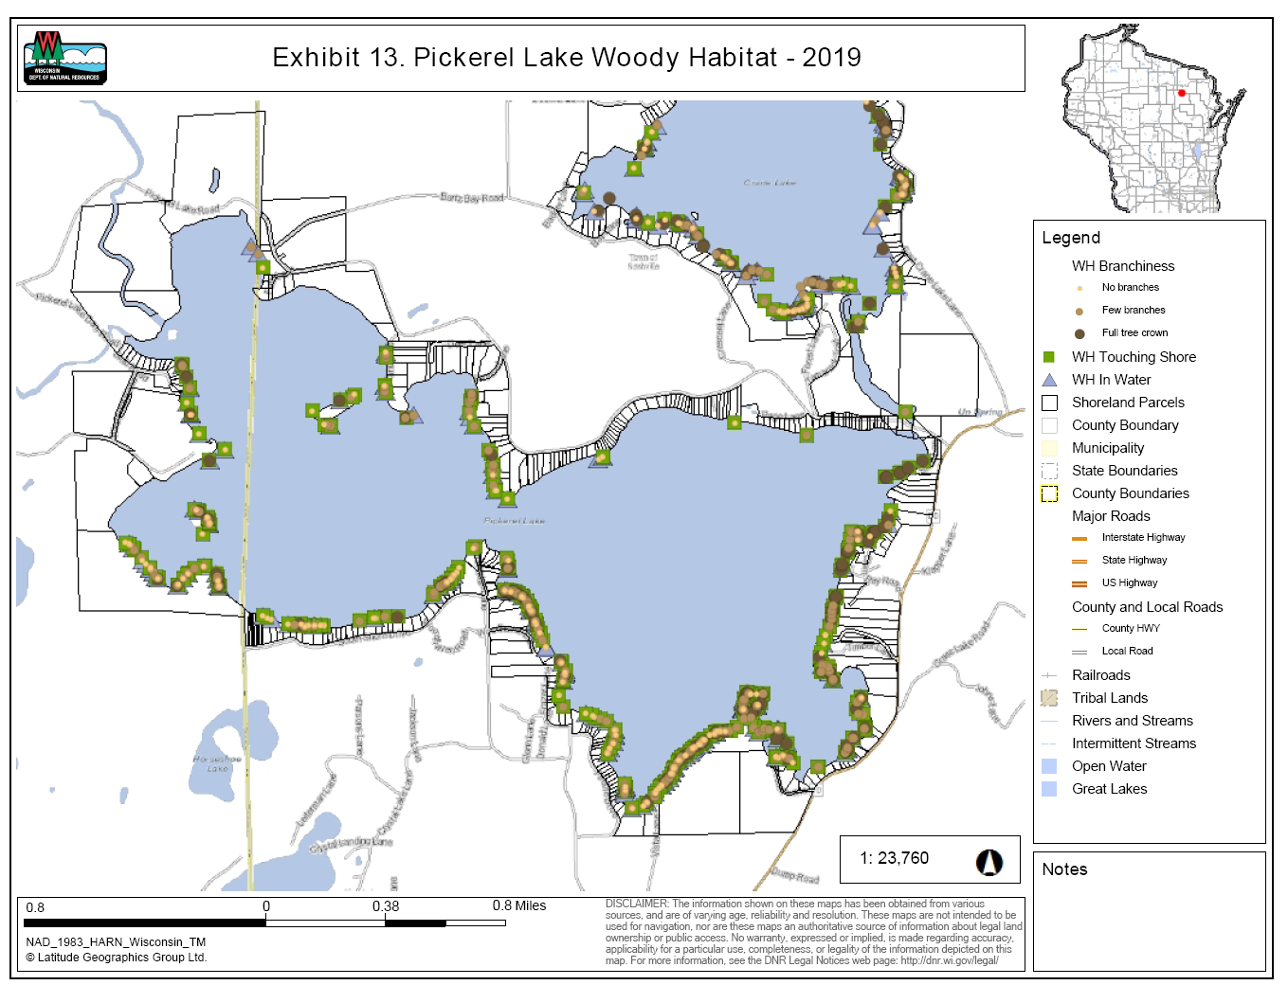

Slide 35
Management Actions
declarative “action” statement that specifies the action
statement of the “objective” that the action serves
“monitoring” statement that specifies the party responsible for carrying out the action and maintaining data
“status” statement that suggests a timeline/calendar and indicates status (not yet started, ongoing, or completed).

Slide 36
Actions Common to both Aquatic Plant Management Plans
Monitor lake shoreline for areas of erosion and excessive terrestrial/wetland vegetation clearing.
Monitor the lake for existing and new aquatic invasive plant and animal species.
Monitor the lake watershed for purple loosestrife.
Identify & highlight high quality areas of littoral zone and riparian areas through review of aquatic plant & shore-land assessment data through reports and online tools.
Lake leaders should encourage/assist landowners to do lake shore/shallow water improvement projects to rehabilitate areas identified through shoreland/shallow water assessments and/or lake user observations

Slide 37
Aquatic Invasive Species
In Crane Lake, 3 known AIS:
banded mystery snail
Chinese mystery snail
Eurasian water-milfoil
Purple loosestrife
In Pickerel Lake, 5 known AIS:
banded mystery snail
Chinese mystery snail
Eurasian water-milfoil
hybrid EWM/NWM
rusty crayfish.

Slide 38
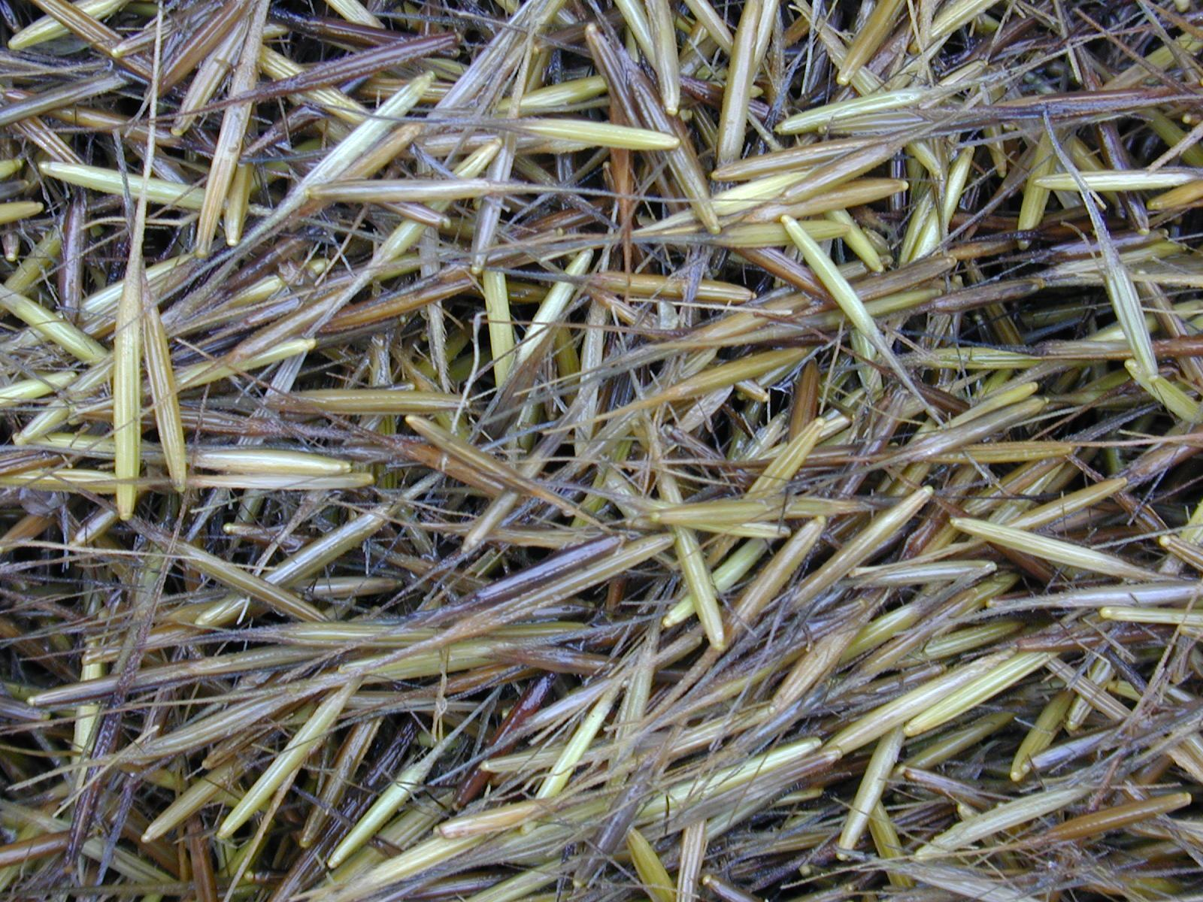

Slide 39
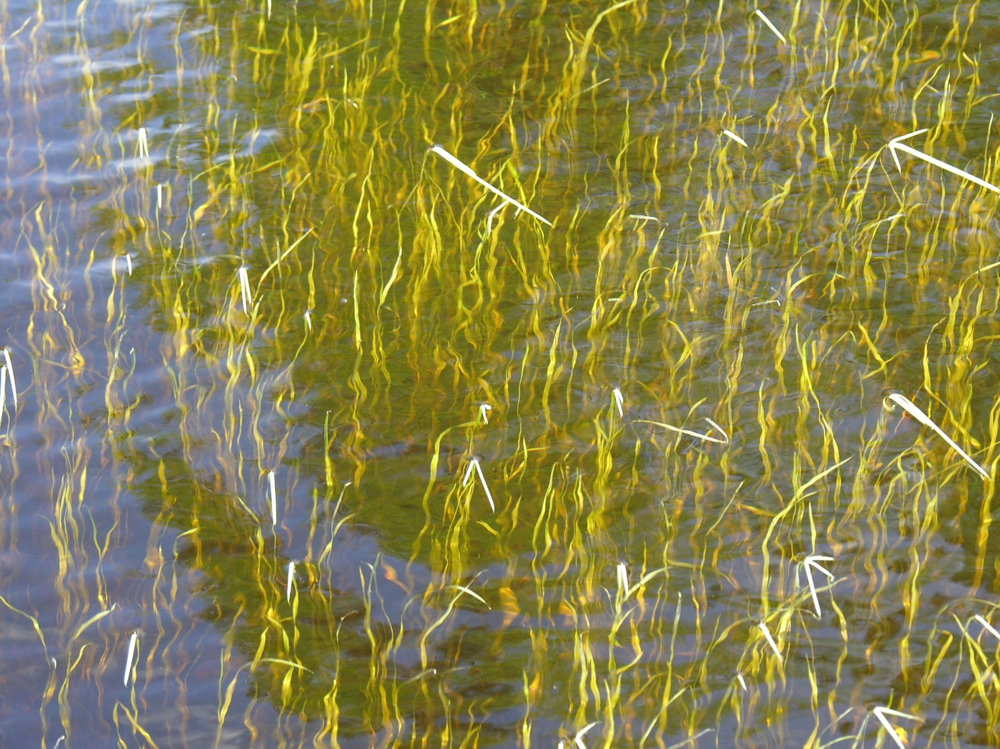

Slide 40
