Slide 1


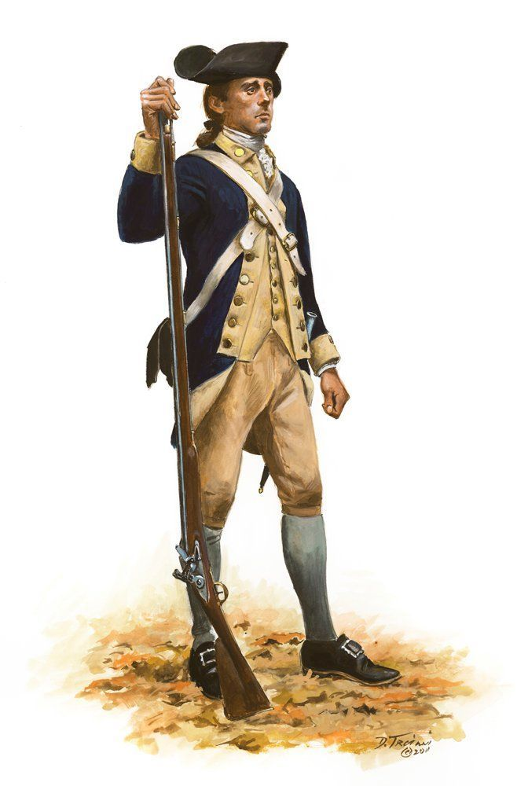
Benjamin Jones, Soldier of the Revolution
Enlisted in Captain Nathan Smith’s Militia Company 29 JUN 1776 part of Maryland's Flying Camp
Captain Thomas Handy’s Company, 5th Maryland Regiment
Commanded by Col. William Richardson of the Maryland Line 26 DEC 1776 and till August of 1778
Quelled Tory insurrection in Somerset and Worcester Counties
1st Maryland Brigade engaged in the battles at Brandywine, 11 September 1777 and Germantown, 4 October 1777
Captain Richard Dorsey's Artillery Company on 17 NOV 1777 and Battle of Monmouth, June 28, 1778
5th Maryland Regiment as a drummer on 1 May 1779 and Private on 1 JUN 1779
Southern Department, 5 April 1780 and Engaged at Battle of Camden, 16 August 1780
Invalid at Fort Whetstone Point. In 1798, the name of Fort Whetstone was changed to Fort McHenry
Benjamin was discharged by order of the governor 8 MAY 1781
On December 21, 1786, he married Providence Odell. They moved from Maryland to Rhea County, Tennessee, in 1814
He died in Hamilton County in 1857 and is buried in the Coulterville Cemetery near his daughter Kitty who married James R. McDonald

