Slide 1


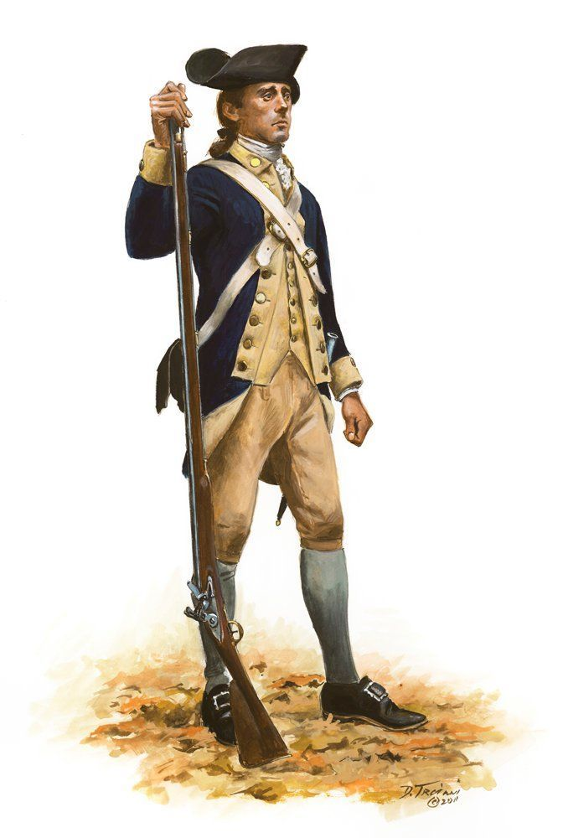
Benjamin Jones, Soldier of the Revolution
Benjamin Jones was enrolled in Captain Nathan Smith's company on 29 JUN 1776 as part of Maryland's 3,400 man Flying Camp requirement to provide forces to General Washington. The flying camp units were disbanded in December of 1776 with many men including Benjamin Jones enlisting in the Maryland Line. Benjamin joined Captain Thomas Handy's company of the 5th Maryland Regiment commanded by Col. William Richardson on 26 DEC 1776 and is known to have served till August of 1778. The first 5th Maryland Regiment was organized on 27 March 1776 and was authorized on 16 September 1776 for service with the Continental Army. The regiment including Benjamin Jones was assigned to the main Continental Army on 27 December 1776. One of the unit’s first missions was to quell a Tory insurrection in Somerset and Worcester Counties. The Maryland Council of Safety recognized the regiment on Feb. 19, 1777 for its spirited conduct in marching to assist General Hooper in quelling the Tory insurrection in Somerset and Worcester Counties.
On 22 May 1777, the 5th Maryland was assigned to the 1st Maryland Brigade. Benjamin would participate in the battles at Brandywine, September 11, 1777 and Germantown, October 4, 1777 while part of this command. "Benj. Jones" is next listed in official records as present as part of Captain Richard Dorsey's Artillery Company on 17 NOV 1777. It was not uncommon for Soldiers from the Infantry regiments to be "seconded" or put on temporary duty with the Artillery so it is totally possible that this service note is from our honored Patriot’s service.
Benjamin was next in action at the Battle of Monmouth, June 28, 1778. He was back with the 5th and is noted as being a Private on 1 April 1778. In August of 1778 he is off the rolls. He is then noted as enlisting for three years and re-enlisting on 22 FEB 1779. He received 100 dollar bounty for a three year enlistment.
He is again in service with the 5th Maryland Regiment as a drummer on 1 May 1779 and a private on 1 JUN 1779. The 5th Maryland was re-organized on 12 May 1779 to nine companies and was later re-assigned to the Southern Department on 5 April 1780.
The 5th Maryland as part of Gen Smallwood’s 1st Maryland Brigade was initially held in reserve as the Battle of Camden began on August16, 1780. Christopher Ward writes of the action by the 1st Maryland Brigade in his book "The War of The Revolution" that, "Otho Williams took charge and brought the brigade forward in line with the American right wing. It was immediately hotly engaged. Williams tried to bring it up to the left of the 2nd Brigade, but the British were between them. Cornwallis saw his chance. He swung Webster's regulars against the front and flank of the 1st Maryland Brigade. The Marylanders gave ground, rallied, were driven back, rallied again, but at last were overcome and routed." " Scattered in small groups or singly, looking vainly for their comrades and for leadership, the beaten men, though clear of their military foe, found themselves in country swarming with civilian enemies. The fugitives from Camden came in daily, but in deplorable condition, hungry, fatigued and almost naked.“ The 5th Maryland ceased to function as an effective force after the battle of Camden.
Benjamin’s last service is as an invalid at Fort Whetstone Point (an earthen star shaped fort located in Baltimore. It was common practice to post men who were recovering from wounds or sick as “invalids” as part of a garrison for a fort or other important installation. In 1798, the name of Fort Whetstone was changed to Fort McHenry.
Benjamin was discharged by order of the governor 8 MAY 1781. On December 21, 1786, he married Providence Odell. They moved from Maryland to Rhea County, Tennessee, in 1814. He died in Hamilton County in 1857 and is buried in the Coulterville Cemetery near his daughter Kitty who married James R. McDonald.

