Slide 1
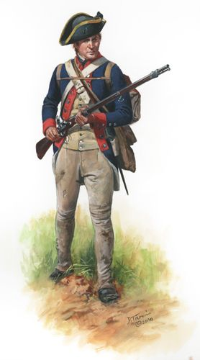
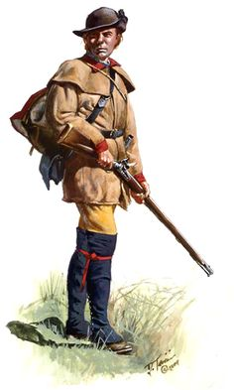
Charles Thurman
Soldier of the American Revolution
Pioneer and Early Citizen of Bledsoe County
Enlisted in Captain Thomas Redd’s Company in 1779
Albemarle Barracks; VA’s Convention Army Guard Regiment
Buckingham Co. Militia 1775 to 1779
Col. George Gibson’s Regiment
17 AUG 1780 to 17 APR 1781
Captain Thomas Ewell; deployment to the Southern Army
Captain Isaac Webb; Southern Army in SC
Captain Nathan Cunningham; Race to the Dan
Captain Nathan Cunningham’s Company
Col. Nathaniel Cocke’s Regiment
Battle of Guilford Courthouse
15 MAR 1781
Captain John Mosley’s Company
1st VA State Regiment
Siege of Yorktown
Captain Nathan Cunningham’s Company
POW Guard Company Yorktown to Winchester, VA

