Slide 1


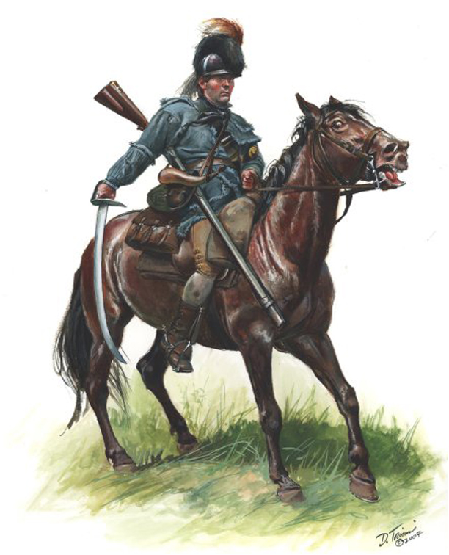
Robert Patterson
Soldier of the American Revolution & Frontier Indian Wars,
Pioneer and First Citizen of Hamilton County
Enlisted in Captain William Gardner’s Company as a “Light Dragoon” in 1779
Battle of Stono Ferry, SC (June 20th, 1779)
Col. Davie’s North Carolina Light Dragoons 1780 to July 1781
Ambush at Hanging Rock, SC (July 30th, 1780)
Attack at Hanging Rock, SC (August 5^{th,} 1780)
Battle of Camden, SC (August 16th, 1780)
Raid on Wahab's Plantation (September 21st, 1780)
Battle of King’s Mountain, SC (October 7th, 1780)
Robert Patterson recorded as a Lieutenant under Capt. William Gardner in 1781
“Race to the Dan”
Trading Ford (February 3^{rd,} 1781)
Shallow Fords of the Yadkin (February 7th, 1781)
Hart's Mill (February 17th, 1781)
Clapp's Mill first action (March 4th, 1781)
Clapp's Mill second action (March 5th, 1781)
Battle of Whitesell's Mill (March 6th, 1781)
Brig. Gen. Griffith Rutherford’s Wilmington Campaign July to November 1781. Capt. Patterson a company commander under Col. Robert Irwin
Robert Patterson, Ensign Knox County Regiment, Hamilton District Militia from 1792 to 1794 may have participated in the Gen. Sevier’s 1793 Etowah campaign
(Battle of Hightower or Etowah Cliffs) near Rome, GA

