Slide 1


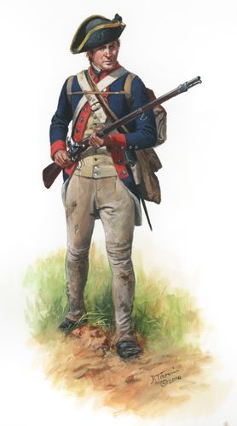
Thomas Palmer
Soldier of the American Revolution ,
Pioneer and Early Citizen of Hamilton County
Enlisted for three years 24 MAR 1777
Captain John Winston’s Company in
Col. Charles Lewis’ 14th Continental Infantry Regiment
Battle of Brandywine September 11th, 1777
Battle of Germantown October 4th, 1777
Valley Forge Encampment 1777 to 1778
Col. William Davies in command
Battle of Barren Hill May 20th, 1778
Battle of Monmouth June 28th, 1778
Virginia Line reorganized
1st Regiment Light Infantry Corps
Battle of Stoney Point July 16th, 1779
Morristown Encampment 2 1779 to 1780
Tobacco Raids / Defense of Virginia 1781
State Militia service Captain Thomas Humphrey’s Company
2nd Virginia State Regiment Col. Charles Dabney
Captain Edward Duke’s Company
Captain John Henry’s Company
Brigadier General Weedon’s Brigade
Gloucester Battle of the Hook
Siege of Yorktown

