Slide 1


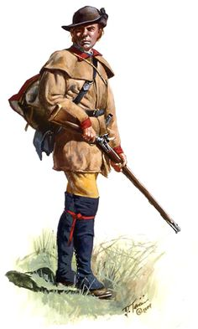
William Jefferson Moore
Soldier of the American Revolution & Frontier Indian Wars,
Pioneer and Early Citizen of Hamilton County
Enlisted in Captain William McAfee’s Company in 1776
Then Captain Aaron Lewis’ Company
Cherokee Expedition under Col. William Christian
Washington County, NC/TN Militia
Col. John Sevier’s Regiment
Defense of the Frontier 1777
Defense of the Frontier 1778
Volunteer, Captain Joseph Wilson’s Company
Col. Shelby’s Chickamauga Expedition 1779
Captain James Wilson’s Company, Col. John Sevier’s Command
Battle of King’s Mountain October 7th, 1780
Battle of Boyd’s Creek December 6th, 1780
Tuskegee March 1781
Moccasin Creek September 11th, 1781
Monck’s Corner #4 October 16th, 1781
Col. Sevier’s Cherokee Expedition 1782
Battle of Lookout Mountain September 20th, 1782

