Slide 1
WELCOME BACK MY FAVORITE PEOPLE ♥

Slide 2
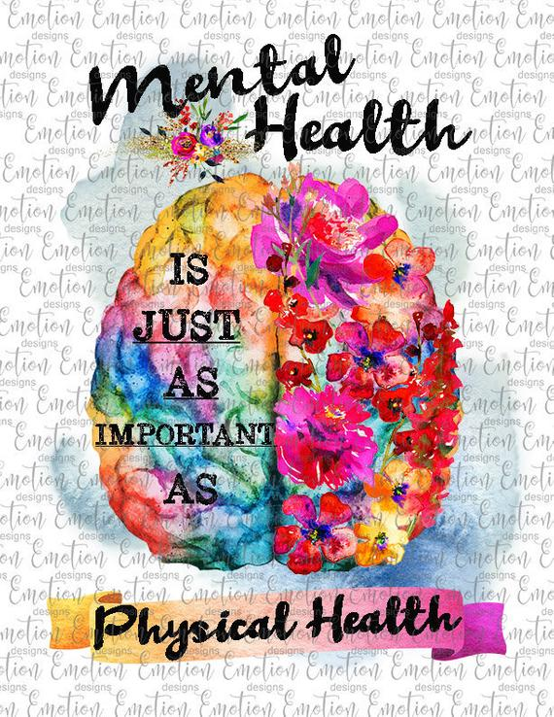
Agenda
-Hello, Names, something cool that happened!!
- Things in the Community//
- How to make a difference elsewhere
- Journaling!!
- game (??)

Slide 3
How to get involved
Volunteering
Potential group opportunity with Mental Health Foundation of West Michigan
Individual Volunteer opportunities
Pine Rest https://www.pinerest.org/join-our-team/volunteer-opportunities/
MHFWM https://www.benice.org/get-involved/volunteer
Update on getting counseling center resources on class syllabi
Potential future documentary screening event
Quell Foundation
Opportunities to write a blog post

Slide 4
Journaling
The Warrior Movement

Slide 5
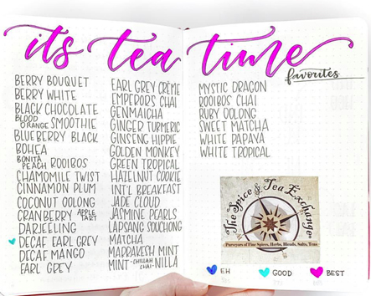
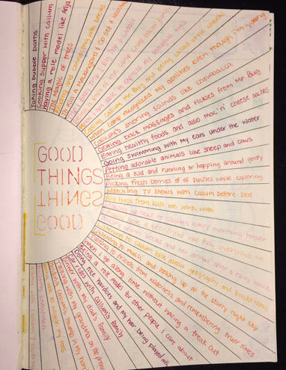
Journaling can be anything you make it!
Need to vent?
Want to keep track of the things you’ve been loving lately?
Need reminders? Affirmations?
Need a safe space to get out your anxiety?
Want something to look back on as a reminder of your personal growth?
Journaling can be whatever de-stresses you

Slide 6
Benefits of Journaling in General
Keep your thoughts organized
Set and achieve goals
Self reflection
Relieve stress
Identify patterns

Slide 7
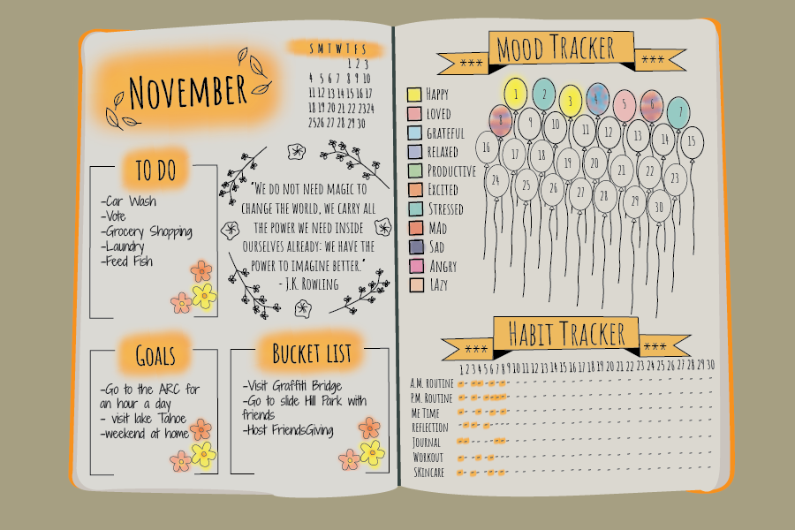
Bullet Journaling

Slide 8
Bullet Journaling
Benefits:
Really good if you’re not a “writer”
Helps you stay attune to your patterns
Helps you stay organized
Peace of mind
Motivation
Creative outlet

Slide 9
Write down 4 things you would want to bullet journal!
Examples include, but not limited to: mood, water intake, activity, daily affirmations, recipes to try, brain dump page, mind map, bucket list, memories page, budget tracker, goals and rewards, daily page fill out…
How will you organize them?
How will you keep the habit going?

Slide 10
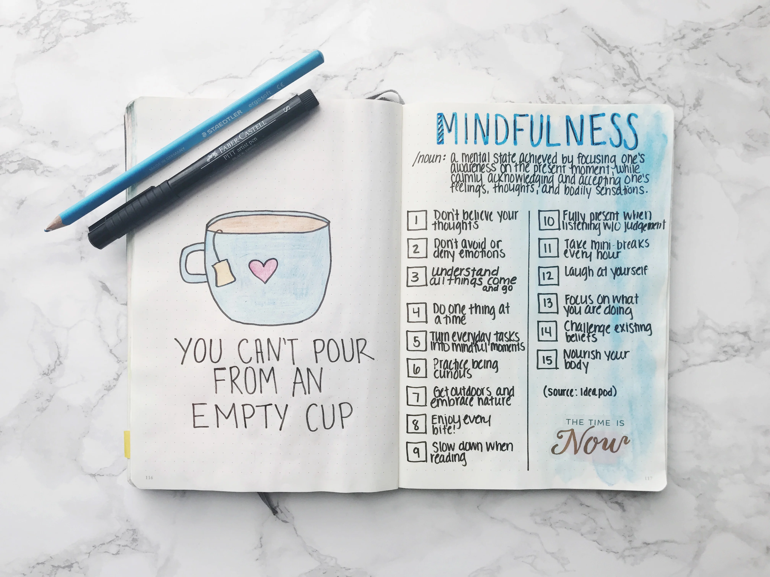
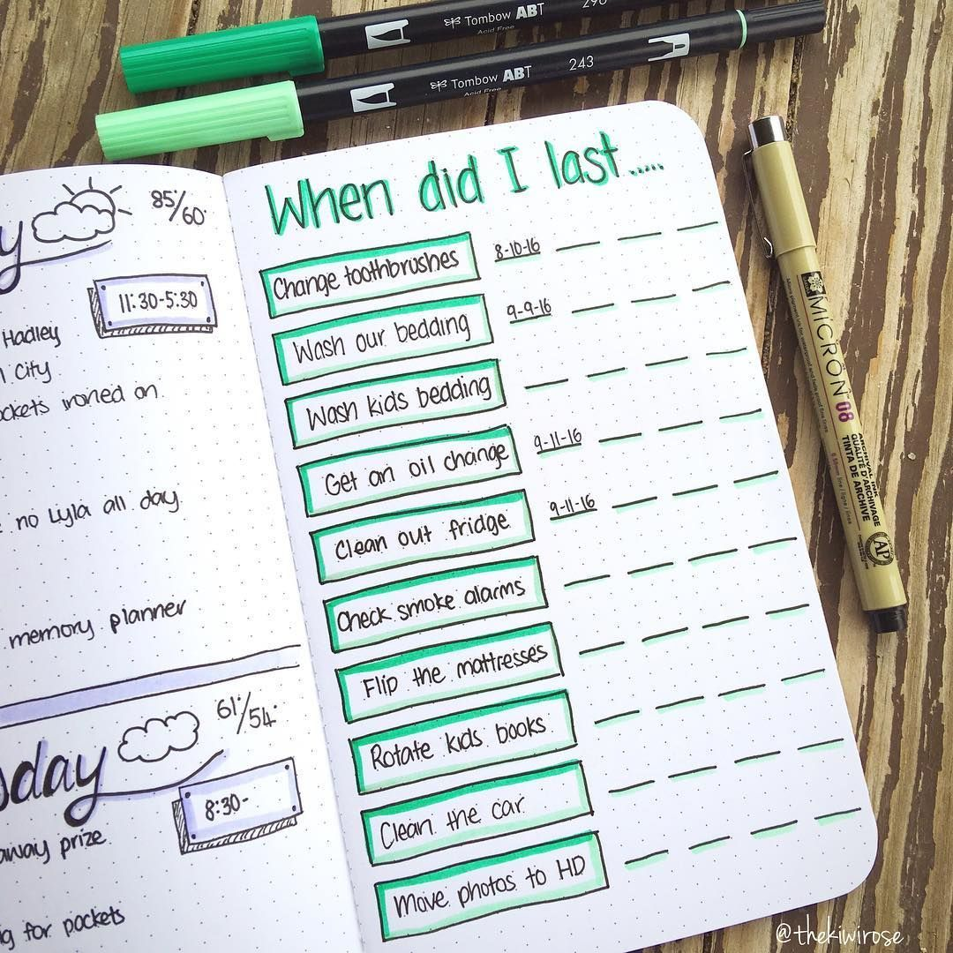

Slide 11
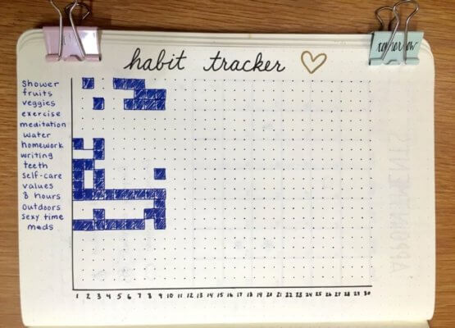
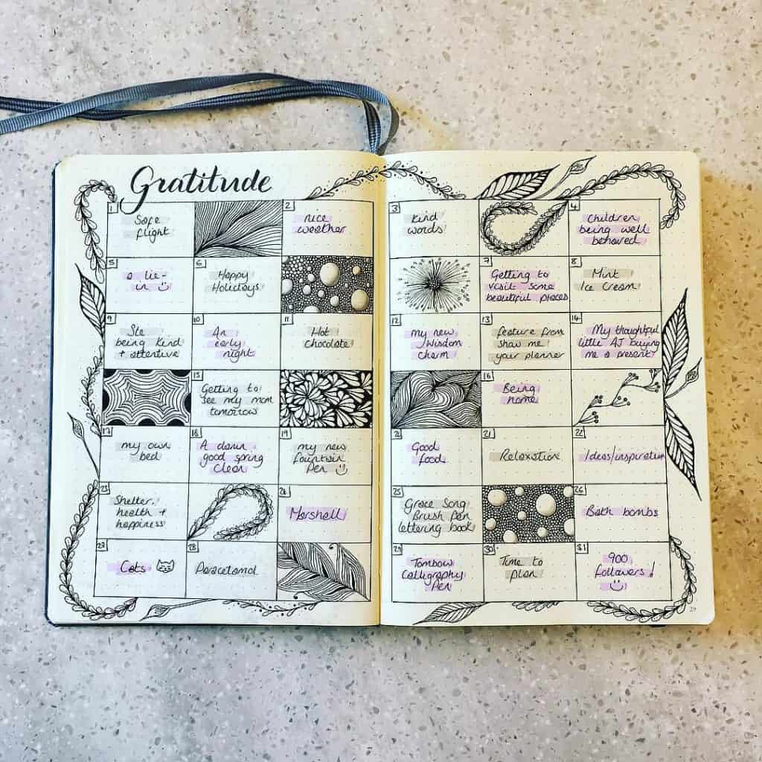

Slide 12
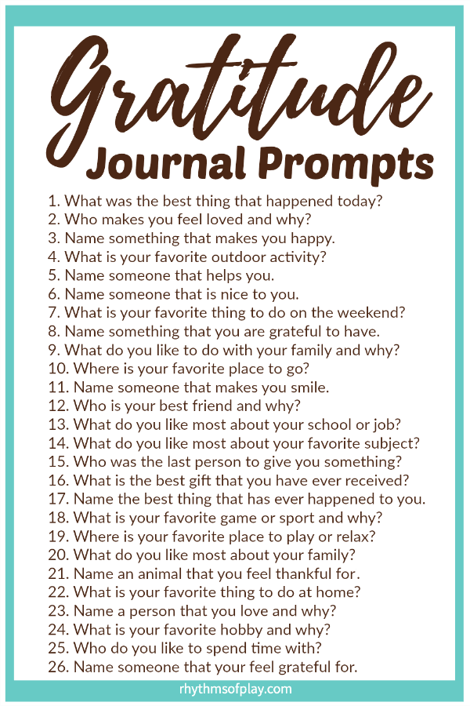
Gratitude Journal

Slide 13
Gratitude Journal
Benefits:
Remember the good things of the day
Help with depression or sad feelings
Redirects thinking
Gain clarity of what you want more/less of in your life

Slide 14
Gratitude Journal- Practice
Choose 2 prompts from the previous list and write it out

Slide 15
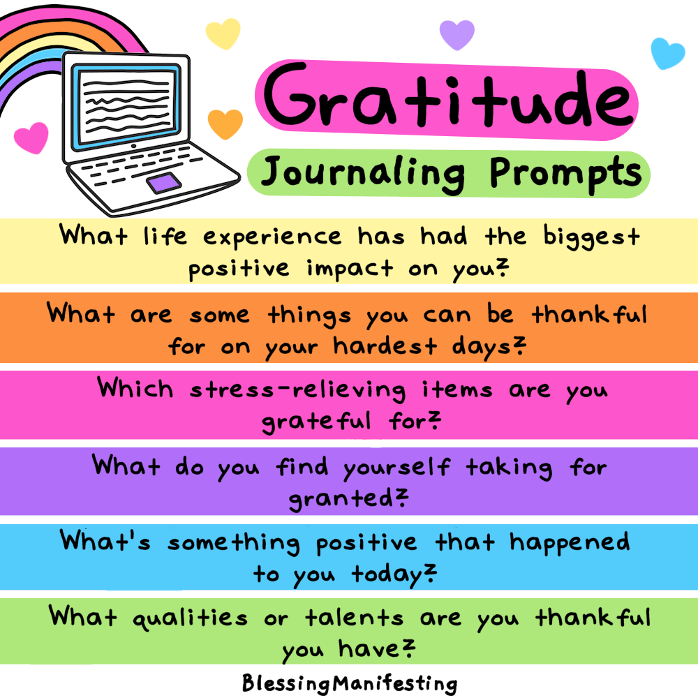

Slide 16
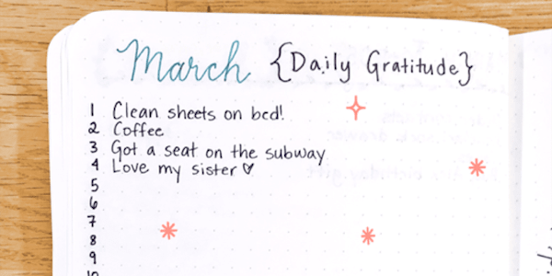

Slide 17
Free Write Journal

Slide 18
Free write Journal
Benefits:
clear your mind
Help wind down from the day
Sort your thoughts
“Free writing is yoga for the mind”
Discover ideas you didn’t know you have
Nobody will read it unless you want them too. More private then ‘venting’.
Lots of prompts online

Slide 19
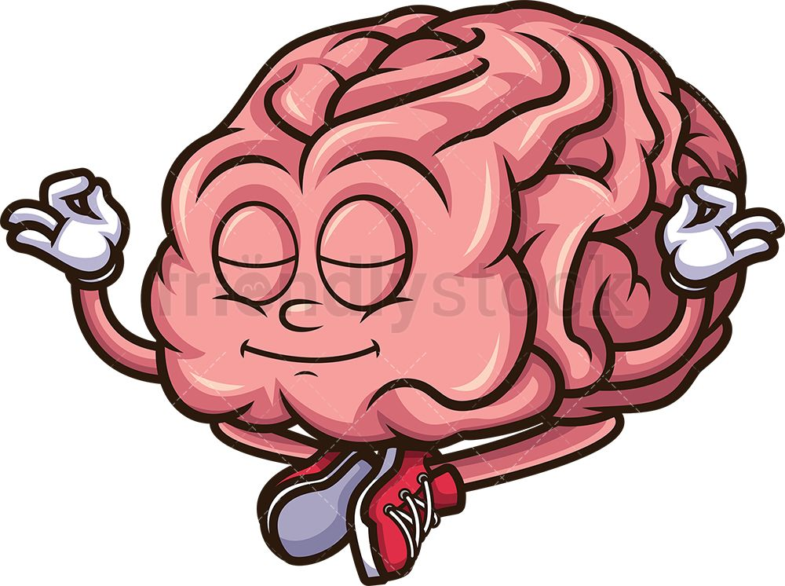

Slide 20
Free Write Activity
Free write about whatever you want for 5 minutes
Ideas: what’s pressing on your mind, things you need to do tonight, what your week looks like, goals you want to accomplish and why..

Slide 21
Time Capsule Journal

Slide 22
Time Capsule Journal
Benefits-
Have a place to remember all the good memories, inside jokes, happy thoughts
A place you can go to when you’re sad
Serves same purpose as scrapbooking but with less time commitment and pictures not required

Slide 23
Time Capsule Journal ACTIVITY
Write two of your favorite memories

Slide 24
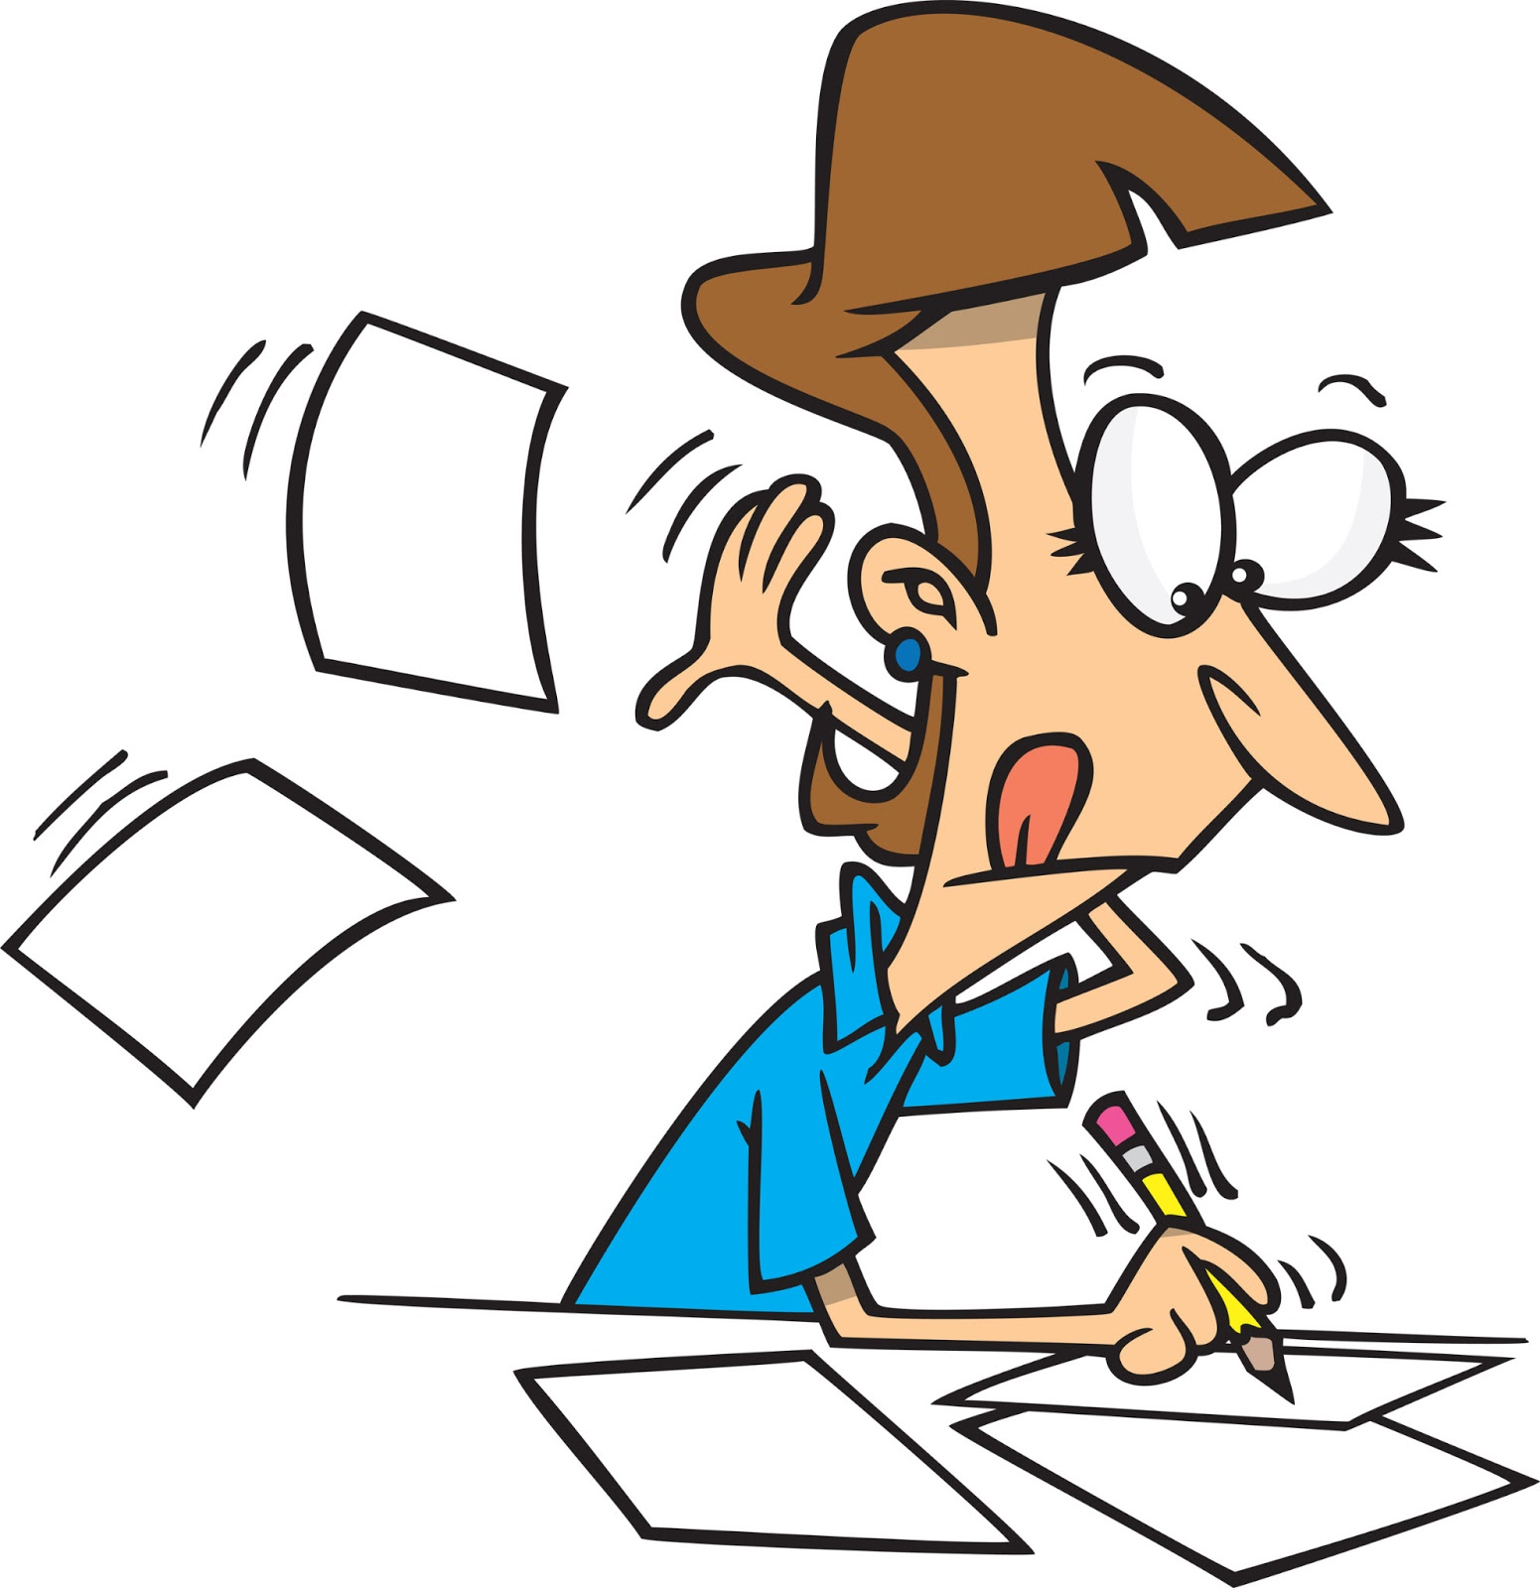
Quick Journal

Slide 25
Quick Journal
Sometimes the thought of keeping a journal can be exciting, but also daunting. If you are keen to keep a record, don’t let the commitment put you off, you can aim to write just one sentence each day.

Slide 26
QUICK JOURNAL PRACTICE
WRITE ONE SENTENCE!!!
Example: inspirational quote, affirmation, motivation, reminder, etc.

Slide 27
Other Journaling Ideas
Goal setting- set goals and outline how to achieve them
Unsent Journaling- when you write a letter to someone and never send it
Write poetry/ songs

Slide 28
Resources
https://screening.mhanational.org/content/how-keep-mental-health-journal

Slide 29
10 Day Journaling Challenge
Day 1- Design a bullet journal spread!
Day 2- Write 5 positive affirmations
Day 3- Write about a challenge you have overcome
Day 4- Write down five things you think are strengths of yours
Day 5- Write out a description of your ideal day
Day 6- write a letter to someone but don’t send it
Day 7- Write out 4 quotes that resonate with you
Day 8- write a letter to your younger self
Day 9- Write about a special memory
Day 10- Write about someone you admire and why you admire them

Slide 30
If time- GAME
Two truths and a lie

