Slide 1
Healthy Goals
The Warrior Movement

Slide 2
Welcome Back Friends!
Omg How ya been?

Slide 3
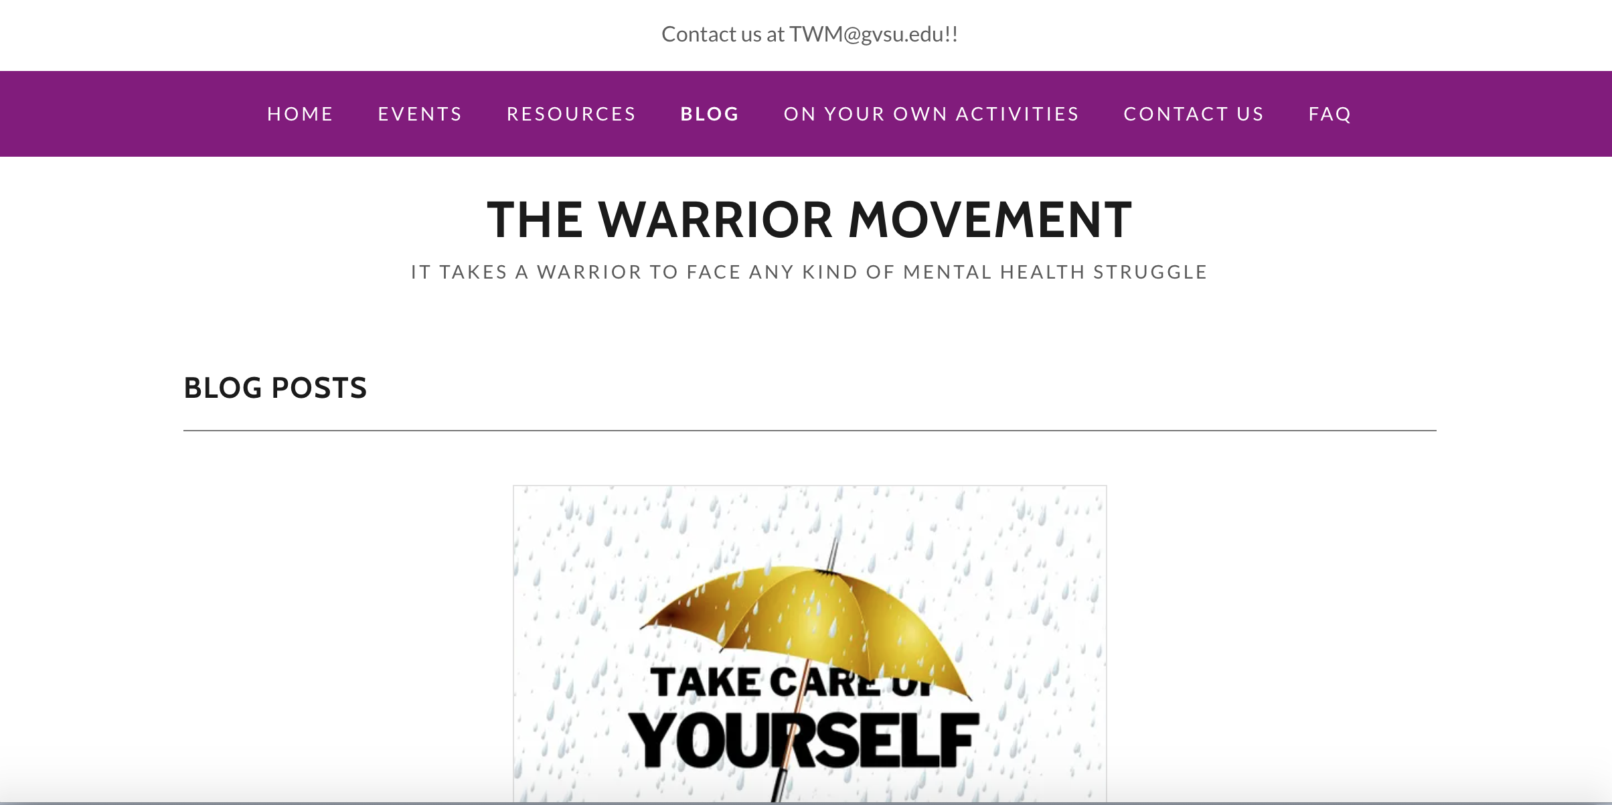
Involvement Opportunities
Blog Posts
Social Media Posts
#WarriorWednesday
Help Austin with Flyer for TWM
Sticker Design Contest

Slide 4
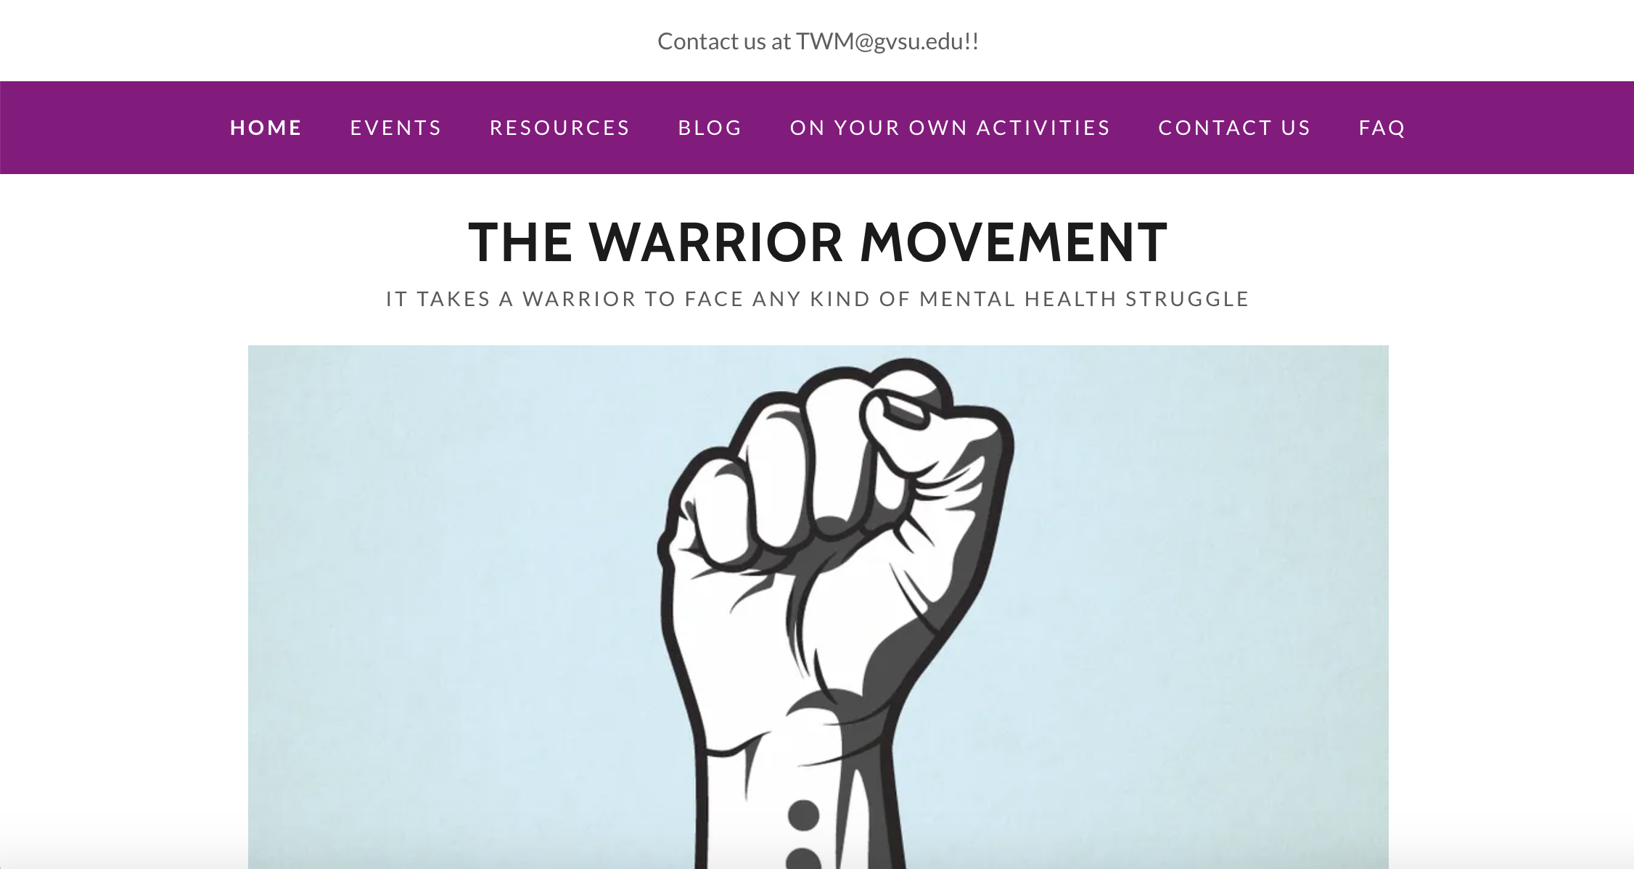
Did you know that we have a website?
You can find the link to our website in the bio of any social media account or look up “thewarriormovement.net” in the search bar!!
What can you find on our website?
Zoom Meeting Slides and Recordings
Mental Health Resources
Blog Posts
On Your Own Activities

Slide 5
Some of our favorite examples of a healthy Goal
Kristin: Doing something that makes you happy everyday; this helps me prioritize myself better.
G: Setting aside time everyday to do self-care tasks; easy to forget when you get busy!
Val: Make more homemade meals and try new recipes; take time to meal prep!
Abby: To be more accepting of myself
Austin: Start taking part in yoga or mindfulness activities regularly
Isabella: Give myself grace when things do not go as planned.

Slide 6
Group discussion
:)
What are some of your long or short term goals for yourself?

Slide 7
What is a healthy goal and why is it important?
Healthy Goals are aims/resolutions with the specific purpose of helping you become happier and healthier that where you currently are at.

Slide 8
Do’s and Don’ts of goal setting
Do:
Make goals that are achievable.
Write your goals on paper.
Frequently check in with yourself and your goals.
Be specific with your goals.
Give yourself grace
Don’t
Make goals that are not achievable.
Expect perfection.
Dwell on past failures.
Forget that you are fully capable of meeting your goals.

Slide 9
What good vs bad goals look like
Good: Trying to fix my wonky sleep schedule
Bad: Instead of sleeping a little, I will always be sleeping
Why is this one “bad”?
If you try to compensate for your little amount of sleep with a huge amount, you may end up losing most of your day.

Slide 10
Good versus bad goals
Good: Learn as much as I can in school
Bad: Get all As
Why is this one bad?
While it is great to get all As, it is often hard to achieve. Instead setting a goal to learn as much as you can is more beneficial long run, but will likely lead to good grades anyways!

Slide 11
Good versus bad goals
Good: Be the healthiest ‘me’ I can be- eat the foods that make my body feel good, ect
Bad: lose weight
Why is this one “bad”?
Setting a goal to just lose weight is very vague, and has the possibility to lead to unhealthy behaviors just to simply reach the goal. If you instead set a goal to be the healthiest you can be, you have grace within what that means and will likely feel a lot better on your journey

Slide 12
Examples of mental health resolutions
Don’t be too hard on yourself. Remind yourself daily that as a human, you will make mistakes or miss goals, and that is okay.
Stay mindful and in the moment.
Eating, self care,
Diligently speak nicely about yourself and treat yourself with respect.
Difference between “I am doing great” and “you are doing great”
Keep a journal/ planner regularly

Slide 13
Examples of mental health resolutions, Continued
Practice self care and attain to your mental health before a crisis occurs
Write 3 things you are grateful for at the end of everyday
Working on learning to say “no”
Asking for help when you need it
Have healthier nighttime/ morning routines
Try a new hobby every month
Less “screen time”

Slide 14
Did this spark any thoughts for new goals?
Is there anything that you can start crack-a-lacking on this semester that would be considered a healthy goal?

Slide 15
Next Meeting...
Concept: Morning and Nightime routines
Date: 2/15/21
Bring a friend for extra points on the challenge!!

