Slide 1
Mindfulness
10-26-2020

Slide 2
Announcements
Quell Foundation documentary
Counseling center does covid isolation support virtually every few days
QPR training coming up Virtually November 11th 2pm-3pm
There’s also one a little further down the pipeline on December 8 from 5pm-6pm
https://www.change.org/p/grand-valley-state-university-administration-give-us-a-spring-break-for-winter-2021?utm_source=share_petition&utm_medium=custom_url&recruited_by_id=49d3dd80-118b-11eb-ae53-c7baa51968e7

Slide 3
Introduction/ Roses and Thorns
Intro: Name, Pronouns, Major, fun fact
Roses and Thorns: one good thing and one bad thing that happened recently

Slide 4
MINDFULNESS: WHAT IT IS AND WHY YOU SHOULD TRY IT
“Mindfulness is a type of meditation in which you focus on being intensely aware of what you’re sensing and feeling in the moment, without interpretation or judgement” (Mayo Clinic).
Mindfulness can:
Help to be more present in the moment
Become more aware to how they relate to the world
Alleviate symptoms of mental health struggles like anxiety, anger or dissociation, among others
Help with physiological symptoms like chronic pain and sleep issues
Help to stay grounded
And more!

Slide 5
How to practice mindfulness throughout the day:
Set aside time. You don’t need a meditation cushion or bench, or any sort of special equipment to access your mindfulness skills—but you do need to set aside some time and space.
Observe the present moment as it is. The aim of mindfulness is not quieting the mind, or attempting to achieve a state of eternal calm. The goal is simple: aim to pay attention to the present moment, without judgment.
Let your judgments roll by. When you notice judgments arise during your practice, make a mental note of them and let them pass.
Return to observing the present moment. Our minds often get carried away in thought. That’s why mindfulness is the practice of returning, again and again, to the present moment.
Be kind to your wandering mind. Don’t judge yourself for whatever thoughts crop up. Just practice recognizing when your mind has wandered off, and gently bring it back.
https://rogersbh.org/about-us/newsroom/blog/power-mindfulness-your-mental-health

Slide 6
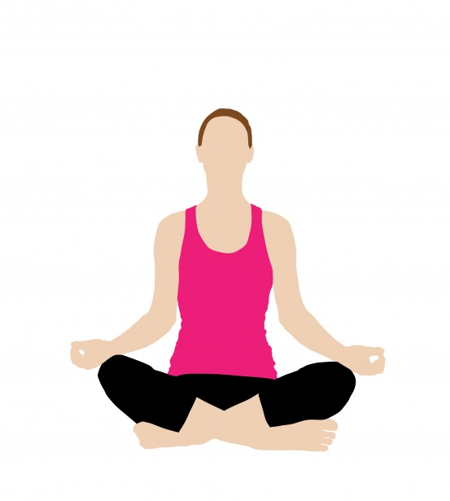
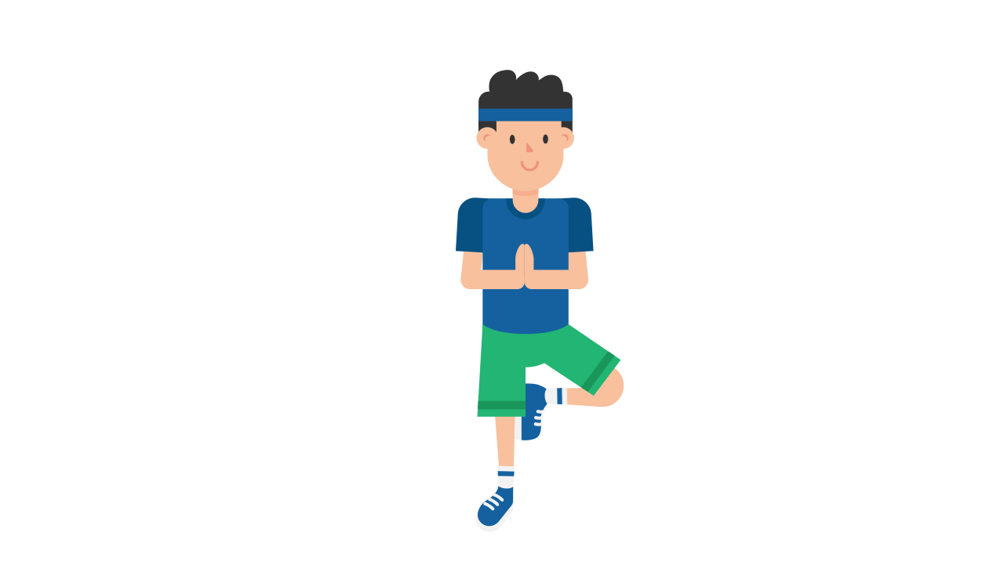
Yoga
Yoga
Increases body awareness
Relieves stress
Reduces muscle tension, strain, and inflammation
Sharpens attention and concentration
Calms and centers the nervous system.
When you focus on the quality and length of your breath, you send freshly oxygenated blood to all parts of your body. As a result, your body's circulatory system perks up and increases your energy.
https://www.youtube.com/watch?v=d8QqXLV3tWM

Slide 7
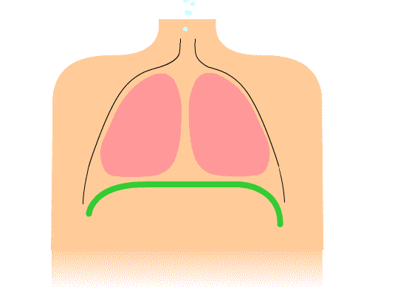
Guided Breathing
Shallow breathing prevents the body from getting enough oxygen. Many people fail to breathe deeply when they feel tense, which is one reason they may feel zapped at the end of a stress-filled day
Paying attention to breathing will force more oxygen into your cells, which slows heart rate, lowers blood pressure, and improves circulation, ultimately providing more energy

Slide 8
https://www.youtube.com/watch?v=awc8MLSpjlQ

Slide 9
PROGRESSIVE MUSCLE RELAXATION
“Progressive muscle relaxation is a non-pharmacological method of deep muscle relaxation, based on the premise that muscle tension is the body's psychological response to anxiety-provoking thoughts and that muscle relaxation blocks anxiety.”
It relies on the idea that if you are fully relaxed, you’re less likely to be anxious.
It can be particularly helpful in relaxing before bed!

Slide 10
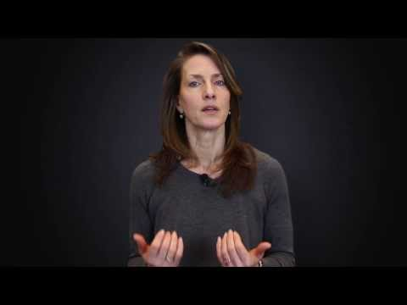
https://www.youtube.com/watch?v=BpCioRUvpRk

Slide 11
PMR STEPS FOR AT HOME USE!
If you’re not in a place that you can listen to the video, here are some quick steps to guide yourself through the process.
START AT YOUR TOES. While you breathe in, tense the muscles in your feet.
Pause for four seconds with your muscles clenched.
As you breathe out, immediately unclench your muscles.
Stay completely relaxed for ten seconds, before moving to your legs.
Repeat the process while slowly working from your feet to your face.
This link has helpful tips on how to safely tense your muscle groups!
NOTE: IF THERE ARE AREAS OF YOUR BODY THAT ARE PRONE TO INJURY OR TENSION, SKIP THEM!
NOTE 2: DO NOT CLENCH YOUR MUSCLES TO THE POINT OF PAIN OR CRAMPING! Especially in your neck, shoulders and upper back, this can cause spasms if you do not pay attention to your body.

Slide 12
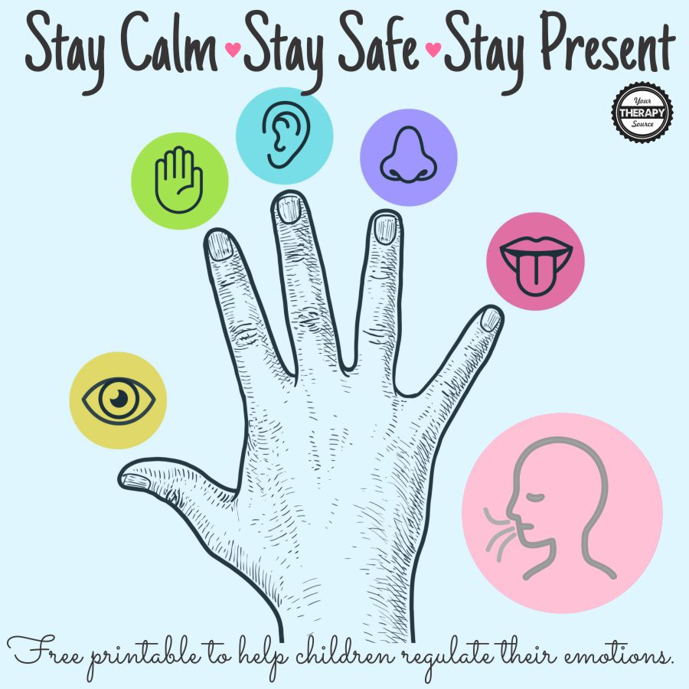
5 Senses Exercise
5 things you can see
4 things you can touch
3 things you can hear
2 things you can smell
1 thing you can taste

Slide 13
Discussion Questions!
Do you know other mindfulness strategies?
What mindfulness strategies do you think you will incorporate, if any?
Do y’all play Among Us?
Reminder: We want to know what meetings you all would like to see us put on! If you have ideas for future meetings, feel free to share them after our discussion, or send us a message or email!
https://docs.google.com/forms/d/1DNZ6iuxKQ6IMFtTJThS4IgoPLozLeUtMYXNziLwSVCQ/viewform?edit_requested=true

