Slide 1
Morning and Nighttime Routines
The Warrior Movement

Slide 2
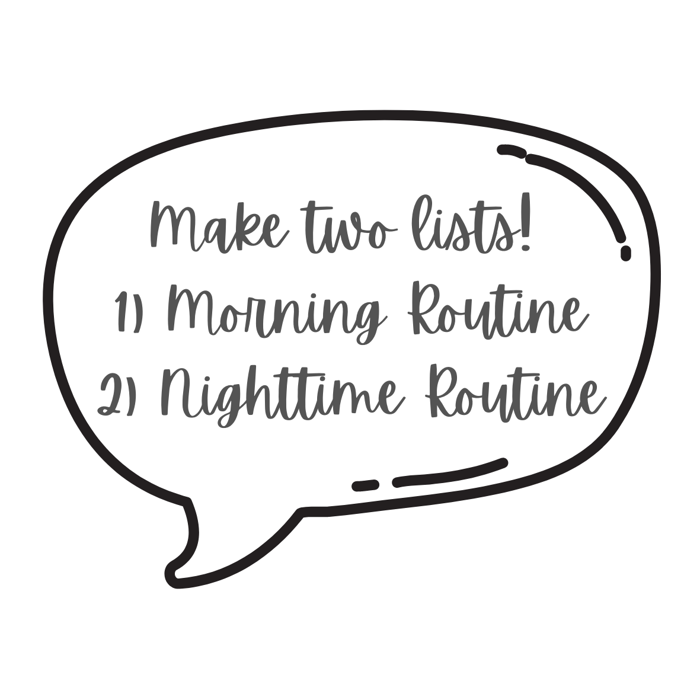
Five Minutes To Write
Grab a writing utensil and a scrap piece of paper!
When the time starts, answer one of the following questions!
If you do have a morning or nighttime routine:
What do your morning and nighttime routine look like?
If you do not have a morning or nighttime routine:
How do you think a morning or nighttime routine could help you? What are some things you would like to implement?

Slide 3
Discussion: Do you have a morning or nightime routine?
YES
What is your favorite part of your routine?
How does a routine change the way your day or night will play out?
What happens when your routine doesn’t go as planned?
NO
How can creating and following a routine (morning or night) help you?
Would you consider creating a morning or nightime routine?

Slide 4
What are the benefits of following a routine?
Lower Stress Levels
Better Sleep
Better Focus on Things within your Control
Work More Efficiently
Created Structure in your Life
Instills Good Habits
Reduces Procrastination
Builds Self Confidence
Helps us Achieve our Goals

Slide 5
Tackling your frog (Austin)
Everyday that you wake up, the first activity that you complete is always the hardest (and sets the pace for the day).
By “tackling your frog” or completing this first task (making your bed, showering, etc.), you set yourself off for success during the rest of your day. Once the first task is done, the next are usually not as bad.

Slide 6
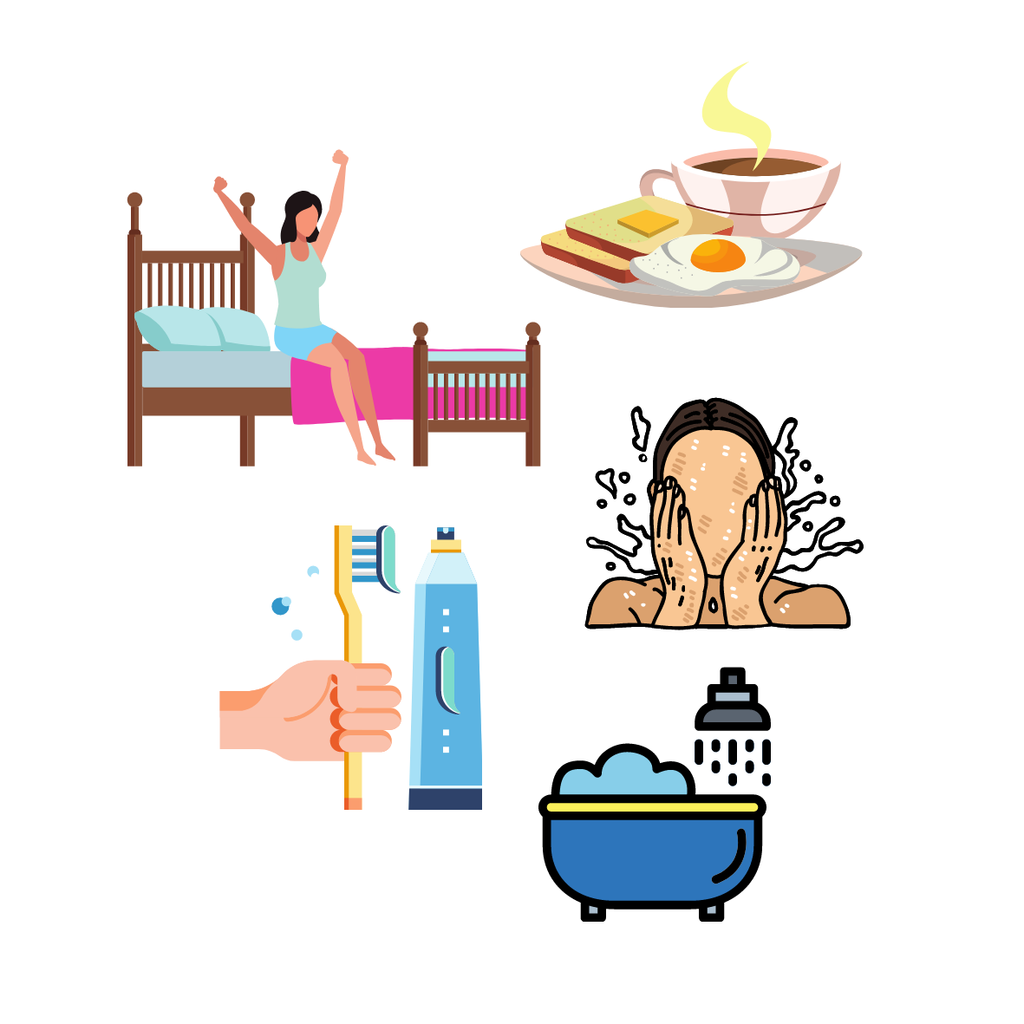
Ideas for your Morning Routine
Do a Short Exercise Session or stretching
Drink a Full Glass of Water Before Getting Out of Bed
Write Down 3 Goals for the Day
Keep a Dream Journal
Read in a Book
Practice a New Language
Meditate
Make your bed

Slide 7
Example of a Healthy, relatively simple, Morning Routine
You wake up at a consistent time, the ideal time to wake up for people in their twenties is about 9:30am. Open your window to let some natural light in, as this can boost your mood. Grab a water bottle and drink at least half of it (8 ounces). While still in bed, you can meditate or say some mantras. Then you get out of bed, do some stretches or quick cardio, and go downstairs and make some coffee and a good breakfast!

Slide 8
Scientific Proof
Dehydration is strongly linked to decreased mental performance, meaning that completing tasks, such as memorizing or learning new things, becomes more difficult. So, drinking a glass in the morning helps you start to stay on top of hydration!
Meditating in the morning will It sets a tone of calm for the entire day, and give you more energy from the endorphins it releases.
Getting up at inconsistent times can confuse your biological clock

Slide 9
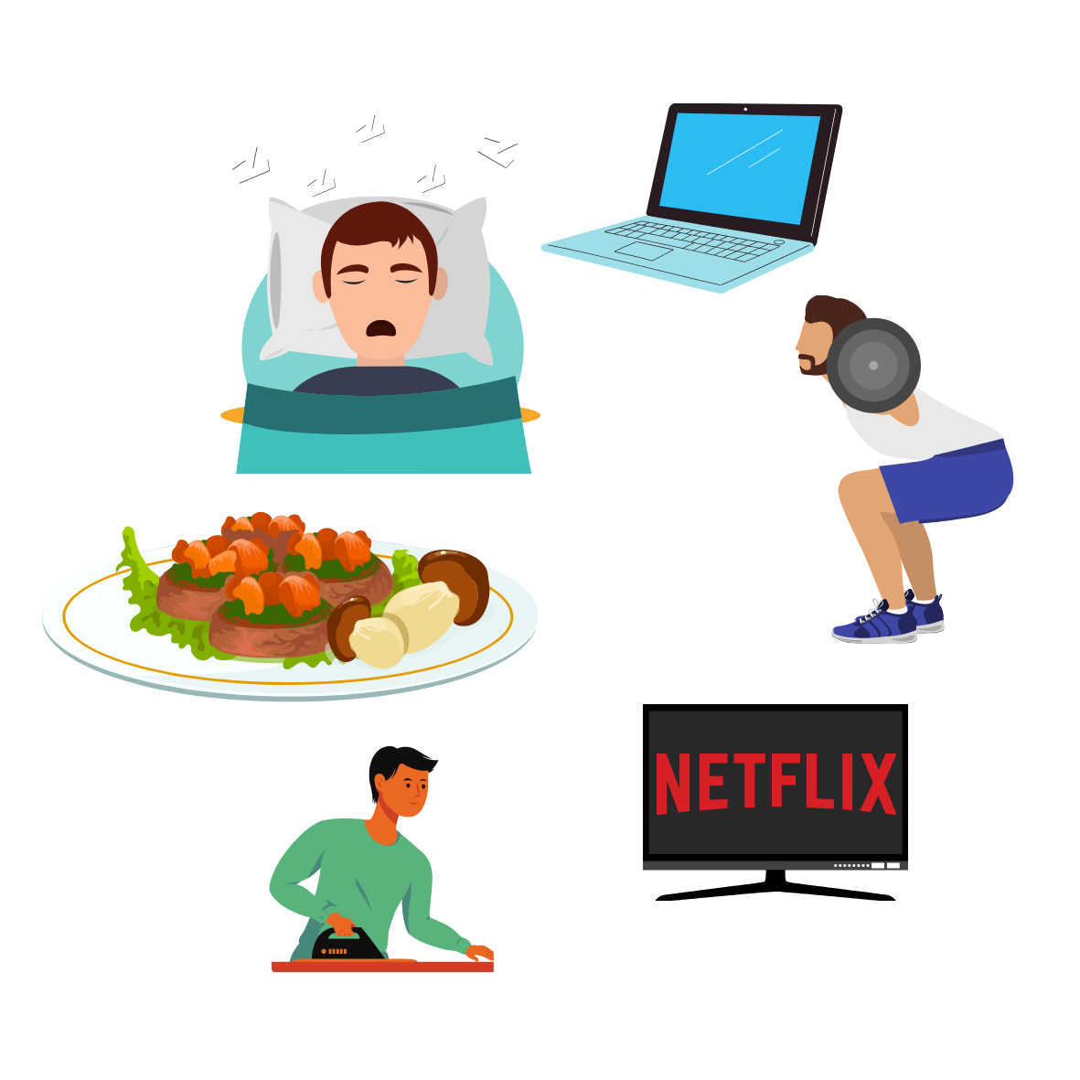
Ideas for your Nighttime Routine
reduce/ eliminate screen time 30 minutes before bed
Read before bed
Meditate
Make a to do list for the next day
Journal and reflect on the day
Practice gratitude
Do something creative
Diffuse essential oils/ try a candle
Listen to calming music

Slide 10
Scientific Proof
Chamomile tea is particularly effective at making you feel sleepy because of its chemical structure. The plant extract contains apigenin, a chemical compound that induces sleepiness when it binds to the GABA receptors in the brain.
In the study of 57 young adults, researchers from Baylor University and Emory University found that writing to-do lists, rather than writing about completed tasks, helped people fall asleep an average of nine minutes faster—in about 16 minutes versus 25.
In one study, adults who listened to 45 minutes of music before going to sleep reported having better sleep quality beginning on the very first night

Slide 11
Example of a Healthy, relatively simple, nighttime Routine
You pick up any messes in the common areas (kitchen, living area, bathroom, ect), dim your lights and unwind with an episode of your favorite show. Afterword, you go and make a cup of hot (decaf, calming) tea, and sit on your bed and journal out your day, reflecting on the good and bad emotions. Afterword, you write out your to do list/ plan for the next day, so you do not have to think about it as you sleep. Now you get up, brush your teeth, spray some essential oils, and lay in bed to some calming music.

Slide 12
Our Challenge- whoever tries the most routine ideas wins a prize :D
https://docs.google.com/document/d/1JtSULEyYWvNJeawiCCHpu4FJhJ9BbURmocoUhpIjTLs/edit?usp=sharing
+1 point for everything you incorporate in the morning/ night time
Bonus points!!: You will get +3 bonus points if you bring a friend to
The next meeting/ brought one today. +2 bonus points for anything
You implemented into a nighttime routine that is not on the list, and
+4 bonus points for any posts to social media about it tagging us!!

