Slide 1
We’ll do a quick intro activity for everyone too :))
Name
Pronouns
Favorite Thanksgiving Food
Roses & thorns

Slide 2
Importance of Mental Health Plans
The Warrior Movement

Slide 3
How a plan will help
When you are in a moment of crisis / struggle, it is sometimes very hard to know what to do to help yourself in that moment. If you plan ahead for those moments, all you have to do is grab your plan / kit/ etc and can start coping.
Hard to predict when a crisis will happen, so doing this when you are just chillin is great
In other cases, it can help other people know what to do- if you choose to involve other people

Slide 4
What a plan can look like
Written plan for how loved ones/ roomates / family/ significant other / etc can help you in that moment and what signs to look for that you may be coming to a crisis/ bad mental health bout
Digital file on laptop
Tangible box/ bag in an easily accessible spot

Slide 5
Digital Mental Health Folder
Having files on your computer to open that are easily accessible can be something really helpful in times of stress.
Especially now with virtual schooling, we are always on or near our computers
This works if digital is better than tangible for you

Slide 6
What to have in your mental health digital folder
List of affirmations
A playlist of songs that help
Pictures of
Loved ones, pets, celebrities, anything else that brings joy or feelings of calm
Quotes
Reminders
Games for distraction

Slide 7
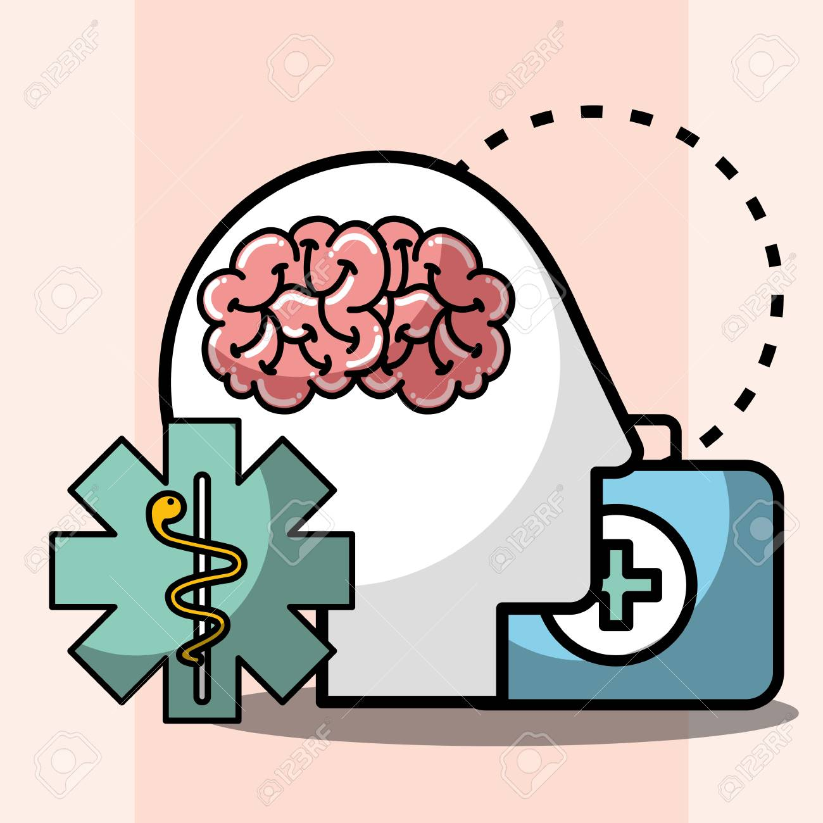
Mental Health Toolbox
A crisis kit is a toolbox that is specific to the person that is put together before a crisis occurs. It is filled with objects, pictures, or reminders to help navigate the symptoms of a mental health struggle.
Helpful because it is something you can put together in advance, and then when you are in a moment where you aren’t doing so hot- you do not have to think about that to do, you just go to your box

Slide 8
Things to include in your mental health toolkit??
Affirmations
A journal/ pen
Earbuds
Essential oils
Gum/ mints / candy
Salt packet
Stress balls/ puddy
Pictures of loved ones
Important reminders
Phone numbers
Medications
Dark chocolate
Tea
Any workbooks you may have
Coloring book
Fidget toys
Self care items (bath bombs?)
Tissues
A snack
Something funny
Handwritten note to self
Something a loved one gave you
Something funny
Crisis hotline numbers
Written crisis plan
Play-doh
Vitamins/ supplements
Notes:
Salt packet can shock your body out of a panic attack because it reverts your brain's attention from “panic!!” to “i need to get myself water”
Dark chocolate can boost serotonin levels

Slide 9
Group Prompt!!! : D
What would you add in your mental health toolbox? Any suggestions we have stand out to you, any different you can think of?

Slide 10
Crisis plan
This is usually a written out plan for you or those close to/ living with you to follow. In case of a mental health emergency
Two crisis options above work well for panic attacks, or crisis’s and mental health issues that are still in the realm of manageable, this one works well in emergencies
This works if you have a written out plan and put it in a central place, known to any party involved in the emergency de-escalation

Slide 11
What to include in a crisis plan?
Warning signs / triggers for others to be aware of (early warning signs, urgent warning signs, etc)
A list coping strategies that work for you
Phone numbers of approved people to call
List of things to make environment safe
Phone numbers to trusted professionals
Notes:
This can be important for you to make for yourself, or suggest to a friend who may be struggling :)

Slide 12
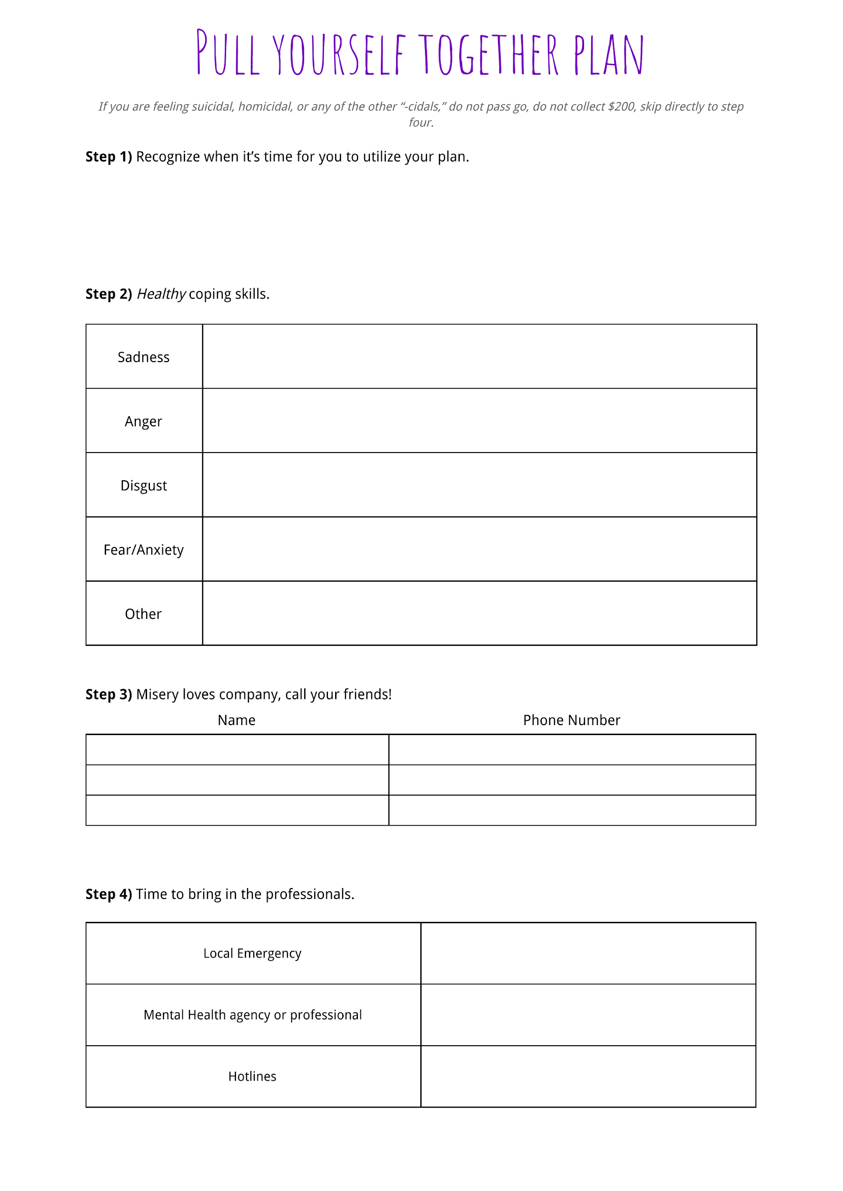

Slide 13
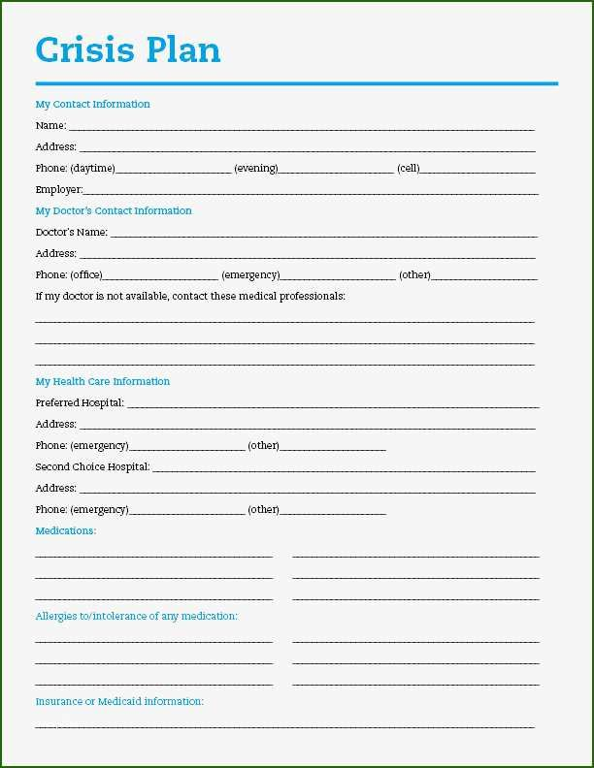

Slide 14
Planning Resources Links:
Crisis planning:
https://www.healthpartners.com/ucm/groups/public/@hp/@public/documents/documents/entry_194822.pdf
https://www.youtube.com/watch?v=7-XFzk_VdsQ
Toolkit:
https://www.youtube.com/watch?v=iuKLW2UVF3c
https://www.youtube.com/watch?v=66AfkBwbvQc

Slide 15
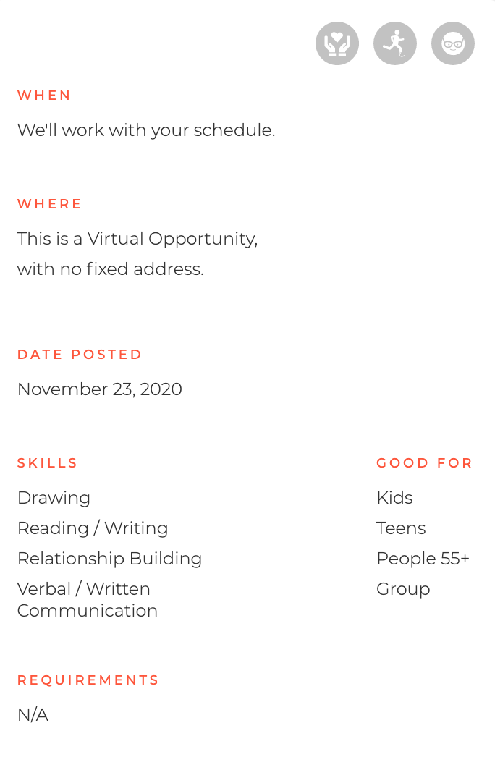
Volunteer Opportunities
Due to the pandemic, many individuals with chronic illnesses have been unable to leave their house, leading to greater levels of loneliness and isolation. This is why Plus One Foundation started our penpal program: to provide heartfelt, handwritten letters and drawings of encouragement to these individuals to brighten their days and ensure they know they're in our thoughts! So far, we have sent 395 letters, and we'd love to send more with your help.
https://www.volunteermatch.org/search/opp3331035.jsp

