Slide 1
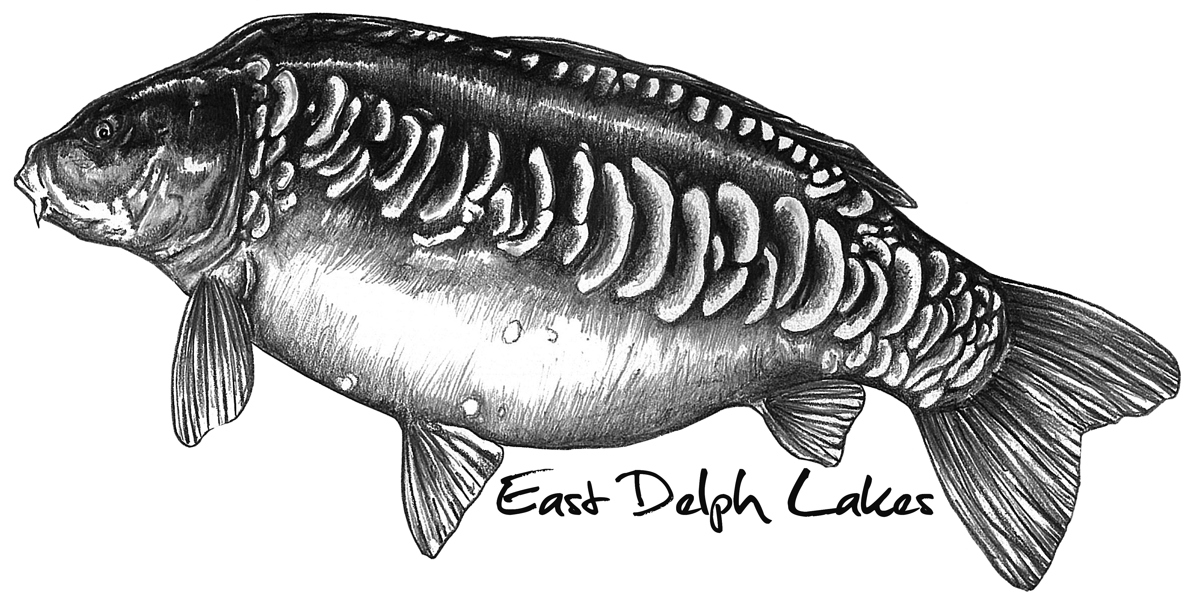
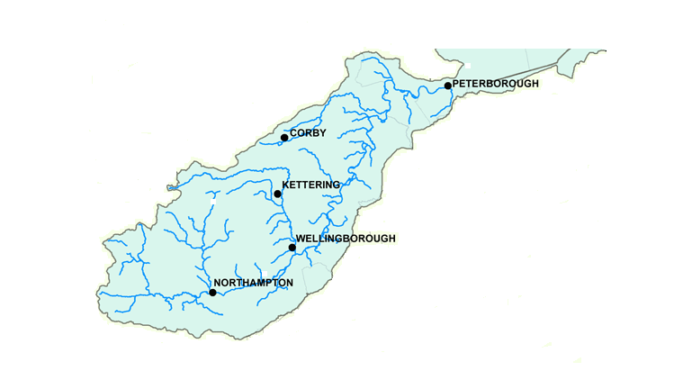
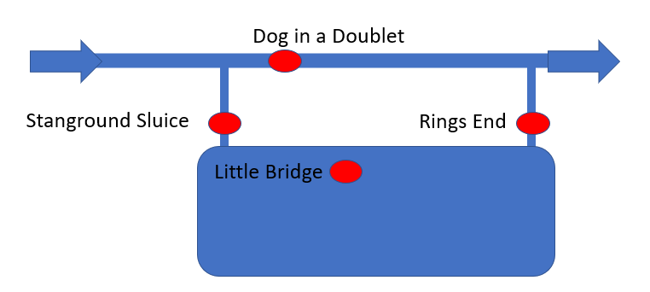
Whittlesey Wash Flood Monitoring
The Whittlesey Wash is flooded by the River Nene, the rivers catchment area is shown on the map. Rainfall outside the area is irrelevant for flooding on the Wash. Water takes about five days to travel from Northampton to Peterborough. During periods of high rainfall river levels can build to a point that there is a risk of flooding to properties along the Nene. To prevent the flooding of these properties water is deliberately released onto the Whittlesey Wash.
Owning a fishery (www.eastdelphlakes.com) in the Whittlesey Wash has taught me how to monitor and predict flooding, this PDF hopes to share a bit of what I’ve learnt. It’s based only on my observations with no ‘fact checking’ from any external agency or organisation.
James Mackay
Dog in a Doublet
Rings End Tidal
A good indicator that the Whittlesey Wash is about to flood is the closure of the North Bank Road, this closes when water levels reach 3.6 AOD at the Dog in A Doublet.
Rings End River
Water is released into the Whittlesey Wash via Stanground Sluice. The sluice opens when river levels there reach 3.8 AOD. The higher the river level the wider the opening. Stanground sluice will close again when river levels have reached 3.6 AOD.
Little Bridge
Stanground
Water is drained from the Whittlesey Wash at Rings End. This can only happen when river levels have sufficiently dropped.
Orton
River levels are available via online monitoring stations shown on the map.
Three different websites are used to read this data, these can be accessed by clicking on the coloured circles. See map key below.
https://riverlevels.uk/ provides data for every monitoring station on the map.
https://flood-warning-information.service.gov.uk/ has excellent graphical format, but does not cover every monitoring station.
https://www.gaugemap.co.uk/ provides graphical format for Stanground Sluice.
The West Lighthouse Tide Timetable is critical to working out how much water can potentially flood into the Wash. During the period when river levels are high it’s ‘good news’ if tides are peaking below 3m. When tides are peaking above 3m during the period of high river levels, the potential for flooding is greater.
Wansford
Lilford
This is because ability of water to flow through the Nene and out to sea is reduced as the tide rises and moves upstream from the sea. ‘Tide lock’ can occur at the Dog in a Doublet sluice stopping the ability of water to move downstream. High tide at the Dog in a Doublet can be calculated by adding 2.5 hours to high tide at West Lighthouse.
Cogenhoe
The Met Office provides reliable rainfall data for the River Nene catchment.
Rainfall forecast
Rainfall history
Nene
Kislinbury
When water levels are rising in the Wash ‘DIY depth markers’ are used at East Delph Lakes. Observe the water hight, then cross refer that height to the data from Little Bridge. For example the East Delph Lakes track floods at 1.18m, the car park floods at 1.37m and the B1040 floods over at 1.43m. It’s possible to predict what levels might impact higher parts of your property in future floods.
Best viewed on tablet or PC.
Not mobile phone ‘friendly’.
The flooded Wash

