Slide 1
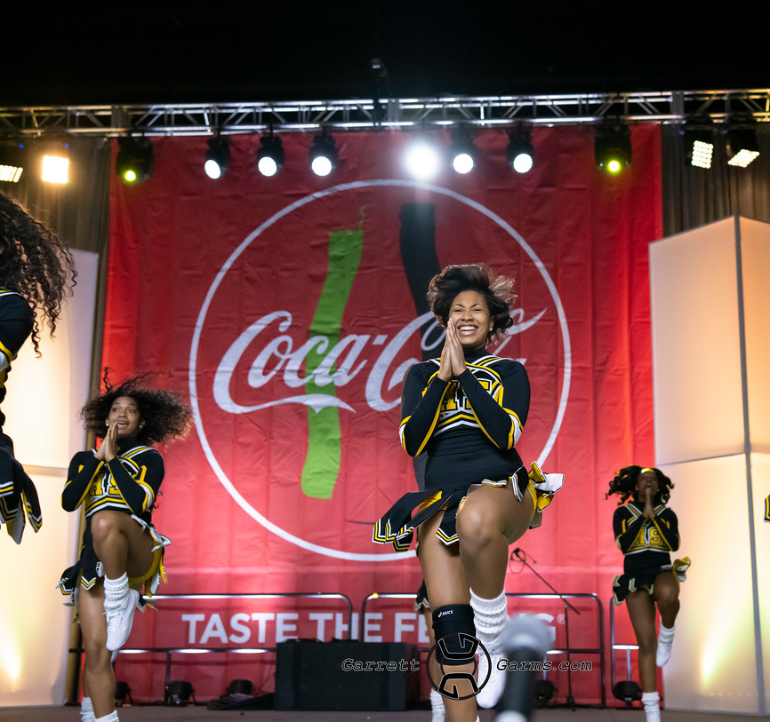
High school cheerleading championship
Friday, February 28, 2020
Fan fest
Charlotte
convention center

Slide 2
Early EVENT REGISTRATION $35 PER PARTICIPANT $10 PER Coach
EARLY BIRD SPECIAL: $35 PER PARTICIPANT ENDS 1/13/20 for teams of 15 or more
$500 flat rate for teams 15 or less
After January 13, 2020, registration fee goes up to $45 per participant for teams with more than 15 participating members or more
After January 13, 2020, registration fee goes up to $650 flat rate for teams of 15 or less.
PARTICIPANTS WILL NEED TO COMPLETE A waiver FORM to participate in the championship
COACHES who will assist with the team back stage will need to register at the $10 per coach rate

Slide 3
t-shirts available
All registered participants will receive a t-shirt
Additional t-shirts will be for sale at the event for $10 per shirt
Small, medium and large
$12-$15 for XL and up
Purchase your t-shirt online now!!

Slide 4
How to register
Visit our website at https://u-fit365.com/competitions
Complete your team registration form- including number of participants and pay total amount due
T-shirt sizes will need to be included on the team registration form along with the team roster.
Complete coaches registration form and pay total amount for all coaches attending (coaches credentials will be distributed on day of event) any coach or team assistant will need to be registered as a coach or participant registration must be paid and complete
Each participant must complete “participant registration” which includes waiver form to have signed and submitted during registration

Slide 5
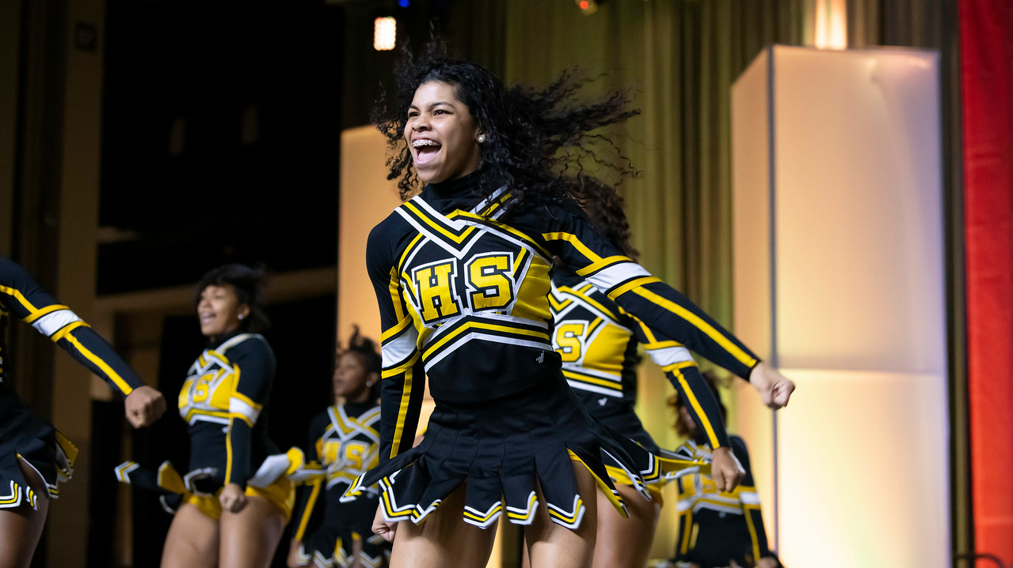
EVENT DETAILS
Ufit has partnered with the ciaa in presenting our stomp n’ shake community with the staged event of the year! PREPARE YOUR SQUAD TO COME AND SHOWCASE THEIR TALENT AND SKILLS DURING THE MOST HISTORICAL TIME OF YEAR FOR STOMP N’ SHAKE CHEERLEADING. With the 2nd year in partnership, this IS THE HIGHLIGHT OF Stomp n shakes’ top thirteen teams. UFIT WILL HOST THIS EVENT, OPEN TO ALL Cheerleading teams WHO PERFORM THE STOMP N’ SHAKE STYLE IN A FUN AND FESTIVE ENVIRONMENT. LET’S HAVE SOME FUN at ciaa’s fan fest for ufit’s high school stomp and shake cheerleading championship! Not only will cheerleaders have a chance to compete but also a chance to be entered into ufit’s annual sns scholarship fund where a recipient is awarded each year! It’s more than cheerleading, it’s our future.

Slide 6
HOW TO PREPARE
YOUR TEAM WILL HAVE UP TO 5 MINUTES TO PERFORM A ROUTINE CATERING TO ”BOTH” SIDES OF THE CROWD, “FRONT AND BACK”.
UNIFORMS, COSTUMES, PROPS ARE ALL WELCOME, “ITS AN EXHIBITION” style performance so we want your best work on the stage!
WOW THE CROWD WITH YOUR CREATIVITY AND ENERGY
Your team will perform on a “stage” so please prepare accordingly for any acrobatic movement such as stunts and tumbling.
NO EXCESSIVE GLITTER/FEATHERS OR EMBELLISHMENTS THAT COULD CAUSE HURT/HARM OR DANGER TO ANY PERFORMERS if to drop on the floor
VULGAR LANGUAGE AND GESTURES ARE PROHIBITED IN MUSIC AND IN CHEERS/CHANTS/DANCES SO PLEASE KEEP IT CLEAN
ALL REGISTERED TEAMS WILL PERFORM TOGETHER FOR A UNITY CHEER AT THE END OF THE EVENT

Slide 7
HOW TO PREPARE CON’T
MUSIC FOR YOUR 5 MINUTE PERFORMANCE SHOULD BE SUBMITTED NO LATER THAN FEBRUARY 17, 2020.
MUSIC WILL NEED TO BE SUBMITTED IN ITS FINAL CUT.
THERE WILL BE DESIGNATED AREAS ON A SCHEDULE OF ROTATION FOR ALL REGISTERED CHEERLEADING TEAMS.
ONCE THE EVENT HAS BEGUN ALL TEAMS WILL NEED TO KEEP PERSONAL ITEMS WITH THEM FOR THE DURATION OF THE EVENT WITH THE EXCEPTION OF PROPS.
UFIT CHEER AND DANCE INC WILL NOT BE HELD RESPONSIBLE FOR ANY LOST OR STOLEN PERSONAL ITEMS OR BELONGINGS.
UNITY CHEER WILL BE available on the ufit website for practice. The cheer will BE PERFORMED TOGETHER.
If you have staff that are not coaching and not cheering, but will be assisting, they will need to register as a coach for this event.

Slide 8
PERKS AND PRIZES
Custom event t-shirt
SCHOLARSHIP PRIZES
Top team to perform at ciaa super Saturday
1st, 2nd and 3rd place cash prize and trophy

Slide 9
SNS ALL STAR 2020
UFIT IS GIVING AWAY SCHOLARSHIP MONEY TO THE REGISTERED PARTICIPANT WITH THE HIGHEST GPA AND COMMUNITY SERVICE HOURS. SEE REQUIREMENTS BELOW
SUBMIT GPA
MUST BE A HIGH SCHOOL SENIOR
MUST HAVE RECEIVED AN ADMISSIONS LETTER INTO THE SCHOOL OF CHOICE.
MUST SUBMIT A ONE PAGE ESSAY ON HOW STOMP N’ SHAKE CHEERLEADING AND SCHOOL INVOLVEMENT HAS ENHANCED YOUR SCHOOL EXPERIENCE.
ONLY ONE ENTRY PER REGISTERED TEAM

Slide 10
Recognizing our sns achievements
We’re excited to host your squad at the high school cheerleading championship! For 7 years we have recognized teams across the sns nation in performance, sns-techinique, creativity and more. In advance, we thank you for your participation!

Slide 11
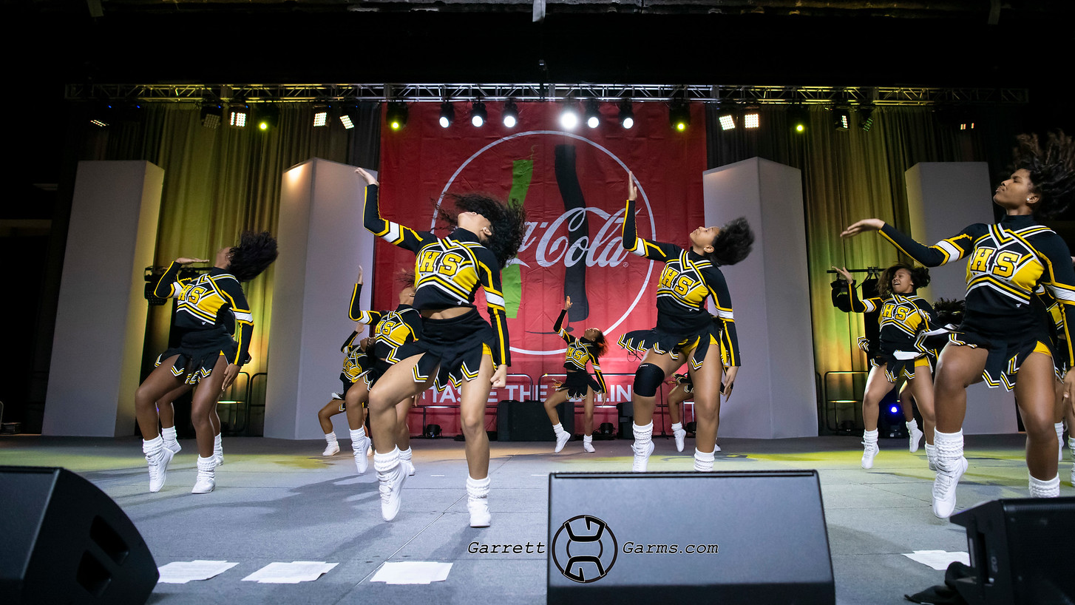
WHAT TO EXPECT
THE MOST SKILLED AND TALENTED STOMP N’ SHAKE TEAMS
SURPRISE CELEBRITY RADIO PERSONALITY HOST
Celebrity performance
Biggest crowd of the year
FUN AND EXCITEMENT the sns way!!!
Lots of jammin’, shakin’ and rockin!
STOMP N’ SHAKES’ HOTTEST DJ, DJ WOOD
THE OFFICIAL championship FOR HIGH SCHOOL SNS SQUADS HAPPENING at ciaa’s fan fest in the charlotte convention center

Slide 12
WHERE TO STAY
BEST PLACES TO STAY DURING THIS HIGH TRAFFIC AND BUSY WEEKEND Will BE IN
ROCK HILL, SC
HUNTERSVILLE, NC
PINEVILLE, SC
CONCORD, NC
OR ANYWHERE 10MILES OUTSIDE OF CHARLOTTE, NC FOR BEST ACCOMODATING PRICES
https://www.hotels.com/search.do?resolved-location=CITY%3A1407168%3AUNKNOWN%3AUNKNOWN&destination-id=1407168&q-destination=Charlotte,%20North%20Carolina,%20United%20States%20of%20America&q-check-in=2020-02-27&q-check-out=2020-02-29&q-rooms=1&q-room-0-adults=2&q-room-0-children=0

Slide 13
WHERE TO EAT
https://www.idontdoclubs.com/2016/01/11/black-owned-restaurants-charlotte-north-carolina/
https://www.happycow.net/north_america/usa/north_carolina/charlotte/
http://www.charlottemagazine.com/Charlotte-Magazine/January-2017/25-Best-New-Restaurants-2017/

Slide 14
Check out what to do during the 2020 ciaa tournament
Ufit presents ciaa’s high school cheerleading championship, FRIDAY, February 28, 2020 > fan fest, charlotte convention center uptown charlotte
https://theciaa.com/sports/2019/9/26/BBALLCHAMP_0926192731.aspx

Slide 15
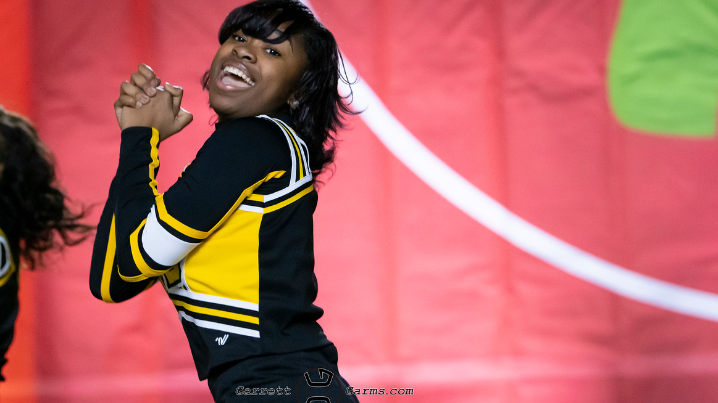
CONTACT UFIT TODAY
FOR MORE INFORMATION, CONTACT US TODAY AT (980)819-1365
FOR MEDIA PASSES CONTACT US MOREINFO@U-FIT365.COM
REGISTER NOW AT https://u-fit365.com/competitions
FOR GENERAL INFORMATION EMAIL US AT MOREINFO@U-FIT365.COM

