Slide 1
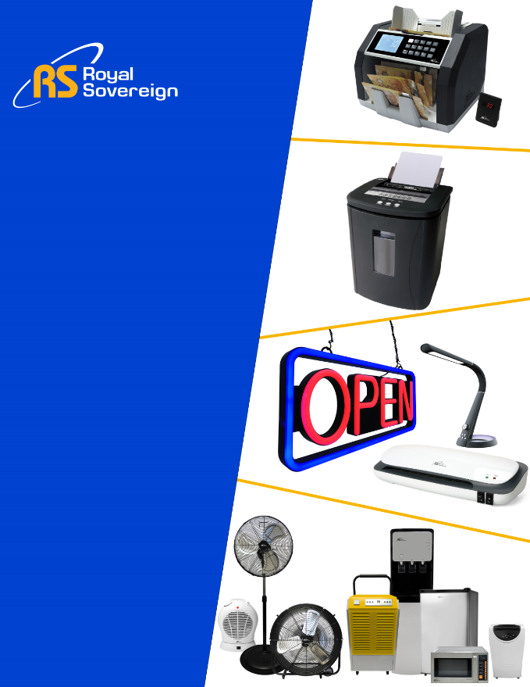
Novexco Stocking Assortment
▪ Cash Management
▪ Office Products
▪ Appliances
▪ Commercial Equipment
Cash Management
www.royalsovereign.ca

Slide 2
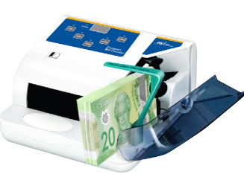

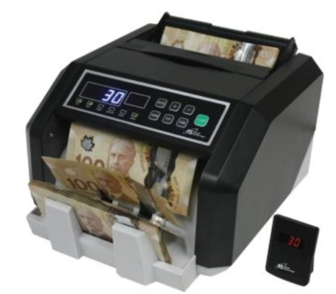

Cash Management
Royal Sovereign offers the most extensive range of cash management solutions to help businesses save time and money.
Bill Counters
Royal Sovereign offers a wide assortment of bill counters to suit your specific application. Our easy to use controls and advanced mechanical technology allow you to count and sort quickly and accurately. Ideal for food and hospitality, retail and service businesses, money exchange and financial banking applications.
RBC-Quickcount
Portable Electric Bill Counter
Features:
• Counts 600 bills per minute
• Side load hopper holds 150 bills at a time
• Counts Canada and US bank notes
• Counterfeit detection for US banknotes
• Use the UV (Ultraviolet) function to check
government and bank issued ID’s such as
passports, credit cards, drivers license, etc.
• Compact and portable
Bill Counters
RBC-ES210-CA
Professional Backload Bill Counter with Counterfeit Detection
Features:
• Dual Canadian and American Counterfeit Detection
• Counts 1400 bills per minute
• Large 200 bill high capacity hopper
• Automatic start / stop or selectable manual mode
• Cumulative and batch counting
• External digital display included

Slide 3
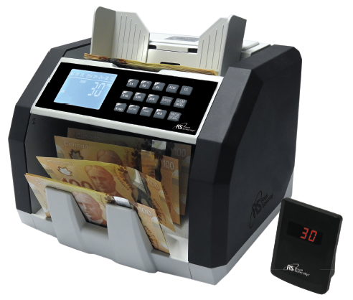

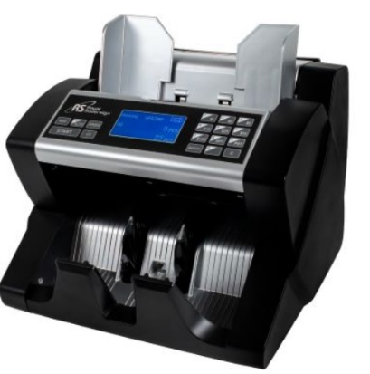
RBC-ED250-CA
Commercial Bill Counter with Selectable Denomination for Value Counting
Features:
• Dual Canadian and American Counterfeit Function
with selectable counterfeit detection
• Counts both value and quantity of selected denomination
• Variable counting speed, 900/1200/1500 bills per minute
• Convenient large front loading hopper holds up to 500
banknotes
• Displays or prints report by denomination, total count and
total values including date and time - printer not included
• Integrated LCD Display screen and bonus external display
• Automatic start / stop or selectable manual mode
• Add mode shows cumulative total of all bills counted
Bill Counters
RBC-ED-300-CA
Professional Frontload Bill Counter with Counterfeit Detection
Features:
• Dual Canadian and American Counterfeit Detection
• High capacity front load hopper counts 1500 bills per minute
• Large 500 bill high capacity hopper
• Automatic start / stop or selectable manual mode
• Cumulative and batch counting
• Retractable handle for easy carrying
Microwave will easily accommodate 2 standard
¼” size steam table pans, 4” deep

Slide 4
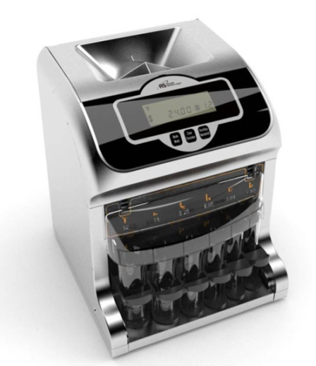

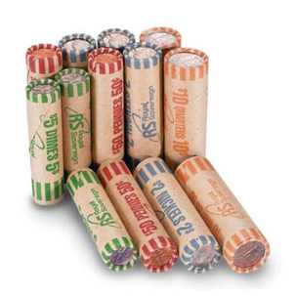
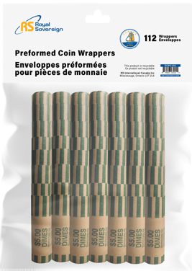
Coin Sorters
Save time and money by using an electric coin sorter. Quickly and accurately sorts Canadian
coins directly into preformed paper coin wrappers (sold separately).
FS-2D-CA-N
2 Row Digital Canadian Corn Sorter
Ideal for stores, business, schools and other organizations
in need of a low to medium volume coin sorting and
counting solution
Features
Counts and sorts up to 180 coins per minute
Unit automatically stops sorting process when a coin tube is full and prompts
user to empty, or advance front row tube to automatically continue filling back
row.
Anti-jam technology automatically detects and clears jammed coins
Removable top cover for manual removal of foreign items or damaged
coins
Coin Wrappers
Coin Sorter and Wrappers
Royal Sovereign offers both preformed coin wrappers for different coin denominations. Preformed coin wrappers are made from quality kraft paper and come preformed and crimped on one end to provide easy and hassle free coin wrapping. Select from 112 pack or 1000 pack sizes
Features:
• Preformed kraft paper
• Crimped end for easy filling
• Fill with coin sorter or by hand
• 80 and 112 Pack conveniently pack in Polybag with Hang Tab
• 500 Pack packaged in Kraft Box
Available
RCWB-112N – 112 Pack Nickel
RCWB-112D– 112 Pack Dime
RCWB-112Q– 112 Pack Quarter
RCWB-112L – 112 Pack Loonie
RCWB-112T – 112 Pack Toonie
RCWB-80A – 80 Pack Assorted
RCWB-500A – 500 Pack Assorted
`

Slide 5
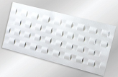
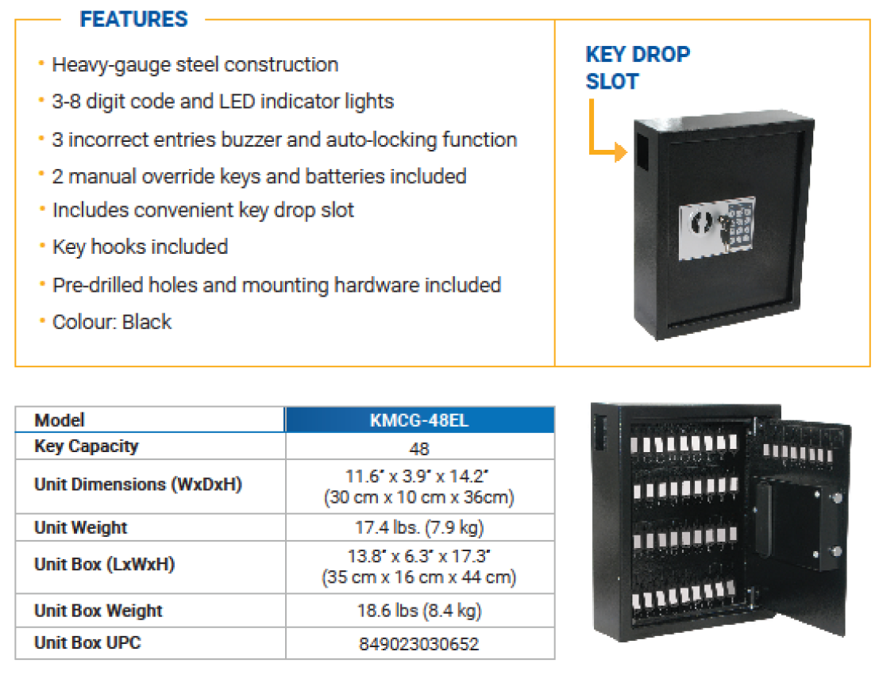
Cash Management Accessories
Royal Sovereign offers an extensive range of cash management accessories. Whether your need be for cash boxes, cash bags or currency cleaning cards, Royal Sovereign has you covered.
Trust Royal Sovereign as your complete one stop provider your Cash Management and Cash Management accessory needs!
RBC-CLN
Currency Counter Cleaning Cards
Features
• Remove dirt, dust, oils and other contaminates from bill
counter
• Cleans entire rounded surface of magnetic heads
• 10 times higher cleaning pressure
• Reaches recessed sensors
• Patented Waffletechnology®
Key Management
ID/Counterfeit Detector
Royal Sovereign Electronic Key Safe keeps your keys and valuables safe and secure. The programmable, battery-operated key pad provides the highest level of control and security; no keys to lose

Slide 6
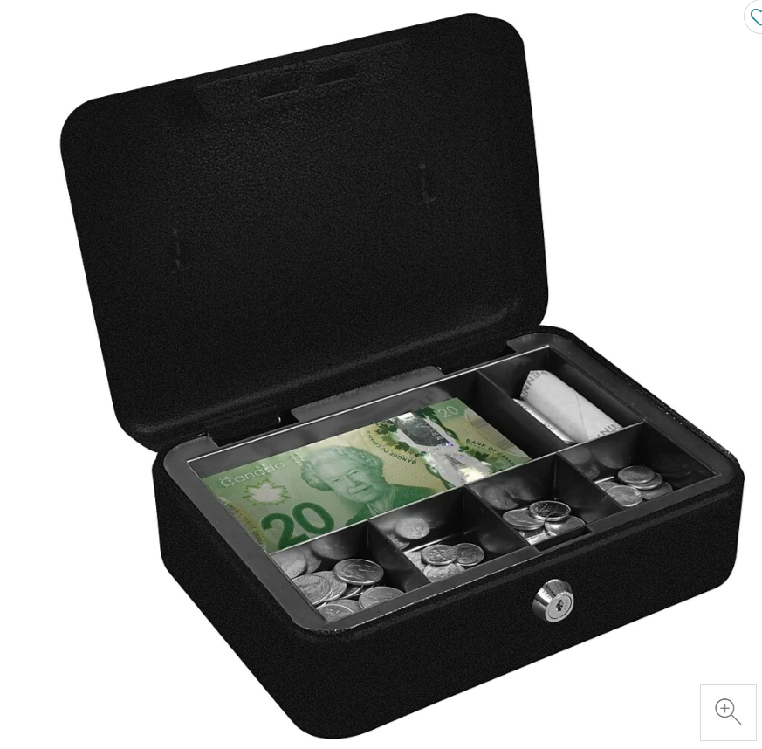
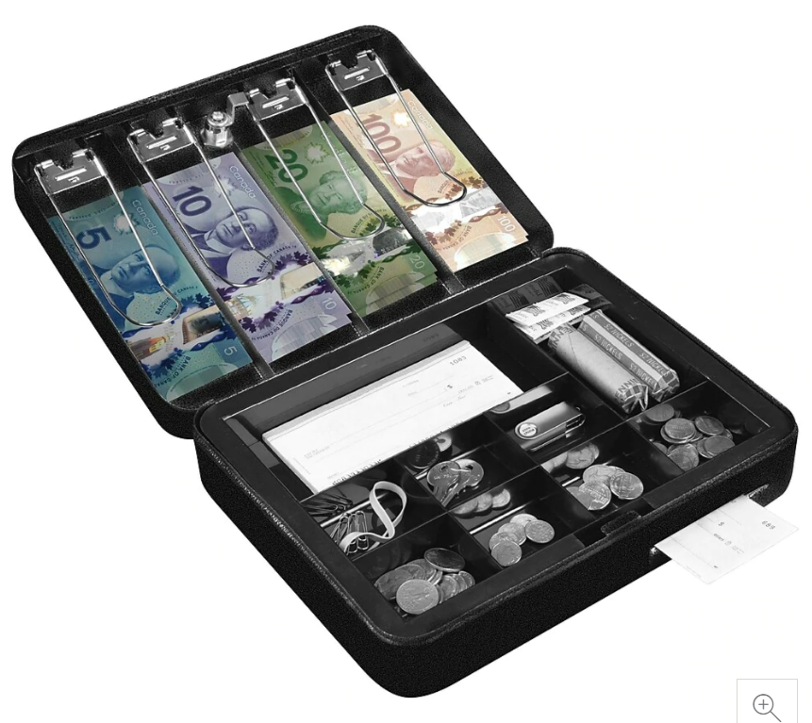
Cash Boxes
Cash boxes are ideal for use at places including: stores, festivals, sporting events and fairs. It provides peace of mind knowing that you have a secure place to store money, receipts, checks and other valuables. All Royal Sovereign cash boxes are made of solid steel construction and include a security lock. Select the ideal cash box for your specific need.
CMCB-200
Full-Size Cash Box
Features:
• Made from solid steel construction (0.8mm thickness)
• Removable tray with 1 bill and 5 coin compartments
• Security lock with 2 keys
• Recessed handling for easy carrying
• Colour: Cool Grey Size: 9.8”w x 7.4”d x 3.9” h
Cash Accessories
CMCB-300
Cash Box
Features:
• Made from solid steel construction (0.8mm thickness)
• Nine compartment tray for coin, receipt and wrappers
• Convenient four compartment bill compartment with spring
loaded bill weight in cover for securing notes
• Separate media slot
• Security lock with 2 keys
• Handling for easy carrying
• Colour: Cool Grey Size: 11.8”w x 9.5”d x 3.7” h

Slide 7
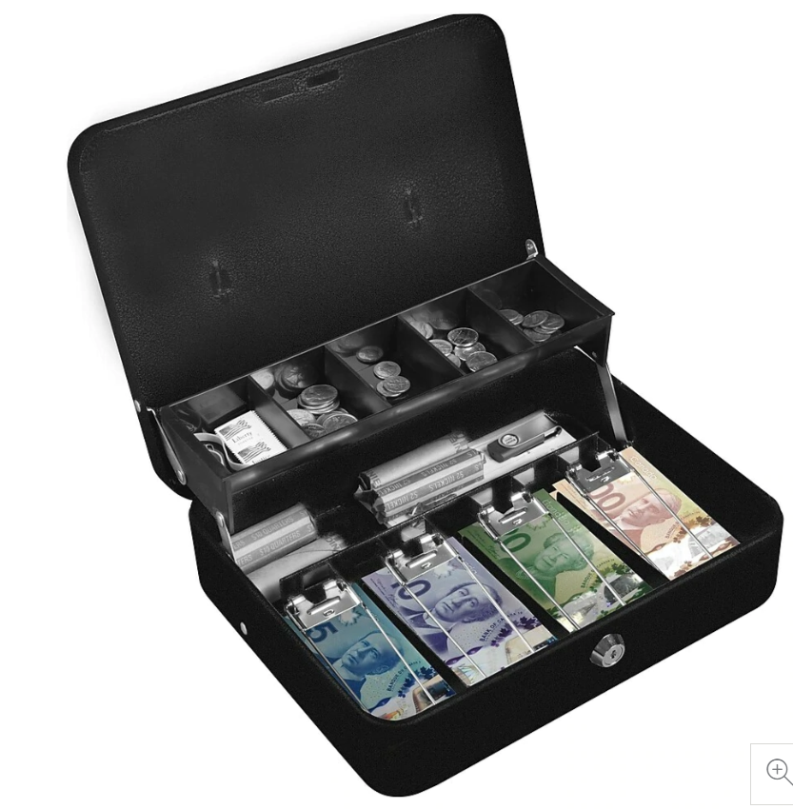
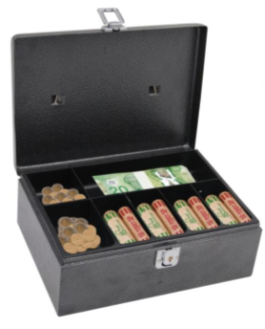
CMCB-400
Tiered Tray Deluxe Cash Box
Features:
• Made from solid steel construction (0.8mm thickness)
• Five compartment tiered tray coin tray for fast and easy
handling of coins
• Four compartment bill compartment with spring loaded bill
weight for securing notes
• Separate compartment for holding coin wrappers
• Security lock with 2 keys
• Handle for easy carrying
• Colour: Cool Grey Size: 11.8 “w x 10.0 w x 4.0” h
Cash Accessories
CMCB-280LL
Full-Size Cash Box with Locking Latch
Features:
• Made from solid steel construction (0.8mm thickness)
• Six coin and 1 bill compartment
• Removable cash tray compartment provides space for
• Key latch keeps cash box secure when unlocked
• Carrying handling
• Colour: Grey Size: 11.“w x 7.8 w x 3.9” h
Microwave will easily accommodate a standard ½ size steam table pan, 4” deep
Microwave will easily accommodate 2 standard
¼” size steam table pans, 4” deep

Slide 8
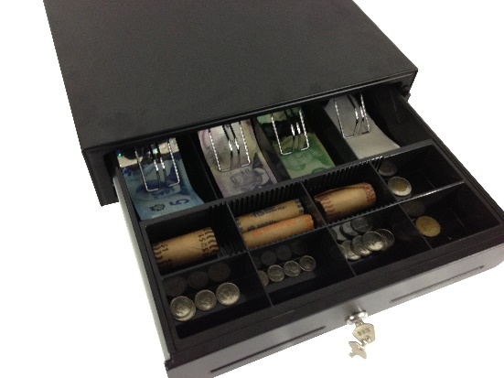
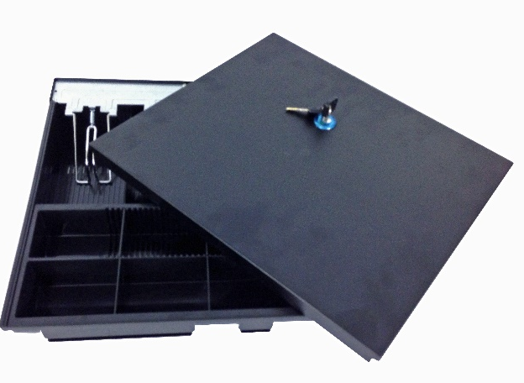
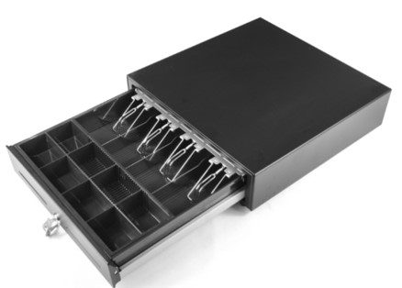
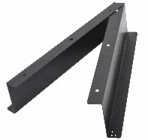
Cash Boxes
The Royal Sovereign push button cash drawer is ideal for small business and store use. Simply press the button on the cash drawer to open the cash drawer. Includes four spring loaded bill compartments, eight coin dividers (four adjustable) and two media slots for quick and secure storage of valuable items. Use the lock function to secure the cash register drawer when not in use.
RCRD-1616M
Cash Drawer
Features:
• Removable plastic tray holder - 4 bill compartments and 8 coin dividers (4 adjustable)
• Heavy-duty – steel construction with rubber feet
• Security Protection -Key Lock With 2 keys and locking lid cover included
• One Touch Operation - push button drawer release
• Dual Media Slots - Provide quick and secure storage of valuable items
• Additional Tray with Locking lid – Ideal for multiple clerks (model RCRD-16T)
RCRD-16T
Cash Drawer with Locking Lid
Features:
• One touch push button manual cash drawer; black finish
• 4 bill compartment with spring-loaded bill weights and 8 coin dividers (4 adjustable)
• Removable coin tray
• Key lock lid secures tray when not in use or during transport
• Heavy duty construction keeps currency secure
• Dimensions: 14.5”W x 13.5”D x 3"H
• Compatible with Royal Sovereign model RCRD-1616M and RCRD-1616UE Cash Drawers
Cash Accessories
RCRD-1616UE
Heavy Duty Electronic Cash Drawer
Features:
• Heavy-duty, steel construction - 24Volt for RJ11/USB
• 4 bill / 8 coin compartment (4 adjustable)
• Dual media slots for quick and secure storage of valuable items
• Lock / Unlock function secures cash drawer when not in use
RCRD-MB
Mounting Brackets for Cash Drawer

Slide 9
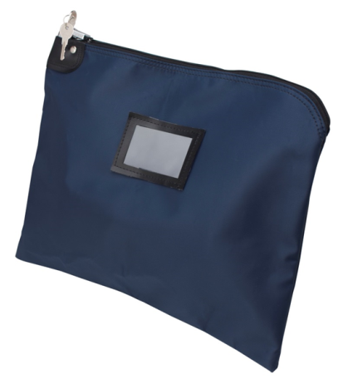
Cash Bags
Royal Sovereign offers both a deposit bag or locking security bags to securely help you carry money and other valuables. Our deposit bags are reusable zippered deposit bags with built in convenient loop handle, while the locking security bags are tamper resistant lockable zipper bags.
CMDB-2500
Locking Security Bag – 16” x 12”
Features:
• High security pop-up and swivel design permits easy access
to zipper in unlocked position
• Solid precision die-cast construction
• Can be locked without the use of a key (2 keys included –
each bag is keyed differently)
• Made from durable laminated nylon with waterproof
polyvinyl and cotton twill backing
• Can withstand the impact of drops for hundreds of trips as
well as daily abuse
• Colour: Navy Blue
Cash Accessories

Slide 10
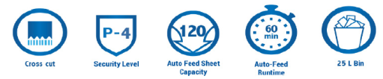
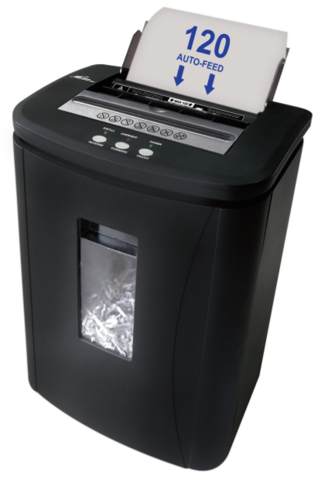
Paper Shredders
Protect personal and confidential information from document based identity theft with a Royal Sovereign shredder. Royal Sovereign provides a range of document shredders from household, small office, home office environments to larger workplaces where more robust heavy duty paper shredding is required.
Auto Feed Shredders
Royal Sovereign’s patented auto feed shredder technology provides convenient, hands-free operation to save you time to work on more important things. The auto feed entry allows users to shred large stacks of paper at a time without having to constantly feed the paper into the machine. Simply insert the paper document into the auto-feed entry and walk away as the paper is conveniently and automatically shredded into tiny particle sized bits. Royal Sovereign patented auto-feed shredders are ideal for use in both small offices and large business applications where high volume of shredding may be required.
RAF-25P
120 Sheet Auto Feed Cross Cut Shredder
Features
Cross Cut P-4 Security
▪ Shreds paper documents and other sensitive material into small
4 x 20mm cross cut pieces for secure destruction
High Capacity Shredding
▪ In auto feed mode, the shredder will pull 1-3 documents at a time to continuously shred up to 120 sheets of paper, including stapled sets
▪ Shreds approximately 900 sheets per hour
▪ Includes 5 sheet capacity manual feed slot for small jobs
▪ Quiet 60dB operation minimizes noise in office and workplace and jobs
60 Minute Continuous Run Time
▪ 60 minutes ON/30 Minutes OFF duty cycle in auto, 8 minutes ON/30 minutes off in manual
Smart Auto-Reverse Function
▪ Built in jam free operation senses paper jams, auto reverses to free jam and then runs forward to continue shredding
Large 25 L (6.5 Gallon) Basket
▪ Holds large quantity of shredded paper before emptying basket is required
▪ Castor wheels for easy portability
▪ Optical display and auto shutdown if basket is full
Energy Saving Mode
▪ Unit goes to standby mode using only 1-2 Watt of power when not in use
▪ Convenient bi window shows quantity of paper shredded
Auto Feed Cross-Cut Shredder
Some Royal Sovereign Hand dryers are infused with Steritouch Antimicrobial protection, which works continuously to help prevent the growth of stain and odour causing bacteria, mold and mildew on the surface of the hand dryer.

Slide 11
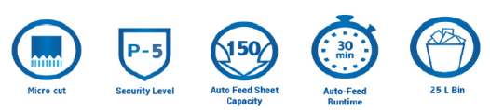
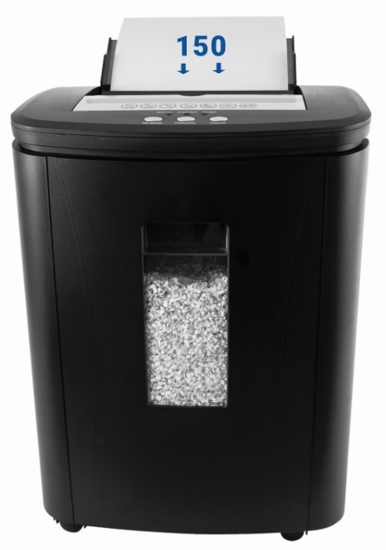
AFX-M150P
150 Sheet High Security Auto Feed
Micro Cut Shredder
Features
.
Micro Cut P-5 Security
▪ Shreds paper documents and other sensitive material into very small 3 x 10 mm (.118” x .393”) micro cut pieces for secure destruction
High Capacity Shredding
▪ In auto feed mode, the shredder will pull 1-3 documents at a time to continuously shred up to 150 sheets of paper, including stapled sets
▪ Shreds approximately 650 sheets per hour
▪ Includes 10 sheet capacity manual feed slot for small jobs
▪ Quiet 58 dB operation minimizes noise in office and workplace
30 Minute Continuous Run Time
▪ 30 minutes ON/60 Minutes OFF duty cycle in auto, 3 minutes ON/60 minutes off in manual
Smart Auto-Reverse Function
▪ Built in jam free operation senses paper jams, auto reverses to free jam and then runs forward to continue shredding
Large 25 L (6.5 Gallon) Basket
▪ Holds large quantity of shredded paper before emptying basket is required
▪ Caster wheels provide easy mobility of shredder from room to room
▪ Optical display and auto shutdown if basket is full
Energy Saving Mode
▪ Unit goes to standby mode using only 1-2 Watt of power when not in use
▪ Convenient bin window shows quantity of paper shredded
Auto Feed Micro-Cut Shredder
Royal Sovereign Patented Auto Feed Technology
The patented motor and cutter mechanism used in our Royal Sovereign auto feed shredders provides improved reliability,
performance and speed. Key benefits of Royal Sovereign’s patented auto feed technology include:
• Multiple Feed Capabilities
The paper shredder has 2 different feeding entries for
ease of use.
Auto Feed - The shredder will automatically begin to
shred stacks of paper when inserted into the auto feed
entry to allow users to shred large stacks of paper at a
time without having to constantly feed paper into the
machine.
Manual Feed - The manual feed entry allows users to
quickly shred multiple or single sheets at a time.
• Auto Controls
The shredder automatically starts shredding paper upon
insertion and will automatically stop when finished.
• Auto Reverse
Automatically reverses to free jams, then runs forward to
continue shredding
• Internal JAM Removal Function
Removal function activates when curled/crumpled paper
is inserted to help prevent a potential paper JAM problem.
• Safety Features
As a safety precaution, if the pull-out basket is taken out
or placed incorrectly or if the cover lid is open the power
will automatically cut off.
• Overheat Protection
To ensure that the shredder does not overheat, the unit
will automatically shut itself off. This helps ensure longer
life of the Royal Sovereign shredder
• Bin Full Indicator
The Bin Full Indicator LED light will turn on when the
basket is full to indicate it is time to empty the basket.
Select from multi-port or single port nozzle. Multi-port hand dryers provide an even flow drying of hands, while single port provides a high intensity dry

Slide 12

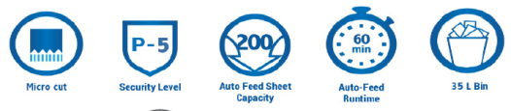

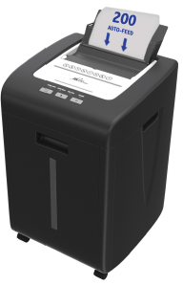
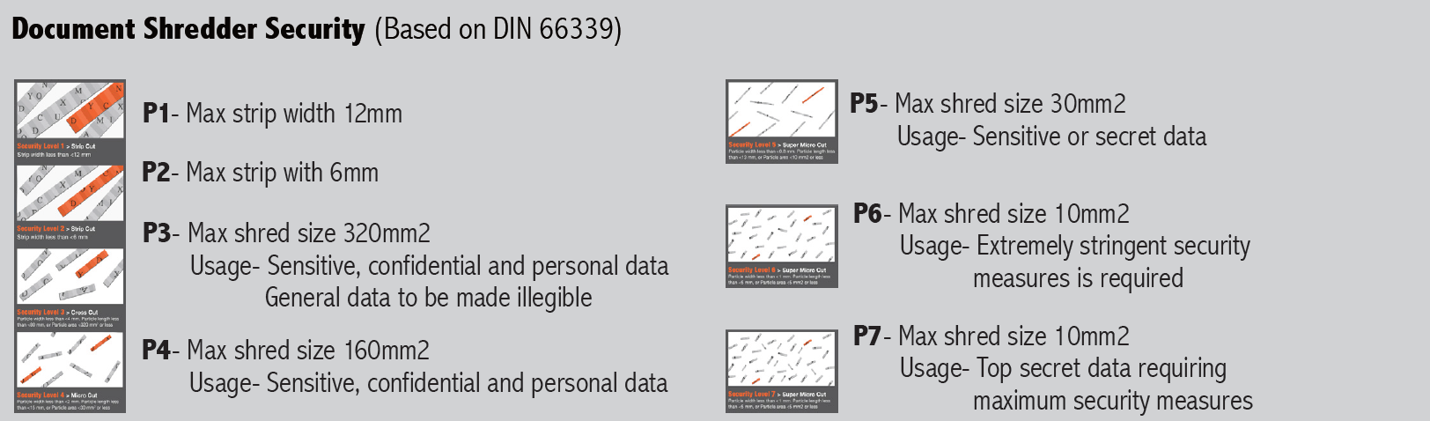
RAF-M200P
200 Sheet High Security Auto Feed Micro Cut Shredder
Coming soon
Features
Micro Cut P-5 Security
▪ Shreds paper documents and other sensitive material into very
small 2 x 14 mm micro cut pieces for secure destruction
High Capacity Shredding
▪ In auto feed mode, the shredder will pull 1-3 documents at a time
to continuously shred up to 200 sheets of paper, including stapled
sets
▪ Includes 10 sheet capacity manual feed slot for small jobs
▪ Quiet 58dB operation minimizes noise in office and workplace
60 Minute Continuous Run Time
▪ 60 minutes ON/60 Minutes OFF duty cycle in auto, 30 minutes ON/60 minutes off in manual
Smart Auto-Reverse Function
▪ Built in jam free operation senses paper jams, auto reverses to free jam and then runs forward to continue shredding
Large 35 L Basket
▪ Holds large quantity of shredded paper before emptying basket is required
▪ Caster wheels provide easy mobility of shredder from room to
room
▪ Optical display and auto shutdown if basket is full
Energy Saving Mode
▪ Unit goes to standby mode using only 1-2 Watt of power when not in use
▪ Convenient bin window shows quantity of paper shredded
Auto Feed Micro-Cut Shredder
Some Royal Sovereign Hand dryers are infused with Steritouch Antimicrobial protection, which works continuously to help prevent the growth of stain and odour causing bacteria, mold and mildew on the surface of the hand dryer.
Select from multi-port or single port nozzle. Multi-port hand dryers provide an even flow drying of hands, while single port provides a high intensity dry

Slide 13

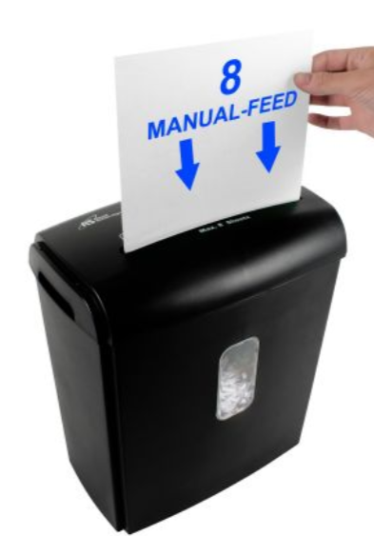
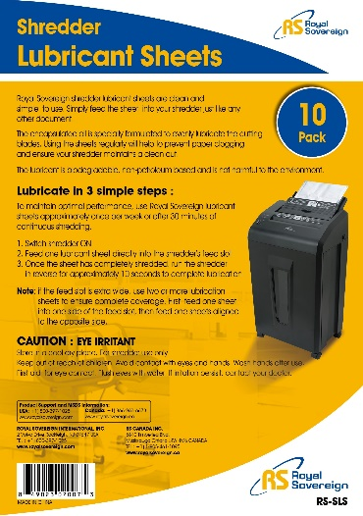
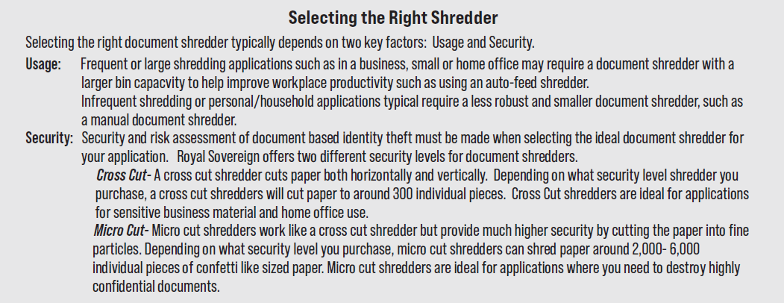
RDS-15C8
8 Sheet Cross-Cut Shredder
Features
Cross Cut P-4 Security
▪ Shreds paper documents and other sensitive material into small
4 x 35 mm (.157” x 1.37”) cross cut pieces for secure destruction
15L (4.0 Gal) Bin
▪ Convenient size for deskside or under desk use. Clear window
shows waste level to indicate when its time to empty bin
Auto Start /Stop
▪ Automatically starts shredding paper when inserted and
automatically stops when finished shredding
▪ Manual reverse switch helps clear any potential jammed paper
8 Sheet Capacity
▪ Shreds up to 8 sheets of paper at a time through 220mm (8.7”)
paper feed
▪ Also shreds staples and credit cards
RS-SLS
Shredder Lubricant Sheets
Manual Document Shredders
Features
▪ Maintains optimal performance
▪ Patented formulation
▪ Ensures shredder blades maintain a clean cut
▪ Helps prevent paper jams.
▪ Reduces noise and paper dust.
▪ Applies just the right amount of lubricant every time.
▪ Lubricant never touches your hands.
Select from multi-port or single port nozzle. Multi-port hand dryers provide an even flow drying of hands, while single port provides a high intensity dry

Slide 14
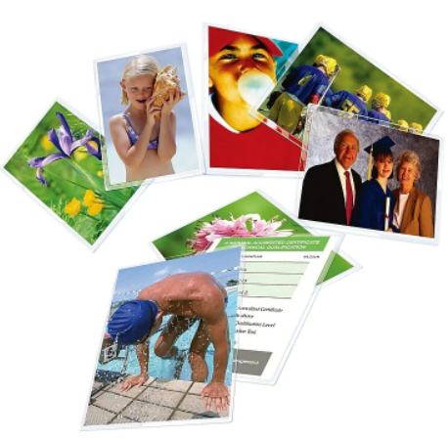
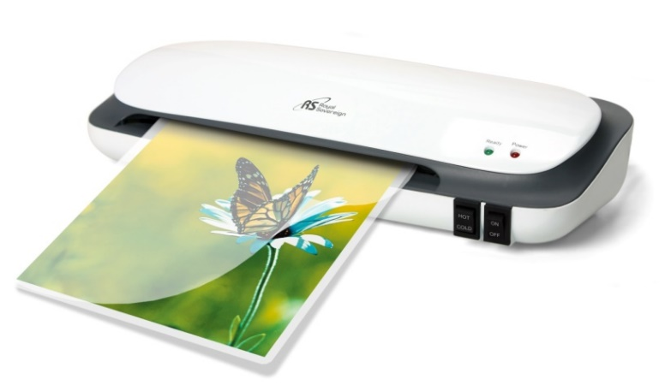
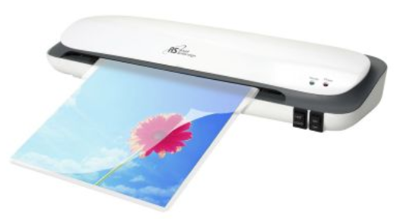
Lamination
Royal Sovereign offers a full range of laminators to suit any specific set of applications, plus thermal pouch film supplies for the project at hand. Whether the need be for a Personal/Home Laminator for that personal home project or a more robust, fast, high quality Business Laminator, Royal Sovereign has the unit to best suit your needs
Personal Laminators
Quality lamination ideal for general home and multi-purpose use to protect and enhance important items
such as: documents, artwork and photos.
CL-923B
9” Pouch Laminator
With 50 Assorted Pouches
Features
2-Roller Technology – Consistently delivers wrinkle and
bubble free lamination
Continuous Lamination – Laminates at 250mm /minute
(9.8”/minute)
Ready to use in 3 minutes
Easy Film Selection - Settings for cold or hot film.
Laminates up to 5 mil thickness
Wide 230mm (9”) laminating width
Overheat Protection – After 30 minutes of non use
Manual jam release lever- retrieves jammed or
incorrectly inserted documents
Personal/Home Laminators
CL-1223
13” Pouch Laminator
Interior Cooking Capacity
Features
2-Roller Technology – Consistently delivers wrinkle and
bubble free lamination
Continuous Lamination – Laminates at 250 mm / minute
(9.8” / minute)
Ready to use in 3 minutes
Easy Film Selection - Settings for cold or hot film
Laminates up to 5 mil thickness;
Wide 330 mm (13”) laminating width
Overheat Protection – After 30 minutes of non use
Manual jam release lever- retrieves jammed or incorrectly
inserted documents
Some Royal Sovereign Hand dryers are infused with Steritouch Antimicrobial protection, which works continuously to help prevent the growth of stain and odour causing bacteria, mold and mildew on the surface of the hand dryer.
Select from multi-port or single port nozzle. Multi-port hand dryers provide an even flow drying of hands, while single port provides a high intensity dry

Slide 15
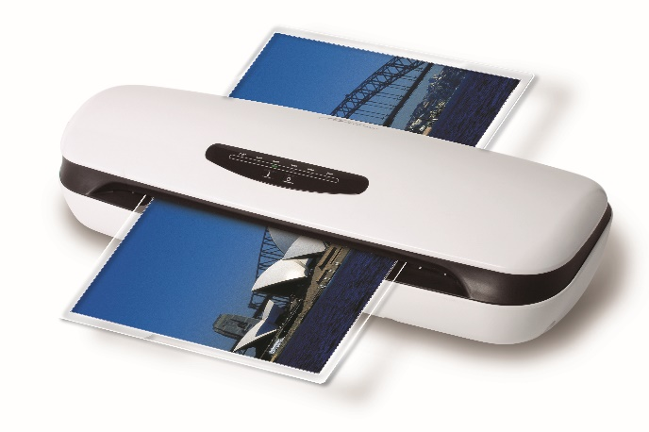

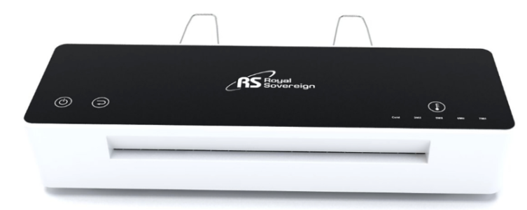
Small Office /Home Office Laminators
High quality laminators with fast warm-up time and increased speed to improve work efficiency. Ideal for
moderate usages for the home, small office home office, schools and general office duties.
ES-1315
13” Pouch Laminator
Features
Accepts documents up to 320mm (13”) wide
Laminates from 3 to 7 mil thickness;
2-Roller Hot Shoe Technology – Consistently delivers wrinkle and bubble free lamination
Accepts hot and cold lamination film
Adjustable cooling tray allows laminated documents to cool off before user handles items
Warm up ready in 5 minutes
Jam release lever will clear any jammed or misfed document
Automatic shut off after 1 hour of non use
Fast 360mm (14.2”) continuous lamination speed
Business Laminators
Business Laminators
Ideal for business and commercial applications this business grade Royal Sovereign laminator is
designed for heavy duty usage, where high quality lamination is essential. The Royal Sovereign
IL-1346W laminator provides fast warm up in less than 60 seconds and fast 600 mm lamination
speed. Use the touch screen display to switch settings for different film thickness from 3-7mil.
IL-1346W
13” Touch Screen, 60 Second Warm Up Business Laminator
Features
Super High Speed Continuous Lamination – Quickly
laminates at 600mm/minute 23.6” /minute
Fast 60 second warm up
4-Roller Technology – Ensures a smooth and professional
bubble-free finish
Easy Film Selection - Settings for cold or hot film of
3, 5,and 7 mil thickness
Variable Temperature– Auto ‘Beep’ notification when
changing pouch film thickness;
Patented Auto Reverse button - Retrieves jammed or
incorrectly inserted documents
Built-in Cooling Pate – Helps to ensure laminated
paper is smooth and wrinkle-free as it exits machine
Accepts documents up to 330mm (13”) wide
Auto shut Off / Overheat Protection – After 30 minutes
of non use
Convenient detachable output tray
Select from multi-port or single port nozzle. Multi-port hand dryers provide an even flow drying of hands, while single port provides a high intensity dry

Slide 16
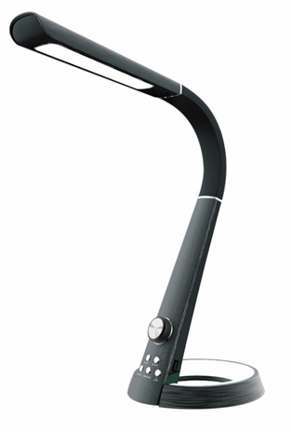
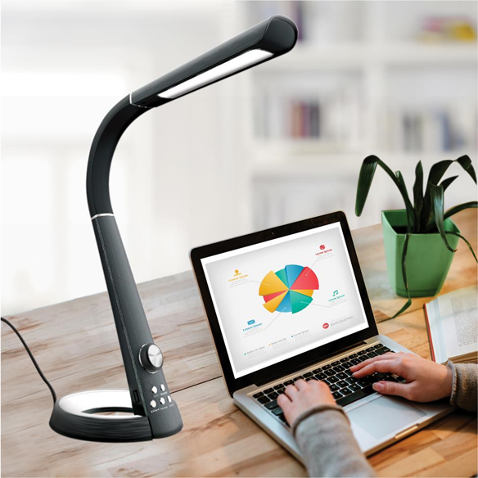
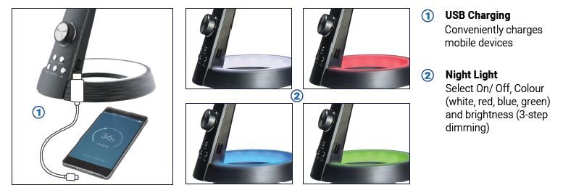
LED Desk Lamps
The Royal Sovereign line of LED lamps provide a safe, energy efficient solution for your Home Office or
Workplace. Available in a variety of styles with task specific functionality and innovative features
RDL-110U
LED Desk Lamp with Fast USB Charging And Nightlight
Features
Adjustable Light:
▪ Select desired light mode from three adjustable light temperatures for relaxing, working or reading (3000K, 4300K, 6300K)
USB Charging:
▪ Use USB Charging to charge mobile phones and other USB Devices (5V, 2.1A)
Night Light Setting
▪ Choose between 4 colours best suited for dimmed light
Push Button Controls
▪ Easy to use touch controls for stepless dimming. Select On/Off, colour (white, red, blue, green) and brightness (3 step dimming)
Task Lamp with USB Charging

Slide 17
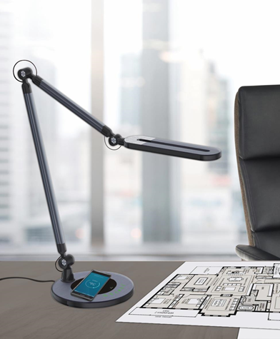
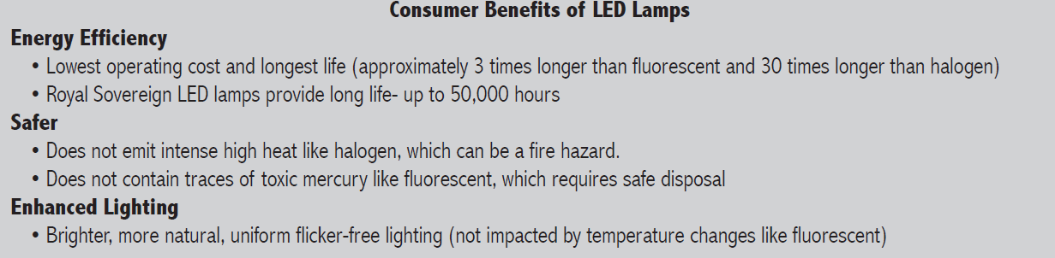
RDL-150-QI
Swing Arm LED Desk Lamp with
Wireless Charging
Features
Adjustable Light
▪ Select desired light mode from three adjustable light temperatures for relaxing, working or reading (3000K, 4000K, 6000K)
▪ Each light temperature mode is dimmable
▪ Diffused uniform light to reduce glare and eye strain
▪ Intelligent memory restores last setting when lamp is turned back on
Wireless Charging
▪ For compatible QI enabled devices
Adjustable Head, Neck and Arm
▪ 3-Way multi-angle lamp head and arm rotation
▪ 180° head rotation
▪ Fully extended reach/ height approximately 32”
Task Lamp with Wireless Charging
Select from multi-port or single port nozzle. Multi-port hand dryers provide an even flow drying of hands, while single port provides a high intensity dry

Slide 18
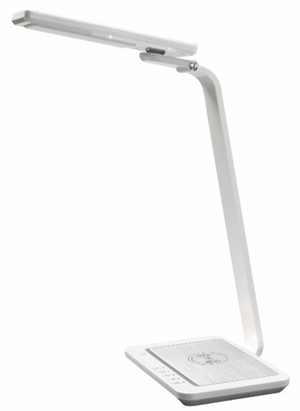
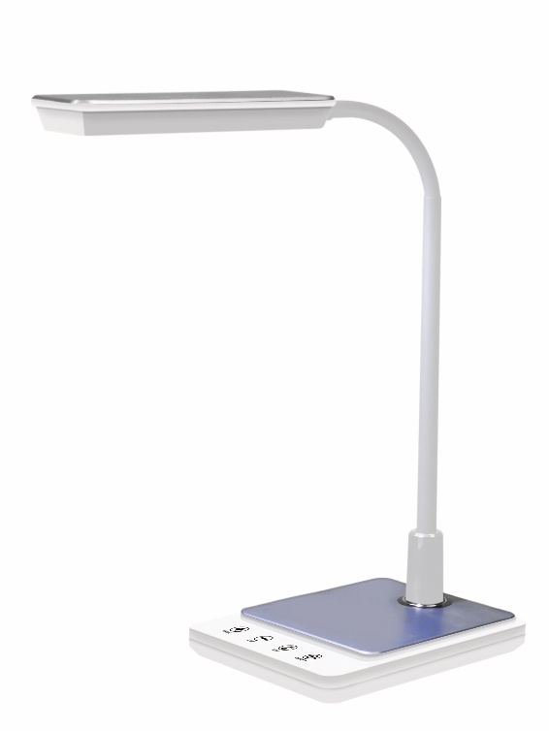
RDL-140-QI-W
Multi-Angle LED Desk Lamp with Wireless Charging
Features
Adjustable Light:
▪ Select desired light mode from three adjustable light
temperatures for relaxing, working or reading (2700K,
4300K, 6300K)
▪ Each light temperature mode is dimmable
▪ Intelligent memory restores last setting when lamp is
turned back on
Fast Wireless Charging:
▪ Use Wireless Fast Charging for wireless QI enabled
devices (Fast charge 10W Samsung / 7.5W iPhone)
Night Light
▪ Selectable two step brightness
Adjustable Head and Arm
▪ 180° left/right and 115° up/down head rotation
▪ 12°arm rotation
Touch Controls
Task Lamp with Wireless Charging
RDL-75U-W
Gooseneck LED Desk Lamp with Fast Charging
Features
▪ Use USB fast charging port to charge mobile phones and other
USB devices (5V/2.0A)
▪ Adjustable light temperature (3000K/4000K/6000K)
▪ Energy efficient with a projected lifespan of 40,000 hours
▪ Intelligent memory restores last settiings when lamp is turned back on
▪ Flexible gooseneck allows you to adjust light angle to personal preference
▪ Touch Controls

Slide 19





LED Signs For Business
Let your customers know your are Open for business! Ideal for retail and service businesses, restaurants, bars and more, this LED illuminated open sign captures attention.
RSB-1345E
LED OPEN sign
Features
Bright Light LED Illumination
▪ Bright LED lighting illuminates large 3D OPEN letters
▪ 300ft (91.4) viewing distance
▪ In daylight can easily distinguish if sign is ON or OFF
Dual Operation
▪ User selectable settings during day: ON or Flash and Scroll. Set to OFF when closed
▪ Use control panel setting or convenient remote
control included
Easy Installation
▪ Can be easily mounted with included hook chain and
mounting screws
▪ Long 10ft (3m) power cord included
Energy Efficient
▪ LED lighting system uses very little energy
compared to Neon
80,000 Hour Projected Life
21.3”W x 9.4 h (54 x 24cm)
LED Bluetooth Messenger Sign
RSB-1340E
LED OPEN sign
Features
Bright LED lighting illuminates large durable acrylic sign
User selectable settings: ON, continuous flash or OFF
Can be seen from more than 100 ft. distance
LED lighting system uses very little energy compared to NEON
and has a projected life of 80,000 hours
Easily mounted with included hook chain and mounting screws
Also Available:
RSB1340F- Open Sign (French)
23.8”w x 12.2”h (60.5 x 31cm)

Slide 20

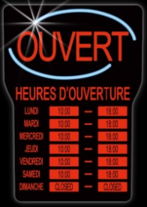

RSB-1342E
LED OPEN Sign with Busines Hours
Features
Bright LED lighting illuminates large durable acrylic sign
Simple peel and stick hour labels used to customize hours of
operation (labels included)
3 user selectable setting: ON (Open and Hours), ON (Business
hours only) or OFF Setting
Can be seen from more than 100 ft. distance
LED lighting uses very little energy compared to NEON and
has a projected life of 80,000 hours
Easily mounted with included hook chain and mounting screw
Also Available:
RSB1342F- Open with Business Hours (French)
16”w x 24”h (40.5 x 61cm)
LED Bluetooth Messenger Sign
RSB-1330E
LED OPEN Sign
Features
Bright LED technology illuminates OPEN sign which attract customer attention
Ideal for retail and service businesses, restaurants, bars and more
Visible from more than 100 ft
User selectable settings: ON, Scrolling, and OFF
80,000 projected life
Easily mount with included hang chain and hooks
Also Available:
RSB1330F- Open with French
Multi-lingual
Select from multi-port or single port nozzle. Multi-port hand dryers provide an even flow drying of hands, while single port provides a high intensity dry

Slide 21

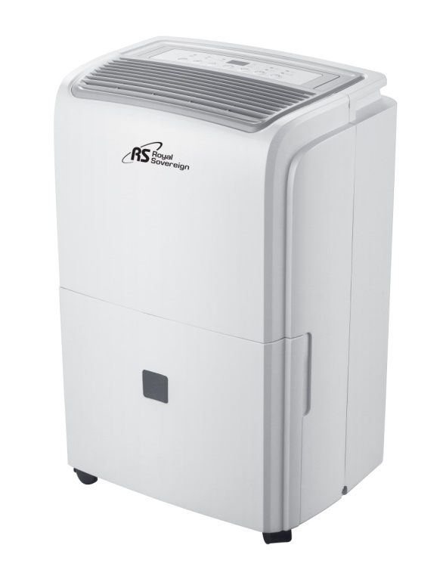
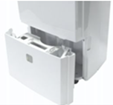
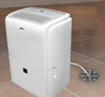
Residential Dehumidifiers
Provide efficient dehumidification power for healthier air quality and a drier, more comfortable environment. Select from a traditional dehumidifier or our patented dehumidifier with built in auto pump. The dehumidifier with auto pump model automatically pumps water up to 16 vertical feet out of a window, into a laundry tub, sink or drain to provide continuous hassle free uninterrupted dehumidification
RDH-430 – 20 Pint DoE Residential Dehumidifier
Features
2 Way Drainage
▪ Continuous Drain: Hose for short linear drainage
▪ Manual: Removable 8 pint (3.8L) bucket
Advanced Electronic Features
▪ Auto Defrost: prevents ice build up on condensing coils
▪ Auto Restart: restarts after a power outage at previous
setting
Digital Controls
▪ Control panel allows you to set your dehumidifier to your
desired humidity level, fan speed and 24 hour timer
▪ Also includes High/Low dehumidification modes, child lock
mode, bucket full and clean filter indicators
Portable Design
▪ Easy glide built in caster wheels and handle make it quick and
effortless when transporting your unit room to room
Residential Dehumidifiers
Interior Cooking Capacity
Removable Bucket Continuous Drain
Select from multi-port or single port nozzle. Multi-port hand dryers provide an even flow drying of hands, while single port provides a high intensity dry

Slide 22
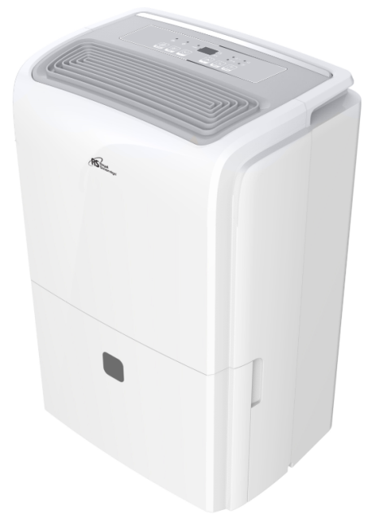
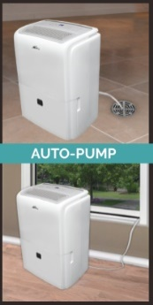
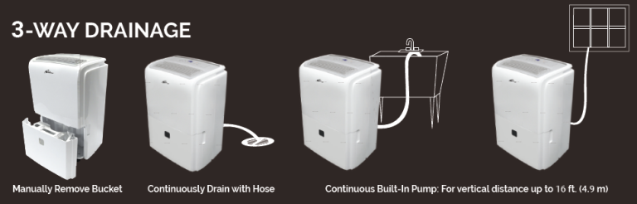
RDH-470P
40 Pint Doe Dehumidifier with Built-in Auto Pump
Features
3 Way Drainage
▪ Continuous Built-In Pump: For vertical distance up to 16 ft. (4.9m)
▪ Continuous Drain: Hose for short linear drainage
▪ Manual: Removable bucket
Advanced Electronic Features
▪ Auto Defrost: prevents ice build up on condensing coils
▪ Auto Restart: Restarts after a power outage at previous setting
▪ Bucket and Water Level Window indicates when bucket is full
▪ Washable filter collects large dust particles and prevents
bacteria build up
Digital Controls
▪ Control panel allows you to set your dehumidifier to your desired
humidity level, fan speed and 24 hour timer
▪ Also includes High/Low dehumidification modes, child lock mode,
bucket full and clean filter indicators
Portable Design
▪ Easy glide built in caster wheels and handle make it quick and
effortless when transporting your unit room to room
Residential Dehumidifiers

Slide 23
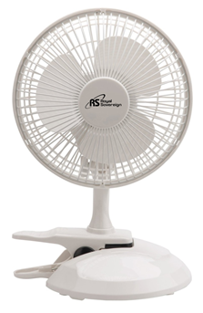
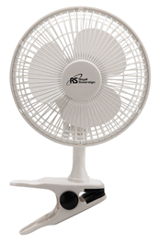


Fans
Help stay cool and help improve air circulation with a Royal Sovereign fan. Royal Sovereign offers an extensive range of residential and office fans to suit your specific needs.
DFN-15
Compact 2-in-1 6” Clip-on and Desk Fan
Features:
Versatile 2-in-1 Application
▪ Use as clip-on fan or as desk fan
▪ Spring loaded clip on cushioned grip easily attached to
desk or table or fan base
Quiet and Powerful
▪ Convenient 2 speed setting (high/low)
▪ Base has 360° degree swivel
▪ Tilt adjustable fan head
▪ Coated steel safety grille
Easy Assembly
Residential /Workplace Fans
DFN-30B
12” Oscillating Desk Fan
Features:
Quiet and Powerful
▪ Convenient 3 speed setting
▪ Wide angle oscillation
▪ Tilt adjustable fan head
▪ Coated steel safety grille
Easy Assembly
DFN-40B
16” Oscillating Desk Fan
Features:
Quiet and Powerful
▪ Convenient 3 speed setting
▪ Wide angle oscillation
▪ Tilt adjustable fan head
▪ Coated steel safety grille
Easy Assembly

Slide 24



Ceramic and Fan Heaters
The Royal Sovereign line of heaters all you to conveniently and cost-effectively heat your living or workspace to your personal comfort needs. Stay nice and toasty in the winter months with a compact fan or ceramic heater. The convenient, economical space heaters provide adjustable heat settings and an adjustable room thermostat control to customize the heater to your surroundings
HFN-30
Compact Oscillating Fan Heater
Features:
• 2 heat settings and fan-only setting for multi-seasonal use
• Oscillation control for even heat distribution
• Adjustable room thermostat
• Overheat protection
• Safety tip-over switch
HFN-50D
Digital Oscillating Compact Heater
Fan Heaters
Features:
• 2 heat settings and auto heat setting
• Adjustable temperature selectable thermostat
• Selectable Timer (24Hr)
• Wide Angle Oscillation
• LCD display shows timer setting, heat mode,
thermostat temperature and room temperature
• Overheat protections and safety tip-over switch
HFN-03
Compact Fan Heater
Features:
• 2 heat settings and fan only setting for multi-seasonal use
• Adjustable room thermostat
• Overheat protection
• Safety tip-over switch
Some Royal Sovereign Hand dryers are infused with Steritouch Antimicrobial protection, which works continuously to help prevent the growth of stain and odour causing bacteria, mold and mildew on the surface of the hand dryer.

Slide 25



HCE-100
Compact Ceramic Heater
Features:
• 2 heat settings and fan only setting for multi-seasonal use
• Adjustable room thermostat
• Overheat protection
• Safe ceramic warmth
• Safety tip-over switch
HCE-160
Oscillating Ceramic Heater
Features:
• 2 heat settings and fan only setting for multi-seasonal use
• Oscillation control for even heat distribution
• Adjustable room thermostat
• Overheat protection
• Safe ceramic warmth
• Safety tip-over switch
Ceramic & Tower Heaters
Ceramic Tower and Infrared Heaters
Provide effective heating of any room or work space with a fashionable, oscillating Ceramic tower or Infrared tower heater.
HCE-190
19” Compact Ceramic Tower Heater
Features:
• 2 Heat settings: 750W /1500W and fan only setting
• Wide Angle Oscillation
• Adjustable room thermostat
• Top mounted controls
• Convenient washable filter maximizes heating and
minimizes dust
• Overheat protection and safety tip over switch
Interior Cooking Capacity
Fan Heater vs Ceramic Heater
A fan heater works by using a fan to pass air over a heating element. This heats up the air and warms the surrounding room. A ceramic heater generates heat using a heater element called PTC. Ceramic heaters tend to have a greater capability of heating larger areas more evenly and are quieter to use than fan heaters

Slide 26




Energy Efficient Panel Heater
The Royal Sovereign Energy Efficient Panel Heater provides silent, ultra energy-efficient, healthy heat for small rooms or personal spaces. This Slim Panel Heater can be used free-standing, wall-mounted or inverted on the floor as a foot warmer.
RPH-260G
Energy Efficient Panel Heater
Features:
• Utilizes Far Infrared Radiant Heat Technology
• Energy Efficient – Two low wattage heat settings of 130W/
260W, auto shut off timer, radiant heating minimizes heat loss.
• Super cost effective to operate
• Auto shut off timer
• Overheat protection and safety tip over switch
• Silent – No blower fan means no noise
Panel Heaters

Slide 27



Breakroom Appliances
Royal Sovereign’s breakroom appliances help provide quick meals, snacka and refreshments at the workplace or home. Royal Sovereign offers a variety of compact refrigerators to keep food fresh and beverages cold where space is at a premium, whether at home, school or work.
RMF-70W
2.6 cu. ft. Compact Refrigerator
Features
Ice box with ice tray
2 L bottle rack
2 adjustable glass shelves
Adjustable thermostat
Reversible door with recessed handle
RMF-113B
4.0 cu ft Compact Refrigerator
Compact Refrigerators
Features
Ice box with ice tray
2 L bottle rack
3 adjustable glass shelves
Adjustable thermostat
Reversible door with recessed handle
RMF-113SS
4.0 cu ft Compact Stainless Steel Refrigerator
Features
Ice box with ice tray
Stainless Steel front
2 L bottle rack
3 adjustable glass shelves
Adjustable thermostat
Reversible door with recessed handle

Slide 28




Beverage and Wine Cooler
RMF-BC128SS
4.5 cu ft Beverage and Wine Cooler
Features
Large 4.5 cu. ft. capacity holds 110 cans and 4 bottles
Tampered window glass door
3 adjustable glass shelves
Chrome wire shelf for wine or sparkling water bottles
Temperature adjustable 40°F -61°F (4°C -16°C)
Interior blue LED light to showcase beverages
Electronic temperature control and with lock out feature
Door hinged on right with magnetic seal
Low noise design (40 dB)
Black with stainless steel door trim
Commercial Microwave
Beverage Coolers /Commercial Microwave
The Royal Sovereign commercial microwave is built with a rugged ‘grab and go’ door handle and a stainless steel interior and exterior. Manufactured for commercial use, the microwaves is ideal for quick service restaurants, office cafeterias, snack bars, supermarkets and more
RCMW25-1000SS
1000 Watt 0.9 cu ft Commercial Microwave
Features
Manufactured for light to medium commercial usage
1000 Watts cooking power
Stainless steel interior and exterior
Touch controls - 3 multi-storage cooking stages, 20 programmable
setting and 3 power levels
Rugged ‘Grab and Go’ handle
Energy-efficient bottom energy feed system
Easy to clean stainless steel and ceramic surfaces
Bright backlit LCD display
0.9 cu. ft.
1000 W

Slide 29





RWD-1750S
Tri-Temperature Hands-Free Bottom Load Water Dispenser
This hands-free paddle design tri-temperature bottom load water dispenser dispenses boiling hot, room and cold water. The bottled water is conveniently stored at the base of the unit and pumps the water into the tanks - no need to lift heavy water bottles and no accidental spills. Modern design ideal for home or workplace. Use with standard 3 or 5 gallon bottles.
Features
Tri-temperature Bottom Load Dispensing
▪ Compressor cooling - dispenses boiling hot, room and cold water
▪ Bottled water is conveniently stored at the bottom of unit
– no heavy lifting of bottles and no accidental spills
▪ Bottle top snaps on bottle for quick and easy operation
▪ Low bottle indicator light
▪ Uses 3 and 5 gallon bottles
Hands-Free Paddle Design
2-Step Child Safety Lock
LED Indicator Lights and
▪ Power, Hot, Cold and Low Water indicator lights
▪ Hot (ON/OFF), Cold (ON/OFF) and Master ON/OFF power switches located at back of unit help conserve
energy when not in use
Bottom Load Water Dispenser
Hands-Free
Paddle Design
Bottom-Load Design
No Lifting of Bottles
Ice Maker
Make clear, restaurant quality high density ice cubes that melt 5 times slower than standard ice, keeping beverages chilled longer without diluting beverage flavor. Hooks up to water supply for continuous ice-making and eliminating the need to manually refill. Ideal for workplace breakrooms, cafeterias and small foodservice establishments
RIM-HD-13SS
High Density Cubed Ice Maker (Plumb-in)
Interior Cooking Capacity
Features
Makes 28.7 (13Kg) of ice per 24 hours or
24 cubes per 15-3 minute cycle
Ice storage capacity of 2.4 lbs. (1.1kg)
Touch pad controls and LED display with
on/off and ice full indicators
Makes clear high density ice
Unit dimension 11.3” x 14.8” x 14.1”, 23 lbs.
Select from multi-port or single port nozzle. Multi-port hand dryers provide an even flow drying of hands, while single port provides a high intensity dry

Slide 30

High Velocity & Commercial Drum Fans
Royal Sovereign’s high velocity commercial fans are manufactured to provide maximum performance, reliability and durability. These fans are ideal for warehouses, factories and other large commercial spaces where large volume air circulation may be required. Select the ideal fan type (drum, pedestal, wall mount, air mover) and size to suit your specific application need.
Circulate air and stay cool. Medium and large sized commercial drum fans are ideal for indoor commercial or industrial applications such as in a factory, warehouse, barn, or outside such as patios or in garages. Easy to use, powerful, and portable all with convenient built-in wheels and handle. Circulates air evenly and quietly though-out the space it is ventilating.
RACC-HV24SE
24” High Velocity Drum Fan, 7855 CFM
Features
High Velocity
▪ Powerful 1/3 horsepower industrial motor provides
high velocity circulation
▪ Delivers 7855 CFM air volume at high fan speed
▪ 3 speed control
▪ Drum can be tilted 180° to modify airflow
Durable Metal Construction
▪ Designed for rugged commercial use
▪ All aluminum blades
Easy Mobility
▪ Built in wheels and dual handle provide for easy mobility
▪ Ships fully assembled -no assembly required
Commercial Drum Fans
Attributes
Fan Size: 24”
Fan Speeds: 3
CFM Air Volume: 7855 CFM (High)
Speed: 1135 RPM (High)
Horsepower: 1/3
Sound: 78dB (High)
Tilt Head: Yes. Up to 180°
Power Consumption/Amperage: 235W, 1.96A
Material: Metal Construction (Aluminum Blades)
Dimensions: 75 x 22.5 x 75.8 cm (29.6” x 8.9” x 29.8”)
Weight: 12.5kg (27.5 lb.)
Royal Sovereign Free App
Some Royal Sovereign Hand dryers are infused with Steritouch Antimicrobial protection, which works continuously to help prevent the growth of stain and odour causing bacteria, mold and mildew on the surface of the hand dryer.

Slide 31



RACC-30SE
30” High Velocity Drum Fan, 11915 CFM
Features
High Velocity
▪ Powerful 1/3 horsepower industrial motor provides
high velocity circulation
▪ Delivers 11915 CFM air volume at high fan speed
▪ 3 speed control
Durable Metal Construction
▪ Designed for rugged commercial use
▪ All aluminum blades
Easy Mobility
▪ Built in wheels and handle provide for easy mobility
▪ Easy assembly -wheel assembly required
Attributes
Fan Size: 30”
Fan Speeds: 3
CFM Air Volume: 11915 CFM (High)
Speed: 865 RPM (High)
Horsepower: 1/3
Sound: 78dB (High)
Power Consumption/Amperage: 234W, 1.96A
Material: Metal Construction (Aluminum Blades)
Dimensions: 83.0 x 46.5 x 84.7 cm (32.7” x 18.3” x 33.3”)
Weight: 17.6kg (38.8 lb.)
Commercial Drum Fans
Water Damage Restoration, Prevention and Ventilation
The Royal Sovereign Commercial and Pro line is manufactured for commercial and industrial applications. Royal Sovereign Commercial and Pro offers leading solutions caused/ potentially caused by water damage.Product solutions include: drying, humidity control and improved air quality. Our ventilation product assortment provides high velocity ventilation solutions used in various commercial, industrial, workplace and home applications.

Slide 32


RACC-36
36” Heavy Duty Commercial Drum Fan, 17455 CFM
Features
High Velocity
▪ Powerful 5/8 horsepower industrial motor provides
high velocity circulation
▪ Delivers 17455 CFM air volume at high fan speed
▪ 3 speed control
Durable Metal Construction
▪ Designed for rugged commercial use
▪ All aluminum blades
Easy Mobility
▪ Built in wheels and dual handle provide for easy mobility
▪ Easy assembly -wheel assembly required
Attributes
Fan Size: 36”
Fan Speeds: 3
CFM Air Volume: 17455 CFM (High)
Speed: 865 RPM (High)
Horsepower: 5/8
Sound: 78dB (High)
Power Consumption/Amperage: 432W, 3.68A
Material: Metal Construction (Aluminum Blades)
Dimensions: 98.0 x 46.5 x 99.2 cm (38.6” x 18.3” x 39.0”)
Weight: 26.0kg (57.2 lb.)
Commercial Drum Fans
RACC-42
42” Heavy Duty Commercial Drum Fan, 23793 CFM
Features
High Velocity
▪ Powerful 4/5 HP belt drive industrial motor provides
high velocity circulation
▪ Delivers 23793 CFM air volume at high fan speed
▪ Convenient 2 speed control
Durable Metal Construction
▪ Designed for rugged commercial use
▪ All aluminum blades
Easy Mobility
▪ Built in wheels and handle provide for easy mobility
▪ Easy assembly - wheel assembly required
Attributes
Fan Size: 42”
Fan Speeds: 2
CFM Air Volume: 23793 CFM (High)
Speed: 508 RPM (High)
Horsepower: 4/5 Belt Drive
Sound: 78dB (High)
Power Consumption/Amperage: 579W, 4.76A
Material: Metal Construction (Aluminum Blades)
Dimensions: 113.0 x 46.7 x 115.5 cm (44.5” x 18.4” x 45.5”)
Weight: 41.5kg (91.3 lb.)
All Royal Sovereign systems come with a light-weight window kit which is easily installed horizontally or vertically on most window frames (33.3” - 49.6”)
Some Royal Sovereign Hand dryers are infused with Steritouch Antimicrobial protection, which works continuously to help prevent the growth of stain and odour causing bacteria, mold and mildew on the surface of the hand dryer.
Select from multi-port or single port nozzle. Multi-port hand dryers provide an even flow drying of hands, while single port provides a high intensity dry

Slide 33

High Velocity Pedestal Fans
These high velocity fans are ideal for warehouses, factories, gyms, commercial and agricultural spaces. Customize your air flow with 3 different speeds, oscillation control, a tilt fan head and adjustable height,
PFNC-20SE
20” High Velocity Oscillating Pedestal Fan , 5800 CFM
Features
High Velocity
▪ At high fan speed delivers 5800 CFM air volume
▪ 3 fan speed settings
Durable Metal Construction
▪ Sturdy round metal base for stability and safety
▪ All aluminum blades
Oscillating Controls
▪ Wide angle oscillation and tilt adjustable head
▪ Adjustable height (46-56”)
Attributes
Fan Size: 20”
Fan Speeds: 3
CFM Air Volume: 5800 CFM (High)
Speed: 1326 RPM (High)
Horsepower: 1/7
Sound: 69dB (High)
Oscillation and Tilt Head: Yes
Adjustable Height:: Yes (46”-56”)
Power Consumption/Amperage: 128W, 1.06A
Material: Metal Construction (Aluminum Blades)
Dimensions: 55 x 55 x 144 (extended) (21.6” x 21.6” x 56”)
Weight: 8.6 kg (17.2 lb.)
High Velocity Pedestal Fans

Slide 34

Air Movers
Ideal for drying floors, walls and ceilings during renovation work and for water damage restoration and janitorial cleaning applications. Easily fits into small or enclosed spaces where large air fans are not practical. Multiple units can be linked together with integrated power outlets for drying large areas.
FAM-100
Commercial Air Mover, 800 CFM
Features
High Velocity
▪ Powerful 1/3 horsepower industrial motor provides high
velocity circulation
▪ Delivers 800 CFM air velocity at high fan speed
▪ 3 fan speed setting
Adjustable Air Flow
▪ 4 Angle drying positions (0°, 20°, 45°, 90°)
Versatile Application Usage
▪ 2 Built-in power outlets
▪ Daisy chain multiple units to dry larger areas
▪ Side stackable for easy storage
Commercial Air Movers
Attributes
CFM Air Volume: 800 CFM
Fan Speeds: 3
Speed: 1600 RPM (High), 1400RPM (Medium),
1200 RPM (Low)
Horsepower: 1/3
Angle Drying Positions: 4 (0°, 20° 45° 90°)
Power Outlets: 2
Daisy Chain: Yes. Up to 4
Stackable: Yes
Amperage: 1.3A /1.5A /2.0A
Material: Rugged Roto-Molded Polyethylene Plastic
Dimensions: 264 x 304 x 320mm (10.4” x 12”x 12.6”)
Weight: 4.5kg (9.9 lb.)

Slide 35

Commercial Dehumidifiers
Designed for rugged commercial use and efficient moisture removal. Ideal for commercial and
industrial environments and for water damage restoration. Select the right commercial dehumidifier for your needs whether with be with or without built-in auto pump. Portable in design with rugged wheels and handle, the Royal Sovereign commercial dehumidifiers can be easily moved from location to location.
RDHC-110
Pint Commercial Dehumidifier
Features
Designed for Commercial Applications
▪ Rugged metal housing for heavy duty use
▪ Efficient moisture removal (110 Pints per day @ 86°F, 80% RH)
▪ Water Tank or Continuous drainage. Includes 5.5L water
collection tank or 5m (16.4ft) hose for continuous drainage
Digital Controls
▪ Electronic controls to set the humidity level and 24 hour timer
▪ Auto restart after a power outage at previous settings
Portable Design
▪ Heavy duty wheels and easy grip handle and built-in side handles.
▪ Stackable for convenient storage.
▪ Convenient cord management bracket to wrap power cord
Washable Filter
▪ Collects large dust particles and prevents bacteria build up.
Easy to remove for cleaning
Commercial Dehumidifiers
Attributes
Dehumidifying Capacity (Pints/ Day):
70 Pints/ Day @ 80˚F, 60% RH
110 Pints/ Day @ 86˚F, 80% RH
127 Pints/ Day @ 90˚F, 90% RH
Application: Water Tank or Continuous drainage
Air Circulation/ Flow: 450 m3/ hr. (264.8 CFM)
Humidistat Range: Adjustable
Operating Temperature: 5˚C - 38˚C (41-100.4°F)
Effective Application Area: 111.5 sq. m (1200 sq. ft.)
Bucket Full Indicator Alarm /Capacity: Yes/5.5L (1.45 Gal)
Drainage Hose Length: 5 m (16.4 ft)
Sound: 60 dB
Electronic Controls/ Digital Display: Yes
Washable Filter: Yes
On/ Off Timer: 24 Hr
Auto Restart /Auto Defrost: Yes/Yes
Dimensions: 430 x 515 x 825mm (17” x 20.3” x 32.5”)
Weight: 36kg (79.3 lb.)

Slide 36

Touchless Hand Dryers
Royal Sovereign offers elegant, durable, high efficiency, fast drying touchless automatic hand dryers to complement any restroom, plus touchless stainless steel soap/hand sanitizer dispensers for your restroom equipment needs
Classic Touchless Automatic Hand Dryers
Save money and enjoy added convenience with the Classic Touchless Automatic Hand Dryer. Enjoy costs savings in the hundreds or thousands of dollars per year by not having to purchase and restock paper towels and by reducing waste removal costs. Ideal for light use (100 hand dries per day), the Classic Touchless Automatic Hand Dryer is ideal for use in an office environment, restaurant or retail business, delivering reliable, quality performance.
RTHD-421S
Classic Touchles Automatic Hand Dryer
Touchless Hand Dryers
Features
▪ Quick Dry – Dries hands in under 20 seconds
▪ Auto Sensor – Turns ON/OFF automatically
▪ Stylish Design- Complements any washroom
▪ Selectable Heat ON/ Heat OFF control
▪ Dual Installation Option – Plug in ready or hard wire
installation
▪ Color: Silver
▪ Dimensions 10” X 6.5” x 11.2”

Slide 37


Conventional
High Efficiency Touchless Automatic Hand Dryers
High efficiency touchless hand dryers enable hands to dry faster than traditional hand dyers. The Royal Sovereign line of high efficiency touchless automatic hand dryers provide added style, elegance and speed options to optimize energy efficiency and user comfort. Provides cost savings in the hundreds or thousand of dollars when compared to paper towel usage. Ideal for use medium and high usage applications (more than 200 hand dries per day) including: restaurants, malls, schools, banks, gas service stations, movie theatres, factories, hotels, etc.
RHD-431SS
High-Efficiency Touchless Automatic Hand Dryer
Features:
• High Efficiency – Dries hands in under 15 seconds
• Auto Sensor - Turns ON when hands are below sensor. Auto Shut
OFF when hands are removed
• Durable - Heavy duty stainless steel construction
• Elegant Design - Sleek attractive design complements any washroom
Other Features
• Selectable Heat ON or Heat OFF control
• Selectable High /Low speed control
• Dual Installation Option - 'Plug in Ready' or hard-wire installation
• Stainless Steel Construction
• Multi-port Nozzle
• 5 Year Limited Warranty (3 Year Motor)
• Color: Polished Stainless Steel
• Dimensions: 9.3”w x 7.9” D x 13” H
Touchless Hand Dryers

Slide 38





Commercial Utility Heater
The Royal Sovereign Pro line offers of rugged, heavy duty utility heaters designed for use in garages, small warehouses, workshops and worksites. The powerful heating output provides heat for rooms of up to 50m2 (540 sq. ft.)
HUT-80
Heavy Duty Utility Heater
Rugged electric utility heater with all metal body and base and long life PTC heating element. Ideal for garages, workshops and worksites.
Features:
Selectable Heat Setting
▪ Low (750W) and High (1500W) heat and fan only setting
▪ Provides 20 sq.m (215 sq. ft.) heating area coverage
▪ Fast 3 second heat generation
▪ Adjustable thermostat control to maintain desired comfort level
Large Angle Tilt Adjustable
Durable Construction
▪ Metal body and base with built in handle and large support legs
Safe Ceramic Heating Element
Interior Cooking Capacity
Touchless Dispensers
Some Royal Sovereign Hand dryers are infused with Steritouch Antimicrobial protection, which works continuously to help prevent the growth of stain and odour causing bacteria, mold and mildew on the surface of the hand dryer.
HWS-480
Garage /Workshop Heater
Select from multi-port or single port nozzle. Multi-port hand dryers provide an even flow drying of hands, while single port provides a high intensity dry
Powerful, rugged electric workshop heater with all metal construction and durable heating element. Comes ready to mount, install and operate with everything you need included. Easy to operate with included remote control and digital readout. Perfect supplementary or primary heat source in workshops, small warehouses, stockroom and garages.
Features
Powerful Heat Output
▪ Up to 4800W /16382 BTU
▪ Provides 50 sq.m (538 sq. ft.) heating area coverage
▪ Adjustable thermostat control can be set between 7-37°C
Multi-Use Application
▪ Wall or Ceiling Mount (brackets included)
▪ Easy to operate with remote control and digital display
Durable All Metal Construction
▪ All Metal construction provides durability. Includes long-life
stainless steel heating element
9 Hour Timer
▪ Selectable 1-9 hour timer with auto shut off

Slide 39
Technical Specifications
Bill Counter
Auto Feed Shredders
Technical Specifications

Slide 40
Technical Specifications
Laminators
LED Desk Lamps
Technical Specifications

Slide 41
Technical Specifications
LED Desk Lamps – Multi Task/Multi-Function 4 or 5-in-1 LED Desk Lamps
Technical Specifications
Fans
Royal Sovereign Free App

Slide 42
Technical Specifications
Portable Air Conditioners
Technical Specifications
Residential Dehumidifiers

Slide 43

Technical Specifications
Heaters - Fan Heater and Ceramic
Tower Heaters
Technical Specifications
Refrigerators

Slide 44
Technical Specifications
Microwave Ovens
IDEAL FOR Everyday use (100 hand dries per day or less)
Technical Specifications
Beverage Cooler

Slide 45

Technical Specifications
Water Dispensers
Technical Specifications
Commercial Drum Fans
All Royal Sovereign systems come with a light-weight window kit which is easily installed horizontally or vertically on most window frames (33.3” - 49.6”)

Slide 46
Technical Specifications
Commercial Wall Mount and PedestalFans
Technical Specifications
Air Movers

Slide 47




Commercial Dehumidifiers
Commercial Utility Heaters
Technical Specifications
Our Brands
Because our products are subject to continuous improvement, Royal Sovereign reserves the right to modify product design and specifications without notice and without incurring any obligation. E&OE
RS International Canada Inc.
191Superior Blvd, Mississauga, Ontario L5T 2L6
T: 905.461.1095 Fax 905.461.1096
www.royalsovereign.ca

