Slide 1

Notes:
Flipped Review of “so you wanna teach a class”
Overview of continuing education vs initial education.
Break outs Continuing Education (group)
Groups will be assigned rosters and a con Ed topic (canned course (ACLS, etc) or agency delivered (agency internal like a con ed cycle or SME from a hospital or area comes in for a class)
Will search and list what they need for CE scan, timeline to submit ahead of course, approvals, rosters, objectives, other
Course delivery- review methods and models
What is needed post course, how long to maintain records
Breakouts initial (group)
Assigned rosters
Search and list pre during and post requirements for initial EMT program (non HS)
Account for ADA, below 16yr old
How to pick curriculum, resources, skills tracking, competency, NREMT prep
Post course documentation, sign off
Accreditation?
The main objective is to drive groups to navigate the VA OEMS website and TPAM

Slide 2


Slide 3
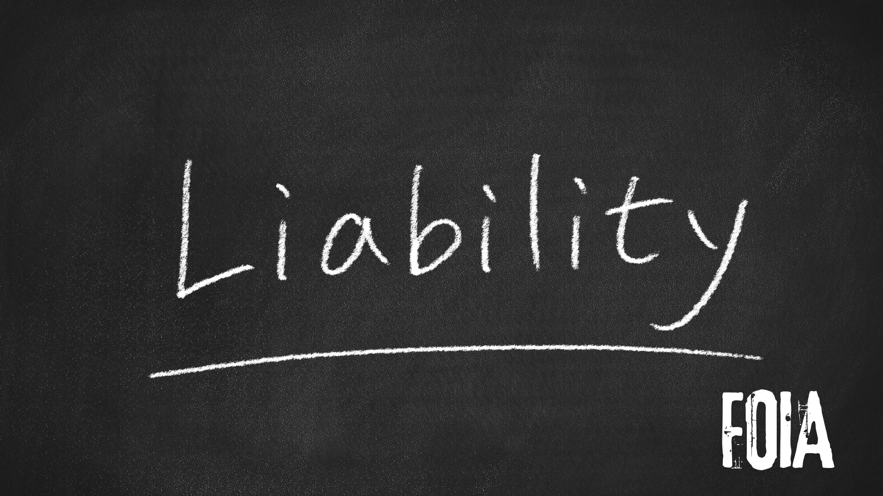

Slide 4


Slide 5


Slide 6


Slide 7


Slide 8

Notes:
Canned courses

Slide 9
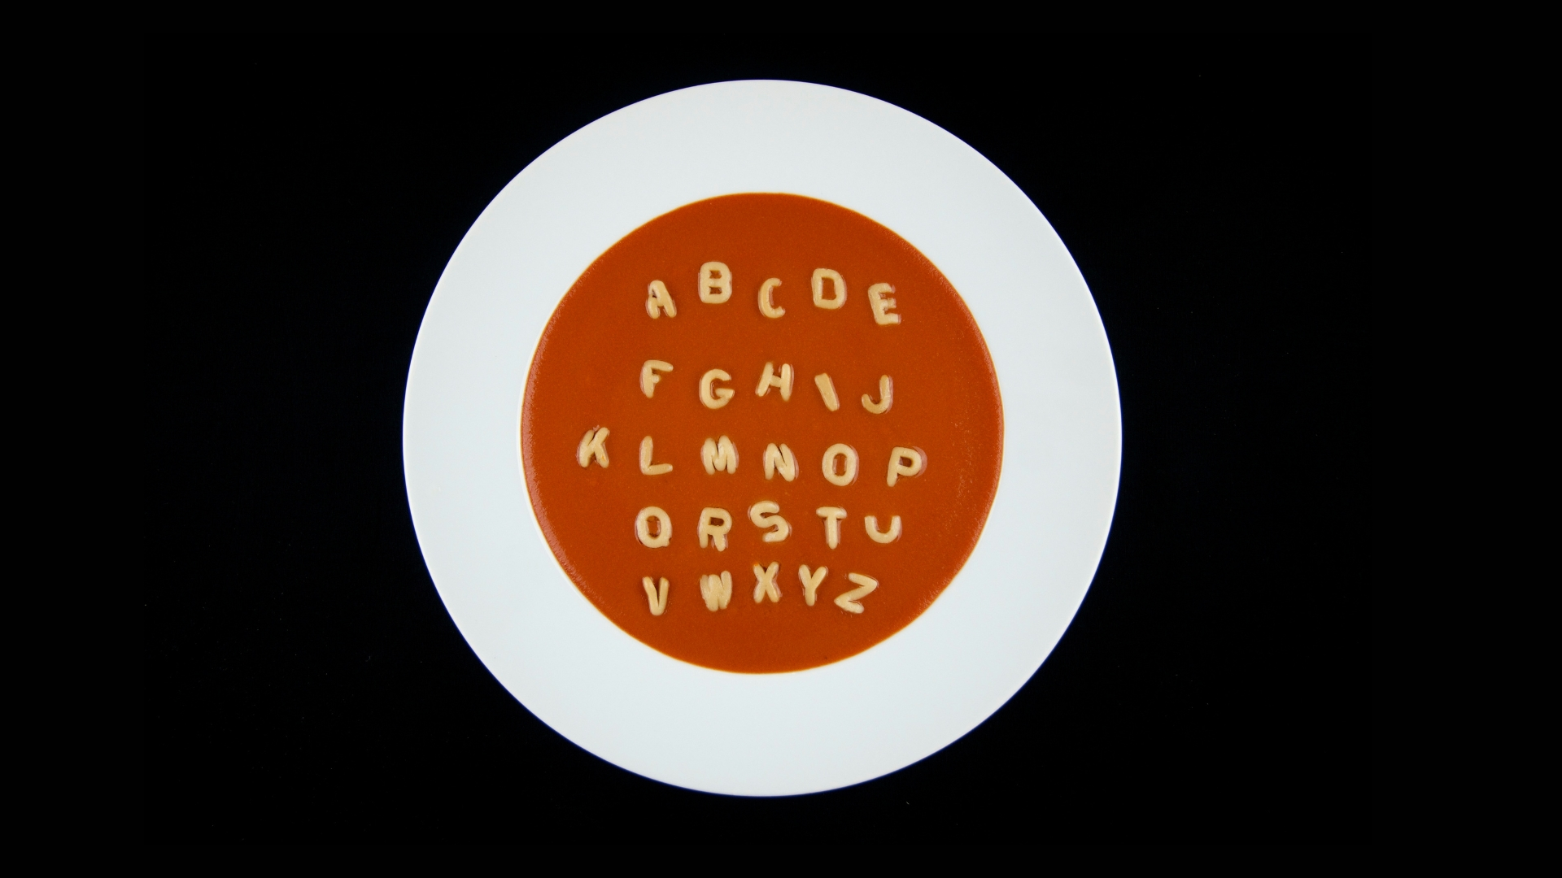
Notes:
Alphabet soup courses (auxillary programs)

Slide 10

Notes:
Skills validation for agency

Slide 11

Notes:
SME teaching (think doc teaching VADs, OB doc teching high risk delivery)

Slide 12

Notes:
Annual Con Ed plan for internal content

Slide 13
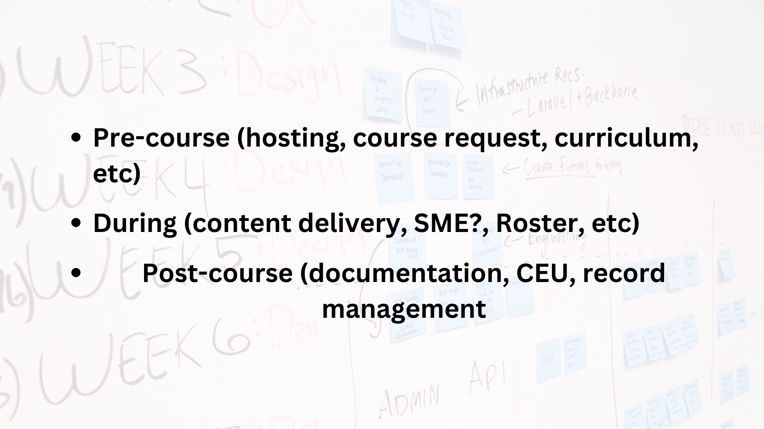

Slide 14


Slide 16


Slide 18


Slide 20


