Slide 1
Saving Forest Lake
Jon Swan, Founder
Save Forest Lake
www.SaveForestLake.com

Slide 2
Forest Lake State Park
Dalton, NH

Slide 3
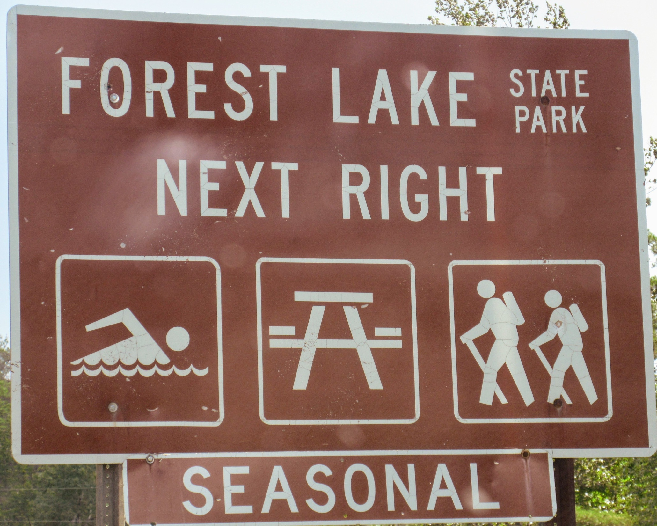
Notes:
Forest Lake State Park in Dalton, NH…one of the ten original state parks

Slide 4
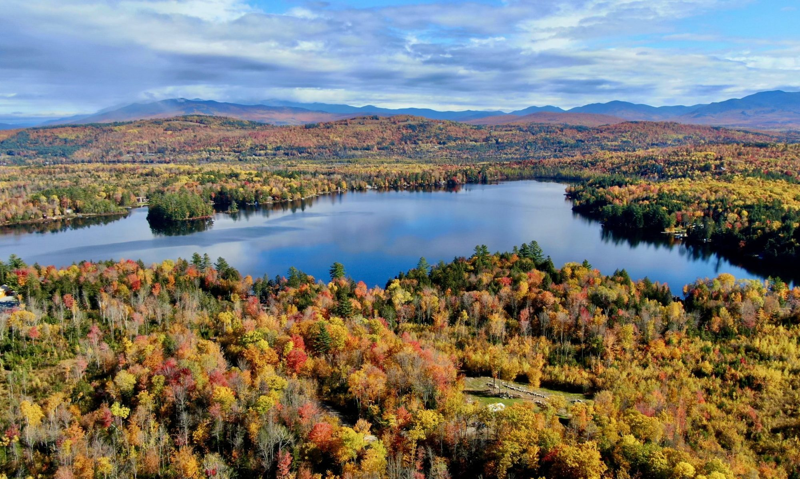
Notes:
She’s a beauty!

Slide 5
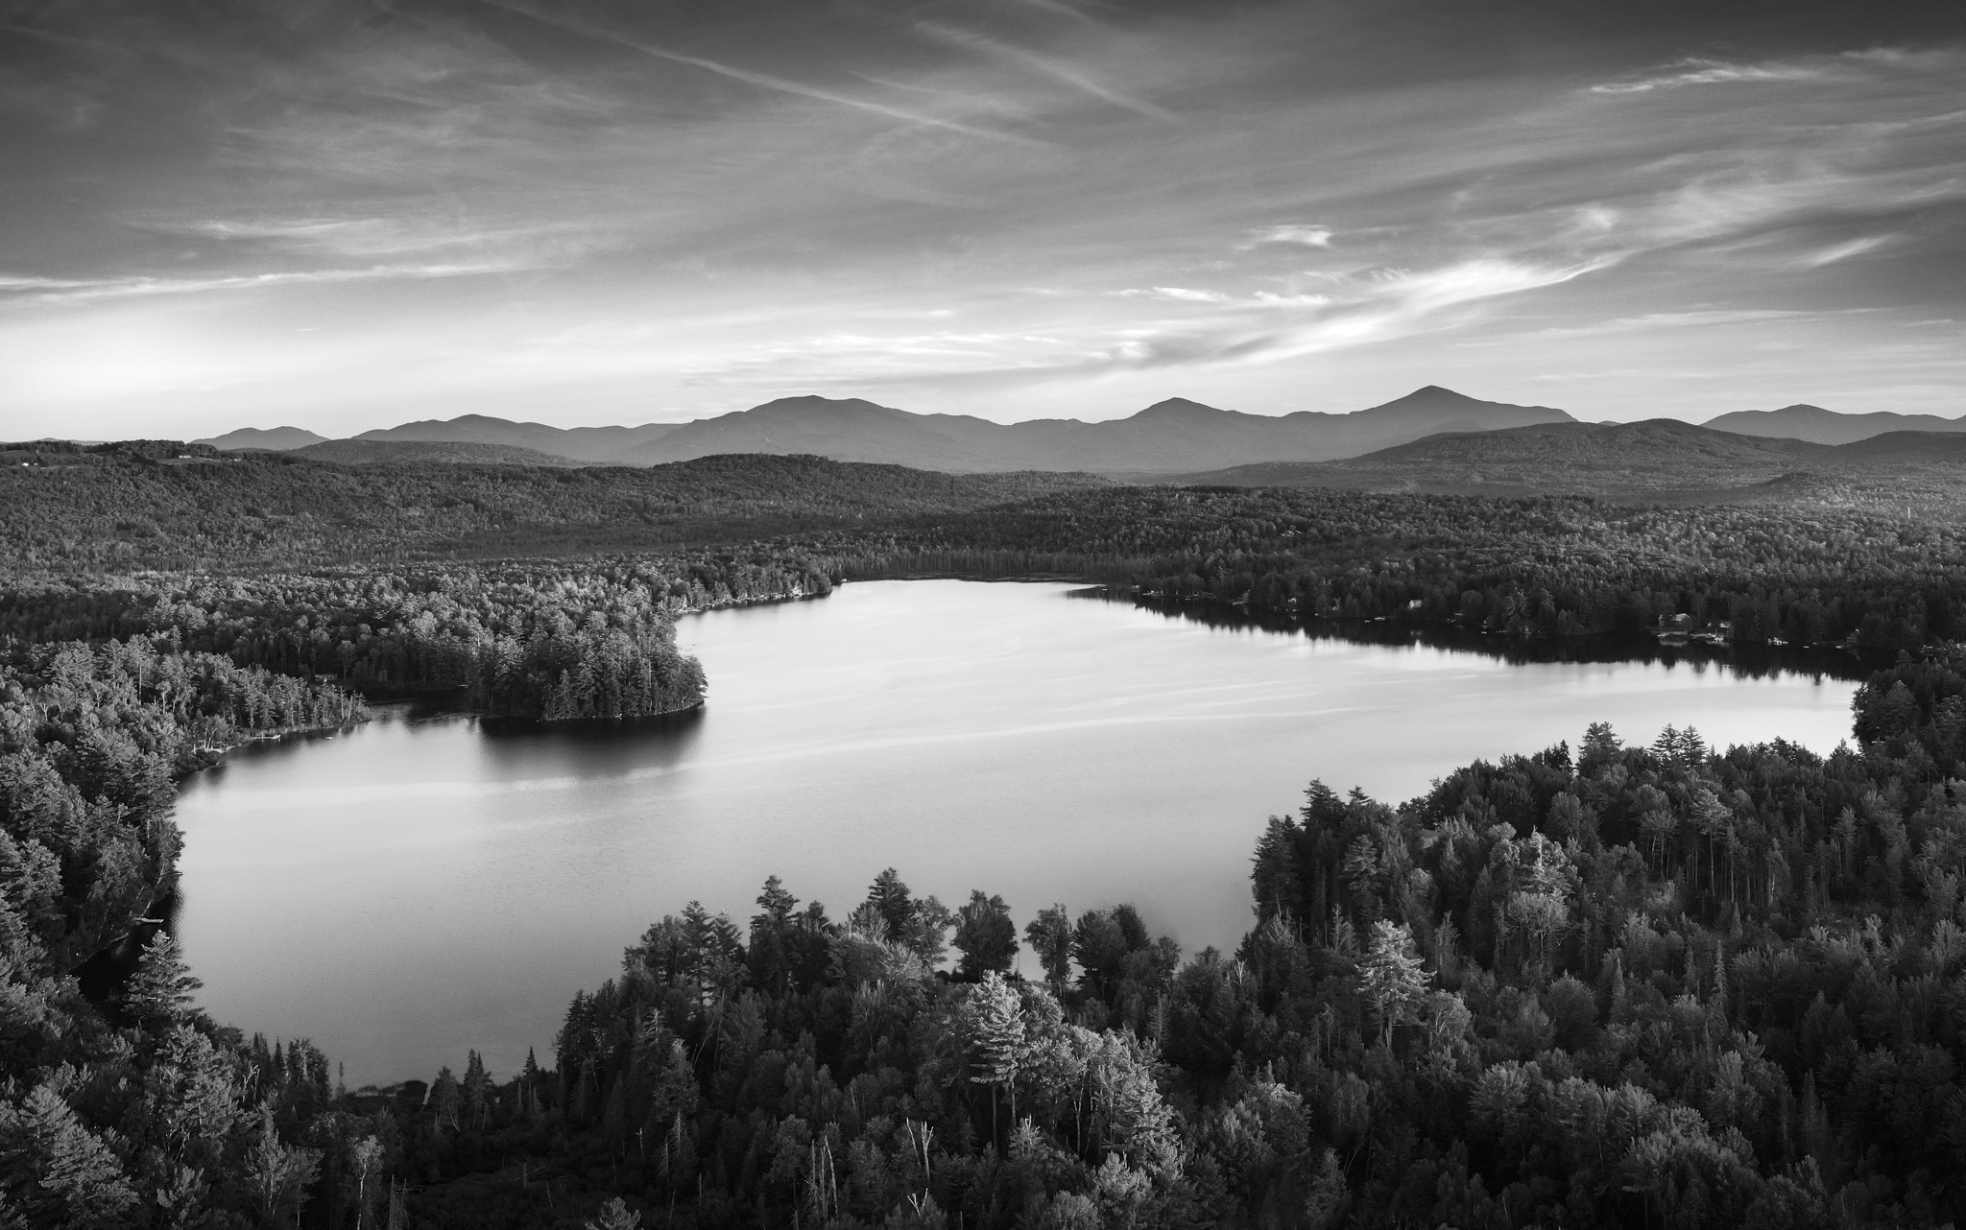
Notes:
Another photo for emphasis

Slide 6
Notes:
People flock to the North Country for the outdoors…why would we allow for it to be trashed?

Slide 7
Notes:
Tourism and outdoor recreation are key economic drivers for the State of New Hampshire

Slide 8
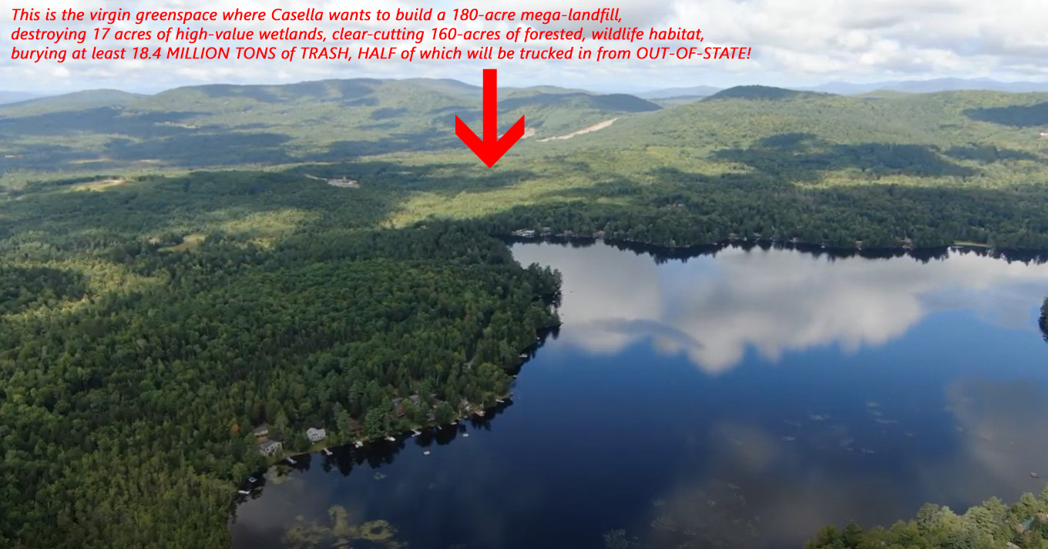
Notes:
Older image from the first-round of permitting

Slide 9
The Proposed 70-acre, 18-year Granite State Landfill Dalton and Bethlehem, NH
"This is an extremely important project that will disturb approximately 148 acres of land, add 25.5 acres of impervious surfaces, destroy 11.5 acres of wetlands, and have adverse effects on the Ammonoosuc River and other known and unknown public interest factors.”
-Jim McClammer, Certified Wetlands Scientist

Slide 10
Aerial photo from the proposed landfill site today
Approximately 148 acres of forested, wetlands habitat will be forever lost

Slide 11
The edge of the proposed landfill boundary is a mere 2700 feet from the water’s edge of Forest Lake
The prevailing winds blow E/SE towards the lake and surrounding homes

Slide 12
Would YOU bring your family to Forest Lake State Park?
Yet another landfill in the heart of the White Mountains region, just 5 miles up the road from the North Country Town of Littleton, would be devastating to our tourism, shopping, and outdoor recreation industries

Slide 13
Q: Who sites a garbage landfill next to a pristine lake and beloved state park?
A: Casella Waste Systems of Rutland, Vermont
Q: Why?

Slide 14
A: Casella needs a new landfill for its MA/CT trash collection routes
The citizens of Bethlehem have long opposed expansion of the controversial 30-year NCES Landfill

Slide 15
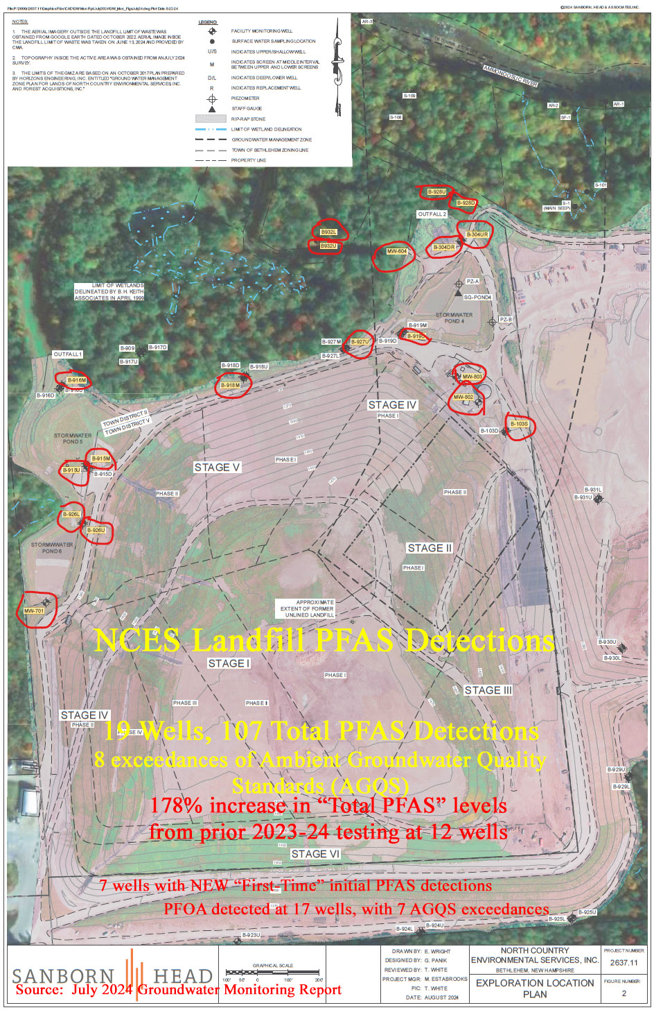
Notes:
This is what Casella is leaving behind in neighboring Bethlehem. Note, this facility is sited entirely within the watershed of the Ammonoosuc River

Slide 16
The proposed landfill site and surrounding vicinity has been tested for PFAS contamination with ZERO detections
Why would any of the permitting agencies permit the introduction of PFAS-laden waste into an area tested to be free from PFAS contamination?
This includes Forest Lake and Alder Brook which both border the project!
Notes:
We currently do not have a PFAS-contamination issue in the vicinity of the proposed landfill…including the site itself, we have clean water, and wish to keep it that way!

Slide 17
Rally/Public Hearing-1st Wetlands Permit Application
July 14, 2021 in Whitefield, NH

Slide 18
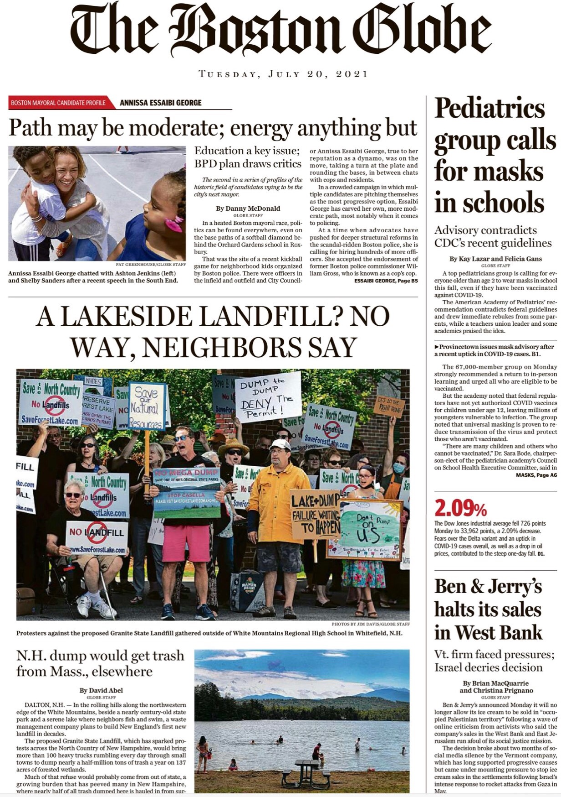
Notes:
We have garnered a lot of press coverage of the last 6 years…

Slide 19
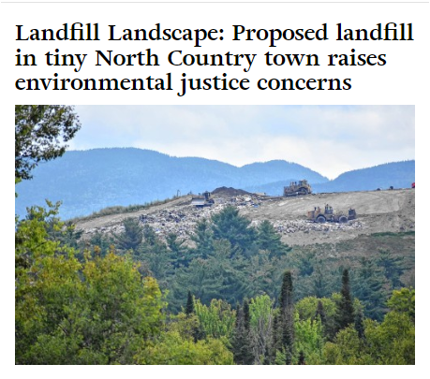
Notes:
A true David V Goliath battle

Slide 21
NHDES has not been our friend
2021 peaceful protest outside of NHDES in Concord urging denial of the wetland permit application…
Following the wetlands public hearing, NHDES requested an “amended” permit application, despite the RSA authorizing only an approval or denial

Slide 22
We’ve had incredible legislative success in the House!
In 2022, HB1454, which would have strengthened environmental regulations regarding landfill siting and setback requirements, passed in both the House and Senate, only to be vetoed by Governor Sununu.
Notes:
So close…5 votes in the Senate. We need more help in Concord!

Slide 23
Where do things stand now?
A 2nd round of permit applications have been submitted and we await the decisions of the permitting agencies and subsequent public hearings.
The US Army Corps of Engineers held an information/listening session in Dalton on June 26, 2024.
Notes:
9 permits currently submitted…we must defeat the permits

Slide 24
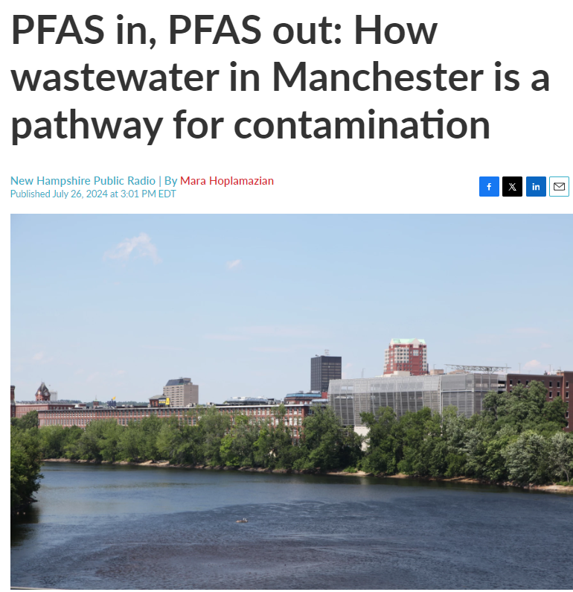
Notes:
This is not just a Dalton or North Country problem…millions of gallons of PFAS-laden leachate will have to be trucked hundreds of miles for disposal

Slide 25
How can you help?
Visit www.SaveForestLake.com and get on our email list to comment on the permit applications and to support legislative efforts
Follow us on social media-Facebook, Twitter, YouTube and spread the word!
Notes:
We need your help…join the fight!

