Slide 1
GHSA Leadership Meeting

Slide 2
Welcome to the 2020 Season

Slide 3
GHSA Leadership Meeting
Agenda
Welcome
GHSA’s Expectations
2020 Rule Changes
Mechanics Changes

Slide 4
GHSA Leadership Meeting
Agenda
NFHS Officials Considerations for Coronavirus
District Coordinators
Training Objectives

Slide 5
GHSA Leadership Meeting
Agenda
Camp Information
Playoff Process
Playoff Evaluation and PEB Role
Setup and Rating - Association Crews

Slide 6
GHSA Leadership Meeting
Agenda
Setup and Ratings - Area Crews
Position Train the Trainers virtual meetings
Questions/Concerns

Slide 7
GHSA Expectations
Kevin Giddens
GHSA
Notes:
Rule Change:
RULE 1 – SECTION 4 – PLAYER DESIGNATIONS
ART. 1 . . . Each team shall designate a player as field captain, and he is the only player who may communicate with game officials.
ART. 4 . . . Each head coach shall designate a representative who will make decisions regarding penalty acceptance or declination. His first choice of any offered decision is final. Decisions involving penalties shall be made before any charged time-out is granted either team. The head coach's designee shall remain in place for the entire game except in case of emergency.
RULE 2 – SECTION 32 – PLAYER DESIGNATIONS
ART. 5 . . . A captain of a team is a player designated to represent his team during:
a. The pregame and overtime coin toss. (Limit of four captains in game uniform.)
b. Penalty decisions following a foul (if designated by the head coach, as in 1-4-4).
c. Ball placement on a try, a kickoff, after a safety, after a fair catch or awarded fair catch, after a touchback and to start an overtime.
RULE 3 – SECTION 5 – CHARGED AND OFFICIAL'S TIME-OUTS — INTERMISSIONS
ART. 2 . . . A charged team time-out occurs when the ball is dead and:
a. The request of either a player or the head coach (or head coach's designee) is legally granted. When a decision on a penalty is pending, a time-out shall not be granted to either team until the designated representative makes his choice. …
RULE 10 – SECTION 1 – PROCEDURE AFTER A FOUL
ART. 1 . . . When a foul occurs during a live ball, the referee shall, at the end of the down, notify both teams. He shall inform the designated representative of the offended team regarding the rights of penalty acceptance or declination and shall indicate to him the number of the ensuing down, distance to be gained, and status of the ball for each available choice. The distance penalty for any foul may be declined. If the penalty is declined or if there is a double foul, there is no loss of distance. In case of a double foul, the designated representative is not consulted since the penalties offset. The choice of options may not be revoked. Decisions involving penalties shall be made before any charged time-out is granted either team.
ART. 2 . . . When a foul occurs during a dead ball between downs or prior to a free kick or snap, the covering official shall not permit the ball to become alive. The referee shall notify both teams, and the designated representative of the offended team will be presented with the options and the effect of acceptance or declination on the down and distance to be gained. The designated representative may accept or decline the penalty.
RULE 10 – SECTION 2 – DOUBLE AND MULTIPLE FOULS
ART. 4 . . . When two or more live-ball fouls (other than nonplayer or unsportsmanlike) are committed during the same down by the same team (multiple fouls), only one penalty may be enforced. The designated representative of the offended team may choose which one shall be administered, or all penalties may be declined. When a team commits a nonplayer or unsportsmanlike foul during that same down, it is administered from the succeeding spot as established by the acceptance or declination of the penalty for the other foul.
Rationale for Change:
Prior to the game, the head coach will notify the referee of the designated representative (coach or player) who will make decisions regarding penalty acceptance or declination.
Case Book: See SITUATIONS 1.4.1, 3.7.3D, 4.2.3B, 8.2.2F, 9.4.4D, 10.1.1B, 10.2.2A, 10.2.2B, 10.2.2C, 10.2.4, 10.4.5E

Slide 8
2020 GHSA Coordinators and Liaisons
James Arnold – State Football Officials Coordinator, State Football Training Coordinator
Rick Boedy – Test Coordinator, Area Crew Coordinator, Rules Interpreter
Keith Hammond – Coordinator of Video Evaluation
Joe Rice – Coordinator of Rubric Development
Hayes Cook – Coordinator of Rubric Scoring Summary
Clifton Puckett – Coordinator of Video

Slide 9
2020 nfhs football rules changes

Slide 10
Halftime Intermission Option Following Weather DelaY RULE 3-1-6c EXCEPTION (NEW)
HALFTIME INTERMISSION
A
B
If weather causes a delay of at least 30 minutes during the last three minutes of the second period, the opposing coaches may mutually agree to shorten the halftime intermission below the 10-minute minimum (PlayPic A). The mandatory 3-minute warm-up must take place before the third period begins (PlayPic B).
Notes:
Rule Change:
RULE 3 – SECTION 1 – LENGTH OF PERIODS – HALFTIME INTERMISSION
ART. 6 . . . State high school associations may determine the length of halftime intermission, provided it is not less than 10 minutes and not more than 20 minutes.
a. 15 minutes is normal for halftime intermission.
b. Halftime intermission may be increased to a maximum of 20 minutes, provided opponents have been notified no later than five minutes prior to the game.
c. By mutual agreement of the opposing coaches, the halftime intermission may be reduced to a minimum of 10 minutes (not including the mandatory warm-up period).
EXCEPTION: If the game is interrupted due to weather during the last three minutes of the second period, and the delay is at least 30 minutes, the opposing coaches can mutually agree to shorten halftime intermission, provided there is at least a one-minute intermission (not including the three-minute warm-up period).
Rationale for Change:
The halftime intermission may be shortened by mutual agreement of opposing coaches if a weather delay occurs during the last three minutes of the second period.
Case Book: See SITUATIONS 3.1.1A, 3.1.1B

Slide 11
40-Second Play Clock Clarification RUles 3-6-1a(1)e EXCEPTIONS 2 and 3 (NEW)
A
B
The play clock will be set to 40 seconds when an officials’ time-out is initially taken for an injury to a defensive player (PlayPic A) or a defensive player has an equipment issue (PlayPic B).
Notes:
Rule Change:
RULE 3 – SECTION 6 – PLAY CLOCK, BALL READY FOR PLAY AND DELAY
ART. 1 . . . Play clock and ready-for-play:
a. Play clock:
1. 25 seconds will be on the play clock and start on the ready-for-play signal:
(a) Prior to a try following a score;
(b) To start a period or overtime series;
(c) Following administration of an inadvertent whistle;
(d) Following a charged time-out;
(e) Following an official's time-out as in 3-5-7 or 3-5-10.
EXCEPTIONS:
1. 3-5-7b;
2. 3-5-7e if initially related to a defensive player; and
3. 3-5-10 if initially related to a defensive player.
(f) Following a legal kick, when either team is awarded a new series; and
(g) Following the stoppage of the play clock by the referee for any other reason. …
Rationale for Change:
To eliminate a potential timing advantage gained by the defensive team, the rules committee approved the play clock being set to 40 seconds when an officials’ time-out is taken for an injury to a defensive player or a defensive player has an equipment issue.

Slide 12
25-Second Play Clock Clarification RULE 3-6-1a(1)f (NEW)
A
B
When either team is awarded a new series after a legal kick (MechaniGram A), the play clock is set to 25 seconds and starts with the ready-for-play signal (PlayPic B).
Notes:
Rule Change:
RULE 3 – SECTION 6 – PLAY CLOCK, BALL READY FOR PLAY AND DELAY
ART. 1 . . . Play clock and ready-for-play:
a. Play clock:
1. 25 seconds will be on the play clock and start on the ready-for-play signal:
(a) Prior to a try following a score;
(b) To start a period or overtime series;
(c) Following administration of an inadvertent whistle;
(d) Following a charged time-out;
(e) Following an official's time-out as in 3-5-7 or 3-5-10.
EXCEPTIONS:
1. 3-5-7b;
2. 3-5-7e if initially related to a defensive player; and
3. 3-5-10 if initially related to a defensive player.
(f) Following a legal kick, when either team is awarded a new series; and
(g) Following the stoppage of the play clock by the referee for any other reason. …
Rationale for Change:
Following a legal kick when either team is awarded a new series, the play clock will be set to 25 seconds.

Slide 13
Disconcerting Act FOUL AND Penalty Reclassified RULES 7-1-9 (NEW), 7-1-9 PENALTY (NEW)
23
Disconcerting acts or words by the defense has been reclassified from an unsportsmanlike foul to a disconcerting act foul, and the penalty changed from 15 yards to 5 yards. Signal 23 will be used to indicate the foul.
Notes:
Rule Change:
RULE 7 – SECTION 1 – BEFORE THE SNAP
ART. 9 . . . No defensive player shall use disconcerting acts or words prior to the snap in an attempt to interfere with A's signals or movements.
PENALTY: Arts. 1, 5, 6 – Encroachment – (S7-18) – 5 yards; Arts. 2, 3 – snap infraction (S7-19) – 5 yards; Art. 7 – false start – (S7-19) – 5 yards; Art. 9 – disconcerting act – (S7-23) – 5 yards.
Rationale for Change:
Disconcerting acts or words by the defense has been reclassified from a unsportsmanlike foul to a disconcerting act foul, and the penalty changed from 15 yards to 5 yards.
Case Book: See SITUATIONS 7.1.7C, 7.1.9

Slide 14
Spiking the ball to conserve time 7-5-2e EXCEPTION, TABLE 7-5-2e EXCEPTION, TABLE 7-5e EXCEPTION
The exception to allow a player to conserve time by intentionally throwing the ball forward to the ground immediately after receiving the snap has been expanded. This exception now includes snaps that are not hand-to-hand.
Notes:
Rule Change:
RULE 7 – SECTION 5 – FORWARD-PASS CLASSIFICATION …
ART. 2 . . . An illegal forward pass is a foul. Illegal forward passes include:
a. A pass after team possession has changed during the down.
b. A pass from beyond the neutral zone.
c. A second and subsequent forward pass(es) thrown during a down.
d. A pass intentionally thrown into an area not occupied by an eligible offensive receiver.
e. A pass intentionally thrown incomplete to save loss of yardage or to conserve time.
EXCEPTION: It is legal for a player positioned directly behind the snapper to conserve time by intentionally throwing the ball forward to the ground immediately after receiving the snap that has neither been muffed nor touched the ground.
TABLE 7-5-2e EXCEPTION, TABLE 7-5e EXCEPTION …
e. Pass intentionally thrown incomplete to save loss of yardage or conserve time.
EXCEPTION: It is legal for a player positioned directly behind the snapper to conserve time by intentionally throwing the ball forward to the ground immediately after receiving the snap that has neither been muffed nor touched the ground.
Rationale for Change:
The exception to allow a player to conserve time by intentionally throwing the ball forward to the ground immediately after receiving the snap, has been expanded to include any player positioned directly behind the center. This exception now includes snaps that are not hand-to-hand.
Case Book: See SITUATIONS 7.5.2B, 7.5.2G

Slide 15
2020 nfhs football editorial changes

Slide 16
Correcting Play Clock Errors RULE 3-4-9 (NEW)
A
B
The referee shall have the authority to correct obvious errors in timing by the play clock (PlayPic A) if discovery is prior to the snap (PlayPic B).
Notes:
Editorial Change:
RULE 3 – SECTION 4 – STARTING AND STOPPING THE GAME CLOCK
ART. 9 . . . The referee shall have the authority to correct obvious errors in timing by the play clock if discovery is prior to the snap.
Rationale for Change:
Clarification

Slide 17
2020 Nfhs football editorial changes
NOCSAE Warning Label | Updated the language in the NOCSAE Warning Label.
1-3-1d and g | Added reference to “Figure 1-3-1”
1-3-1i (NEW) | Added a new heading for “Method of Measuring the Ball”
Table 1-7 | Updated Table 1-7 of allowable State Association Adoptions for football.
2-33-2 | Penalty decisions following a foul further clarified.
2-41-9 | Further defined the spot where a run ends.
3-1-6 (NEW) | Added a new Article on halftime intermission that use to be in TABLE 3-1.
3-1-7 (NEW) | Added a new Article on three-minute warm-up period that use to be in TABLE 3-1.
TABLE 3-1 | Added mandatory three-minute warm-up period to TABLE 3-1.
3-4-8 | Grammar edit to the Article.
7-2-5a | Clarified player formation and numbering requirements.
7-5-12 | Deleted a portion of the Article that dealt with lineman.
Notes:
Comment on Slide:
This slide lists the rules references and a brief description of the football editorial changes that were made to the 2020 NFHS Football Rules Book.

Slide 18
2020 Nfhs football editorial changes
TABLE 7-5 | Clarified enforcement spots and added rules references to TABLE 7-5.
8-2-4 | Deleted “results of the play” and added “penalty.”
9-5-1d | Re-lettered items under Article 1 after deleting item on disconcerting act.
9-9 PENALTY | Deleted a signal reference in Article 3.
10-4-2 EXCEPTION | Added “legal” before “free or scrimmage kick down.”
10-5-1j | Added “legal” before “kick.”
Penalty Summary | New format. Added “Disconcerting Act” foul under loss of 5-yards penalty.
NFHS Official Football Signals | Added New Signal 17 on play clock and revised Signal 23 for disconcerting act.
Appendix H (NEW) | Added a new Appendix H on “Modifications for Competition Below Ninth Grade.”
Index | Added Intermission, Length of Halftime to Index.
Notes:
Comment on Slide:
This slide lists the rules references and a brief description of the football editorial changes that were made to the 2020 NFHS Football Rules Book.

Slide 19
2020 nfhs football rules reminders

Slide 20
FOOTBALL JERSEY NUMBERS RULE 1-5-1c
The entire body of the number (the continuous horizontal bars and vertical strokes) exclusive of any border(s) shall be approximately 1½-inches wide, and a single solid color that clearly contrasts with the body color of the jersey starting in 2024.
Notes:
Rules Reminder:
RULE 1 – SECTION 5 – PLAYER EQUIPMENT
ART. 1 . . . Mandatory equipment. Each player shall participate while wearing the following pieces of properly fitted equipment, which shall be professionally manufactured and not altered to decrease protection: …
c. Numbers
1. The numbers shall be clearly visible and legible using Arabic numbers 1-99 inclusive and shall be on the front and back of the jersey.
2. The numbers, inclusive of any border(s), shall be centered horizontally at least 8 inches and 10 inches high on front and back, respectively.
3. The entire body of the number (the continuous horizontal bars and vertical strokes) exclusive of any border(s) shall be approximately 1½-inches wide.
4. The color and style of the number shall be the same on the front and back.
5. Through the 2023 season, the body of the number (the continuous horizontal bars and vertical strokes) shall be either:
(a) a continuous color(s) contrasting with the jersey color; or
(b) the same solid color(s) as the jersey with a minimum of one border that is at least ¼-inch in width of a single solid contrasting color.
6. Effective with the 2024 season, the entire body of the number (the continuous horizontal bars and vertical strokes) shall be a single solid color that clearly contrasts with the body color of the jersey.
Comment on Slide:
Rule change in 2019. The purpose of numbers on jerseys is to provide clear identification of players. In order to enhance the ability to easily identify players, the committee has clarified the size requirements for jersey numbers through the 2023 season. The committee also added a new requirement that, effective in the 2024 season, jersey numbers must be a single solid color that clearly contrasts with the body color of the jersey.

Slide 21
Football JERSEY numbers RULES 1-5-1c, 1-5-1c(6)
The style of the numbers on all three of these jerseys are legal now and will be in 2024 as well.
Notes:
Rules Reminder:
RULE 1 – SECTION 5 – PLAYER EQUIPMENT
ART. 1 . . . Mandatory equipment. Each player shall participate while wearing the following pieces of properly fitted equipment, which shall be professionally manufactured and not altered to decrease protection: …
c. Numbers
1. The numbers shall be clearly visible and legible using Arabic numbers 1-99 inclusive and shall be on the front and back of the jersey.
2. The numbers, inclusive of any border(s), shall be centered horizontally at least 8 inches and 10 inches high on front and back, respectively.
3. The entire body of the number (the continuous horizontal bars and vertical strokes) exclusive of any border(s) shall be approximately 1½-inches wide.
4. The color and style of the number shall be the same on the front and back.
5. Through the 2023 season, the body of the number (the continuous horizontal bars and vertical strokes) shall be either:
(a) a continuous color(s) contrasting with the jersey color; or
(b) the same solid color(s) as the jersey with a minimum of one border that is at least ¼-inch in width of a single solid contrasting color.
6. Effective with the 2024 season, the entire body of the number (the continuous horizontal bars and vertical strokes) shall be a single solid color that clearly contrasts with the body color of the jersey.
Comment on Slide:
Rule change in 2019. The purpose of numbers on jerseys is to provide clear identification of players. In order to enhance the ability to easily identify players, the committee has clarified the size requirements for jersey numbers through the 2023 season. The committee also added a new requirement that, effective in the 2024 season, jersey numbers must be a single solid color that clearly contrasts with the body color of the jersey.

Slide 22
Football JERSEY numbers RULES 1-5-1c, 1-5-1c(6)
The style of the numbers on these jerseys are legal through the 2023 season. The following four types of number designs will be illegal in 2024.
Notes:
Rules Reminders:
RULE 1 – SECTION 5 – PLAYER EQUIPMENT
ART. 1 . . . Mandatory equipment. Each player shall participate while wearing the following pieces of properly fitted equipment, which shall be professionally manufactured and not altered to decrease protection: …
c. Numbers
1. The numbers shall be clearly visible and legible using Arabic numbers 1-99 inclusive and shall be on the front and back of the jersey.
2. The numbers, inclusive of any border(s), shall be centered horizontally at least 8 inches and 10 inches high on front and back, respectively.
3. The entire body of the number (the continuous horizontal bars and vertical strokes) exclusive of any border(s) shall be approximately 1½-inches wide.
4. The color and style of the number shall be the same on the front and back.
5. Through the 2023 season, the body of the number (the continuous horizontal bars and vertical strokes) shall be either:
(a) a continuous color(s) contrasting with the jersey color; or
(b) the same solid color(s) as the jersey with a minimum of one border that is at least ¼-inch in width of a single solid contrasting color.
6. Effective with the 2024 season, the entire body of the number (the continuous horizontal bars and vertical strokes) shall be a single solid color that clearly contrasts with the body color of the jersey.
Comment on Slide:
Rule change in 2019. The purpose of numbers on jerseys is to provide clear identification of players. In order to enhance the ability to easily identify players, the committee has clarified the size requirements for jersey numbers through the 2023 season. The committee also added a new requirement that, effective in the 2024 season, jersey numbers must be a single solid color that clearly contrasts with the body color of the jersey.

Slide 23
Tripping rules 2-45, 9-4-3o, 9-4-3o PENALTY
The foul for tripping has been expanded to include the runner. It is now illegal to trip any opponent. Tripping is the intentional use of the lower leg or foot to obstruct an opponent below the knee. The penalty is 15 yards.
Notes:
Rules Reminder:
RULE 2 – SECTION 45 – TRIPPING
Tripping is the intentional use of the lower leg or foot to obstruct an opponent below the knee.
RULE 9 – SECTION 4 – ILLEGAL PERSONAL CONTACT
ART. 3 . . . No player or nonplayer shall: …
o. Trip an opponent.
PENALTY: … Art. 3o – illegal tripping – (S38-46) – 15 yards; …
Comment on Slide:
Rule change in 2019. In an effort to decrease risk, tripping the runner is now prohibited. It is now a foul to intentionally use the lower leg or foot to obstruct a runner below the knees.
Case Book: See SITUATION 2.42.1

Slide 24
2020 nfhs football points of emphasis

Slide 25
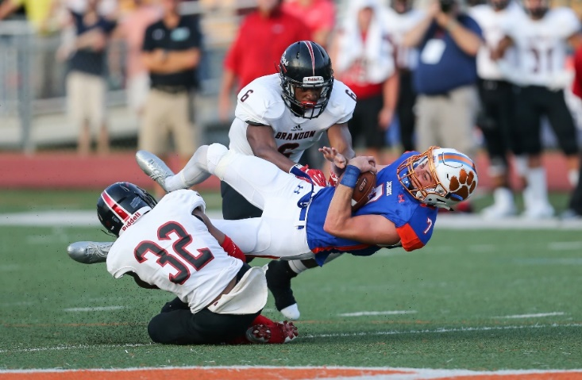
2020 nfhs football points of emphasis
1. Sportsmanship
Intentional Grounding
3. Ineligible Downfield and Line of Scrimmage Formation
Notes:
Comment on Slide:
The following football points of emphasis were selected by the NFHS Football Rules Committee for the 2020 high school football season. These three football points of emphasis need to be stressed to all coaches, game officials, players, parents, school administrators, appropriate health-care professionals and all others who have an interest in high school football.

Slide 26
SPORTSMANSHIP
A
B
C
When considering sportsmanship, many may first think only of the game participants (athletes and coaches) within the timeframe of the game. Although players and coaches are the most visible in their displays of sportsmanship, proper sportsmanship also includes public address announcers (PlayPic A), bands (PlayPic B) and spectators (PlayPic C).
Notes:
Sportsmanship (Point of Emphasis):
When considering sportsmanship, many may first think only of the game participants (athletes and coaches) within the timeframe of the game. However, proper sportsmanship also includes the pregame warm-up period, postgame handshake activity, spectator behavior (both students and adults), parents of athletes, public-address announcements and announcers, and bands. All of the above constituents have a role in promoting good sportsmanship.
Players and coaches are the most visible in their displays of sportsmanship. Their behavior sets the tone for fans, game officials and others. As recognizable personalities, it is an expectation that coaches model good behavior. Players must represent their schools and communities as ambassadors of good sporting behavior beginning with pregame activities and concluding with end-of-game activities.
Game officials generally do not assume control until taking the field approximately 30 minutes prior to the scheduled kickoff. Therefore, coaching staffs and game administrators must be vigilant and responsible for ensuring proper sportsmanship during this time. Once the contest begins, school administrators are responsible for the proper conduct of all spectators. This may take the form of reading a sportsmanship public-address announcement prior to the contest and remaining vigilant for possible issues during the contest. Student bodies and spectators in general should be reminded that any behaviors conducted at the expense of the opponents is unacceptable and will be addressed accordingly.
Public-address announcers are responsible for delivering pertinent game-related information – not to be a play-by-play person or cheerleader. Taking liberties with biased and/or inflammatory announcements must not be tolerated. Their purpose is not to editorialize the quality of play or incite the home crowd in any way.
Working with the band/music director, the school administration must set proper guidelines and ensure compliance regarding when live or recorded music may be utilized.
Good sportsmanship does not occur on its own. Only with specific planning and coordination by all constituents is good sportsmanship achievable. Good sportsmanship is about respect. Good sports win with humility, lose with grace and do both with dignity.

Slide 27
INTENTIONAL GROUNDING
A
B
Under NFHS rules, unless using the legal exception in Rule 7-5-2e, intentional grounding is a foul whenever a forward pass is thrown to prevent a loss of yardage or to conserve time (PlayPic A) or to an area not occupied by an eligible receiver (PlayPic B). High school referees need to be aware of these situations and, with the help of the line judge and linesman, make the correct call under NFHS football rules.
Notes:
Intentional Grounding (Point of Emphasis):
Due to the growing prevalence of televised football, one of the most misunderstood rules at the high school level is intentional grounding. Under NFHS rules, intentional grounding is a foul whenever a legal forward pass is thrown into an area not occupied by an eligible receiver, or when a pass is thrown to prevent a loss of yardage or to conserve time. The only exception to this rule is when the passer intentionally throws the ball forward to the ground immediately after receiving the snap.
Under NFHS rules, it is a foul if there was no eligible receiver in the area of the pass, regardless of the passer’s position on the field. Across the country, we are seeing more high school quarterbacks throw the ball away to avoid a sack when outside the pocket, thinking this is legal based on what is seen on television. High school referees need to be aware of these situations and, with the help of the line judge and linesman, make the correct call under NFHS football rules. This is a foul that should be called after the game officials have gathered and discussed the play. When a foul does occur, the penalty flag needs to be thrown by the referee. The penalty is 5 yards from the spot of the foul and a loss of down.

Slide 28
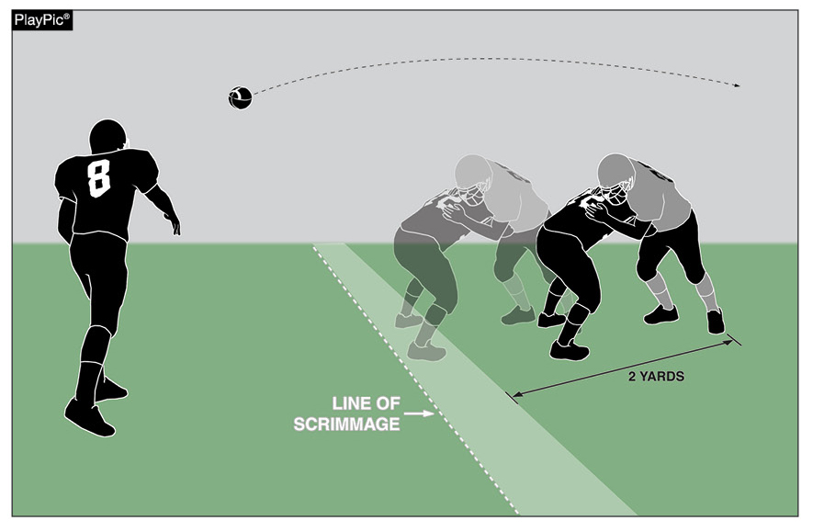
INELIGIBLE DOWNFIELD
Ineligible A players may not advance beyond the expanded neutral zone on a legal forward pass play before a legal forward pass that crosses the neutral zone is in flight. The neutral zone expands two yards behind the defensive line of scrimmage following the snap. When identifying A players who are illegally downfield it is important to make sure that the A player is clearly beyond the expanded neutral zone (2 yards) at the moment that the pass occurs.
Notes:
Ineligible Downfield (Point of Emphasis):
Some clarification was recently provided in identifying when an ineligible Team A player is illegally downfield on a pass play. By rule, ineligible Team A players may not advance beyond the expanded neutral zone on a legal forward pass play before a legal forward pass that crosses the neutral zone is in flight. The neutral zone expands 2 yards behind the defensive line of scrimmage following the snap. The position of the ineligible Team A player at the moment of the legal pass is the only factor in determining if the player is illegally downfield. When identifying Team A players who are illegally downfield, it is important to make sure that the Team A player is clearly beyond the expanded neutral zone (2 yards) at the moment that the pass is in flight. Players can travel multiple yards in a quick period of time. These players can be legally within the expanded neutral zone when the pass is thrown but beyond as the pass moves downfield. If B touches the pass in or behind the neutral zone, this restriction is terminated.

Slide 29
LINE OF SCRIMMAGE FORMATION
Only one player may not be on the line but still penetrate the vertical plane through the waistline of his nearest teammate who is on the line. This player (A) must be in position to receive a hand-to-hand snap, but does not have to actually receive it. By rule, he is the only player allowed to be positioned in “no man’s land” at the snap. All other players not on the line must be clearly positioned as backs. The player marked (B) is in an illegal position.
A
B
Notes:
Line of Scrimmage Formation (Point of Emphasis):
In order for the offensive team to have a legal scrimmage formation at the snap (assuming the numbering exception is not being used), at least five Team A players, numbered 50-79, must be on the line of scrimmage. Also, no more than four Team A players may be backs. Only one player may not be on the line but still penetrate the vertical plane through the waistline of his nearest teammate who is on the line. This player must be in position to receive a hand-to-hand snap, but does not have to actually receive it. By rule, he is the only player allowed to be positioned in “no man’s land” at the snap. All other players not on the line must be clearly positioned as backs.

Slide 30
2020 nfhs Mechanics Changes 2020

Slide 31
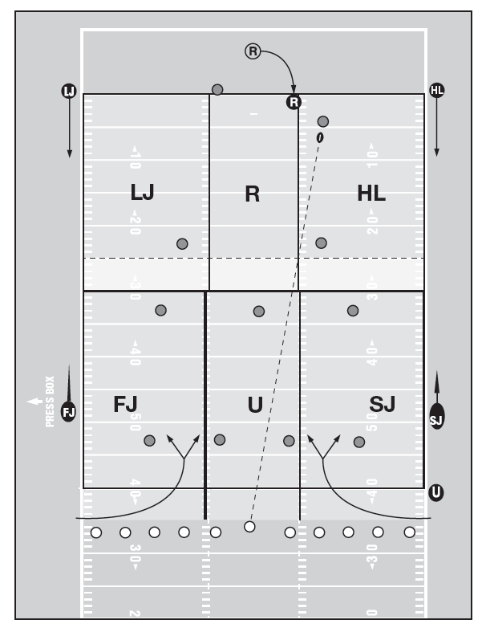
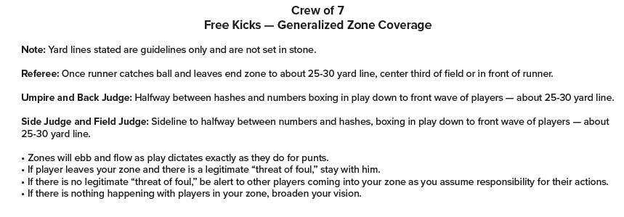
Mechanics Changes 2020

Slide 32
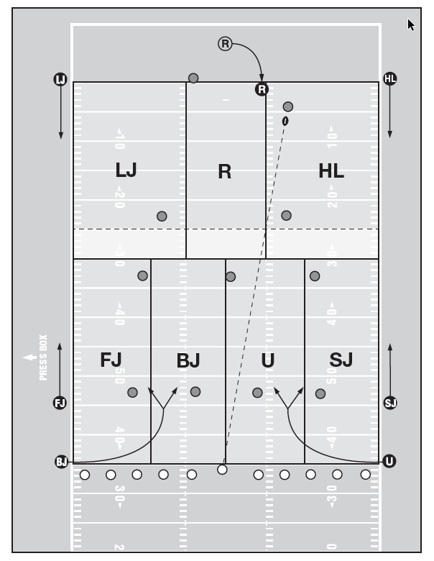
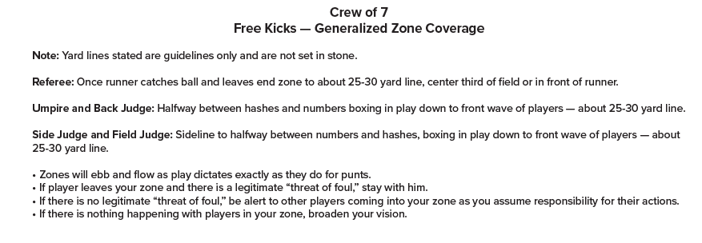
Mechanics Changes 2020

Slide 33
2020-2021 nfhs football game officials manual

Slide 34
2020-2021 Nfhs football game officials manual REMINDERS
Game Officials Manual
The Game Officials Manual Committee added and/or updated the following items for 2020-2021:
1. Added new NFHS General Instructions for Football Game and Play Clock Operators.
2. Changed NFHS Official Signal 23 to Disconcerting Act in the signal chart.
3. Updated the Pregame Conference Responsibilities for the Crew.
4. Game officials’ uniforms updated.
5. Strongly recommend that Line-to-Gain Crews be adults.
6. The referee should have the ball marked ready for play in three to five
seconds following the placement of the ball.
7. In five-person officiating crews, the line judge will now time the game if a visible game clock is not available.
Notes:
Comment on Slide:
Reminders for 2020 from the NFHS Football Game Officials Manual Committee on the 2020-2021 NFHS Football Game Officials Manual and other items.
See comments on the slide.

Slide 35
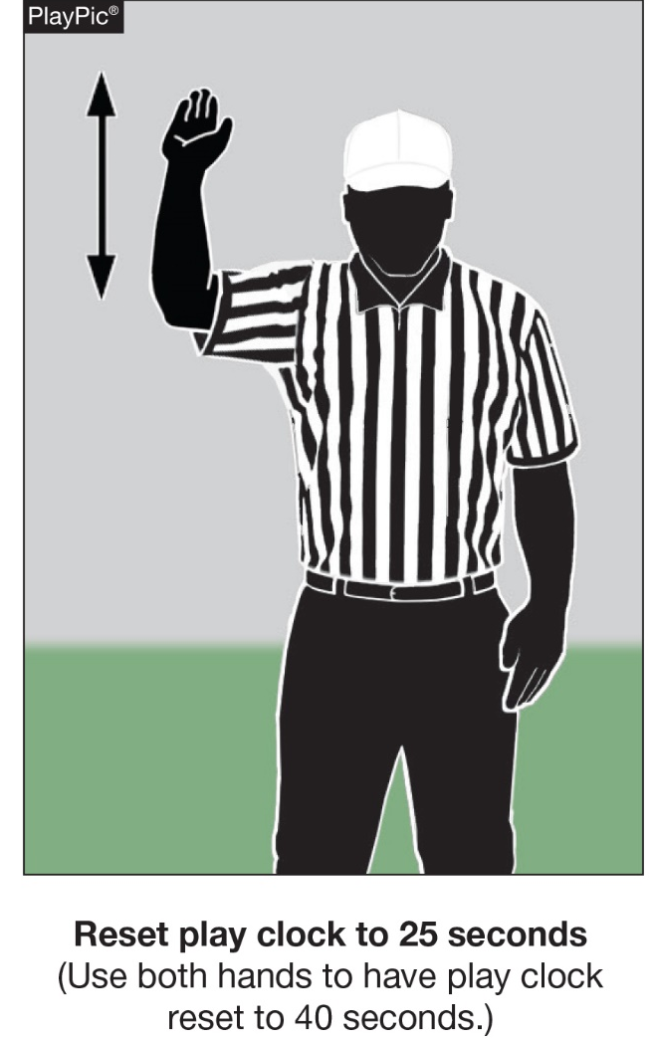
Reset Play Clock-Signal 17 (NEW) NFHS Official Football Signals
Game Officials Manual
Notes:
Comment on Slide:
A new NFHS Official Signal for Reset Play Clock (Signal 17) was added to the signal chart.

Slide 36
2020-21 NFHS football information

Slide 37
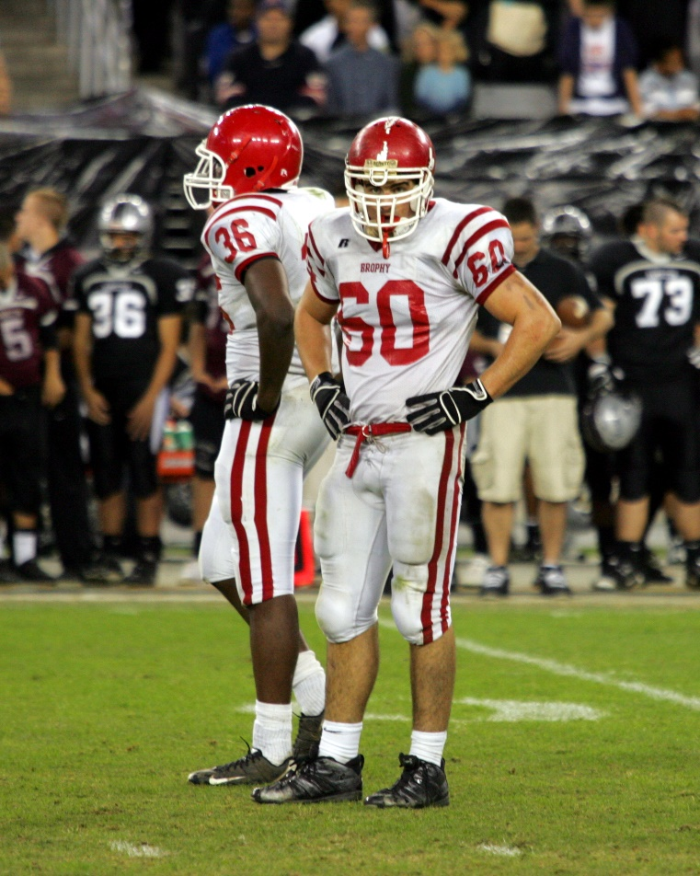
2021 nfhs football rule change proposal online form
Due:
November 1, 2020
Must be submitted to your state association office for approval.
Notes:
Comment on Slide:
ALL 2021 NFHS Football Rule Change Proposal Online Forms must first go through the state association office before it can be sent to the NFHS.
Only member state associations, football coaches and football game officials approved by the member state association, members of the NFHS Football Rules Committee and the NFHS can submit football rule change online proposal forms.
ALL 2021 NFHS Football Rule Change Online Proposal Forms must be submitted electronically online to the NFHS.

Slide 38
NFHS Rules Book as e-Books
E-books features:
Searchable
Highlight areas of interest
Make notes
Easy navigation
Adjustable viewing size
Immediate availability
www.nfhs.org/ebooks for more information
Notes:
Comment on Slide:
Overview of NFHS Rules Books and Case Books as E-Books.
Cost is $6.99 each.
Download from iTunes and Amazon.

Slide 39
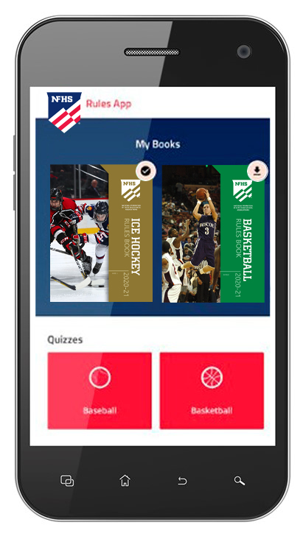
NFHS Rules App
Rules App features:
Searchable
Highlight notes
Bookmarks
Quizzes for all sports
Easy navigation
Immediate availability
Free to paid members of the NFHS Coaches and Officials Associations
www.nfhs.org/erules for more information
Notes:
Comment on Slide:
NFHS Rules App is free to download.
Each book subscription is $6.99.
NFHS Coaches and Officials Association paid members get all books for free.
100% states members get books for free in sports designated by their state.
For 2020-21 – Rules Apps for all NFHS rules books and case books available on iTunes and Google Play. Rules books and case books will be cross-linked. Searchable content.

Slide 40
Nfhs officials education

Slide 41
Notes:
Comment on Slide:
OFFICIALS EDUCATION
Every opportunity should be taken to improve upon officiating. Clinics, course work, observations, video review, association meetings should all be considered when attempting to improve one’s skills in officiating. The NFHS has provided opportunities for officials and prospective officials to take courses and to review video to support learning and developing officiating skills.
Sport-Specific Officiating courses are offered in several sports. They are ideal for new officials and those in the first few years of officiating. These courses introduce officials to the mechanics and techniques used in the sport and provide specific information on an area within that sport. Individuals can complete a course within 30-45 minutes. The cost of these courses is $10.00 to NFHS Officials Association members and $20 for non-members.
“Interscholastic Officiating” is a general course on sports officiating and it is free to members and cost $20 for non-members. This course provides an introduction to skills and concepts used as an official. Several topics are covered such as: basics of becoming and staying an official, science of officiating, art of officiating, how to combine these skills for successful officiating.
Video clips are made available to NFHS Officials Association members. The video is clipped on specific topics and provides the rules references as well as dialogue on the topic.
The courses and videos are offered at www.NFHSLearn.com .
Courses Available:
Officiating Football
Officiating Volleyball – Ball Handling
Officiating Volleyball – Alignment
Officiating Basketball
Officiating Basketball – Three-Person Mechanics
Soccer – Fouls and Misconduct
Soccer - Offside
Swimming and Diving
Officiating Wrestling
Umpiring Softball
Future Courses to be Considered:
Umpiring Baseball
Field Hockey
Track and Field
Umpiring Softball – Mechanics
Communication Among Officials and Coaches

Slide 42
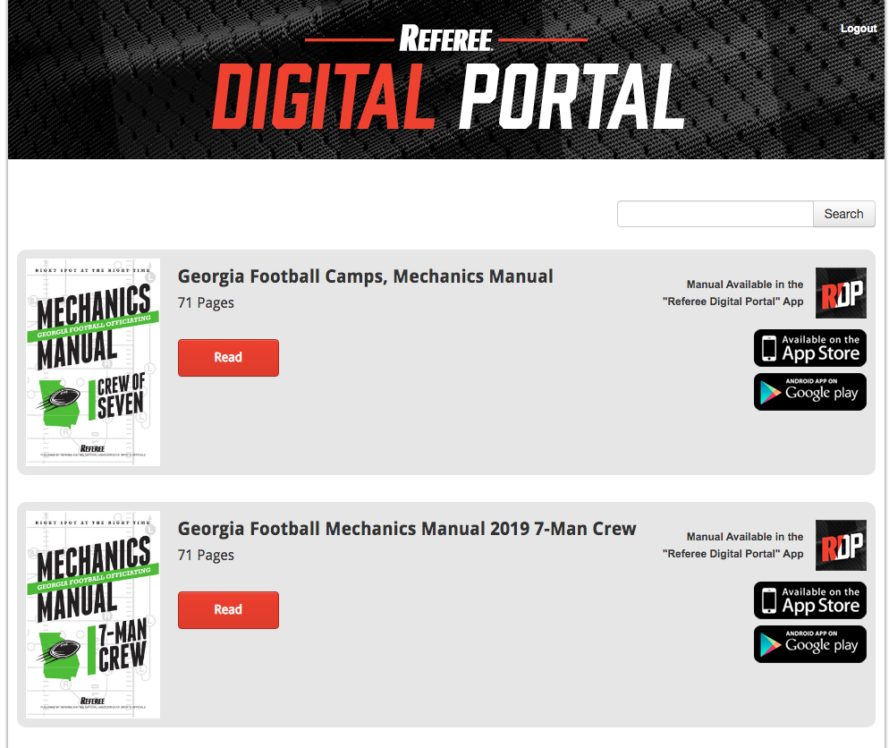
Notes:
Rule Change:
RULE 1 – SECTION 4 – PLAYER DESIGNATIONS
ART. 1 . . . Each team shall designate a player as field captain, and he is the only player who may communicate with game officials.
ART. 4 . . . Each head coach shall designate a representative who will make decisions regarding penalty acceptance or declination. His first choice of any offered decision is final. Decisions involving penalties shall be made before any charged time-out is granted either team. The head coach's designee shall remain in place for the entire game except in case of emergency.
RULE 2 – SECTION 32 – PLAYER DESIGNATIONS
ART. 5 . . . A captain of a team is a player designated to represent his team during:
a. The pregame and overtime coin toss. (Limit of four captains in game uniform.)
b. Penalty decisions following a foul (if designated by the head coach, as in 1-4-4).
c. Ball placement on a try, a kickoff, after a safety, after a fair catch or awarded fair catch, after a touchback and to start an overtime.
RULE 3 – SECTION 5 – CHARGED AND OFFICIAL'S TIME-OUTS — INTERMISSIONS
ART. 2 . . . A charged team time-out occurs when the ball is dead and:
a. The request of either a player or the head coach (or head coach's designee) is legally granted. When a decision on a penalty is pending, a time-out shall not be granted to either team until the designated representative makes his choice. …
RULE 10 – SECTION 1 – PROCEDURE AFTER A FOUL
ART. 1 . . . When a foul occurs during a live ball, the referee shall, at the end of the down, notify both teams. He shall inform the designated representative of the offended team regarding the rights of penalty acceptance or declination and shall indicate to him the number of the ensuing down, distance to be gained, and status of the ball for each available choice. The distance penalty for any foul may be declined. If the penalty is declined or if there is a double foul, there is no loss of distance. In case of a double foul, the designated representative is not consulted since the penalties offset. The choice of options may not be revoked. Decisions involving penalties shall be made before any charged time-out is granted either team.
ART. 2 . . . When a foul occurs during a dead ball between downs or prior to a free kick or snap, the covering official shall not permit the ball to become alive. The referee shall notify both teams, and the designated representative of the offended team will be presented with the options and the effect of acceptance or declination on the down and distance to be gained. The designated representative may accept or decline the penalty.
RULE 10 – SECTION 2 – DOUBLE AND MULTIPLE FOULS
ART. 4 . . . When two or more live-ball fouls (other than nonplayer or unsportsmanlike) are committed during the same down by the same team (multiple fouls), only one penalty may be enforced. The designated representative of the offended team may choose which one shall be administered, or all penalties may be declined. When a team commits a nonplayer or unsportsmanlike foul during that same down, it is administered from the succeeding spot as established by the acceptance or declination of the penalty for the other foul.
Rationale for Change:
Prior to the game, the head coach will notify the referee of the designated representative (coach or player) who will make decisions regarding penalty acceptance or declination.
Case Book: See SITUATIONS 1.4.1, 3.7.3D, 4.2.3B, 8.2.2F, 9.4.4D, 10.1.1B, 10.2.2A, 10.2.2B, 10.2.2C, 10.2.4, 10.4.5E

Slide 43
2020 nfhs Considerations for Coronavirus

Slide 44
2020-21 Officials Considerations for Returning to Officiating
In support of the Guidance for State Associations to Consider in Re-opening High School Athletics and Other Activities document released last month by the NFHS, the NFHS Officials Advisory Committee offers these considerations for state associations for the 2020-21 season. The considerations outlined in this document are meant to decrease potential exposure to respiratory droplets by encouraging social distancing, limiting participation in administrative tasks to essential personnel and allowing for appropriate protective equipment. These considerations are meant to cover officials in all sports while keeping in mind that protocols are different in each sport and adjustments may need to be made.

Slide 45
Return to Competition
Uniform
LEGAL UNIFORM
Long sleeves are permissible.
Long pants are permissible.
Undergarments are permissible but must be of a similar length for the individual and a solid like color for team.
OFFICIALS UNIFORM AND EQUIPMENT
Air horns are permissible.
Electronic whistles are permissible (supplies are limited).
Choose a whistle whose tone will carry outside.
Fox 40 Mini
Fox 40 Unisex Electronic - 3 tone
Ergo-Guard - (3 tone) - orange
Windsor - (3 tone) grey
Check the market for other choices.
Cloth face coverings are permissible.
Gloves are permissible.

Slide 46
Officials are not responsible for monitoring activities on the sidelines, such as social distancing, hand washing, symptoms of illnesses and other such issues. This monitoring remains with the coaching staff and school personnel.

Slide 47
Rules Considerations
PREGAME CONFERENCE
Limit attendees to one official, the head coach from each team, and a single captain from each team; or speak with the team representatives in a separate meeting.
Use of headsets with other crew members (if applicable).
Script the conference to ensure consistency with both teams.
Coin Toss – Head Referee and 2 captains.
Move the location of the pregame conference to the center of the court/field. All individuals maintain a social distance of 3 to 6 feet.
Suspend handshakes prior to and following the pregame conference.
Maintain social distancing while performing all pregame responsibilities.
Encourage bench personnel to observe social distancing of 3 to 6 feet.
Maintain social distancing of 3 to 6 feet between the substitute, officials and/or teammate(s) by encouraging substitutions to occur closer to the area designated for substituting.

Slide 48
Pregame and Postgame Ceremony
Suspend pregame protocol of shaking during introductions.
Suspend postgame protocol of shaking hands

Slide 49
Personal Responsibilities
TRAINING
Attend online meetings to review the rules for the coming year.
Start physical training using online video or complete skills alone. If you have been diagnosed with COVID-19, you should be cleared by your medical provider prior to initiating an exercise program.

Slide 50
COMPETITION
If you do not feel well and COVID-19 symptoms are present, notify the contracted school, your crew members, your assigner and stay at home.
Take temperature in the morning and then again prior to leaving home/work for a contest.
Notify site administrator immediately if temperature is elevated above 100.3 or a level recommended by your local or state health department.

Slide 51
“Vulnerable individuals” are defined by CDC as people 65 years and older and others with serious underlying health conditions. Officials fitting this description may wish to seek medical advice prior to returning to officiating.
Communicate with school athletic administrator about school/corporation contest expectations.
Upon arrival at site and throughout the contest, wash and sanitize your hands frequently.

Slide 52
Travel – considerations should be given to travel policies.
Do not share uniforms, towels, apparel and equipment.
Maintain social distancing of 3 to 6 feet while in the locker room and/or on the court/field.
Bring your own beverages.

Slide 53
GHSA By-Law 2.71 (c) (5) Directs host schools to provide a safe and secure changing areas for contest officials. In accordance with the safety provisions being instituted for returning to GHSA athletic competition, please follow the recommended provisions for contest officials throughout the regular season and playoffs. All members schools hosting a regular-season and/or playoff contest/event shall sanitize the officials' dressing area prior to their arrival, and provide sanitizing supplies in the dressing area for the individual needs of the contest officials, and have ample space to social distance.

Slide 54
2020 District Coordinators

Slide 55
Area 1: Phil Salter - All Star, WGFOA, Columbus, Gold Leaf
Area 2: Ryan Wingers - Southern Eagle, Gold Coast, Hinesville, Coastal, Area 3: Lee Newsome - MGFOA, ICFOA, Augusta, Emerald City
Area 4: Clifton Puckett - NWGA, NEGA, EVFOA,
Area 5: Larry Akins - AAFOA, AQBC, GOAA, CCFOA
Area 6: Bryan Stradley - Peach St., Multi-Co, GFOA, Lanier

Slide 56
Training 2020

Slide 57
Recommended Virtual Training – zoom/other, etc.
Verify Training Schedule with District Coordinator
DC may host a Varsity Camp for 6-person Mechanics
Varsity Camps will be online and free for 2020
Playoff Camps will be online and cost $30.00 in 2020
All Rules questions please email Rick Boedy and James Arnold
All Mechanics questions email James Arnold
Cc – Kevin Giddens on all emails

Slide 58
Training Camp 2020

Slide 59
Varsity Camps – Free
3 Online sessions and a test at the end of each session
· GHSA, New Rules and Mechanics
· 6 Person Mechanics review by position
· Problem area session – rules/Mech.

Slide 60
2020 Playoff Camps
Online – Cost $30.00
6 Sessions online – with Test after each session
o Position meeting
o GHSA , Rules and Mechanics
o 4 Sessions on Problem Areas

Slide 61
2020 Playoff Camps
Sign up will be online
Testing will be online with a google document attached to each online session and submitted online
No Credit for the camps unless testing is completed
No Refunds on camps
$2.00 surcharge for paying with credit card online on PayPal

Slide 62
Playoff process 2020

Slide 63
Officials Eligibility for the Playoffs
Must attend a GHSA Playoff camp in 2020
Must work enough GHSA games during the 2020 season to get credit for the year
Must complete the GHSA online Clinic
Must take and pass the online rules test with an 84 or better
Must take the online seven person mechanics Clinic In November

Slide 64
Association Crews Playoff Eligibility
For Rounds 3, 4 and 5
The Number of crews each association can submit for evaluation for the last 3 rounds of the playoffs will be determined by the number of Playoff eligible officials in each association.

Slide 65
Setup and Rating
Association Crews
The P.E.B will evaluate the Association Crews only
Evaluate crews in their “area” after Weeks 11 of the regular season.
Then evaluate another “area” each week after.
All crews will have ranking before the post-season begins as a baseline

Slide 66
Setup and Rating
Association Crews
Quarterfinal round- 32 games split up among the PEB board
Semifinal round- all 12 rank 16. Each crew evaluated in person also.
All scores are sent to Kevin to keep the running tally of rankings
The Evaluation Form will be sent to you weekly

Slide 67
Setup and Rating
Association Crews
Crews must be sent in to Kevin for review for eligibility by week 8
All crews must work together weeks 11 and 12 of the regular season for review
Crew Member out dates have to be coordinated with Kevin (he will work it out on a case by case basis)
Crews will be rated weekly
Scores and Evaluations will be sent out weekly

Slide 68
Setup and Rating
Association Crews
Crews that meet the playoff standard will work in the playoffs
Crews will be evaluated each week of the playoffs and will advance if ratings dictate
Evaluations will be sent to crews and association leaders
Rating will determine the crews working quarter finals, semi-finals and Finals

Slide 69
District Crews
State will be divided in to 6 Districts
Each association can submit only 7 officials – 1 for each position
Crews will be determined by Rick – with feedback from video, PEB area members and association leaders.

Slide 70
District Crews
D1: All Star, WGFOA, Columbus, Gold Leaf
D2: Southern Eagle, Gold Coast, Hinesville, Coastal
D3: MGFOA, ICFOA, Augusta, Emerald City
D4: NWGA, NEGA, EVFOA,
D5: AAFOA, AQBC, GOAA, CCFOA
D6: Peach St., Multi-Co, GFOA, Lanier

Slide 71
Setup and Rating – Area Crews
Travel will be required for all area crew members
Crew Member out dates have to be coordinated with Rick (he will work it out on a case by case basis)

Slide 72
Setup and Rating – Area Crews
All crews must work together weeks 11 and 12 of the regular season for review
Crews will be rated Weekly
Crew that meet the playoff standard will work in the playoffs

Slide 73
Setup and Rating – Area Crews
Crews will be evaluated each week of the playoffs and will advance if ratings dictate
Evaluations will be sent to crews and association leaders
Rating will determine the crews working quarter finals, semi-finals and Finals

Slide 74
Setup and Rating – Area Crews
The Association that sends the R is responsible for Assigning, billing and paying the whole crew regardless of the associations represented in the crew.
Also, that association is responsible for sending, billing and paying the clocks and chains (If needed).

Slide 75
Setup and Rating – Area Crews
Deadline for nominations: October 1, 2020
Area Crews released by Mr. Giddens: October 15, 2020
Area Crews begin to work together: October 30, 2020 (last two weeks of season)

Slide 76
Position Reps Training 2020

Slide 77
Trainer and Position Assoc. Reps Training
We will host a Zoom Meeting for Position Reps and the top 3 Members (At each Position) from each association
Each Position will be a separate Zoom Meeting
Dates will be announced
Clinicians will review mechanic and answer questions from your groups

Slide 78
Flag Football 2020

Slide 79
Flag Football
Each Associations assigned Football schools that has a Flag Football team in 2020 is also assigned to cover their Flag Football Games
We will play NRISA Flag Football Rules – with the exceptions listed on the GHSA website – Under Flag Football

Slide 80
Flag Football
Coordinator of Flag FB Officials – James Arnold
Flag FB Liaisons – Jay Worley, Todd Downs & David Reynolds

Slide 81
Flag Football
Each official that works Flag is will order there own book from NRISA (amazon).
Virtual Training will be in August
GHSA Officials that are registered for FB will be required to pay a separate fee to the GHSA - $12.00
Officials Registered to work only Flag - $32.00

Slide 82
Flag Football
Games Fees are list on the GHSA website
Schools playing Flag are listed on the GHSA website
Schools are required to play 2 games per site per day

Slide 83
Flag Football
If your association chooses not to cover Flag please let me know ASAP
I will assign your games to another group.
Training Info TBA

Slide 84
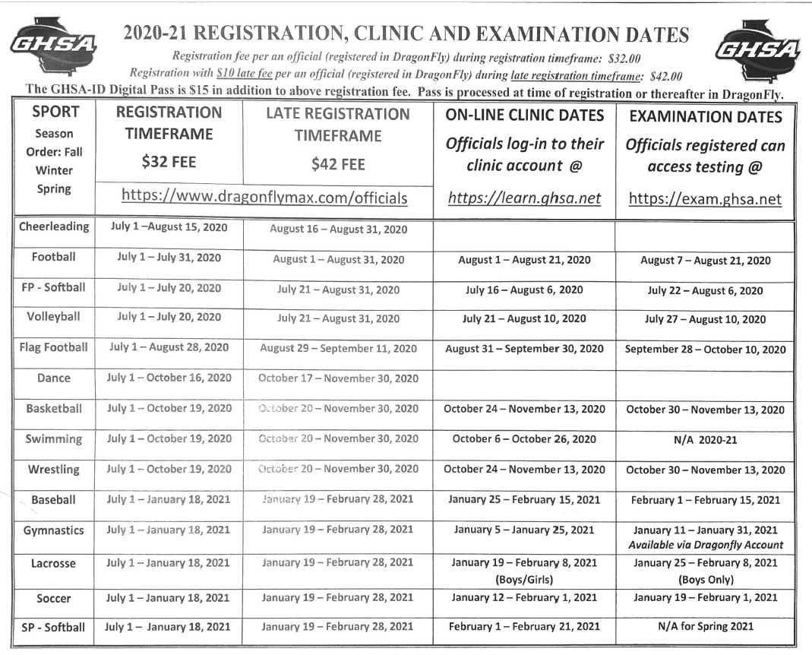
Important Dates

Slide 85
Questions And Concerns

Slide 86
Thank You For All you Do!

