Slide 1
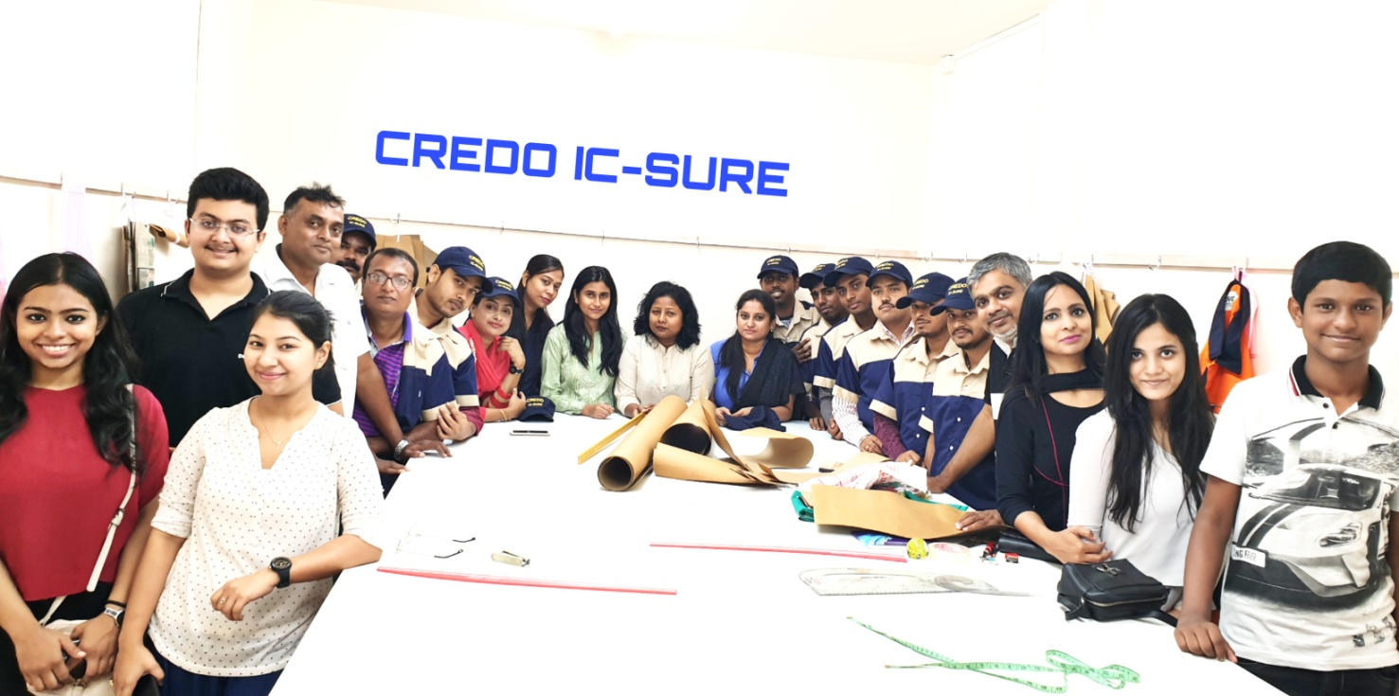
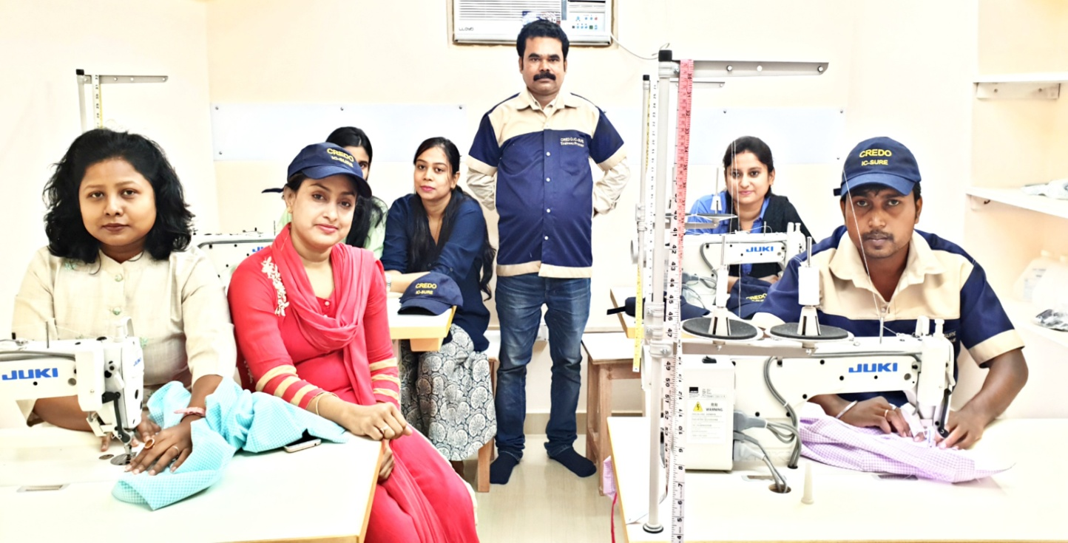
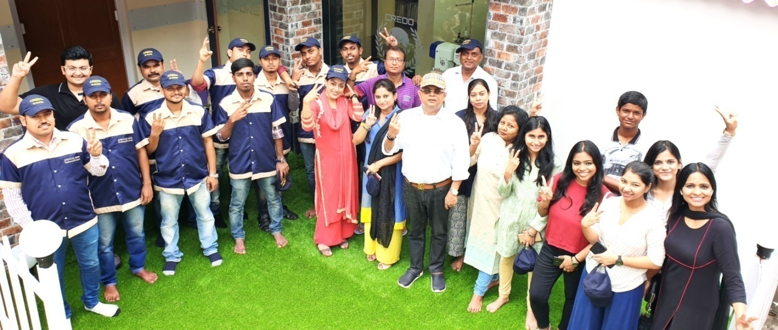
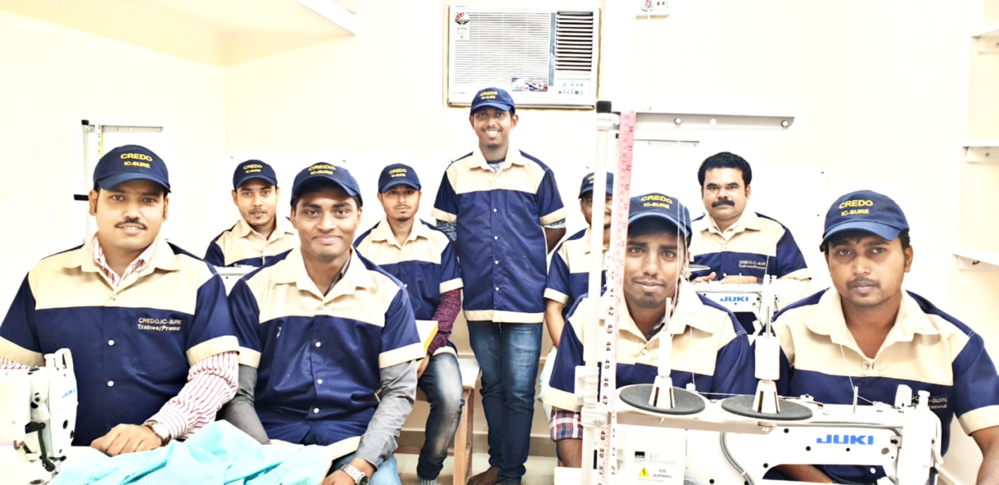
CREDO
A PINAKI ROYCHOWDHURY INITIATIVE

Slide 2
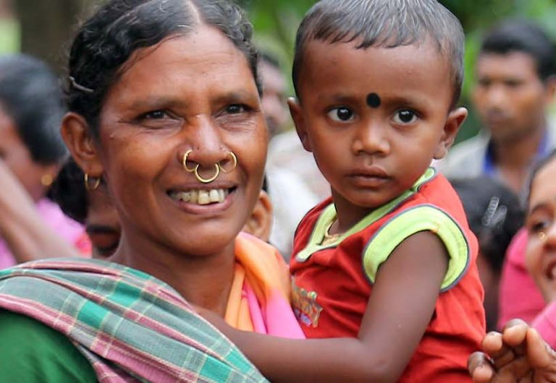
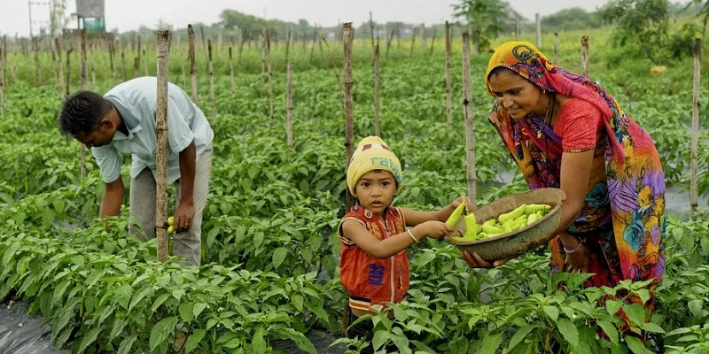
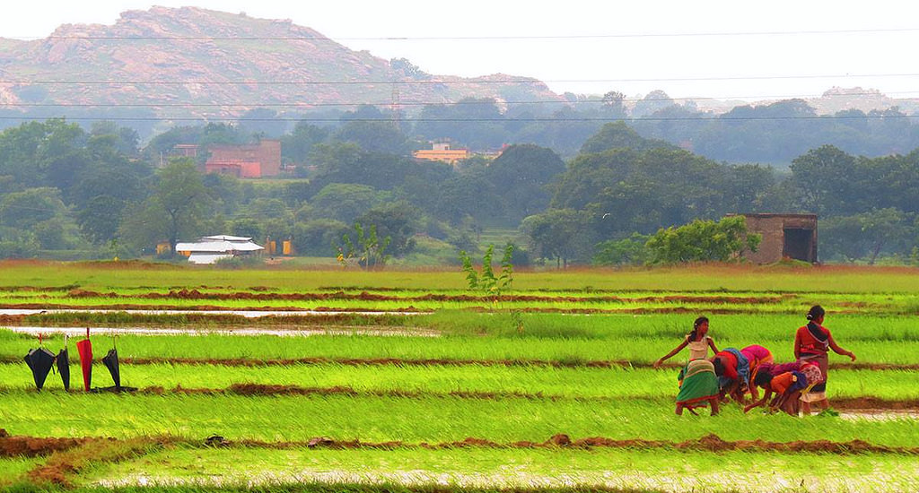
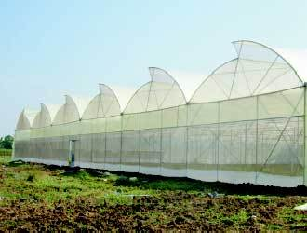
VISION : EMPOWERED TRIBAL JHARKHAND

Slide 3
agri business approach letter
ISSUES
Medieval farming techniques with poor access to technology and funds plague the Indian farmers. Small land holdings and natural calamities further add pressure to the already dwindling farm profits. Farmers are either too poor or ill-trained as a result they abuse or under use chemical based pesticides and fertilizers with over/under of irrigation resulting into crop failure or poor yield. Almost nil access to organized retail and value added export markets- thus no impetus towards quality and profits.
Solution? SYNERGY!
SOLUTIONS
TECHNOLOGY:- Use of High yield seeds, proper sowing agronomics, micro irrigation, water conservation and rain water harvesting, Soil development, Crop protection, Crop rotation, Soil nutrient recuperation, Use of Bio fertilizers and nutrients to reduce expensive chemical usage.
INFRA: Farm to processing, warehousing and cold storage. Reduce wastage: Immediate opportunity to increase market reach by up to 40%!
Use of modern Farm equipment and onsite processing of harvest.

Slide 4
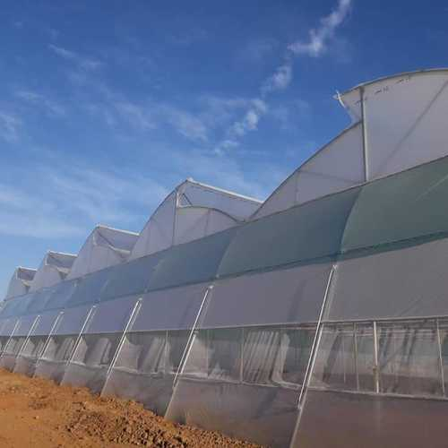
Harvesting
Wholesale market
Terminal markets / distributors
Retail markets
Local Mandi
Regional Mandi/ Auction
Loss in Transit
40%
PRICE HIKE
400%
Consumers

Slide 5
Organised retailers are crowded in this space
Competitors high
Middle
Income
Group
20% in volume
Buy from street vendors
Price + Quality conscious
High
Income
Group
5% in volume
Buy from retail chains
Quality & variety conscious
Low Income
Group
40% in volume
Buy from neighbourhood markets (evening)
Pay more for less quality
Hotels & caterers
25% of volume
Buy from wholesale mandi
Food & Drink processors
5% of volume
Product specific buyer
Large volume
** fixed price
* range
Export
1% of volume
Best quality/ specific products only

Slide 7
Proposal for Intensive Farming

Slide 8
Targets :

Slide 9
Targets :

Slide 10
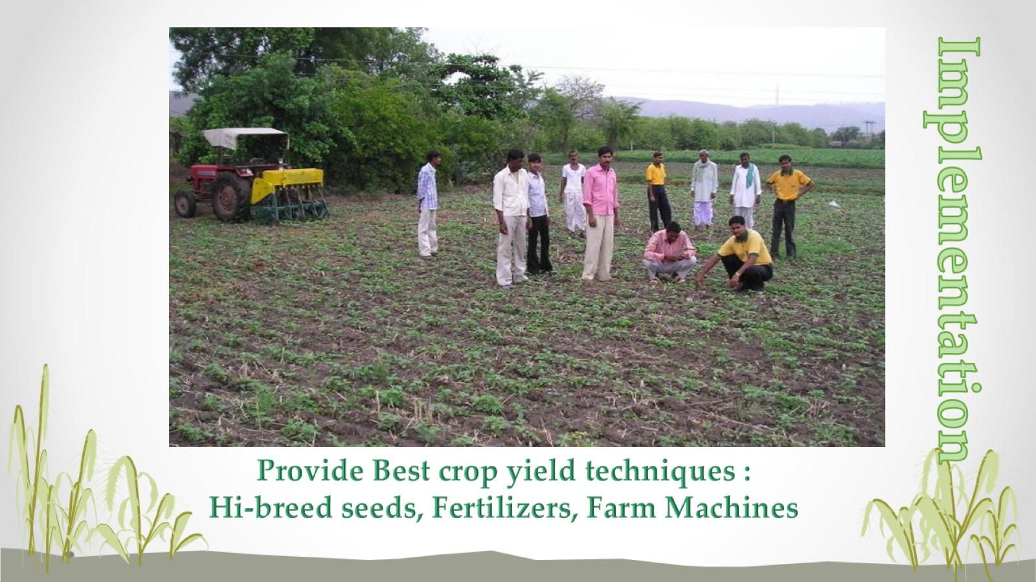

Slide 11
Greenhouse Facility

Slide 12
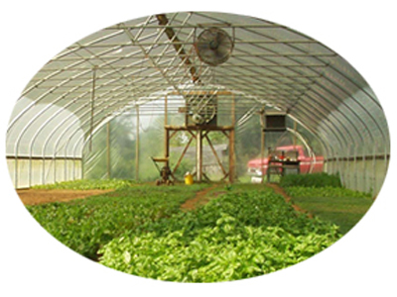
Crop Cultivation

Slide 13
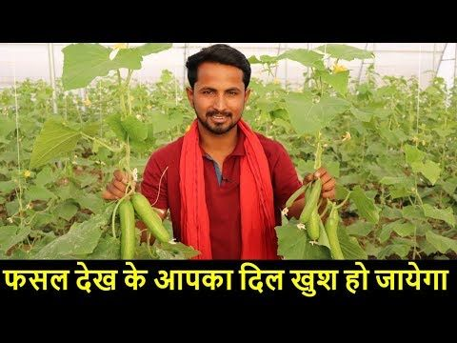
Tomato, Capsicum, Coloured Capsicum, Cauliflower, Cabbage, Okra, Bitter Gourd, Onion, Coriander, Spinach, Chilli, Radish etc.
Chrysanthemum, Carnation, Gerbera, Rose, Marigold, Orchid, Gladiolus etc.
Strawberry, Papaya,
Lemons, Melons,
Amla, etc.

Slide 14
Typical Bunch

Slide 15
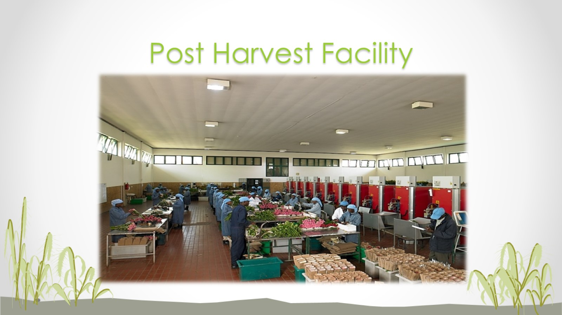
Post Harvest Facility

Slide 19
EXPORT QUALITY BANANAS

Slide 20
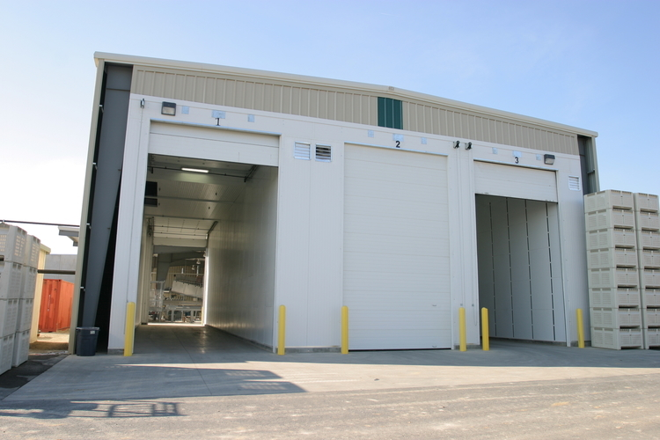
Ripening & Processing unit

Slide 21
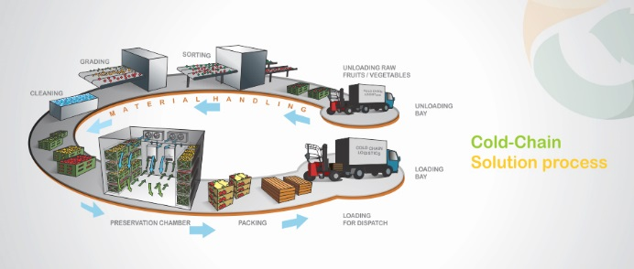
Ripening & Processing unit
All climacteric fruits like banana, mango, papaya etc. need to be ripened artificially after harvesting. Ethylene induced ripening is the only safe and approved scientific method.

Slide 22
Floriculture
Cotton & Farm fibre to Garments
Cotton Crop to handloom Yarn,
Yarn to Garments

Slide 23
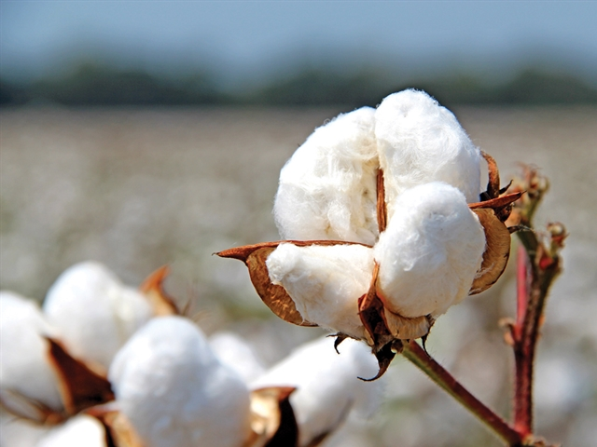
Cotton is an immensely important crop for the sustainable economy of India and livelihood of the Indian cotton farming community.
It is cultivated in about 312 lakh hectares across the world and in around 117 lakh hectares in the country.
Thus, India accounts for around 37.5% of the global cotton area and contributes to 26% (i.e 6.20 Million MT) of the global cotton produce of 23.92 Million MT.
Cotton continues to enjoy a pre-eminent and the most favoured fibre status among the Indian textile mills, as the major raw material for the textile industry.
Government Schemes for development of cotton sector: With a view to improve production, productivity and quality of cotton as also to increase the income of cotton farmers by reducing the cost of cultivation through transfer of technology etc., the Govt. of India has launched Technology Mission on Cotton in February 2000 with four Mini Missions as under:
Objective Nodal Agency
Cotton Research and Indian Council of Agricultural
Technology Generation Research
Transfer of Technology Ministry of Agriculture
& Dev.
Improvement of Ministry of Textiles
Marketing Infrastructure
Modernization of Ministry of Textiles
factories

Slide 24
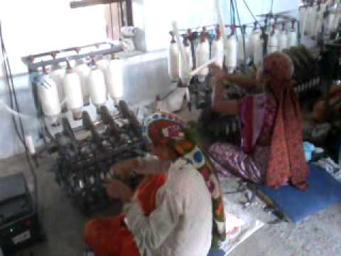
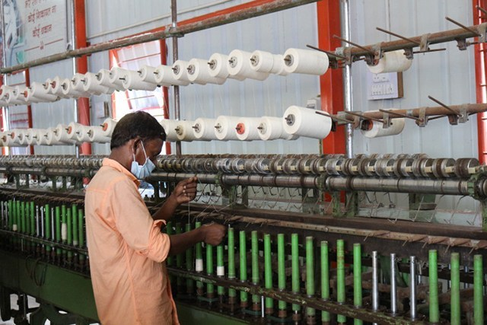
Solar Charkha
Micro charkha

Slide 25
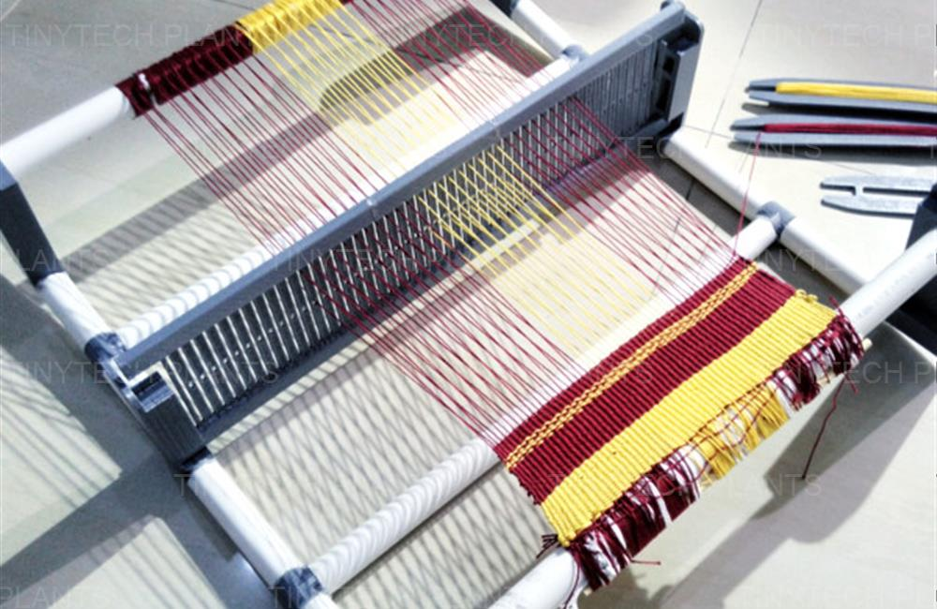
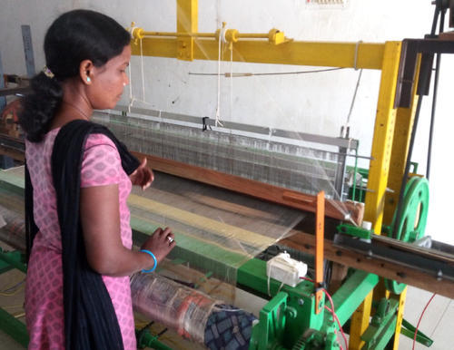
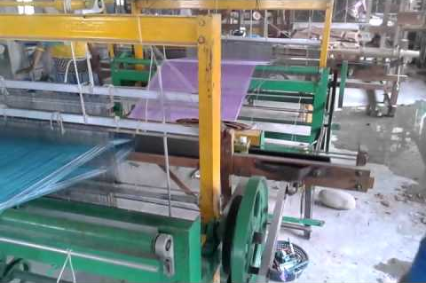
Solar Loom

Slide 26
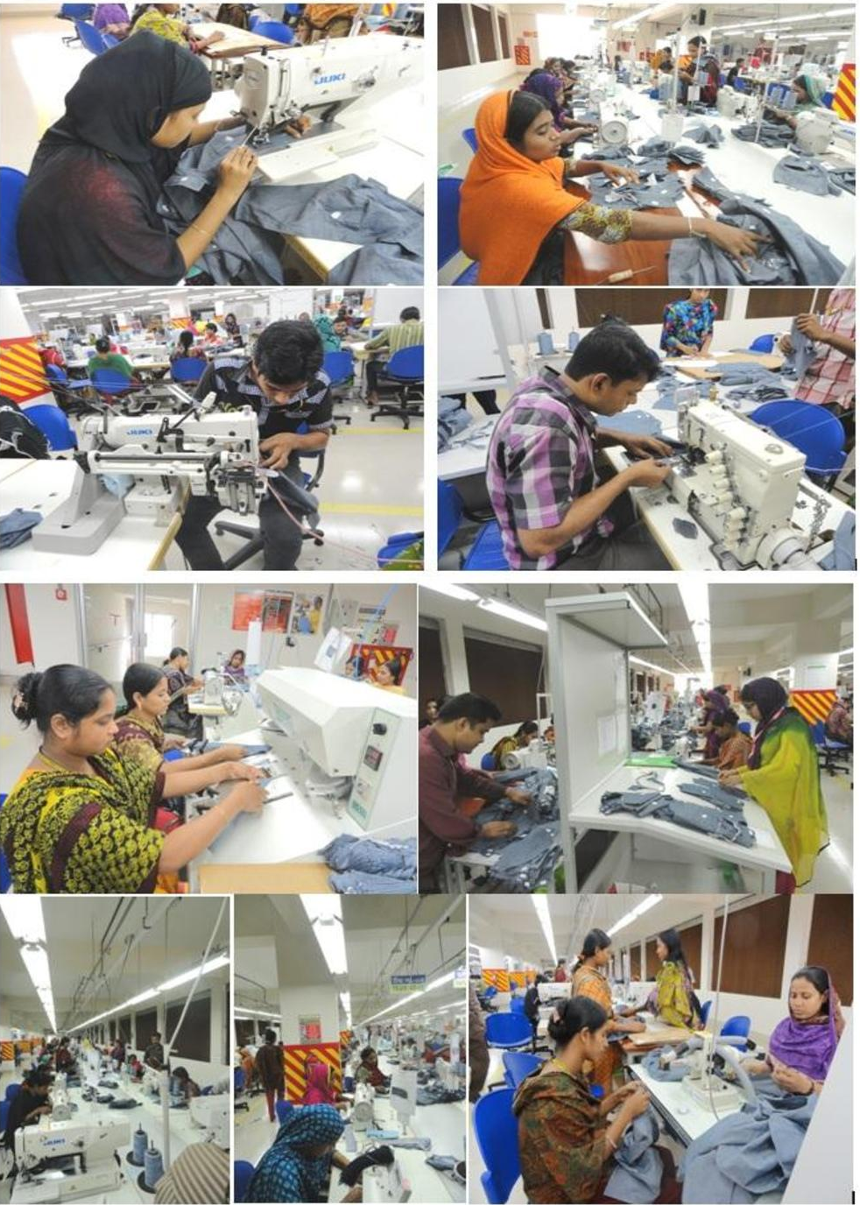
Garments

Slide 27
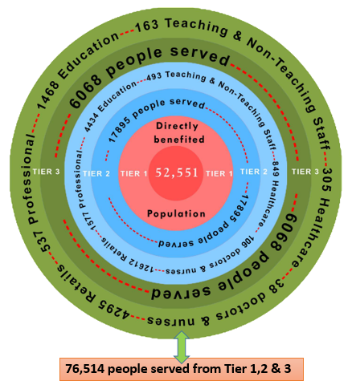
ECONOMICS OF POVERTY ERADICATION
52,551 people directly benefit from TIER 1 which fosters 732 entrepreneurs & 5,837 workers where entrepreneur
earns a fixed stipend of Rs. 10,000
per month and a yearly bonus
of Rs. 1,27,946/-; each worker
earns a fixed monthly stipend
of Rs. 6000/- per month and
a yearly bonus of Rs. 10,697/-
6,068 people benefit from TIER 3- 1468 served from educational avenues generating 163 employment, 305
served from healthcare institutes generating 38 people’s employ-
ment & 4295 people served from
retail services generating
537 people’s employment.
76,514 people served as a
result of this project creating
a farm business of Rs 100 crores
annually and non farm business
of Rs,100 crores. The additional purchasing power reach is another
Rs.100 crores through secondary
market consumption. The Straight line economy shall support a Rs.300 crores trade/ manufacturing/service community
17,895 people benefit from
TIER 2. 4,434 served from
educational avenues gener-
ating 493 people’s employ-
ment,849 served from Healthcare institutes generating 106 people’s employment and 12612 from retail services generating 1577 people’s employment.

Slide 28
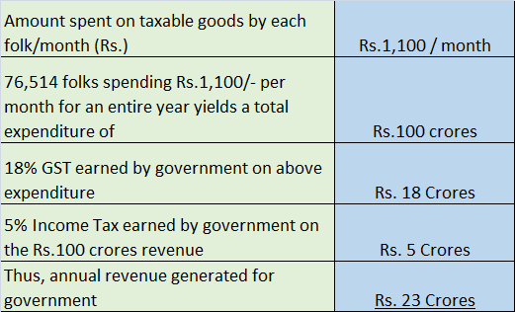
The Smart Accounting
Return on Human investment

Slide 29
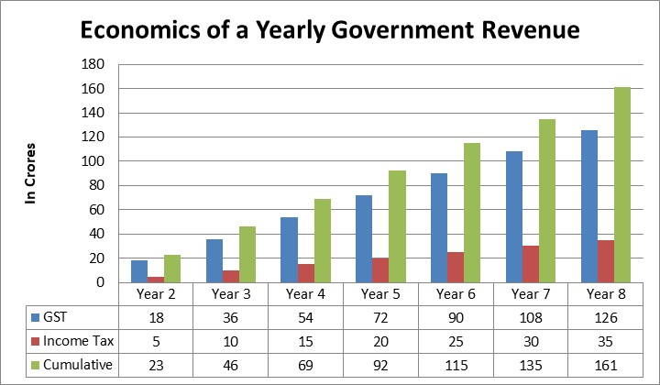
154 CRORES= 161 CRORES

Slide 30
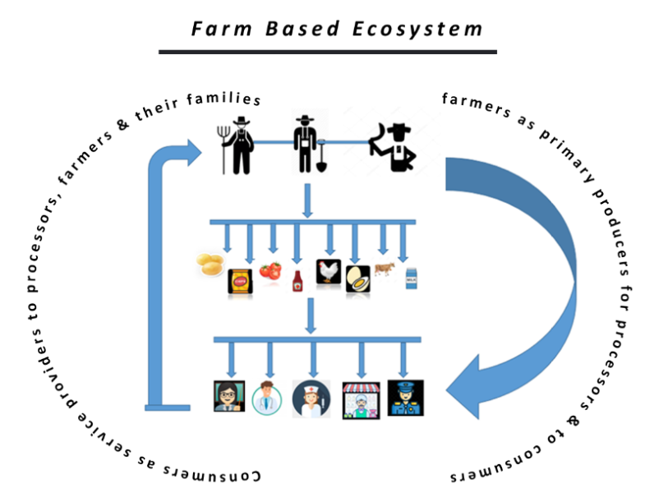
Farmers producing crops
Crops leading to processed food
Food consumed by consumers
Consumers as service providers to farmers & their families as doctors,
engineers, teachers, securities,
Shopkeepers etc.

Slide 31
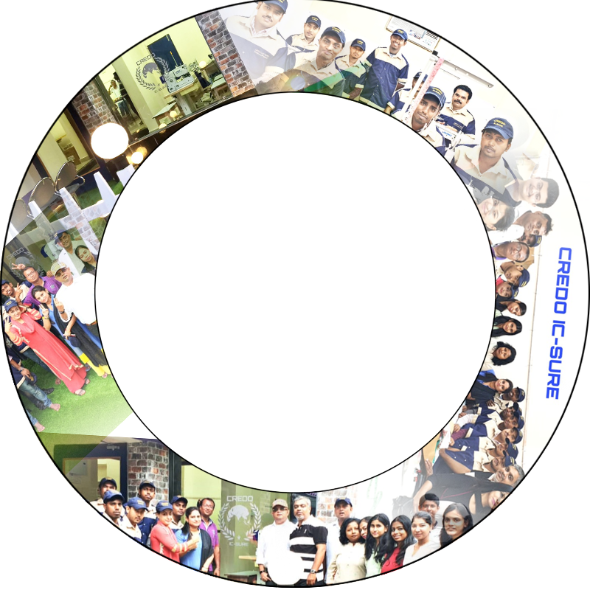
Location & Contact
Head office
175, Block-G, 2nd Floor , New Alipore Kolkata- 700053
Tring Tring
+91 9007055566
Email
pinaki@prcgroup.in

