Slide 1
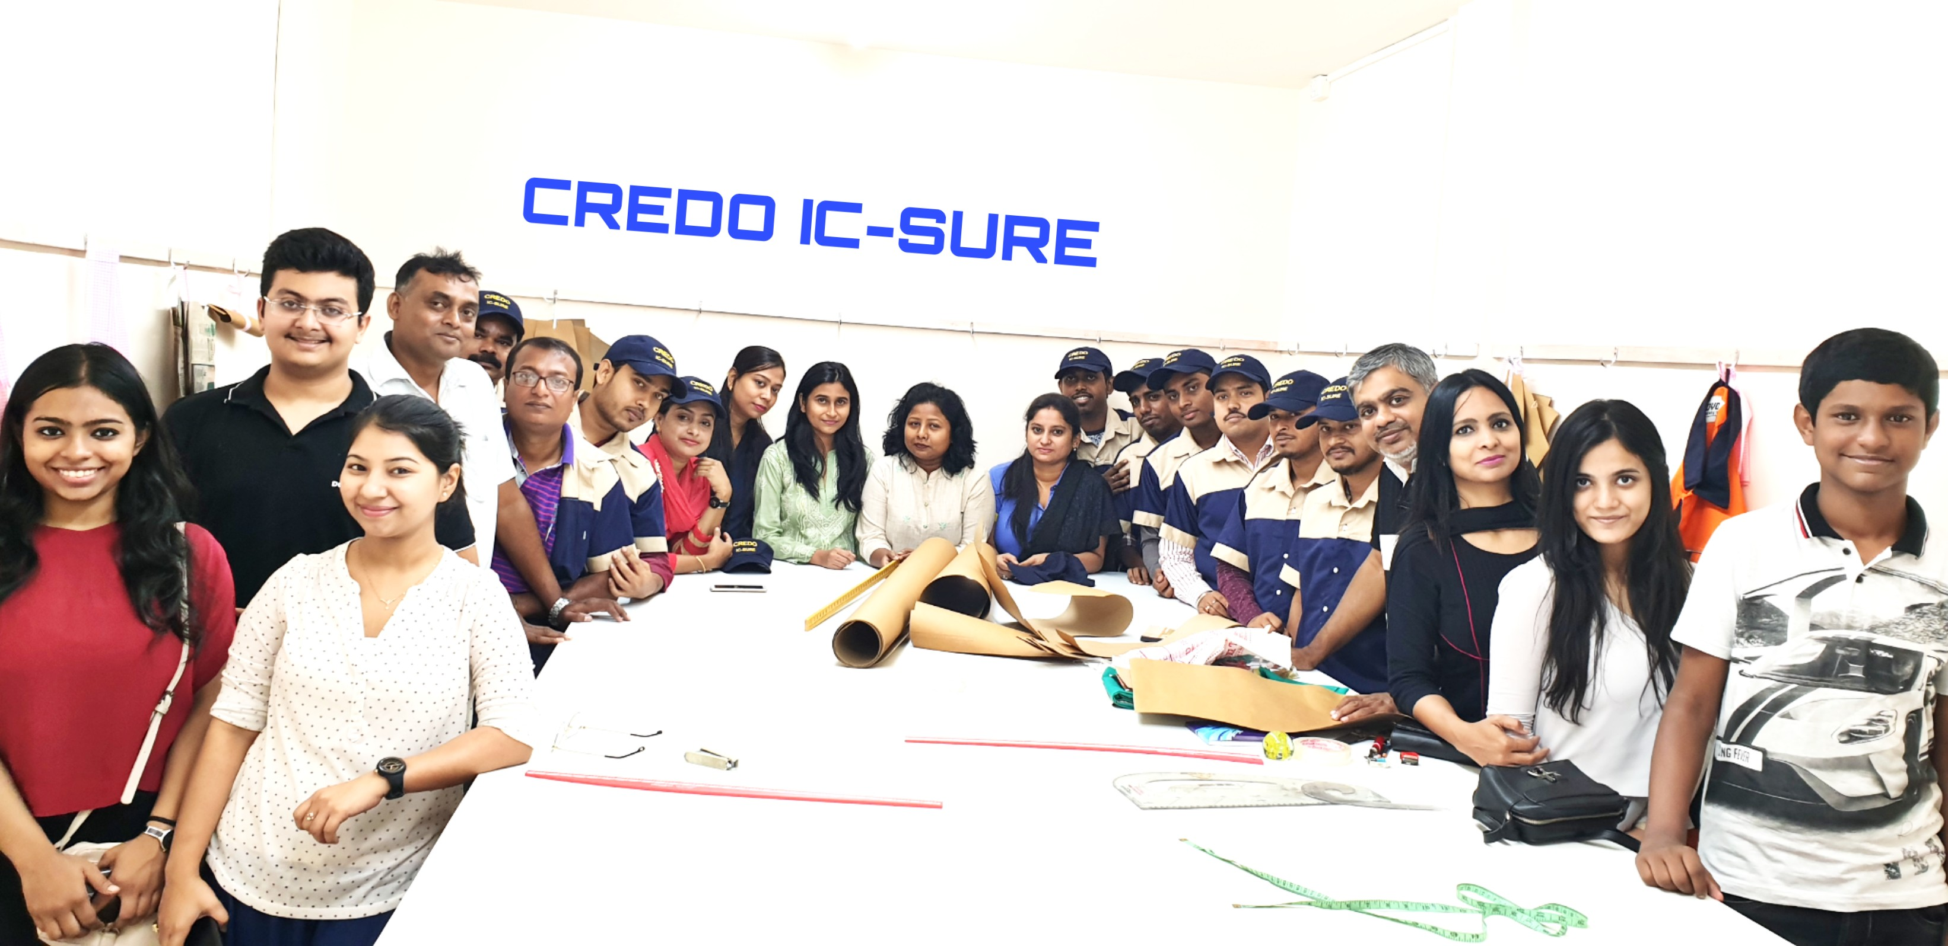
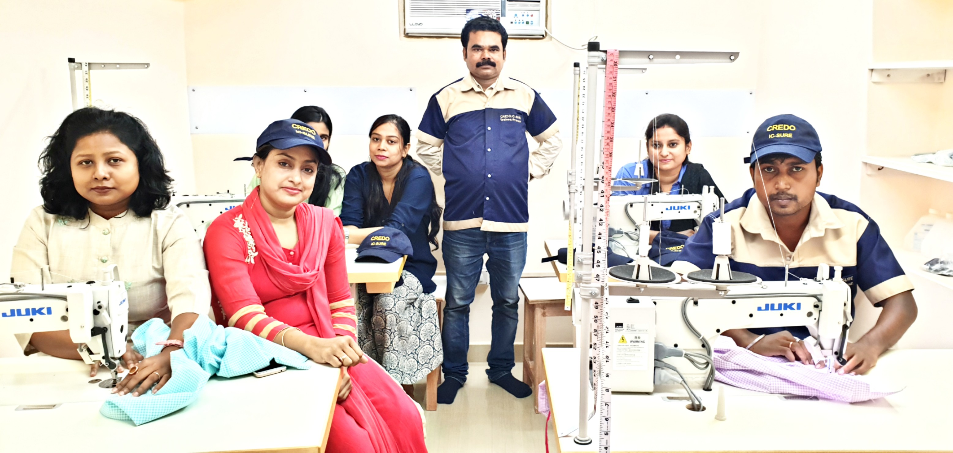

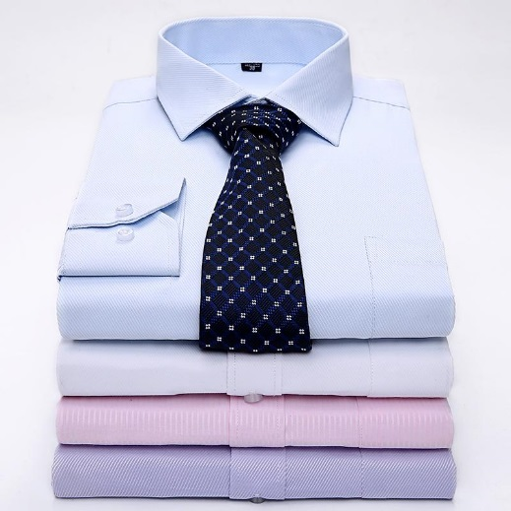

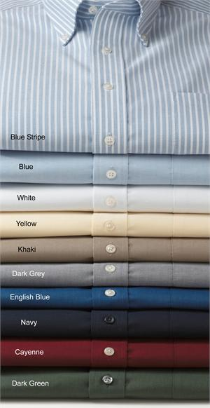
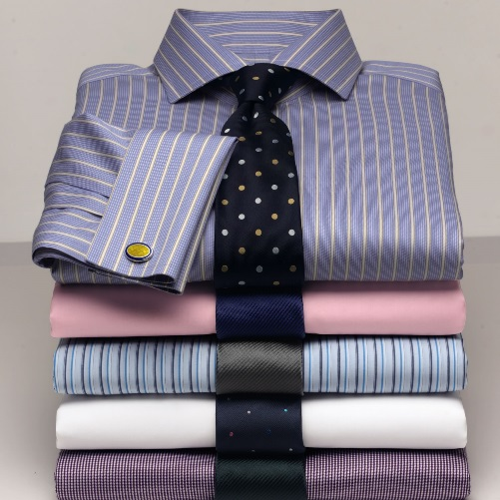
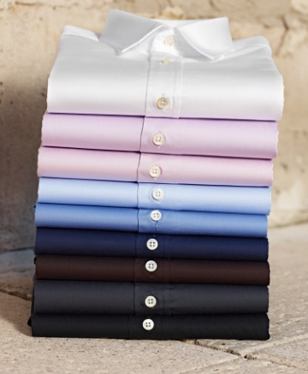


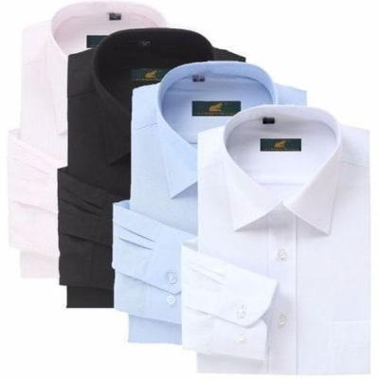

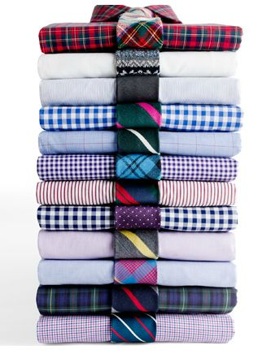

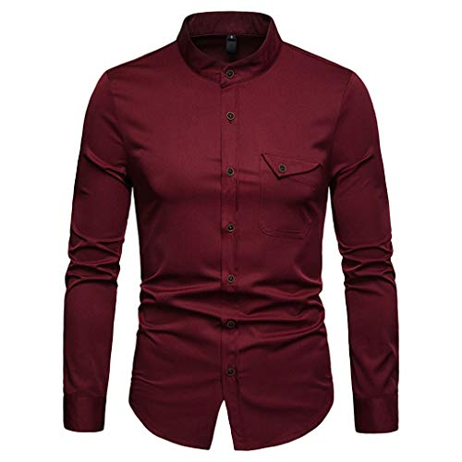
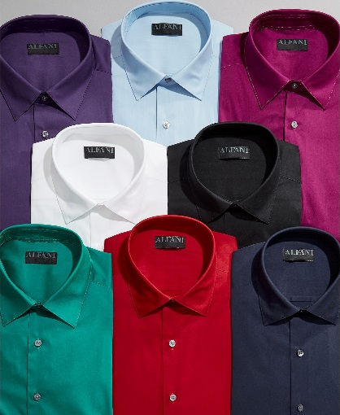
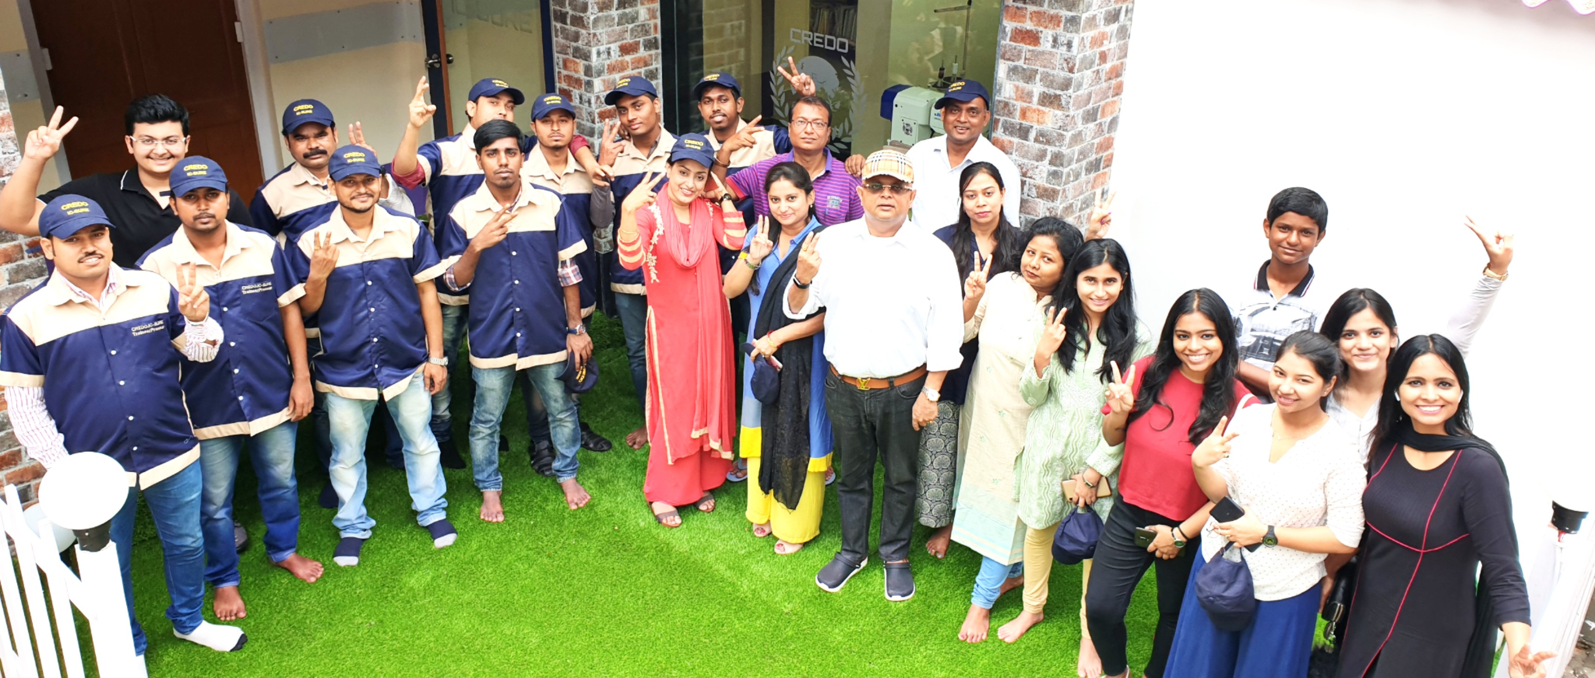
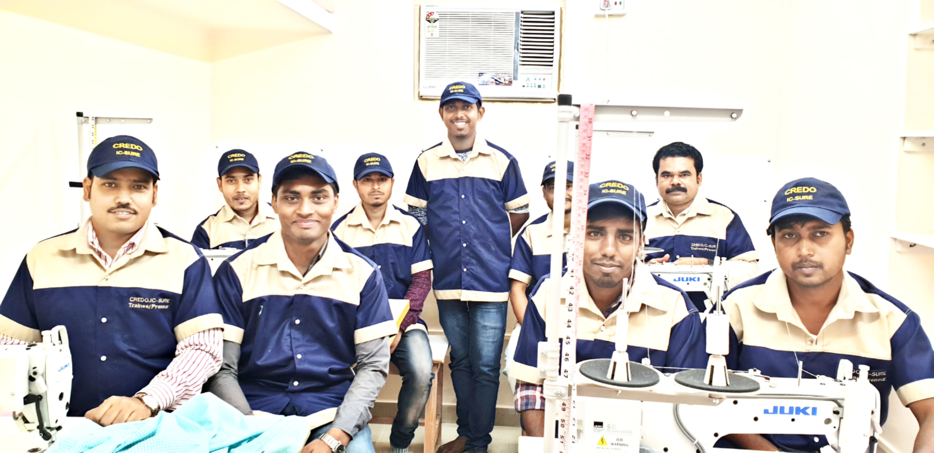
CREDO
Confederation of Rehabilitation Empowerment & Daedal Organizations

Slide 2


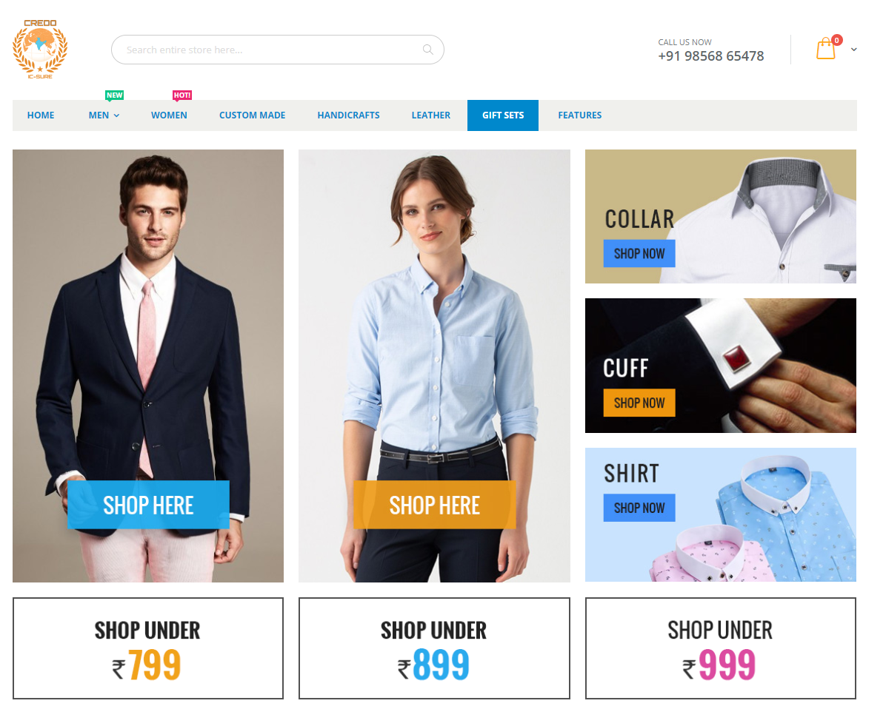
EARN with CREDO:
Dealership Program
ZERO investment earning with CREDO – No upfront payments, no deposits and absolutely no hidden costs! Earn your respect and financial freedom TODAY!
CREDO is the e-commerce online platform (www.credoforu.com) where you can join for FREE as our online dealer and find economic independence :-

Slide 3

JOIN AS A REFEREE (we prefer to call you “CREDO MITRA” enjoying 5% commission on each and every sales without any targets) - Join as a referee by calling 7044426060 or email to sales.icsure@prcgroup.in for more information!
PROMO
CODE
All commissions are on Ex-factory price, TDS deduction and GST as applicable.

Slide 4

JOIN AS A RESELLER (we prefer to call you “CREDO Promoter” enjoying up to 23% commission on sales
based on targets) on the garments offered by CREDO online (Join as reseller by calling 7044426060 or email to sales.icsure@prcgroup.in for more information!
All commissions are on Ex-factory price, TDS deduction and GST as applicable.

Slide 5
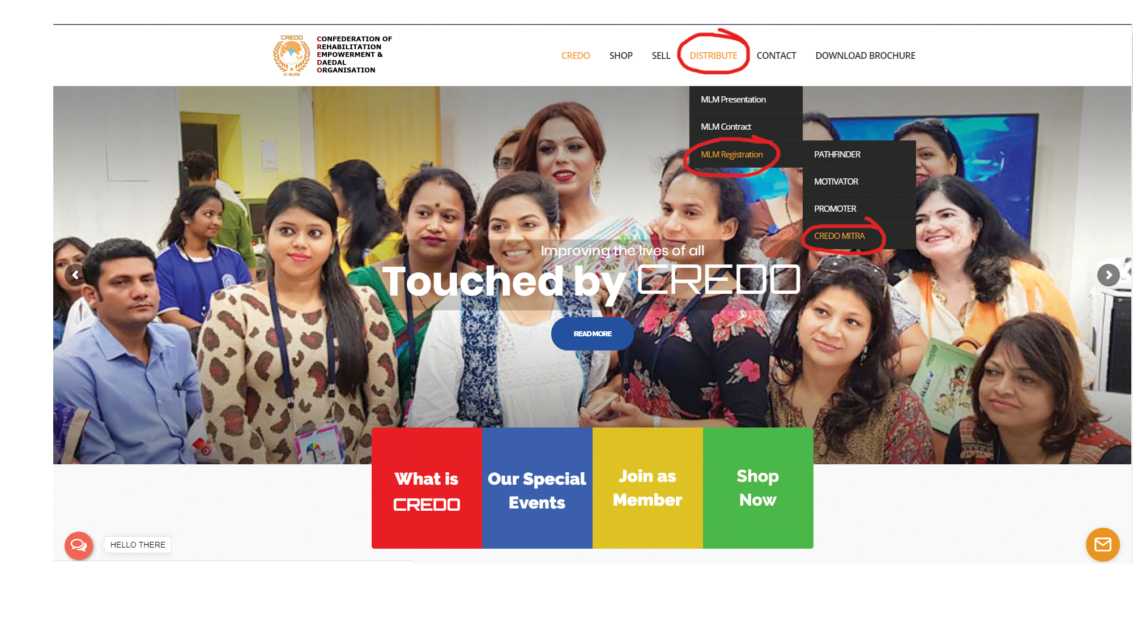
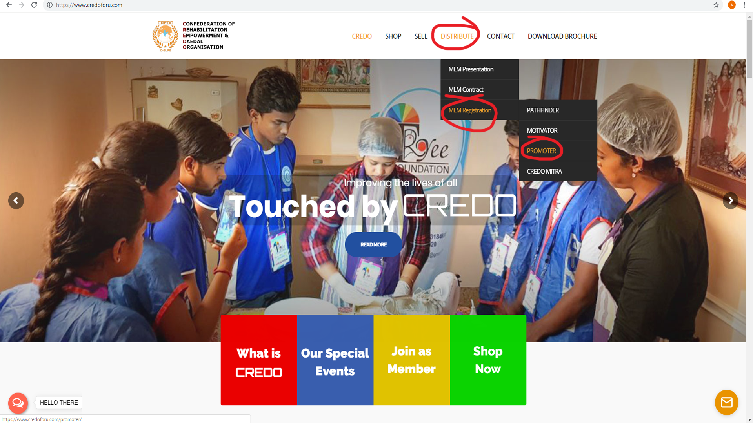
HOW DO YOU JOIN AND EARN?
Simple.
Call 7044426060 or email to sales.icsure@prcgroup.in
fill up the simple form sent to you by our Team leader.
That’s it! You are READY GET-SET-GO TO EARN!
After you provide us with your contact number, our team leader will contact you to explain the entire process.
Watch the training video at our website www.credoforu.com

Slide 6

Process:
Our team will explain the following to you
Once you have filled up the basic KYC form, you will receive a special PROMOCODE from CREDO that shall be generated ONLY FOR YOU!
Super Discount PROMO CODE
PromoCode

Slide 7

You can represent CREDO with your friends and family in your neighbourhood as a member of CREDO CHARITABLE TRUST and share the special PROMOCODE given to you by our team member.

Slide 8


Once your friends and family enters the special PROMOCODE at www.credoforu.com, they will get 50% discount on the garments
available on our website PLUS YOU will receive your commissions
directly (either by cheques sent by speed post or remitted to your given bank account as per the KYC provided by you).
Super Discount !!

Slide 9
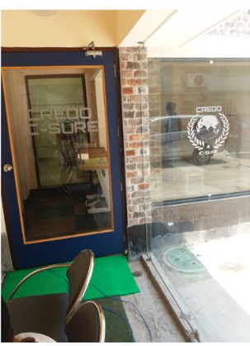
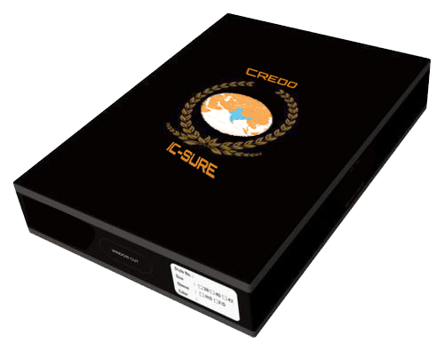



WHAT HAPPENS NEXT?
Once your special PROMOCODE is entered at our web site factory store to avail 50% discount and buyer has either selected the Cash on Delivery or payment gateway option, we shall confirm the order to the buyer.
Each garment shall be inspected and then shipped directly to the buyers.
The buyer is free to exchange the garment delivered up to 15 days from the date of delivery.
Once the 15 days Exchange / Return date expires, we shall calculate the commission payable to you at the end of the calendar month.

Slide 10




As per the standing instructions given by you, we shall remit the commission in the next month direct to your bank account or send an account payee cheque by speed post to your address.
Every time the buyer who has logged in your special PROMOCODE makes a purchase online from our website factory store in the future, you shall automatically keep on receiving your commissions through out your life!
So, it is a ONE time marketing effort for you with LIFE TIME of earnings!
Can anything be better!

Slide 11

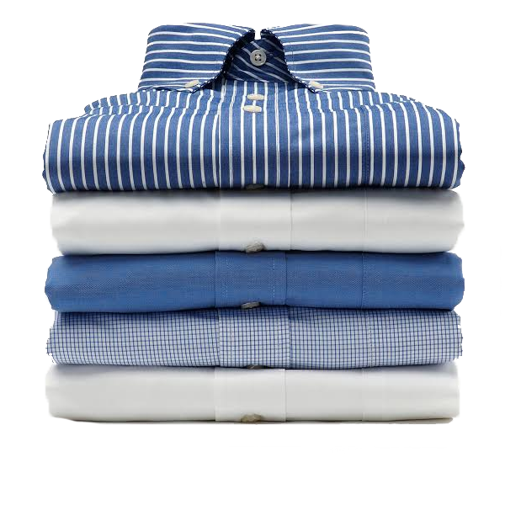
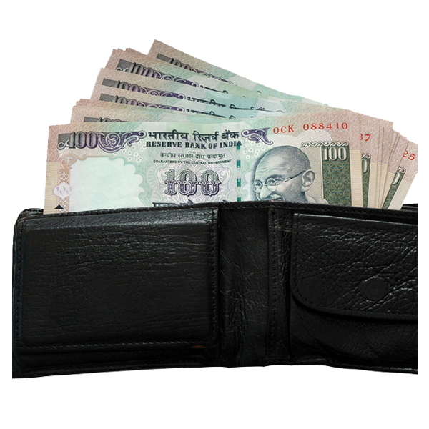
E X P L A I N I N G T H E C R E D O : D E A L E R P R O G R A M
ZERO INVESTMENT, ZERO RISK, EARN WHEN YOU WANT – OWN YOUR LIFE!
CREDO invests in the garments (you do not have to pay a single Rupees),
CREDO delivers to buyers found by you (Our courier services directly delivers to your buyers),

Slide 12


CREDO collects payments online (It is our responsibility to collect payment online or CASH against delivery – no risk to you NOR to buyer),
CREDO even manages returns and refunds (We shall be happy to exchange or refund 100% money to buyers in the unlikely case of their dissatisfaction with our products with ZERO claims on you).

Slide 13


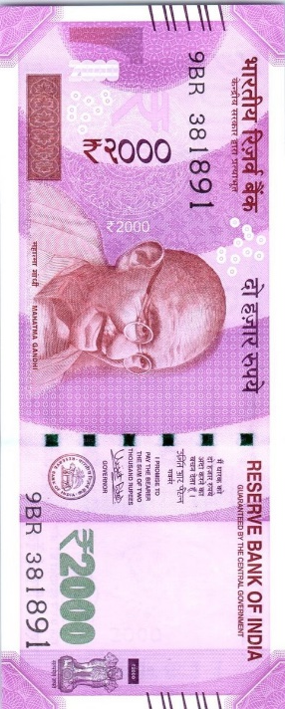
CREDO pays you commission for sales generated through you which
you receive for a LIFE TIME as our Dealer every time your Promocode
is used at www.credoforu.com! So, you promote only ONCE and receive COMMISIONS sitting at the comfort of your home till OLD AGE!

Slide 14





SAVE with CREDO:
CREDO guarantees you promotional codes for deep discounts.
On all ONLINE purchase made at our Webstore at FACTORY prices!
CREDO guarantees best EX-FACTORY prices to you….ALWAYS! (Shirts made of Raymonds, Arvind, Siyarams, Mafatlal, Italian Satin fabrics from Rs 800 onwards)
CREDO guarantees special discount over and above existing promotions…ALWAYS!
CREDO guarantees highest quality of stitching using German Gutermann thread, computer controlled JAPANESE machines with 6-months guarantee on stitcihng!

Slide 15

CREDO helps every household in balancing their household budgets without compromising in Quality. We have developed an online store filled with goodies (garments) made from best of fabrics, manufactured at our State-of-the-art Japanese manufacturing unit AT EX-FACTORY PRICES to ensure that EVERY HOUSEHOLD BENEFITS! (Click FACTORY PRICE STORE to visit our webstore and generate your PROMOCODE).

Slide 16
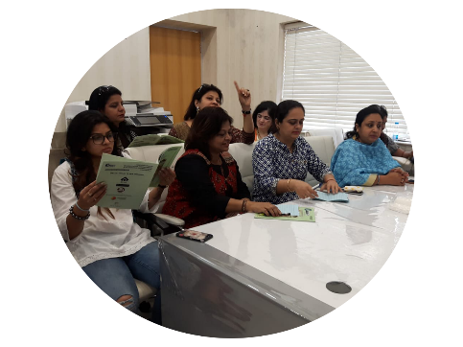


UNDERSTANDING CREDO CHARITABLE TRUST
  CREDO is a non profit charitable NGO. CREDO stands for Confederation of Rehabilitation, Empowerment & Daedal Organisations. (visit www.credoforu.com/about for our activities)

Slide 17
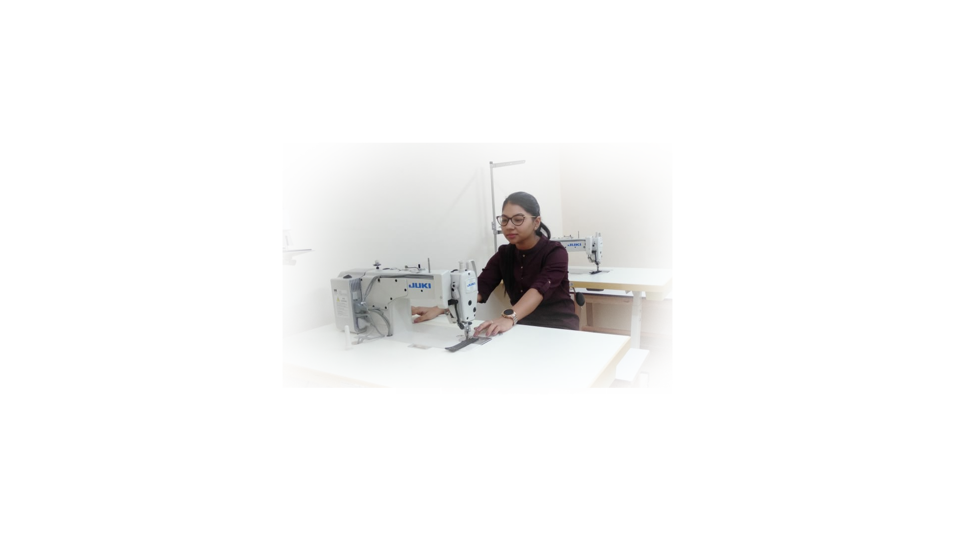
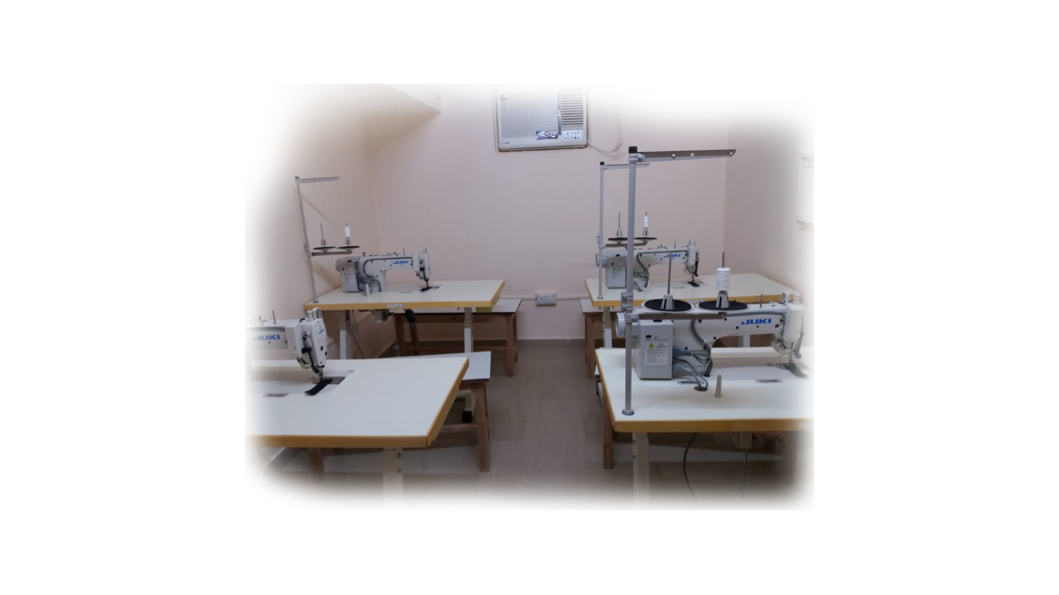
  CREDO has started it’s Training & Incubation centre to employ the Urban and Rural poor in garments manufacturing where employment and entrepreneurship is promoted. The Charitable manufacturing centre is air-conditioned, maintains highest standard of quality and ethics, uses Japanese computer controlled high precision machinery where every employee is paid more than the industry standard.

Slide 18

Location & Contact
Head office
175, Block-G, 2nd Floor , New Alipore
Kolkata- 700053
Tring Tring
+91 7044426060
Email
credo@credoforu.com

