Slide 1
GROUNDING AND BONDING
FOR
AMATEUR RADIO
BY PAUL MELVIN K4PGM

Slide 2
GROUNDING & BONDING
WHY IS IT SO
COMPLICATED?
BY
PAUL MELVIN
K4PGM

Slide 3
ELECTRICAL CIRCUIT

Slide 4
ELECTRICAL CIRCUIT

Slide 5
HOW MUCH CURRENT ?
FEEL THE SENSATION.

Slide 6
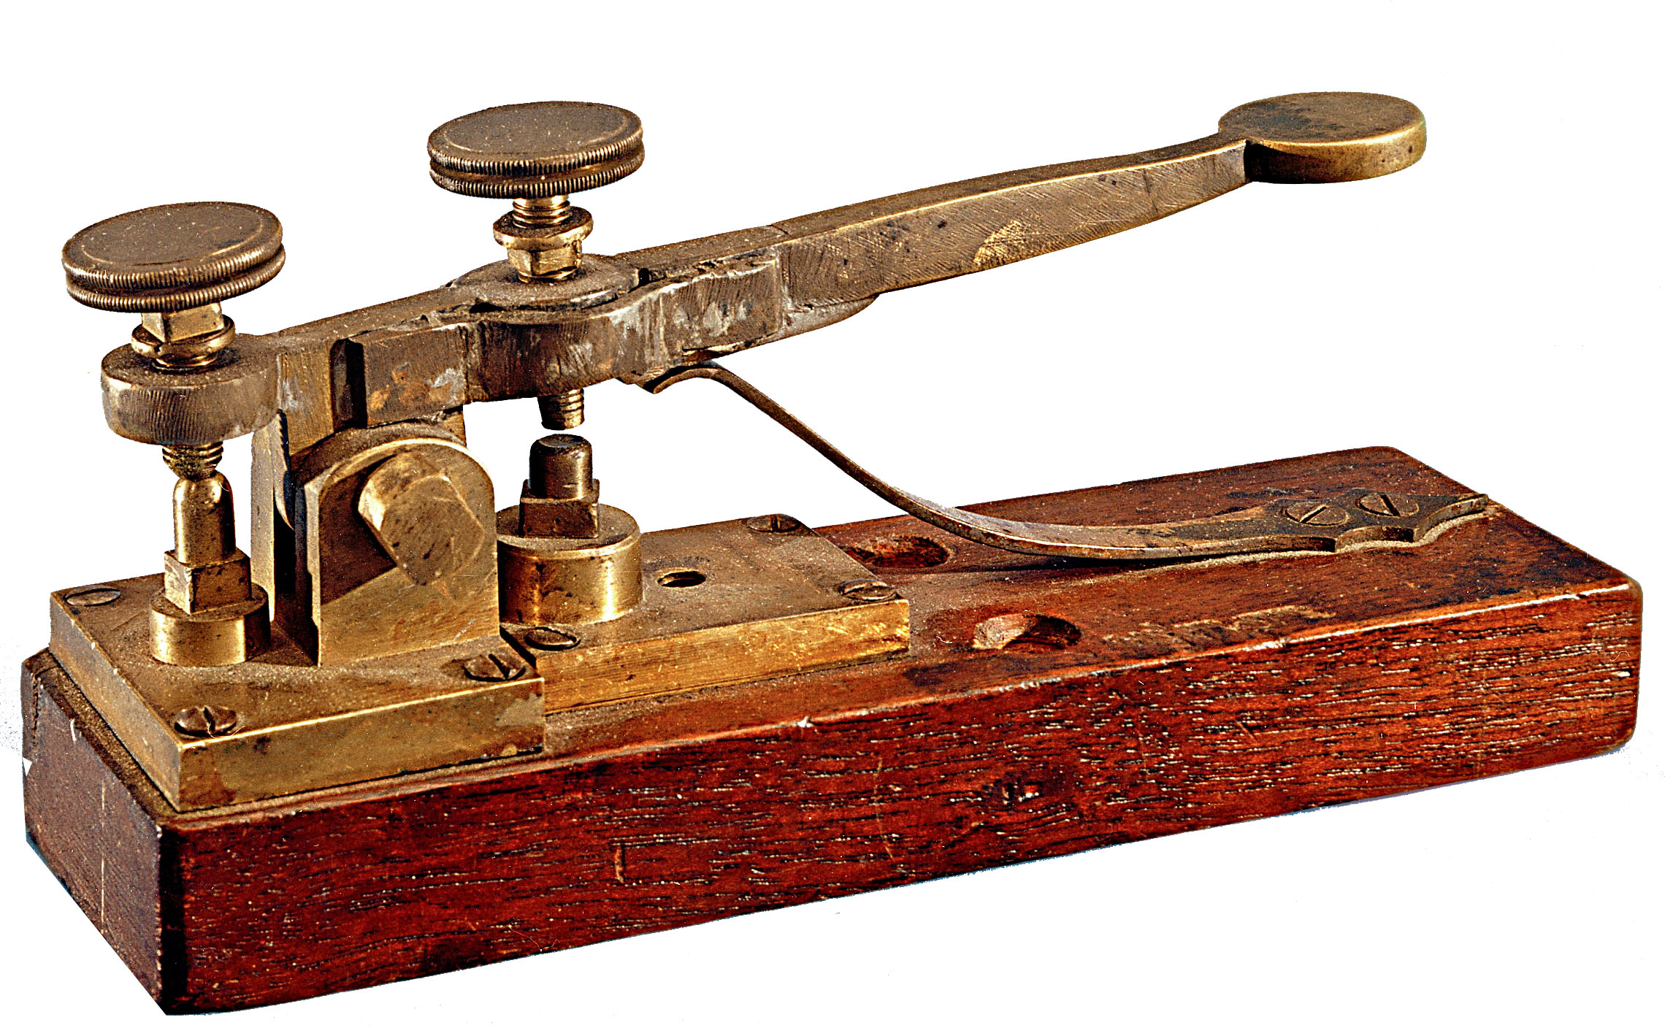
Where it all began!
Telegraph was the first nationwide electrical system.

Slide 7
GROUNDING & BONDING EXPLAINED
Grounding is the connection of the electrical circuit to the earth.
This allows a safe means for unused current to be returned to the source and removed from conductive surfaces.
Bonding is the connection of equipment so there is no potential voltage between equipment.
Both bonding and grounding must be used to assure a safe environment.

Slide 8
GROUNDING and BONDING
TYPICAL GROUNDING/BONDING CONNECTION

Slide 9
CALL IT WHAT YOU WANT!
Grounding
Earthing
Protective earth conductor
That green wire?

Slide 10
REASONS FOR GROUNDING
SAFETY
REDUCES ELECTRICAL SHOCK HAZARDS
CURRENT AMOUNTS AND EFFECTS
LIGHTNING
REDUCES STATIC BUILD UP
HELPS TO RETURN SURGES SAFELY TO GROUND.
RF BURNS AND SHOCK HAZARDS
RADIO FREQUENCY INJURY

Slide 11
It’s The Law!
General requirements
Grounding of electrical equipment
Bonding of electrical equipment
Bonding of electrically conductive materials and other equipment
Effective ground fault current path

Slide 12
2017 NEC
National Electrical Code
Enacted as law by NC legislators
Insurance concerns.
Article 250
Covers grounding and bonding.
Ensures safety and fire protection.
Notes:
It is the law
Will your insurance pay for damages that are not connected to ground per law?

Slide 13
EQUIPMENT GROUNDING
Normally non-current-carrying conductive materials enclosing electrical equipment, or forming part of such equipment, SHALL be connected to earth so as to limit the voltage to ground on these materials.
Metal cases
Radio
Tuner
Meters
amplifiers

Slide 14
EQUIPMENT BONDING
Normally non-current-carrying conductive materials enclosing electrical conductors or equipment, or forming part of such equipment, SHALL be connected together and to the electrical supply source in a manner that establishes an effective ground-fault current path.
Connect it all together
Everything listed in previous grounding slide!

Slide 15
CONDUCTIVE MATERIALS AND OTHER EQUIPMENT
Normally non-current-carrying electrically conductive materials that are likely to become energized SHALL be connected together and to the electrical supply source in a manner that establishes an effective ground-fault current path.
If it is conductive and can become energized then bond it and ground it!

Slide 16
EFFECTIVE GROUND-FAULT CURRENT PATH
Electrical equipment, wiring and other electrically conductive material likely to become energized SHALL be installed in a manner that creates a low impedance circuit facilitating the operation of the over current device.
Grounding must allow for the correct operation of:
Circuit Breakers
Fuses
Circuit interrupters

Slide 17
ELECTRICAL SAFETY GROUNDING
#1 REASON FOR GROUNDING
PERSONAL SAFETY
SAFETY OF PERSONS VISITING
FIRE SAFETY
PROTECTION OF EQUIPMENT

Slide 18
YOUR STATION
DESIGN YOUR STATION
Use best practices to install electrical
Power equipment with low DC voltage
Less likely to cause serious injury
Mitigate areas of high current
High current causes more serious injuries
GROUNDING IS YOUR BEST PROTECTION!

Slide 19
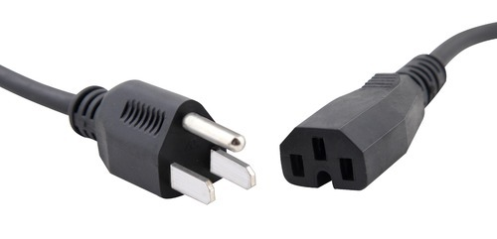
AREAS OF CONCERN
OUTLETS
Are outlets grounded per NEC?
Are all ground prongs intact?

Slide 20
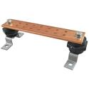
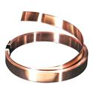
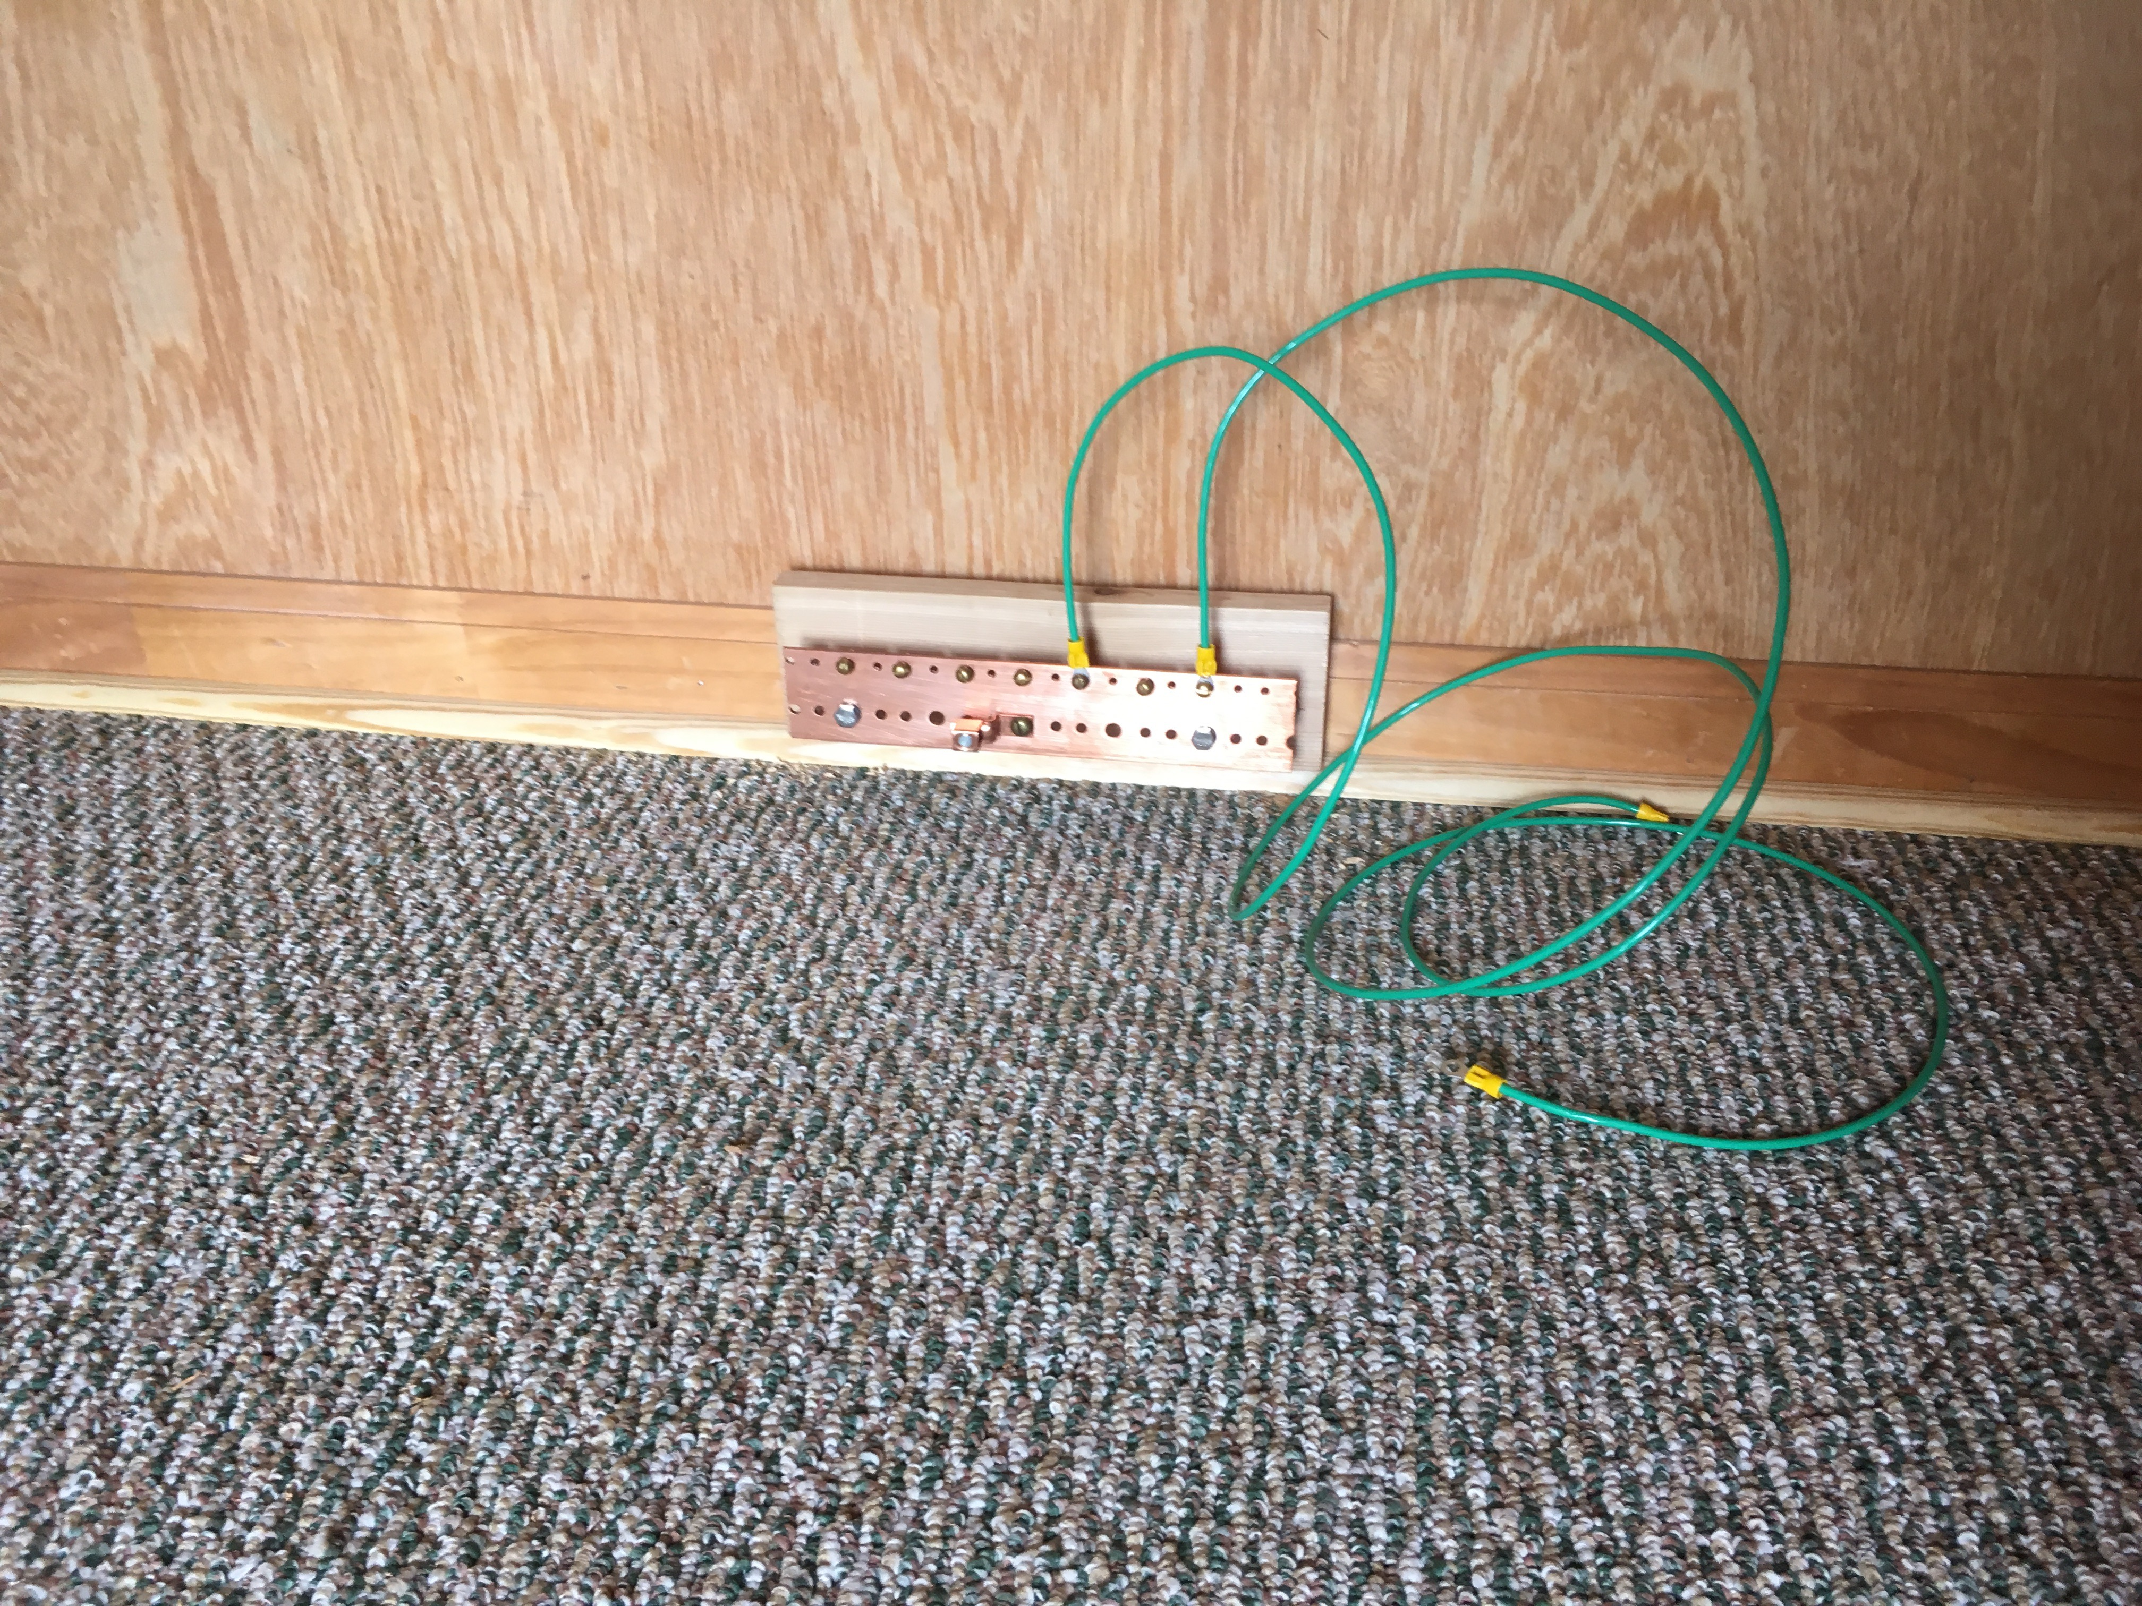
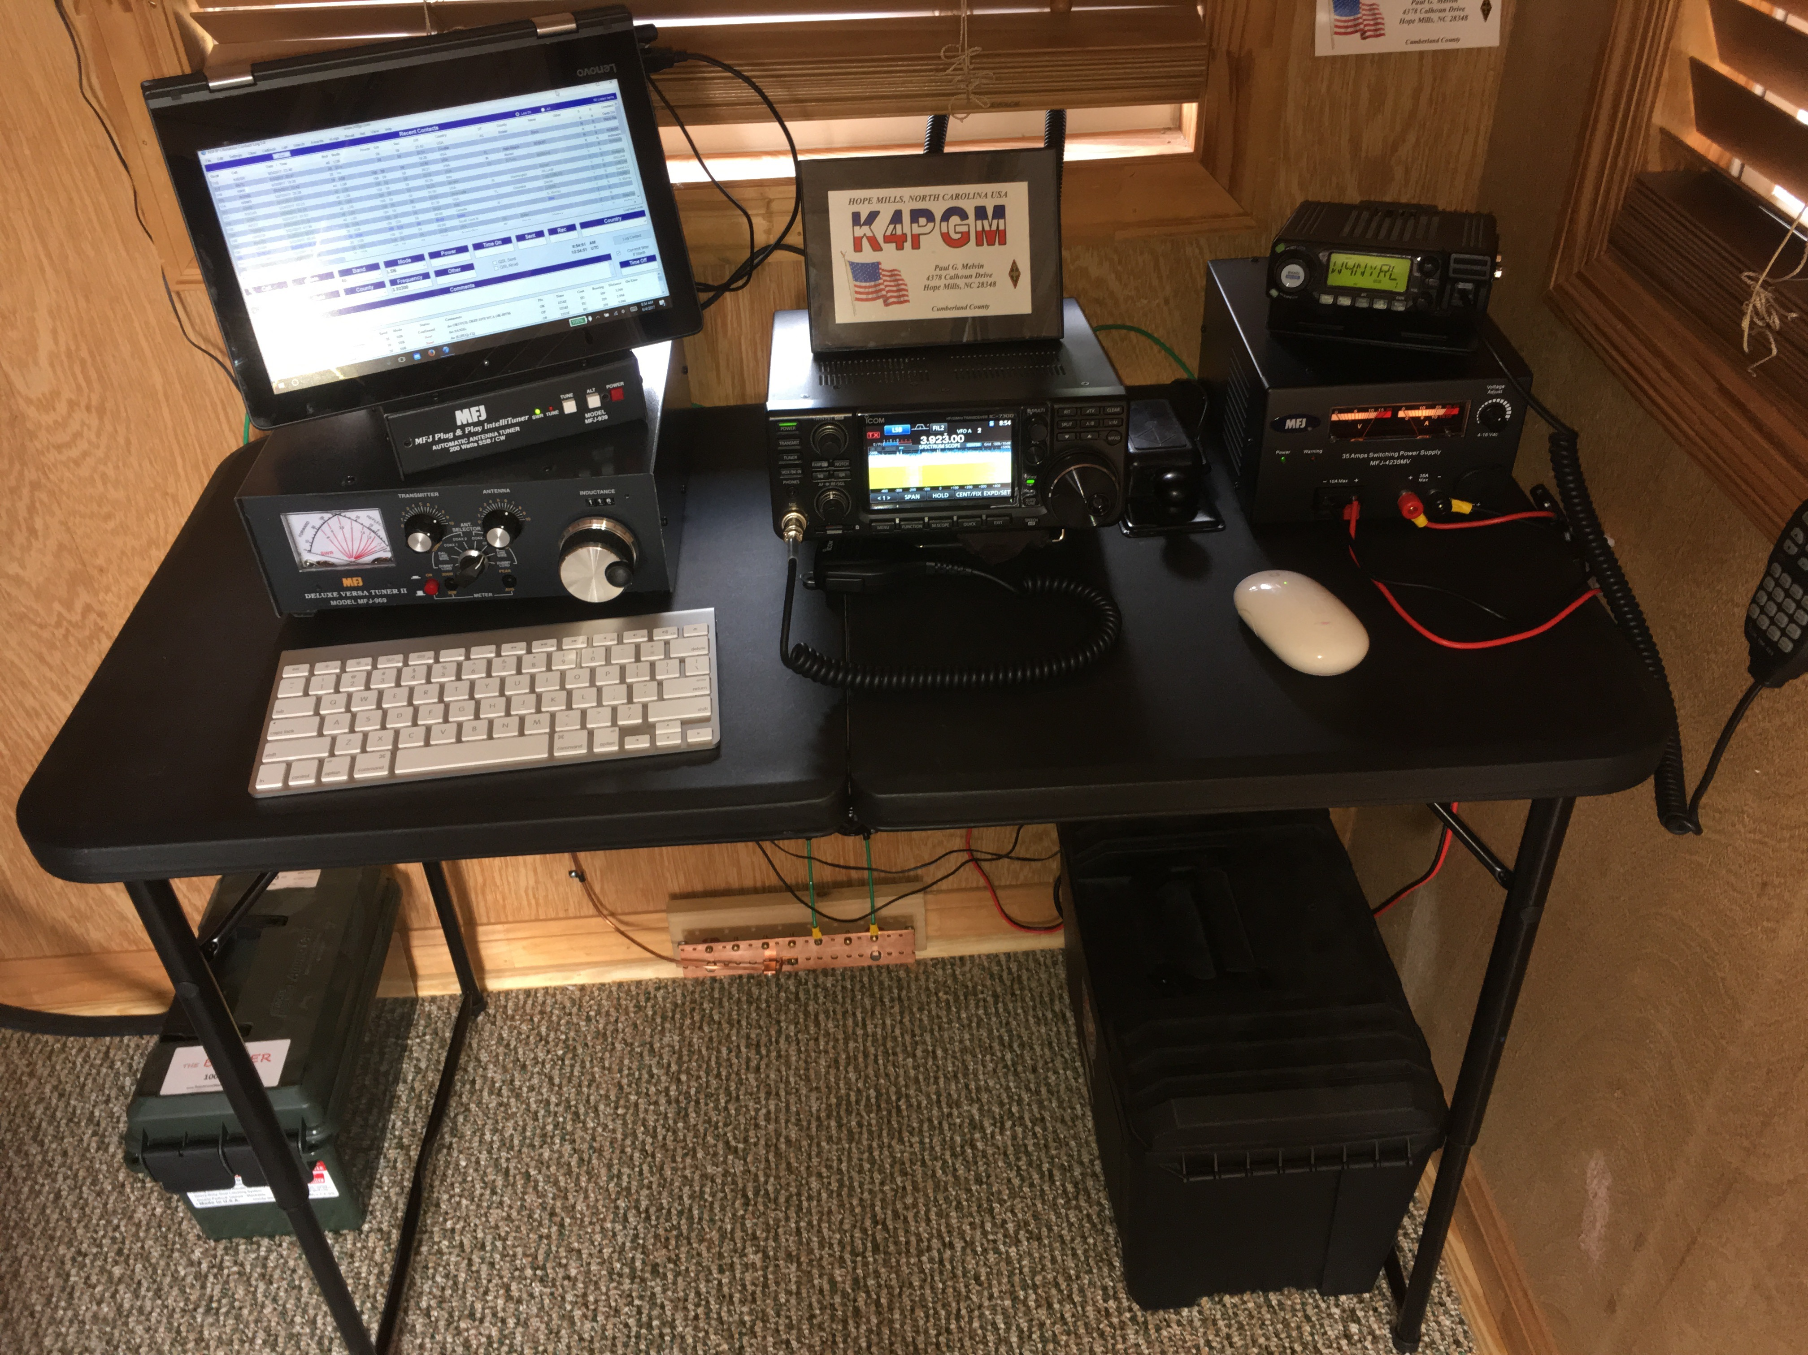
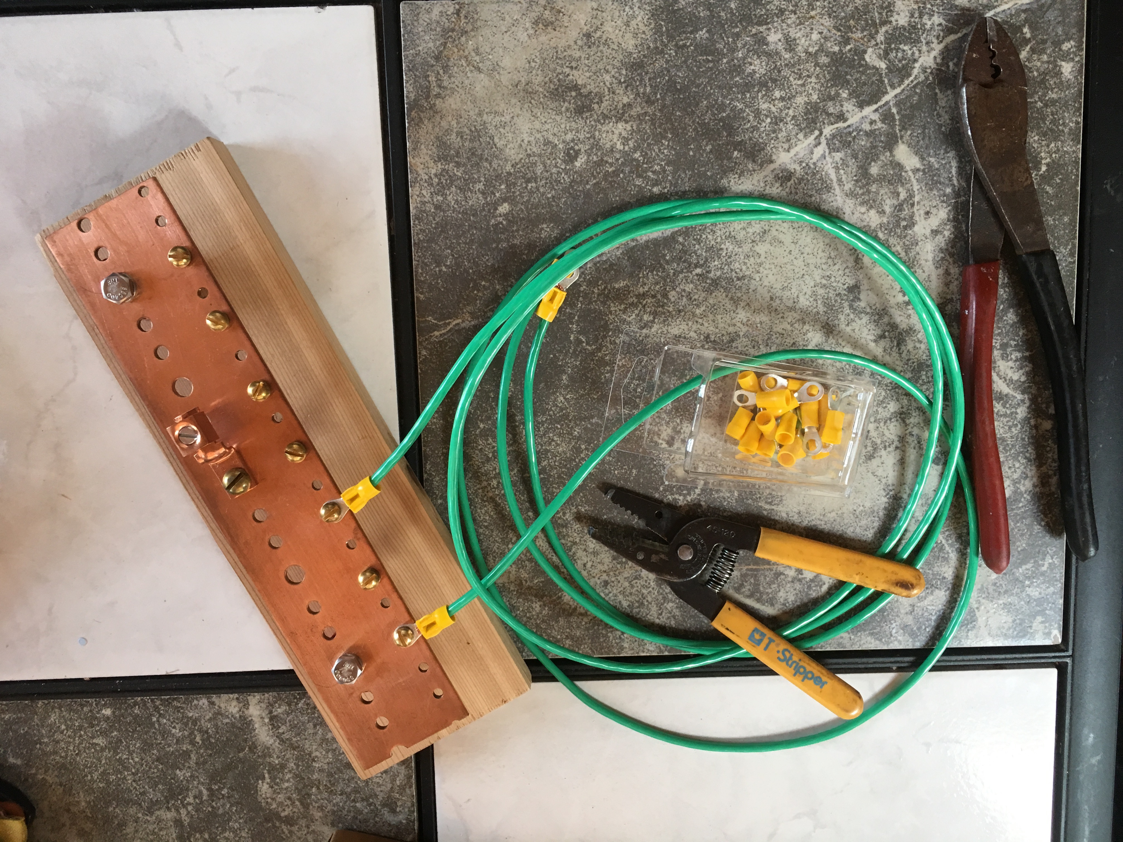
STATION GROUNDING
DON’T LEAVE ANYTHING UNGROUNDED

Slide 21
LIGHTNING PROTECTION
LIGHTING SURGES AND STRIKES
CANNOT BE PREVENTED
CAN BE DIVERTED TO GROUND
CAN REDUCE THE AMOUNT OF CURRENT FLOWING THROUGH EQUIPMENT.
MOST RADIO EQUIPMEN IS SOLID STATE
THE COMPONENTS OPERATE AT LOW VOLTAGE
HIGHER VOLTAGE FROM SURGES DAMAGE THEM BEYOND REPAIR.
YES IT IS A GAMBLE. INCREASE YOUR ODDS.

Slide 22
BOND THAT EQUIPMENT!

Slide 23
ANTENNA/TOWER
GROUNDING AT THE CONNECTION POINT
GROUND THE SHIELD AND ALL METALLIC PARTS THAT DO NOT CONNECT TO THE CENTER CONDUCTOR.
GROUND THE TOWER OR POLE AT THE BASE ON EACH LEG OR MULTIPLE TIMES.
DRIVE 8’ GROUND RODS
BOND THEM TOGETHER WITH COPPER CONDUCTOR.

Slide 24
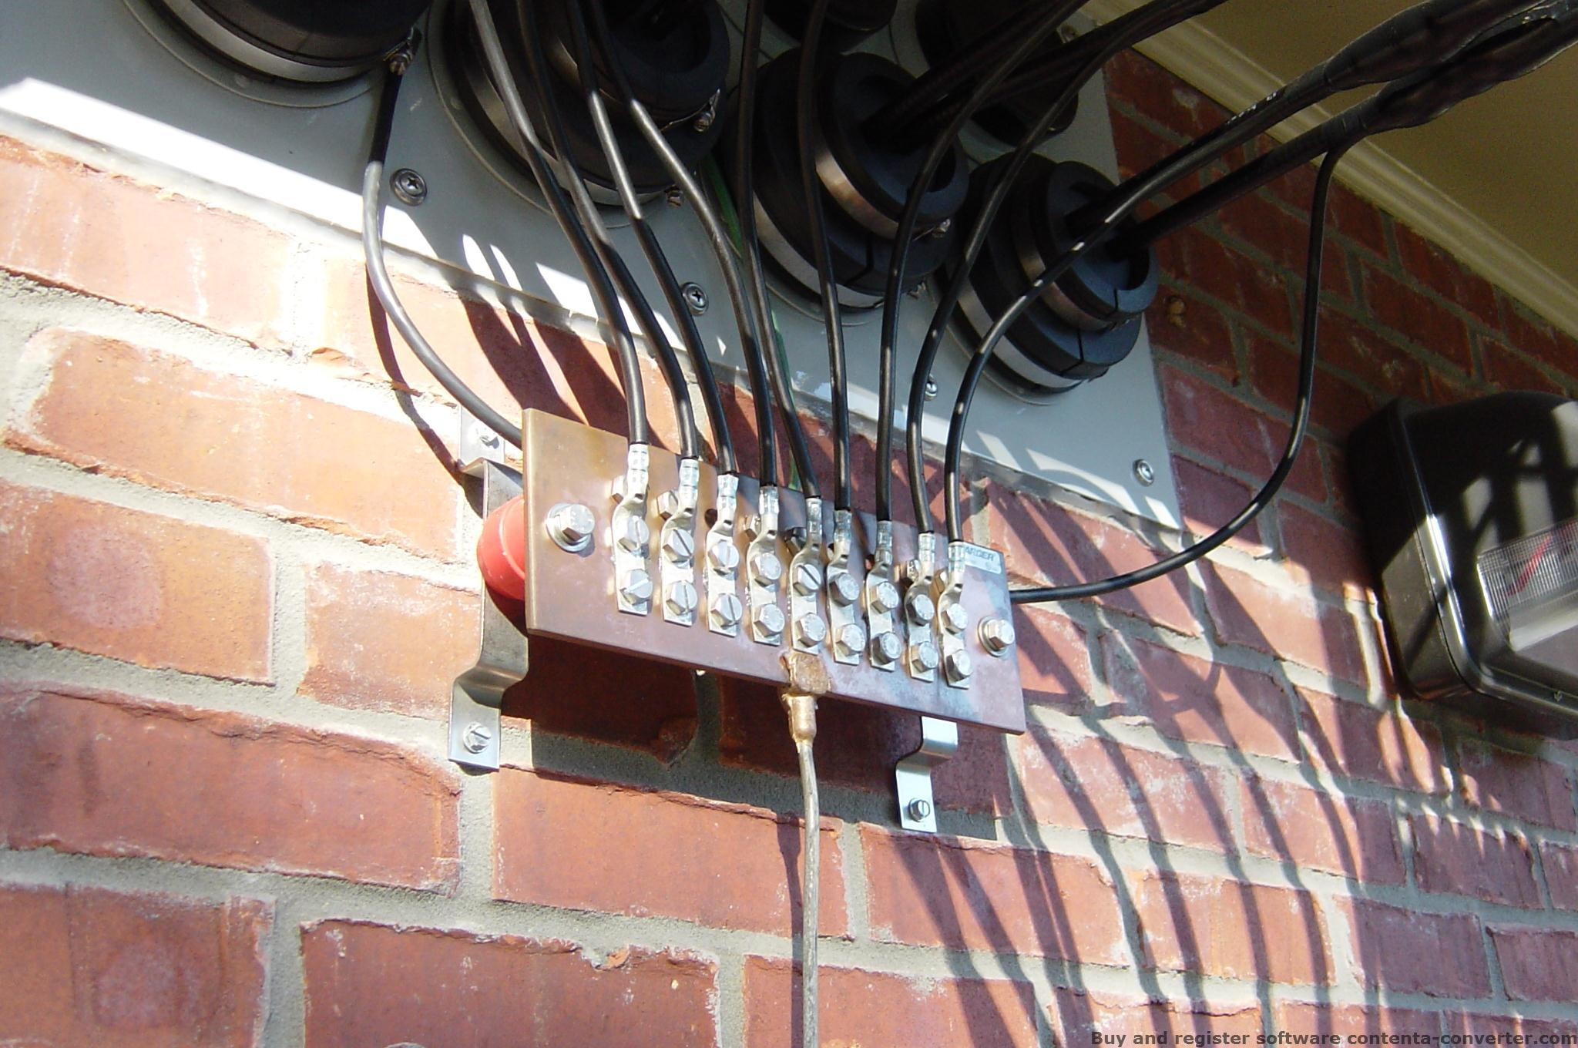
TOWER AND ENTRY GROUNDING

Slide 26
LIGHTNING SURGE PROTECTORS

Slide 27
RF MANAGEMENT
RADIO FREQUENCY VOLTAGE AND CURRENT CAN DISRUPT NORMAL OPERATION (RFI).
“THERE IS NO RF GROUND”
EQUALIZE AUDIO AND RF THROUGHOUT YOUR STATION
BOND ALL CONDUCTIVE MATERIALS
BONDING DOES NOT ASSURE “0” AUDIO AND RF VOLTAGE BUT KEEPS IT THE SAME SO CURRENT WILL BE REDUCED.

Slide 28
REMEMBER!
YOU CANNOT OVER GROUND!
KEEP ALL EQUIPMENT BONDED TO REDUCE POTENTIAL VOLTAGE AND CURRENT.
KEEP ALL GROUND CONDUCTORS AS SHORT AS POSSIBLE.
ALL GROUNDING ELECTRODES MUST BE BONDED TOGETHER.

Slide 29
GROUNDING AND BONDING
FOR
AMATEUR RADIO
BY PAUL MELVIN K4PGM

