Slide 1
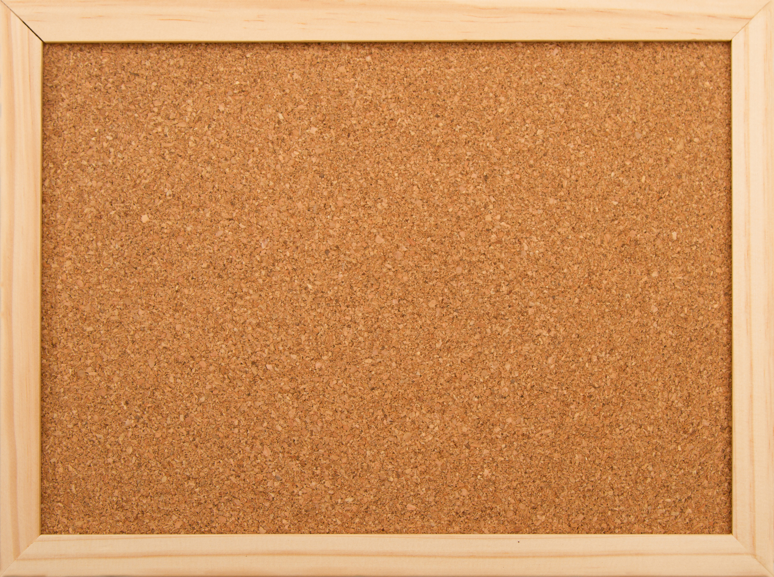
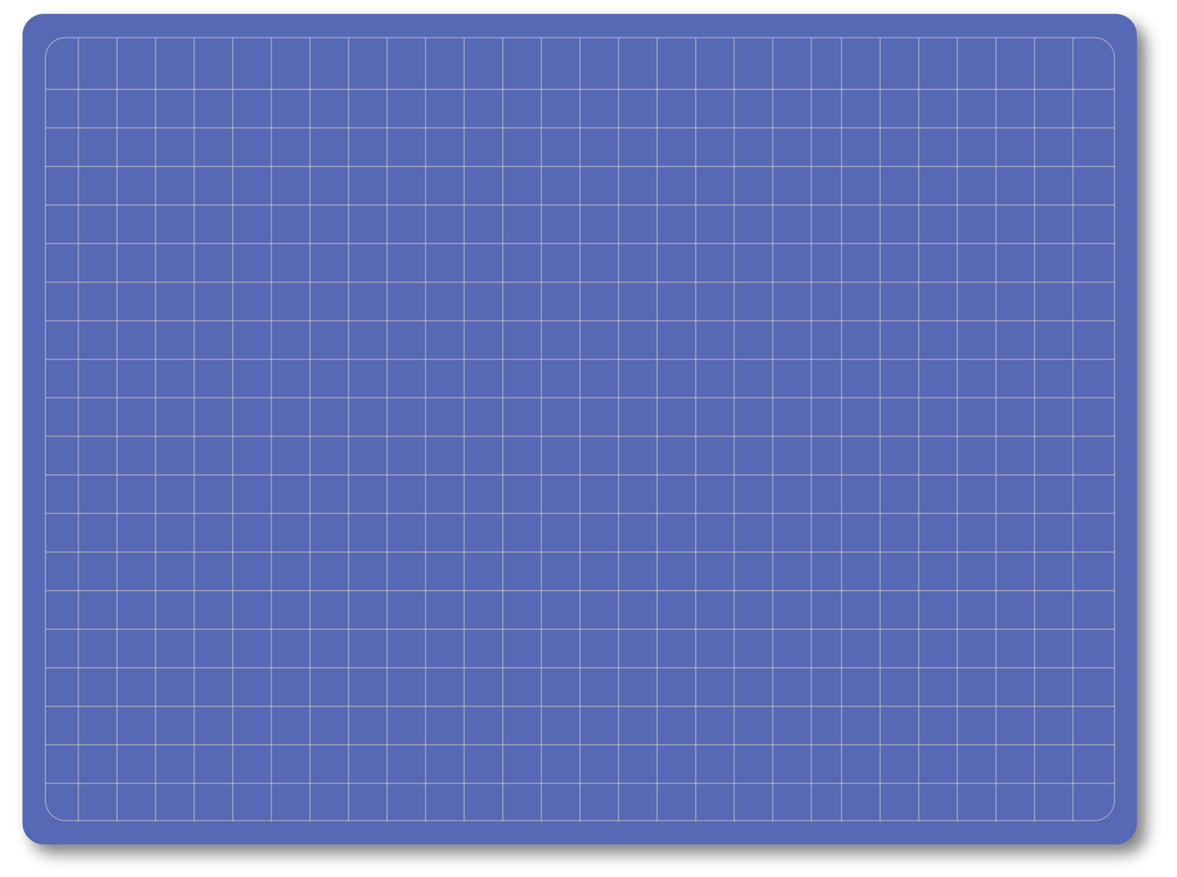

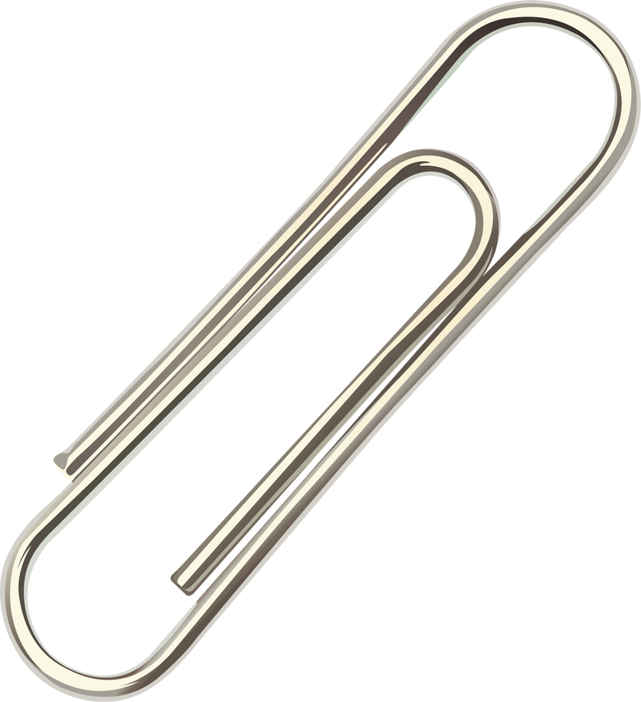
2026
JAKE’S LAW PLAYGROUNDS

Slide 2
THE FOLLOWING IS A LIST OF THE INCLUSIVE PLAYGROUND PROJECTS THAT WERE APPROVED FOR GREEN ACRES GRANTS UNDER JAKE’S LAW PROGRAM IN NEW JERSEY BETWEEN 2023-2025

Slide 3
THE LIST IS
ORGANIZED BY COUNTY

Slide 4
ATLANTIC COUNTY
BRIGANTINE CITY
Hammonton Township
Somers Point

Slide 5
BERGEN COUNTY
North Arlington & Lyndhurst Township
Bergen County
East Rutherford Boro
Fort Lee Boro
Franklin Lakes
Garfield City
Rutherford Boro
Teaneck Township
Bergen County
Dumont boro
Englewood City
Fort Lee Boro
Ridgefield Park Village

Slide 6
BURLINGTON COUNTY
Hainesport
Moorestown
Maple Shade Township
Burlington City
Evesham Township
Willingboro

Slide 7
CAMDEN COUNTY
WINSLOW TOWNSHIP (OPENED 2024)
Pennsauken (OPENED 2025)
Camden City

Slide 8
CAPE MAY COUNTY
LOWER TOWNSHIP
Stone Harbor

Slide 9
CUMBERLAND COUNTY
BRIDGETON

Slide 10
ESSEX COUNTY
Nutley Township
West Orange Township
Cedar Grove
Maplewood
Millburn Township
Montclair
Verona Township

Slide 11
GLOUCESTER COUNTY
WASHINGTON TOWNSHIP
GLOUCESTER TOWNSHIP

Slide 12
HUDSON COUNTY
North Bergen
Bayonne City
Hoboken City
Secaucus Township
Hoboken
Hudson County
Seacaucus Township
Union Township

Slide 13
HUNTERDON COUNTY
CLINTON TOWNSHIP
HUNTERDON COUNTY

Slide 14
MERCER COUNTY
MERCER COUNTY
TRENTON CITY

Slide 15
MIDDLESEX COUNTY
Carteret
North Brunswick
Sayreville Boro
South River Boro
North Brunswick Township
East Brunswick
Perth Amboy City
Monroe Township
Monroe Township
Old Bridge Township
South River Boro

Slide 16
MONMOUTH COUNTY
Holmdel
Howell
Little Silver
Oceanport
Fair Haven Boro
Red Bank
Spring Lake Boro
Belmar
Eatontown
Freehold
West Long Branch

Slide 17
MORRIS COUNTY
MADISON BORO

Slide 18
OCEAN COUNTY
Forked River
Beach Haven Boro
Lavalette Boro
Tom’s River Township
Pine Beach Boro
Seaside Heights

Slide 19
PASSAIC COUNTY
West Milford
Passaic County
Bloomingdale Boro
Little Falls Township
Wayne Township
Woodland Park

Slide 20
SALEM COUNTY
PENNSVILLE TOWNSHIP

Slide 21
SOMERSET COUNTY
MONTGOMERY TOWNSHIP

Slide 22
SUSSEX COUNTY
BYRAM TOWNSHIP
SPARTA TOWNSHIP

Slide 23
UNION COUNTY
Union County
Plainfield City
Linden City
New Providence
Plainfield
Summit City

Slide 24
WARREN COUNTY
PHILLIPSBURG

Slide 25
FOR MORE INFORMATION VISIT:
WWW.OUR-VIEW.COM

