Slide 1







VIPERS
BASEBALL &
SOFTBALL

Slide 2
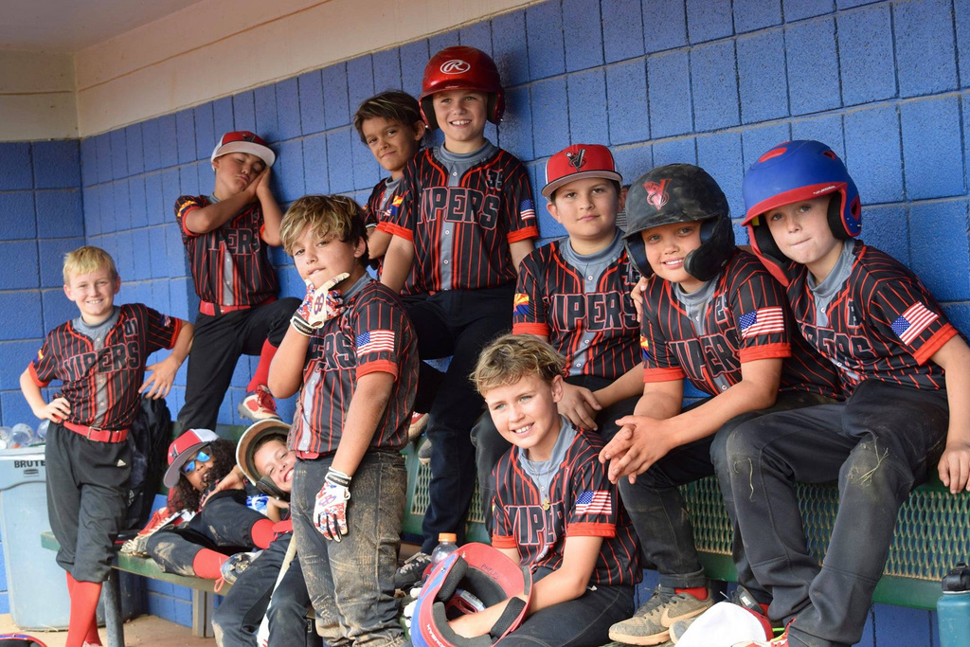
WELCOME TO THE FAMILY
We are excited you’ve decided to join us! We look forward to making memories that will last a life time.

Slide 3
INTRODUCING THE BOARD MEMBERS
President - Mike Thornhill (Manager 15u)
Vice President - Scottie Taylor (Coach 13u Black)
Treasurer - David Meraz (Manager 11u)
Trustee - Justin Janecek (Manager 13u Black)
Trustee - Jason Sitzer (Manager 10u Black)
Trustee - Justin Wilson (13u Coach/Softball Coordinator)

Slide 4

VIPERS BACKGROUND
-Started in 2019 by Mike Thornhill and Gram Messer as a way to get insurance and fields.
-2020 Mike formed the first actual Vipers team to play in a 9u tournament.
-Like all new teams, they started slow and did not win many games, but we learned a lot!
-In Season 2 that original team went 7-18-1 playing in 10u AA at mostly local events.
-In 2022 Vipers split into 2 teams 10u and 11u. The first season with more than 1 team.
-In October of 2022 we formed Lake Havasu Vipers as a Not for Profit Corporation. 501c3
-2023 we fielded 6 teams ranging from 9u up to 13u.
-This year we have 11 total teams (8 Baseball & 3 Softball) 9u-16u
-Over 120 kids getting chance to grow by playing baseball at a higher level!

Slide 5
SEASON EXPECTATIONS
-The success of a season are not measured by our win loss records.
-We measure the success of a season by the growth of each individual player and the team as a whole.
-Growth of the player includes both growth as a player, an athlete, and as a person.
-Our goal is to get a little better everyday, and have the players want to come back next season.
-Baseball/Softball is a GAME and we will treat it as such. Games are supposed to be fun & challenging.
-Athletes will treat all coaches with respect and they will be treated with respect.
-Athletes will respect their teammates. This includes all fellow Vipers and Lady Vipers.
-There will be no tolerance for bullying or belittling other players. We all progress at different rates.
-Emphasis will be placed on having fun! Baseball is already hard!

Slide 6
PRACTICES
-Most teams will practice twice a week. Practices are usually 2 hours long. Occasionally on weekends
-All practices are considered mandatory as they are essential for growth of the player and the team.
-Please communicate openly with your teams’ coach if you will be missing any practices.
-Please don’t miss practice due to transportation issues. Most families/coaches are willing to help.
-Team practices are the bare minimum to helping your athlete’s development and future success.
-Please ask a coach for ideas about what else they can do at home on their own to get better.
-Or ask about opportunities that are available with other pitching, hitting, fielding coaches in the area.

Slide 7
TOURNAMENTS
  Common goal for most teams is to play 2 tournaments per month. (Usually every other weekend)
  Most tournaments are 2 days (Sat & Sun) and are 3 GG. (3 Games Guaranteed)
  Typical 2 day tournament is 2 pool/seeding games on Saturday. Sunday will be Bracket Play.
  Sunday Bracket play will be single elimination. Win to advance, or lose and go home.
  We plan to improve on helping coaches chose the right tournaments for their teams.
  Not much is learned when you are winning 15-0 or losing 0-15.
  Be prepared to travel inside Mohave County, Phoenix Valley Area, Las Vegas, and maybe more!

Slide 8
PARENT EXPECTATIONS
  Respect Coaches and Officials: All or our Coaches and Officials are dedicated to providing a great experience for the players. Please avoid any negative comments towards them, the team, or the other players/parents on the team. Please address any issues you have directly with a coach or official in a private and respectful manner.
  Promote good Sportsmanship: Model this by demonstrating respect for the game, your opponents, and the umpires. Encourage your child to do the same and play with honor and integrity.
  Avoid sideline coaching: Trust the coaches to guide the team. Please refrain from shouting instructions from the bleachers. Sideline coaching can cause more confusion and anxiety than it helps.
  Communicate Constructively: If you have questions, feedback, or other concerns please address it with the coach in a constructive and respectful manner. We are all here to support your athlete’s growth and want to address issues promptly.

Slide 9




PARENT EXPECTATIONS CONT’D
  Honor the Commitment: Ensure that your child attends practices and games, and is on time and prepared with all necessary equipment. If you have schedule conflicts please contact your coach.
  Enjoy the Experience: Remember that playing baseball is a fun and enriching experience for your child. Enjoy their games, celebrate their achievements, and appreciate the growth and development of your child, and their teammates. Also, enjoy the travel! Its not 100% about baseball.
  We will play at many beautiful parks and facilities. Some of these places will sell alcohol. If you are going to partake in an alcoholic beverage, please do so responsibly. We as an organization have worked hard to earn a reputation of being respectful. We intend to keep it that way. No alcohol at public parks.

Slide 10
FINANCE$
  Travel expenses and lodging are the responsibility of each individual family.
  $200 start up fee will go towards registration fees, insurance, practice fields and lights, equipment, and first tournament. ***Due 9/15/24***
  Starting October 1st monthly dues will be $150 per player. This goes towards future tournaments. any excess funds will be rolled over and to be used for the team at the coaches discretion. (i.e. team hoodies, bags, pizza party, desired practice gear, etc.)
  Most teams will start playing tournaments in October and will end in March when Little League begins.
  Uniforms have been sponsored and are FREE! Player will receive 4 Jerseys, 3 Hats, and 1 pant. Generally parents will be responsible for socks, belts, and two other pants. This will vary slightly from team to team so please reach out to your coach with any questions.

Slide 11
FINANCE$
MONTH 1 (11u) September
  12 players + 2 practice players
  14 players x $200 = $2800
  Insurance -$127
  USSSA Reg fee -$85
  PG Reg fee -$99
  background check -$15
  Fields and lights -$104.86
  Helmet Decals -$101.25
  Balls, tee, net, no flys -$433.63
  USSSA tourney 10/5 -$783.35
  TC parade of lights -$802.13
--------------------------------------------------
  Total fees Month 1= $2424.22
--------------------------------------------------
  $2800 - $2424.24 = $375.78
MONTH 2 (11u) October
  Dues = 12x$150 + 2x$100 = $2000
  $2000 + $375 = $2375 for October
  USSSA 10/20 tourney -$783.35
  NCS Tourney 10/26 -$755.00
  USSSA Tourney 11/2 -$783.35
-------------------------------------------------------
  Total Expenses $2321.70
  Total Funds Available $2375.00
-------------------------------------------------------
  Total Remaining $53.30
MONTH 3 (11u) November
  Dues $2000
  Remaining money $53.30
  USSSA Tourney 11/16 -$783.35
  USSSA (3-day) 11/9 -$888.00
  PG tourney 11/29 (?) -$750.00
-------------------------------------------------------
  Total Expenses -$2421.35
  Total Available $2053.30
-------------------------------------------------------
  Total Remaining -$368.05

Slide 12
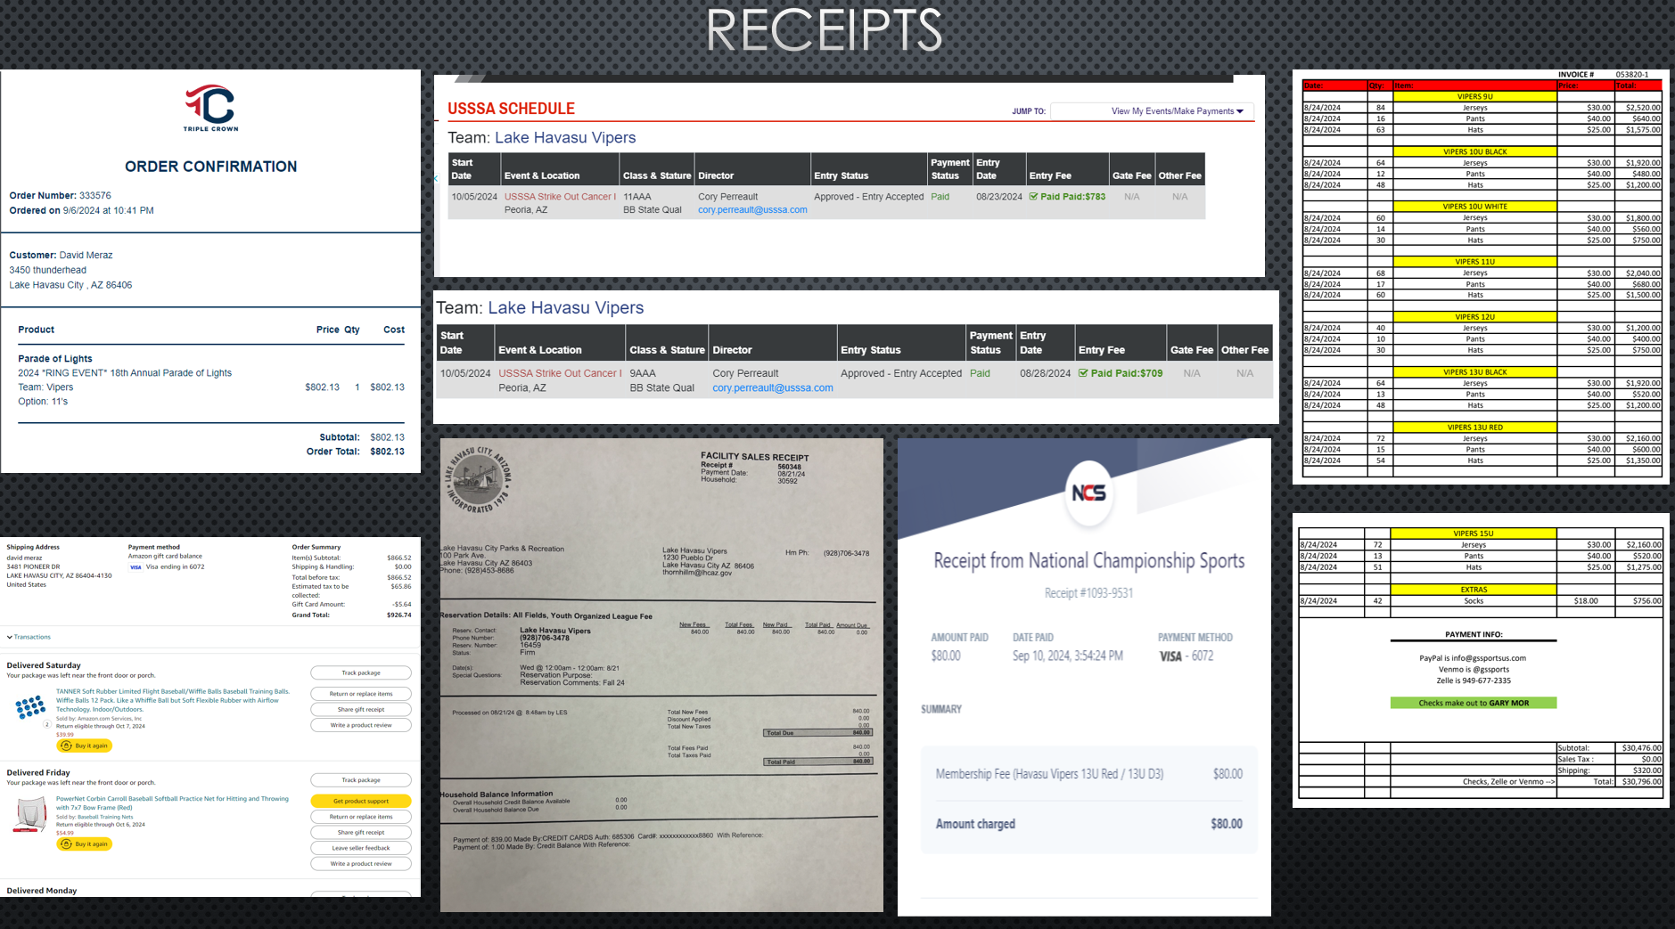
Join Now

Slide 13
COST ANALYSIS OF OTHER TEAMS
Trosky Baseball (PHX)
  Start up $450
  Uniforms $315
  Monthly $325
--------------------------------
5-Star Mafia (PHX)
  Start up $430
  Uniform $240
  Monthly $250
CBA Vegas (NV)
  Start up $0
  Uniforms $145
  Monthly $65
  Tourneys $75
(based on 10 players and $750 fee)
  Estimated $215
---------------------------------
Heavy Hitters (Prescott)
  Paid up front
  Sept-Dec 1 lump sum
  6 tourneys
  Total $650 / 4 months
  =$162.50
Birdgang (PHX)
  Start up $1200
  Uniforms included
  Monthly $375
---------------------------------------
TBT Baseball (PHX)
  Start up $250
  Uniforms $250
  Monthly $275

Slide 14
DONATIONS THIS SEASON
  3 Major Jersey Sponsors: Anderson Toyota, Big O Tires, APX Real Estate Group
  Uniform Package covered for all players, Baseball and Softball
  Parents responsible for White and Black pants, Socks, and Belt....TBD
  Individual donations will be added to teams available balance and used at coaches discretion to benefit the whole team.

Slide 15

RUMORS AND FAQ
  Do Coaches get paid at all?
  Are we paying for coaches hotel rooms out of team funds?
  Why are the fees $25 higher this year?
  Is the extra money to build/open a facility?
  Do coaches kids get a discount?
  Do Board Members get benefits or discounts?
  Are there Sponsorships available?
  Is the grass on the other side always greener?

Slide 16


OPEN TO YOUR QUESTIONS

Slide 17




THANK
YOU
We appreciate you taking the time to be here with us. We are only as good as the people who are a part of our organization. We want all parents and kids to be proud to be Havasu Vipers!

