Slide 2
March Mission Lender call
Updates and Best Practices

Slide 3
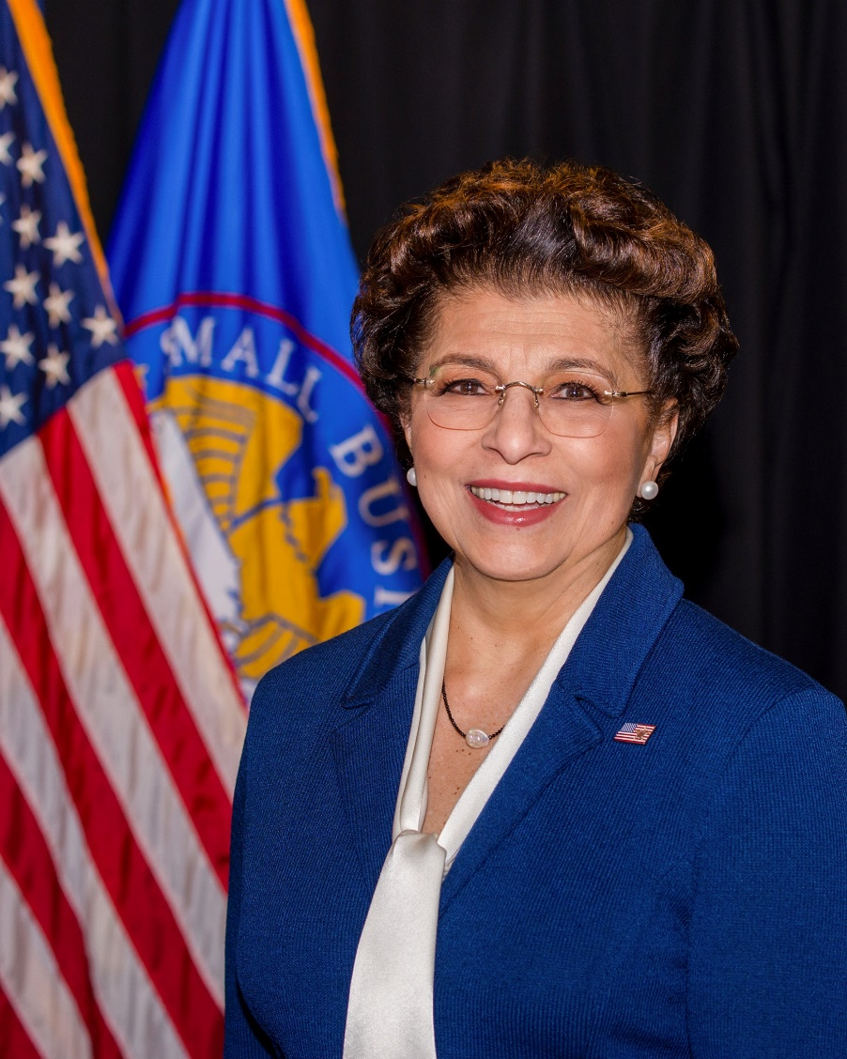
Economic Injury Disaster Loans (EIDL)
The U.S. Small Business Administration (SBA) is offering designated states and territories low-interest federal disaster loans for working capital to small businesses suffering substantial economic injury as a result of the Coronavirus (COVID-19).
Upon a request received from a state’s or territory’s Governor, SBA will issue under its own authority an Economic Injury Disaster Loan declaration*
*As provided by the Coronavirus Preparedness and Response Supplement Appropriations Act that was recently signed by the President.
Administrator Jovita Carranza

Slide 4
What can you do with the microloan program
Microloans can be deferred up to 6 months no payments but cannot exceed 7 years…..yes 7 years we had a rule change.
If Microloan is in deferment you MUST still report in MPERS by pushing the “no change” button and provide a quick statement.
You as a lender can request for a deferment in payment on your SBA loan for 6 months.
Microloans can be used as a interim disaster relief loan BUT you must have language on the note that states that was the loan purpose.

Slide 5
UPDATES and REMINDERS
Please be aware that providing a microloan as an interim loan does not guarantee that the SBA disaster loan will be approved.
Please submit your grant applications. We are trying to get you monies as fast as possible and delaying the grant end date will not help that goal.
AEO, OFN and CAMEO are providing webinars and best practice forums and needed information for your organizations.
We still require blue ink on the NOTE but all grant forms can be E signed.
End of the quarter is coming please update MPERS ASAP, this is important it is grant review season and if MPERS is not updated it will delay your grant funds.
As of April 2nd we will no longer be under the 1/55th rule so please send in your loan request for approval, yet another reason why MPERS must be updated.

Slide 6
Economic Injury Disaster Loans (EIDL)
Revised Criteria (as of March 17, 2020)
Faster, Easier Qualification Process for States Seeking SBA Disaster Assistance.
Historically | Revised
At least five small businesses have suffered substantial economic injury as a result of a disaster with at least one business located in each declared county/parish. | Only required to certify that at least five small businesses within the state/territory have suffered substantial economic injury, regardless of where those businesses are located.
Expanded, Statewide Access to SBA Disaster Assistance Loans for Small Businesses.
Historically | Revised
SBA disaster assistance loans only available to small businesses within counties identified as disaster areas by a Governor. | Economic Injury Loans related to Coronavirus will be available statewide following an economic injury declaration by the Governor.

Slide 7
Economic Injury Disaster Loans (EIDL)
What businesses are eligible to apply?
Small businesses, agricultural cooperatives & aquaculture businesses
Most private non-profit organizations
Includes:
Businesses directly affected by the disaster
Businesses offering services directly related to the businesses in the declaration
Other businesses indirectly related the industry that are likely to be harmed by losses in their community

Slide 8
Economic Injury Disaster Loans (EIDL)
Criteria for Loan Approval
Credit History
Applicants must have a credit history acceptable to the SBA.
Repayment
SBA must determine that the applicant business has the ability to repay the disaster loan.
Eligibility
Applicant business must be physically located in a declared state and suffered working capital losses due to the coronavirus pandemic; not due to a downturn in the economy or other reasons.

Slide 9
Economic Injury Disaster Loans (EIDL)
How much can a business borrow?
Eligible entities may qualify for loans up to $2 million.
Interest rates:
3.75 percent for small businesses
2.75 percent for nonprofit organizations
Terms up to 30 years.
Eligibility for these working capital loans are based on:
Size & type of business (must be a small business)
Business’ financial resources
How can loan funds be used?
Working capital loans
Pay fixed debts, payroll, accounts payable, and other bills that could have been paid had the disaster not occurred
Not intended to replace lost sales/profits or for expansion

Slide 10
Economic Injury Disaster Loans (EIDL)
What are the collateral requirements?
Economic Injury Disaster Loans over $25,000 require collateral
Real estate as collateral if available
SBA will not decline a loan for lack of collateral, but requires borrowers to pledge what is available
Important information
Apply online: DisasterLoan.sba.gov (Not through a bank)
No cost to apply
No obligation to take the loan if offered
Applicants qualify for an EIDL for the Coronavirus (COVID-19) disaster even if they have an existing SBA Disaster Loan
Loans cannot be consolidated

Slide 11
Economic Injury Disaster Loans (EIDL)
Ineligible Entities:
Agricultural Enterprises
If primary activity of the business (including its affiliates) is as defined in Section 18(b)(1) of the Small Business Act, neither the business nor its affiliates are eligible for EIDL assistance.
Religious Organizations
Charitable Organizations
Gambling Concerns or organizations that derive more that 1/3rd of their annual gross revenue from legal gambling activities
Casinos & Racetracks

Slide 12
Economic Injury Disaster Loans (EIDL)
Information Required
Completed SBA loan application (SBA Form 5)
Tax Information Authorization (IRS Form 4506T)
Available through online application or at IRS.gov
Most recent Federal Income Tax Return
For principals, general partners or managing member, and affiliates
Including all schedules
Schedule of Liabilities (SBA Form 2202)
Personal Financial Statement (SBA Form 413)
Filing electronically is easiest, fastest and most accurate

Slide 13
Economic Injury Disaster Loans (EIDL)
Additional Filing Requirements
Additional information may be requested:
If most recent Federal income tax return not yet filed:
Year-end profit & loss statement
Balance sheet
Current year-to-date profit & loss statement
Additional Filing Requirements (SBA Form 1368) providing monthly sales figures.

Slide 14
BEST PRACTICES
Going old school lenders are using couriers to get blue ink signatures.
Curb service, stores that are allowed to be open are using curb service to provide products. Using gloves, transit box, and empty your transit box outside have all been good tips for business’s and the community.
Using TA time to help apply for disaster loan.
Ebay and other E sales is a great way to keep income flowing.
Many colleges have online courses and they are FREE, so those that can’t be open can sharpen some business skills.
Assist in filing taxes, even with the filing date moved to July refunds are a great source of cash.
Type in your solutions!

Slide 15
Questions?

