Slide 1
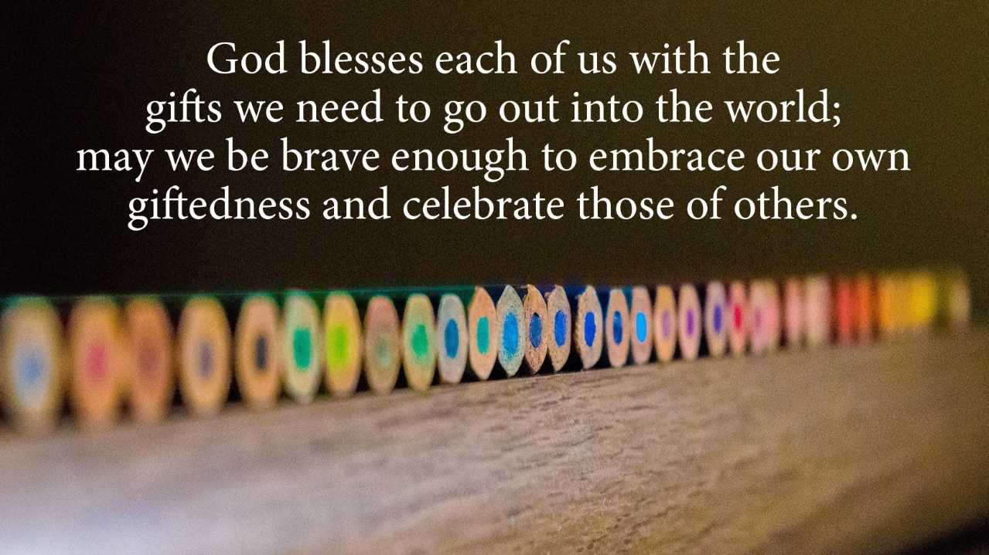
Welcome Province VIII Daughters

Slide 2

Our 7-Fold Gift. Empowering us to Serve the Order
8:15 Zoom Waiting Room open
Barbara Shreve- Moderator
Opening Prayers and Welcome - Ane Deister and The Rev. Canon Beatrice “Cookie” Clarke
Annual Business Meeting- Ane Deister Province VIII President
How to Choose a Spiritual Book – Kathryn Bunch
Visio Divina- Carolyn Hoffmann
BREAK for 10 minutes
Our 7-Fold Gift. Empowering us to Serve the Order: Susan O’Brien
Susan Bray- Anderson, Sandi Lanzarotta
Conclusion- Ane Deister
Lift High the Cross
Benediction - The Rev. Canon Beatrice “Cookie” Clarke

Slide 3
“Being a Daughter , is Who You Are, not something you do."

Slide 4
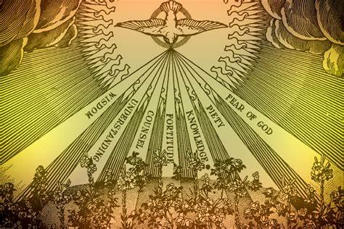

Slide 5
The 7 Fold Gift IN A Nutshell.
WISDOM illumines the mind and instills an attraction to God.
UNDERSTANDING is the Aha!!! Moment
COUNSEL functions as a sort of supernatural intuition, to illuminate the will of God.
FORTITUDE- is often called might. It makes us rise above our lukewarm nature.
KNOWLEDGE reveals to us the mysterious significance of what we read in the bible
SPIRIT OF TRUE GODLINESS- To understand completely the significance that God is our Father that we are his beloved Daughters, with a desire to please him. (Piety)
HOLY FEAR is ADORATION OF Our Lord.

Slide 6

We pray.
"Pour out upon us the
Sevenfold GIFT of the Holy Spirit"
What gift are we asking for?
What is included?
How will I use it?
When should I use it?
Am I willing to share it with others?

Slide 7
Strategic Plan Goal #4
Raise up and MENTOR
Daughters for Service
to the Order.

Slide 8
The purpose of the sevenfold gift is to impact the lives of those God sends us to. To reach the world with the Gospel of Jesus Christ…in our chapter & Diocese and in the world…..
The Question is…
Why do we say “no”?
Why not say….
“I can do that…with God’s help.”

Slide 9


What To Do... ?
To Say, “YES.”
The ANSWER is….
PRAY. PRAY. PRAY. first!
Ask more informational questions.
Pray again.
Know your resources. Who can help me?
Know that you are not alone. The Holy Spirit and others will gladly help you.
Prayer of Thanksgiving for God’s help.

Slide 10

Creating a FLOWING River in your chapter.
Does your chapter have a flowing river of sisters willing to serve? …. Or is the flow more like a trickle?
Encourage the FLOW of Growth. ..
Give new members a task right away.
Every sister is part of the team. You are not alone!
Recognize excellence and achievements
Great resource: www.doknational.org

Slide 11
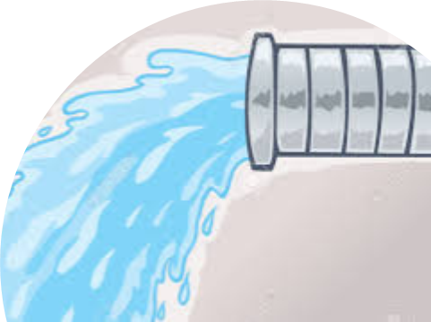
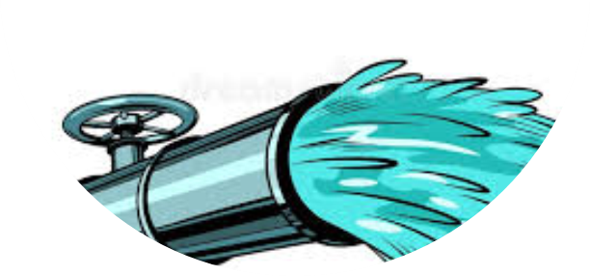
.
Sandi Lanzarotta
has some real - life stories to share.
How each of our unique gifts can be used
in service to the order.
Your Gifts can create the
GUSHING, FLOWING river
in your chapter & Diocese!
Teaching
Helps
Mercy
Hospitality
Craftsmanship
Faith

Slide 12

Help Me to Say "Yes"
"I am afraid of saying 'Yes,' Lord.
Where will you take me?
I am afraid of drawing the longer straw,
I am afraid of signing my name to an unread agreement,
I am afraid of the 'yes' that entails other 'yeses.'
And yet I am not at peace.
You pursue me, Lord, you besiege me.
I seek out the din for fear of hearing you, but in a moment of silence you slip through.
I turn from the road, for I have caught sight of you, but at the end of the path you are there awaiting me.
Where shall I hide? I meet you everywhere.
Is it then impossible to escape you?
by Michael Quoist

Slide 13
“Being a Daughter , is Who You Are, not something you do."
Of the many facets of the gift,
what do you recognize in yourself?

Slide 14
Say 'Yes,'
I need your 'yes' as I needed Mary's 'yes' to come to earth,
For it is I who must do your work,
It is I who must live in your family,
It is I who must be in your neighborhood, and not you.
For it is my look that penetrates, and not yours,
My words that carry weight, and not yours,
My life that transforms, and not yours.
Give all to me, abandon all to me.
I need your 'yes' to be united with you and to come down to earth,
I need your 'yes' to continue saving the world!
O Lord, I am afraid of your demands, but who can resist you?
That your Kingdom may come and not mine,
That your will may be done and not mine,
Help me to say 'Yes.' "

