Slide 1
Praying an Icon with Visio Divina
Notes:
I’m going to lead a prayer exercise called praying an Icon. Please relax and get comfortable.
Praying an Icon is a contemplative practice where we slow down to pray and pay attention to God

Slide 2
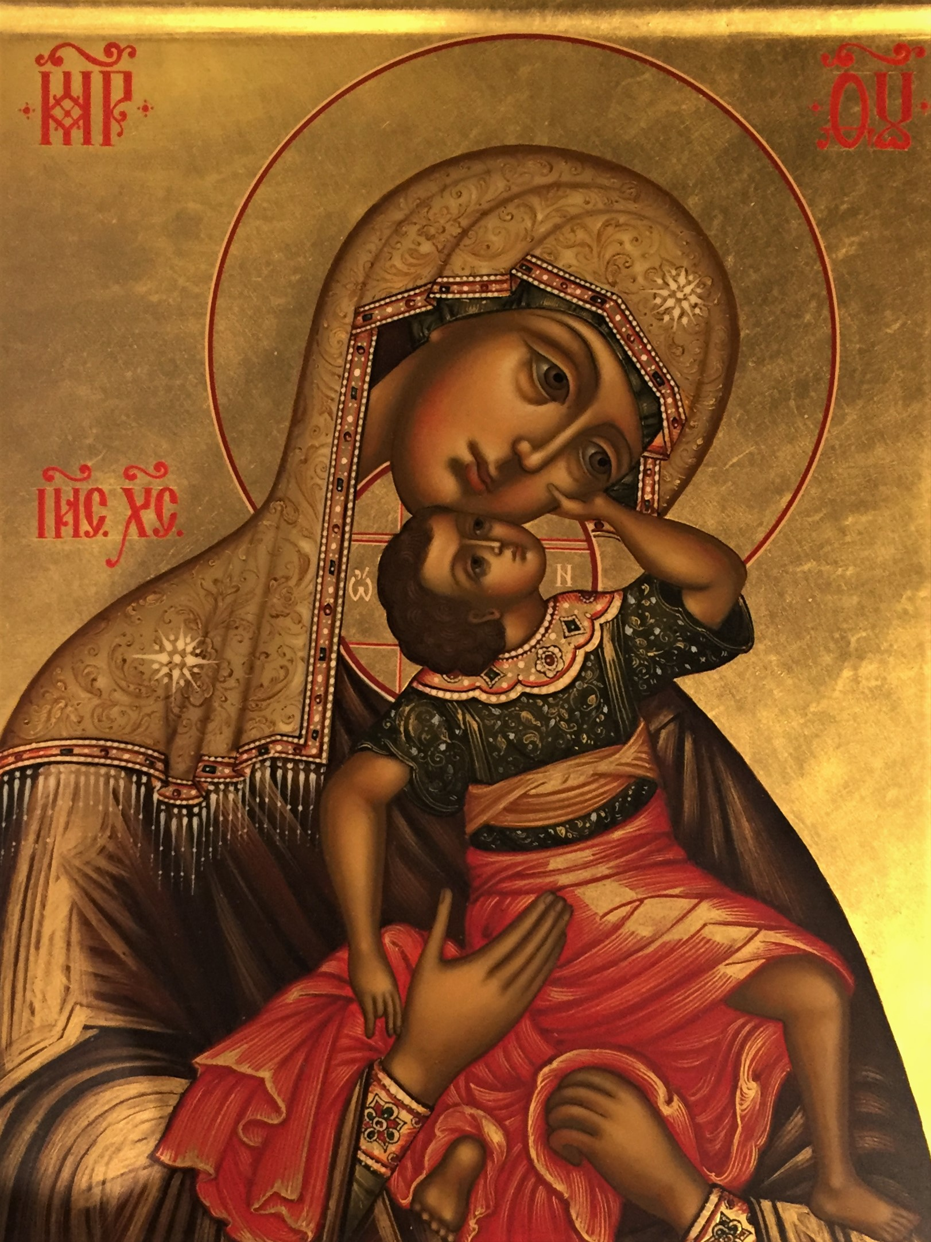
Icon: A sacred image
“Joyful” Icon of Mother of God
“Child Leaping with Joy” Icon
1795, Moscow
Used for teaching scripture stories within the church
Notes:
Icons were used in the early Christian world for teaching scripture stories as well as theology. You see, back then, the Bible wasn’t accessible to everyone. There weren’t many copies and those printed were in Greek, Hebrew and Latin. Only the priests and rich people had access to them. So, people began writing Icons. They say writing, instead of painting, because they are meant to be read.
The Icon above, the “Joyful” Mother of God Icon, was written in 1795 in Moscow, most likely at a monastery. This icon on this slide would be painted exactly like the original icon. In fact, this icon was painted about the year 2000, 200 years after the original was painted, and again in a Russian monastery.

Slide 3
The Icon tells a story
The Transfiguration Icon
Written by Theophanes the Greek around 1403
Looking at an Icon is like gazing into the heavenly realm. They are writings of things not of this world.
Christ: Eternity
Moses and Elijah: The Past
The Disciples: The Future
Meaning: We are also called to be disciples
Notes:
When I first saw icons, I thought they were just really ugly religious art. Then I learned that the reason they were ugly to me is because they use a different kind of perspective than we are used to. In most artwork the vanishing point is back behind the painting, drawing you in. In icons, the vanishing point is out behind you, including you in the picture.
The Transfiguration Icon you are looking at was written in 1403 by Theophanes the Greek who was the teacher of Andrei Rublev, who wrote “The Trinity” we will look at next. Christ, gleaming in white, draws together the past (Moses and Elijah), the present (the three disciples), and the future…the disciples who we are also called to be.

Slide 4
Visio Divina: A new Prayer Practice
New Encounters with God
Latin for Divine Seeing
Visio Divina is a prayer practice which opens the eyes of one’s heart
We sink into God’s presence, finding God within and experience healing for hurts that long to be restored in our soul
Notes:
Our church, Trinity Episcopal Cathedral, in Reno, NV, had an art exhibit 4 years ago in 2016. Included in this exhibit where new icons that were untraditional and recently written icons that were shown together.
The untraditional icons were assembled and painted by Russian-born artist, Ludmila Pawlowska. She called the show Icons in Transformation. Included in the show where traditional icons, such as the two in the center aisle of this photo. They were created in a Russian Monastery as a copy of the original icon.

Slide 5
Visio Divina and Lectio Divina
Divine Seeing
Divine Reading
Isaiah 11: 1-3: Now there are a variety of gifts but one Holy Spirit...To each is given the Gift of the Spirit for the common good...the gift of Wisdom, of Understanding, of Counsel, of Strength, the gift of Knowledge, the gift of Piety and the gift of the Fear of God.
Notes:
Here is an example of an image that I found on the internet. It shows the Holy Spirit as a dove. Radiating from the dove you will see the Gift of the Holy Spirit. The gift is broken into seven rays of light. The plants on the ground are thriving and healthy under this light. The clouds are rolled back, and the dove is healing the earth.
Now, that’s what I got out of the image. The Divine Reading that this image portrays is Isaiah 11: 1-3, and you see that it is written on the slide, the gift of the Holy Spirit; Wisdom, Understanding, Counsel, Strength, Knowledge, Might, and Fear of the Lord.
Both the image and the words say the same thing.

Slide 6
Rublev’s Trinity: The Oaks of Mamre story
Genesis 18: The Lord appeared to Abraham by the oaks of Mamre as he sat at the entrance of his tent in the heat of the day. He looked up and saw three men standing near him…He said, my Lord, if I find favor with you do not pass your servant…rest yourselves under the tree…
Notes:
Here’s an icon from Genesis 18, The Oaks of Mamre story. This is Rublev’s Trinity. You can see the three visitors sitting here at the table with the Oak of Mamre in the background. But it also teaches the theology of the Trinity.
Let me read to you about the picture as you look at it. In Rublev’s icon painting he depicts the three heavenly visitors sitting at a table with a cup placed before them on the table. The figures represent left to right the Father, Son and Holy Spirit.
Others had painted this Biblical story, but in the year 1400, Rublev was the first to paint only the three angelic figures and to make them of equal size. Rublev depicts the three as One Lord. Each holds a rod in his left hand, symbolizing their equality. Each wears a cloak of blue, the color of divinity, and the face of each is exactly the same, depicting their oneness.

Slide 7
The Father
The Hidden Creator with an almost transparent robe
He blesses the Son with his right hand
His face is the only one lifted high and yet his gaze is turned to the other two figures
All figures have the same face, depicting their oneness
Notes:
The Father is like the figure on the left of the Trinity Icon.
His divinely blue tunic is cloaked in a color that is light and almost transparent because he is the hidden Creator.
With his right hand he blesses the Son – he is pleased with the sacrifice he will make.
His head is the only one that is lifted high and yet his gaze is turned to the other two figures.

Slide 8
The Son
He wears the blue of divinity and the reddish purple of royal priesthood
With his hand he blesses the cup he is to drink, the sacrifice for humanity
His head is bowed in submission to the Father on the left
Notes:
The Son is portrayed in the middle figure of the Trinity Icon.
He wears both the blue of divinity and the reddish purple of royal priesthood.
He is the King who descends to serve as priest to the people he created and to become part of them.
With his hand he blesses the cup he is to drink, accepting his readiness to sacrifice himself for humanity
His head is bowed in submission to the Father on the left.

Slide 9
The Holy Spirit
Over his divinely blue tunic he wears green, symbolizing life and regeneration
His hand rests on the table saying he will be with the Son as He carries out his mission
His head is inclined toward the Father and the Son
His gaze is toward the open space at the table where you are invited to sit
Notes:
The Holy Spirit is indicated in the figure on the right of the Trinity Icon.
Over his divinely blue tunic he wears a cloak of green, symbolizing life and regeneration.
His hand is resting on the table next to the cup, suggesting that he will be with the Son as he carries out his mission.
His head is inclined toward the Father and the Son.
His gaze is toward the open space at the table where you are invited to sit.

Slide 10
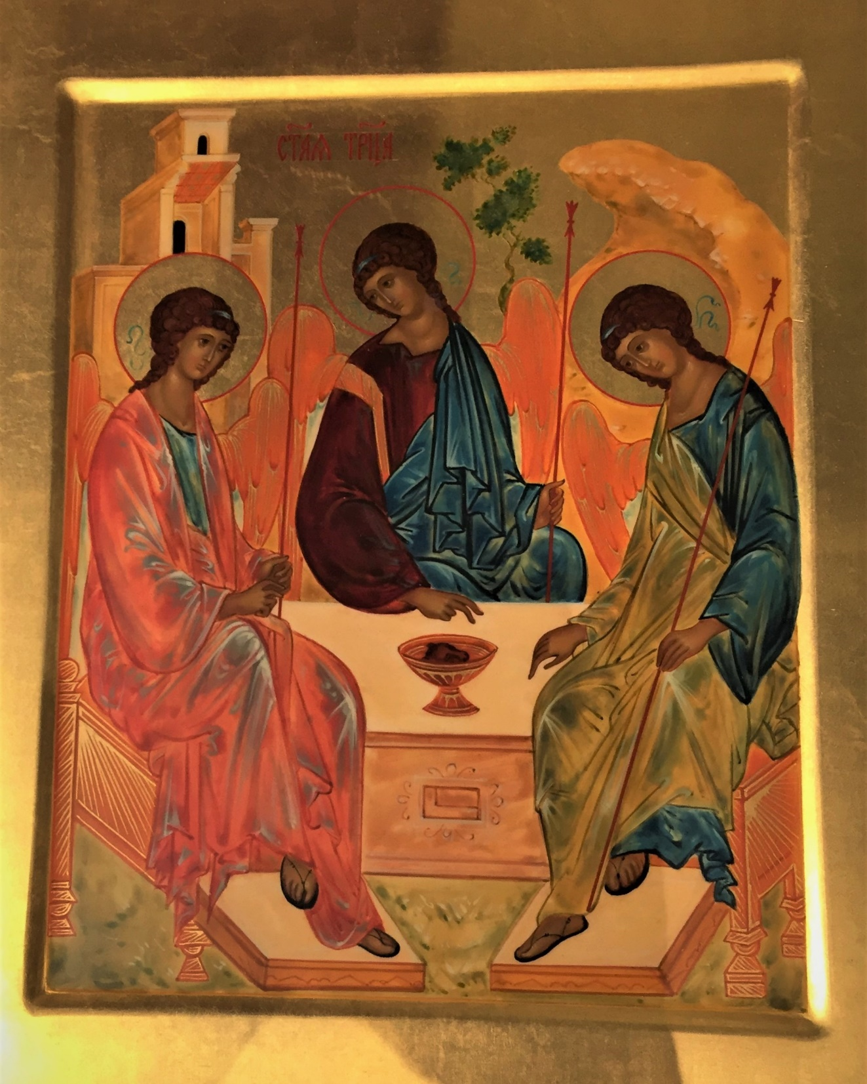
Notes:
Now, I’d like you to picture yourself sitting at the empty space at the table.
Look at each part of the Trinity in your mind’s eye.
You might feel drawn to one, and slightly uncomfortable with another.
I’ll give you some time to quietly sit and get a sense of how you feel in the presence of the Trinity.
Try to understand your feelings about each one.
Wait upon the Lord.

Slide 11
Do you have feelings about the Trinity that surprised you?
Can you see how looking with the eyes of your heart, Visio Divina, instead of the eyes of your mind, Lectio Divina, is different? How so?
Now that you have considered and “prayed an Icon”, would the practice be useful to you?

